Slide 1


Workplace Communication-2 Days
Your
Company
Logo
Notes:
The Trainer is free to customise this edidtable slide & entire presentation as per their own/client branding- You may keep the fonts/ Animation/ Images same to save the editing time.
Facilitator’s Notes:
Say: Hello! And Welcome to 1 –Day workshop on Workplace Communication!
Though Communication is one of the most spoken word but most of the challenges that exisit are because of lack of proper communication- Hence this is a very essential component for the workplace performance. How you communicate with you line manager, colleagues, other departments, team members etc play a big role in your overall career progression.
This is a highly engaging workshop full of videos, Activities, scenarios, role plays, etc to help your learn by practicing the concepts. So sit back relax and lets start our learning Journey.
Lets move to next slide.

Slide 2

Agenda
Module No. | Topic- Day 1
Module 1 | Understanding workplace Communication
Module 2 | Communication Process
Module 3 | Cornerstone for effective Communication -5Ws+ H
Module 4 | 4 C’s of Effective Communication
Module 5 | Making Communication Fool Proof- LADR Model
Module 6 | Forms of Communication -Mehrabian Model
Module No. | Topic- Day 2
Module 1 | Verbal Communication
Module 2 | Vocal Communication
Module 3 | Visual And Written communication
Module 4 | Non Verbal Communication-Body Language
Module 5 | Types of Communication
Module 6 | Barriers to effective Communication
Notes:
Facilitator’s Notes:
Tell: The agenda of the today’s training is to learn:
Module 1 Understanding workplace Communication
Module 2 Communication Process
Module 3 Cornerstone for effective Communication -5Ws+ H
Module 4 4 C’s of Effective Communication
Module 5 Making Communication Fool Proof- LADR Model
Module 6 Forms of Communication -Mehrabian Model
Lets move to next slide.

Slide 3

Role of Communication @Workplace
Boosts employee morale
Boosts employee Engagement
Improves Productivity
Improve Satisfaction Score
Better team collaboration and cooperation
Notes:
Say: What are the roles of communication?
Communication is fundamental to the existence and survival of humans as well as to an organization. It is a process of creating and sharing ideas, information, views, facts, feelings from one place, person or group to another. Communication is the key to the Directing function of management.
Communication in the workplace is important because it boosts employee morale, engagement, productivity, and satisfaction. Communication is also key for better team collaboration and cooperation. Ultimately, effective workplace communication helps drive better results for individuals, teams, and organizations. Also, reduces workplace conflicts and serves the purpose of motivation.
Better conflict management and conflict mitigation
A more connected and resilient team
Improved surfacing of problems and challenges
More productive and engaged teams
Supercharged innovation and ideation
Help cross functional teams work together effectively
Improved employee happiness and satisfaction
A culture of trust, openness and radical candour
Knowledge and skill sharing
Better relationships and improved empathy
More effective, fit-for-purpose solutions
Highly aligned and driven teams
Lets Move to the next slide

Slide 4

Suno- Sunao
Notes:
Facilitator Notes
This activity has a linkage to the next slide- After playing the activity and debrief move to the next slide.
This activity is a version of Chinese whisper- The format of the activity is follows
All the participants are required to stand in a circle
You will call one member from the entire team and tell him/her a story (Trainer is free to narrate a story in regional language for better experience)
The same participant goes back and whispers the story in the ears of the next participant- Remember the participant who is listening the story cannot ask the participant to repeat again or cannot ask the questions.
This cycle goes on till all the participants are covered and then finally the last person will say the story that he/she has hear loudly in the class.
Story: Trainer can choose their own story as well or use the reference story given below
One upon a time their was a village named Ramgarh. There were 2 brothers staying in Ramgarh named Ram & Sham, Ram was married to Sham’s sister in law name Gita and Shyam was married to Ram’s sister in law named Sita. Sita & Gita were 2 real sisters. In Ramgarh their was a famous Dacoit named Gabbar singh.
Debrief:
The last participant will definitely get the story wrong and everyone will burst into laughter. Trainer then narrates the real story and ask a very important question- why did it happen. Why did the participants not remember what was said. Was language a problem, was message difficult the answer is NO.
One of the biggest reason is that nobody followed any process to make communication easier- What I mean by this is that when the first participant was sharing the story with the second one the only objective he/she had was to narrate the story- The narrator did not pay any attention to frame an appropriate message, ask for a feedback etc.
This is the same thing which happens with most of us in the workplace. We communicate the message but rarely think of whether the other person will understand, or we hardly take a feedback on what the other person has understood.
Lets look at how we can overcome this by understanding the communication process- Move to the next slide

Slide 5



Basic Communication Process
To
Sends
Feedback
Interprets
Sender
Message
Formulates
Receiver
To
Message
Delivers through
Channel
Notes:
Say: So what is communication process?
Call for ideas and brainstorm before displaying the image.
After image display, Say: Communication is an ongoing process that mainly involves three components namely. sender, message, and recipient. The components involved in the communication process are described below in detail:
Sender: The sender or contact generates the message and transmits it to the recipient. He is the source and the first contact
Message: It is an idea, knowledge, opinion, truth, feeling, etc. produced by the sender and intended for reference.
Encoding: The message produced by the sender is encrypted in a symbolic way such as words, pictures, touches, etc. before transfer.
The media: This is how the coded message is conveyed. The message can be conveyed orally or in writing.
Recording: It is a process of modifying the signals sent by the sender. After recording the message is received by the recipient.
Recipient: You are the last person in the chain and the message you sent was sent. If the recipient receives the message and understands it correctly and acts on the message, only then the purpose of the communication is achieved.
Answer: Once the recipient confirms to the sender that you received the message and understood it, the communication process is complete.
Noise: Refers to any restrictions caused by the sender, message or recipient during the communication process. For example, incorrect telephone connection, incorrect coding, incorrect recording, careless recipient, incorrect understanding of message due to discrimination or inappropriate touch, etc.
Trainer to ask the participants. Can you co-relate from the previous activity what was missing/ what could have been done by the send to ensure that the last participant also gets the same message as it was conveyed to the first participant..
Move to the next slide.

Slide 6


Notes:
Say: We’ve all fallen victim to some of the common misbeliefs surrounding workplace communication.
For example, you may by now have realized that it’s completely ridiculous to rely solely on email — but there are plenty of other, seemingly plausible communication myths misinforming internal communication at your workplace.
Although some of these perceived pearls of wisdom may seem harmless, they can seriously harm your company’s bottom line. According to a report by Holmes, it’s estimated that poor communication costs the average organization $62.4 million per year.
To help you avoid this nightmare scenario, we will debunk the 10 most common communication myths at the workplace, and offer their more effective alternatives to help your organization’s communication thrive.
Brainstorm some Myths: Ask from participants to share some
Move to the next slide.

Slide 7
Listening
Doubts Clarify
Reconfirm
Asking Questions
L
A
D
R
Module 5
Fool Proofing Communication – LADR Approach
Notes:
Welcome to module 5
LADR Model- Read out LADR and its full form for the participants.
Move to the next slide and showcase the video

Slide 8

Role Play-1
Today RAM is meeting his manager Vishnu to seek his input for starting a new project/ preparing a new report. Ram wants to make sure that he has understood Vishnu's expectation and avoid any chances of rework.
Use LADR Model for the same.
Notes:
Facilitator Note:
The facilitator is free to add scenario’s as per the client industry and business however we have shared a general scenario which will be applicable in all situations.
Scenario:
Trainer needs to call two volunteers to act as RAM & Vishnu in the role play- (Trainer can record the role play /click pictures of the same to share the same with the client)
The trainer needs to help the participants apply LADR- Model effectively in this role play. The highlights will be as follows
RAM need to focus on Listening Actively and asking right questions.. Past
:L- Listening to Vishnu brief & expectation (Making Notes), eye contact, smile
A- Asking Questions –Questions like Project Details, Formats, Stakeholders, report submission deadlines
D- Clarify any doubts- (RAM should specially check on any formats in which the reports/project need to be prepared to eliminate any doubts that RAM may have)
R- Reconfirm- The actionable, project deliverables, time lines and Vishnu’s expectation from RAM-As has been understood by him
RAM may send an email to Vishu as minutes of the meeting email to document all the necessary details.

Slide 9
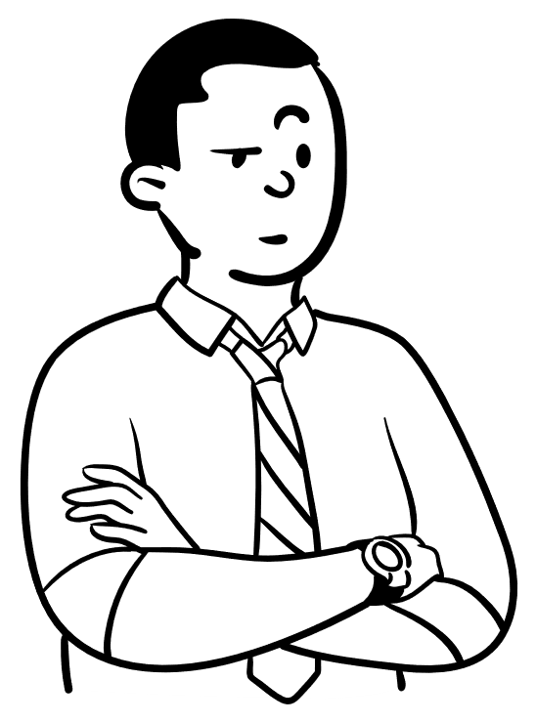
Mehrabian's Communication Theory
55%
Body Language
38%
Vocal
7%
Verbal
Notes:
Say: If not, Don’t worry. We will get to know about it in some time. Professor Albert Mehrabian has pioneered the understanding of communications since the 1960s. Albert Mehrabian’s 7-38-55 Communication model says that 7% of the meaning of feelings and attitudes takes place through the words we use in spoken communications, while 38% takes place through tone and voice and the remaining 55% of communication of these factors take place through the body language we use (specifically our facial expressions).
Total Emotion/Attitude Communicated = 7 percent Verbal + 38 percent Vocal + 55 percent Facial
So What?
A lesson we can draw from this research is that we need to pay attention to far more than just the words others are using when we communicate with them. Similarly, we should also be aware of what we communicate to others through our tone and body language, not just our words. We convey huge amounts of information this way. As leaders and managers, it’s important that we understand what we’re communicating and that we try and communicate intentionally.
Also, we should also ensure that we can listen effectively.

Slide 10
Types of Communication
Communication
Assertive
Passive
Empathetic
Aggressive
Notes:
Say: Communication can further be categorized into 4 types:
Assertive
Aggressive
Passive and
Empathetic
So what are these?

Slide 11





Barriers of Communication
Linguistic
Psychological
Emotional
Physical
Cultural
Notes:
Say: As communication has medium for message to be convyed…it is implied to have barriers as well. The process of communication has multiple barriers. The intended communique will often be disturbed and distorted leading to a condition of misunderstanding and failure of communication. The Barriers to effective communication could be of many types like linguistic, psychological, emotional, physical, and cultural etc. We will see all of these types in detail below.

Slide 12





98752-08472
Hello@freelancetrainings.com
www.freelancetrainings.com
406, Titanium City Centre Mall, Anand Nagar, Satellite, Ahmedabad-380015
Notes:
Thank the participants

