Slide 2



Train The Trainer (TTT) Workshop- 3 Days
Notes:
Note for the trainer: start the day with enthusiasm. Your enthusiasm should reflect in your tone of voice and body language.
Good morning everyone!
How are you today. Are you ready to dive into a day of learning, growth, and transformation? I know I am!
Today, we have a unique opportunity to learn from each other, challenge ourselves, and take our personal and professional lives to the next level. Today’s workshop is highly engaging, filled with activities, role plays, videos and discussions that are designed to inspire and empower you.
But this isn't going to be a passive experience. This isn't a lecture where you sit back and listen to someone else talk. This is an interactive, dynamic, and engaging workshop that requires your full participation, your curiosity, and your willingness to learn.
Throughout the day, you'll have the chance to connect with other like-minded individuals, share your own experiences and insights, and gain new skills and knowledge that will help you achieve your goals. You'll be challenged, pushed outside your comfort zone, and supported every step of the way.
So, are you ready to embrace this day with open hearts and open minds? Are you ready to learn, grow, and transform? I know I am, and I can't wait to see what we'll achieve together.
Let's get started!

Slide 3



Workshop Agenda
Understanding The Training Process
Training Need Analysis (TNA)
Adult Learning Principles
Designing
Training Program
Pre-Training Phase-1
Content Design
Learning Space Design
Delivering Training-1
Platform Skills
Delivering Training-2
Facilitation Skills
Delivering Training-3
Handling Difficult Audience
Post Training Phase
Training Effectiveness
Notes:
The agenda of todays workshop is as follows
Understanding The Training Process
Training Need Analysis (TNA)
Adult Learning Principles
Designing A Training Program
Pre-Training Phase-1- Content Design
Learning Space Design
Delivering Training Phase-Part-1-Platform Skills
Delivering Training Phase -Part-2- Facilitation Skills
Delivering Training Phase -Part-3- Handling Difficult Audience
Post Training Phase
Training Effectiveness

Slide 4


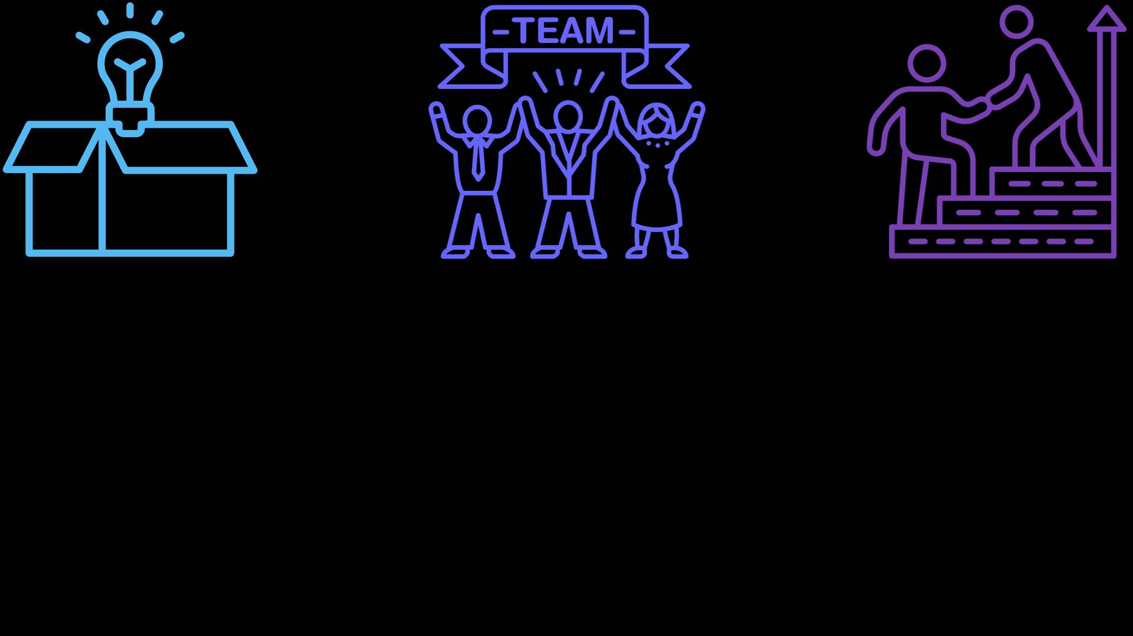
What is Training at Workplace
process of imparting knowledge, skills, and competencies to employees in order to improve their performance and productivity within a specific job or role.
Skills Development
Onboarding
Compliance and Safety
Professional Development
Cross-Training
Performance Improvement
Product Knowledge
Team Building
Leadership Development
Notes:
Workplace training refers to the process of imparting knowledge, skills, and competencies to employees in order to improve their performance and productivity within a specific job or role. Training at the workplace serves several purposes and can take various forms, including:
Skills Development: Workplace training helps employees acquire and enhance the skills necessary to perform their job tasks effectively. This could involve technical skills, such as operating machinery or using software, as well as soft skills like communication and leadership.
Onboarding: It's common for new employees to undergo orientation and onboarding training when they join a company. This helps them become familiar with the organization's culture, policies, procedures, and job expectations.
Compliance and Safety: Certain industries and organizations have strict regulations and safety requirements. Workplace training ensures that employees are aware of and compliant with these rules, reducing the risk of accidents and legal issues.
Professional Development: Many organizations invest in the professional growth of their employees. This can include training programs, workshops, and courses that expand their knowledge and prepare them for advancement within the company.
Cross-Training: Cross-training involves teaching employees multiple skills or roles within the organization. This not only makes the workforce more flexible but also helps prevent bottlenecks when key personnel are unavailable.
Performance Improvement: Training can be used to address performance issues and gaps in employee knowledge or skills. It is an opportunity to provide constructive feedback and help individuals improve.
Product Knowledge: Employees may need training to understand the products or services the company offers thoroughly. This is particularly important in sales and customer service roles.
Team Building: Some training programs focus on building better working relationships and improving team dynamics. These programs can include team-building exercises and conflict resolution training.
Leadership Development: For individuals in leadership positions or those being groomed for leadership roles, leadership development training can help them acquire the necessary skills to manage teams effectively.
In summary, workplace training is a dynamic and essential component of modern organizations. It plays a crucial role in employee development, job satisfaction, and overall company success. Effective workplace training programs are designed to meet specific organizational objectives and adapt to the evolving needs of employees and the business itself.

Slide 5


Understanding Training Process & Components
Consist of a series of steps and components designed to facilitate the acquisition of knowledge, skills, and competencies by individuals or groups.
Needs Assessment
Setting Objectives
Designing the Training Program
Content Development
Selecting Instructors or Facilitators
Delivery of Training
Participant Engagement
Assessment and Evaluation
Feedback and Adjustments
Monitoring Progress
Documentation and Reporting
Post-Training Support
Notes:
The training process consists of a series of steps and components designed to facilitate the acquisition of knowledge, skills, and competencies by individuals or groups. Understanding these components is essential for creating effective training programs. Here's an overview of the key components of the training process:
Needs Assessment:
Identify the specific learning needs and objectives of the training program. This involves understanding what skills or knowledge gaps exist among the target audience.
Setting Objectives:
Clearly define the desired outcomes of the training. What should participants be able to do or know by the end of the program? Objectives should be specific, measurable, achievable, relevant, and time-bound (SMART).
Designing the Training Program:
Develop the content and structure of the training program. Consider the format (e.g., in-person, virtual, e-learning), materials, resources, and instructional methods.
Content Development:
Create the training materials, including presentations, handouts, videos, and exercises. Ensure that the content aligns with the training objectives and is engaging and relevant to the learners.
Selecting Instructors or Facilitators:
Choose qualified trainers or facilitators who have expertise in the subject matter and the ability to effectively convey information to participants.
Delivery of Training:
Conduct the training sessions according to the program's design. This may involve classroom instruction, online modules, hands-on workshops, or a combination of delivery methods.
Participant Engagement:
Encourage active participation and engagement among participants. Use interactive activities, discussions, and practical exercises to reinforce learning.
Assessment and Evaluation:
Measure the effectiveness of the training through assessments and evaluations. Assessments can include quizzes, tests, skill demonstrations, and self-assessments. Gather feedback from participants to identify areas for improvement.
Feedback and Adjustments:
Analyze assessment results and participant feedback to identify strengths and weaknesses of the training program. Make necessary adjustments and improvements for future sessions.
Monitoring Progress:
Keep track of participants' progress and performance throughout the training. Offer additional support or resources as needed to help learners meet their objectives.
Post-Training Support:
Offer ongoing support and resources to participants after the training to help them apply what they've learned in the workplace. This might include job aids, mentorship, or access to reference materials.
Documentation and Reporting:
Maintain records of the training process, including attendance, assessment results, and feedback. This documentation can be useful for tracking progress and compliance.
Effective training programs consider all these components and follow a structured process to ensure that learning objectives are met, and participants acquire the necessary knowledge and skills. Flexibility and adaptability are key, as training programs may need to evolve to address changing organizational needs and industry trends.

Slide 6


Importance of TNA in designing a Training Workshop
Serves as the foundation upon which training programs are built and ensures that the training is targeted, relevant, and aligned with organizational goals.
Tailored Content
Alignment with Objectives
Maximized
Impact
Increased Engagement
Improved
Relevance
Targeted Learning Objectives
Cost
Efficiency
Measurable
Outcomes
Employee
Buy-In
Continuous Improvement
Notes:
Training Needs Analysis (TNA) plays a pivotal role in the design of effective training workshops. It serves as the foundation upon which training programs are built and ensures that the training is targeted, relevant, and aligned with organizational goals. Here's why TNA is important in designing a training workshop:
Tailored Content: TNA identifies the specific skills, knowledge, and competencies that employees need to develop. This information allows you to customize the content of the training workshop to meet the precise needs of the participants. As a result, the training is more likely to be engaging and directly applicable to their roles.
Alignment with Objectives: TNA ensures that training workshops align with the strategic objectives of the organization. When training is closely tied to organizational goals, it becomes a strategic tool for achieving those objectives.
Maximized Impact: By focusing on the areas where employees need the most improvement, TNA ensures that the training workshop has a maximum impact on performance. This makes the best use of participants' time and resources and minimizes the risk of training becoming a box-checking exercise.
Increased Engagement: When employees perceive that the training addresses their specific needs and challenges, they are more likely to be engaged and motivated to participate actively in the workshop. This leads to better learning outcomes.
Improved Relevance: TNA helps avoid the delivery of irrelevant or redundant training content. Employees are more likely to appreciate and apply what they learn in a workshop when it directly relates to their job responsibilities.
Targeted Learning Objectives: TNA assists in setting clear and specific learning objectives for the training workshop. These objectives provide a roadmap for both trainers and participants, making it easier to measure the effectiveness of the training.
Cost Efficiency: Developing and delivering training can be resource-intensive. TNA helps organizations invest their training budgets wisely by focusing resources on areas where they will have the most significant impact.
Measurable Outcomes: TNA sets the stage for measuring the success of the training workshop. By establishing baseline performance measures and post-training assessments, organizations can quantitatively evaluate the impact of the training.
Employee Buy-In: Involving employees in the TNA process can foster a sense of ownership and buy-in for the training program. When employees feel their input is valued, they are more likely to participate actively and positively in the training.
Continuous Improvement: TNA is not a one-time activity. It promotes a culture of continuous improvement in training and development. Regularly conducting TNAs allows organizations to adapt to changing needs and evolving skill requirements.
In summary, Training Needs Analysis is a critical step in the design of training workshops because it ensures that the training is relevant, aligned with organizational objectives, and capable of delivering measurable results. It helps organizations make informed decisions about the content, format, and delivery of training, ultimately leading to more effective and impactful learning experiences for participants.

Slide 7


Skills Required for a World Class Trainer
Subject Matter Expertise
Effective Communication
Instructional Design
Facilitation Skills
Time Management
Active Learning Techniques
Technology Proficiency
Presentation Skills
Notes:
Becoming a world-class trainer requires a combination of skills and attributes that go beyond just expertise in a particular subject matter. To excel in the field of training, whether in a corporate setting, educational institution, or any other context, trainers should possess the following key skills:
Subject Matter Expertise: A deep and comprehensive knowledge of the subject matter being taught is fundamental. Trainers should be experts in the content they are delivering, which lends credibility and fosters trust among learners.
Effective Communication: Strong communication skills are paramount. Trainers must be able to convey information clearly, adapt their communication style to different audiences, and actively listen to participants.
Instructional Design: Understanding how to design effective training materials and curricula is vital. This includes structuring content logically, creating engaging activities, and using instructional technology when appropriate.
Facilitation Skills: The art of facilitating group discussions and activities is a core competency for trainers. This involves managing group dynamics, encouraging participation, and maintaining a positive and inclusive learning environment.
Time Management: Efficiently managing training sessions and adhering to schedules is important. Trainers should balance time between content delivery, activities, and opportunities for questions and discussion.
Active Learning Techniques: Incorporating active learning methods, such as group discussions, case studies, role-playing, and hands-on activities, can enhance the learning experience and increase retention.
Technology Proficiency: In today's digital age, trainers should be comfortable using training technology and software, including Learning Management Systems (LMS), virtual classrooms, and multimedia tools.
Presentation Skills: Effective trainers have strong presentation skills, including the ability to use visuals, storytelling, and engaging delivery techniques.
Becoming a world-class trainer often involves ongoing professional development and a commitment to honing these skills over time. Additionally, trainers should seek feedback from participants and colleagues to continually improve their training effectiveness.

Slide 8


Understanding Adult Learning Styles
Visual Learners
1
6
Social Learners
Auditory Learners
2
7
Solitary Learners
Kinesthetic Learners
3
8
Global Learners
Reading/
Writing Learners
Sequential Learners
4
9
Logical Learners
Concrete Learners
5
10
Notes:
Adult learning styles refer to the preferred ways in which adults acquire, process, and retain information. Understanding these styles can help educators and trainers design effective learning experiences for adult learners. Here are some common adult learning styles:
Visual Learners: Visual learners prefer to learn through visual aids such as charts, graphs, diagrams, videos, and images. They benefit from seeing information in a visual format.
Auditory Learners: Auditory learners learn best through listening and verbal communication. They thrive in settings that include lectures, discussions, and verbal explanations.
Kinesthetic Learners: Kinesthetic learners are tactile and learn best by engaging in physical, hands-on activities. They prefer to learn by doing and through practical experiences.
Reading/Writing Learners: These learners excel when provided with written materials. They prefer to read and write to process information. They benefit from written resources like textbooks and note-taking.
Logical/Mathematical Learners: Logical learners are analytical and appreciate structured, systematic approaches to learning. They excel in problem-solving, critical thinking, and data-driven activities.
Social Learners: Social learners thrive in group settings and prefer to learn through interaction and collaboration with peers. Group discussions and teamwork are effective for them.
Solitary Learners: Solitary learners prefer to learn independently. They are most productive when they can study, reflect, and process information on their own.
Global Learners: Global learners prefer to understand the big picture before delving into details. They benefit from an overview of the subject matter first to grasp the context.
Sequential Learners: Sequential learners appreciate structured, step-by-step approaches to learning. They prefer to learn information in a linear and organized manner.
Concrete Learners: Concrete learners thrive with real-world, practical examples. They understand abstract concepts better when they can relate them to tangible, everyday experiences.
It's important to note that most adults have a combination of these learning styles, and their preferences may vary depending on the context and the subject matter. Effective teaching and training should consider these diverse learning styles and provide a mix of instructional methods to accommodate the needs of adult learners.

Slide 9
Building a Storyboard
Define clear learning objectives and choose a structure.
Break content into sections and identify key elements.
Determine visual elements and media to use.
Script the narrative and plan interactivity.
Design the user interface (UI) for screens or slides.
Create a visual layout with placeholders and sequence content logically.
Include notes and instructions for developers and designers.
Seek feedback and make revisions as needed.
Test and prototype interactive elements.
Finalize the storyboard and obtain stakeholder approval.
Implement version control and track changes.
Maintain open communication and collaboration among the team.
Monitor progress and conduct quality assurance checks.
Notes:
Creating a storyboard is a crucial step in the development of multimedia or e-learning content. It helps outline the visual and narrative structure of your training materials. Here's a guide on building a storyboard:
Define clear learning objectives and choose a structure.
Break content into sections and identify key elements.
Determine visual elements and media to use.
Script the narrative and plan interactivity.
Design the user interface (UI) for screens or slides.
Create a visual layout with placeholders and sequence content logically.
Include notes and instructions for developers and designers.
Seek feedback and make revisions as needed.
Test and prototype interactive elements.
Finalize the storyboard and obtain stakeholder approval.
Implement version control and track changes.
Maintain open communication and collaboration among the team.
Monitor progress and conduct quality assurance checks.
Building a storyboard provides a structured framework for the development of effective training content. It ensures that your training materials are organized, visually appealing, and aligned with your learning objectives.

Slide 10






Thanks for Participation
90239-71970
Hello@freelancetrainings.com
www.freelancetrainings.com
406, Titanium City Centre Mall, Anand Nagar, Satellite, Ahmedabad-380015

