Slide 1


Time Management- Workshop
Your
Company
Logo
Your
Company
Logo
Workshop Name
Company Name
Trainer Name
Notes:
Note for the trainer: Start the day with enthusiasm. Your enthusiasm should reflect in your tone of voice and body language.
Say: Good morning, ladies and gentlemen! (Pause for a moment) Can you all hear me clearly? (Trainer: Good Morning!)
Thank you for joining us today. I hope you're all feeling energized and ready for an exciting learning experience. (Pause for a moment) Let's begin by setting the tone for the day. (Trainer: Good Morning!)
Now, I want everyone to take a deep breath in... and let it out with a big "Good morning!" on the count of three. Are you ready? One, two, three... Good morning! (Trainer: Good Morning!)
Fantastic! Give yourselves a round of applause for that enthusiastic start. (Applaud the participants)
Today is not going to be a typical presentation where you sit back and listen passively. No, it's going to be a dynamic, engaging journey where we all participate and learn from one another. We'll be incorporating activities, discussions, and experiential learning to make the most of our time together. (Pause for a moment)
But before we dive into the workshop, I kindly request everyone to switch their mobile phones to silent mode. This will ensure minimal distractions and allow us to fully focus on the valuable content and activities we have planned. You can always check your phones during the scheduled breaks. (Pause for a moment)
So, are you ready to embark on this exciting learning adventure? (Pause for a moment) Great! Let's get started and make today a memorable and enriching experience for all of us. (Trainer: Good Morning!)
Today`s, workshop modules are designed to understand “Time Management”
Note: Before proceeding to the workshop, please make sure your mobile phones are on silent mode and avoid attending or checking them during the workshop. You can check your phones during the breaks.

Slide 2
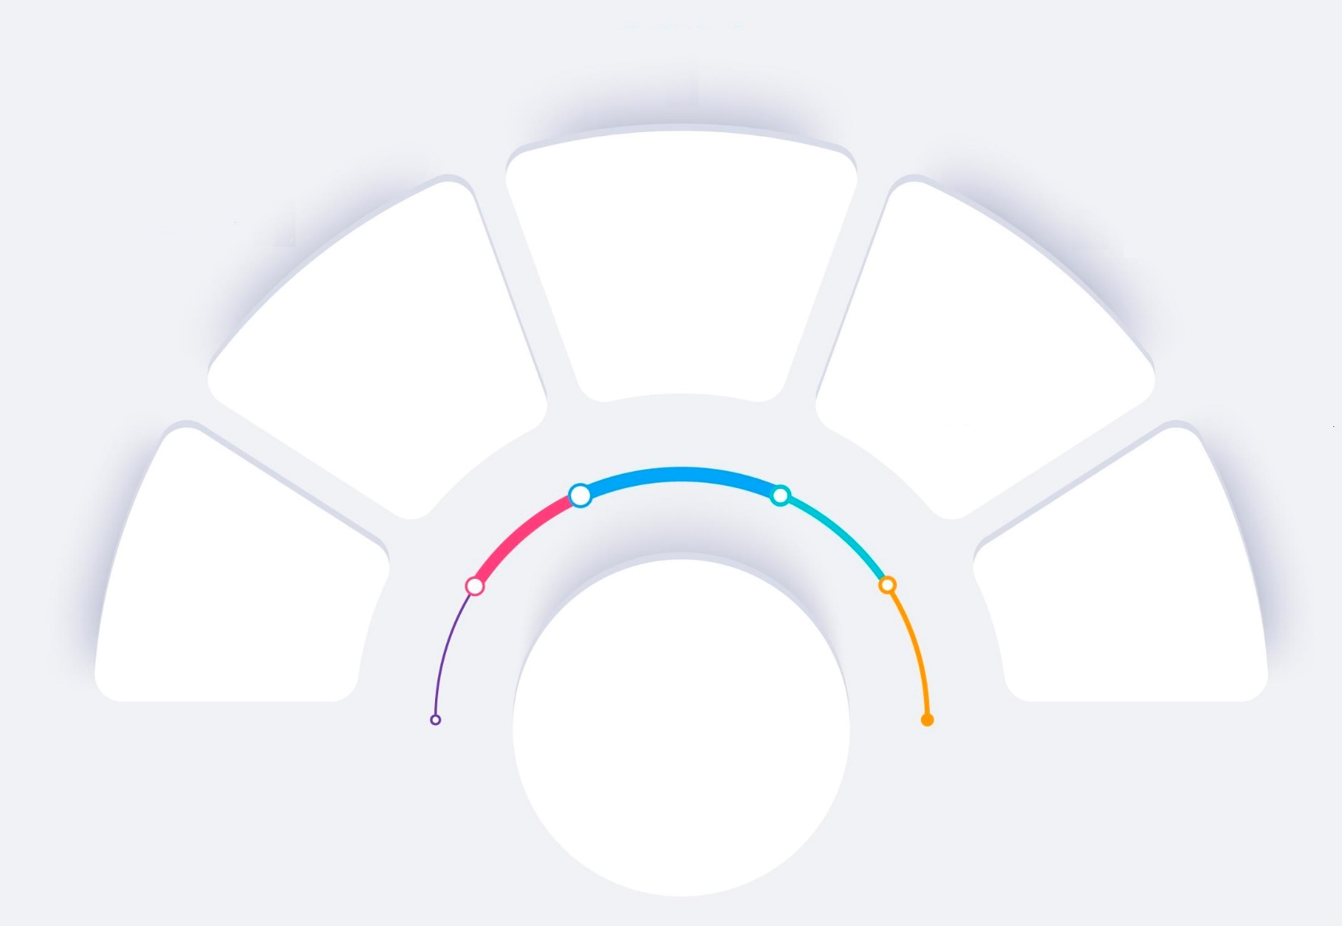






Workshop Agenda –The Modules
Identifying Time Robbers
Prioritization
SMART Goals
Planning & Organizing
Stakeholder Management
Understanding Time Management
Notes:
Welcome to the First Time Manager Workshop. Are you excited for today`s workshop? let me introduce todays workshop modules.
Understanding Time Management
Planning & Organizing
Prioritization
Identifying Time Robbers
Setting SMART Goals
Stakeholder Management
I'm feeling really enthusiastic about this experience, I think it's going to be great.

Slide 3

Understanding Time/ Where Does Time Go?
Notes:
Taking cues from their funny stories trainer takes up this question to the participants to understand their perspective.
Can we really manage time?
Trainer takes in all the answers and can be noted in the flipchart as a reference for later discussion. Trainer doesn’t close the discussion with an answer, but says – Lets See! Whats the fundamental challenge.
Transition to the next slide

Slide 4




Part-1- Lets understand Transactional time
Transaction time is a time spent by any professional in
Sleeping
Bathing
Commute to work in a week
Eating
Please write down what is your Transactional time for each category
Notes:
Each Participant to write down how much time he/she spends for the transactional work each week . Please note that this activity is highly specific-i.e. different participants will have different schedule and timing for all the tasks. So don’t copy of try to make it generic
Eat: . If u take 20 Mins for breakfast and 45 mins each for Lunch and dinner and 15 mins for morning and evening tea/smoke break. Then in a day you spend (20+ 45+45+ 15+15)=140 Mins. In a week you may be spending 140*7= 980 Mins or 980/60 = 16 Hrs
Sleep: E.g If you sleep 6 Hours in a day then weekly you spend 42 Hours (6*7= 42) and if you take a nap in afternoon on Sunday’s please feel free to add that time also.
Bath-
Commute To Work- Both Morning & Evening-Say 1 Hr every day it comes to 5 Hrs per week (1*5)-considering 5 days working

Slide 5

Some Time Facts
Professionals, are spending up to 23 hours a week in meetings. That’s over 1000 hours per year. What’s more, a survey by Harvard Business Review of over 180 senior managers found that 72% said the meetings they attended were unproductive and inefficient
Indians spend more time in daily office commute than people in most countries in the world, with more than 2 hours on the road every day, according to a report by office commute platform MoveInSync. On an average, Indians spend 7% of their day in commuting to office
In a recent study of working professionals, 40% reported getting interrupted 10 or more times per day. Meetings, texts, chat messages, emails, and conversations with work colleagues can really sap your time. Report by Docusign
Notes:
Employees are spending too much time in meetings and video meetings
According to Harvard Business Review, executives, are spending up to 23 hours a week in meetings. That’s over 1000 hours per year. What’s more, a survey by HBR of over 180 senior managers found that 72% said the meetings they attended were unproductive and inefficient.
A study by Harvard Business School of over 3 million people during the early days of the COVID-19 pandemic showed that employees were attending 13% more meetings than they were before working from home. To avoid wasting time in meetings, make sure the meeting is essential before you accept the calendar invite and follow an agenda.
https://www.docusign.co.uk/blog/6-scary-facts-about-time-wasting
Indians spend more time in daily office commute than people in most countries in the world, with more than 2 hours on the road every day, according to a report by office commute platform MoveInSync. On an average, Indians spend 7% of their day in commuting to office, averaging less than 3 minutes per kilometre. ‘Travel Time Report Q1 2019 vs Q1 2108’ report is based on the data collated from the rides on MoveInSync platform across Bengaluru, Hyderabad, Chennai, Pune, Mumbai and Delhi-NCR .. Read more at: https://economictimes.indiatimes.com/jobs/indians-spend-7-of-their-day-ge-to-their-office/articleshow/70954228.cms?utm_source=contentofinterest&utm_medium=text&utm_campaign=cppsttingt
40% of employees report getting more than 10 interruptions per day
In a recent study of working professionals, 40% reported getting interrupted 10 or more times per day. Meetings, texts, chat messages, emails, and conversations with work colleagues can really sap your time. You can reduce time wasted on emails by allocating specific times of the day to check your email and messages - for example, in the morning, during the middle of the day and at the end of the day. It will reduce the time you spend in your inbox.
https://www.docusign.co.uk/blog/6-scary-facts-about-time-wasting

Slide 6

All Work are not Equal – That’s why Planning is Important
Notes:
Trainer asks participants if everything we do is of equal importance and relevance. If not then what do we do about it.
Trainer Lets look at some examples of how Value and Priority is different for different tasks in the organisations.
Engineering Team: The Engineering team's primary focus is on developing new software features and fixing bugs. Their main goal is to deliver high-quality products to the customers. Within the team, they prioritize tasks based on their impact on product functionality and customer satisfaction. For example, if there is a critical bug affecting a large number of users, it will be given a high priority to ensure a swift resolution.
Marketing Team: The Marketing team's objective is to promote the company's products and services, increase brand awareness, and generate leads. They prioritize tasks based on their potential to drive revenue and expand the customer base. For instance, launching a new marketing campaign or attending a major industry event would be considered high-value tasks for the Marketing team.
Customer Support Team: The Customer Support team focuses on providing assistance and resolving customer issues. Their main priority is to ensure customer satisfaction and retention. They prioritize tasks based on urgency and the impact on customer experience. For example, addressing critical customer complaints or handling urgent support tickets would be given top priority to maintain customer loyalty.
In this example, the value and priority of work differ across the organization. The Engineering team emphasizes product quality and functionality, the Marketing team emphasizes revenue generation and brand promotion, and the Customer Support team emphasizes customer satisfaction and issue resolution. Each team needs to plan their tasks accordingly.
Lets see how planning benefits us in the same.

Slide 7




Simple Ways to Leverage time
Batching similar
kind of work
Taking Advantage
of Commute time
Using technology
Making Meetings Effective
Notes:
Batching Similar Tasks: simple trick to staying productive is using block scheduling planning to group similar tasks into one batch throughout the week. For example, instead of emailing prospects randomly throughout the week, schedule a 2-hour block twice a week to focus on business development. By grouping similar tasks together, you can develop a groove and work faster and more efficiently.
Take advantage of your commute. Leverage time on your commute by scheduling calls to be completed during that time.
Utilize technology. There are several apps or software you can use to save time. For example, you can use a calendar app that sends reminders for upcoming events to eliminate the time needed for follow-up. Or you can use project management software to keep track of where your team is on a project.
Use meetings to address multiple topics. If you are meeting with someone, use that time to cover additional topics you intended to discuss. This will help you save time by eliminating the need to schedule another meeting or going back and forth over email.

Slide 8

URGENT
IMPORTANT
Module-3 Urgent V/s Important
Notes:
Welcome to the Module on Prioritisation. In this module we will learn
Not all tasks are Important- Urgent Important Concept
Urgent Important Matrix
Plotting Urgent Important Matrix

Slide 9
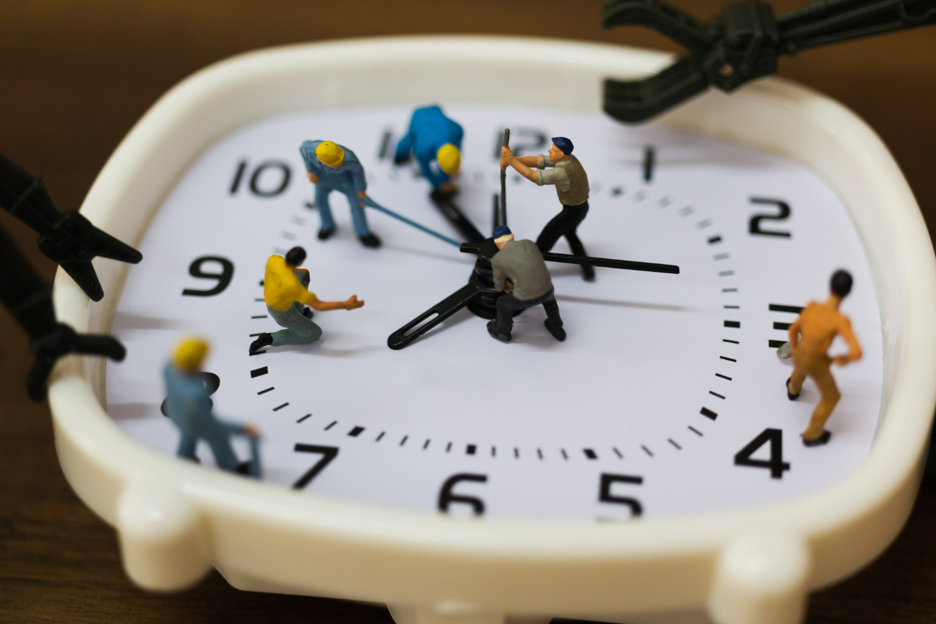
Identifying Time Robbers
Notes:
Welcome to the 4th Module on Identifying Time Robbers. In this module you will learn the following.
Different type of time Robbers (Inflicted Vs Others Inflicted)
Procrastination the biggest enemy
Dealing with Procrastination
Pareto’s Rule of 80/20
Eat the Frog
Now, we will learn a variety of skills that will help us to utilize time in an effective way..

Slide 10

Different type of time Robbers
Procrastination
Meetings
Interruptions
Multitasking
Excessive internet and social media use
Poorly defined goals and priorities
Inefficient processes and systems
Lack of delegation or teamwork
Personal distractions
Poor time management
Notes:
Time robbers, also known as time thieves or time wasters, are activities or factors that consume or steal valuable time at the workplace, often resulting in decreased productivity and efficiency. Here are some common types of time robbers you may encounter:
Procrastination
Meetings
Interruptions
Multitasking
Excessive internet and social media use
Poorly defined goals and priorities
Inefficient processes and systems
Lack of delegation or teamwork
Personal distractions
Poor time management
Meetings: While meetings are essential for communication and collaboration, they can become time robbers if they are disorganized, too frequent, or lack a clear agenda and purpose. Unproductive or lengthy meetings can consume valuable time that could be better utilized for productive work.
Interruptions: Constant interruptions from coworkers, phone calls, emails, or instant messages can disrupt workflow and hinder concentration. Examples include unnecessary or prolonged conversations, frequent requests for assistance, or excessive socializing.
Multitasking: Contrary to popular belief, multitasking often leads to decreased productivity. Constantly switching between tasks can result in loss of focus and reduced efficiency. It's more effective to prioritize and complete tasks one at a time.
Excessive internet and social media use: While the internet is a valuable tool for work-related research and communication, excessive use of non-work-related websites, social media platforms, or personal email can easily become a time robber. It's important to maintain discipline and set boundaries to minimize distractions.
Poorly defined goals and priorities: Without clear goals and priorities, it's easy to get caught up in unimportant or low-value tasks that consume time without contributing to overall productivity. It's crucial to establish clear objectives and identify tasks that align with them.
Inefficient processes and systems: Cumbersome or outdated processes, systems, or tools can significantly impact productivity. Time spent navigating complex procedures, dealing with technical issues, or waiting for slow equipment can all contribute to time theft.
Lack of delegation or teamwork: Failing to delegate tasks or effectively collaborate with colleagues can lead to unnecessary duplication of effort, delays, or overwhelmed individuals. Sharing responsibilities and utilizing the strengths of team members can save time and enhance productivity.
Personal distractions: Personal matters, such as personal calls, excessive breaks, or non-work-related activities, can divert attention and time away from work. Maintaining discipline and separating personal tasks from work hours can help mitigate these distractions.
Poor time management: Inadequate planning, failure to set deadlines, ineffective prioritization, or underestimating the time required for tasks can all contribute to time theft. Developing strong time management skills and utilizing tools like to-do lists or calendars can help improve efficiency.
By identifying these time robbers and implementing strategies to minimize or eliminate them, individuals and organizations can enhance productivity, improve time management, and make better use of their work hours.

Slide 11

Eat That Frog!
The eat the frog strategy is a prioritization and productivity method used to help people identify difficult tasks. The idea is that you identify one challenging task (the frog) and complete the task first thing in the morning (eating it).
Notes:
Do the most important right in the morning
The eat the frog strategy is a prioritization and productivity method used to help people identify difficult tasks. The idea is that you identify one challenging task (the frog) and complete the task first thing in the morning (eating it).
To put it simply, eating the frog is the process of identifying your most difficult task of the day and completing it before you do any other work. If you have to eat two frogs, eat the bigger one first. Identify which task is more challenging, and do that first thing.

Slide 12

Step-3 : Implement the Action Plan
Notes:
Implementing an action plan as an effective manager involves the following steps:
Communicate the plan: Communicate the action plan to your team members, stakeholders, and anyone else who is involved in the implementation process. Ensure that everyone understands their roles and responsibilities, and what is expected of them.
Set timelines and milestones: Set specific timelines and milestones for each step of the action plan. This will help keep the implementation on track and ensure that progress is being made.
Assign tasks and delegate responsibilities: Assign specific tasks to team members and delegate responsibilities based on their strengths and areas of expertise. Ensure that everyone understands their role in the implementation process.
Monitor progress: Regularly monitor progress and identify any issues or obstacles that arise. Address these issues in a timely manner to keep the implementation on track.
Provide support and resources: Provide your team members with the resources they need to complete their tasks, including training, tools, and equipment. Provide support and guidance as needed.
Evaluate and adjust: Continuously evaluate the progress of the action plan and make adjustments as needed. This may involve revising timelines, reallocating resources, or making changes to the plan itself.
Celebrate successes: Celebrate successes and milestones along the way. This will help motivate your team and reinforce their commitment to the implementation process.
By following these steps, you can effectively implement an action plan and achieve your goals.

Slide 13


Stakeholder - Activity
Notes:
The objective of this activity is to help the participants understand the meaning of Stakeholder and the importance of the stakeholders in your career progress. The trainer is free to choose any training activity to derive the same objective from their own resources,
Lets start with the activity
Hand out a packet of straws (at least 150), a roll of sticky tape and a pair of scissors to each team;
Tell the teams that the aim of the exercise is to build the tallest, free-standing tower, using the materials provided, in the time given (30minutes)
15 mins into the activity tell that the tallest tower has to hold a tennis ball on the top of the tower for atleast 15 secs
Trainer has to observe how different players have played their parts, how each player played an important part to get the work done. Also with the 3rd announcements how priorities changes and how players deliver.
What have you learnt from this activity
What were the different roles that each team member played while building the tower
To complete your individual task in your team was your performance dependent on any other team members
How can you co-relate this activity to your daily workplace performance
Trainer to draw a parallel of this activity to how we also function in our daily lives at work places, how we have to coordinate with others and deliver.
Note:

Slide 14





Thank You
98752-08472
Hello@freelancetrainings.com
www.freelancetrainings.com
406, Titanium City Centre Mall, Anand Nagar, Satellite, Ahmedabad-380015

