Slide 1


Your
Company
Logo
Tele-Sales Workshop
Notes:
Note for the trainer: start the day with enthusiasm. Your enthusiasm should reflect in your tone of voice and body language.
Good morning everyone!
How are you today. Are you ready to dive into a day of learning, growth, and transformation? I know I am!
Today, we have a unique opportunity to learn from each other, challenge ourselves, and take our personal and professional lives to the next level. Today’s workshop is highly engaging, filled with activities, role plays, videos and discussions that are designed to inspire and empower you.
But this isn't going to be a passive experience. This isn't a lecture where you sit back and listen to someone else talk. This is an interactive, dynamic, and engaging workshop that requires your full participation, your curiosity, and your willingness to learn.
Throughout the day, you'll have the chance to connect with other like-minded individuals, share your own experiences and insights, and gain new skills and knowledge that will help you achieve your goals. You'll be challenged, pushed outside your comfort zone, and supported every step of the way.
So, are you ready to embrace this day with open hearts and open minds? Are you ready to learn, grow, and transform? I know I am, and I can't wait to see what we'll achieve together.
Let's get started!

Slide 2



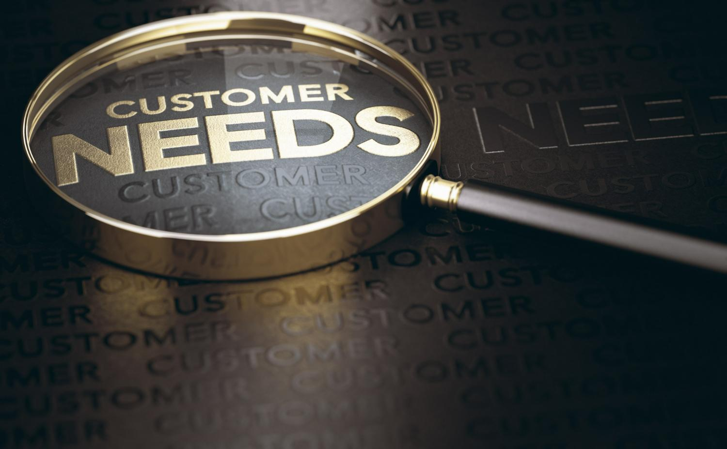

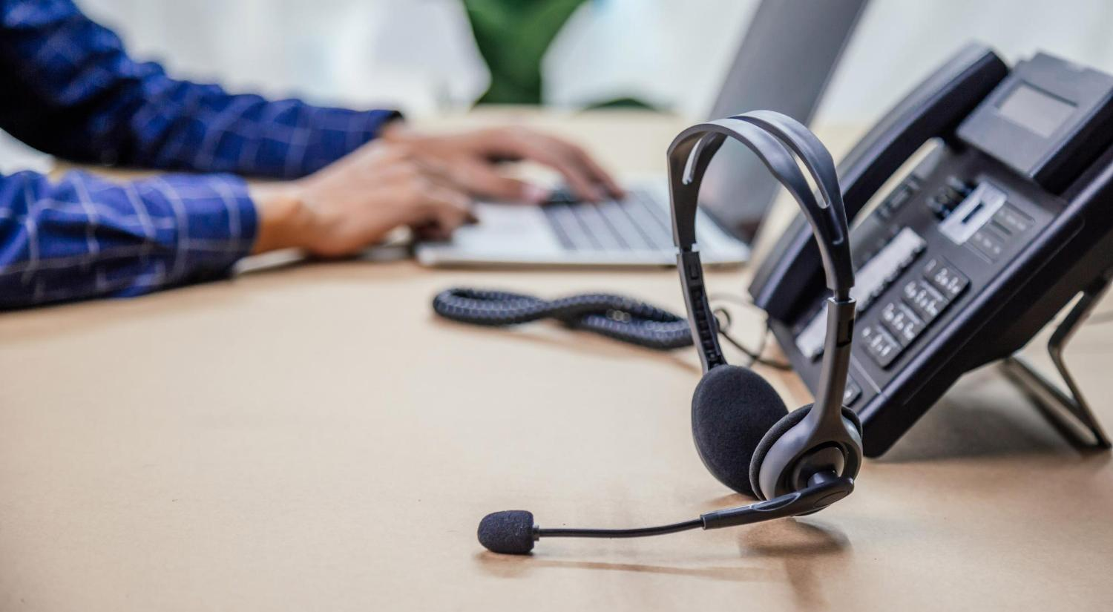
Workshop Agenda Day-1
Introduction to Tele Sales
The Tele sales Process
Mastering a sales Pitch
Understanding Customer Needs
Product Pitching & Objection Handling
Common Tele-Sales Etiquettes
Notes:
Welcome to the Tele-Sales Workshop. Are you excited for today`s workshop? let me introduce todays workshop modules.
Introduction to Tele sales
The Tele sales Process
Mastering the Sales Pitch
Understanding Customer Needs
Product Pitching & Handling sales Objections
Common Tele sales Etiquettes
Move to next slide

Slide 3
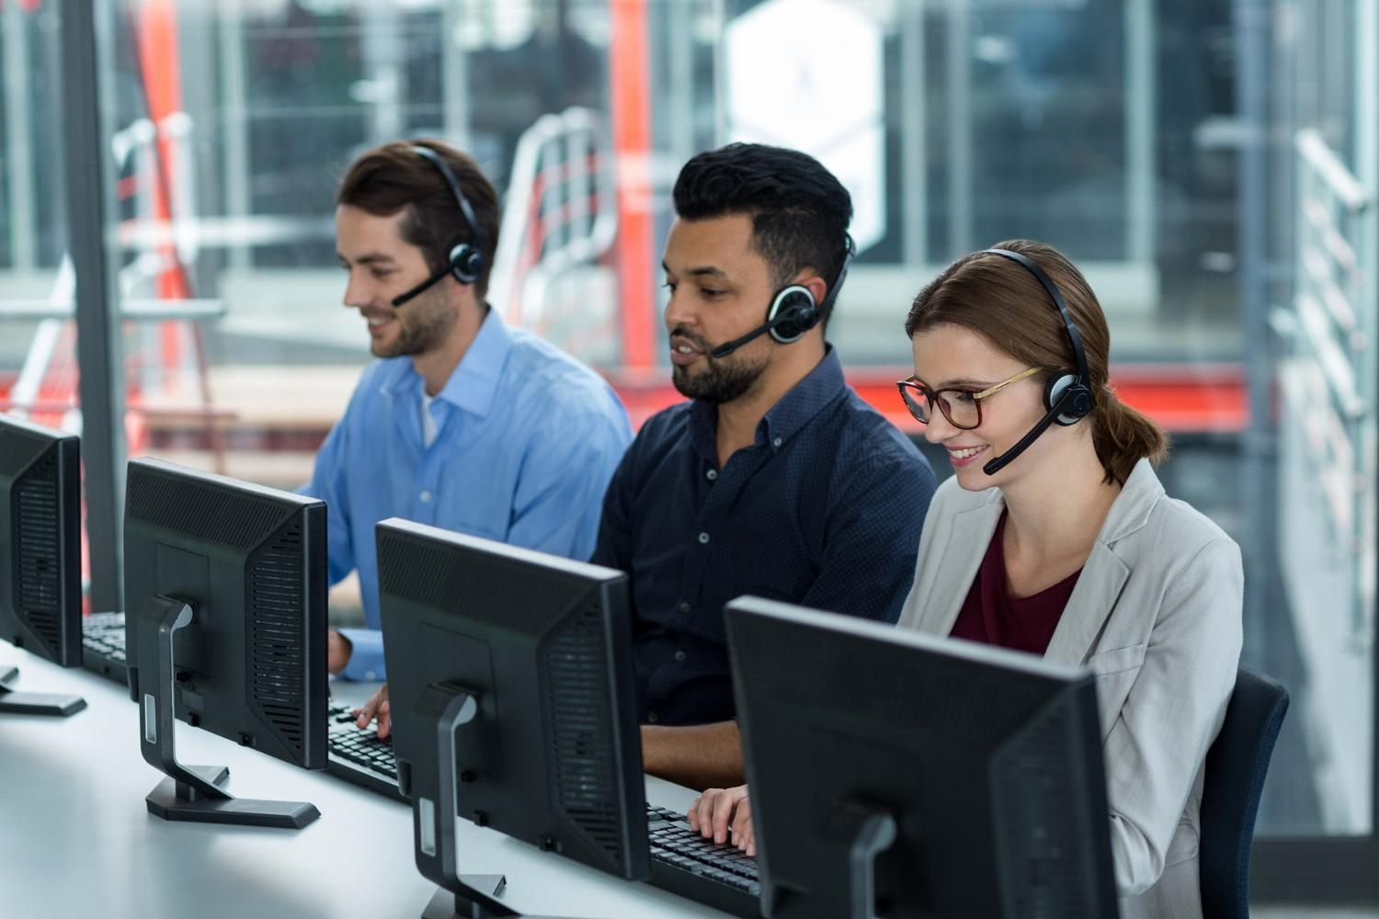
What is Tele sales?
Tele sales, also known as telemarketing or inside sales, is a proactive sales strategy.
It involves contacting potential customers over the phone to promote products/services.
The goal is to secure sales, generate leads, and build relationships.
Used in various industries: Consumer products, services, B2B solutions.
Notes:
Tele sales, also known as telemarketing or inside sales, is a sales strategy that involves reaching out to potential customers or clients over the phone to promote products or services and ultimately secure sales or generate leads. It is a direct and proactive approach to sales, where sales representatives, known as tele sales Professionals or telemarketers, initiate conversations with prospects to present offers, answer inquiries, address concerns, and close deals.
The primary objective of tele sales is to engage prospects, build relationships, and persuade them to take action, whether it's making a purchase, setting up a meeting, signing up for a service, or providing contact information for further follow-up. Tele sales is widely used across various industries, from consumer products and services to B2B (business-to-business) solutions.
information for further follow-up. Tele sales is widely used across various industries, from consumer products and services to B2B (business-to-business) solutions.

Slide 4
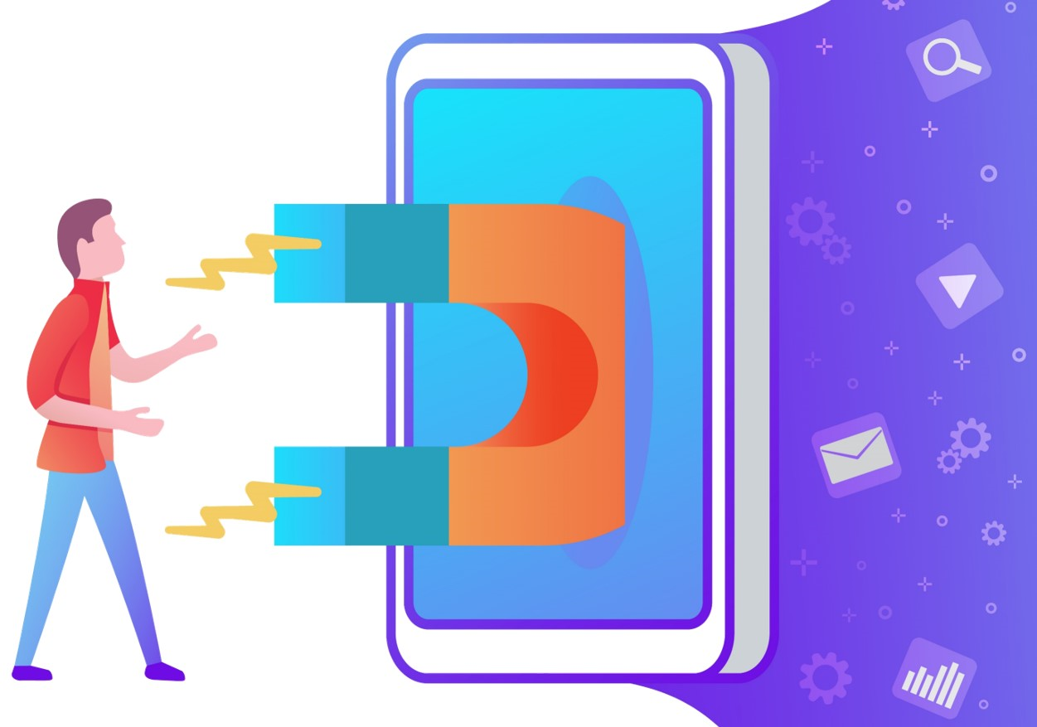
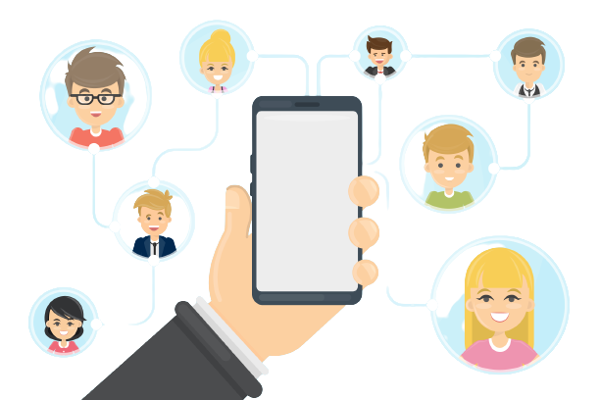




Tele sales Process
Outbound Calls
Follow-Up and Relationship Management
Lead Generation
Tele sales Process
Closing the Sale
Pitching and Selling
Handling Objections
Notes:
The process of tele sales typically includes the following steps:
Outbound Calls: Tele sales Professionals initiate calls to the leads to introduce the product or service, present its benefits, and attempt to generate interest.
Lead Generation: Tele sales Professionals often work with a list of potential leads obtained through various means, such as previous customers, online inquiries, purchased lists, or marketing campaigns.
Pitching and Selling: During the call, the tele sales agent will deliver a sales pitch tailored to the prospect's needs and preferences. They will highlight the product's features, advantages, and unique selling points to persuade the prospect to make a purchase or take the desired action.
Handling Objections: Prospects may have questions or objections related to the product or service. Tele sales Professionals must be prepared to address these concerns effectively and provide the necessary information to overcome objections.
Closing the Sale: The ultimate goal of tele sales is to secure a sale or commitment from the prospect. This could involve completing a purchase, setting up an appointment, or obtaining consent for further follow-up.
Follow-Up and Relationship Management: In some cases, tele sales may require follow-up calls to nurture leads or maintain relationships with existing customers, encouraging repeat business and fostering customer loyalty.
Tele sales is a widely used sales technique across various industries and business sectors, ranging from consumer goods and services to business-to-business (B2B) solutions. It offers several advantages, including the ability to reach a large audience quickly, cost-effectiveness compared to in-person sales, and the potential to gather valuable customer feedback.

Slide 5





Challenges Faced by Tele sales
Building Rapport Remotely
Engaging and Keeping Prospect Interest
Time Management and Productivity
Language Barriers
Call Screening and Gatekeepers
Challenges
Notes:
1. Building Rapport Remotely:
Building rapport and establishing trust with prospects over the phone can be challenging. Without the benefit of face-to-face interactions and body language cues, tele sales Professionals must rely on their communication skills to create a connection with potential customers. This requires active listening and effective communication techniques.
2. Engaging and Keeping Prospect Interest:
In tele sales, the first few seconds of a call are crucial in capturing the prospect's attention. Sales Professionals need to deliver an engaging and compelling introduction to keep the prospect interested in the conversation. Moreover, maintaining the prospect's interest throughout the call and addressing objections effectively can be challenging but crucial to converting leads into customers.
3. Time Management and Productivity: Tele sales professionals need to balance their time efficiently to reach as many prospects as possible while maintaining the quality of their interactions. Meeting call quotas and sales targets can be demanding, and managing time effectively to maximize productivity is a constant challenge.
4, Language Barriers: Telecallers may encounter prospects who speak different languages or have varying levels of fluency in the language used for communication. Overcoming language barriers requires effective communication skills and, in some cases, language support tools.
5. Call Screening and Gatekeepers: In business-to-business (B2B) tele sales, tele callers often have to navigate through gatekeepers or receptionists who screen calls for decision-makers. Convincing gatekeepers to put them through or finding alternative ways to reach the right contact can be challenging.

Slide 6

Suspecting
Initial stage where the tele sales team identifies a wide pool of potential prospects who could be interested in the product or service.
Suspects
E.G The tele sales team gathers a list of contacts from a trade show attendee list. These contacts are potential suspects as they showed interest in the industry, but there's limited information about their specific needs.
Some of the common Suspecting sources include
Lead Database and CRM systems
Social Media database
Industry & Tradeshow directories
Website visitors
Market research reports
Professional Networking Platforms
Higher the Suspects, Higher the sales closures
Notes:
Suspecting: This is the initial stage where the tele sales team identifies a wide pool of potential prospects who could be interested in the product or service. At this point, there might be minimal information available about these prospects. This stage is all about broad awareness and initial data collection.
Example: The tele sales team gathers a list of contacts from a trade show attendee list. These contacts are potential suspects as they showed interest in the industry, but there's limited information about their specific needs.
Lead Databases and CRM Systems: Utilize customer relationship management (CRM) systems and lead databases to access a vast pool of potential prospects. These tools provide data on companies, industries, job titles, and more, helping tele sales teams identify contacts with potential interest.
Social Media Listening and Monitoring: Monitor social media platforms to identify individuals or companies discussing relevant topics related to your product or industry. Tools like social media listening software can help you track relevant keywords and engage with prospects who show potential interest.
Industry and Trade Show Directories: Access industry-specific directories and trade show attendee lists. These resources often provide information about individuals or companies actively participating in events related to your industry, making them potential suspects.
Website Visitor Tracking: Implement website visitor tracking tools that provide insights into who visits your website, what pages they view, and their engagement level. This helps identify potential leads based on their interest in your content.
Market Research Reports: Invest in market research reports that provide information about trends, challenges, and potential opportunities within your industry. These reports can help you identify target segments and companies with potential interest.
Professional Networking Platforms: Leverage platforms like LinkedIn to identify professionals within your target audience. Utilize advanced search features to narrow down contacts based on industry, job title, company size, and more.
Remember, these suspecting tools are the starting point for identifying potential prospects. The key is to combine these tools with effective research and data analysis to ensure that the identified leads align with your ideal customer profile and have a higher potential for conversion.

Slide 7
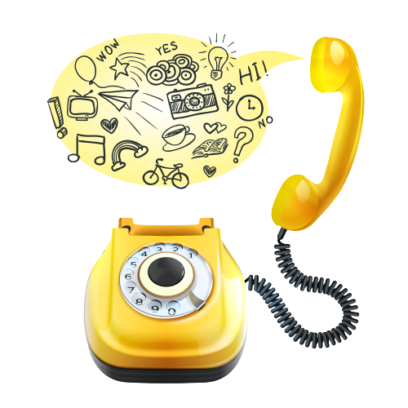
Tele calling Script- Need & Reason
is a structured set of dialogues that guide a tele caller (a person making phone calls) through a conversation with a potential customer or client.
Notes:
A tele-calling script for tele sales professionals is a structured set of dialogues and prompts designed to guide sales conversations with potential customers over the phone. It typically includes an engaging introduction, a presentation of product benefits and features, responses to common objections, a persuasive call to action, and closing remarks. The script aims to provide a clear and consistent framework for tele sales agents to effectively convey information, address customer concerns, and guide the conversation towards achieving sales objectives. It's important for tele sales professionals to adapt the script to the flow of the conversation and the customer's responses while maintaining a personable and customer-centric approach.

Slide 8
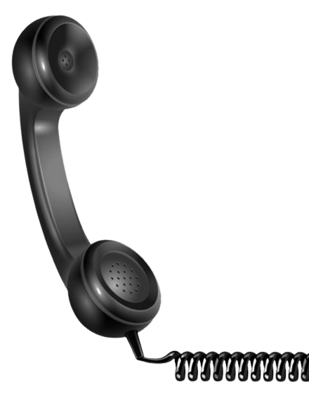
Greetings over the call
"Hello! I’m ………………..calling from [Company Name]. Am I talking to……………..
Good [morning/afternoon]! I'm reaching out from [Company Name]. Am I speaking with …… [Prospect Name].
Good [morning/afternoon]. I'm [Your Name] calling from [Company Name]. Am I talking to [Prospect Name] from company XYZ
"Good [morning/afternoon]. Thank you for taking my call. I'm [Your Name] with [Company Name],
Notes:
Here are some greetings for salespersons over the phone:
Hello! I’m ………………..calling from [Company Name]. Am I talking to……………..
Good [morning/afternoon]! I'm reaching out from [Company Name]. Am I speaking with …… [Prospect Name].
Good [morning/afternoon]. I'm [Your Name] calling from [Company Name]. Am I talking to [Prospect Name] from company XYZ
"Good [morning/afternoon]. Thank you for taking my call. I'm [Your Name] with [Company Name],
Remember to speak with a friendly and professional tone, and to actively listen to the customer's needs and questions. This can help build a positive rapport and increase the chances of a successful sale.

Slide 9

Generating Interest
Most important part of the Tele sales Pitch ensuring customer engagement
Try providing the benefits that the prospect/ customer will get after listening the call like Personalized, Curiosity Inducing, Solution focused, benefit oriented.
Personalized : "Good [morning/afternoon]! This is [Your Name] from [Company Name]. I hope you're having a great day. I noticed your interest in [product/service] on our website. How can I assist you further?"
Curiosity-Inducing : "Hello there! It's a pleasure to speak with you. This is [Your Name] calling from [Company Name]. We're known for something truly unique, and I'm excited to share it with you. Ready to hear more?"
Benefit-Oriented "Hi! This is [Your Name] from [Company Name]. I hope I'm not catching you at a bad time. We've got some fantastic news – we've just launched [product/service] that's been delivering [benefits to the customer]. Interested to know more?"
Solution-Focused: "Good [morning/afternoon]. Thank you for taking my call. I'm [Your Name] with [Company Name], and we specialize in [solution relevant to customer's needs]. I'd love to discuss how we can help you today."
Notes:
Generating interest while calling a customer in a sales call is an important part of the sales process. Here are some tips to help you generate interest and engage customers during a sales call:
This is the most important part of the tele sales pitch or the sales pitch as it will define whether the customer is going to listen to you further or disconnect the call- Remember that simple and boring calls that you might also be receiving- like are you looking to get a loan/ credit card, we don’t entertain those calls because they fail to generate interest/ engagement for us to listen further.
Successful tele sales professional use this part as a hook or a trailer to capture the attention of the prospect/ customer by highlighting a benefit that the customer may get/ a solution that the customer may get after listening to the call. These benefits can be categorized as Personalized, Curiosity Inducing, Benefit oriented and solution oriented. The examples of each category is given below and the Generating Interest statement/ benefit statement is marked in bold.
Personalized : "Good [morning/afternoon]! This is [Your Name] from [Company Name]. I hope you're having a great day. I noticed your interest in [product/service] on our website. How can I assist you further?"
Curiosity-Inducing : "Hello there! It's a pleasure to speak with you. This is [Your Name] calling from [Company Name]. We're known for something truly unique, and I'm excited to share it with you. Ready to hear more?"
Solution-Focused: "Good [morning/afternoon]. Thank you for taking my call. I'm [Your Name] with [Company Name], and we specialize in [solution relevant to customer's needs]. I'd love to discuss how we can help you today."
Benefit-Oriented "Hi! This is [Your Name] from [Company Name]. I hope I'm not catching you at a bad time. We've got some fantastic news – we've just launched [product/service] that's been delivering [benefits to the customer]. Interested to know more?"

Slide 10
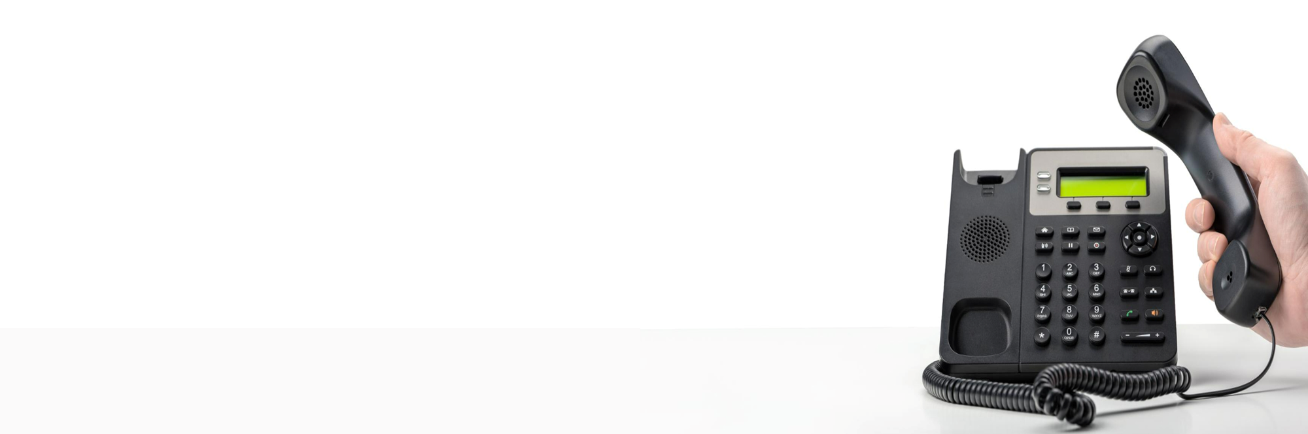
Tips while calling a customer to get an Appointment
Don’t speak too fast or slow.
Stress on the important words.
Make the call as personalised as possible, specially while calling an existing bank client.
No accents, Don’t try to sound too stylish. Be yourself.
Even in a Cold Call, a reference really helps.
Use the words Meeting, instead of appointments.

Slide 11
What is Tele sales Etiquette?
Tele sales Etiquette is crucial for creating a positive and effective experience for both sales representatives and potential customers over the phone.
Notes:
Tele sales etiquette is crucial for creating a positive and effective experience for both sales representatives and potential customers over the phone. Here are the top tele sales etiquettes to ensure successful interactions:

Slide 12






Thanks for Participation
Hello@freelancetrainings.com
www.freelancetrainings.com
98752-08472
406, Titanium City Centre Mall, Anand Nagar, Satellite, Ahmedabad-380015

