Slide 1


Tele calling Skills Workshop
Your
Company
Logo
Notes:
Note for the trainer: start the day with enthusiasm. Your enthusiasm should reflect in your tone of voice and body language. This workshop is for anyone associated with tele calling whether Sales / Non sales role, whether inbound and outbound tele calling.
Good morning everyone!
How are you today. Are you ready to dive into a day of learning, growth, and transformation? I know I am!
Today, we have a unique opportunity to learn from each other, challenge ourselves, and take our personal and professional lives to the next level. Today’s workshop is highly engaging, filled with activities, role plays, videos and discussions that are designed to inspire and empower you.
But this isn't going to be a passive experience. This isn't a lecture where you sit back and listen to someone else talk. This is an interactive, dynamic, and engaging workshop that requires your full participation, your curiosity, and your willingness to learn.
Throughout the day, you'll have the chance to connect with other like-minded individuals, share your own experiences and insights, and gain new skills and knowledge that will help you achieve your goals. You'll be challenged, pushed outside your comfort zone, and supported every step of the way.
So, are you ready to embrace this day with open hearts and open minds? Are you ready to learn, grow, and transform? I know I am, and I can't wait to see what we'll achieve together.
Let's get started!

Slide 2


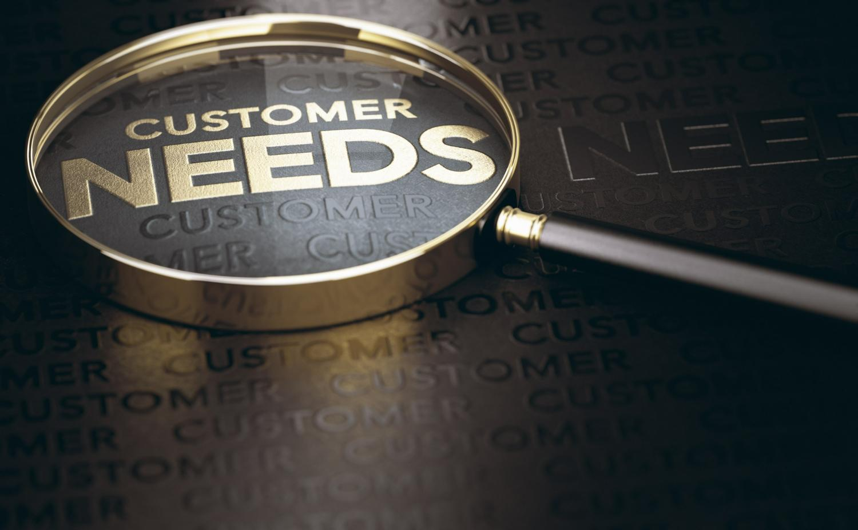
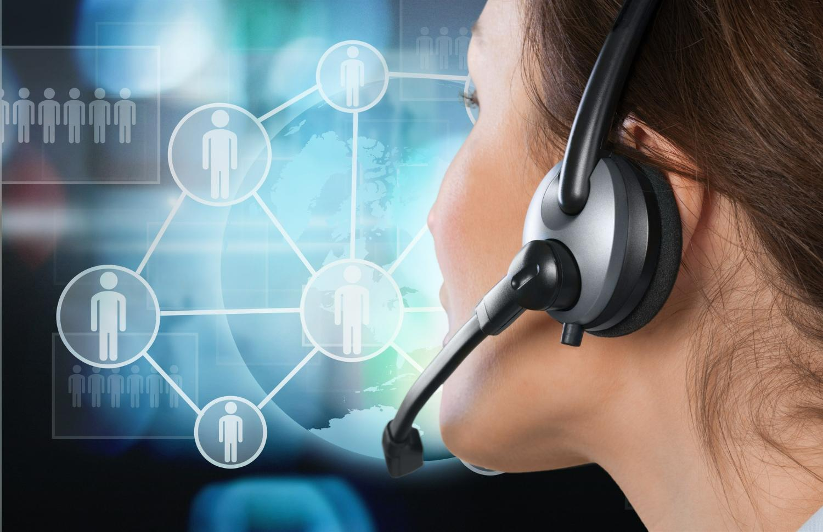
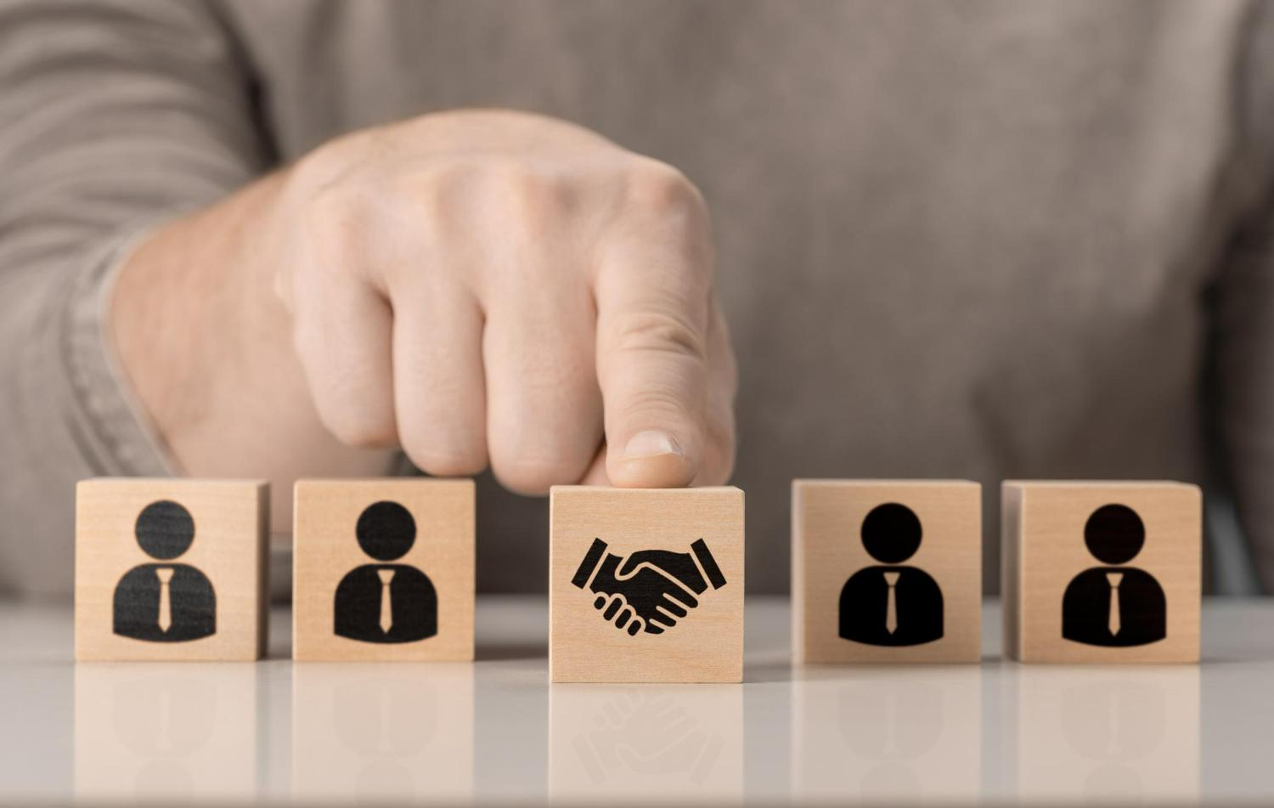

Workshop Agenda
Understanding the Role of Telecallers
Tele calling Script
Understanding Customer Needs
Building Impactful Communication
Building Rapport & Trust
Handling Irate Customers
Notes:
Welcome to the Tele-Calling Workshop. Are you excited for today`s workshop? let me introduce todays workshop modules.
Introduction to Tele Calling
The Tele calling Script
Understanding Customer Needs
Building Impactful communication
Building Rapport & Trust
Handling Irate Customers
So lets Get Set Go
Move to next slide

Slide 3




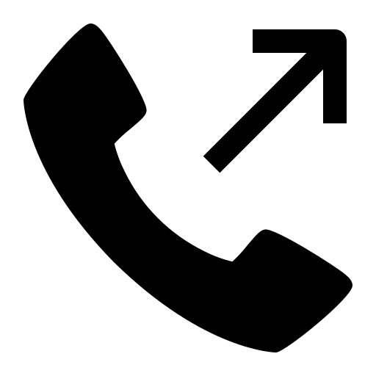

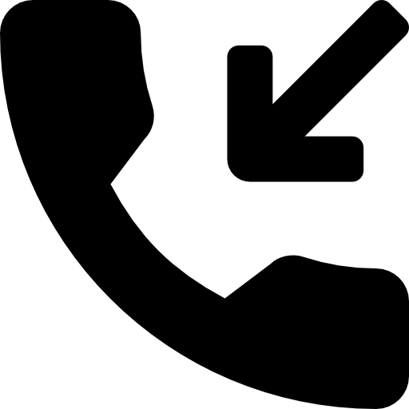
Telecallers & Its Roles
Tele calling is engage with customers over the phone to provide assistance, answer inquiries, resolve issues, and ensure a positive customer experience.
Basis the Job function Tele caller can assume various role
Market Research Tele callers
Sales Vs Non-Sales
Outbound Tele callers
Collections Tele callers
Customer Support Tele callers
Inbound Tele callers
Notes:
The primary responsibility of a telecaller is to engage with customers over the phone to provide assistance, answer inquiries, resolve issues, and ensure a positive customer experience. This role can be categorized into two main types: selling and non-selling. Telecaller is an individual who engages in making or receiving telephone calls as part of their job responsibilities. There are various types of telecalling roles that exist
Outbound Telecaller: Outbound telecallers make calls to potential customers or existing clients. Their main objective might be to promote products or services, generate leads, conduct surveys, or gather feedback. They often work in sales or marketing departments.
Inbound Telecaller: Inbound telecallers receive calls from customers or clients who have inquiries, issues, or need assistance. They are responsible for providing information, addressing concerns, resolving problems, and ensuring a positive customer experience.
Customer Support Telecaller: This type of telecaller focuses exclusively on providing assistance and support to customers. They handle inquiries, troubleshoot problems, guide customers through processes, and ensure that customers have a positive interaction with the company.
Collections Telecaller: Collections telecallers are typically employed by financial institutions to contact customers who have outstanding payments or debts. Their role involves reminding customers about payments, negotiating repayment plans, and ensuring the collection of overdue amounts.
Market Research Telecaller: These telecallers conduct surveys or gather information from individuals or businesses to support market research efforts. They might inquire about consumer preferences, opinions, or industry trends.

Slide 4





Telecalling Benefits- Organisations
Building Trust and Loyalty
Feedback and Listening
Proactive Problem Solving
Personalized Interaction
Cost-Efficiency
Notes:
Building strong customer relations is essential for any organization's long-term success. Telecalling can be a valuable tool for fostering these relationships. Here are five ways in which telecalling can help an organization build strong customer relations:
Cost-Efficiency: Telecalling is often more cost-effective than in-person customer interactions. It reduces the need for physical infrastructure and allows organizations to handle a higher volume of customer inquiries at a lower cost.
Personalized Interaction: Telecalling allows for direct, one-on-one conversations with customers. Telecallers can address customer inquiries, provide personalized assistance, and offer tailored solutions based on individual needs. This personalized interaction makes customers feel valued and understood, leading to stronger relationships.
Proactive Problem Solving: Telecallers can proactively reach out to customers to address potential issues or concerns before they escalate. This proactive approach shows that the organization cares about the customer's experience and is committed to resolving problems promptly, which enhances trust and customer loyalty.
Feedback and Listening: Telecallers have the opportunity to gather feedback directly from customers. They can listen to customer opinions, suggestions, and concerns, providing the organization with valuable insights for improving products, services, and overall customer satisfaction. This active listening demonstrates the organization's commitment to continuous improvement.
Building Trust and Loyalty: Consistent and positive interactions with telecallers can build trust and loyalty over time. When customers have positive experiences with telecallers who genuinely care about their needs, they are more likely to remain loyal to the brand, recommend it to others, and become brand advocates.

Slide 5
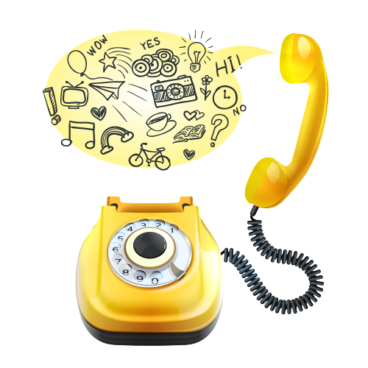
Tele calling Script
is a structured set of dialogues that guide a tele caller (a person making phone calls) through a conversation with a potential customer or client.
Notes:
A tele calling script is a structured set of dialogues and prompts used by tele callers during phone conversations with customers or clients. It outlines key talking points, questions, and responses to guide the conversation toward specific objectives, such as sales, appointments, or information gathering. The script ensures consistent communication, provides information effectively, and helps tele callers handle various scenarios while maintaining a professional and engaging interaction.

Slide 6
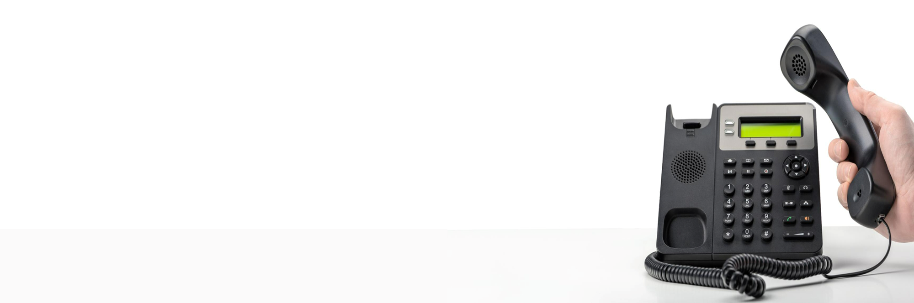
Tips while calling a customer
Don’t speak too fast or slow.
Stress on the important words.
Make the call as personalised as possible
No accents, Don’t try to sound too stylish. Be yourself.

Slide 7

Identify Customer Needs
Selling Skill
Model
Effective Communication
Personalized Solutions
Increased Trust and Credibility
Maximizing Sales Opportunities
Avoid Miscommunication
Enhancing Customer Satisfaction
Notes:
Understanding customer needs is crucial in tele calling as it enables tailored communication, builds trust, and facilitates effective problem-solving, ensuring meaningful interactions that meet customers' specific requirements.
Effective Communication: When a tele caller understands the customer's needs, they can tailor their communication to address those specific requirements. This leads to a more relevant and engaging conversation, which can enhance the overall customer experience.
Personalization: By grasping the customer's needs, a tele caller can personalize their approach. This personal touch demonstrates that the company values the customer as an individual, increasing the likelihood of building a positive relationship. Understanding customer needs allows the tele caller to suggest appropriate solutions or products that directly align with what the customer is seeking. This can lead to higher satisfaction and a better match between customer expectations and the company's offerings.
Building Trust: When customers feel understood, they are more likely to trust the tele caller and the information they provide. This trust is crucial for building a lasting relationship and can contribute to customer loyalty.
Maximizing Sales Opportunities: In a sales context, understanding customer needs enables the tele caller to position products or services as solutions that meet those needs. This targeted approach can lead to higher conversion rates.
Avoiding Miscommunication: Miscommunication can lead to misunderstandings or frustration on the customer's end. By understanding needs, tele callers can ensure that the information they convey is accurate and relevant, minimizing the chances of miscommunication.
Enhancing Customer Satisfaction: Ultimately, when a tele caller demonstrates a genuine interest in understanding and addressing customer needs, it significantly contributes to higher levels of customer satisfaction. Satisfied customers are more likely to remain loyal and recommend the company to others.
Lets see how to uncover the customer needs using the LADR Model

Slide 8

Doubts should be Clarified
Non- Judgmental Questions
Summarizing
Seeking feedback to get accuracy in understanding
Notes:
Say: So now when you have learnt L and A, now guess what would be D?
D Stands for Doubts to be Clarified:
By asking open clarifying questions, the listener is making the Speaker elaborate on their thoughts and providing a more detailed version of them. This not only helps the listener better understand what the Speaker meant but also helps them form an opinion of their own regarding the Speaker's views. Clarification is important in many situations especially when what is being communicated is difficult in some way. Some examples of non-directive clarification-seeking questions are:
“I'm not quite sure I understand what you are saying.”
“I don't feel clear about the main issue here.”
“When you said ........ what did you mean?”
“Could you repeat ...?”
Clarifying involves:
Non-judgemental questioning.
Summarising and seeking feedback as to its accuracy.
Some Guidelines for Clarifying:
Clarification is the skill we use to ensure that we have understood the message of the Speaker in an interpersonal exchange. When using clarification follow these guidelines to help aid communication and understanding.
Admit if you are unsure about what the speaker means.
Ask for repetition.
State what the speaker has said as you understand it, and check whether this is what they really said.
Ask for Specific examples.
Use open, non-directive questions - if appropriate.
Ask if you have got it right and be prepared to be corrected.
R Stands for Reconfirm before proceeding:
As we discussed in earlier points, it is always advised to re-confirm the message received is correct and as per senders expectation or not and then proceed further. You may repeat the gist of the message received and acknowledge that you have correctly received the message.
For example, In aircrafts, ATC (Air traffic control) guides the plan in air to land on some X runway. The same message is repeated by the Pilot to ATC in order to ensure that what they heard is what was communicated. Thus, Re-confirming is critical aspect to fool proof the communication.

Slide 9

Impactful Communication
Your
Company
Logo
Serves as the cornerstone of successful customer engagement, leaving an indelible mark on the customer's experience.
Clear and concise communication, active listening to customers' needs, provides customized solutions for customers
These well-crafted interactions, personalized touches ensures a positive and lasting impression, creating the foundation for strong, enduring customer relations.
Notes:
Impactful communication serves as the cornerstone of successful customer engagement, leaving an indelible mark on the customer's experience.
Telecallers, armed with the art of clear and concise communication, actively listen to customers' needs, express genuine empathy, and employ a friendly tone while tackling challenges. This positive language and professional demeanor not only build a bridge of trust but also demonstrate the organization's commitment to addressing concerns and providing tailored solutions.
It is through these well-crafted interactions, personalized touches, and a continuous quest for improvement that telecallers ensure a positive and lasting impression, creating the foundation for strong, enduring customer relations that define the organization's image.

Slide 10
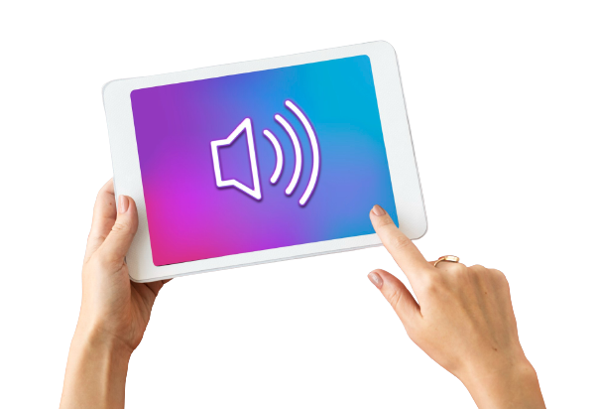
Volume & Pace
Maintaining the appropriate volume of voice during Telecalling is essential for clear communication and a positive customer experience.
Here are some "do's" and "don'ts" to guide Telecallers in managing their voice volume effectively.
Speak Clearly
Adjust Volume to the Customer
Speak at a Moderate Pace
Pay Attention to Background Noise
Avoid Shouting/ Whisper
Avoid Monotone
Notes:
Maintaining the appropriate volume of voice during telecalling is essential for clear communication and a positive customer experience. Here are some "do's" and "don'ts" to guide telecallers in managing their voice volume effectively:
Do's:
Speak Clearly: Articulate words clearly and enunciate properly. This ensures that the customer can understand the information being conveyed, reducing the need for the customer to ask for repeated clarifications.
Adjust Volume to the Customer: Match your voice volume to the customer's speaking style. If the customer is speaking softly, lower your volume slightly to avoid overwhelming them. If the customer has a louder voice, adjust your volume accordingly to maintain a comfortable conversation.
Speak at a Moderate Pace: Speak at a pace that allows the customer to follow the conversation without feeling rushed. A moderate pace gives the customer time to process information and respond comfortably.
Pay Attention to Background Noise: Ensure that your voice is clear and audible, even in environments with some background noise. Use noise-cancelling technology if available to minimize distractions.
Avoid Shouting/ Whsiper: Shouting or speaking too loudly can be off-putting to customers and may convey a sense of aggression. Maintain a respectful volume even when dealing with challenging situations. Speaking too softly or whispering can lead to misunderstandings. The customer may have difficulty hearing important information, leading to frustration or miscommunication.
Avoid Monotone: A monotonous voice lacks enthusiasm and can make the interaction less engaging. Vary your tone to convey interest, empathy, and a genuine desire to help the customer.

Slide 11

Building Rapport- The meaning
Building rapport refers the process of establishing a connection, building trust, and developing a positive relationship with your prospect/ customer to achieve business success.
Notes:
Building rapport with customers refers to the process of establishing a connection, building trust, and developing a positive relationship with them. It involves creating a comfortable and friendly environment, listening to their needs and concerns, showing empathy and understanding, and finding common ground. By building rapport, you can establish a foundation for a successful business relationship based on trust, respect, and mutual understanding. Building rapport is especially important in sales and customer service, as it can help to increase customer loyalty and satisfaction, and ultimately lead to more business success.

Slide 12

“Your most unhappy customers are your greatest source of learning. - Bill Gates
Notes:
Say: When we say no to a customer for something the obvious reaction that you would get is a disappointed, complaining or angry customer. So don’t you think its important that we learn how to manage such situation? Of course it is! Keeping that in mind, lets move to our next topic.
Ask: A complaint is a gift. Do you agree?
Note: Elicit responses to understand the participants view point on Complaints.
Say: In this business, Customer Complaints sometimes come up. However, it’s important for us to recover well from the mistakes/complaints that come from the customer. It is a proven fact that if you recover well from a complaint that the customer has, you are likely to get more business and appreciation from the customer once the complaint is resolved.
Stop thinking that complaints are a bad thing. Customers who want to tell you how they feel about your business should be encouraged.
Start thinking about how thoughtful your business could be, and what powerful corrective actions you could take, if you could understand how every one of your customers felt.
The complaint can be turned into an opportunity for your business. Therefore, we should look at every customer complaint as an opportunity to get more business from him.

Slide 13






Thanks for Participation
98752-08472
Hello@freelancetrainings.com
www.freelancetrainings.com
406, Titanium City Centre Mall, Anand Nagar, Satellite, Ahmedabad-380015

