Slide 1


Your
Company
Logo
Tele calling Workshop-2 days
Notes:
Note for the trainer: start the day with enthusiasm. Your enthusiasm should reflect in your tone of voice and body language.
Good morning everyone!
How are you today. Are you ready to dive into a day of learning, growth, and transformation? I know I am!
Today, we have a unique opportunity to learn from each other, challenge ourselves, and take our personal and professional lives to the next level. Today’s workshop is highly engaging, filled with activities, role plays, videos and discussions that are designed to inspire and empower you.
But this isn't going to be a passive experience. This isn't a lecture where you sit back and listen to someone else talk. This is an interactive, dynamic, and engaging workshop that requires your full participation, your curiosity, and your willingness to learn.
Throughout the day, you'll have the chance to connect with other like-minded individuals, share your own experiences and insights, and gain new skills and knowledge that will help you achieve your goals. You'll be challenged, pushed outside your comfort zone, and supported every step of the way.
So, are you ready to embrace this day with open hearts and open minds? Are you ready to learn, grow, and transform? I know I am, and I can't wait to see what we'll achieve together.
Let's get started!

Slide 2
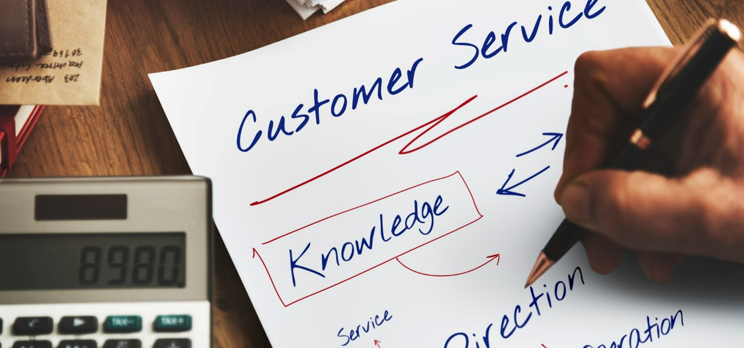




Workshop Agenda Day-1
Tele calling Essentials
Understanding the Role of Telecallers
Building an Attitude of Ownership & Accountability
Moment of Truth
Telecalling Script
Notes:
Welcome to the Tele-Calling Workshop Day-1. Are you excited for today`s workshop? let me introduce todays workshop modules.
Telecalling Essentials
Understanding the Role of Telecaller
Building an Attitude of Ownership & Accountability
Moment of Truth
Telecalling Script
Move to next slide

Slide 3
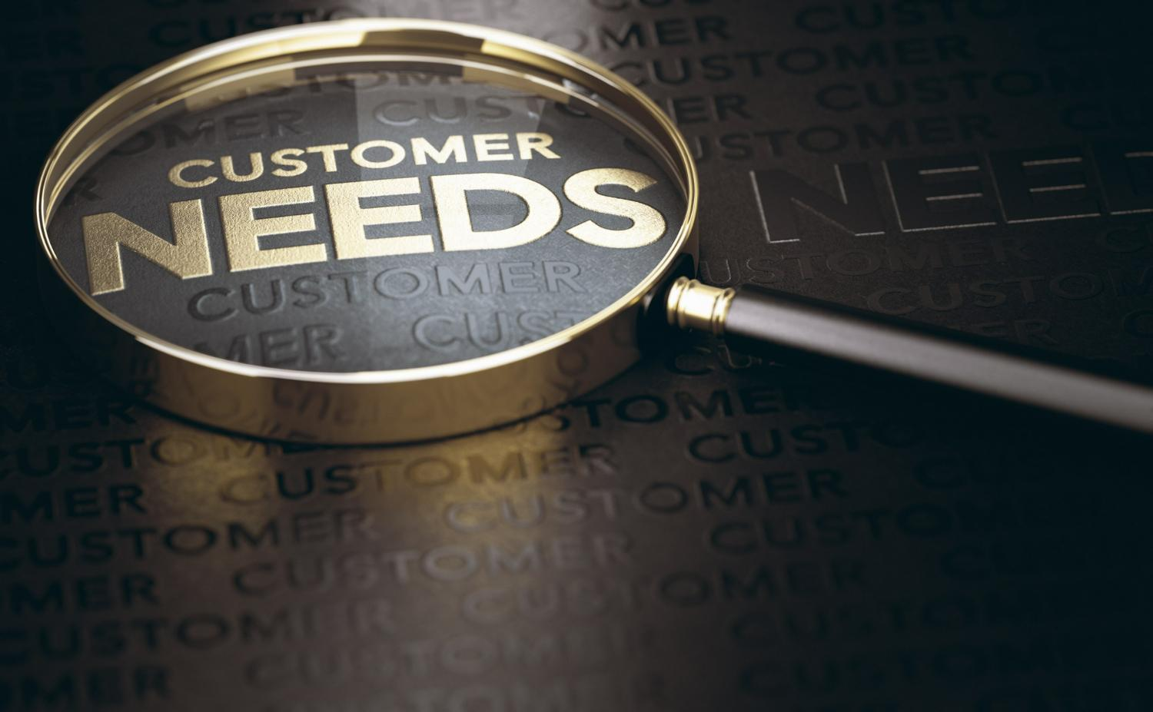
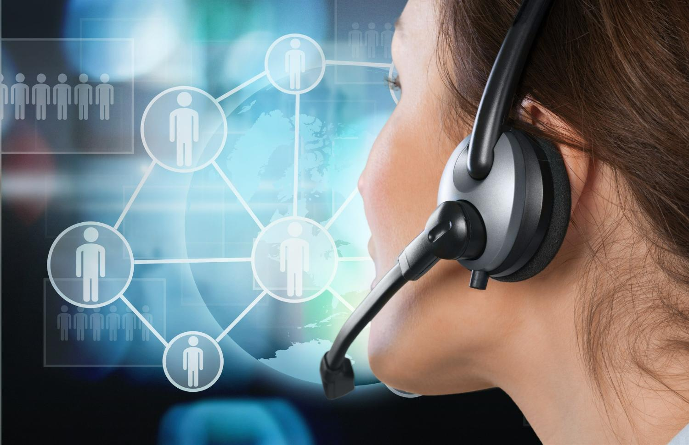
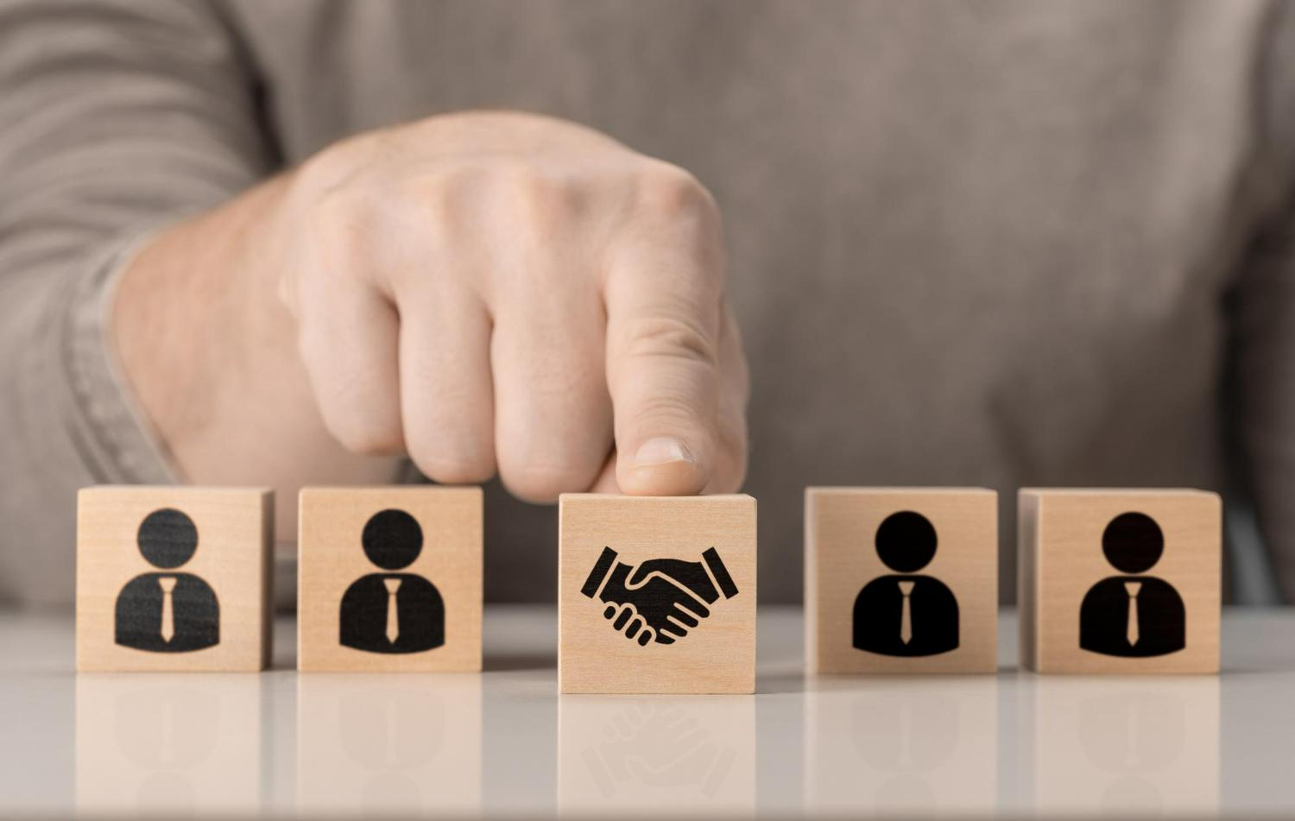


Workshop Agenda Day-2
Understanding Customer Needs
Building Impactful Communication
Building Rapport & Trust
Handling Irate Customers
Post Call Activities
Notes:
Tele-calling Workshop Day-2
Understanding Customer Needs
Building Impactful Communication
Building Rapport and Trust
Handling Irate Customers
Telecalling Tips
Move to next slide

Slide 4
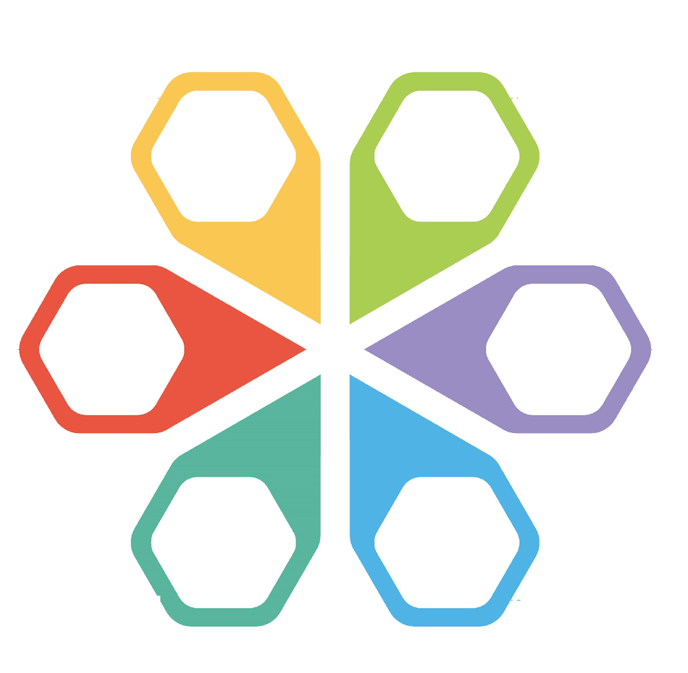



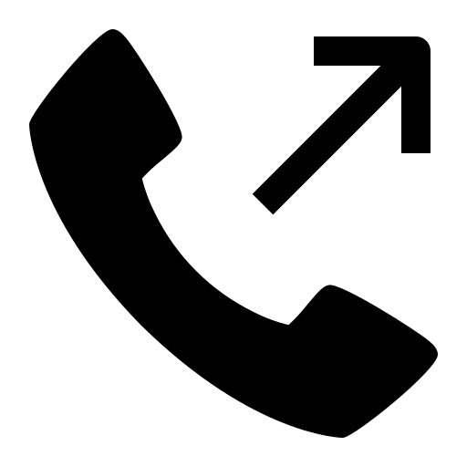

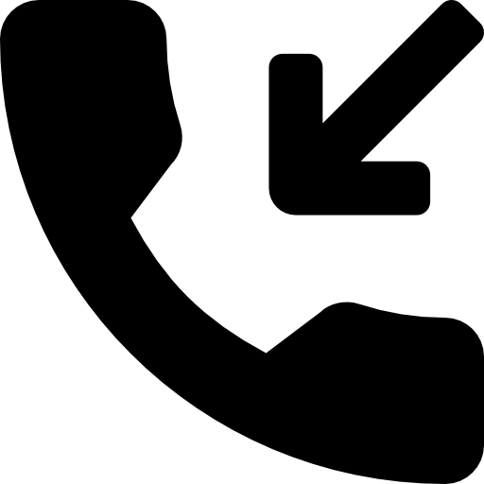
Telecallers & Its Roles
Tele calling is a process to engage with customers over the phone to provide assistance, answer inquiries, resolve issues, and ensure a positive customer experience.
Basis the Job function Tele caller can assume various role
Market Research Tele callers
Sales Vs Non-Sales
Outbound Tele callers
Collections Tele callers
Inbound Tele callers
Customer Support Tele callers
Notes:
The primary responsibility of a telecaller is to engage with customers over the phone to provide assistance, answer inquiries, resolve issues, and ensure a positive customer experience. This role can be categorized into two main types: selling and non-selling. Telecaller is an individual who engages in making or receiving telephone calls as part of their job responsibilities. There are various types of telecalling roles that exist
Outbound Telecaller: Outbound telecallers make calls to potential customers or existing clients. Their main objective might be to promote products or services, generate leads, conduct surveys, or gather feedback. They often work in sales or marketing departments.
Inbound Telecaller: Inbound telecallers receive calls from customers or clients who have inquiries, issues, or need assistance. They are responsible for providing information, addressing concerns, resolving problems, and ensuring a positive customer experience.
Customer Support Telecaller: This type of telecaller focuses exclusively on providing assistance and support to customers. They handle inquiries, troubleshoot problems, guide customers through processes, and ensure that customers have a positive interaction with the company.
Collections Telecaller: Collections telecallers are typically employed by financial institutions to contact customers who have outstanding payments or debts. Their role involves reminding customers about payments, negotiating repayment plans, and ensuring the collection of overdue amounts.
Market Research Telecaller: These telecallers conduct surveys or gather information from individuals or businesses to support market research efforts. They might inquire about consumer preferences, opinions, or industry trends.

Slide 5





Telecalling Benefits- Organisations
Building Trust and Loyalty
Feedback and Listening
Proactive Problem Solving
Personalized Interaction
Cost-Efficiency
Notes:
Building strong customer relations is essential for any organization's long-term success. Telecalling can be a valuable tool for fostering these relationships. Here are five ways in which telecalling can help an organization build strong customer relations:
Cost-Efficiency: Telecalling is often more cost-effective than in-person customer interactions. It reduces the need for physical infrastructure and allows organizations to handle a higher volume of customer inquiries at a lower cost.
Personalized Interaction: Telecalling allows for direct, one-on-one conversations with customers. Telecallers can address customer inquiries, provide personalized assistance, and offer tailored solutions based on individual needs. This personalized interaction makes customers feel valued and understood, leading to stronger relationships.
Proactive Problem Solving: Telecallers can proactively reach out to customers to address potential issues or concerns before they escalate. This proactive approach shows that the organization cares about the customer's experience and is committed to resolving problems promptly, which enhances trust and customer loyalty.
Feedback and Listening: Telecallers have the opportunity to gather feedback directly from customers. They can listen to customer opinions, suggestions, and concerns, providing the organization with valuable insights for improving products, services, and overall customer satisfaction. This active listening demonstrates the organization's commitment to continuous improvement.
Building Trust and Loyalty: Consistent and positive interactions with telecallers can build trust and loyalty over time. When customers have positive experiences with telecallers who genuinely care about their needs, they are more likely to remain loyal to the brand, recommend it to others, and become brand advocates.

Slide 6

What is Attitude?
The way a person thinks or feels about a specific person, place, action or experience.
Notes:
Ask: What is attitude?
Elicit response.
Say: Attitude is the way a person thinks or feels about a specific person, place, action, or experience. Similar to the individual perspective, attitude encompasses the individual’s particular emotions and the way in which they act towards people and work. Attitude is a specific disposition that combines factors like beliefs, opinions, moods, and emotions. Sometimes, attitude is referred to as an outlook or mental state that affects the way people perceive the world around them and the way they experience life, work, relationships, and more.
Ask: Why is positive attitude so important for professional excellence?
Transition to the next slide.

Slide 7
Circle of Concern, Influence and Control
Your past decision/ choice/ behaviour
Weather
If public transport is on time
World peace
Other People`s Action
The outcome of most court cases
Threat of war
Other People`s Thoughts
Other People`s Choice
Government policy
Who follows me on Social media
My thoughts
My words
My actions/ behavior
My reactions
My decisions/ choices
My attitude/ mindset
My mood
My work ethic
My productivity at works
Sport Match
Death
The Media
My commitments
Whether people like me or not
Where you were born
My reputation
Being made redundant
My children`s future
Traffic
Whether I get promoted
How much stock a retailer has
Who I vote for
Economy/ Prices
Where I work
How much my partner loves me
Celebrities behaviour & opinions
Stranger`s behaviour & driving habit
Strangers comments on forum & social media
Cyber threats
Notes:
Explain the 3 circles to the participants with examples

Slide 8

1. Average Moment of Truth
What the Customer expects
What the Customer gets
Notes:
The first type of Moment of truth is the Average moment of truth.
Say: When a business delivers exactly what the customer expects, it creates an average moment of truth for the customer. In this scenario, the customer's experience aligns with their preconceived expectations, resulting in satisfaction. While meeting expectations can be seen as an average or baseline level of service, it is still crucial for customer satisfaction.
Here's why:
Meeting Basic Requirements: When a business fulfills the customer's expectations, it means they have met the fundamental requirements of the customer. This is important because failing to meet these basic expectations can lead to dissatisfaction and potentially drive customers away.
Consistency and Reliability: Consistently meeting customer expectations builds a reputation for reliability and dependability. Customers appreciate businesses that consistently deliver on their promises and provide a predictable experience. This helps in establishing trust and can lead to repeat business.
Reinforcing Positive Brand Image: Meeting customer expectations contributes to a positive brand image. Satisfied customers are more likely to speak positively about their experiences, leading to positive word-of-mouth and recommendations. This helps attract new customers and strengthens the company's reputation in the marketplace.
Avoiding Negative Moments of Truth: Failing to meet customer expectations can result in negative moments of truth. These instances occur when a customer's experience falls short of their expectations, leading to dissatisfaction, complaints, or even negative reviews. By delivering what is expected, businesses can avoid such negative moments and their potential repercussions.
Customer Retention: While meeting expectations may not create an extraordinary experience, it still contributes to customer satisfaction and retention. Satisfied customers are more likely to remain loyal and continue doing business with a company. This loyalty can result in repeat purchases and long-term customer relationships.
It is important to note that meeting expectations alone may not be sufficient for differentiation or creating strong customer loyalty. Businesses should strive to exceed expectations and provide exceptional experiences whenever possible. However, consistently meeting expectations forms the foundation for customer satisfaction and establishes a baseline level of service that customers rely on.

Slide 9
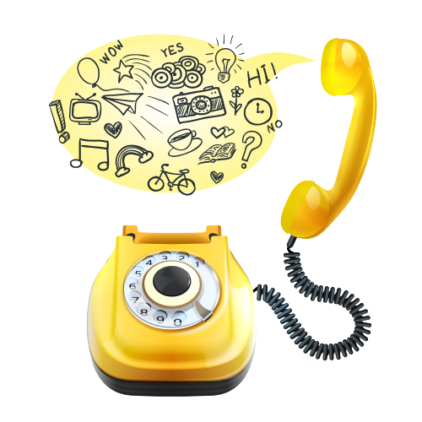
Tele calling Script
is a structured set of dialogues that guide a tele caller (a person making phone calls) through a conversation with a potential customer or client.
Notes:
A tele calling script is a structured set of dialogues and prompts used by tele callers during phone conversations with customers or clients. It outlines key talking points, questions, and responses to guide the conversation toward specific objectives, such as sales, appointments, or information gathering. The script ensures consistent communication, provides information effectively, and helps tele callers handle various scenarios while maintaining a professional and engaging interaction.

Slide 10

Generating Interest
Start with a friendly greeting, it can help to establish a positive
Using the customer's name throughout the call can help to build rapport and personalize the conversation.
Show enthusiasm and passion assisting the customer/prospect
Inbound Calling- Know the customer’s/ caller’s specific needs and customize the purpose of your call to assist the caller with that need
Outbound calling: If you are calling the customer/prospect clearly state the benefit that your customer will be getting after listening to you
Notes:
Generating interest while calling a customer in a telecall is an important part of the tele calling process. Here are some tips to help you generate interest and engage customers during a call:
Start with a friendly greeting: A warm and friendly greeting can help to establish a positive tone for the call and make the customer feel more comfortable.
Use the customer's name: Using the customer's name throughout the call can help to build rapport and personalize the conversation.
Be enthusiastic: Show enthusiasm and passion for your product or service. This can be contagious and help to generate interest and excitement in the customer.
Inbound Calling- If receiving a call from customer Know the customer's specific needs and customize the purpose of your call to assist the caller with that need e.g. If a customer says I want to know more about the product that I saw in your advertisement- The tele caller should say, Sure, I will assist you in the same and help you to get complete information during our call. You are free to ask any querries that you may have during the call for better understanding.
Outbound calling: if you are calling the customer/prospect clearly state the benefit that your customer will be getting after listening to you. E.g. if you are helping the customer to update their account details on your app then tele caller will use the following lines” This call is regarding helping you to transfer your money securely through our app by uploading your account information.
Get to know the customer's needs: Ask open-ended questions to understand the customer's specific needs and how your product or service can address them. This shows that you are interested in helping them solve their problem rather than just making a sale.
Offer a solution: Explain how your product or service can help solve the customer's problem or meet their needs. This shows the value of what you are offering and can help to generate interest.
By following these tips, you can help to generate interest and engage customers during a call, ultimately increasing the chances of a successful sale.

Slide 11

Identify Customer Needs
Selling Skill
Model
Effective Communication
Personalized Solutions
Increased Trust and Credibility
Maximizing Sales Opportunities
Avoid Miscommunication
Enhancing Customer Satisfaction
Notes:
Understanding customer needs is crucial in tele calling as it enables tailored communication, builds trust, and facilitates effective problem-solving, ensuring meaningful interactions that meet customers' specific requirements.
Effective Communication: When a tele caller understands the customer's needs, they can tailor their communication to address those specific requirements. This leads to a more relevant and engaging conversation, which can enhance the overall customer experience.
Personalization: By grasping the customer's needs, a tele caller can personalize their approach. This personal touch demonstrates that the company values the customer as an individual, increasing the likelihood of building a positive relationship. Understanding customer needs allows the tele caller to suggest appropriate solutions or products that directly align with what the customer is seeking. This can lead to higher satisfaction and a better match between customer expectations and the company's offerings.
Building Trust: When customers feel understood, they are more likely to trust the tele caller and the information they provide. This trust is crucial for building a lasting relationship and can contribute to customer loyalty.
Maximizing Sales Opportunities: In a sales context, understanding customer needs enables the tele caller to position products or services as solutions that meet those needs. This targeted approach can lead to higher conversion rates.
Avoiding Miscommunication: Miscommunication can lead to misunderstandings or frustration on the customer's end. By understanding needs, tele callers can ensure that the information they convey is accurate and relevant, minimizing the chances of miscommunication.
Enhancing Customer Satisfaction: Ultimately, when a tele caller demonstrates a genuine interest in understanding and addressing customer needs, it significantly contributes to higher levels of customer satisfaction. Satisfied customers are more likely to remain loyal and recommend the company to others.
Lets see how to uncover the customer needs using the LADR Model

Slide 12

Doubts should be Clarified
Non- Judgmental Questions
Summarizing
Seeking feedback to get accuracy in understanding
Notes:
Say: So now when you have learnt L and A, now guess what would be D?
D Stands for Doubts to be Clarified:
By asking open clarifying questions, the listener is making the Speaker elaborate on their thoughts and providing a more detailed version of them. This not only helps the listener better understand what the Speaker meant but also helps them form an opinion of their own regarding the Speaker's views. Clarification is important in many situations especially when what is being communicated is difficult in some way. Some examples of non-directive clarification-seeking questions are:
“I'm not quite sure I understand what you are saying.”
“I don't feel clear about the main issue here.”
“When you said ........ what did you mean?”
“Could you repeat ...?”
Clarifying involves:
Non-judgemental questioning.
Summarising and seeking feedback as to its accuracy.
Some Guidelines for Clarifying:
Clarification is the skill we use to ensure that we have understood the message of the Speaker in an interpersonal exchange. When using clarification follow these guidelines to help aid communication and understanding.
Admit if you are unsure about what the speaker means.
Ask for repetition.
State what the speaker has said as you understand it, and check whether this is what they really said.
Ask for Specific examples.
Use open, non-directive questions - if appropriate.
Ask if you have got it right and be prepared to be corrected.
R Stands for Reconfirm before proceeding:
As we discussed in earlier points, it is always advised to re-confirm the message received is correct and as per senders expectation or not and then proceed further. You may repeat the gist of the message received and acknowledge that you have correctly received the message.
For example, In aircrafts, ATC (Air traffic control) guides the plan in air to land on some X runway. The same message is repeated by the Pilot to ATC in order to ensure that what they heard is what was communicated. Thus, Re-confirming is critical aspect to fool proof the communication.

Slide 13

Impactful Communication
Your
Company
Logo
Serves as the cornerstone of successful customer engagement, leaving an indelible mark on the customer's experience.
Clear and concise communication, active listening to customers' needs, provides customized solutions for customers
These well-crafted interactions, personalized touches ensures a positive and lasting impression, creating the foundation for strong, enduring customer relations.
Notes:
Impactful communication serves as the cornerstone of successful customer engagement, leaving an indelible mark on the customer's experience.
Telecallers, armed with the art of clear and concise communication, actively listen to customers' needs, express genuine empathy, and employ a friendly tone while tackling challenges. This positive language and professional demeanor not only build a bridge of trust but also demonstrate the organization's commitment to addressing concerns and providing tailored solutions.
It is through these well-crafted interactions, personalized touches, and a continuous quest for improvement that telecallers ensure a positive and lasting impression, creating the foundation for strong, enduring customer relations that define the organization's image.

Slide 14
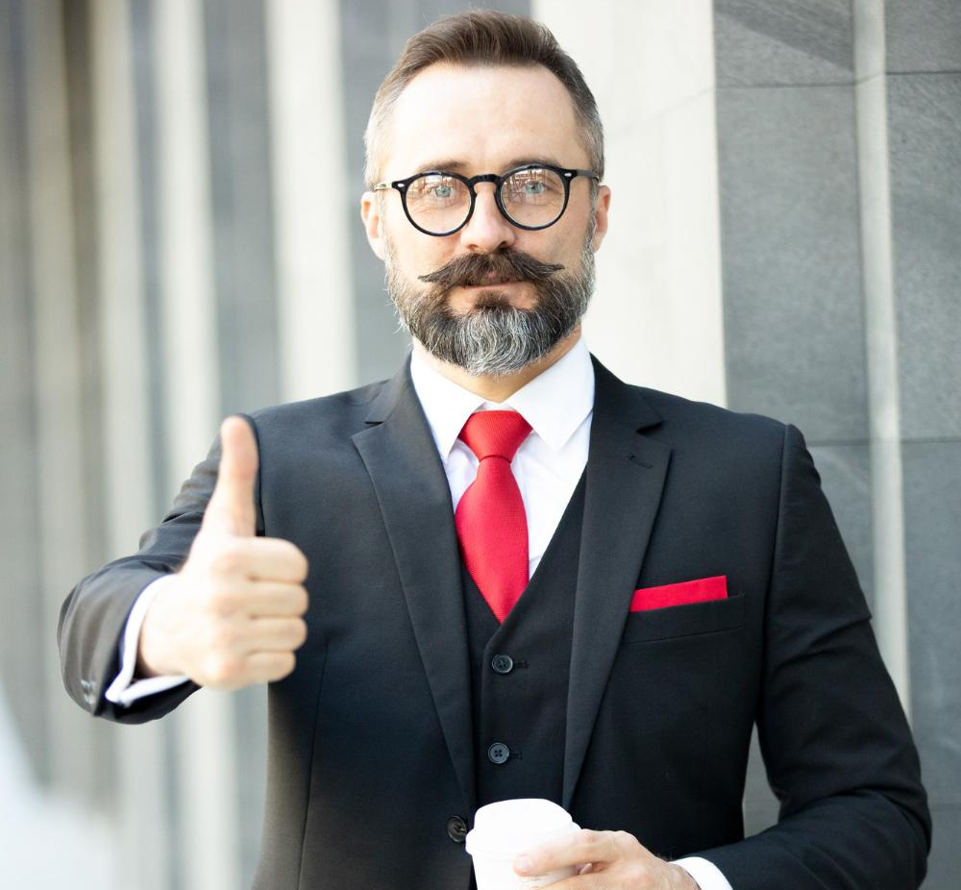
Build rapport like a boss!
Subject matter expertise
Name Game
‘Same-here‘ moments
First Impressions
Happy Face
Go the extra mile when you can
Small talk like a champ
Notes:
Subject Matter Expertise – You can build limited rapport with your customers if you don’t have accurate and thorough knowledge of your products and services. A tele calling professional needs to be a good conversationalist but without the knowledge of the products, a sale that is beneficial to the customer cannot be made. You may not be a flamboyant Speaker but if you have subject matter expertise you can provide great consultation to the customer that can win you both repeat business and referrals.
Use their name – When you use their name (or title like Sir/Ma’am) you automatically personalize the conversation. People inherently feel included and important. But do not overdo it!
Same here moments – Discover same-here moments with the customer. It could be anything that the customer and you have something in common to bond over–
Same hobby
Place you live
IPL team you favour
Your school
‘Me-too’ moments help create better bond and likeability between people.
First impressions matter – First impressions are made by people basis their personal perceptions about life. Some things you can control, some others you can’t (such as your face or personality reminds them of someone they dislike. What are the things you can control to increase your likeability factors?
Your dapper dressing and fashion sense)
Body Language and Tonality
Your grooming and hygiene
Prowess on your language
Self-confidence
Positive attitude
We will discuss this in detail in the Module on Body language and Tone of Voice
Display being visibly happy – Every customer likes to feel welcomed. A positive and happy demeanor Speaks volumes of how hospitable you are and how inclusive you are in helping the customer with their financial objectives.
Display your intention to go the extra mile to help – The difference between a good and a great professional is the ability to offer excellent customer service. Effective professionals realize this and build rapport by going the extra mile to service customers from time to time depending on the situation.
Make small talk – Small talk is not just about talking about the weather or the cricket matches. People think that small talks are conversation fillers that can be insignificant which is far from true. Small talk is an art. To make great small talk you need to:
Be interested in your customer’s world.
Make a mental note of the things that might be helpful or of interest to them
Take an interest in knowing about current affairs, Sports, economy, etc. Basically the more you know the better conversations you can hold.
Interestingly, there will be times when small talk will back fire. So you must know when to avoid it. Let’s look at what all the avoid while building a good rapport.
Transition to the next slide.

Slide 15
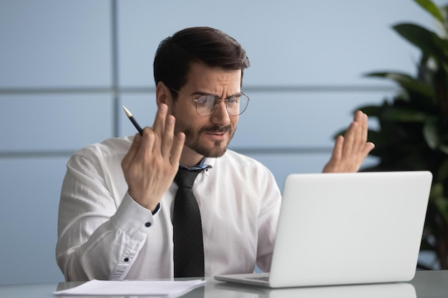
Dealing with an Irate Customer
Help him to empty the cup
Gently Shift to ‘Solution’ mode
Close pleasantly
Notes:
Say: When dealing with irate customers, we need to follow the 3 steps mentioned above. We will go through these steps in detail through the next slides.
Note for the trainer: Involve the participants in a small discussion before moving to the next slide.
Ask : Has anyone faced an angry customer? How did you handle it? Were there any situations that were beyond your power to control the customer?
Note for the trainer: This is to be a random discussion. Elicit responses.

Slide 16
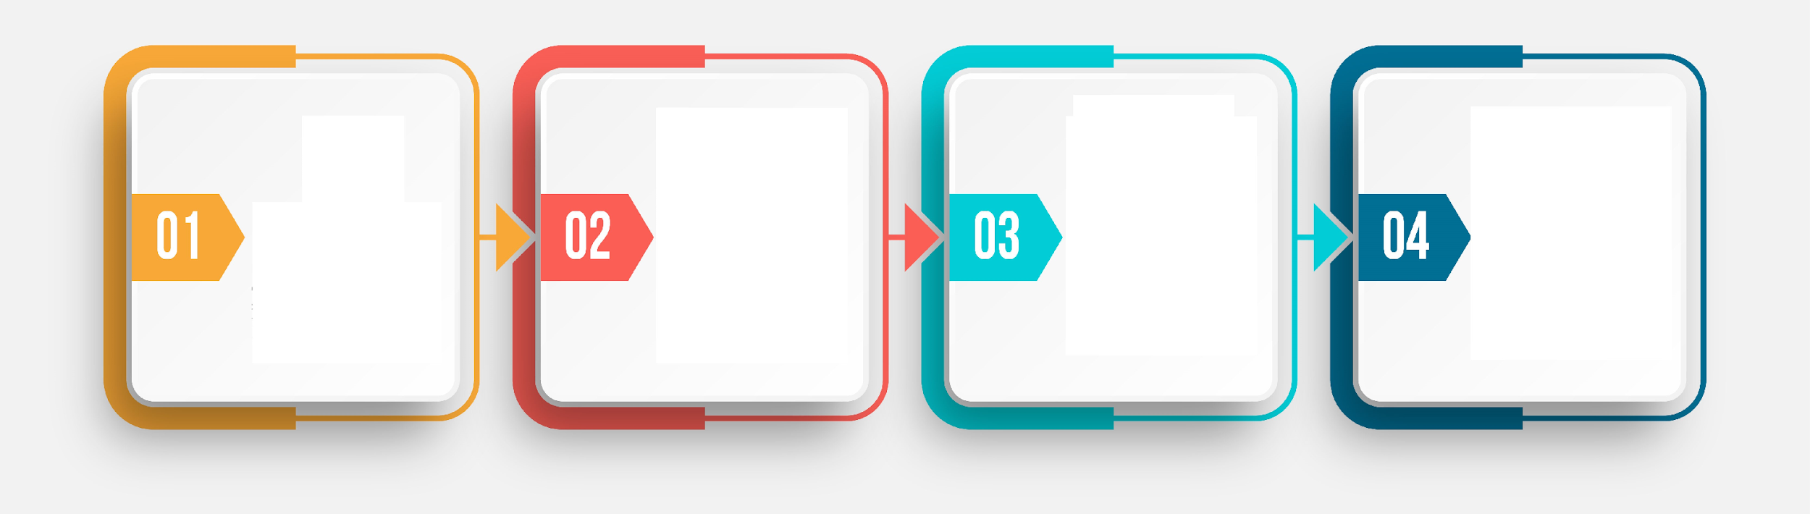
Post Calling Activities
Note Taking
Updating in the CRM
Send follow-up information/ Tasks
Thankyou mail/ conformation
Notes:
It is very important for any telecaller to follow the post calling activities. Usually during a call with the customer or prospect there may be a lot of information that might have been shared and the same needs to be recorded and mentioned for future communication. Also lot of times the customer might have asked for the some followup email/ information or details which the telecaller needs to share and hence the post calling activities are very important.
These Include
Notes Making- During a call as discussed in earlier slides the telecaller needs to focus only on listening to the customer or prospect and avoid notes taking as much as possible as multitasking may lead to communication gap
Updating the Information in the Company’s CRM
Sending followup Information/ Tasks- Many a times telecallers need to followup with the customers and hence following up on information is very important.
Thankyou email / conformation to the customer
We will discuss the same in details in next slide

Slide 17
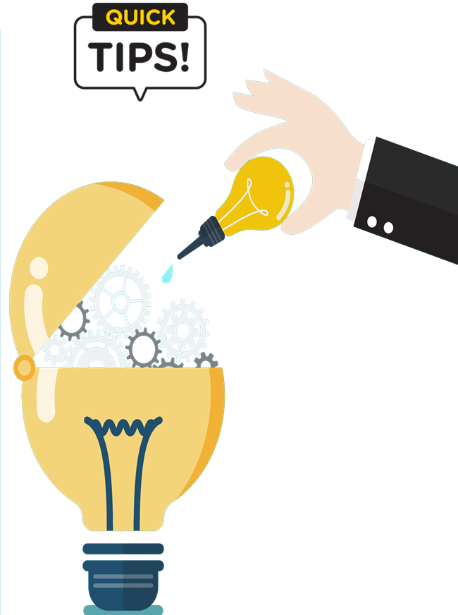
Tips for Effective Telecalling
Actively Listen: Actively listen without interrupting, and use what you've heard to tailor your responses and provide relevant solutions.
Empathy and Understanding: Understand their perspective, acknowledge their feelings, and convey that you're there to help.
Clear Communication: Be concise in your explanations and ensure that the customer comprehends the information you're conveying.
Problem-Solving Skills: Be proactive in offering solutions to customer issues or inquiries.
Maintain Professionalism: Use appropriate language, stay calm even in challenging situations, and be respectful
Follow-Up and Closure: Offer a follow-up if necessary, and ensure the customer knows how to reach out again if they have more questions. Always end the call on a positive note.
Notes:
Active Listening: Pay close attention to the customer's needs, concerns, and questions. Actively listen without interrupting, and use what you've heard to tailor your responses and provide relevant solutions.
Empathy and Understanding: Show genuine empathy towards the customer's situation, especially if they're experiencing issues or frustrations. Understand their perspective, acknowledge their feelings, and convey that you're there to help.
Clear Communication: Speak clearly and use simple language. Avoid jargon or technical terms that the customer might not understand. Be concise in your explanations and ensure that the customer comprehends the information you're conveying.
Problem-Solving Skills: Develop effective problem-solving skills. Be proactive in offering solutions to customer issues or inquiries. If you're unsure, offer to investigate and follow up promptly with a solution.
Maintain Professionalism: Present a professional demeanor throughout the call. Use appropriate language, stay calm even in challenging situations, and be respectful. Remember that you're representing the organization.
Follow-Up and Closure: After addressing the customer's concern, confirm their satisfaction with the resolution. Offer a follow-up if necessary, and ensure the customer knows how to reach out again if they have more questions. Always end the call on a positive note.
By applying these tips, you'll enhance the quality of your telecalling interactions, improve customer satisfaction, and contribute to a positive image of the organization.

Slide 18






6 Things to Avoid in Telecalling
Avoid Aggressive Behavior
Don't Interrupt
Don't Make False Promises
Avoid Being Dismissive
Don't Rush the Call
Avoid Lack of Knowledge
Notes:
Avoid Aggressive Behavior: Aggressive communication, including raising your voice, using confrontational language, or showing impatience, should be completely avoided. Such behavior can make customers feel uncomfortable and escalate the situation.
Don't Interrupt: Interrupting the customer while they're speaking can be perceived as disrespectful and may prevent you from fully understanding their concerns. Allow the customer to express their thoughts before responding.
Don't Make False Promises: Avoid making promises that you can't keep. Be honest about what you can do for the customer and set realistic expectations. Overpromising and underdelivering can erode trust.
Avoid Being Dismissive: Never dismiss the customer's concerns, even if they seem minor. Every issue is important to the customer, and it's essential to show respect and a willingness to address their needs.
Don't Rush the Call: While efficiency is important, rushing through a call at the expense of quality can lead to misunderstandings or incomplete issue resolution. Take the time needed to ensure the customer's needs are met.
Avoid Lack of Knowledge: Be well-informed about the products, services, and policies of your organization. Lack of knowledge can lead to frustration for both you and the customer. If you're unsure, it's better to say you'll find the information and get back to them.
By avoiding these common pitfalls, telecallers can provide more effective customer service, build positive relationships, and contribute to a better overall experience for the customer.

Slide 19






Thanks for Participation
98752-08472
Hello@freelancetrainings.com
www.freelancetrainings.com
406, Titanium City Centre Mall, Anand Nagar, Satellite, Ahmedabad-380015

