Slide 1


Soft Skills Workshop -2 Days
Your
Company
Logo
Notes:
Facilitator’s Notes:
Trainer to say in the loudest voice “Hello, Good Morning”. Then the participants will say ‘Good Morning’ in reply.
Trainer to say once again in the loudest voice “Hello Good Morning”. Trainer should speak in an energetic, passionate and enthusiastic tone. This activity/gesture will set the tone and energy for the session/workshop
Trainer: Well done friends! Great job! (Clap Loudly and tell the participants to clap as well for the superb performance.)
Trainer: I'm excited to be here with you all today and appreciate your presence. I hope you're all doing well and are ready to dive into the material.Move to next slide.

Slide 2
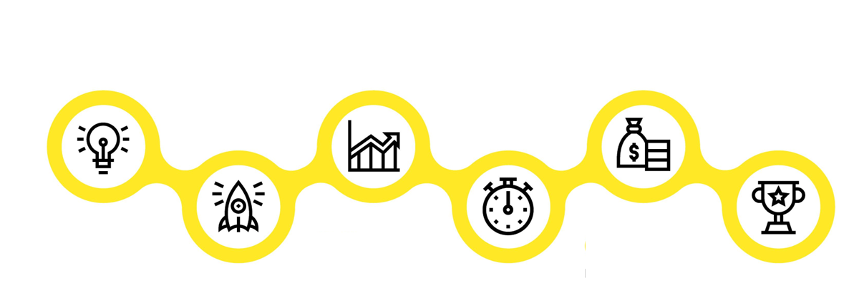






Agenda of Workshop- Day 1
Components of Soft Skills
Module 1
Module 3
Module 5
Understanding Soft Skills
Impactful
Communication
Goal Setting
Module 2
Module 4
Module 6
Building an Attitude
of Ownership
Building a Fool Proof Communication
Being a Team Player
Notes:
The agenda of todays workshop is as follows
Understanding Soft Skills
Building an attitude of Ownership at workplace
Impactful communication
Building Fool Proof Communication
Goal Setting
Being a Team player

Slide 3





Agenda of Workshop- Day 2
Components of Soft Skills
Module 1
Module 3
Module 5
Managing Stakeholders
First Impression is the last Impression
Email etiquette
Module 2
Module 4
Recap/Revision
Manging Time & Prioritisation
First Impression is the last Impression Part-2
Notes:
The agenda of todays workshop is as follows
Managing Stakeholders
Managing Time & Prioristising
First Impression is the Last Impression-Part-1
First Impression is the Last Impression-Part-2
Email Etiquettes
Recap

Slide 4

What are Soft Skills?
  Soft skills are "people skills" that help you work smoothly with your colleagues, bosses, and clients.
  They're not about what you know how to do, but how you do it.
Notes:
Imagine you're at your job, and you need more than just technical know-how to succeed. You know how to do your tasks, like using a computer or making reports – those are your "hard skills." But there's something else that's super important too. These are your "soft skills," and they're like the friendly and helpful side of you at work.
Soft skills are like the "people skills" that help you work smoothly with your colleagues, bosses, and clients. They're not about what you know how to do, but how you do it. They are often intangible and difficult to quantify but play a crucial role in personal and professional success. Soft skills complement technical or hard skills and are essential for building strong relationships, improving communication, and enhancing overall work performance. Here are some key categories of soft skills:

Slide 5



Achieving Personal Excellence
Attitude
Skills
Knowledge
Notes:
Developing Soft Skills Leads to achieving Personal excellence
Developing soft skills is like sharpening the tools needed for personal effectiveness. It enhances your attitude by fostering better communication, empathy, and adaptability. These skills refine your abilities, such as problem-solving and teamwork, boosting your confidence and performance. Additionally, by honing soft skills, you enrich your knowledge of interacting positively, making you more approachable and capable in various situations, ultimately driving personal success.
Attitude: Attitude refers to a person's mindset or perspective. A positive attitude can help individuals overcome obstacles, maintain focus, and stay motivated
in the face of challenges. Soft Skills requires a positive attitude that is characterized by resilience, self-confidence, and a growth mindset. Without a positive attitude, it can be difficult to achieve personal goals and objectives.
Skills: Skills are the abilities and competencies that individuals possess to perform specific tasks or activities. In order to be personally effective, individuals must possess a range of skills, including communication, problem-solving, time management, leadership, and teamwork. Developing these skills can help individuals to better manage their personal and professional lives and achieve their goals.
Knowledge: Knowledge refers to the understanding and awareness that individuals have of themselves, others, and the world around them. Soft Skills requires individuals to have a strong knowledge base in areas such as self-awareness, emotional intelligence, critical thinking, and decision-making. This knowledge can help individuals make informed choices, build strong relationships, and achieve personal and professional success.
In summary, a combination of a positive attitude, strong skills, and relevant knowledge is essential for Soft Skills. Individuals who possess these qualities are better equipped to overcome challenges, achieve their goals, and make a positive impact in their personal and professional lives.

Slide 6

Why is having a positive attitude important for a professional
  Boosts productivity
  Reduces stress
  Supports learning
  Improves problem-solving
  Increases confidence
  Increases resilience
  Helps you manage conflict
Notes:
Our attitude is directly responsible for our behavior. More wholesome our attitude, the more empowered our conduct.
With a positive attitude, you can improve your emotional well-being and self-image. It is a powerful tool for personal growth and professional excellence.
The power of a positive attitude in the workplace has been proven to:
Boost productivity
Reduce stress
Support learning
Improve problem-solving
Increase confidence
Increase resiliency
Help manage conflict
A positive attitude could also be regarded as one that is oriented toward finding what is best about a given situation or environment and then building on that.
While many factors are responsible to propel a wholesome professional attitude, we will be discussing four key ones today:
Taking ownership and accountability at work
Having a solution-centric approach
Avoiding blame game
Operating from one’s circle of control.
Transition to the next slide.

Slide 7
Circle of Concern, Influence and Control
Circle of concern
Circumstances/Issues/ Problems
Over which we have No control- Also
known as No control Zone
Circle of influence
Circle of control
Circumstances/Issues/ Problems
Over which we have a indirect control
Invest your time, Energy
& Emotions Here
Circumstances/Issues/ Problems
Over which we have a direct control
Invest your time, Energy
& Emotions Here
Notes:
Dr. Stephen Covey in his best-seller book 7 Habits of Highly Effective People, talks about the three circles. Each of these represents a certain aspect of our life. As you see the outer circle (of no control ) will be the largest and the inner most (of control) will be the smallest.
Let’s learn in detail.
Circle of Concern: (Red Zone) Also known as the circle of no control, this comprises the wide range of circumstances, issues, and problems that we have, but over which we do not have any control. Examples: Past decisions, world peace, wars, natural calamities, government policies, death, traffic, company policies, election results, etc.
Circle of Influence:(Yellow Zone) This comprises those circumstances over which we have indirect control. Example: Other people’s thoughts, other people’s actions, other people’s choices and decisions, your future, your family’s future, etc.
Circle of Control (Green Zone): This encompasses those circumstances, issues, and problems that we have direct control over.
Example: My thoughts, my actions, my reactions, my mood, my work ethic, my choices, etc.
Professionals that have excellent attitude almost always operate primarily from circle of control (where they have direct control over) and then from the circle of influence (where they still have some degree of control). This attitude helps them focus only on things that they can do and accept things that they cannot. Professionals with bad attitude usually are stuck in ‘circle of concern’. They fret, complain, get stressed and waste time of thinking and discussing about how life and things are unfair. This is like hitting a wall expecting it to move and is a viscious cycle to continue with the stress cycle.
Let’s take a closer look at how the circles look with examples.
Transition to the next slide.

Slide 8
Types of Communication
Communication
Assertive
Aggressive
Passive
Empathetic
Notes:
Say: Communication can further be categorized into 4 types:
Assertive
Aggressive
Passive and
Empathetic
So what are these?

Slide 9

Listen Actively
Take Notes
Count One Two Three
Empathize like you care
Don’t Multi-task
Don’t Interrupt
Avoid Listening with a Bias
Don’t get distracted
Notes:
Say: So now when you have learnt about 4Cs for effective communication, it is important for us to know ensure that we fool proof our communication to avoid errors and enhance our communication style.
So what is LADR? Any Guesses?
L Stands for Listening actively:
Listening is easy, but it’s not fool-proofed. 45% of your communication is used for listening, but are you using them to your ADVANTAGE! Here are 4 Tips on FOOLPROOFING your LISTENING SKILLS
Take Notes: Take notes either shorthand or longhand with quick references to refer later. Record the presentation with a recorder to boost your listening process and physically engage the brain, eyes and fingers. By taking the time to write notes, it sends a good message to your audience and a sign of respect!
Count One Two Three :Delay slightly before you speak, so you absorb and understand better. This prevents you from being perceived as anxious and helps you listen to their last thought. Remember, interrupting the other party is disrespectful!
Empathize like you Care : Uncross your arms and legs, sit straight in your chair or maintain an athletic stance. It is best to face the other party or speaker while leaning forward to display attentiveness. Lastly, make eye contact, which shows that you care!
Don’t Multi-Task: Focus by removing any external or internal distraction. Block any noise or room clutter to prevent your mind from wandering. Remember, people whose desks/offices that are a mess are perceived as not being good listeners! One of the example is Listening as well as working on Laptop or system, etc..
Never interrupt while the other person is speaking.. It may irritate him/her, make him/her feel like you are not trying to understand his/her perspective. Also, you may miss out on important results as a result of your interruptions!!!!
Listening with a Bias :ok! Biased listening happens when a person hears only what he wants to hear based on the perceptions or beliefs that he has, typically leading to misinterpretations and misunderstandings! Stephen R. Covey explained that with a nice quote, ‘most people do not listen with the intent to understand; most people listen with the intent to reply’..
Avoid Distraction : Avoid any sort of distraction while you are listening like a phone call, an email. If something is urgent please ask for a permission to finish it and do that in next 2-3 minutes. Else avoid the same while listening.
Move to next slide

Slide 10

What is Interpersonal Effectiveness
The ability to understand, communicate and interact with other people in a way that leads to productive working relationships and enables the achievement of desired outcomes for you, your team and the organization.
Notes:
Interpersonal effectiveness refers to the ability to communicate and interact with others in a way that is respectful, assertive, and responsive to the needs of both oneself and others. It involves the skills of effective listening, expressing oneself clearly and assertively, understanding and respecting others' perspectives, negotiating conflicts, and managing emotions in relationships.

Slide 11

Who is a stakeholder?
Any person/ department who has an impact on your work performance
This can include employees, customers, investors, suppliers, government agencies, etc
Stakeholder Management is maintaining good relations with your stakeholders and keeping them engaged
Notes:
As your career develops, and you become more successful, the actions that you take start to affect more and more people. And the more people you affect, the more likely it is that some of them will have significant power and influence over your work.
These people are your stakeholders. They could be strong supporters of your projects – or they could block them. So you need to identify who your stakeholders are and win them over as soon as possible.
Knowing our stakeholder and their expectation from us regarding the project or our daily work will help us plan and prioritise our work efficiently. This will also keep the stakeholder satisfied and in loop.
Lets move to next slide and understand stakeholder management better.

Slide 12

URGENT
IMPORTANT
Urgent V/s Important

Slide 13
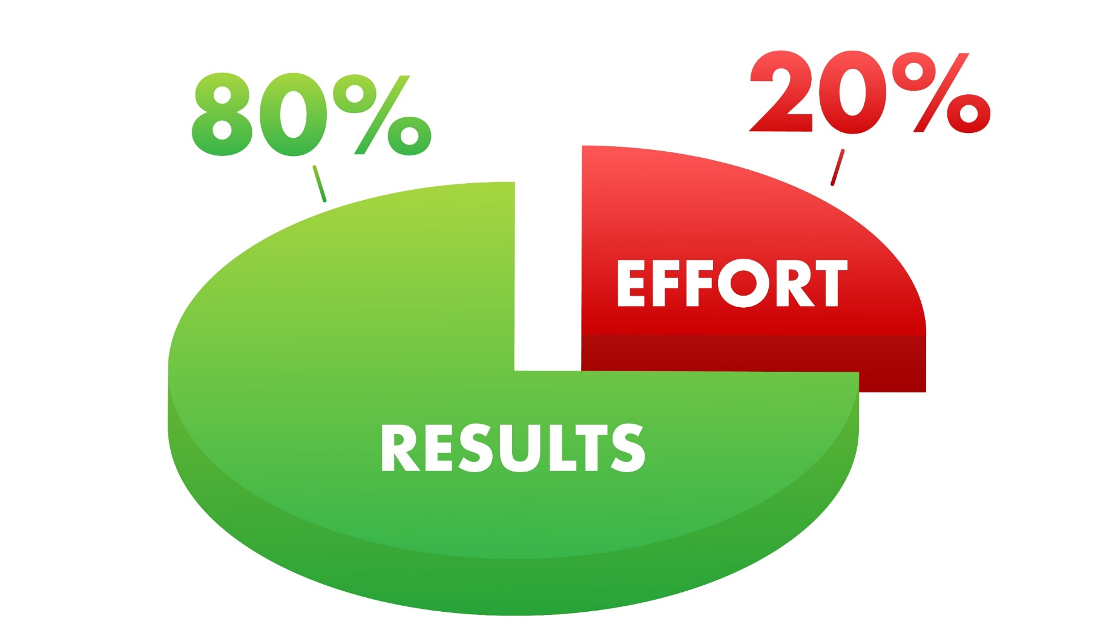
Understanding Pareto's Principle
80% of outcomes (or outputs) result from 20% of all efforts (or inputs) for any given event
Notes:
Benefits of using the Pareto principle
The biggest advantage of using the Pareto principle is that you can create the maximum amount of impact with the least amount of work. This can allow your team to work more efficiently and stay focused on specific initiatives.
The 80/20 rule can help your metrics increase in less time, simply by prioritizing initiatives in the right order.
Other benefits of using the Pareto principle:
Clear priorities both for you and your team
Increased daily productivity
Ability to portion your work into manageable segments
More focused strategy

Slide 14

Using 80/20 Principle for Prioritising Work
Clear priorities both for you and your team
Increased daily productivity
Ability to portion your work into manageable segments
More focused strategy
Notes:
Benefits of using the Pareto principle
The biggest advantage of using the Pareto principle is that you can create the maximum amount of impact with the least amount of work. This can allow your team to work more efficiently and stay focused on specific initiatives.
The 80/20 rule can help your metrics increase in less time, simply by prioritizing initiatives in the right order.
Other benefits of using the Pareto principle:
Clear priorities both for you and your team
Increased daily productivity
Ability to portion your work into manageable segments
More focused strategy

Slide 15

Corporate dressing for Male –Some other tips
  Do not wear flashy belts with broad buckles.
  The colour of your belt & shoes should match.
  Make sure your sleeves touch the base of your hand. Do not roll up sleeves at work
  Wear clean & washed socks.
  Your socks should match the color of your pants /shoes
  Shoes should be polished.

Slide 16

Casual dressing Some other tips
  Women’s slacks are one of the favorite clothing pieces
  Wear them with one of your favorite formal shirts, a casual tweed blazer, or a light sweater
  The suit is, without doubt, the most formal piece of all the business formal wardrobe
  To complete the perfect business casual outfit, you should take care of your shoes.
Notes:
Pair a blazer with a casual
Try wearing a sheath dress with an oversized linen blazer, bright and funky trench coat, or a chunky sweater for a more laid-back office environment. hirt, jeans or chinos, or a lightweight dress to keep the look clean and simple but still semi-formal.
Combine formal shirt with linen chinos, dark jeans (these should not be bleached or ripped), a sweater, or an oversized trench coat.
Wear slacks with one of your favorite formal shirts, a casual blazer, or a light sweater
Wear a pencil skirt with an informal shirt tucked in or a flared skirt with a plain t-shirt that fits you well.
Go for a suit in bright pastel colors that can be easily combined with a simple white t-shirt and ballerinas
Go for sleek looking loafers as a part of the dress code
For most women, a business wardrobe consists of essential pieces in neutral colors, such as black, dark blue, beige, or white.
Luckily for all, the business casual style allows us to introduce more colors into our daily outfits and make the whole color scheme available.

Slide 17


Introduction
  Hello Ma’am, I am RAM Kumar, ABC Ltd. It’s pleasure to meet you.
  Good morning everyone! My name is Ram Kumar, ABC Ltd. How may I help you?
  Younger/junior/lesser important people are introduced to older/senior/more important people
  Junior ranking professionals to senior ranking professionals & Business contacts, boss and staff to clients
  Personal acquaintances/family members to business professionals in any business function
  Ram (subordinate) meet Mr. Doshi (client) who is our esteemed customer.
  Sam sir (boss), this is Mr. Srivastav our customer from the Baroda branch.
Introducing Self
Introducing Others
Notes:
This slide is self Explanatory-
Trainer to focus on Introducing others- especially the hierarchy- As this might be a new for participants to understand

Slide 18

Professional Handshake
  Culture Specific (Namaste/Shake hand)
  Make sure your right hand is open so the lower joint of the thumb of both parties touch to ensure firm grip.
  The grip should be firm--not limp or so strong that it hurts the other person. Firm Handshake shows Credibility, Confidence & Trust
  Adjust your grip to that of the other person and always stand and shake hand- Don’t do the same while sitting.
  A good handshake has a smooth up-and-down motion.
  Gauge when the person wants to end the shake, and then do so right away. (Ideal time is 2-3 seconds)
Notes:
Say Handshake is the first contact with anyone and hence it lays a very strong foundation of confidence, Trust and as a result a great first impression .Points to note
Handshake is culture specific and in some conservative cultures it is not the handshake that people are comfortable with. Gauge the culture and then either use a handshake or Namaste
Ensure right hand is open and palms touch
Have a firm grim not strong or limp. The firm handshake denotes confidence, credibility and Trust
Adjust grip basis comfort of the other party
Smooth up and down motion are features of a good handshake
Facial expressions and body language will indicate when the other person wants to end the handshake so observe the same and be aware
Ask so what is the right way to give a visiting card ?
Take responses then say ok now lets move to the next slide and learn the same

Slide 19
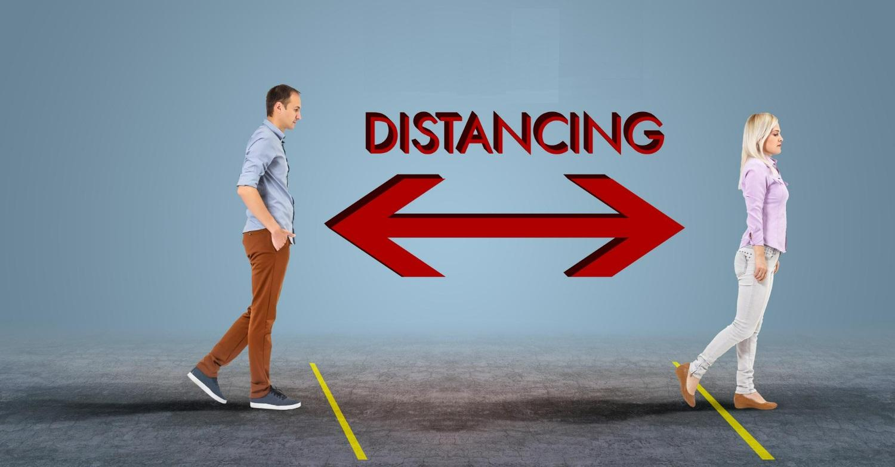
Space
  Edward T. Hall invented the concept proxemics- which mentions the space Etiquettes.
  Four Types of interpersonal distance, or degrees of proximity that we experience
  Public distance- (12-25 Feet)
  Social distance (4-12Feet)
  Personal distance (1.5- 4 Feet)
  Intimate distance (Less than 1.5 Feet)
Notes:
Classical proxemics theory was started in the 1960s by anthropologist Edward T. Hall. 1960s by anthropologist Edward T. Hall. Edward Twitchell Hall, Jr. was an American anthropologist and cross-cultural researcher. He is remembered for developing the concept of proxemics . Proxemics is the study of how space is used in human interactions..
He classified four degrees of interpersonal distance, or degrees of proximity that we experience
Public distance
Social distance
Personal distance
Public distance :At this distance (between 12–25 feet), you must speak louder to be heard, and it’s more difficult to maintain direct eye contact, so the connection between two people is minimal.
Social distance : This distance (between 4–12 feet) relies on visual and auditory cues to form a connection, since you’re still too far apart to touch or perceive body heat.
Personal distance : This distance (between 1.5–4 feet) is kept during interactions with friends. Here, vision is clear, eye contact is strong, and conversation flows easily.
Intimate distance: This distance (less than1.5 feet) is kept during interactions with friends. Here, vision is clear, eye contact is strong, and conversation flows easily.

Slide 20






98752-08472
Hello@freelancetrainings.com
www.freelancetrainings.com
406, Titanium City Centre Mall, Anand Nagar, Satellite, Ahmedabad-380015

