Slide 1

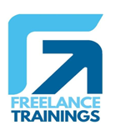
Collaboration Skills
Your
Company
Logo
Notes:
Collaboration Skills
Collaboration Skills
Elements of Collaboration Skills
Essential Collaboration Skills
Building Trust in Collaboration
Building Virtual Collaboration
Barriers to Effective collaboration

Slide 2
Workshop Agenda
Understanding Collobration
Skills
Elements of Collaboration skills
Essential Collaboration Skills
Building Trust in collaboration
Building Virtual Collaboration
Barriers to collaboration skills
Notes:
Welcome to the workshop on Collaboration Skills. Are you excited for today`s workshop? let me introduce todays workshop modules.
Understanding Collaboration skills
Elements of collaboration skills
Essential Collaboration Skills
Building Trust in collaboration
Building Virtual Collaboration
Barriers to collaboration skills
I'm feeling really enthusiastic about this experience, I think it's going to be great.

Slide 3
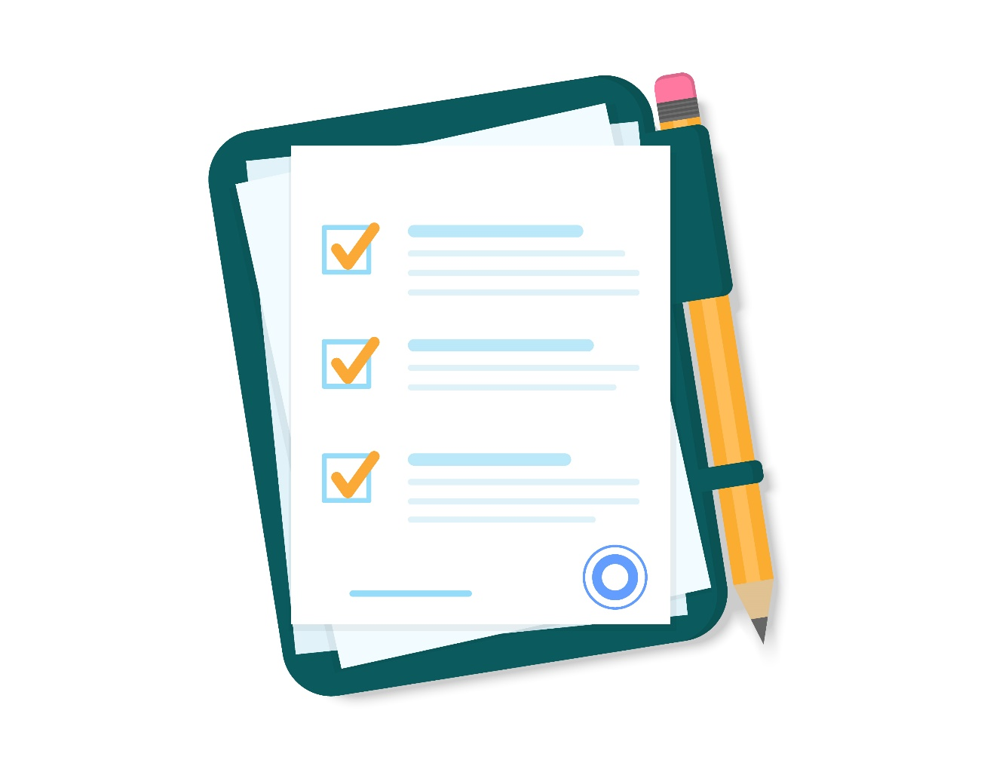
Pre Training Assessment
Notes:
Note for Trainer: A pre Training assessment will help you to understand the Participant’s knowledge level/awareness on the workshop topics. This will help you to customize the workshop examples and deep dive on points which need detailed explanation.
Provide pre-training assessment questionnaire to all the participants from your content Kit. Note please don’t give more than 15 mins for the assessment

Slide 4

Module-1 Understanding Collaboration Skills
Notes:
Collaboration Skills
What is a collaboration
Types of collaboration
Impact of Collaboration on Individuals & Teams
Myths related to conflicts

Slide 5

Impact of Collaboration on Individuals
Enhanced Problem-Solving
Diverse Perspectives
Skill Development
Professional Growth
Enhanced Communication
Better Decision-Making
Improved Productivity
Increased Job Satisfaction
Notes:
Collaboration skills offer a wide range of benefits for individuals in both personal and professional contexts. Here are some of the key advantages of possessing strong collaboration skills:
Enhanced Problem-Solving: Collaboration allows individuals to tap into the collective knowledge and expertise of a group. When working together, individuals can brainstorm solutions to complex problems and generate innovative ideas.
Diverse Perspectives: Collaboration exposes individuals to diverse viewpoints and approaches. This diversity of thought can lead to well-rounded solutions and a deeper understanding of different perspectives and cultures.
Skill Development: Collaborating with others provides opportunities to develop a wide range of skills, including communication, teamwork, negotiation, conflict resolution, and adaptability. These skills are valuable in various aspects of life.
Professional Growth: Collaborative work often involves working with people from different backgrounds and roles. This can broaden an individual's network and create opportunities for career advancement and personal growth.
Enhanced Communication: Collaboration necessitates effective communication, including active listening, clear articulation of ideas, and the ability to convey complex concepts to others. These communication skills are highly valuable in personal and professional settings.
Better Decision-Making: Collaboration enables individuals to gather more information, evaluate different options, and make informed decisions. Group decision-making often results in more balanced and well-informed choices.
Improved Productivity: Collaboration allows individuals to focus on their core strengths and delegate tasks to others with complementary skills. This delegation can significantly increase overall productivity.
Increased Job Satisfaction: Working in a collaborative environment where contributions are valued and recognized can lead to higher job satisfaction and a more positive work experience.

Slide 6


Myths Related to collaboration
Collaboration Is Always the Best Approach
Some tasks may be more efficiently completed independently, and excessive collaboration can lead to unnecessary complexity and delays.
Collaboration Equals Consensus
In fact, productive collaboration can involve healthy debates and discussions to arrive at the best solution, even if not everyone fully agrees.
Collaboration Is Always Harmonious
Effective collaboration includes the ability to address conflicts constructively and find resolutions that benefit the team and the organization.
Notes:
Myth 1: Collaboration Is Always the Best Approach
Reality: While collaboration is valuable, not all tasks require a collaborative approach. Some tasks may be more efficiently completed independently, and excessive collaboration can lead to unnecessary complexity and delays.
Myth 2: Collaboration Equals Consensus
Reality: Collaboration does not always lead to unanimous agreement or consensus. In fact, productive collaboration can involve healthy debates and discussions to arrive at the best solution, even if not everyone fully agrees.
Myth 3: Collaboration Is Always Harmonious
Reality: Collaborative efforts can involve conflicts and disagreements. However, effective collaboration includes the ability to address conflicts constructively and find resolutions that benefit the team and the organization.

Slide 7
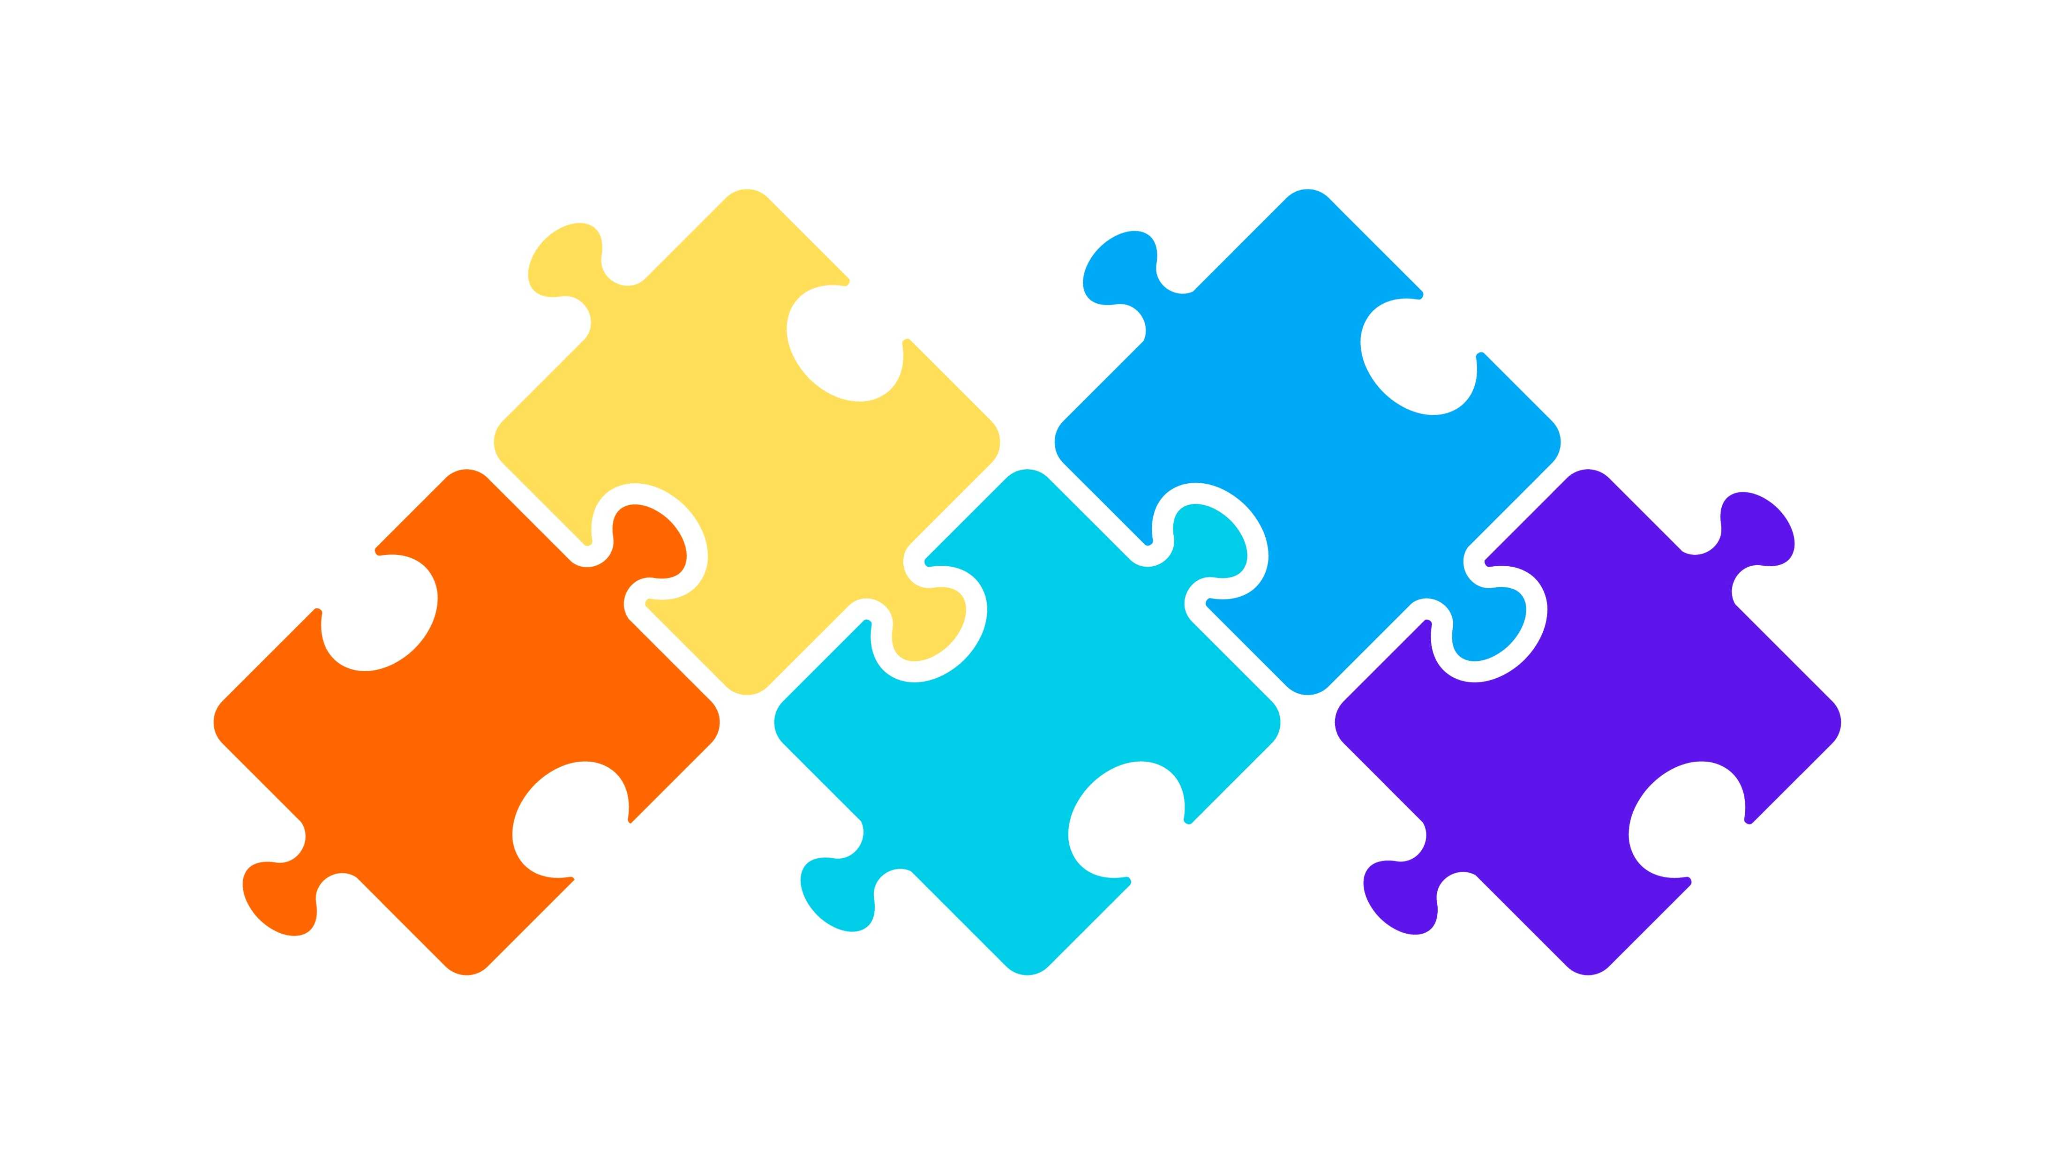
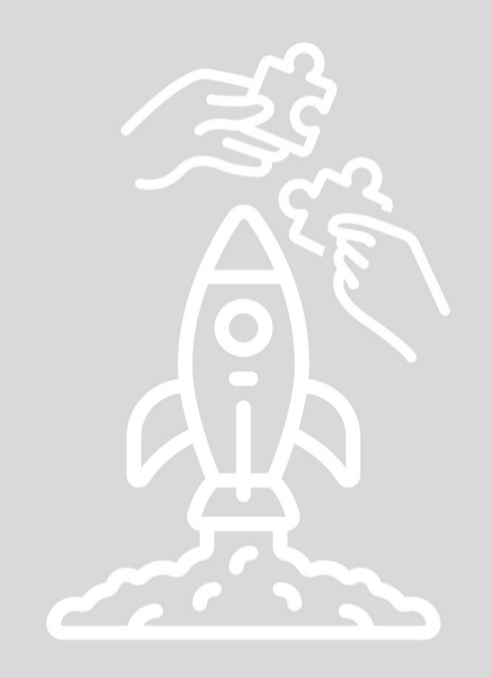


Types of collaboration
Project-Based Collaboration
Matrix Collaboration
Cross-Functional Collaboration
Interdepartmental Collaboration
Virtual Collaboration
Notes:
Teams within an organization can collaborate in various ways to achieve common goals and enhance overall productivity and effectiveness. Here are some of the common types of collaborations among teams within an organization:
Cross-Functional Collaboration: This type of collaboration involves teams from different functional areas or departments working together. For example, marketing and product development teams collaborating to launch a new product.
Project-Based Collaboration: Teams come together to work on specific projects or initiatives. These teams are often temporary and disband once the project is completed. Project teams can include members from various departments with diverse skill sets.
Interdepartmental Collaboration: Teams within different departments collaborate on ongoing activities or processes to improve efficiency and effectiveness. This type of collaboration is common in large organizations with multiple departments.
Matrix Collaboration: In a matrix organization, employees belong to both a functional team (e.g., marketing, engineering) and a project team (e.g., a specific project). This dual reporting structure allows for flexibility and expertise-sharing.
Virtual Collaboration: Teams collaborate remotely, often across geographic locations, using digital tools and technologies. Virtual teams are increasingly common in today's globalized and remote work environments.

Slide 8
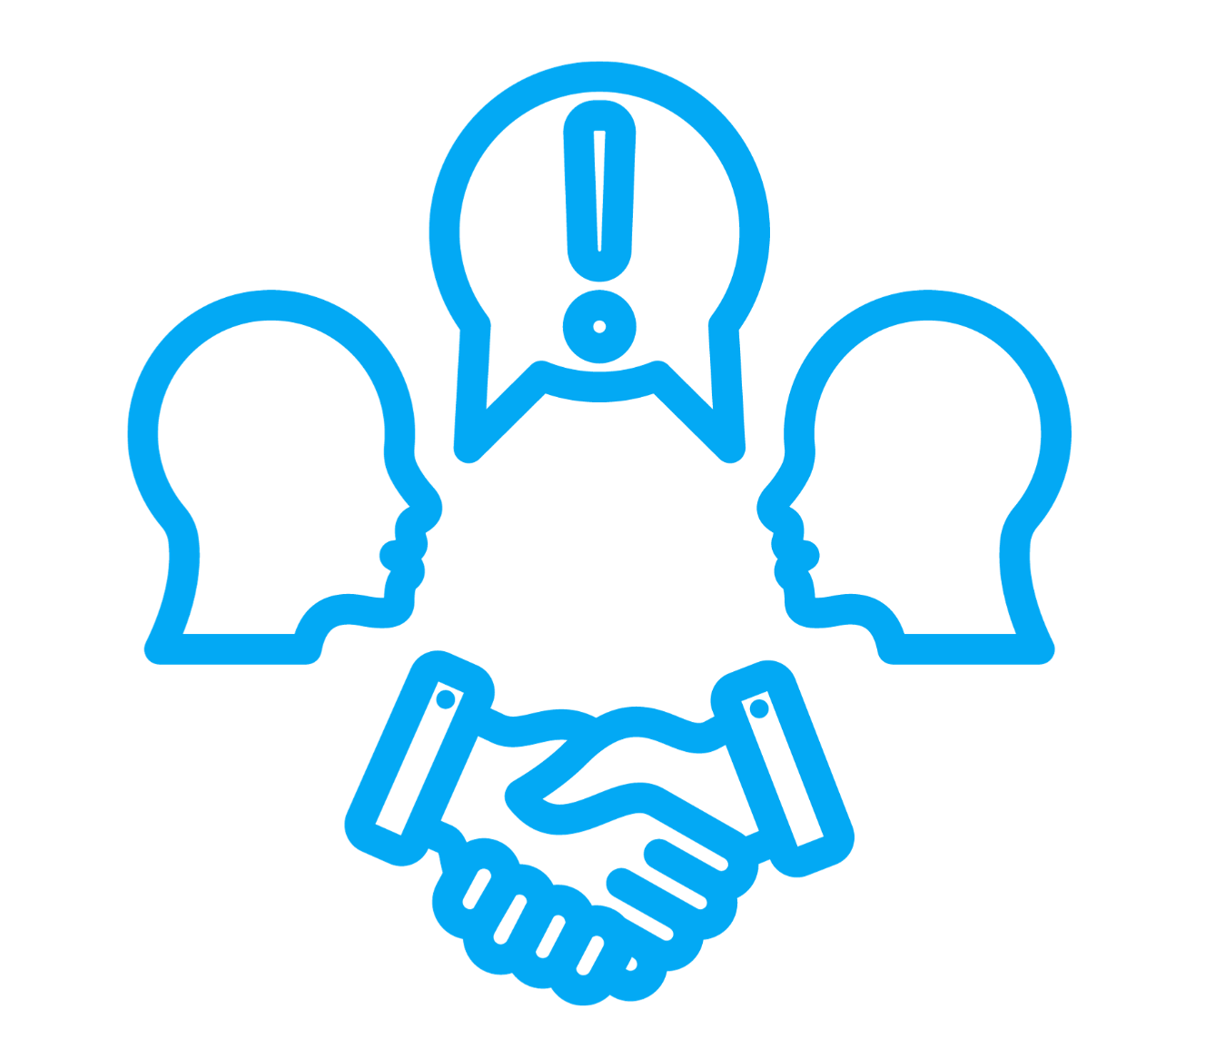



How to Make Collaboration Work
Clearly Define Objectives
Select the Right Team
Establish Roles & Responsibilities
Set Expectations
Build Trust
Conflict Resolution
Notes:
Making collaboration work effectively involves careful planning, communication, and a commitment to fostering a collaborative culture. Here are key steps and strategies to ensure successful collaboration:
Clearly Define Objectives: Start with a clear understanding of why collaboration is necessary and what specific goals or objectives you aim to achieve through collaboration. Ensure that all participants have a shared understanding of these goals.
Select the Right Team: Identify and assemble a team with the relevant skills, expertise, and experience needed to achieve the objectives. Consider diversity in the team to bring different perspectives to the table.
Establish Roles and Responsibilities: Define the roles and responsibilities of each team member. Ensure that everyone knows their role and how it contributes to the overall project or goal.
Set Expectations: Communicate clear expectations regarding timelines, deliverables, communication channels, and the quality of work. Establish a shared understanding of what success looks like.
Build Trust: Trust is essential for collaboration to thrive. Encourage trust-building activities, and ensure that team members can rely on each other to fulfill their commitments.
Conflict Resolution: Develop strategies for resolving conflicts constructively. Conflicts are inevitable, so having processes in place to address them is crucial for maintaining collaboration.
By following these steps and strategies, you can create an environment where collaboration can flourish and lead to successful outcomes, whether in the workplace or other collaborative settings.
Trainer : Have you all understood this
Participants- A loud Yes
Trainer- Lets see how much have you understood and trainer introduces the team to an activity

Slide 9

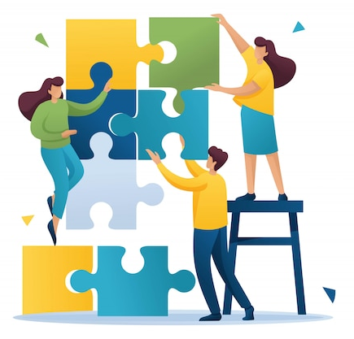
Activity -Building a Tallest Tower
Notes:
The objective of this activity is to help the participants to be able to apply the steps of previous slide and apply the steps in an experiential manner. The trainer is free to choose any training activity to derive the same objective from their own resources,
Lets start with the activity,
Hand out a packet of straws (at least 150),
Tell the teams that the aim of the exercise is to build the tallest, free-standing tower, using the materials provided, in the time given (15 minutes)
Trainer has to observe how each team is applying the learnings of various steps, like defining clear objectives, selecting the right team member, Conflict resolution etc.
After the towers are build and the activity is done each trainer needs to invite each group for quick 3 minutes of presentation on how they applied the steps and What have they learnt from this activity
What were the different roles that each team member played while building the tower
To complete your individual task in your team was your performance dependent on any other team members
How can you co-relate this activity to your daily workplace performance
Trainer to draw a parallel of this activity to how we also function in our daily lives at work places, how we have to coordinate with others and deliver.
Note:

Slide 10

Emotional Intelligence
Ability to recognize, understand, manage, and effectively use one's own emotions and the emotions of others in various situations.
It encompasses a range of skills related to emotional awareness and interpersonal relationships.
Notes:
Emotional Intelligence (EI) refers to the ability to recognize, understand, manage, and effectively use one's own emotions and the emotions of others in various situations. It encompasses a range of skills related to emotional awareness and interpersonal relationships. Here are some key points about emotional intelligence:
Self-Awareness: Recognizing and understanding your own emotions, as well as their impact on your thoughts and behavior.
Self-Regulation: The ability to control and manage your emotions, particularly in challenging or high-stress situations, and to resist impulsive reactions.
Empathy: Sensing and understanding the emotions and perspectives of others, and showing compassion and consideration for their feelings.
Social Skills: The capacity to navigate social interactions effectively, including communication, conflict resolution, and building positive relationships.
Motivation: A strong internal drive and self-motivation to pursue goals, even in the face of setbacks or obstacles.
Emotional Resilience: The ability to bounce back from adversity, cope with stress, and maintain a positive outlook even in challenging circumstances.
Conflict Resolution: The skill to manage and resolve conflicts in a constructive and empathetic manner, promoting understanding and cooperation.
Effective Communication: The capacity to express emotions and thoughts clearly and empathetically, while also being a good listener.
Empathetic Leadership: Recognizing and responding to the emotional needs of team members, fostering a positive and supportive work environment.
Influence: The skill to positively influence and inspire others through effective communication and emotional connection.
Self-Motivation: Maintaining a sense of purpose and motivation even when external rewards are minimal, driven by personal values and goals.
Positive Outlook: Cultivating a positive and optimistic attitude, which can have a beneficial impact on personal well-being and interactions with others.
Relationship Building: Nurturing and maintaining healthy, meaningful relationships with others, based on trust and empathy.
Emotional intelligence is considered a valuable skill in both personal and professional life, as it can enhance interpersonal relationships, leadership effectiveness, conflict resolution, and overall emotional well-being. Developing emotional intelligence involves self-awareness, practice, and a willingness to continually improve one's ability to manage emotions and connect with others empathetically.

Slide 11
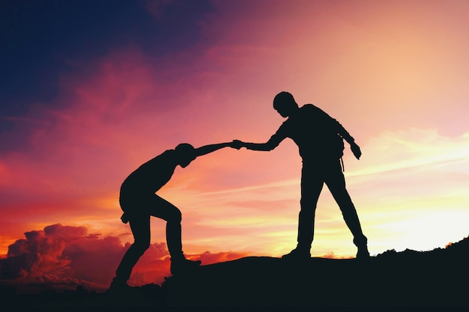
Building Empathy
Notes:
Empathy!!!
Effective communication is vital to accomplish business goals and tasks. Using empathetic communication helps to create a cohesive team that works together towards business objectives. Here are some ways that you can use empathetic communication at work. It's no surprise that great leaders and thriving organizations care about empathetic communication among their teams. But research shows that empathetic communication skills are in short supply. In this article, we outline six ways leaders and workplaces can practice empathetic communication in the workplace.

Slide 12
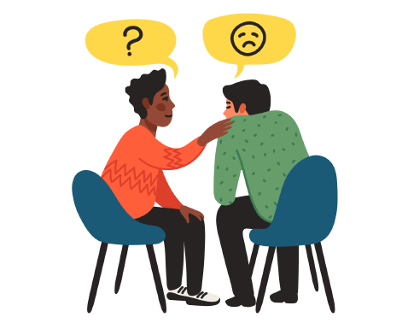
Building Empathetic Communication
Empathetic communication is the practice of understanding and sharing the feelings, thoughts, and perspectives of another person.
Active Listening
Acknowledge Emotions
Use Empathetic Language
Put Yourself in Their Shoes
Offer Solutions and Follow-Up
Notes:
Empathetic communication is the practice of understanding and sharing the feelings, thoughts, and perspectives of another person. Empathetic communication is crucial for creating a positive experience, especially when addressing concerns, resolving issues, or providing support. Here are five steps that professionals can take to build empathetic communication:
Active Listening: Actively listen to the words, tone, and emotions. Pay attention to their concerns, questions, or frustrations without interrupting. This demonstrates that you value their input and are genuinely interested in understanding their perspective.
Acknowledge Emotions: Recognize and acknowledge the customer's emotions, even if the issue isn't directly caused by your organization. Express empathy and understanding for their feelings, showing that you care about their experience.
Use Empathetic Language: Choose words that convey empathy and understanding. Avoid using dismissive phrases and demonstrate that you are on the customer's side, working together to address their concerns.
Put Yourself in Their Shoes: Imagine how the customer might be feeling in their situation. This helps you better understand their perspective and respond in a way that resonates with their needs.
Offer Solutions and Follow-Up: After understanding the customer's concerns, provide appropriate solutions or options. Ensure that the customer knows what steps will be taken to address the issue, and follow up to confirm that the solution was effective.
By following these steps you can build empathetic communication that helps customers feel heard, understood, and valued. Empathetic communication enhances the customer experience, fosters trust, and contributes to strong customer relationships.

Slide 13

Module-4 Building Trust in Collaboration
Notes:
Building Trust in Collaboration
The role of trust in collaboration.
Team-building activities to foster trust and cooperation.
Strategies for building strong cross-functional teams

Slide 14


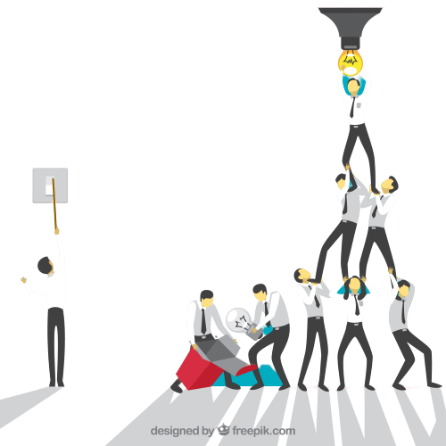
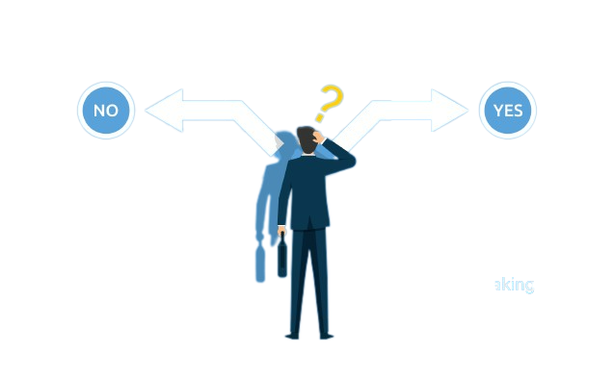


Importance of Trust
Improves efficiency, engagement, and productivity
Enhances teamwork and collaboration
Enhances decision-making
Decreases stress and burnout in the workplace
Increases employee loyalty and retention
Notes:
The pointers are self-explanatory. Trainer can elicit examples for these points.
Trainer:
How can we build trust?
Transition to the next slide.

Slide 15
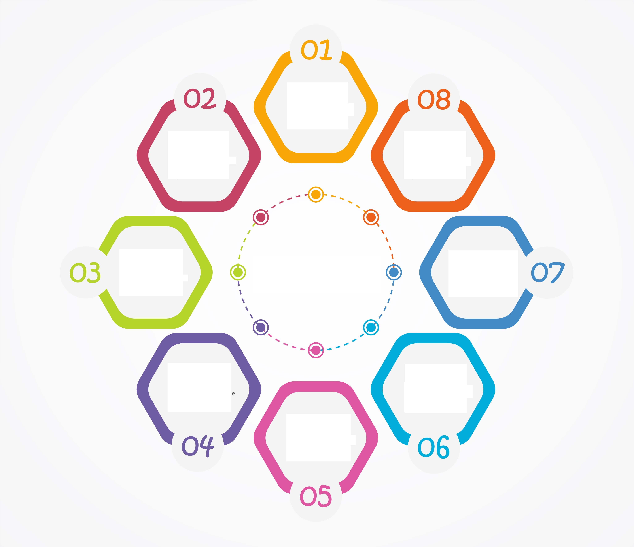
Causes of Workplace Conflict
Misaligned
Goals and
Priorities
Poor
Communication
External
Pressures
Resource
Allocation
Workplace
Conflicts
Change
Management
Role Ambiguity
and Overlaps
Lack of
Trust
Cultural
Differences
Notes:
Interdepartmental workplace conflicts can arise due to various reasons, stemming from differences in goals, communication breakdowns, or resource allocation. Here are the top 8 reasons along with explanations:
Misaligned Goals and Priorities: Departments may have conflicting objectives or priorities, leading to clashes when their goals don't align with the overarching objectives of the organization. Lack of clarity about shared goals can cause friction.
Poor Communication: Inadequate communication channels or a lack of effective communication between departments can result in misunderstandings, assumptions, and conflicts. Information silos or a failure to convey critical information often exacerbate tensions.
Resource Allocation Disputes: Conflicts may arise when departments compete for limited resources such as budget, manpower, or time. When resources are unevenly distributed or one department feels disadvantaged, tensions can escalate.
Role Ambiguity and Overlaps: Unclear delineation of roles and responsibilities between departments can lead to overlaps or gaps in workflow. This ambiguity can cause turf wars or finger-pointing when tasks fall through the cracks.
Cultural Differences: Departments might have distinct work cultures or norms that clash with each other, leading to misunderstandings or conflicts. Diverse work styles, values, or beliefs can create friction if not managed properly.
Lack of Collaboration and Trust: When departments work in isolation or fail to collaborate, trust issues can emerge. A lack of cooperation, teamwork, or sharing of information can breed suspicion and conflict.
Change Management Issues: Resistance to change or differing attitudes towards organizational changes can cause conflicts between departments. When one department embraces change and another resists, it can lead to tension and disruption.
External Pressures: External factors like market changes, regulatory shifts, or economic challenges can impact departments differently. Conflicts may arise when departments have varying responses to these external pressures, leading to disagreements on strategies or approaches.
Lets Look at how to manage the conflicts using a very famous Thomas Kilmann Model.

Slide 16
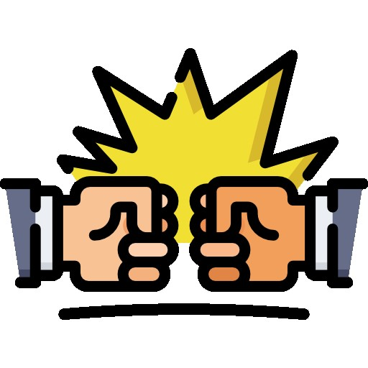

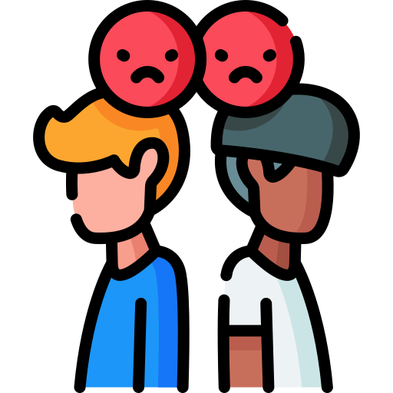
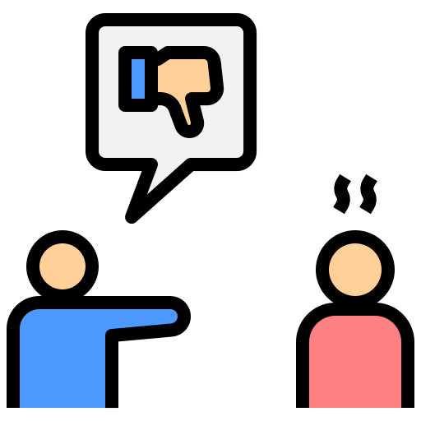
Thomas Kilmann's Conflict Management Matrix
Competing
Collaborating
Low Assertiveness High
Compromising
Avoiding
Accommodating
Low Cooperative High
Notes:
The Thomas-Kilmann Conflict Mode Instrument (TKI) is a widely used conflict resolution model developed by Kenneth Thomas and Ralph Kilmann in the 1970s. It's a tool designed to assess an individual's behavior in conflict situations and to help them understand their approach to handling conflicts. The model identifies five primary conflict resolution styles or modes:
The two axes of the Thomas-Kilmann Conflict Mode Instrument are:
Assertiveness: This axis measures the extent to which an individual tries to satisfy their own concerns or goals in a conflict situation.
High Assertiveness: Reflects a strong focus on personal needs, desires, and goals. Individuals with high assertiveness tend to push for their own positions or solutions in a conflict.
Low Assertiveness: Indicates a tendency to prioritize the needs and concerns of others over one's own. People with low assertiveness often avoid confrontation and may yield to others' demands to maintain harmony.
Cooperativeness: This axis measures the extent to which an individual tries to satisfy the concerns or goals of others in a conflict situation.
High Cooperativeness: Involves a focus on satisfying the needs and concerns of others. Individuals with high cooperativeness might sacrifice their own interests to ensure that others' needs are met.
Low Cooperativeness: Indicates a focus on achieving personal goals, often at the expense of others' needs or concerns. People with low cooperativeness might compete aggressively to win their position in a conflict situation.
The combination of these two axes results in five conflict-handling modes:
Accommodating (Unassertive and Cooperative): This style involves self-sacrifice for the benefit of others or giving in to the other party's concerns. It's cooperative but might neglect one's own needs or interests.
The TKI model helps individuals understand their default conflict resolution style and teaches them to adapt their approach based on the situation, relationship dynamics, and the desired outcome. Different situations might call for different approaches, and being able to flexibly use these styles can be beneficial in managing conflicts effectively.

Slide 17

Module-5 Building Virtual Collaboration
Notes:
Building Virtual Collaboration
Extra challenges of virtual collaboration
Virtual collaboration tools ideas and suggestions
Good virtual communication practices

Slide 18

Extra Challenges of Virtual Collaboration
Communication Issues
Technology Hurdles
Building Trust & Rapport
Managing Time Zones
Work life Balance
Social Isolation
Notes:
While virtual collaboration offers many advantages, it also presents several unique challenges that teams and organizations must navigate effectively. These challenges can impact productivity, communication, and team cohesion. Here are some extra challenges of virtual collaboration:
Communication Issues: Misunderstandings can arise more easily in virtual settings due to the lack of non-verbal cues and face-to-face interaction. Different time zones, language barriers, and reliance on written communication can lead to communication gaps and misinterpretations.
Technology Hurdles: Technical issues such as poor internet connectivity, software glitches, or compatibility problems with different devices can disrupt communication and collaboration, hindering productivity.
Building Trust and Rapport: Without the opportunity for casual interactions and in-person bonding, establishing trust and strong relationships among team members can be challenging. This can affect teamwork and collaboration.
Managing Time Zones and Cultural Differences: Working across different time zones can create scheduling difficulties for meetings and real-time collaboration. Additionally, diverse cultural backgrounds may lead to varying work styles, communication norms, and approaches to problem-solving, requiring sensitivity and adaptability.
Distractions and Work-Life Balance: Remote work environments can blur the lines between professional and personal life, leading to distractions, difficulty in setting boundaries, and potential burnout among team members.
Social Isolation and Engagement: Remote work can lead to feelings of isolation and disengagement. Without regular in-person interactions, team morale and a sense of belonging to a cohesive group can suffer.
To address these challenges, teams can implement strategies such as fostering open and clear communication, using collaborative tools effectively, establishing regular check-ins, setting clear goals and expectations, providing training on remote work best practices, encouraging team building activities, and promoting a culture of trust and inclusivity. Flexibility and adaptability are crucial for overcoming the obstacles posed by virtual collaboration.
Give me an activity that can be used in the workshop to practice virtual collaboration

Slide 19

Rewarding Team Collaboration
Team Celebrations
Recognition Awards
Incentive Programs
Flexible Work Arrangements
Professional Development Opportunities
Leadership Opportunities
Share Success Stories
Notes:
Rewarding team collaboration is an important way to recognize and incentivize teamwork, foster a collaborative culture, and motivate team members to work together effectively. Here are some strategies for rewarding and recognizing team collaboration:
Team Celebrations: Hold team celebrations or social events to acknowledge successful collaboration and team achievements. These can include team lunches, dinners, or virtual gatherings.
Recognition Awards: Create recognition awards or certificates specifically for collaboration. Recognize teams or team members who consistently demonstrate effective collaboration skills.
Incentive Programs: Implement incentive programs that reward teams for achieving collaboration-related goals, such as completing cross-functional projects or improving interdepartmental communication.
Flexible Work Arrangements: Offer flexible work arrangements or additional time off as a reward for collaborative achievements. This can help promote work-life balance.
Professional Development Opportunities: Provide opportunities for team members to attend workshops, training, or conferences that enhance their collaboration skills and professional growth.
Leadership Opportunities: Recognize collaborative team members by offering leadership opportunities or involving them in decision-making processes or special projects.
Share Success Stories: Share success stories of collaboration within the organization to inspire and motivate other teams and individuals.
Remember that the most effective rewards for collaboration will vary from one organization to another and among team members. It's important to create a recognition and rewards system that aligns with your organization's culture and values while also considering the preferences and motivations of your team members.
Regenerate

Slide 20


Photo Time
Notes:
Hey It is Photo Time.
Time to click a group photo for the workshop with all the participants.

