Slide 1


Employee Retention Workshop
Your
Company
Logo
Notes:
The workshop is titled as Employee Retention workshop but the trainer is advised to change the name to some other topic while delivering the presentation e.g People Development Workshop, Growing People workshop to avoid any
Facilitator’s Notes:
Say: Hello! And welcome to a 1–day workshop on Employee Retention
It is one of the most challenging aspects for leaders and organizations.
Anticipating attrition and plugging it will prevent knowledge voids, work-resource imbalance, as well as employee replacement costs.
This workshop includes an understanding of the various aspects of employee retention. It includes many discussions, case studies and role-plays to deepen the learning. Let’s start our learning journey.
Move to the next slide.

Slide 2
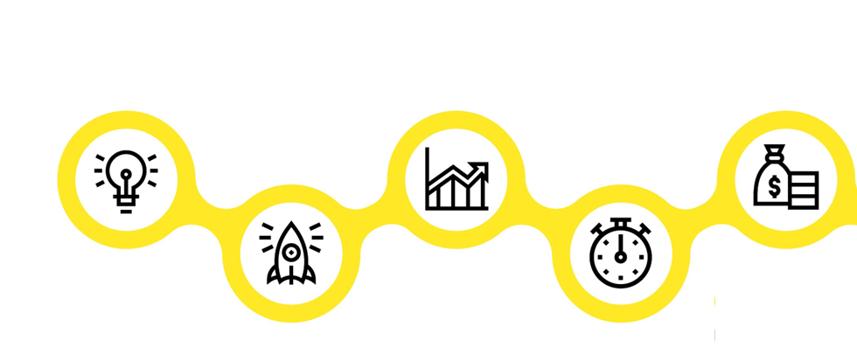





Agenda
Module 1
Module 3
Module 5
The interplay of systems
Manager’s responsibility
Appreciating & Motivating the Team
Module 2
Module 4
The Manager-Employee
relationship
Skills of a Manager
Notes:
Facilitator’s Notes:
Tell: The agenda of today’s training is to learn:
Module 1 The interplay of systems
Module 2 The Manager-Employee Relationship
Module 3 Manager’s responsibility
Module 4 Skills of a Manager in Employee Retention
Module 5 Appreciating & Motivating Team
Let us dive into the first concept for the day!
Move to the next slide.

Slide 3

The Interplay of Systems
Module I
Notes:
Right since we are born, we are all a part of a system. We belong to a family, a lineage, a friend group, a community, a society,
Likewise, professionally, we are also a part of a larger system - an industry, a sector, an organisation, a specialisation, a team.
All these systems are interconnected – either nested one inside the other or influence each other considerably.
Ask: So, in an organisation, how are these systems formed?
Can you state a brand case as an example?
Allow participants to state their responses.
Acknowledge responses.
Move to the next slide.

Slide 4
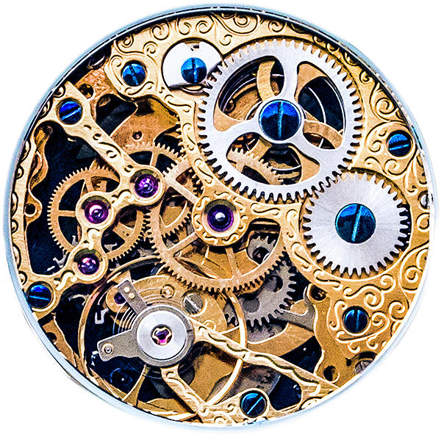
Macro-units and Micro-units
Notes:
Now that we have seen the various parts of an organisational system, let us look at macro- and micro-units.
Ask: What is the meaning of macro and micro?
Elicit responses and acknowledge.
Macro is a larger system, and micro is a smaller system.
Ask: When we say larger and smaller, what does it indicate?
Elicit responses and acknowledge.
It indicates that these systems are relative.
The biggest macro-unit is the organisation itself.
Organisations that have multiple brands, branches or departments can be considered macro-units as compared to individuals or smaller teams. (micro)
Every micro-unit is like a small gear that has to work well for the macro-unit to run smoothly.
Smaller glitches can have a cumulative effect on the macro-structure. i.e. the organisation
For the benefit of the session, today we will consider the organisation as the macro-unit and an employee as a micro-unit.
Ask: How does a micro-unit affect the macro-unit?
Elicit responses and acknowledge.
Move to the next slide.

Slide 5
Why do employees stay?
Compensation and Benefits
Recognition
Development Opportunities
Company Culture
Work-life balance
Job Security
Meaningful, challenging or unique work
Supportive leadership
Cordial peer group
Transparent Communication
Notes:
The pointers mentioned in the slide are self-explanatory.
The facilitator could ask how they perceive:
Cordial peer group: Supportive team members make positivity, work-life balance and knowledge improvement possible.
Often, a cooperative team makes it possible for an employee to look at the bright side of their work and company.
A cordial and experienced peer group could also make an employee feel motivated to come to work every day.
Transparent communication: Transparency is often misunderstood. It does not mean that every piece of information has to be shared with an employee.
However, it is better to under-commit to expectations to avoid a dip in morale and attrition.
For example, it is possible that a company may not be able to offer a salary hike when the employee expects it.
But there may be some benefits or lucrative or unique opportunities that may compensate for the same.
To sum it up, it is prudent not to falsely commit to retain the employee in the organisation.
Trainer to say:
You may notice that most factors mentioned are often beyond the purview of the immediate Manager.
So, now tell me what is the role of a Manager?
Move to the next slide.

Slide 6
Roles Managers play
Organizational goals
Team performance
People management
Notes:
Trainer: The main roles of a manager will fall into the following 3 broad categories:
1. Organizational goals – It is important for every manager to know and the understand the organizational goals. If possible, also the organizational culture and values. This will make it easier to be aligned and motivated and also align and motivate the team to achieve these goals.
There are several businesses that fall flat because its employees do not know and understand their goals and vision. This is especially true in the service industry. Even some big brands such as Air India, Maruti and Big Bazar have taken a hit because their goals and strategies weren’t clear and its employees couldn’t match up to the basic expectations of the brand.
2. Team performance – The vision of the company is broken down into small goals for teams to achieve. These goals have smaller steps to be executed, which are evaluated as team performance. For example, if customer satisfaction is the vision of a company, resolving complaints within 24 hours may be the goal and that may have several steps like classifying the problem, troubleshooting, offering solutions or workarounds and collecting feedback.
You will find that most companies have dedicated teams to achieve specific goals
3. People management – We must remember that people are a vital resource in achieving organisational goals. One of the main reasons why people management is difficult is that every person perceives and acts differently. If you want to clean your room, you know how you would do it. However, if you ask someone else to clean your room, even with clear and detailed instructions, the outcome may not be exactly as you desired. This is because each employee will perceive instructions and goals in his or her own way and execute the task as per their understanding.
Of course, managers were also smart, and to overcome this hurdle, they created the concept of SOPs or Standard Operating Procedures.
These are 3 major categories, which are considered a manager’s responsibility.
Needless to say, all this is simple in theory and a lot more complex in practice.
Let us sum up the difference between a Manager and a Leader.
Move to the next slide.

Slide 7

The Manager-Employee Relationship
Module II
Notes:
The Manager-Employee Relationship has its own path – its ups and downs – ebbs and flows.
Let us see how these interactions could play out with a new employee – both fresh out of college and a tenured/experienced employee.
Move to the role play on the next slide.

Slide 8
Gauging the employee
Ability to learn
Performance
Temperament
Team interaction
Notes:
The first 3 weeks can reveal much of the employee’s calibre, skill, personality, and socio-emotional quotient.
All this provided, you are observant and communicative enough.
Ask: What can you gauge in an employee?
Elicit responses and acknowledge.
Debrief:
Ability to learn: The first week (or many more weeks) is used for training and inducting the employees.
Many training sessions include assessments to evaluate the understanding of employee.
However, a manager can also receive feedback from the trainer about how much the employee has learned.
Performance: Beyond the training, the employee is given simpler tasks or tasks independently or under the guidance of a senior. Although the benchmarks for performance are much lower for a newcomer, one can gauge how efficiently an employee is able to execute tasks. For an employee who has prior experience in the domain, this period will reflect how proficient they are in the field.
Temperament: The new environment attempts to offer a lot of comfort and leeway to new employees.
However, the newness of the team, the work and the culture is quite the test of a person’s reactions to common hurdles faced.
This may often give an insight into the person’s temperament.
We may discover that a person is particular, punctual, even-tempered, patient, needs instructions, or cooperative.
Alternately, we may discover some traits that we may find difficult to accept or work with.
This is especially useful when working with experienced employees since they have preconceived notions about an organisation and people.
(Temperament is the natural part of your character that affects your moods and the way you behave)
Team interaction: How comfortably the employee is getting along with the other team members will also help you eventually build belonging, loyalty, and channels of influence.
If an employee is an introvert and feels like a misfit in your team of extroverts, you may need to communicate more frequently to help them find their place in the team.
So much for gauging an employee for their temperament and skills, they are also doing the same.
They are evaluating managers on their scale of expectations and comfort.
Once again, we will be optimistic and presume that the employee decides to stay on.
As time passes, the relationship grows or, to put it bluntly, changes form.
One reason I say this is that it is not necessary that the journey is smooth sailing.
The Manager–Employee bond is formed after many “trust evaluations” beyond the hearsay about the manager.
Ask: Presuming that trust and belonging are established, what does it take to sustain this?
Elicit responses and acknowledge.
Move to the next slide.

Slide 9
Change Management
Realizing the need for change
Communicating the benefit of change
Communicating what to expect
What is their role in this change?
Notes:
Change is an unavoidable aspect of every organisation, even life.
Since it is decided by the top management and is often communicated to the managers much later.
Many organisations inform the managers just before the change is about to be implemented.
If the news is authentic, the manager could give the team an idea (even a vague one is enough)
What changes for the employee is to be better prepared for what is in store for them.
Change in products or services – even expansion or diversification will affect the employee in some way or the other.
Ask: In what way can positive change impact an individual employee?
Elicit responses and acknowledge.
Possible responses are:
Growth opportunities
Extra workload
Internal shifts and process changes
Expectation of skill development
Increased responsibility for the manager, which may affect the employee
Of course, we know that policy changes can affect the customers and the employees alike.
Therefore, times of crisis and change are crucial moments when managers must have clear, consistent communication.
With this, we understand that any change, both positive or otherwise, can impact an employee.
We are all seekers of control and balance, and anticipating and being prepared for changes can have a significant impact on a person.
We will further examine the significance of a manager’s role in an organisation.
Move to the next slide.

Slide 10
Building Belonging & Trust
Positive
Negative
Notes:
Ask: Which comes first – belonging or trust? To build the other.
Elicit responses and acknowledge.
This is a chicken-and-egg question.
Let us understand how.
We are all born into certain families, and we belong to a specific set of parents.
Ask: Do we have any choice in that?
No.
We are then introduced to different people by our immediate caregivers.
We feel comfortable and belong to them. (well, mostly)
This belonging helps us trust them.
For e.g. if children have been scolded by their parents, they give the parents a benefit of doubt.
They trust them. (of course, parents also justify that we are scolding you because we care for you.)
Later on in life, we find friends. (mostly sharing common interests, values, attitudes)
Through our experiences with them, we begin to trust them.
And when they pass our trust-tests, we belong to them.
Ask: In the case of a Manager and Employee, what is the probable option?
Elicit responses and acknowledge.
The second scenario is the more probable one in the case of a Manager and an Employee.
Trust is developed over time through experiences for the employees
It is a journey of developing trust in each other.
Ask: Can all experiences be positive? Or rather, can you guarantee that all your experiences with your employees are positive?
No.
Ask: What can you ensure?
That positive experiences outweigh the unpleasant ones.
And over a period of time, this trust converts into belonging and possibly even loyalty.
And this can happen by following simple things.
Ask: What will help build trust? (skills, behaviours, qualities)
Elicit responses and acknowledge.
Possible responses:
Respect, Listening, Empathy, Courtesy, Understanding, etc.
Simple gestures are enough to build trust in an employee.
In some time, we will revisit all the basic skills you would have heard a zillion times in your training sessions.
As always, life is simple, but practising these simple things is difficult.
Ask: Moving on, when trust and belonging are built, what happens?
Elicit responses and acknowledge.
It changes the team’s and the organisational culture.
Let us see how a manager can influence culture and growth.
Move to the next slide.

Slide 11
Being aware of bias
Perception
First thoughts about something
Almost automatic, based on past experiences
Opinion
Conclusion drawn due to perception and present experience
Is thought of, consciously or unconsciously
Judgment
Thought mixed with strong emotion
Rigid (almost unshakeable) belief, feeling and approach towards something or someone
Behaviour, action or approach based on opinions
Bias
Notes:
Ask: What is a bias?
Elicit responses and acknowledge.
Bias is an extreme, rigid and often irrational belief or feeling towards someone or something.
Biases can be positive or negative.
Either way, it tends to make a person choose a side and become partial.
This phrase – “hamare ghar me aisa nahi hota” is a biased statement, making the other person feel that their behaviour or thought is unacceptable.
Positive biases create partiality as well.
He will be loyal because he really needs the job. (money)
Although this statement can be quite harmless on its own, during promotions or fair evaluations, this can really make things argumentative for the selection panel.
Movie reference – last scene in 12th Fail.
Ask: How do we form these, and when do they become risky?
How is a bias formed?
Elicit responses and acknowledge.
Perception is usually the first, involuntary thought about something or someone.
Our mind is a HUGE archive of memories.
Whenever we encounter something new, it goes back to the archive to find any similarities from our past experiences. Depending on the comparison, our mind creates an image (and therefore a slight liking or dislike).
Example: Let us say you look at me and some gesture of mine reminds you of your childhood friend, you will probably find me pleasant. Alternatively, if I remind you of your mean neighbour, you may unknowingly find me unpleasant.
This is, of course, the first impression.
Trainer: What is the quote – First impression is the (make the audience complete the quote)
First impression may not be the last impression, but it can be a lasting impression, which means that it may take some time for you to change your perception of someone.
That is why during interviews, we all try to create the best perception possible.
But you will also realise that over time, through interactions, perceptions can change.
Have you faced this?
Elicit examples of when they have changed the first impressions of people.
Trainer:
When perception is confirmed through interactions, it becomes an opinion or a belief. This may happen consciously or unconsciously. Of course, when someone brings it to your notice, you will have examples to share of why you think or feel this way about a person.
For example, if the first perception of someone is that they are arrogant and for whatever reason your interaction with the person is unpleasant, you now believe that your assessment of this person was right in the first place.
“See? I told you he is like that” is a very common statement you hear.
Judgment
Now the game gets tougher. You have a belief, and over time, it gets stronger through feeling strongly about it.
Ask participants to complete the following sentences with the first word that crosses their mind: (within 3 seconds)
All politicians are _________
Rich people should __________
Teenagers must _________
The Indian Cricket Team is ______
Money is _________
Celebrities are _________
To be rich, one has to _____________.
You will notice that we may not have experienced any interaction with politicians or celebrities.
But we have an opinion about them.
Have you interacted with many politicians or the Indian team? But our expectations of how they should be versus what is presented to us through the media turn a belief into a judgment.
For example, starting with the belief - just because he is in a higher position doesn’t give him the right to be arrogant – it moves on to people in higher positions being arrogant.
Based on our judgments, we start approaching people or situations in a certain way, often reacting very strongly to it.
Bias
This is the next step after judgment. Bias is a rigid (almost unshakeable) belief, feeling and approach towards something or someone. So much that there is no thought, logic or rationale behind it.
For example, some organisations believe that sales jobs are only for men.
Newer employees must wait for a long time before they get promoted.
Most statements made with shoulds and musts tend to be biased statements.
This brings us to a tricky phenomenon called unconscious bias.
Move to the next slide.

Slide 12
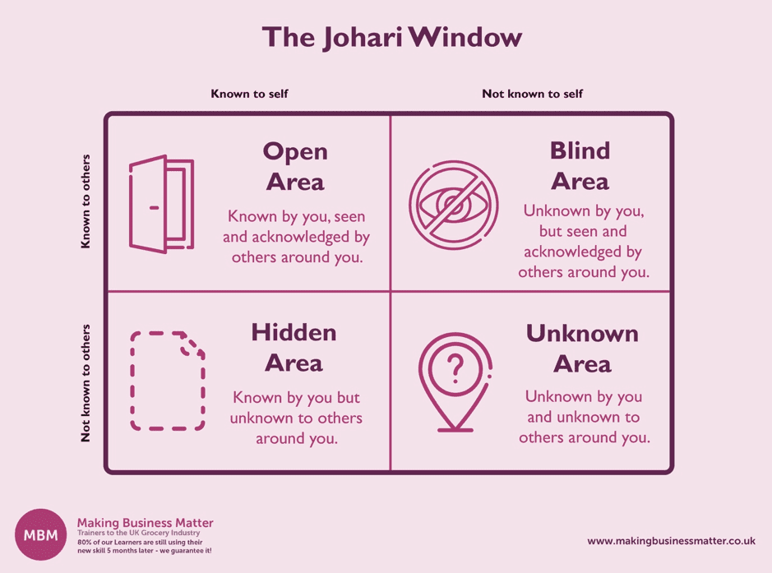
Overcoming Unconscious Bias
Notes:
Ask: What do you understand by unconscious bias?
Elicit responses and acknowledge.
Everything unconscious is unknown to us.
Ask: Considering the bias is unconscious (which means you don’t know you have it), how do you prevent it?
Elicit responses and acknowledge.
You will realise that the answer to a complex question is often simple.
Here is an example:
You are getting ready for an important meeting or event.
When you want to be sure that you look good and everything is ok with your appearance, what do you do?
Elicit responses and acknowledge.
You look in a mirror.
In this case, our mirrors are people that we interact with.
People’s responses, reactions, expressions, body language, tone, choice of words, and behaviour changes can reflect that something may have gone awry.
Also, information through the grapevine is a good source of information for us. (generally called feedback).
To become aware of our thoughts and behaviours is a journey in itself.
Does it call for therapy or coaching?
Well, that depends. Depends on how open or ready you are to see yourself in its entirety.
This was beautifully explained by a duo called Joseph Luft and Harrington Ingham, who termed the tool – the Johari window.
The 2 axes represent how much we know about ourselves and how much others do.
The 4 quadrants indicate the awareness levels of a person.
Open – known to you and known to others – maybe you have mentioned this before in public. For e.g, You like that people are on time.
Hidden – known to you and unknown to others – you have not communicated this due to its sensitivity or lack of focus on the matter – For e.g. You feel guilty after shouting at your team members.
Blind – others know something about you that you have not realised yet. For e.g., you become irritable when a task fails or get a dressing-down from your boss.
Unknown – you and others don’t know this aspect. This comes up only due to circumstances. For e.g., how you handle failure.
This tool needs you to introspect and collate data and review it to gain more awareness about yourself.
Ask: Unconscious bias lies in which quadrant?
Elicit responses and acknowledge.
In Quadrant 2 or very rarely in quadrant 4. mostly, it is a blind spot.
Just in case, something has gone awry and an employee is dissatisfied, are there signs?
Yes, definitely.
If you are mindful and observant, an employee who wants to leave many bread crumbs.
Let us look at what they are.
Move to the next slide.

Slide 13

Module IV
Skills of a Manager
Notes:
There are several skills that a Manager is expected to possess.
However, we will look at the most common ones that are instrumental in employee retention.
Move to the next slide.

Slide 14

Feedback skills
Acknowledge both strengths and areas of improvement
Help them with the way forward – support or coach
Be compassionate and honest
Schedule follow-ups, as necessary

Slide 15

Problem-solving
Understand how the problem is affecting the employee
Empathise as necessary
Ask for solutions from the employee
State your challenges if the employee is open to understanding
Negotiate and arrive at the best alternative in that situation
Notes:
Often, the solutions to the employee’s problems may lie beyond your control.
Attempt to pacify and look for feasible solutions before turning them down.
Remember, we cannot pacify everyone’s needs but when the employee understands your intent and effort, often that is enough for them.
This brings us to the end of today’s session.
End of session.

Slide 16

Module 5 MANAGING Team- Team Motivation & Appreciation
Notes:
Keeping employee morale up is very important for various reasons.
Let us discuss how motivation and appreciation matter.
Transition to the next slide.

Slide 17

How to appreciate using VIP-HRs Model
V – Ensure there is VARIETY
I – Notice when feedback is IMPLEMENTED
P – Appreciate PUBLICALLY
H – Appreciate the HARDWORK not just the results
R – Make it RECURRENT
S – Make it SPECIFIC
Notes:
Add variety
Be versatile with your appreciation - about what you appreciate in others as well as how you appreciate - in team meetings, over emails, notes or small goodies.
Notice when feedback is implemented
One of the most important moments where appreciation matters the most is when an employee implements feedback. It motivates the employee to continue and builds trust in you.
Acknowledge them publicly
When someone on your team does something great (doesn’t always have to be extraordinary), acknowledge them publicly. First, this shows the entire organization the value you, as the leader, place on the accomplishment. Second, it gives the employee visible credit for the achievement. Third, because you have done so publicly, it gives others a license to recognize the employee for his or her accomplishment. Give public acknowledgment and you create a situation that can lead to a higher order emotional level of appreciation.
Acknowledge attitude, dedication, and hard work not only results
Build a habit of acknowledging positive changes in an employee, apart from work, is also equally important. For example, you could acknowledge an employee for being punctual or reliable.
Make it recurrent
Appreciate frequently and genuinely. You don’t need to save your appreciation for your annual performance meeting at the same time, you don’t need to appreciate someone every day. Being genuine will help you do this better.
Let us look at some phrases that you can use to appreciate.
Transition to the next slide.

Slide 18





Thank You
98752-08472
Hello@freelancetrainings.com
www.freelancetrainings.com
406, Titanium City Centre Mall, Anand Nagar, Satellite, Ahmedabad-380015

