Slide 1


Executive Presence
Your
Company
Logo
Notes:
Trainer:
Welcome to a workshop on Executive Presence.
The concepts that we will see in this session are probably familiar to all of you.
However, with time evolution of terms happens although the premise remains the same.
Let us set some ground rules for the day.
Move to the next slide.

Slide 2

What are your expectations from the workshop?
Notes:
The trainer will do expectation mapping.
They can ask the participants what are their expectations from the workshop.
Alternatively, the trainer can ask them to discuss in groups and one of them can share with the trainer.
The trainer will note them down on the flipchart.
Now that we are all set, let us move on to the agenda for today.
Move to the next slide.

Slide 3







Agenda
Understanding executive presence
Story telling
Creative & Compelling story
Emotional Intelligence
Building Trust
The art of influence
Developing Charisma
Notes:
Trainer:
This workshop is quite extensive, covering extremely significant aspects of the topic.
There are 7 modules, each covering a significant topic:
Understanding executive presence
Storytelling
Creating a compelling story
Emotional intelligence
Building trust
The art of influence
Developing charisma
Each of these modules will bring more clarity to the larger concept - “Executive Presence”.
Let us now dive deeper into them.
Move to the next slide.

Slide 4
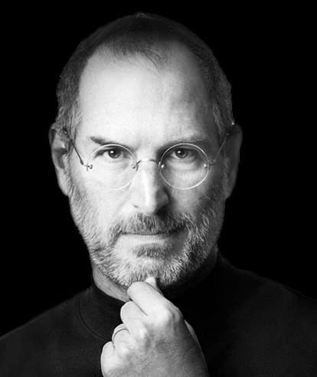

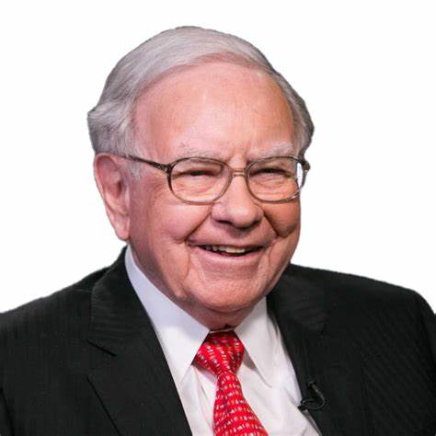
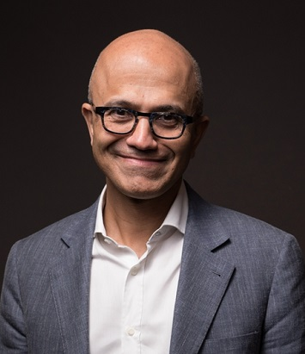
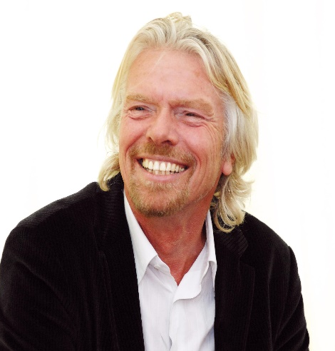
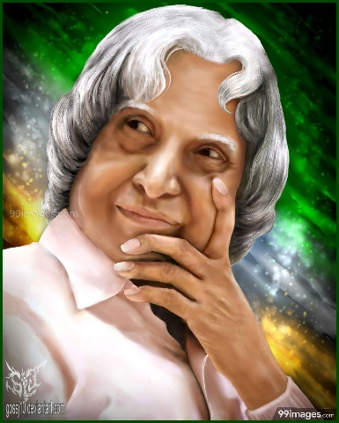
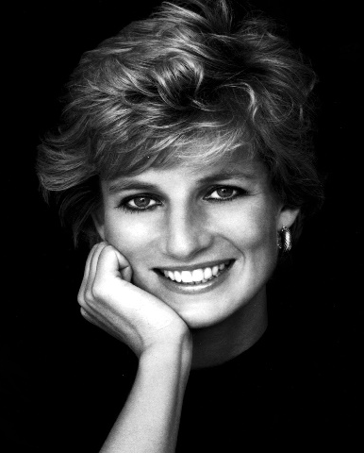
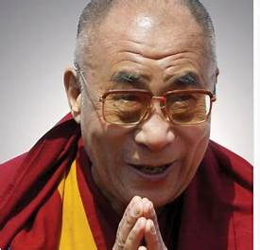
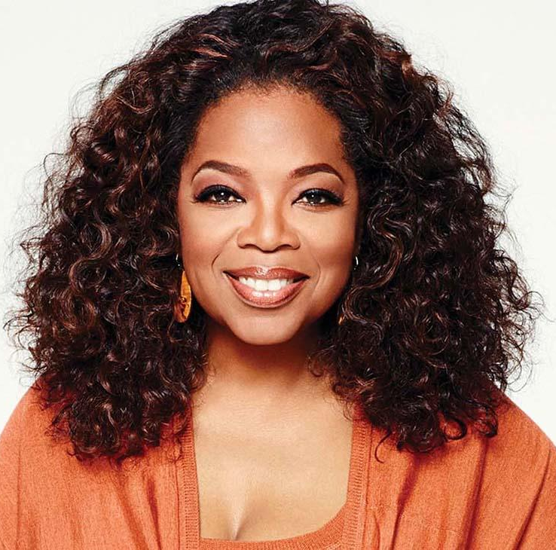
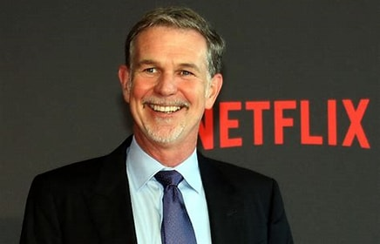

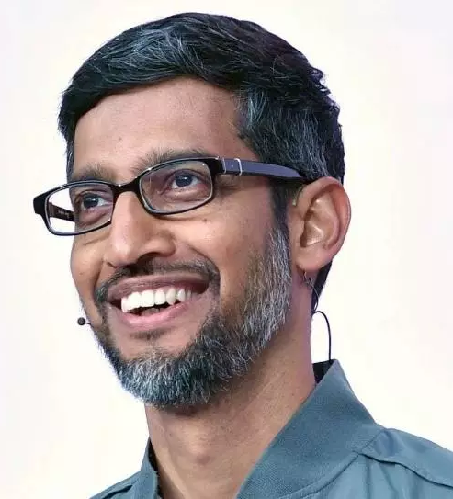
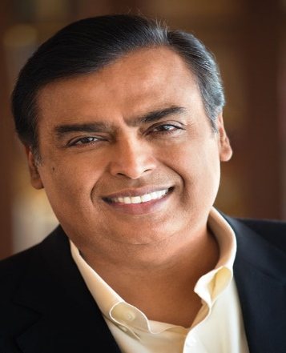
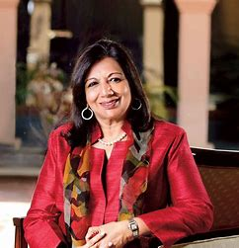
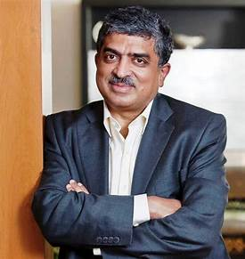
Notes:
Activity:
Identify the famous personalities in the image.
Which companies do they lead?
Elicit responses and acknowledge.
Responses:
Steve Jobs (Apple)
Bill Gates (Microsoft)
Warren Buffet (Berkshire Hathaway)
Satya Nadella (Microsoft)
Richard Branson (Founder of Virgin Group)
Dr APJ Abdul Kalam (Hon. President Of India)
Princess Diana (Princess of Wales)
Dalai Lama (Spiritual leader)
Oprah Winfrey (American talk show host)
Reed Hastings (CEO of Netflix)
Indra Nooyi (CEO of Pepsi)
Sundar Pichai (CEO of Alphabet Inc./Google)
Mukesh Ambani (Chairman of Reliance Industries)
Kiran Mazumdar-Shaw (Founder of Biocon)
Nandan Nilekeni (Chairman of Infosys)
Trainer to ask:
What, do you think, are the similarities between them?
Elicit responses and acknowledge.
Possible responses:
Charisma
Competent
People-centric
Inspiring
Communication
Influential
Confidence
Visionary etc.
Although these people are from different backgrounds, professions, and walks of life, they have a unique ‘presence’.
This “presence” can be witnessed through their conduct and achievements.
Although this presence is often associated with leadership, we arrive at an important question.
Move to the next slide.

Slide 5
Core Elements of Executive Presence
Connections
Persona
Skills
Character
Notes:
Trainer:
Is it always true that people without designation cannot be leaders or executives?
Elicit responses and acknowledge.
Responses may be mixed.
Debrief:
These ‘leaders’ started small – hired as any other employee was.
Some people, even without designation, have the ownership to make positive changes.
Maybe driven by their ambition initially, then developing a vision bigger than themselves, people with such executive presence end up influencing others (knowingly or unknowingly)
You may see such characters in movies as well.
Trainer:
Can you name some movie characters who had such a presence?
Elicit responses and acknowledge.
Possible responses:
Coach Kabir Singh in Chak De India, Harry Potter, Katniss Everdeen from Hunger Games,
Dre from the Karate Kid and so many more…
Debrief:
These characters were memorable also because of their persona or presence.
They may not have been seemingly extraordinary but were heroes at the end of the day.
The definition of executive presence has also evolved.
The external layers that are immediately noticeable are:
How a person communicates, connects with people, or understands people
The personality that a person carries – their appearance, confidence and energy they exude
These are obvious from the way they conduct themselves in an open forum.
However, deep within they have skills and a solid, unshakeable character ethic (as Stephen Covey says).
Putting up an act over decades is impossible for a person.
Some deep-rooted values, ethics and traits drive the person to exude this persona.
Let us look at what form the core elements of “executive presence”
Move to the next slide.

Slide 6
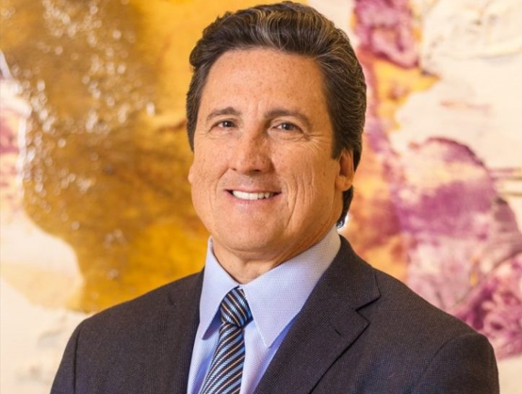
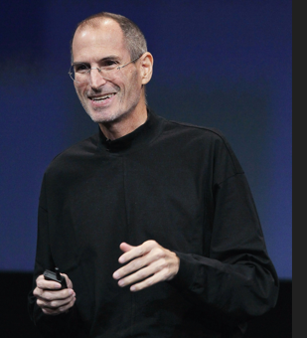
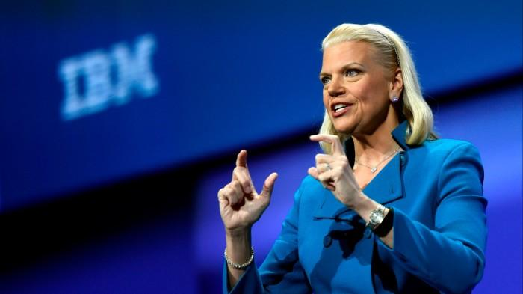
Real-life examples
CEO of MGM Resorts International, Bill Hornbuckle
Apple Co-founder and CEO, Steve Jobs
CEO of IBM from 2012 to 2020, Ginni Rometty
Notes:
Here are some real-life examples of executive presence in leadership:
In 2020 after Covid struck, the CEO of MGM Resorts International, Bill Hornbuckle, introduced a “culture of yes”.
He understood the apprehensions of the customers and the challenges of the staff.
He authorized the staff to say yes to the customers and the managers to say yes to the staff – regardless of any requests they made. This connection and trust he instilled in the staff and the customers made his executive presence more memorable.
2. The CEO of IBM from 2012 to 2020, Ginni Rometty believed in looking beyond the pedigree, while hiring for the company. Many trainable and determined candidates, who had not graduated from the “top colleges” were hired.
This improved the company’s credibility as an employer.
3. The late Apple Co-founder and CEO, Steve Jobs believed in minimalism and authenticity.
Starting from his clothes to his presentations and product launches, every part of his persona reeked of simplicity.
He was always known as a genius and an inspiration.
4. Jørgen Vig Knudstorp took the responsibility of reviving Lego, he was involved with every single team in the company to understand their challenges. He was then able to create goals that were able to pull the company towards profits.
5. Alessandro Manfredi, the Marketing Head of Dove promotes authenticity by redefining the definition of beauty.
6. Google has always encouraged an informal dress code while focusing more on an employee’s talent and skill.
-----------------------------------------------------------------------------------------------------------------------------
How can we assess our own executive presence?
Elicit responses and acknowledge.
Debrief on the next slide.
Move on to the next slide.
--------------------------------------------------------------------------------------------------------------
The trainer can find more examples on the below website.
Source:
https://hbr.org/2024/01/the-new-rules-of-executive-presence

Slide 7

Assessing personal executive presence
Self-awareness
Authenticity
Connections
Continuous improvement
Notes:
Self-awareness – This is the most important aspect of any individual.
We will look at more of how to be more self-aware in the upcoming module.
Self-aware people automatically develop good self-confidence.
Authenticity is the next significant parameter that you must assess in yourself.
Being yourself is quite complex since external demands and pressures may sway our authenticity.
Building and maintaining harmonious connections will help you open up your perspectives, help you engage better, and build credibility.
Continuous improvement through constructive feedback and setting self-improvement goals can help us develop and refine our executive presence.
Although executive presence is quite a personal journey for each of us, the above-mentioned points can help us understand our standing.
What kind of a persona we would like to build and portray is absolutely up to us.
Which values matter to us and are applied effortlessly can be discovered by us over time.
What professional image we would like to build is a choice we can make.
Long story short, executive presence is less about “doing” but more about “being”.
Let us take up an activity to assess ourselves.
Move to the next slide.

Slide 8


Self Assessment Activity
Notes:
Activity: Handout -1
Props needed: Worksheet (one per participant)
Self-assessment activity worksheet
There are no right and wrong answers to the questions.
----------------------------------------------------------------------------------------------------------------
Let us look at the next module on engaging with others through storytelling.
Move to the next slide.

Slide 9

Understanding storytelling
Notes:
Storytelling is the in-thing in the corporate world. (training, leadership, marketing and advertising)
People with executive presence (leaders) don’t give speeches anymore.
They don’t give any advice on what and how people must do things.
Instead, they turn to stories – being indirectly influential or persuasive.
Stories have embedded messages that hit home through resonating thoughts and emotions.
Stories give the listener space and choice to think, feel and then decide whether to act on something.
Having said that, every interesting story has twists and turns.
Remember, every listener will have a question in their mind – “why should I listen to this?”
So the story has to “make sense” to the listener.
Trainer:
Share a story that ‘made sense’ or ‘resonated’ with you.
Elicit responses and acknowledge.
Let us look at the impact that storytelling has.
Move to the next slide.

Slide 10










Activity
Notes:
Activity:
Props needed: None
The trainer must read out the names of the following movies/serials/epics and ask the participants what emotions they evoked.
Chak De India
Swades
Golmaal
Munnbhai MBBS
3 Idiots
Schindler’s List
Forest Gump
Harry Potter
Aladdin/Cinderella
The Conjuring
----------------------------------------------------------------------------------------------------------------
Many participants may not have seen many of these movies.
In such a case, the trainer can ask movies/stories that caused the following emotion:
- Happy
Motivated
Patriotic
Sad
Angry
Scared
Participants can also mention biographies or events that may have made them feel a certain way.
Move to the next slide.

Slide 11
Emotional connection through stories
Happiness
Sadness
Fear
Patriotic
Laughter
Restless
Anger
Curious
Notes:
As we said earlier, emotional connection is the basis of storytelling.
Any emotion evoked is good enough.
Humour is the best in this aspect.
The recall of laughter is the highest.
Evoking empathy for other emotions.
Excitement, curiosity, hope, sadness, and fear may all be evoked in a story.
Some leaders have also used anger (righteous or otherwise), disgust and fear to influence people.
Trainer:
Can you share instances of leaders who have used anger, disgust or fear?
Elicit responses and acknowledge.
Possible responses:
Hitler
Mussolini
Stalin
Let us look at an example of a story.

Slide 12

Stories that inspire and influence
Concise yet evoking curiosity
Realistic
Solution-driven or hopeful
Notes:
Stories that inspire and influence are often real and personal.
Although every story carries the capacity to influence a listener, what matters most is for a listener to know something has been realistically dealt with or achieved.
Qualities of a good story (whether real or creative) are:
Concise yet evoking curiosity – this is for a narrative. Movies and books have the same approach but are filled with other elements to keep us hooked on.
Realistic (in thoughts, emotions, and actions) – Even if the storyline may be imaginary and creative, the emotions and actions must be realistic. Even in stories like Harry Potter, the context is set in a school of magic and within that context, all the events are possible. When trying to influence or persuade, being realistic is a significant parameter.
Solution-driven or hopeful – We are not fond of ambiguity. We like to know what happens next. We prefer closure to events, especially happy ones. At least, the story must evoke hope that things will fall into place.
----------------------------------------------------------------------------------------------------------------------
We may have seen movies that leave us hanging without any closure.
But these are darker themes, rarely used to inspire.
-----------------------------------------------------------------------------------------------------------------------
Let us look at how to create a compelling story.
Move to the next slide.

Slide 13
Key messages and themes
  Hurdles
  Emotions
  Creativity
  Help
  Success
  Learning
  Hope
Problem
Solutions
Outcome
Notes:
Trainer:
Start at the end - What is the change you would like to see in someone?
What is stopping this change from happening becomes the main theme of the story.
Other related messages and details can be embedded once the basic structure is set.
If the issue or challenge is evident, then it becomes the key theme of the story.
The journey from identifying the challenge to solving it to the change you would like to see becomes the entire story.
What secondary challenges a protagonist may face are also key messages.
If the storyteller picks up a familiar scenario or experience and modifies it to the listeners, it may connect better.
This will happen since the narrator will be familiar with what emotions or challenges may be faced in the journey of overcoming the issue – making it more relatable and realistic.
Move to the next slide.

Slide 14
Structuring a compelling narrative
Desired outcome
Main challenge
What would you like to see?
Other hurdles
Why is the outcome not being achieved?
Details
What emotions are adding to hurdles?
What is the context?
How can I create curiosity?
Notes:
Identify the desired outcome
Find the challenge/issue in achieving the outcome.
If you know the challenge, then that becomes the theme.
Put in 2-3 hurdles in achieving the outcome
Add in emotions to these hurdles
Put in details to build curiosity and context.
Weave all these aspects.
Let us understand it from a well-known story “The Thirsty Crow”.
Identify the desired outcome (Drinking water)
Find the challenge/issue in achieving the outcome. (Can’t find water and can’t reach water)
If you know the challenge, then that becomes the theme. (Water too low to reach)
Put in 2-3 hurdles in achieving the outcome (flying all around)
Add in emotions to these hurdles (tired, helpless, irritated maybe)
Put in details to build curiosity and context. (maybe put in other animals or introduce some human element like the crow getting hiccups or feeling dizzy)
Weave all these aspects.
--------------------------------------------------------------------------------------------------------
Now the story that we narrate can be hypothetical (creative) or personal (experiential).
Let us see how our personal stories can be impactful.
Move to the next slide.

Slide 15
Understanding Emotional Intelligence
Self-awareness
Self-management
Understanding others
Managing relationships
Notes:
There are 4 aspects to emotional intelligence – all of them very simple and complex at the same time.
They are:
Self-awareness means knowing ourselves – the great, the good, the bad, the ugly – all of it! Learning about - how we think, what situations, people, or behaviours affect us, and how we act when we feel certain emotions. The best way to manage our thoughts and emotions in our personal and professional lives is to become aware of them.
Self-management is being able to manage ourselves and ensure our reactions are channelled healthily and our reactions are appropriate to the situation. Only when we understand our emotions, we will be able to manage them.
Understanding others – After you are self-aware, you can understand others better - how they feel in certain situations and why they act the way they do. Self-awareness increases the chances of feeling empathy. Since we have experienced something, we understand how situations may affect other people.
Managing relationships – Understanding others now opens up perspectives about how you can communicate, respond, and manage situations with others. With greater empathy, we are able to form genuine connections with others, making relationships stronger.
Emotional intelligence has been the ‘talk of the town’ for more than a decade now.
Being considered a major part of people management and leadership, EI plays a very important role in gaining the credibility, respect and trust of others.
Let us look at self-awareness, which is the starting point for any kind of change within us.
Move to the next slide.

Slide 16
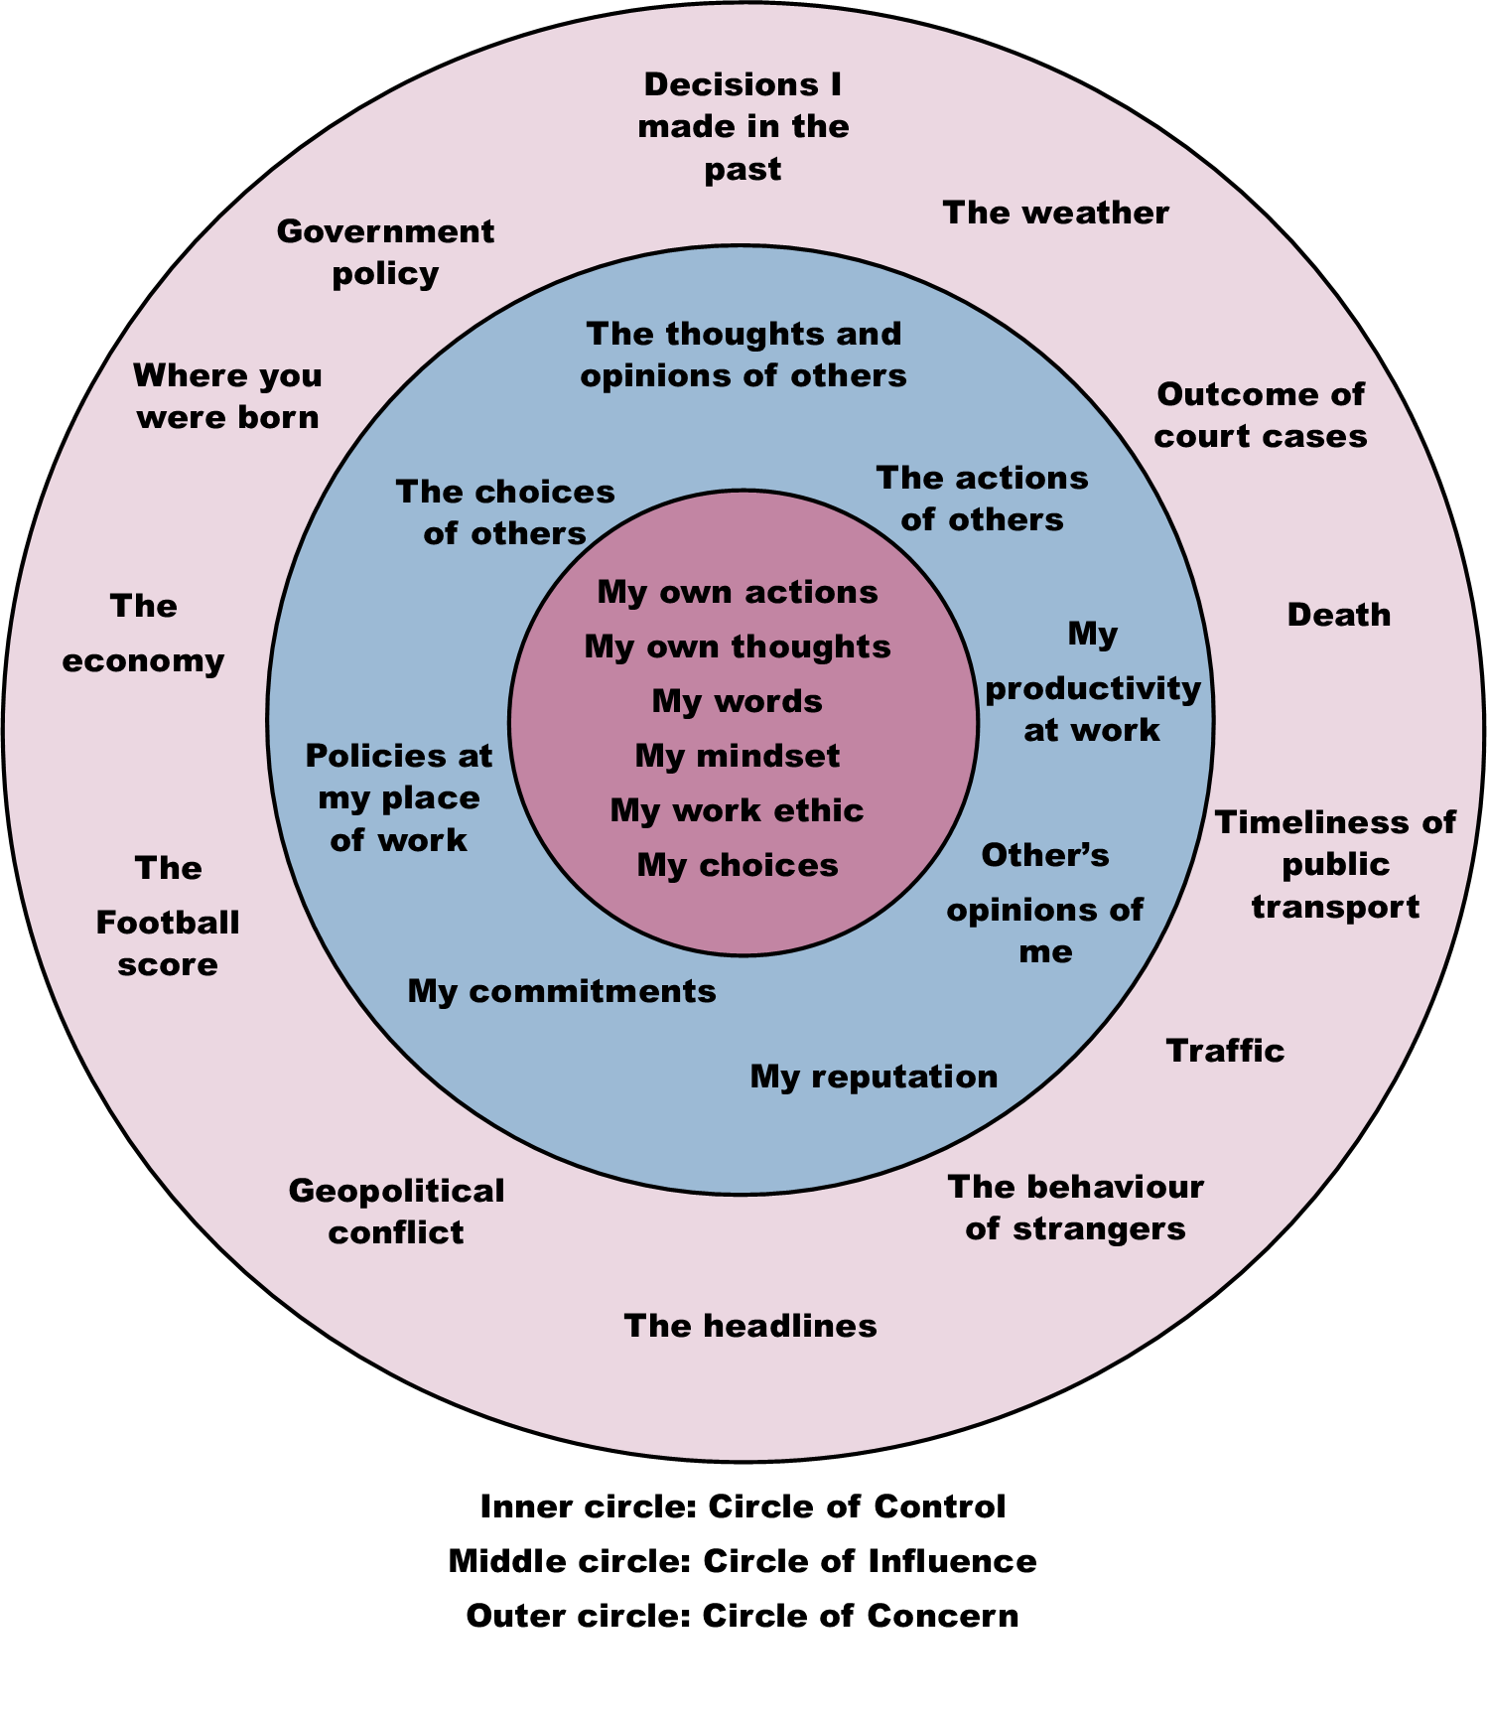
Notes:
Skim through the example.
The more we learn to manage our emotions, we also begin to understand what others may feel.
This is called empathy.
Let us look at how to build empathetic listening skills.
Move to the next slide.

Slide 17

Building empathetic listening skills
Listen to understand
Connect with emotion
Access your memory
Don’t assume
Use the golden rule
Offer help, with consent
Notes:
Trainer:
Communication is the most important life skill.
But consider this: You've spent years learning how to read and write, years learning how to speak. But what about listening? What training or education have you had that enables you to listen so that you really, deeply understand another person?
The ability to hear is a gift. The willingness to listen is a choice.
To interact effectively and influence others, you first need to understand them.
And you can't do that with technique alone.
If the other person senses that you're using some technique, they sense manipulation.
They wonder why you're doing it, and what your motives are and don't feel safe enough to open up.
But listening is a skill learnt over time – a habit to be honed.
Empathy is about connecting with the other person instead of trying to find an appropriate response.
“It must be so difficult to lose (a person, object, opportunity).”
“I can’t imagine the pain you must be feeling.”
“I understand it’s not easy”
How to develop empathy:
Listen to understand
Connect with the underlying feeling and express your perspective
If you have experienced something similar in your past, try to remember what you felt
Don’t assume
Try to imagine what you would like to hear if you were in a similar situation (The Golden Rule is to treat others as you would want to be treated)
Offer help, if possible and if the other person is open to receiving help
As it is said, all of these skills start with an intent – a willingness.
With the clarity of intent, developing skills is quite simple.
Let us look at a very interesting video.
Move to the next slide.

Slide 18
Building the foundations for lasting trust
Competence
Capability
Intent
Integrity
Empathy
Notes:
Trainer:
What do you understand by these 5 terms and can you share some examples of how each of these helps in building trust?
Elicit responses and acknowledge.
Debrief:
Intent – The intent of a person is at the core of establishing trust
Although we may not know or understand a person’s intent, their communication and actions make it evident to us. Honest intentions of a person help us trust them more. Transparent communication will also ascertain this. Even if the person says that they won’t be able to help us, we would find it easy to trust them.
Capability – is whether the person is able to help us? Do they have the resources , the ability and the aptitude to help us?
Competence – is the person skilled enough to help us? How well are they able to help us?
The difference between capability and competence is if they are able to help us and how well they are able to help us.
Integrity in a person helps us trust that they are honest and credible enough to help us or do something for us.
Empathy – helps us understand how well another person understands our situation and how well they connect with our emotion. This alone may not help us trust someone since empathy must lead to action.
The likelihood of trusting empathetic people is higher.
Let us look at how to judge trustworthiness.
Move to the next slide.

Slide 19

Techniques to repair trust
Clarify your intent
Communicate clearly
Be authentic
Keep your grace in place
Notes:
Repairing is always an iffy process.
Things may not be as good as the original – but near original is possible.
However, like the ancient Japanese technique of wabi-sabi, broken things can be mended with gold and the final product will have a beauty of its own.
Likewise with trust.
Broken trust may not be intentional.
Many factors may cause the trust to fray or break.
Repairing trust is a straightforward process but needs a great deal of consistency, patience and intent.
- First and the foremost step is to clear the air (misunderstanding)
If it requires apology and empathy, it should be given liberally.
The skill needed here is clear communication.
The second step is to reiterate intent.
State what you would like in the relationship.
Also, what you would do from your end to keep the relationship?
The third step is simple and complex at the same time.
Be authentic. Live by your commitment.
Communicate openly and regularly.
While all of this is happening, give the other person and yourself time and space to change.
Waiting for things to fall in place GRACEFULLY is an important part of executive presence.
This can also be called composure.
Only by building trust, one will be able to influence others.
Move to the next slide.

Slide 20

Developing influence without legitimate power
Liking
Trust
Recommendations
Need (for solutions)
Notes:
Trainer:
If one can’t use their authority to influence, what do you think can help them?
Elicit responses and acknowledge.
Debrief:
To develop influence without legitimate power, other aspects of a person’s personality and presence come into play.
The obvious reasons why someone will even listen to you to be influenced are:
Liking – Like Robert Cialdini says in the Psychology of Persuasion, If you can get someone to like you, influencing them becomes that much easier. So here is another question.
Trainer:
What makes people like you (anyone)?
Elicit responses and acknowledge.
People may like you for your persona, behaviour, temperament, courtesy, and possibly for appreciating, complimenting or praising them etc.
Trust – If someone trusts you, that is the easiest way to influence others – no questions asked!
Trainer:
What builds trust?
Elicit responses and acknowledge.
We have already seen this - credibility, competence, ability, integrity, benevolence…
References or endorsement – If someone they trust has recommended you or endorsed you, influencing may be easier. References and networking work on this principle.
Need – If there is a problem that you can solve and you can prove your expertise or credibility in offering solutions, you have their buy-in.
------------------------------------------------------------------------------------------
All of these tactics become that much tricky when it comes to influencing difficult people.
Let us look at how we can achieve that?
Move to the next slide.

Slide 21

Avoiding the 4 common persuasion mistakes
Not listening/understanding
Being pushy
Not adapting
Not knowing your value
Notes:
Several influencers may tend to overdo things while getting through to people.
It is important to be mindful and avoid the 4 common persuasion mistakes many influencers make.
Not listening/understanding
Being pushy
Not adapting
Not knowing your value
We know what the result of doing the above is.
The trainer can ask the participants for examples.
----------------------------------------------------------------------
So, how can we evolve to accept all diverse kinds of people?
Move to the next slide.

Slide 22

Charisma in leadership
Vision
Passion
Communication
Authenticity
Emotional intelligence
Notes:
As we have seen charisma plays a big role in leadership and influencing others.
For those of you who are already in leadership positions or those who aspire to be.
Let us understand how to enhance our self-awareness using the five charisma leadership factors.
Vision – Leaders need to have a clear vision. Communication has to be aligned with this vision. This clarity of vision or purpose or goal helps motivate others towards a bigger purpose.
Question to ask yourself –
- What is my vision or purpose or goal?
- What do I want to achieve in the bigger scheme of things?
- How can I contribute towards something bigger than myself?
Passion – As we know, passion is contagious.
Question to ask yourself –
- What do I love doing?
- What do I care about?
- What makes me happy?
- What am I motivated to do?
Communication – We have seen time and again that communication is a huge part of charismatic leadership. This communication also includes listening, empathy, body language, assertiveness, storytelling and so many related skills.
Question to ask yourself –
- Am I confident in my speech and body language?
- Am I able to speak effortlessly in front of a crowd?
- Am I able to communicate my thoughts with passion and conviction?
- Am I able to hold the interest of my listeners?
Authenticity – Being true to yourself and others is a significant trait in leadership.
Question to ask yourself –
- Do I know my strengths and weaknesses?
- Am I able to accept myself and my weaknesses?
- Am I able to walk the talk?
- Am I able to receive feedback and work towards self-improvement?
Emotional intelligence – We know emotional intelligence is necessary to build strong connections with oneself and others.
Question to ask yourself –
- Am I able to manage my emotions?
- Am I able to understand others’ emotions and connect with them?
- Am I able to accept other people’s perspectives?
Let us see how to harness our hidden charisma.
Move to the next slide.

Slide 23





Thank You
98752-08472
Hello@freelancetrainings.com
www.freelancetrainings.com
406, Titanium City Centre Mall, Anand Nagar, Satellite, Ahmedabad-380015

