Slide 1



Resume Writing & Interviewing Skills
Notes:
Facilitator’s Notes:
Say: Hello! And Welcome to 1 –Day workshop on Resume writing & Interviewing skills.
Though resume is one of the most spoken word but most of the challenges that exist are because of lack of proper resume making & poor interviewing skills- Hence this is a very essential component for the workplace performance. How you prepare your resume, customise it to job description, Pre interview preparation., Interviewing etc play a big role in your overall career progression.
This is a highly engaging workshop full of videos, Activities, scenarios, role plays, etc to help your learn by practicing the concepts. So sit back relax and lets start our learning Journey.
Lets move to next slide.

Slide 2
Agenda
Understanding Resume
Job
Descriptions & Resume Customisation
Cover Letters
LinkedIn Profile
Interviewing Skills
& Practice
Group Discussions
Notes:
Trainer to define the agenda of the day

Slide 3

Resume
Formal document summary of an individual's education, work experience, skills, achievements, and other relevant information.
It is typically used when applying for jobs and is one of the essential tools in the job search process.
The primary purpose of a resume is to showcase a candidate's qualifications.
It convince potential employers that they are a strong fit for the position they are applying for.
Notes:
The resume is often the first impression a potential employer has of you, so investing time and effort into creating a professional and compelling document can greatly improve your chances of securing the opportunities you're seeking. A well-structured resume aims to showcase your suitability for a specific position by highlighting your relevant accomplishments, experience, and skills.

Slide 4
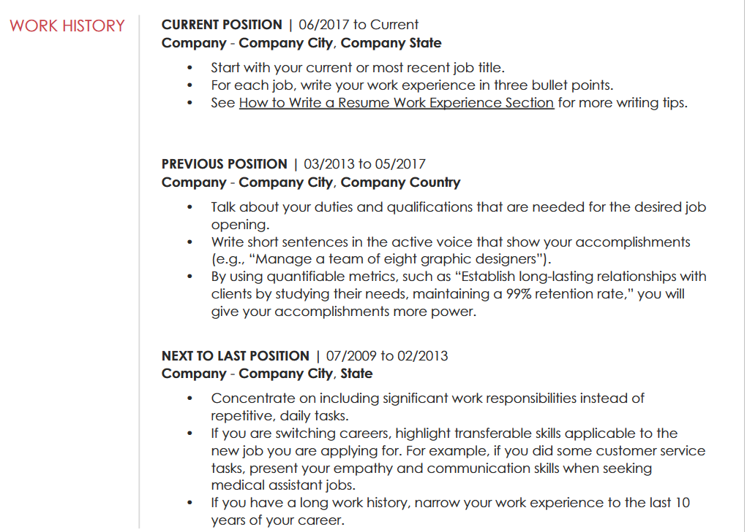


1. Chronological Resume
Chronological Resume: It presents the candidate's work experience in reverse-chronological order, starting with the most recent job and moving backward in time. This format highlights the candidate's career progression and stability and is suitable for candidates with a solid work history and a clear career path.
Easy to follow, preferred by many employers, showcases steady career growth.
May expose gaps in employment history, not ideal for candidates with limited work experience or frequent job changes.
Notes:
1.Chronological Resume: The chronological resume is the most common and widely used format. It presents the candidate's work experience in reverse-chronological order, starting with the most recent job and moving backward in time. This format highlights the candidate's career progression and stability and is suitable for candidates with a solid work history and a clear career path.
Advantages: Easy to follow, preferred by many employers, showcases steady career growth.
Disadvantages: May expose gaps in employment history, not ideal for candidates with limited work experience or frequent job changes.

Slide 5

Resume Layout
Research Industry Norms
Consider Your Career Level
Think About Your Content
Balance Readability and Visual Appeal
Use White Space Effectively
Be Consistent
Search on Internet and You will easily find editable templates for the same.
Notes:
Choosing the right resume layout is essential to present your qualifications, skills, and experiences in a clear and visually appealing manner. The layout you choose should align with your industry, career level, and personal style. Here are some steps to help you choose the best resume layout:
Research Industry Norms: Start by researching common resume formats and layouts in your specific industry. Different industries may have preferred styles, so understanding what is standard can guide your decision.
Consider Your Career Level: The layout of a resume can vary depending on your career level. For example:
For entry-level positions or recent graduates, a simple and clean design with a focus on education and relevant skills might be suitable.
For mid-career professionals, a more comprehensive layout highlighting work experience and accomplishments might be appropriate.
For executives or those with extensive experience, a sophisticated layout with a strong emphasis on achievements and leadership abilities may be preferable.
Think About Your Content: Your resume layout should complement the content you plan to include. Consider the sections you want to showcase (e.g., work experience, education, skills) and how the layout can best organize and present that information.
Balance Readability and Visual Appeal: A well-designed resume strikes a balance between readability and visual appeal. Choose fonts, font sizes, and spacing that are easy to read, and use headings and bullet points to enhance readability. Avoid overly complicated designs that can distract from your content.
Use White Space Effectively: White space (empty spaces on the page) can improve the overall look and readability of your resume. Avoid overcrowding the page and use white space strategically to create a clean and professional appearance.
Be Consistent: Consistency in your resume layout is crucial. Use the same formatting for headings, bullet points, and margins throughout the document. This creates a sense of cohesion and professionalism.
Common resume layouts include: (Chronological, Functional, Combination

Slide 6



Examples
Bachelor of Business Administration (BBA)
University of Commerce, Townsville, USA
Expected Graduation: June 2023
Concentration: Marketing, Management
Associate of Arts in Graphic Design
Community College, Cityville, USA
Graduated: December 2022
Coursework: Digital Illustration, Typography, Branding and Identity
Master of Science in Civil Engineering
State University, Cityville, USA
Graduated: May 2023
Thesis: Sustainable Infrastructure Development
Notes:
Trainer can choose certain examples of their own. While explaining this the trainers can make the participants practice the same as well.

Slide 7

Reviewing
Check for Errors: Review your resume thoroughly to catch any spelling, grammar, or punctuation errors. These mistakes can create a negative impression.
Check Dates and Details: Verify that all dates, names, and contact information are accurate.
Review Order of Sections: Ensure the order of sections is logical and showcases your strongest qualifications first.
Remove Irrelevant Information: Eliminate any irrelevant details that don't contribute to your qualifications or the specific job you're applying for.
Notes:
Check for Errors: Review your resume thoroughly to catch any spelling, grammar, or punctuation errors. These mistakes can create a negative impression.
Check Dates and Details: Verify that all dates, names, and contact information are accurate.
Review Order of Sections: Ensure the order of sections is logical and showcases your strongest qualifications first.
Remove Irrelevant Information: Eliminate any irrelevant details that don't contribute to your qualifications or the specific job you're applying for.
Proofreading:
Take a Break: After formatting and reviewing your resume, take a break before proofreading. It helps you view the document with a fresh perspective.
Read Aloud: Read your resume aloud to identify awkward phrasings or mistakes that might have been missed while reading silently.
Use Spell Checkers: Utilize spell-checking tools or software to catch any spelling errors.
Check Dates and Numbers: Verify all dates, numbers, and contact information for accuracy.
Seek Feedback:
Ask a Friend or Mentor: Have someone you trust review your resume. Fresh eyes can often catch errors or suggest improvements.
Career Services: If available, seek assistance from your college's career services center. They can provide valuable feedback and guidance on resume preparation.
5. Save as PDF:
Once you've made the necessary edits and are satisfied with your resume, save it as a PDF file. PDF ensures that the formatting remains intact across different devices and operating systems.

Slide 8
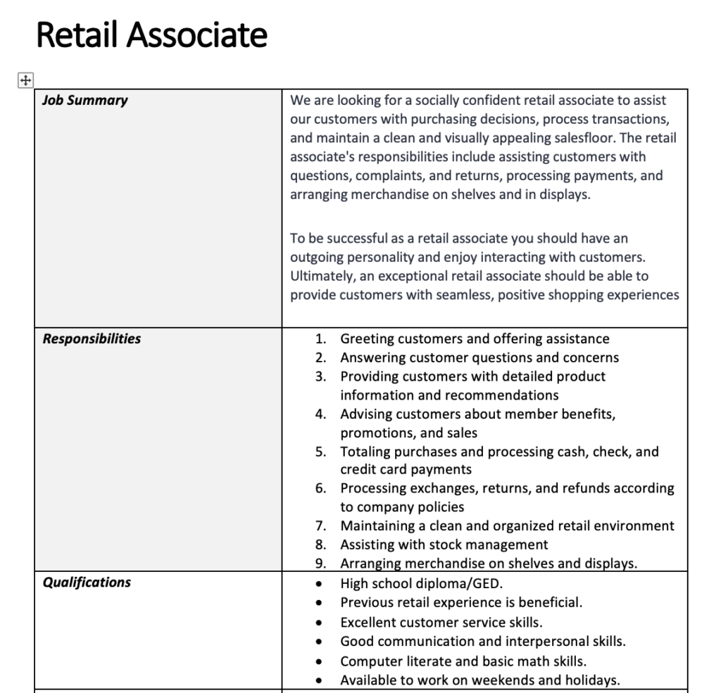
Understanding Job Descriptions
A written document that provides a detailed overview of the responsibilities, tasks, duties, and requirements of a specific job position within an organization.
It serves as a crucial communication tool between employers and potential employees, as it outlines the expectations and qualifications needed to perform the job effectively.
Notes:
A written document that provides a detailed overview of the responsibilities, tasks, duties, and requirements of a specific job position within an organization.
It serves as a crucial communication tool between employers and potential employees, as it outlines the expectations and qualifications needed to perform the job effectively

Slide 9
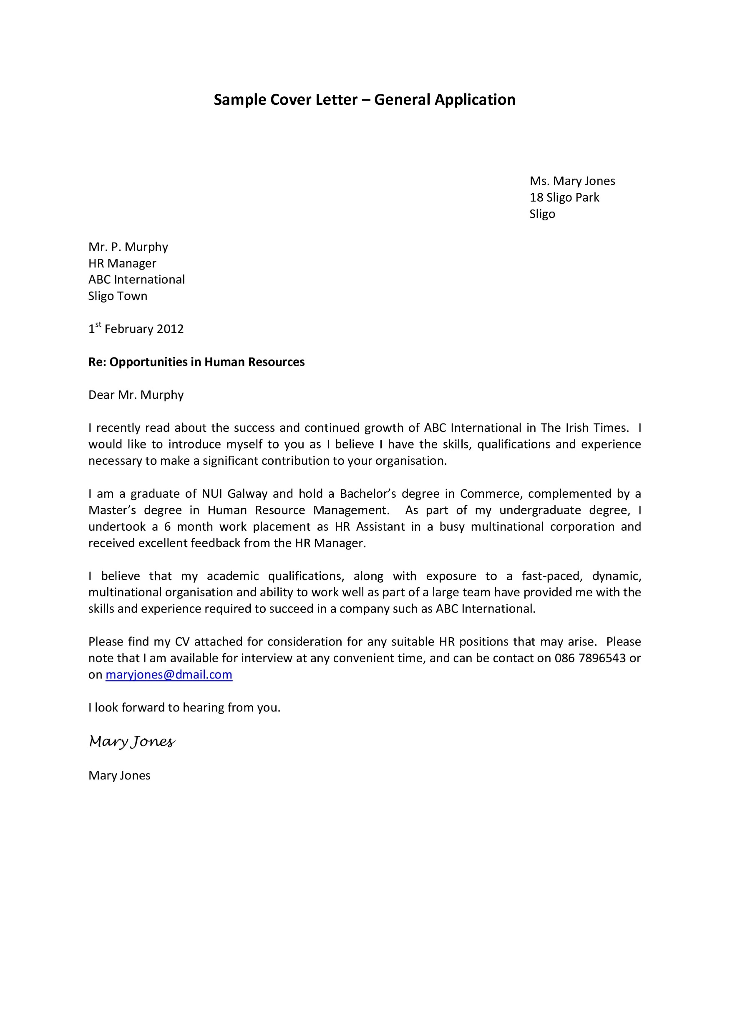
What is a Cover Letter
A cover letter is a formal document submitted alongside your resume when applying for a job or internship.
It provides an opportunity to introduce yourself to the prospective employer, showcase your qualifications, and express your interest in the position.
A well-crafted cover letter complements your resume and allows you to highlight specific experiences, skills, and achievements that make you a strong candidate for the job.
Notes:
What is a cover letter
A cover letter is a formal document submitted alongside your resume when applying for a job or internship.
It provides an opportunity to introduce yourself to the prospective employer, showcase your qualifications, and express your interest in the position.
A well-crafted cover letter complements your resume and allows you to highlight specific experiences, skills, and achievements that make you a strong candidate for the job.
A well-written cover letter can leave a positive impression on potential employers and increase your chances of being called for an interview.

Slide 10

What are Interviewing Skills
Interview skills refer to the set of abilities and behaviors that individuals can develop to perform well during job interviews.
Interview skills are essential in making a positive and lasting impression on the interviewer.
Interview skills increasing the chances of being selected for the job.

Slide 11



Interview Process
During the Interview
Before the Interview
After the Interview

Slide 12



Thanks for Participation
www.creatingimpact.in
406, Titanium City Centre Mall, Anand Nagar, Satellite, Ahmedabad-380015

