Slide 1


Your
Company
Logo
MS Word Workshop-1 Day
Notes:
Welcome to a presentation on Ms Word.
Please note as a Trainer you need to make this more engaging by demonstrating all the points live to your participants as mentioned in the slides
Begin the day with enthusiasm and generating energy and motivation in your teams

Slide 2

Agenda
Sr. No | Modules
Module -1 | The Ribbon
Module -2 | Basic Document Creation & Editing
Module -3 | Advanced Text Formatting
Module -4 | Working with Graphics and Texts
Module 5 | References & Reviews
Module 6 | Charts & Graphs
Module 7 | Mail Merge
Notes:
This is the agenda for 1 day workshop on Ms Word. Trainer can customise the same with their own examples and exercises. Please ensure that you engage the participant with some activity/Quiz/ Practice session to make this very engaging

Slide 3
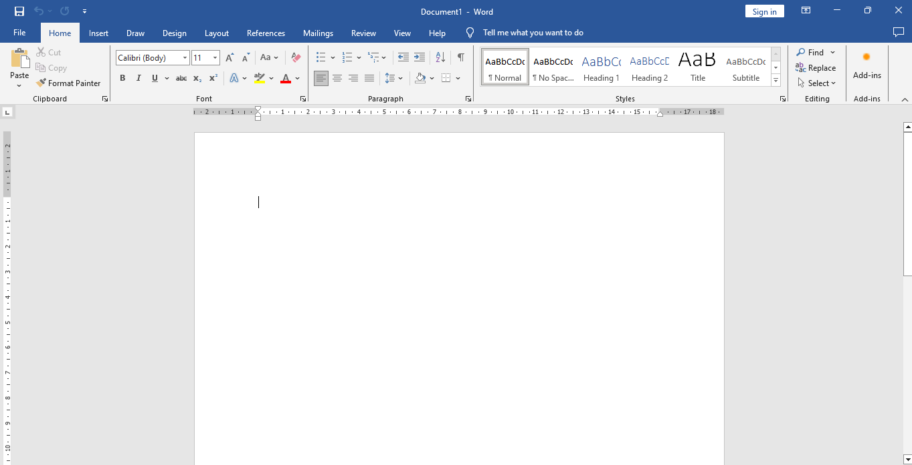

HOME
Most commonly used features for editing and formatting text
Clipboard: Cut, copy, and paste text.
Font: Change font style, size, color, and apply text effects like bold, italics, and underline.
Paragraph: Adjust alignment, line spacing, bullets, and numbering.
Styles: Apply predefined text styles for consistent formatting.
Editing: Find, replace, and select text.
Notes:
Trainer notes-Home tab
Provides the most commonly used features for editing and formatting text.
Key Features:
Clipboard: Cut, copy, and paste text.
Font: Change font style, size, color, and apply text effects like bold, italics, and underline.
Paragraph: Adjust alignment, line spacing, bullets, and numbering.
Styles: Apply predefined text styles for consistent formatting.
Editing: Find, replace, and select text.

Slide 4

Quiz
Under which tab can you find the options to change the font style and size?
Which tab contains the option to insert a table into your document?
Where can you find the options to set the page margins and orientation?
In which tab would you go to add a header or footer to your document?
Notes:
Under which tab can you find the options to change the font style and size?
Answer: Home
Which tab contains the option to insert a table into your document?
Answer: Insert
Where can you find the options to set the page margins and orientation?
Answer: Layout
In which tab would you go to add a header or footer to your document?
Answer: Insert
Which tab contains the option to insert a table into your document?
Answer: Insert
Where can you find the options to set the page margins and orientation?
Answer: Layout
In which tab would you go to add a header or footer to your document?
Answer: Insert

Slide 5
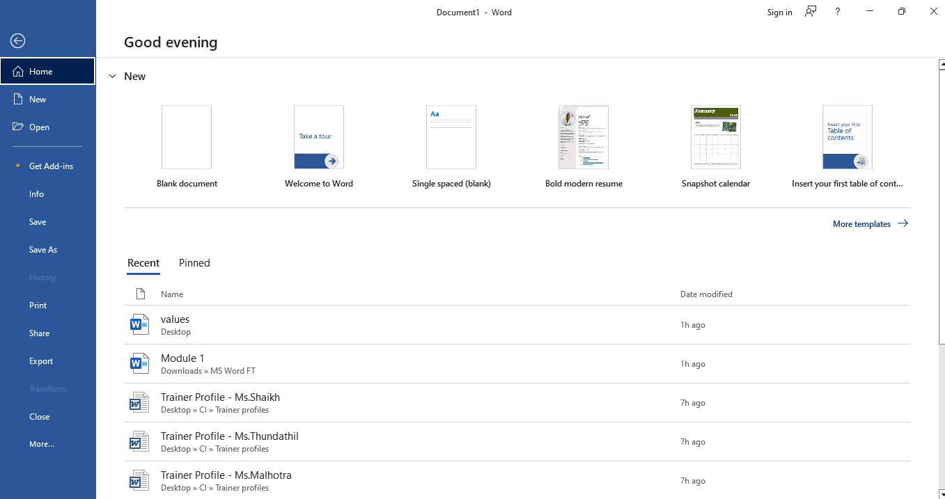

Create a new document.
Open existing documents
Save the document in various formats.
Print the document
Save the document in various formats.
Customize Word settings.
Notes:
Trainer notes-File Tab
Manages the overall document and application settings.
Key Features:
New: Create a new document.
Open: Open existing documents.
Save/Save As: Save the document in various formats.
Print: Print the document.
Options: Customize Word settings.

Slide 6
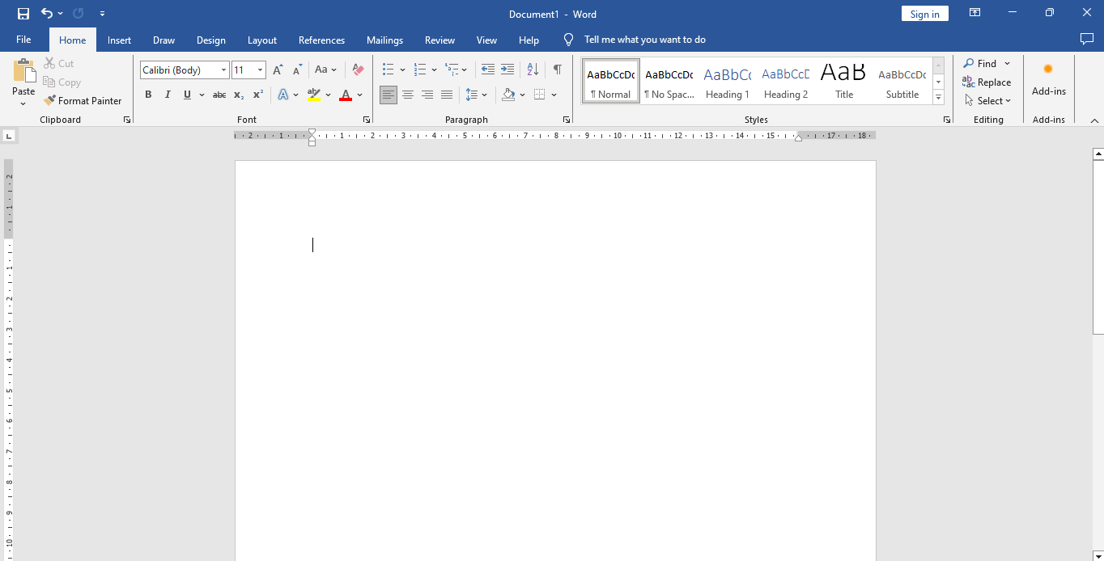
Left Align
Justify
Centre Align
Right Align
By formatting paragraph with alignment option and adjust line spacing and indents using paragraph group
This is left aligned
This is Centre aligned
This is right aligned
This Is Justified. It distributes space equally.
Notes:
4 Paragraph Formatting (alignment, line spacing, indents)-Improve readability by formatting paragraphs. Use the alignment options (left, center, right, justify) in the Home tab. Adjust line spacing and indents through the Paragraph group to control the space between lines and the position of text blocks.

Slide 7
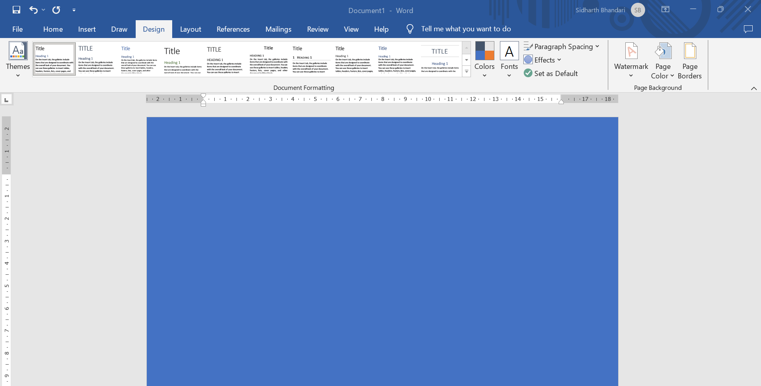

Page Colour
It allows you to choose from a variety of colours or create custom colours to enhance the visual appeal of your document
Go to Design Tab and in the same choose the page colour.
Apply the desired colour and it will be seen like this for your entire document
Notes:
Page Colour-You can change the page color by navigating to the "Design" tab and selecting "Page Color." This feature allows you to choose from a variety of colors or create custom colors to enhance the visual appeal of your document. Applying a page color can make your document stand out, especially in digital formats. However, it's important to consider readability and printability when selecting a background color.

Slide 8
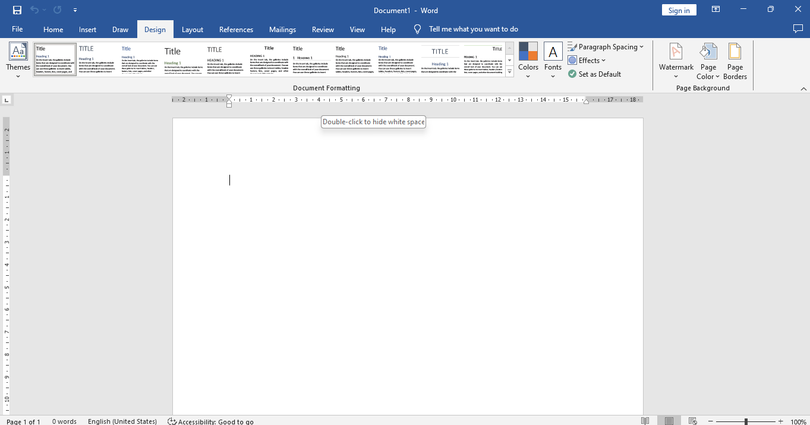

Slide 28
Page Borders
It allow you to add decorative or professional frames around your document pages
Click on Design
In Design Select Page Border
Lets Proceed ahead.
Notes:
Page Borders-Page borders in allow you to add decorative or professional frames around your document pages. They can be customized with various styles, colors, and widths to enhance the visual appeal of your content. You can apply borders to individual pages, sections, or the entire document, and adjust settings like margin distances and art designs. This feature is useful for creating standout reports, invitations, and certificates.

Slide 9
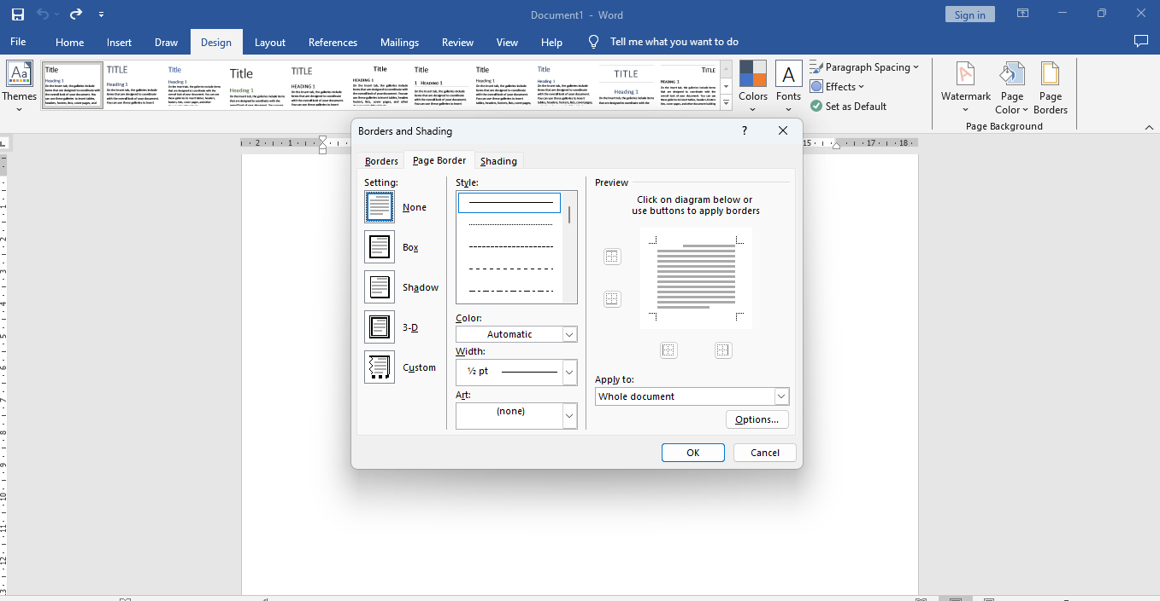
Choose the Border Style from drop down list
Border Preview Pane
Page border when selected opens a Borders and Shading window
Border line width
Whether you want to apply the same to whole document or a selected page only
Choose the Border Color from Drop down list
After making the selections and click ok
Notes:
Self Explanatory on Slides

Slide 10

Group Activity
Team members needs to work together on this activity
Prepare a document having black page background and white page borders mentioning 1 paragraph about the group strength.
All paragraph lines needs to be in Bold and font size to be 18 and font style to be Verdana

Slide 11
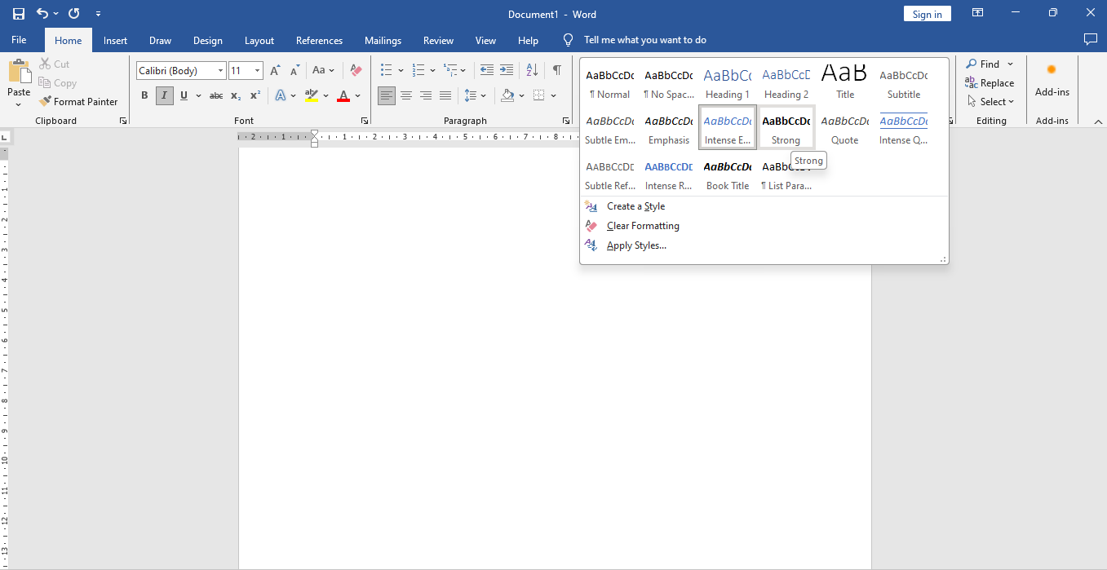


Click on home tab option
By selecting style from home tab option you can change look of your content
Select style option of your choice for example strong and you write or change document in the format style
After selecting strong option in style font style of “Word Presentation “ is formatted.
Notes:
Style-Styles and themes in Microsoft Word enable users to maintain consistency and professionalism across documents. By using predefined styles, users can quickly format headings, paragraphs, and lists.

Slide 12


Sample
Notes:
Self Explanatory on Slides

Slide 13
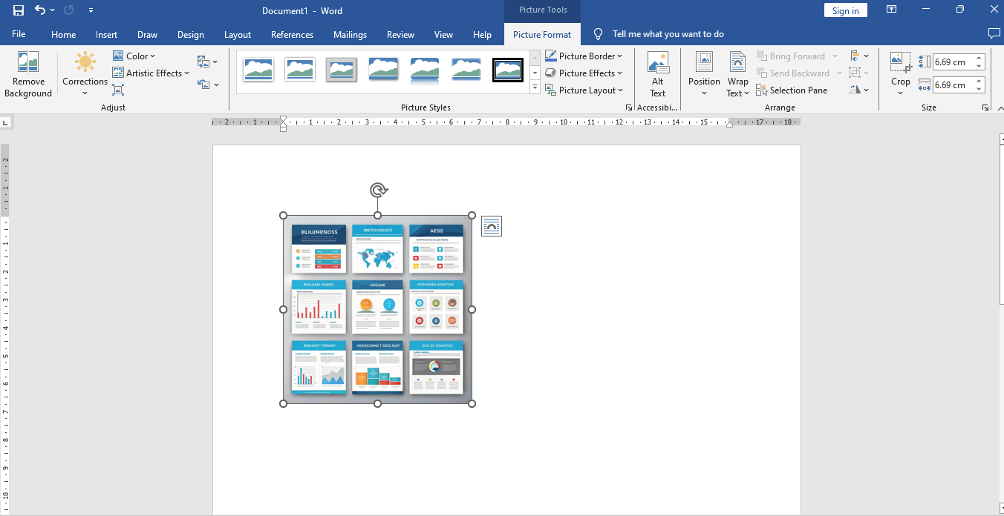
Formatting a Picture
When image is place & you click on it so picture tab is open
Click on the picture that you want to format and Picture format box will be highlighted
It ensure that text flows smoothly around graphics and objects

Slide 14
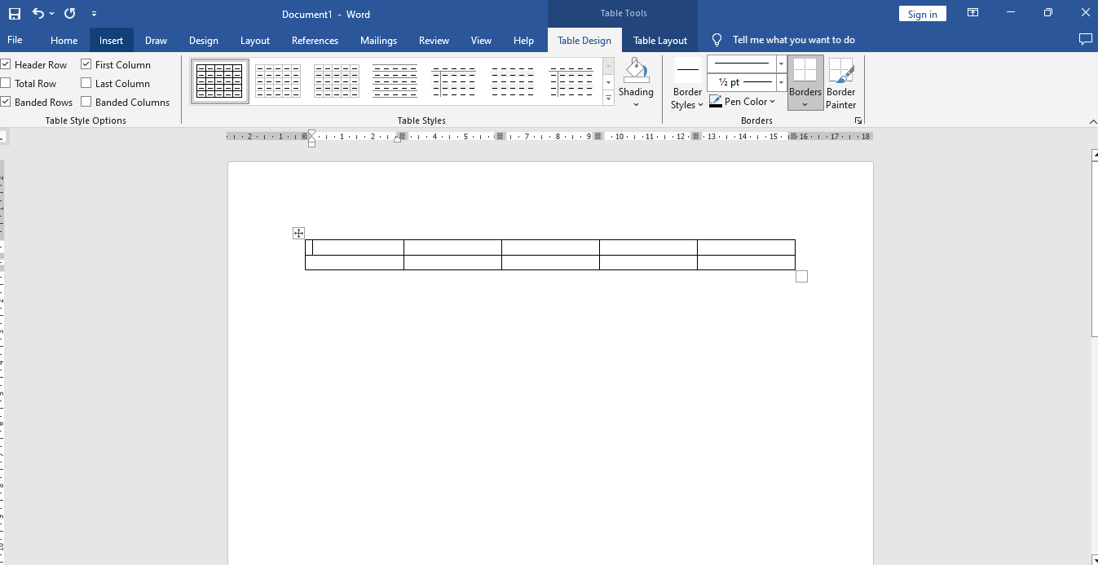
You can choose the predesigned table option or create a customized one
Notes:
Self Explanatory on Slides

Slide 15
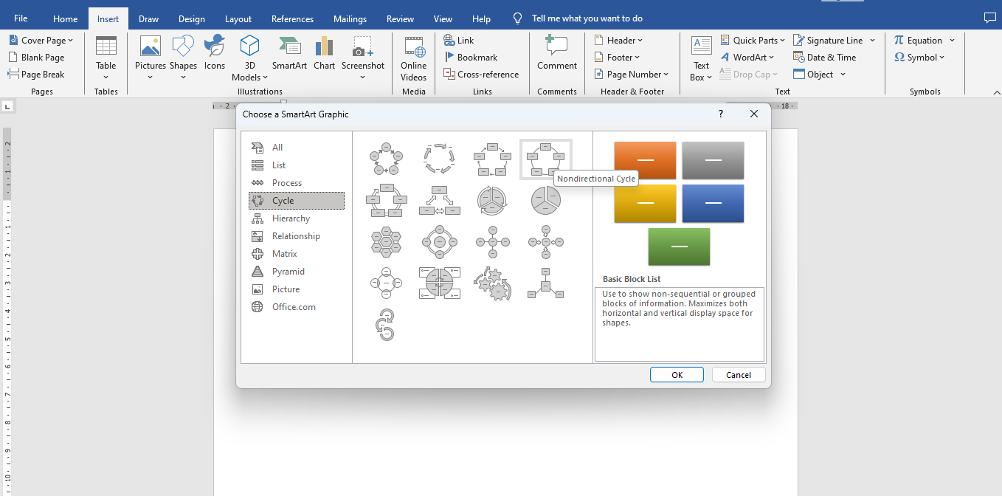
Inserting SMART Art
Click on Insert
Choose smart Art Graphic from options
You can choose the predesigned smart and can customized the same
Notes:
Smart Art-It is a feature that allows users to create visual representations of information. It includes a variety of graphics, such as lists, processes, cycles, hierarchies, and more, which can enhance the presentation and understanding of data. Users can customize SmartArt by adding text, changing colors, and adjusting layouts to fit their document's needs. This tool helps make complex information more accessible and engaging.

Slide 16
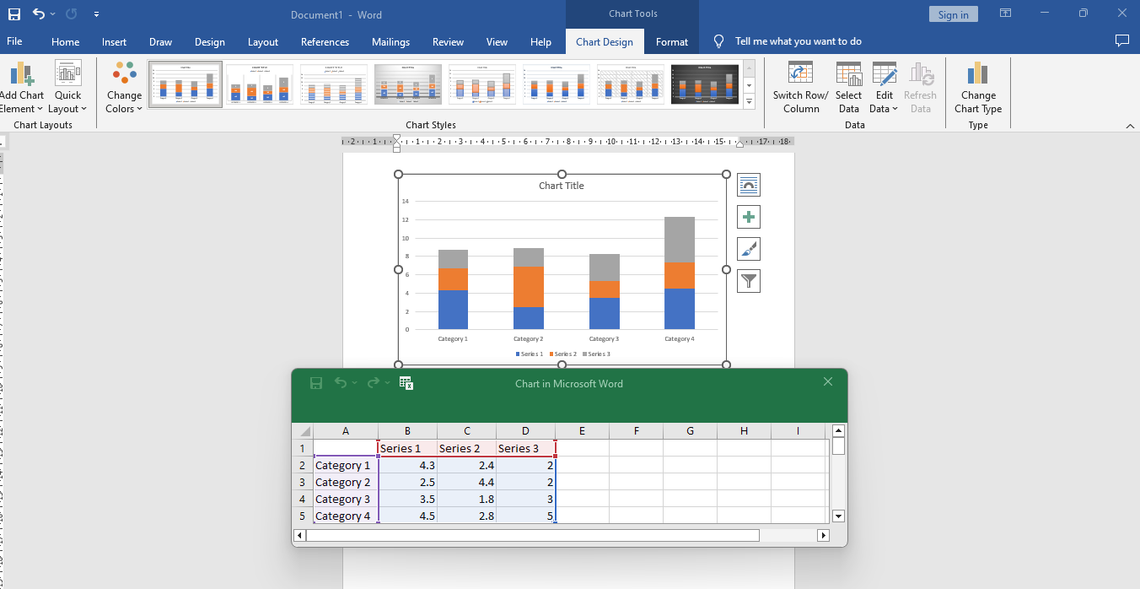
Step-3
You can always customize the same by double click on the chart
Selected Chart will appear and a data Box will open
Fill the data details and this will help you to customize your charts
Once you fill the details and close the excel sheet your chart will appear on scree
Notes:
Self Explanatory on Slides

Slide 17
Practice Activity
Make a Line chart for the following data
Sr.No | Month | Temperature
1 | June | 44
2 | July | 45
3 | August | 38
4 | September | 30
5 | October | 27
6 | November | 18
7 | December | 12
Notes:
This is a practice activity for the participants. Trainer is free to provide his/her own data for this activity

Slide 18






98752-08472
Hello@freelancetrainings.com
www.freelancetrainings.com
406, Titanium City Centre Mall, Anand Nagar, Satellite, Ahmedabad-380015

