Slide 1

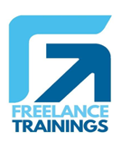
Interpersonal Skills Workshop-2 Days
Your
Company
Logo
Notes:
Trainer- Good Morning participants
Participants need to respond with extra enthusiasm
Welcome to this highly anticipated and energizing workshop on interpersonal skills! Today, we embark on a transformative journey together, where we will unlock the immense potential within ourselves to build strong, meaningful connections with others. This workshop is not just about learning techniques; it's about igniting the fire of motivation within each of us, propelling us to become more influential communicators and empathetic individuals. As we dive into the world of interpersonal skills, we will explore the art of active listening, the power of effective communication, and the magic of building trust and rapport.
Are you ready to sharpen your Interpersonal skills. Get a loud yes from the participants

Slide 2





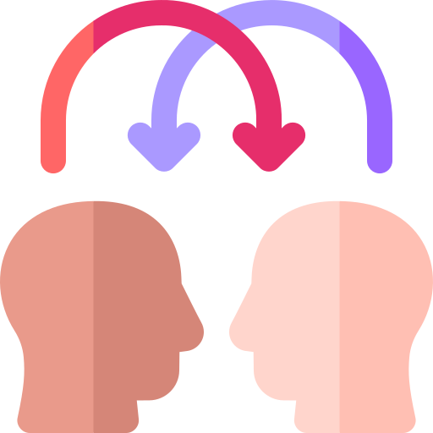

Workshop Agenda Day 1
Team Communication
Impactful
Communication
Emotional
Intelligence
Building
Rapport
Personality
Styles
Developing
Empathy
Understanding Interpersonal Skills
Notes:
Welcome to the Interpersonal skills Workshop. Are you excited for today`s workshop? let me introduce todays workshop modules.
Understanding Interpersonal Skills
Different Personality styles and how to identify them
Emotional Intelligence
Impactful Communication
Building Rapport
Developing Empathy & Active Listening
Move to Next Slide

Slide 3





Workshop Agenda –Day 2
Team Communication
Making First Great Impressions
Non Verbal communication
Vocal
Communication
Collaboration
Skills
Interpersonal
conflict
Understanding Interpersonal Skills
Notes:
Welcome to the Interpersonal skills Workshop. Are you excited for today`s workshop? let me introduce todays workshop modules.
Being Team Player Collaboration Skills
Mastering Non Verbal Communication
Making First Great Impressions
Vocal Communication
Dealing with Interpersonal conflict
Tips on Interpersonal Skills
Move to Next Slide

Slide 4
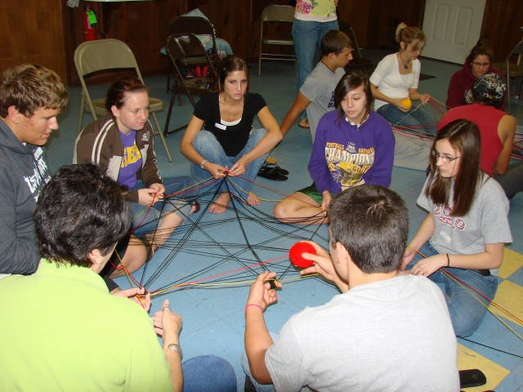
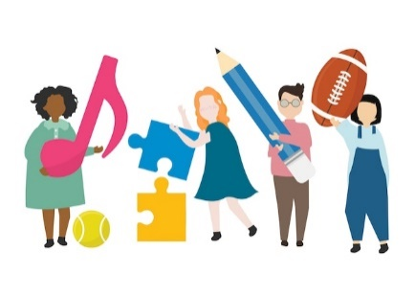
Activity- Unwind
Module-1
Understanding Interpersonal Skills
Notes:
LET’S Unwind Objective To demonstrate the interdependency of individuals in an organization and hence the importance of great interpersonal skills.
Resources
A Big Ball of wool/Ball of String Procedure This activity involves all the participants in the class to stand in a circle.
The first person is given a ball of string and is asked to hold one end of the thread and then throw the ball to any person who he /she feels like throwing to. The next person. Likewise, needs to hold a part of the string and throw the ball to anybody from the circle.
The process continues till the ball of string / wool has been passed on to every person in the circle. At the end of the activity; every person needs to have held a small part of the long string.
The participants are asked to detangle the string such that a free flowing string passes from one participant to the one standing next to him.
Discussion Questions Even with the independent nature of our jobs, most of us still need others why?
Can you think of any cases where we operate totally without support?
Debrief:
We are part of an organization. The success of our work will largely depend also on the support that we receive from our colleagues, peers, inter-departmental staff etc.. This is the reason that having good interpersonal skills is important. The rest we will see through the course of the day.

Slide 5

What is Interpersonal Effectiveness
The ability to understand, communicate and interact with other people in a way that leads
to productive working relationships and
enables the achievement of desired outcomes
for you, your team and the organization.
Notes:
Interpersonal effectiveness refers to the ability to communicate and interact with others in a way that is respectful, assertive, and responsive to the needs of both oneself and others. It involves the skills of effective listening, expressing oneself clearly and assertively, understanding and respecting others' perspectives, negotiating conflicts, and managing emotions in relationships.

Slide 6

Importance of Interpersonal skills for Organisations
People drive business and hence whatever impacts people will ultimately impact the business results. (Enhanced Sales, Customer Delight)
Better interpersonal relationships lead to more motivated and productive employees. (Employee engagement)
Effective interpersonal relationships are directly related to achievement of results and a positive culture (Organizational efficiency)
Notes:
The slide is self explanatory

Slide 7
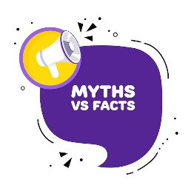
Myths about Interpersonal Skills
People have to always agree with one another.
I Always need to say Yes.
II like everyone and everyone likes me.
I should sacrifice my needs for those of others.
Being with people all the time.
I should have a lot of friends.
Notes:
People have to always agree with one another. No, interpersonal effectiveness does not mean that people have to always agree with one another. In fact, interpersonal effectiveness involves being able to communicate effectively and respectfully with others, even when there are disagreements or differences of opinion. It is about finding ways to express one's own thoughts and feelings in a clear and assertive way, while also listening actively to others and understanding their perspectives.
I Always need to say Yes. No, you do not always need to say yes. In fact, it is important to be able to say no when necessary in order to maintain healthy boundaries and prioritize your own needs and responsibilities. Saying yes all the time can lead to burnout, resentment, and a lack of respect from others, as it may communicate that your time and resources are not valuable.
I like everyone and everyone likes me. : Interpersonal effectiveness does not mean having a mutual admiration society. It is not possible for us to like everyone we interact or work with. However it is important for us to be able to maintain a professional working relationship with people.
I should sacrifice my needs for those of others.: While it is important to be considerate and empathetic towards others, it is not healthy or sustainable to sacrifice your own needs and well-being for the sake of others. Neglecting your own needs and prioritizing the needs of others all the time can lead to burnout, resentment, and a lack of respect from others. It is important to strike a balance between meeting your own needs and taking care of others. This means recognizing your own limits and boundaries, being assertive about your own needs and priorities, and communicating your needs clearly and respectfully to others.
Being with people all the time. Having good relationships with people is not directly proportional with the frequency of time spent but with the quality of interaction. You do not need to occupy the mind of another at all times to be important to them. But the kind of interaction that you have and the outcome of that interaction is what will define the effectiveness of the relationship.
I should have a lot of friends. Interpersonal effectiveness is not limited to friendship. It goes beyond that. It is the ability to interact with others in such a way that you are able to achieve your desired outcomes. It is true that people who are very effective in their relationships are likely to have more friends. But having fewer friends does not mean that you are any less effective.

Slide 8

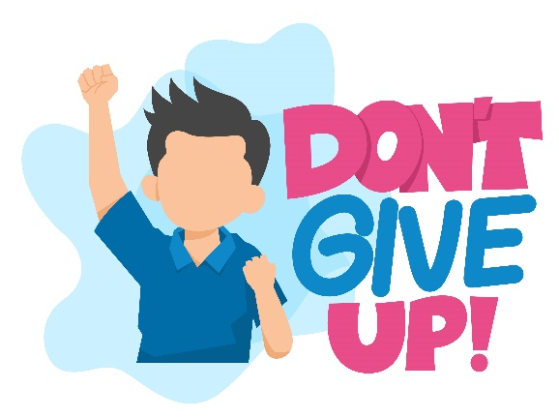


Building a Charismatic Personality
Positive Attitude
Effective Communication
Creating Strong First Impression
Building a Charismatic Personality includes developing Positive Attitude, impactful Communication and Great First Impression with others).
Notes:
Developing a charismatic personality can indeed be a key component in enhancing interpersonal skills and fostering effective workplace communication and professional relations. Charisma is a combination of various qualities that can attract and influence others positively. Here are some aspects to consider when aiming to cultivate a charismatic personality:
Positive Attitude: Maintaining a positive outlook and radiating optimism can create an uplifting and inviting atmosphere, encouraging better interactions with colleagues and clients
Impactful Communication : Being articulate, concise, and persuasive in your communication can capture people's attention and convey your ideas more effectively.
Building Great first Impression with others : Non-verbal cues, such as maintaining eye contact, using open gestures, and mirroring others, can convey confidence and build rapport.
The trainer should drive the discussion towards importance of attitude, positive communication, body language.

Slide 9
DISC Model
Dominance
Influence
Steadiness
Compliance
Direct, decisive, independent and to the point. Bottom line and results oriented. Often strong-willed, enjoys challenges and immediate results
Optimistic, social and outgoing, Enjoys being on teams, sharing openly, entertaining and motivating others.
Cautious and concerned. Focused on what is "correct“ Plans ahead and concerned about accuracy
Team players, cooperative and supportive of others, Prefers being in the background, working in a stable environment. Often good listeners and to prefers to avoid conflict and change.
Notes:
Trainer: DISC Model will help us to understand the various personalities and once we know it then it becomes difficult to deal with them.
The DiSC model is a tool used to understand various personality and behavioral style. DiSC is an acronym that stands for the four main personality profiles described in the DiSC model: (D)ominance, (i)nfluence, (S)teadiness and (C)onscientiousness. This will help you identify the major personality styles and how to build productive relations with them.
Trainer to Debrief Every Style with their unique characteristics
Driver/ Dominance/ Winner
D styles are motivated by winning, competition, and success. They prioritize taking action, accepting challenges, and achieving results and are often described as direct and demanding, strong-willed, driven, and determined. D styles tend to be outspoken, but can be rather skeptical and questioning of others.
Fears: being seen as vulnerable or being taken advantage of, Values: competency, action, concrete results, personal freedom, and challenges, Overuses: the need to win, resulting in win/lose situations, Influences others by: assertiveness, insistence, competition, In conflict: speaks up about problems; looks to even the score, Could improve effectiveness through: patience, empathy DiSC Classic patterns: Developer, Result-Oriented, Inspirational, Creative
Influence/ Enthusiast
i styles are motivated by social recognition, group activities, and relationships. They prioritize taking action, collaboration, and expressing enthusiasm and are often described as warm, trusting, optimistic, magnetic, enthusiastic, and convincing.
Fears: loss of influence, disapproval, being ignored, rejection,Values: coaching and counseling, freedom of expression, democratic relationships, Overuses: optimism, praise, Influences others through: charm, optimism, energy, In conflict: expresses feelings, gossips,Could improve effectiveness through: being more objective, following through on tasks, DiSC Classic patterns: Promoter, Persuader, Counselor, Appraiser
Steadiness/ Peacemaker
S styles are motivated by cooperation, opportunities to help, and sincere appreciation. They prioritize giving support, collaborating, and maintaining stability and are often described as calm, patient, predictable, deliberate, stable, and consistent.
Fears: change, loss of stability, offending others, letting people down, Values: loyalty, helping others, security, Overuses: modesty, passive resistance, compromise, Influences others by: accommodation, consistent performance, In conflict: listens to others’ perspectives; keeps their own needs to themselves, Could improve effectiveness through: displaying more self-confidence, revealing their true feelings
Compliance/ Analyst
C styles are motivated by opportunities to gain knowledge, show their expertise, and produce quality work. They prioritize ensuring accuracy, maintaining stability, and challenging assumptions. They are often described as careful, analytical, systematic, diplomatic, accurate, and tactful.
Fears: criticism and being wrong; strong displays of emotion, Values: quality and accuracy, Overuses: analysis, restraint, Influences others by: logic, exacting standards, In conflict: focuses on logic and objectivity; overpowers with facts, Could improve effectiveness through: acknowledging others’ feelings; looking beyond data

Slide 10
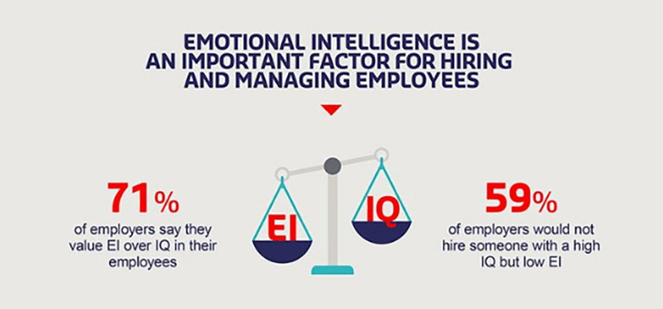
Advantages of EI VS IQ
Source Time Jobs

Slide 11
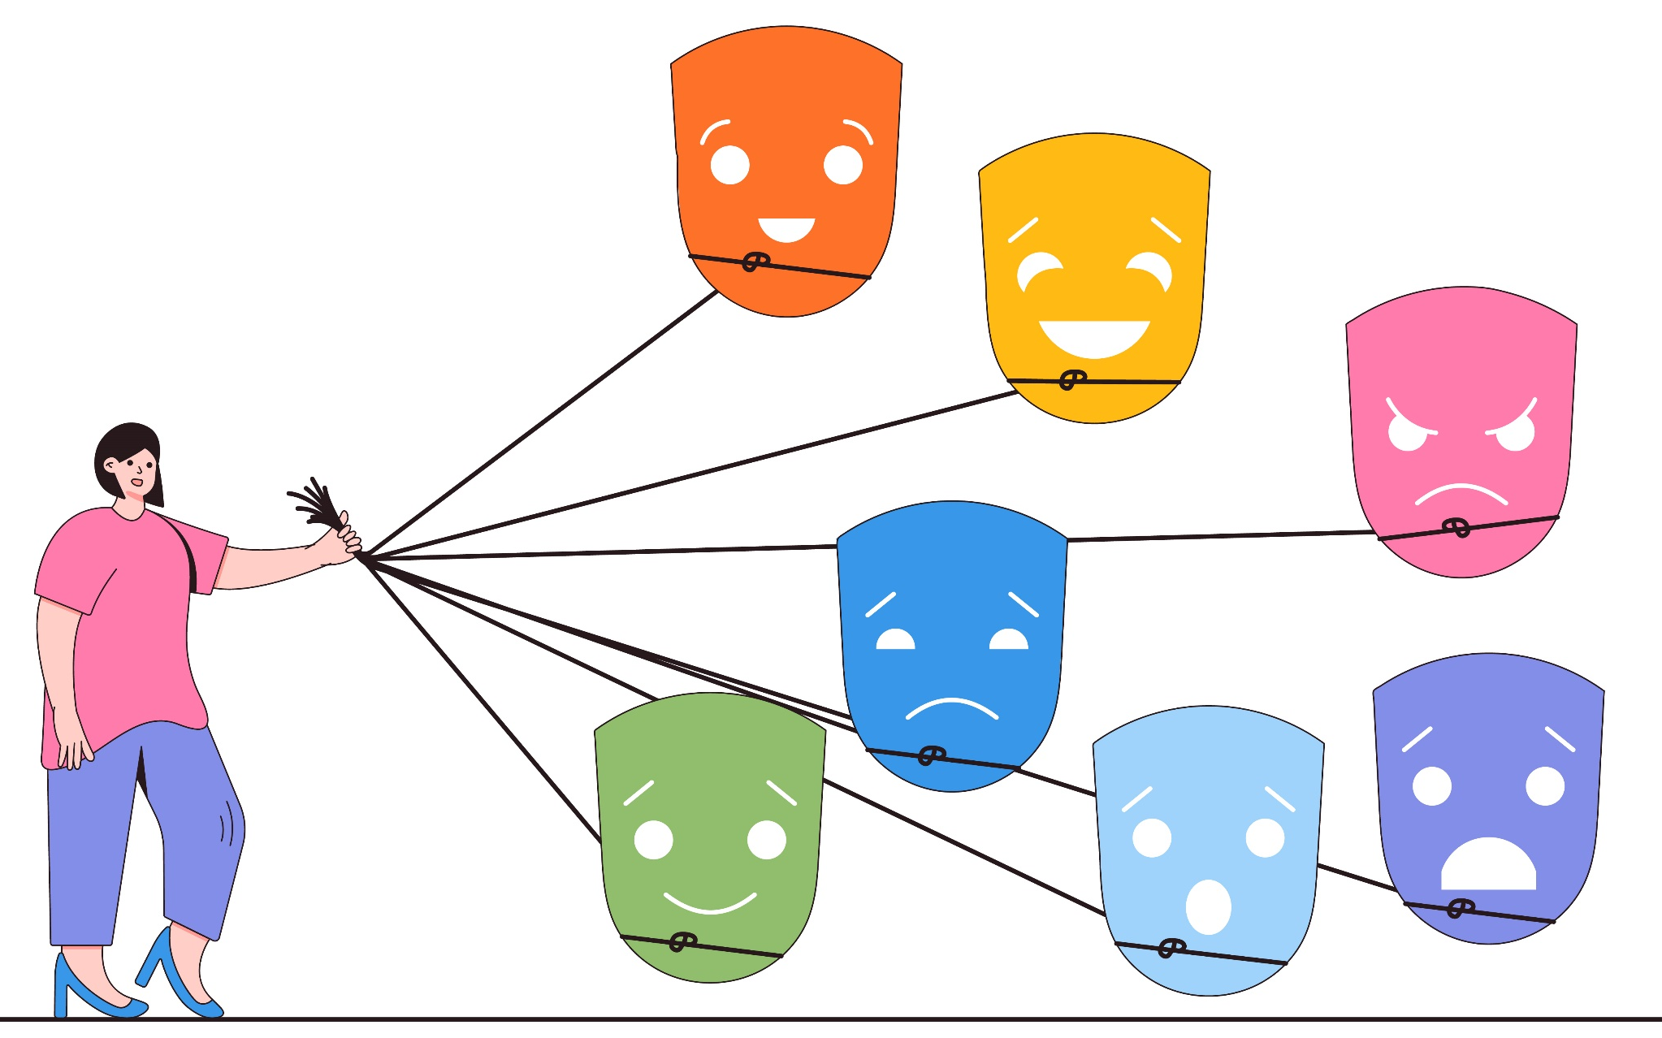
Self-Awareness enhances Emotional Control
Notes:
Trainer talk about the benefits of being self aware.
When you enhance your self-awareness, it allows you to better understand your emotions and reactions. Individuals with strengths in this area are:
Aware of their own emotional reactions
Skilled at differentiating among a range of emotional states
Mindful of how they’re feeling at any given time
Comfortable with appropriately expressing a range of emotions in various personal and workplace settings
Able to understand the functions served by negative or challenging emotions
Able to pinpoint the causes of their reactions
Able to avoid personalizing others’ reactions
Aware of how their reactions impact others
Able to anticipate how their behaviour and reactions impact others
Supportive of others who may be nervous or apprehensive when it comes to expressing their emotional states

Slide 12
Circle of Concern and Circle of Influence
Circle of concern
Circumstances/Issues/ Problems
Over which we have No control- Also
known as No control Zone
Circle of influence
Circle of control
Circumstances/Issues/ Problems
Over which we have a indirect control
Invest your time, Energy
& Emotions Here
Circumstances/Issues/ Problems
Over which we have a direct control
Invest your time, Energy
& Emotions Here
Notes:
The Circle of Influence, Concern, and Control is a concept popularized by Stephen Covey in his book "The 7 Habits of Highly Effective People." It represents three different areas that encompass the issues and aspects of life that individuals may encounter:
Emotional Intelligent people because they are more self aware they work on the things they can influence, change themselves and don’t stress on the concerns which are beyond their control. Its important to see how we can increase the circle of influence time to time and do our best to drive things better.
Trainer to explain these 3 circles very clearly

Slide 13
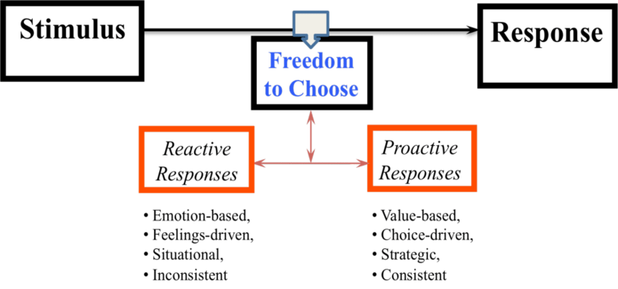
Notes:
Learning from Circle of Control, Influence & Concern. Once you become aware of your emotional reactions now you will have the freedome to choose whether to be reactive or proactive and thus leading to better interpersonal relations.
Trainer to share relevant examples

Slide 14

Build rapport like a boss!
Subject matter expertise
Name Game
‘Same-here‘ moments
First Impressions
Happy Face
Go the extra mile when you can
Small talk like a champ
Notes:
Subject Matter Expertise – You can build limited rapport with your customers if you don’t have accurate and thorough knowledge of your products and services. A sales professional needs to be a good conversationalist but without the knowledge of the products, a sale that is beneficial to the customer cannot be made. You may not be a flamboyant Speaker but if you have subject matter expertise you can provide great consultation to the customer that can win you both repeat business and referrals.
Use their name – When you use their name (or title like Sir/Ma’am) you automatically personalize the conversation. People inherently feel included and important. But do not overdo it!
Same here moments – Discover same-here moments with the customer. It could be anything that the customer and you have something in common to bond over–
Same hobby
Place you live
IPL team you favour
Your school
‘Me-too’ moments help create better bond and likeability between people.
First impressions matter – First impressions are made by people basis their personal perceptions about life. Some things you can control, some others you can’t (such as your face or personality reminds them of someone they dislike. What are the things you can control to increase your likeability factors?
Your dapper dressing and fashion sense)
Body Language and Tonality
Your grooming and hygiene
Prowess on your language
Self-confidence
Positive attitude
We will discuss this in detail in the Module on Body language and Tone of Voice
DiSplay being visibly happy – Every customer likes to feel welcomed. A positive and happy demeanor Speaks volumes of how hoSpitable you are and how inclusive you are in helping the customer with their financial objectives.
DiSplay your intention to go the extra mile to help – The difference between a good and a great sales professional is the ability to offer excellent customer service. Effective sales professionals realize this and build rapport by going the extra mile to service customers from time to time depending on the situation.
Make small talk – Small talk is not just about talking about the weather or the cricket matches. People think that small talks are conversation fillers that can be insignificant which is far from true. Small talk is an art. To make great small talk you need to:
Be interested in your customer’s world.
Make a mental note of the things that might be helpful or of interest to them
Take an interest in knowing about current affairs, Sports, economy, etc. Basically the more you know the better conversations you can hold.
Interestingly, there will be times when small talk will back fire. So you must know when to avoid it. Let’s look at what all the avoid while building a good rapport.
Transition to the next slide.

Slide 15

Things to avoid in Rapport Building
Being insincere
Interrupting
Over-sharing
Being too familiar
Making assumptions
Notes:
While building rapport with customers is an important aSpect of establishing a positive relationship, there are also some things that should be avoided. Here are some things to avoid when building rapport with customers:
Being insincere: Customers can usually tell when someone is being insincere, and it can damage the relationship. Avoid using insincere flattery or pretending to share interests that you don't actually have.
Interrupting: Interrupting customers can be seen as disreSpectful and can prevent them from sharing their needs and concerns. Avoid interrupting customers and allow them to finish their thoughts before reSponding.
Over-sharing: While it can be helpful to share some personal information to build rapport, avoid oversharing personal details that could be considered inappropriate or unprofessional.
Being too familiar: While being friendly and personable can help to build rapport, avoid being too familiar with customers, as it can come across as unprofessional or inappropriate.
Making assumptions: Avoid making assumptions about customers based on stereotypes or preconceptions. Instead, listen to their needs and concerns and reSpond accordingly.
By avoiding these things, you can build a positive and reSpectful relationship with customers that is based on trust, reSpect, and mutual understanding

Slide 16
Why Empathy?
Source: Forbes.com
Notes:
This slide show why empathy is a much sought after skills

Slide 17

Interpersonal Skills for Collaboration -Give Constructive Feedback.
Notes:
Feedback Is a wonderful tool to empower the other person and also the interpersonal skills – but it has to be done in a right way.
Consider switching your style and giving a feedback sandwich. With this method, you start by giving a positive, encouraging statement. Follow that with constructive criticism, and then offer some more positive words. The positive statements are the “bread” of the sandwich and the criticism is the “filling”. Whether you’re a boss, a teacher, or a parent, you might find that this is the method that works for you! You can also focus on ways to give effective feedback in any situation.
3 steps of a feedback sandwich
There are three components — or ingredients — to a feedback sandwich.
Step one: Praise. The conversation starts with positive feedback. In this step, the person giving feedback reiterates praise and what the person receiving feedback is doing well.
Step two: Negative feedback. This is where the “sandwich” comes into play. In the middle of the conversation, the person giving feedback relays the negative or constructive feedback.
Step three: Praise. Lastly, the conversation ends with another section devoted to positive feedback. The intent of ending with praise is to end on a good note.

Slide 18

Have an Open Communication
Notes:
Say: Now that you have learnt about Empathy and also understand the needs of your customers, the next essential skill to perfect everyday interactions with your customers is by having an open communication. In order to enhance interpersonal skills one should have open communication.
Open communication is crucial for fostering a healthy and productive work environment. It refers to the exchange of information, ideas, and feedback in a transparent and honest manner. When individuals and teams practice open communication, it can lead to improved collaboration, increased trust, and better problem-solving. Here are some key aspects of open communication:
Transparency: Open communication requires being transparent and sharing relevant information with others. This includes sharing updates, progress, challenges, and any changes that may impact the team or organization. Transparency helps build trust and ensures that everyone is on the same page.
Active Listening: Communication is not just about speaking, but also about listening actively. When engaging in conversations, it's important to pay attention, understand others' perspectives, and ask clarifying questions. Active listening shows respect and encourages open dialogue.
Feedback and Constructive Criticism: Open communication involves providing feedback and constructive criticism to help individuals and teams improve. Feedback should be specific, timely, and focused on behavior or actions, rather than personal attacks. It should also be balanced with recognition and appreciation for achievements.
Collaboration and Information Sharing: Open communication encourages collaboration and the sharing of ideas and information across departments, teams, and individuals. This can be achieved through regular meetings, email updates, shared documents, project management tools, and other communication channels. By sharing knowledge and expertise, teams can benefit from each other's insights and experiences.
Conflict Resolution: Open communication plays a vital role in resolving conflicts effectively. When conflicts arise, it's important to address them openly and honestly, allowing all parties involved to express their perspectives. Active listening, empathy, and a willingness to find common ground are key to resolving conflicts and maintaining positive working relationships.
Emotional Intelligence: Open communication is enhanced by emotional intelligence, which involves understanding and managing emotions, both in oneself and others. Emotional intelligence helps individuals navigate difficult conversations, express themselves appropriately, and empathize with colleagues' feelings and perspectives.
To foster open communication in an organization, leaders and managers play a critical role. They should lead by example, promote a culture of transparency, encourage feedback and collaboration, and provide the necessary tools and platforms for effective communication.
By practicing open communication, organizations can break down silos, improve decision-making, enhance employee engagement, and create a supportive and inclusive work environment.

Slide 19



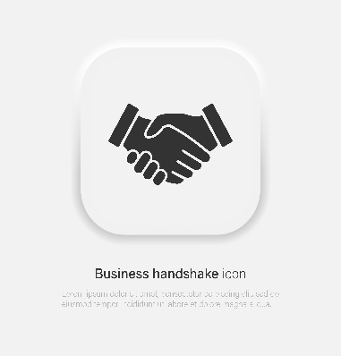


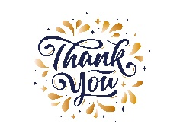
Creating IMPACT
I – Introduce yourself
M –Make eye contact
P – Professional handshake
A – Acknowledge personal space
C – Create a good first impression
T – Thank the person
Notes:
Have a proper introduction say
Hello/Good morning /afternoon/evening Sir /mam my name is xyz pleasure meeting you
Make eye contact and talk it shows confidence
Have a firm grip while shaking hands
Ask questions during the conversation to understand and communicate better
Create a good first impression ie grooming ,dress code and personality
Thank the person before taking your leave eg Thank you Sir/Mam have an amazing day

Slide 20
The 4 Paradigms of Human Interaction
Win - Lose
Lose - Win
Lose - Lose
Win – Win
Notes:
Say: Let us now understand the 4 possible states from which people may operate when they deal with each other
The first of the them is the Win-Lose paradigm. People who believe in this paradigm will believe that they can win only if the other person loses. By extension of this, they also believe that if the other person wins they will definitely lose. Such people are thus always focused on finding ways to over power other people. While win lose can give some quick short term gains, it would not be beneficial for strengthening a good long term relationship.
For example – Between a boss & a subordinate the boss always loads the subordinate with extra work, makes him work over the weekends & moreover himself does nothing. The work is of such a nature that does not develop the subordinate in any manner & he does it just out of fear of his boss. The boss wins & the subordinate loses since he has nothing to gain from it.
The next paradigm is Lose-Win. Such people believe that they are losers and that they will always lose and that others will always win…they will always lose and make compromises that are always unfavorable to them. Thus the lose win paradigm cannot nurture a long standing mutually fulfilling relationship.
For example – In the same example the subordinate believes that he is a loser & he will keep making such compromises to save his job or out of fear of the bosse’s firing. Moreover these compromises are not benefitting him for his development in any way since the extra tasks assigned to him are such that they don’t have any element of self development in it for him.
People who think Lose-Lose are those who energies are always focused on ensuring that the other persons loses. For this sake…they wouldn’t mind losing themselves.
For example – There is a classic case of a husband and wife who went through a bitter divorce suit. Finally the court granted the divorce and asked the husband {a prosperous man} to liquidate his properties and remit 50% of the sale proceeds to his wife. The angered man sold his luxury car costing millions for US Dollar 5, his farm house for USD 10 and remitted 50% of the proceeds to his wife!
Effective people always think Win-Win i.e. Creating a win-win is possible only if one has an ‘abundance’’ mentality…a feeling that there is enough in this world for everybody and hence both of us can win. The opposite of an abundance mentality is a scarcity mentality…a feeling that everything in this world is in short supply thus if I have to win, you have to lose and if you win I would lose. It is important to understand that ‘abundance’ or ‘scarcity’ is a mentality and may not have anything to do with reality
For example, in the after math of the tsunami in Japan where the entire country faced huge destruction {the time when they had to bury one of their nuclear plants}, the government started distributing food and water . The Japanese stood in queues, even without anybody to police them, to collect the food and water. Some of them even allowed foreigners to collect the food and water before they did!
The reality here was a scarcity situation but the mentality of the people was ‘abundance’. On the other hands in certain places you see situations when food is distributed free….there is sufficient stock available for everybody but people still vie with each other and almost create a stampede…here the reality is abundance, but the mentality is scarcity
Some us may be wondering whether it is feasible to think abundance in a scenario like ours where there is a bell curve and forced ratings! But just think about this is a our career a 20-20 cricket match or a one day international {pause for response}….it’s neither because it is actually a test match. In a long 30 year career, many events and decisions which appear very significant in the short term get averaged out in the long term {like for example the decision on whether I should take science or commerce after my 10th}…thus despite a bell curve people can still ‘think’ abundance

Slide 21

Sticking to Convictions with Diplomacy
Clearly articulate your stance
Active Listening
Build Rapport & Trust
Find win win solutions
Lead by example
Notes:
Trainer: in a workplace as discussed in the DISC personality style we find different personality styles. Following are 5 ways to manage Diplomatic people
Clearly articulate your stance: Be confident and assertive when expressing your ideas or decisions to diplomatic individuals. Clearly communicate your rationale and reasoning behind your convictions, providing them with a solid understanding of your perspective. Avoid being confrontational, but stand firm in your beliefs.
Active listening: Diplomatic individuals often value open dialogue and understanding. Practice active listening to comprehend their viewpoints fully. Show genuine interest in what they have to say, ask clarifying questions, and acknowledge their input. This approach fosters mutual respect and encourages them to reciprocate the same level of respect for your convictions.
Build rapport and trust: Diplomatic people tend to value trust and positive relationships. Invest time in building rapport with them. Find common ground, share personal insights, and demonstrate that you value their opinions. When they perceive you as trustworthy and respectful, they are more likely to be receptive to your ideas.
Find win-win solutions: Diplomatic individuals often seek compromise and collaboration. Look for opportunities to find win-win solutions that address their concerns while aligning with your convictions. Show a willingness to negotiate and be flexible when possible. This approach encourages cooperation and constructive problem-solving.
Lead by example: Demonstrate conviction and integrity in your actions and decisions. Be consistent in your behavior and adhere to your principles. Diplomatic individuals appreciate leaders who lead with conviction and walk their talk. Your consistency will earn their respect and reinforce the validity of your ideas.

Slide 22

Dealing with Difficult People
Remain Calm and Composed
Empathise
Choose your battles
Seek common ground
Conflict resolution skills
Notes:
Dealing with difficult people at the workplace can be challenging, but enhancing your interpersonal skills can significantly improve your ability to handle such situations. Here are eight effective ways to deal with difficult people and enhance your interpersonal skills:
Remain calm and composed: Stay composed and avoid reacting emotionally to difficult behavior. Take deep breaths, and maintain a calm demeanor, as this will help you think more rationally and respond appropriately.
Empathize: Put yourself in their shoes and try to understand the reasons behind their difficult behavior. Demonstrating empathy can help diffuse hostility and foster a more understanding atmosphere.
Choose your battles: Not every issue is worth confronting, and sometimes it's best to let minor disagreements go. Assess the situation and decide when it's necessary to address the problem and when it's better to avoid unnecessary conflict.
Seek common ground: Find areas of agreement or shared interests with the difficult person. By identifying common ground, you can build a connection and create a foundation for more constructive conversations.
Conflict resolution skills: Develop conflict resolution skills to handle difficult situations effectively. Focus on finding solutions rather than placing blame, and be open to compromise when necessary.
By applying these strategies, you can enhance your interpersonal skills and build more positive and productive relationships with difficult people at the workplace. Remember that improving your ability to handle challenging situations can lead to a more harmonious and collaborative work environment.

Slide 23






98752-08472
Hello@freelancetrainings.com
www.freelancetrainings.com
406, Titanium City Centre Mall, Anand Nagar, Satellite, Ahmedabad-380015

