Slide 1


Your
Company
Logo
Presentation Skills- 2 Days
Notes:
Note for the trainer: start the day with enthusiasm. Your enthusiasm should reflect in your tone of voice and body language.
Say: Good morning!
Note for the trainer: trainer to say in the loudest voice “Good Morning”. Then the participants will say ‘Good Morning’ in reply.
Say: Oh! I can't hear properly. Let’s try once more. This time louder than the last time. “Good Morning”.
Note for the trainer: Trainer to say in the loudest voice “Good Morning”. Please understand, this is to set the initial energy level of the participants. It is important that the trainer shows enthusiasm so that the participants can reflect the same level of energy.
Say: Well done! Great job! (Applaud the participants after their attempt to encourage.)
So, are you worried that this day is going to be filled with boring lectures? (Don’t wait for a reply) Well, you will be surprised at the way this day will go….
This is not going to be a classroom session where you will just sit and listen to me talking. It is going to be a fun filled, energy packed day with lots of interaction amongst us & a lot of learning from each other. We will learn each module through activities and experiential learning. Science shows that’s how adults learn best.. And that’s exactly how we will learn today!
Note for the trainer: Say the above with great conviction and stress the highlighted words. Pause for a second before starting the next paragraph.
Say: Before proceeding to the workshop, please make sure your mobile phones are on silent mode and avoid attending/checking it during the workshop. You can check your phones during the breaks.

Slide 2
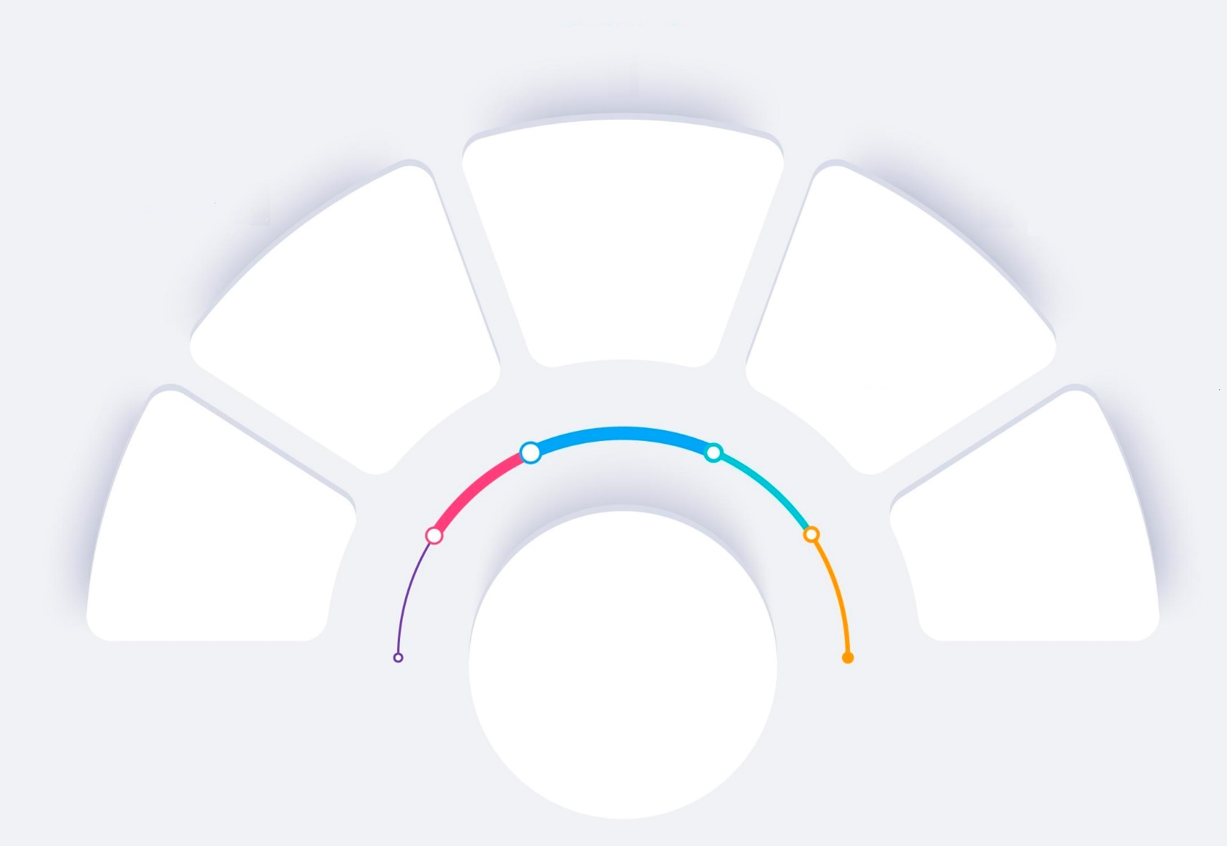
Workshop Agenda
Pre-Presentation Preparation
Understanding Presentation Skills
Preparing Impactful content
Presentation Structure-Design
Pre Workshop Presentations
Modules
Day-1
Homework for day 2
Notes:
Welcome to the workshop
Today we are going to cover the following topics
Pre workshop presentations
Understanding Presentation Skills
Pre-Presentation Preparation-
Preparing Impactful Content
Presentation Structure-Design
Tips for Impactful presentation
Homework-Demo topics to make a presentation on Day 2

Slide 3
Workshop Agenda
Handling Q & A
Dealing with Difficult Audience
Tackling Nervousness & fear
Post Training Presentations
by participants
Presentation Delivery
Modules
Day-2
Notes:
Welcome to the workshop
Today we are going to cover the following topics
Understanding Presentation Skills
Pre-Presentation Preparation- Content
Presentation Structure-Design
Presentation Delivery
Presentation Practice

Slide 4
Components of Effective Presentation
Content
Design
Delivery
Is what you write on the slides. This is what you need to present it to the audience.
Is the look and feel of the presentation i.e. the animations, sequence, slides layouts, videos etc. Expressing of the content.
Is delivering the presentation to the Audience.
Notes:
Content, design, and delivery are three key components of world-class presentations. Here's a brief explanation of each:
Content: The content of a presentation refers to the information that is being conveyed. World-class presentations have a clear and compelling message that is tailored to the audience's needs and interests. The content should be well-organized, easy to understand, and supported by relevant examples and evidence.
Design: The design of a presentation refers to the visual elements that are used to convey the message. World-class presentations have a clean and visually appealing design that enhances the message and engages the audience. This includes using high-quality images, consistent branding, and clear typography.
Delivery: The delivery of a presentation refers to how the message is communicated to the audience. World-class presentations have a confident and engaging delivery style that captures the audience's attention and keeps them interested throughout the presentation. This includes using appropriate body language, tone of voice, and eye contact to establish a connection with the audience. Additionally, world-class presenters are able to handle unexpected challenges or questions with grace and professionalism.

Slide 5
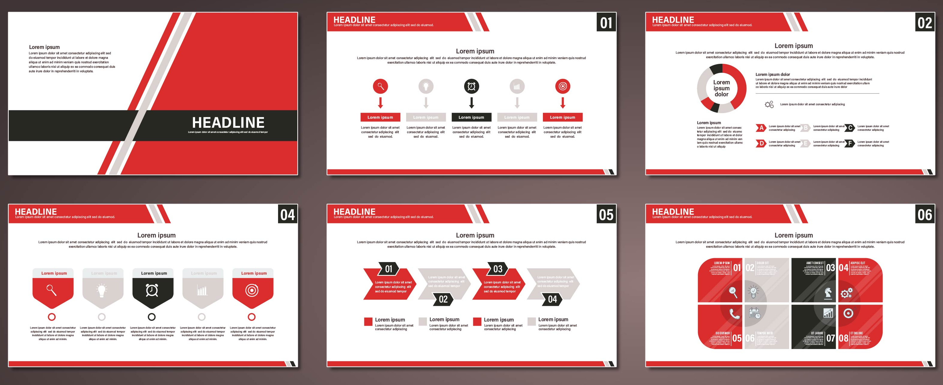
Presentation Structure-Design
Notes:
Welcome to Module 3 on Presentation Structure-Design
Structure of Presentation
Use of Presentation tools
Structure, Outline, Fonts, Design, Bullets, sound, Hyperlink, charts, graphs etc.
Working with Visual Aids ( Flipcharts, Videos, Whiteboards)Facial Expression

Slide 6

1. Logical Sequence
20% time to intro & concept, 60% for the main message and 20% towards summary & Conclusion.
Should take in to consideration all types of audience- VAK.
Must be well paced allowing time to audience to digest the key messages.
Notes:
Allocating time for different sections of a presentation can be a useful guideline for presenters. The 20-60-20 rule is a common guideline that suggests spending:
20% of your time on the introduction and concept: Use this time to introduce yourself, set the stage for your presentation, and provide context for your audience. 60% of your time on the main message: Use this time to communicate your key messages, share information, and provide supporting evidence. 20% of your time on the summary and conclusion: Use this time to summarize your main points, reiterate your key messages, and provide a call to action or conclusion.
The VAK model is one way to categorize these learners based on their preferred learning styles:
Visual learners: These learners prefer to see information presented in a visual format, such as diagrams, charts, and images.
Auditory learners: These learners prefer to hear information presented verbally, such as through lectures, discussions, or audio recordings.
Kinesthetic learners: These learners prefer to learn through hands-on activities, such as demonstrations or interactive exercises.
By considering the different learning styles of your audience, you can tailor your presentation to better engage and communicate with them. For example, you might use visual aids such as diagrams or charts to appeal to visual learners, or include interactive exercises to engage kinesthetic learners. You might also incorporate verbal cues or use storytelling techniques to appeal to auditory learners.
Overall, considering the different learning styles of your audience can help you create a more effective and engaging presentation that resonates with all members of your audience.

Slide 7

8. Wrong Colour Combination
Notes:
Using contrast effectively in your PowerPoint slides can help improve the legibility and visual appeal of your presentation. One way to do this is to consider the contrast between the font color and the slide background color. Here are some tips to keep in mind:
Choose a high-contrast font color: Use a font color that contrasts well with the slide background color to ensure that the text is easily readable. For example, if you have a dark background, use a light font color, and if you have a light background, use a dark font color.
Test the contrast: Before finalizing your font and background colors, test the contrast between them. You can do this by stepping back from your computer screen or printing out a sample slide and viewing it from a distance. If you can't easily read the text, adjust the colors until you achieve a good level of contrast.
Avoid using too many colors: Using too many colors can be distracting and reduce the readability of your presentation. Stick to a simple color scheme with a few contrasting colors that complement each other.
Use bold fonts for emphasis: If you want to draw attention to certain text, use bold fonts rather than changing the font color. This ensures that the text remains readable while still standing out on the slide.
By using contrast effectively, you can create visually appealing and readable PowerPoint slides that enhance the impact of your presentation.

Slide 8
Importance of using video or audio
Increases Impact
Better Retention
Concentration
Lighter Atmosphere
Notes:
Increases impact
Better retention
Lessens boredom
Creates light mood

Slide 9

1. Be Yourself & Be Genuine
Notes:
Say: Be Yourself
Be Real. Let your personality show. Don’t try to be someone else. Try to be your best self.
The more real you are, the more the audience will connect with.
How natural is your presentation style? (Don’t elicit response). So often it seems that presenters leave their personalities behind as soon as they set foot on stage. It’s not clear where people got the idea that a presentation should be done without any personality or enjoyment, but it has resulted in many boring and ineffective presentations.
I can’t stress enough how important it is to be yourself. Rather than getting in front of the group and reciting your memorized script (or worse, reading it), just be yourself. When you are being yourself, you come across far more confident – a big contributor to ensuring audience engagement – and the key to a successful presentation.
If you are naturally energetic and outgoing, yet get up on stage and become timid, apologetic, or even robotic, the audience will become uncomfortable – and an uncomfortable crowd focuses on the wrong things. Real audience engagement is then lost.
If, on the other hand, you’re normally more reserved and quiet, you can still give an excellent presentation. Being yourself means drawing upon your strongest personality traits and incorporating them into the presentation. When you are particularly passionate about a topic, you tend to display more energy, more leadership, and more confidence. By working within your natural personality, you’ll be able to give a great presentation.
Giving presentations is not easy for everyone, but it is something anyone can learn to do and improve upon. Just keep in mind that the presentation is not about you, but about your audience. You’re just the messenger. So be the best messenger you can be.
Be Genuine
An audience never connects with someone who they think is over smart and full of himself.
People usually like down to earth people. People like Funny people. People like genuine people.
If you talk down to people – if you act too smart – they will never connect with you. If they don’t connect with you, its very easy for them to pull you down.
That’s why have genuine respect for the audience you are talking too.

Slide 10

2. Have a Conversational Style
Notes:
Say: Do not commit the mistake of memorizing your presentation. Understand the message and deliver it in the simplest and the most convincing manner that you would.
No matter what the subject matter is, no matter what visual aids are used, the most successful and most powerful conversations are the ones delivered using a natural, conversational style.
When it comes to presentation, we do need to prepare. We do need to practice and we do need to have a good idea of what we are going to say. However, to create that conversational style we have to interact with our audience. Sounding mechanical or robotic will only disconnect you and your audience. Using rhetorical questions can help, moving around on the stage and looking at our audience also helps. there are so many ways to help you to create that natural, conversational style.
If you are one of the many presenters out there that have to write out your words, try a different approach. Get yourself a voice recorder, and during your preparation have a conversation with yourself. Imagine you are talking to someone about what you are going to say in your presentation. Think: “I am having a conversation”. Then, when you are happy with your words, transcribe the words onto paper.

Slide 11

3. Connect to the Audience
Notes:
Say: The most boring presentations are the ones where presenters go on talking endlessly! People sleep with their eyes open. Are you that kind of a presenter? (Elicit response)
Being interactive is key to making presentations fun. Laughing, playing games and interaction makes moments. Moments make memories and memories help you to digest information and learn.
Say:
1. Refer to Audience Members by Name: People love to receive recognition, especially if it’s acknowledgment in front of peers or colleagues.
So, the next time you speak, don’t be afraid to name-drop — that is, to drop names of people who are in the audience while you’re speaking.
Better yet, use stories or examples involving people who you know will be in your audience to illustrate your points. At a minimum, you know at least one person will be paying attention.
2. Have a Sense of Humour:
Have you ever wondered why so many presentations start with the speaker making a joke? When a presenter starts with a joke, it sends a signal to the audience that they can relax.
Unfortunately, audiences have been conditioned by bad presenters to expect to be bored. It’s all too easy for audience members’ minds to wander.
Sprinkling jokes throughout a presentation guarantees your audience will pay a little more attention. So including a little humour in your presentation is actually a great way to get your points across.
Ensure that you do not overdo it. Poking too much fun at self might lead to the audience joining in and not taking you seriously. Also, overtly making fun in a disrespectful way will only humiliate the audience (who might not receive it well.) Also too much humour can take the seriousness off the presentation. Your presentation can’t be only about fun and enjoyment.
The humor should be
Clean
Rehearsed
Energizing
Action oriented
Truth
Make a relevant point
Fun
3. Wrap Your Points in Relevant Stories
The best presenters understand the power of stories. Nearly every audience would much rather hear stories than receive the information any other way. (With the possible exception of interpretative dance – if you can deliver all of your presentations in the form of interpretative dance, that would be awesome.)
But it’s not enough to just tell funny or amusing stories. You need to tell stories which illustrate your points.
4. Open Your Heart
If you really want to make a connection with your audience, get personal.
Tell a revealing story. Share a side of you few ever see. Allow it all to hang out, warts and all.
People will respect your honesty and candour, especially if you show you are not perfect.
Sure, it’s won’t be easy to be truly open and vulnerable. But few things in life are easy. And the payoff will be worth it.
5. Don’t intimidate or confuse your audience. Do everything you can to make them feel that they are just as smart as you are.
6. If you don’t know…say so. Your audience will always appreciate honesty
7. Sound Passionate and Enthusiastic; like you are happy to meet them and to present to them!

Slide 12

6. Using the Room Well
Notes:
Say:
There are many benefits of movement in a presentation:
- It adds energy and variety to your presentation.
- It makes you look more confident – because people who are nervous are generally frozen in one spot.
- And as an added bonus, if you move, you may start to feel more confident. That’s partly because movement will help dissipate the extra adrenalin in your system.
Do not stand in one spot. Walk around as you present. You need to be close enough to the audience to seem that you are one of them. A presentation is not a speech and you are not expected to be on the podium. Be in the physical proximity of your audience making the whole learning environment a lot more personalized. At any stage ensure that you have a one arm worth distance maintained so that you do not enter their space.
Use the room well, regardless of the room arrangement. Walk around the tables, up the aisle, walk around the corners as you present.
Ensure that the person sitting in the remotest corner feels like he has accessibility to you.
Important : Check your position while you are center stage. Never ever stand between the screen and the projector. You may be blocking the view!

Slide 13
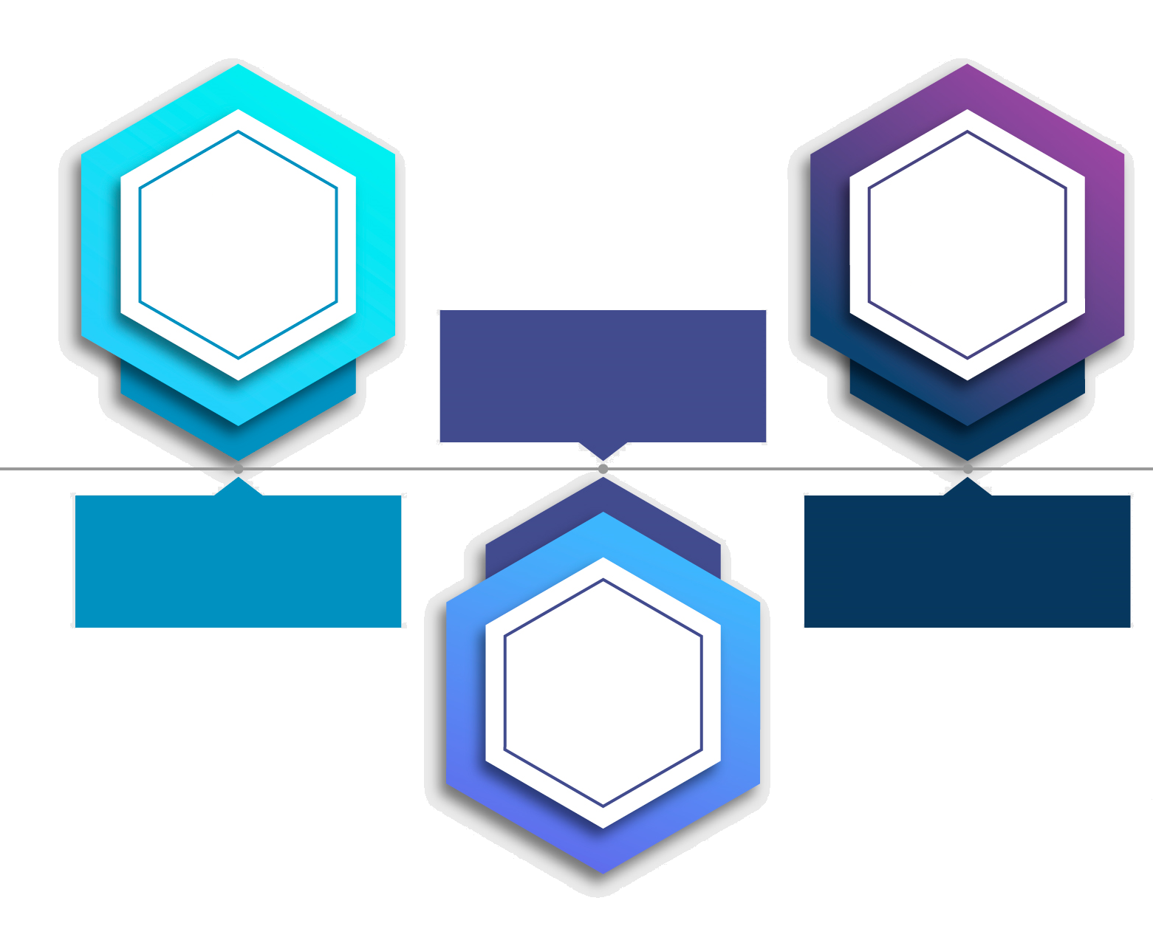
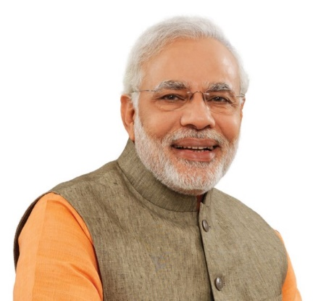

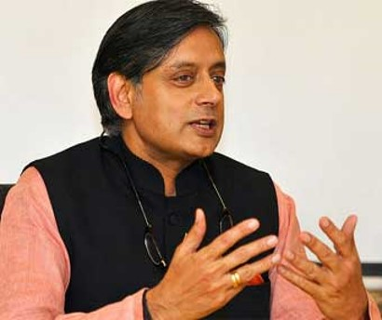
Tips! –Learn from Other speakers
Learn from the good speakers
Emulating Good Speakers makes you better
Learn even more from the bad ones
Notes:
Say: Emulating Good Speakers makes you better. Learn from the good speakers. Learn even more from the bad ones.
Think about the best speakers you know, the ones who are always good when they get up to speak. Think about what makes him/her such a good speaker and try to be as good as them.
At the same time also listen to the bad speakers to understand the don'ts.
Let us now look at this video that demonstrates a good presenter.

Slide 14

Make the Ending Powerful
Make the Ending Powerful - a lucid and purposeful conclusion
Notes:
Say: Make the Ending Powerful - a lucid and purposeful conclusion
The conclusion has an important role to play in the presentation so it should not be neglected. The findings of the main body of the presentation are summarized and are once again tied to the core message, building up to a powerful finale. The ending breaks the tension that has been maintained throughout the presentation, potentially allowing for an open ending that can transition into a group discussion.
Generally, however, a look back at the introduction is a good idea, so that the audience gains an overarching view of the entire concept.
To end a session, you should summarize the points that the audience have learned during the presentation.
Finally remember to end the presentation on a positive note. Give some emotionally empowering quotes, thought provoking videos, stories etc. so that the audience leave the session with a high positive note.

Slide 15

Dealing with a Difficult Audience
Notes:
Welcome to the module on Dealing with a Difficult Audience. In this module we will learn • Handling Side Conversations • Late Arrivals • Handling difficult Characters (Jester, Cynic, Talker)
• Engaging the Indifferent audience

Slide 16








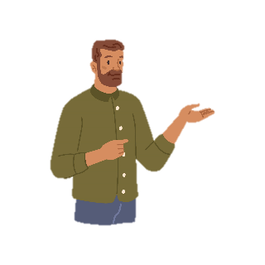
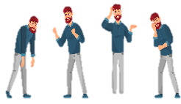
Handling Side Conversations
Ignore, Focus on Presentation
Silence until they finish
Give them that little extra attention with the quick stare
You could ask them whether they have a point of view
Read the audiences’ body language. They could need a break
Notes:
Say: Do the following to in order to handle side conversations:
Ignore them
Silence until they finish – be silent until they finish talking or their attention gets diverted towards your silence. They feel embarrassed & stop conversing.
Give them that little extra attention with the quick stare. This will again divert everyone’s attention to them which makes them feel embarrassed & they stop conversing.
You could ask them whether they have a point of view. -
Read the audiences’ body language. They could need a break.

Slide 17
Common Types of Difficult Behavior
Jester
Cynic
Indifferent
Talker
Whisperer
Notes:
Jester:
The joker or class clown who, on the one hand can help reduce inhibitions and barriers by getting people laughing, but on the other hand may not recognize the limit to their behavior and can monopolize or derail a session.
How to overcome it:
Limit the number of times they intervene.
Peer pressure may also inhibit interjections once the trainees understand your position.
Coach the individual by offering that, “We appreciate your humor, but our time here is limited and we want to make sure that others also have a chance to contribute / get through the material.”
Cynic:
Could be a senior staff or negative person who has seen the efforts of trying hard result in failure. May have had trouble having ideas respected in the past, or may feel that they are ill equipped to succeed at what you are presenting.
How to overcome it:
Explain benefits to making changes and work on gaining commitment.
Listen to and acknowledge their doubts/fears so that they are addressed through training.
Allow them to explain the reason for their doubt one time only, ask them for a solution, and then indicate that you are moving on.
Indifferent:
Does not participate in discussions or activities except at the bare minimum. Like the cynic, indifference can come from having tried and failed, or having ideas ignored.
How to overcome it:
Uncover the cause and find ways to involve the individual, respecting and encouraging their involvement to build confidence.
Talker:
Disrupts by interjecting comments or anecdotes, or chats about something similar that happened to them. In severe display can be monopolizing and distracting.
How to overcome it:
Use proximity to stand close to them and silence them politely when they take a breath. Example: “I appreciate your comment, Bob; perhaps you can tell the full story at the break,” and then move on.
Elicit their cooperation by directing their energies and comments.
At a break explain that you have appreciated their input but you must ensure that the group all participates equally and ask for their support.
Whisperer:
Starts side conversations that may or may not be related to the training.
How to overcome it:
Check for understanding by asking if they misunderstood or are having difficulty hearing. You may need to adjust your training approach. If they are having unrelated conversations, politely ask them to hold off until the break.
Insert an energizer or activity that requires a rearrangement so that the whisperers are no longer seated together.
Stop talking until they notice that they are distracting you.
Ask one of them a question about what you have just covered, acting like you did not realize they were involved in another conversation.

Slide 18






When to Take the Questions Offline?
Too many cross questions – know when to stop
Out of subject questions
Take questions only where that person who needs the answer
Notes:
Say:
Too many cross questions – In such a case know when to stop. Tell the questioner that you will discuss it offline after he asks the 3rd question.
Out of subject questions – tell that its out of the scope of this subject & discuss such questions offline.
Questions where only that person needs the answer or it is relevant to only one person – take it offline. For e.g. – a question pertaining to logistics when the audience is a mixed batch from various other domains.

Slide 19

Tackling Nervousness & Fear
Notes:
Welcome to the module on Tackling Nervousness & Fear. In this module you will learn
• Types of Speakers • Ways to handle Nervousness and fear-Part-1 • Ways to handle Nervousness and fear-Part-2

Slide 20






98752-08472
Hello@freelancetrainings.com
www.freelancetrainings.com
406, Titanium City Centre Mall, Anand Nagar, Satellite, Ahmedabad-380015
Notes:
End of the presentation

