Slide 1


Your
Company
Logo
Presentation Skills
Notes:
Note for the trainer: start the day with enthusiasm. Your enthusiasm should reflect in your tone of voice and body language.
Say: Good morning!
Note for the trainer: trainer to say in the loudest voice “Good Morning”. Then the participants will say ‘Good Morning’ in reply.
Say: Oh! I can't hear properly. Let’s try once more. This time louder than the last time. “Good Morning”.
Note for the trainer: Trainer to say in the loudest voice “Good Morning”. Please understand, this is to set the initial energy level of the participants. It is important that the trainer shows enthusiasm so that the participants can reflect the same level of energy.
Say: Well done! Great job! (Applaud the participants after their attempt to encourage.)
So, are you worried that this day is going to be filled with boring lectures? (Don’t wait for a reply) Well, you will be surprised at the way this day will go….
This is not going to be a classroom session where you will just sit and listen to me talking. It is going to be a fun filled, energy packed day with lots of interaction amongst us & a lot of learning from each other. We will learn each module through activities and experiential learning. Science shows that’s how adults learn best.. And that’s exactly how we will learn today!
Note for the trainer: Say the above with great conviction and stress the highlighted words. Pause for a second before starting the next paragraph.
Say: Before proceeding to the workshop, please make sure your mobile phones are on silent mode and avoid attending/checking it during the workshop. You can check your phones during the breaks.

Slide 2

Workshop Agenda
Presentation Structure-Design
Pre-Presentation Preparation- Content
Presentation Delivery
Understanding Presentation Skills
Presentation
Practice
Modules
Notes:
Welcome to the workshop
Today we are going to cover the following topics
Understanding Presentation Skills
Pre-Presentation Preparation- Content
Presentation Structure-Design
Presentation Delivery
Presentation Practice

Slide 3

What are Presentation skills?
A presentation is a means of one to many communication that can be adapted to various speaking situations.
Presentation skills are the skills you need in delivering effective and engaging presentations to a variety of audiences.
Notes:
Ask: What is a presentation & what are presentation skills?
Note: Elicit responses & discuss a few.
Say: A presentation is a means of one to many communication which can be adapted to various speaking situations, such as talking to a group, addressing a meeting or briefing a team.
Presentation skills are the skills you need in delivering effective and engaging presentations to a variety of audiences. These skills cover a variety of areas such as the structure of your presentation, the design of your slides, the tone of your voice and the body language you convey.
Presenting information clearly and effectively is a key skill to get your message or opinion across and, today, presentation skills are required in almost every field. Whether you are a student, administrator or executive, if you wish to start up your own business or stand for an elected position, you may very well be asked to make a presentation.

Slide 4

Myths Vs Reality
Good presenters are born, not made.
Presentation skills can be learned and improved through practice and training.
A great presentation is all about the content.
Effective presentations also require strong delivery skills, such as body language, tone of voice, and audience engagement.
Memorization is the key to a successful presentation.
Relying solely on memorization can lead to a rigid and inflexible presentation that may not adapt well to unexpected situations or audience feedback.
Speaking fast makes you sound more confident and knowledgeable.
It can make difficult for the audience to follow the presentation and may lead to misunderstandings or confusion.
Notes:
Myth: Good presenters are born, not made. Reality: While some individuals may have a natural talent for presenting, presentation skills can be learned and improved through practice and training.
Myth: A great presentation is all about the content. Reality: While content is important, effective presentations also require strong delivery skills, such as body language, tone of voice, and audience engagement.
Myth: Memorization is the key to a successful presentation. Reality: While it's important to be familiar with your content, relying solely on memorization can lead to a rigid and inflexible presentation that may not adapt well to unexpected situations or audience feedback.
Myth: Speaking fast makes you sound more confident and knowledgeable. Reality: Speaking too quickly can actually make it difficult for the audience to follow the presentation and may lead to misunderstandings or confusion.
Continued…… on next slide

Slide 5
Components of Effective Presentation
Content
Design
Delivery
Is what you write on the slides. This is what you need to present it to the audience.
Is the look and feel of the presentation i.e. the animations, sequence, slides layouts, videos etc. Expressing of the content.
Is delivering the presentation to the Audience.
Notes:
Content, design, and delivery are three key components of world-class presentations. Here's a brief explanation of each:
Content: The content of a presentation refers to the information that is being conveyed. World-class presentations have a clear and compelling message that is tailored to the audience's needs and interests. The content should be well-organized, easy to understand, and supported by relevant examples and evidence.
Design: The design of a presentation refers to the visual elements that are used to convey the message. World-class presentations have a clean and visually appealing design that enhances the message and engages the audience. This includes using high-quality images, consistent branding, and clear typography.
Delivery: The delivery of a presentation refers to how the message is communicated to the audience. World-class presentations have a confident and engaging delivery style that captures the audience's attention and keeps them interested throughout the presentation. This includes using appropriate body language, tone of voice, and eye contact to establish a connection with the audience. Additionally, world-class presenters are able to handle unexpected challenges or questions with grace and professionalism.

Slide 6

Preparing Yourself for a Presentation
Notes:
Ask: Is it important to be prepare for the presentation? Why?
Note: Elicit response
Say: Preparation is the single most important part of making a successful presentation. This is the crucial foundation and you should dedicate as much time to it as possible avoiding short-cuts.
Not only will good preparation ensure that you have thought carefully about the messages that you want (or need) to communicate in your presentation but it will also help boost your confidence.

Slide 7

Building right content
Why
How
What
Cornerstone of Effective Presentation
Who
Where
When
Notes:
Building the right content for a presentation can certainly be a challenging task. The 5 W’s & H (Who, What, Why, When, Where & How) play a critical role in creating effective PowerPoint content. By considering these key questions, you can ensure that your content is relevant, engaging, and tailored to your audience's needs.

Slide 8
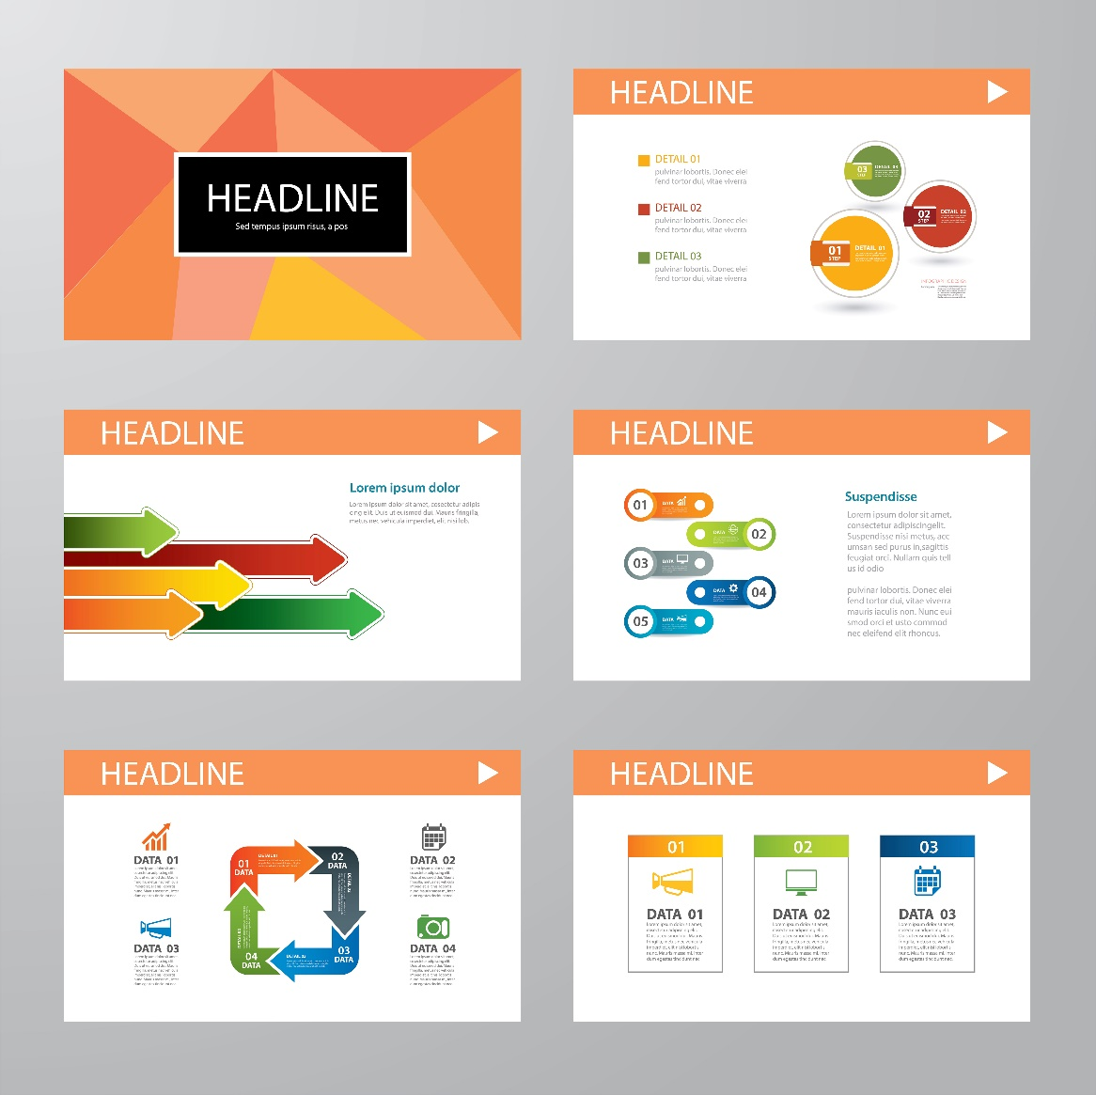
Design /Structure of the presentation
  Logical Sequence of presentation- Start to End
  Design & Layout of the slide
  Presenting Data Vs Text
  Usage of Pictures & Videos
  Slide formatting –Fonts, Bullets , Color
Notes:
We will discuss these points one by one in the upcoming slides

Slide 9

Effective Delivery Is…..
Body Language
Voice
Confidence
Preparation
Engaging Audience
Managing Difficult Audience
Delivery
Notes:
Body Language,Voice

Slide 10

  Body language is a silent orchestra, as people constantly give clues to what they’re thinking and feeling.
Notes:
Welcome to the next module on Body Language
Say it’s a silent language wherein we get clues on what people are thinking and feeling
Non-verbal messages including body movements, facial expressions, vocal tone and volume, and other signals are collectively known as body language.

Slide 11






When to Take the Questions Offline?
Too many cross questions – know when to stop
Out of subject questions
Take questions only that person who needs the answer
Notes:
Say:
Too many cross questions – In such a case know when to stop. Tell the questioner that you will discuss it offline after he asks the 3rd question.
Out of subject questions – tell that its out of the scope of this subject & discuss such questions offline.
Questions where only that person needs the answer or it is relevant to only one person – take it offline. For e.g. – a question pertaining to logistics when the audience is a mixed batch from various other domains.

Slide 12
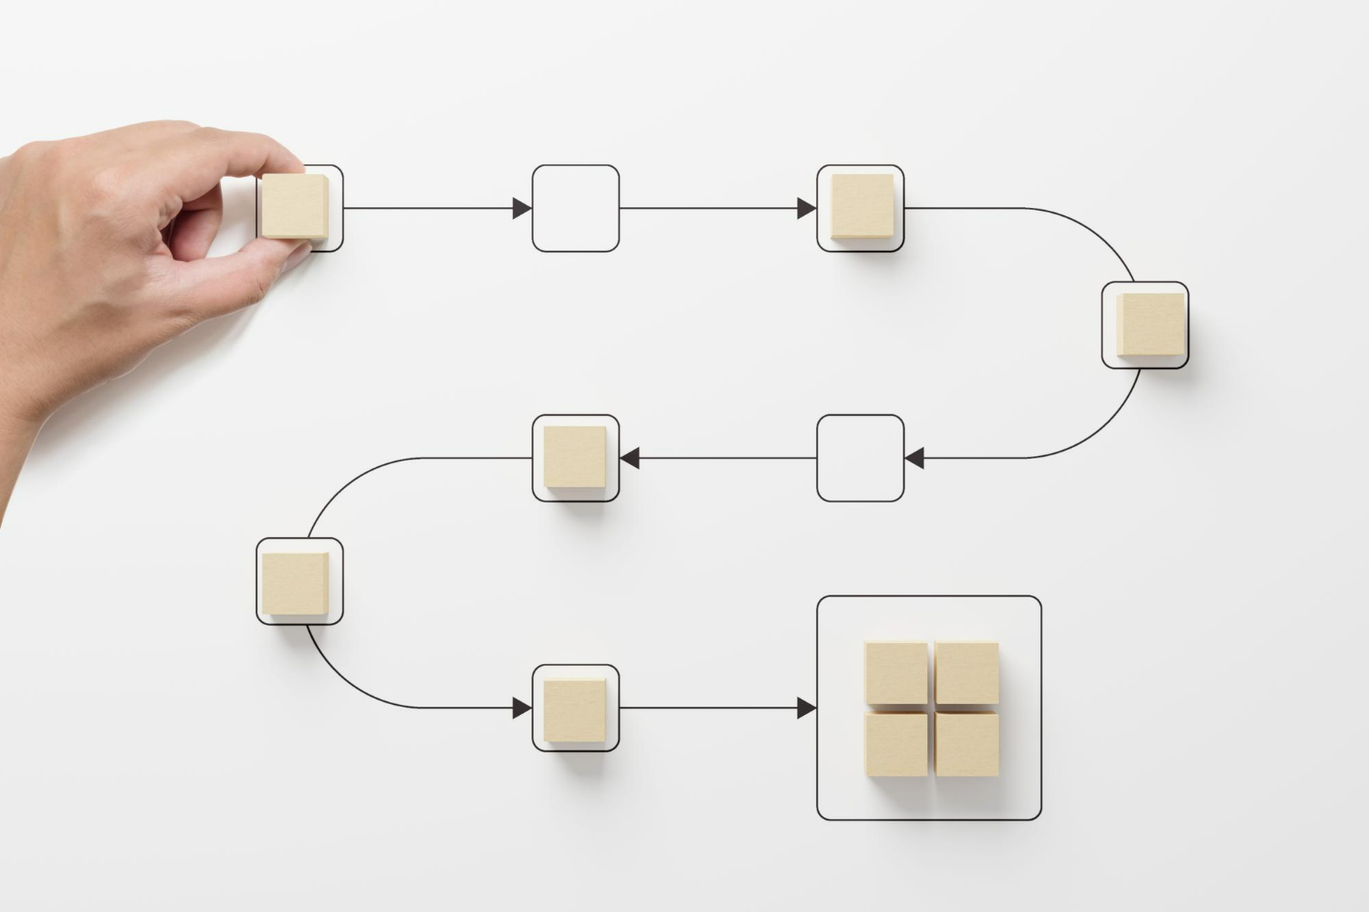
4. Simplify
Notes:
Say: Avoid complicated jargon & abbreviation. You don’t sound smart by using complicated language.
Simple Rule: It’s best to keep your communication simple. If you must use jargons; consciously make sure that the audience understand what you are saying so that you are on the same platform as they are.
Let us now look at a video that will help us to understand the importance of simplifying our communication while presenting.

Slide 13

6. Using the Room Well
Notes:
Say:
There are many benefits of movement in a presentation:
- It adds energy and variety to your presentation.
- It makes you look more confident – because people who are nervous are generally frozen in one spot.
- And as an added bonus, if you move, you may start to feel more confident. That’s partly because movement will help dissipate the extra adrenalin in your system.
Do not stand in one spot. Walk around as you present. You need to be close enough to the audience to seem that you are one of them. A presentation is not a speech and you are not expected to be on the podium. Be in the physical proximity of your audience making the whole learning environment a lot more personalized. At any stage ensure that you have a one arm worth distance maintained so that you do not enter their space.
Use the room well, regardless of the room arrangement. Walk around the tables, up the aisle, walk around the corners as you present.
Ensure that the person sitting in the remotest corner feels like he has accessibility to you.
Important : Check your position while you are center stage. Never ever stand between the screen and the projector. You may be blocking the view!

Slide 14


7. Well Groomed
Notes:
The presenter should be well groomed for the presentation .

Slide 15






98752-08472
Hello@freelancetrainings.com
www.freelancetrainings.com
406, Titanium City Centre Mall, Anand Nagar, Satellite, Ahmedabad-380015
Notes:
End of the presentation

