Slide 1



Workshop on Image Management- 2 days
Notes:
The Trainer is free to customise this editable slide & entire presentation as per their own/client branding- You may keep the fonts/ Animation/ Images same to save the editing time.
Say Good morning/Afternoon /evening welcome to the workshop on business Etiquette
Welcome to the workshop on ‘Business Etiquette’! Today is going to be a fun filled, energy packed session with lots of interaction amongst us & a lot of learning from each other. We will learn each module through activity and experiential learning. Science shows that’s how adults learn best.. And that’s exactly how we will learn today!
Note: Trainer to say the above paragraph with lot of enthusiasm.
Transition to the next slide

Slide 2
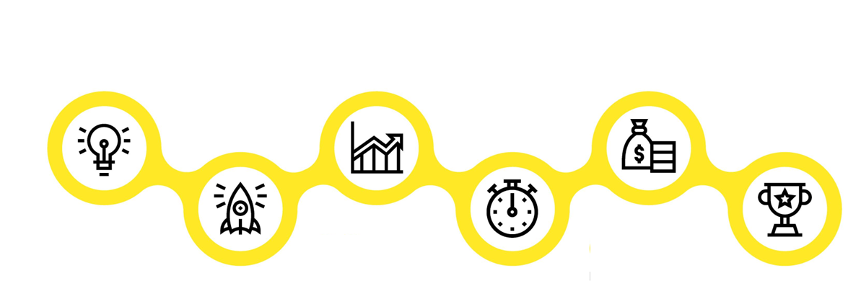

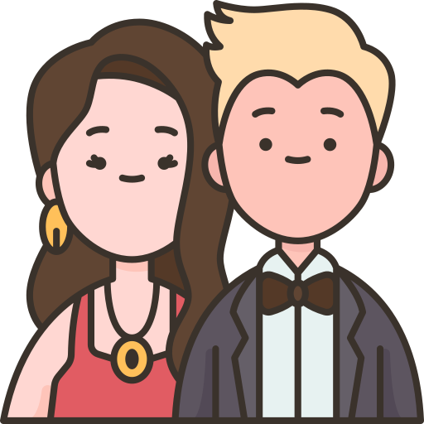




Personal Vs Professional Image
Personal Image:
How individuals present themselves in non-work settings, encompassing social and personal life.
Professional Image:
Pertains to how individuals present themselves in the workplace,
Module 1
Module 3
Module 5
Understanding Image
Management
Components of Image Management
Non Verbal Communication
Looks Matter- Grooming
Module 2
Module 4
Module 6
Building an Attitude
of Ownership
Mastering Body Language
Watch the Odour
Personal Hygiene
Notes:
Differences between personal and professional image in more detail: (In the components of Image management trainer please note that we have already covered Understanding Image Management in last 2-3 slides and hence we move on to building an attitude of ownership
Personal Image:
Personal image relates to how individuals present themselves in non-work settings, encompassing social and personal life.
Appearance: It includes aspects like clothing choices, grooming, and personal style, which may vary widely based on personal preferences and social circles.
Behavior: In personal contexts, behavior is often driven by personal relationships, and individuals may express themselves more freely or casually. Politeness and etiquette are still important but might differ from professional settings.
Communication: Personal communication is often more relaxed and informal, including the use of slang or informal language depending on the social setting.
Emphasis on Authenticity: In personal image management, authenticity plays a significant role. Individuals are encouraged to express their true selves and values. While they may still adapt to various social settings, the core of their personal image often revolves around their genuine identity.
Varied Social Circles: Personal image can vary greatly depending on the social circles and personal relationships. For example, someone's personal image with family and close friends may differ from how they present themselves to acquaintances or in a dating context.
Flexibility and Fluidity: Personal image is more flexible and fluid, allowing individuals to experiment with different styles and behaviors without the same level of scrutiny they might face professionally.
Emotional Expression: Personal image often allows for the expression of a wider range of emotions, including vulnerability and personal quirks, which may not be as common or acceptable in a professional context.
Privacy and Boundaries: Individuals have greater control over their privacy and boundaries in personal life. They can choose what to share or keep private, and they may set their own boundaries for personal interactions.
Professional Image:
Professional image pertains to how individuals present themselves in the workplace, encompassing behavior, attire, and communication in professional settings.
Conformity to Workplace Standards: In the professional world, individuals are expected to adhere to specific workplace standards and norms. This includes dressing appropriately according to industry or company guidelines. Conformity ensures a level of consistency and professionalism in the workplace.
Strict Behavior Expectations: Professional behavior is characterized by adherence to rules, policies, and codes of conduct. It often requires a high level of self-discipline, respect for hierarchy, and a commitment to organizational goals. Professionalism is essential for maintaining a productive and harmonious work environment.
Formal Communication: Professional communication is typically formal, structured, and goal-oriented. It emphasizes clarity and precision in written and spoken communication. The use of professional jargon may be common to ensure clear and efficient communication in a business context.
Alignment with Organizational Goals: In a professional context, individuals are expected to align their actions and image with the organization's mission, values, and objectives. This alignment ensures that all employees work toward common goals and objectives.
Ethical Considerations: Maintaining a professional image involves ethical considerations related to honesty, integrity, and compliance with workplace policies and industry standards.
Workplace Relationships: Professional image is closely linked to relationships with colleagues, superiors, and clients. Building trust and credibility is essential for success in the workplace. Maintaining professional relationships often requires a balance between approachability and maintaining professional boundaries.
Performance and Accountability: Maintaining a professional image involves demonstrating competence and accountability for one's work. It includes meeting deadlines, delivering quality results, and upholding ethical standards. Accountability is crucial for maintaining trust in professional relationships.
Continuous Learning: Professional image often requires a commitment to continuous learning and skill development to stay competitive in the workplace. Embracing change and growth is essential for long-term career success.
In summary, personal image centers on how individuals present themselves in their personal lives, allowing for more individual expression, while professional image focuses on how individuals present themselves in a workplace setting, adhering to specific standards and expectations that can have a significant impact on their career and the organization they represent.

Slide 3


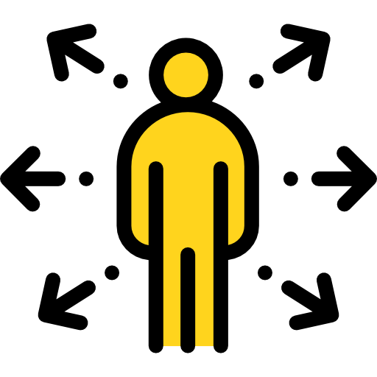


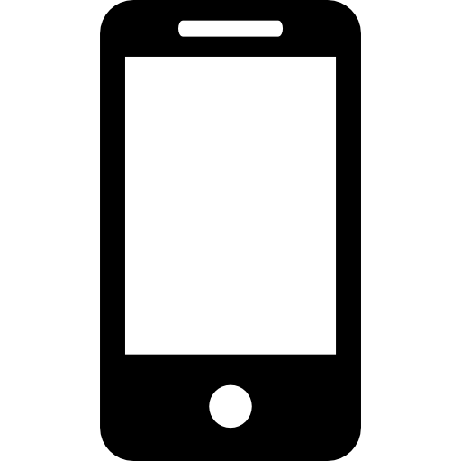
Agenda of Workshop- Day 2
Module 1
Module 3
Module 5
Vocal Communication
Email Etiquette
Social Etiquette
Module 2
Module 4
End of Workshop
Dining Etiquette
Telephone & Meeting Etiquette
Notes:
The agenda of todays workshop is as follows
Understanding Brand & Personal Branding
Building an attitude of Ownership at workplace
Non Verbal communication
Mastering Body language
Looks Matter –Grooming & Etiquette
Watch for Odour- Personal Hygiene

Slide 4
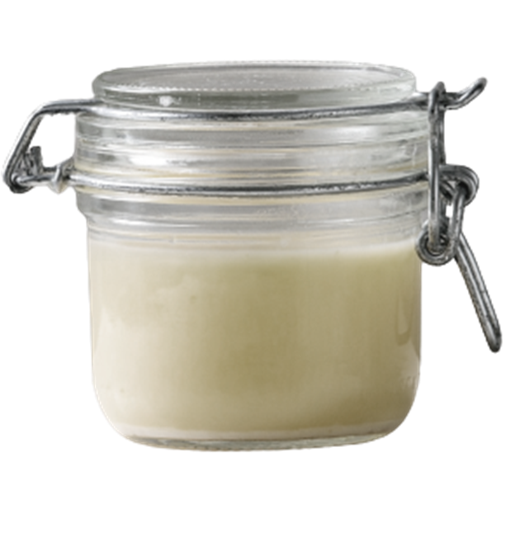
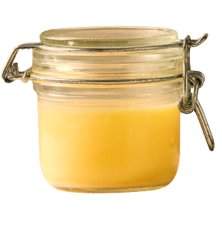

Which Ghee would you like to buy for your family?
Pure Ghee
Option 1
Option 2
Notes:
Which Ghee will you want to buy for your family. Both the products are of the same quality and of the same price.
Option A Or B.
80% of the audience will say Option 2- Ask the participants why and wait for the responses. The responses will be like
Option A is of dark colour giving an impression of impure
Option A is not a Brand
Option A is a loose ghee
Option A does not look hygienic
Trainer to prompt for answers and then move to the next slide

Slide 5

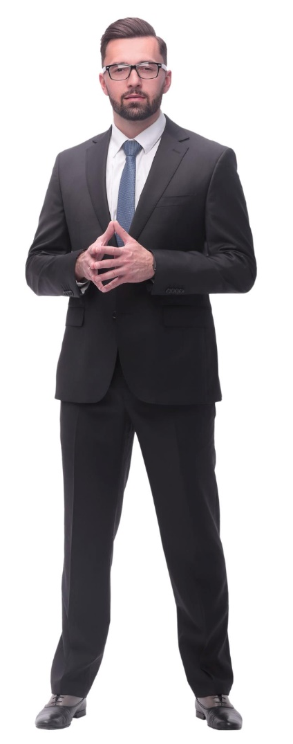
Who would you like to Hire as Manager
Option 1
Option 2
Notes:
Which of the 2 professionals will you like to hire
Option A Or B.
80% of the audience will say Option 2- Ask the participants why and wait for the responses. The responses will be like
Option A doesnot look serious
Option A is not dressed proferly
Option A is of casual nature
Trainer to prompt for answers and then move to the next slide

Slide 6

Tips to enhance vocal communication
Focus on:
Tone of Voice
Volume / Modulation / Pitch
Pace
Pause
Intonation
Pronunciation
“It’s not just what you say that stirs people. It’s the way that you say it.” - William Bernbach
Notes:
Say: Yes you guessed it right…elements of good presentation…and why are we discussing presentation here ?
Because – it is one of the best example to explain Vocal communication (verbal aspect).
Vocal presentation matters in any type of presentation: in-person, online, real-time, asynchronous. Vocal variety affects how you are heard. Here are a few tips for effective verbal presentation from presentation skills training consultant Gavin Meikle, who identifies key elements, common errors, and good practices to develop greater vocal impact.
This set of communication focuses on:
Tone of Voice
Volume
Pitch
Pace
Pause
Intonation
As legendary advertising creative director William Bernbach noted, “It’s not just what you say that stirs people. It’s the way that you say it.”
So let us understand in detail:

Slide 7
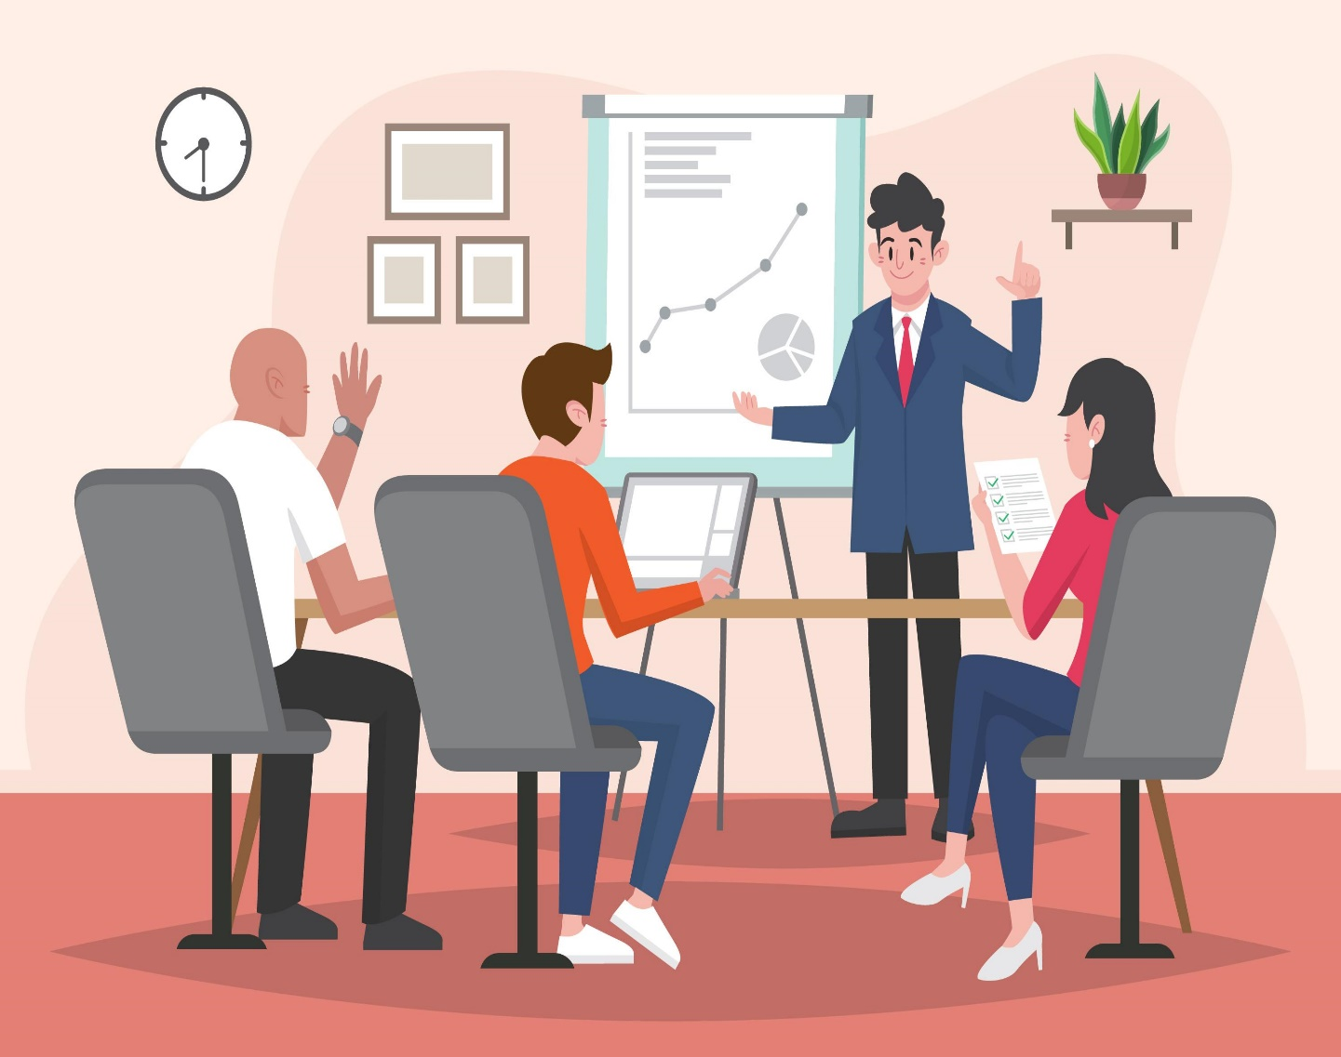
Volume / Modulation / Pitch
1. Project your Voice
2. Have Proper Posture
3. Practice Proper Distance
4. Vocal Variety
5. Start Strong
6. Finish Strong
7. Practice makes Perfect
Notes:
Say: This next in the list is Volume or Modulation or Pitch. It is one of the simpler concepts that can go a long way in making your presentation better. Volume is how loud a speaker’s voice is during a presentation; Volume is one of the most vital elements of any speech. If your voice does not reach the audience, it becomes much harder for your content to resonate with the audience; and Projecting your voice demonstrates confidence, which is a crucial element of presenting a good speech.
Research suggests a general preference for lower vocal pitch, with participants ascribing more positive personality traits to lower pitched voices. That’s not to say that you should artificially lower your voice, but simply try to be conscious if your voice tends to rise when you speak and try to modulate it.
Tips for Using Effective Volume
1. Project your Voice: Make sure you are speaking loud enough so the person furthest in the back can clearly hear what you say. Try visualizing your voice as a physical presence that you are pushing to the back of the room.
2. Have Proper Posture: Standing with proper form will go a long way in helping your voice travel further. Stand tall and you will notice the difference.
3. Practice Proper Distance: Make sure your volume is sufficient enough to minimize the distance between you and the audience. This is especially true if you tend to speak quietly or have a naturally quiet voice.
4. Vocal Variety is what we call Pitch or Modulation: Speaking with a proper volume is important but also make sure you are also varying your volume. Speaking at different volumes throughout your presentation is an effective way to highlight key points. Speaking at a lower volume draws your audience in. Alternatively, a louder volume will emphasis key points.
5. Start Strong: Begin your speech with a commanding volume. This is an effective way to capture the audience attention right away.
6. Finish Strong: Emphasize your conclusion by using a commanding volume. Speak loudly, clearly, and with an appropriate pace to bring a sense of closure to your speech.
7. Practice makes Perfect: Practice at home or in a classroom with your roommates, friends, family, or anyone who will listen. Practice in a variety of room sizes with an audience member sitting at the back of the room. Have your audience member make note of your vocal variety and if they can hear you throughout the whole presentation.
Thus Volume or Pitch are one aspect of Vocal Verbal Communication

Slide 8

Intonation – Tone of Voice
Notes:
Say: Last but not the least is Intonation or you can say Tone of Voice– This describes changes in vocal tone within a sentence. In order to achieve the desired effect, use the three common intonation patterns appropriately.
Ending a spoken sentence with a rising tone indicates a question or suggestion.
Ending a spoken sentence with a descending tone is generally interpreted as an order.
A flat intonation is used to indicate a statement.
Activity:
Let’s Try using the tone:
Trainer to write the below statement on the Board:
“Do you like Tea?”
Now turn by turn randomly ask people to emphasis on one word and see how the meaning changes with each tone.
Like: Do you like Tea? – emphasis on “Do” – means simple question which requires answer in Yes or No.
Now shift the tone to “YOU” – Do You like Tea? – now the meaning changes to a doubt whether you like tea or not – its no more a question about tea rather it is a question about you.
Go on with next word “Tea” – Do you like Tea? – this is intimidating and question rather calls for a doubt on tea…it seems you like something else not tea/ Is tea a good drink ?....
So with each variation – meaning changes…
This is how tone of voice matter.

Slide 9
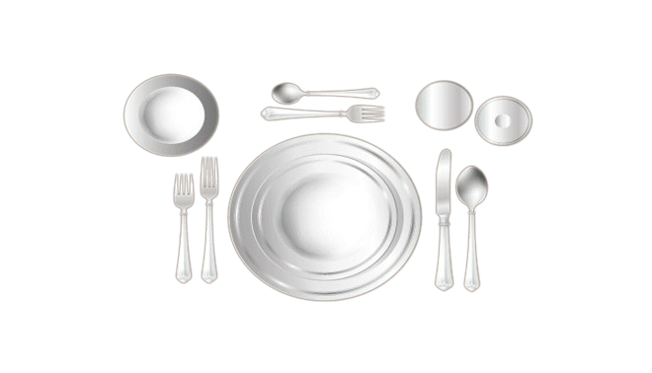
Place Setting
Desert Fork & Spoon
Water Glass
Bread Plate
Wine Glass
Salad Fork
Soup Spoon
Dinner Fork
Dinner Knife
Notes:
Say: Let us now understand how your table would have been set in a very formal lunch or dinner meetings.
The following is a standard table setting for a three-course meal. Note the basic "outside-in" rule. The piece of flatware that will be used last is placed directly next to the plate you are using.
FORKS
Both forks are placed on the left of the plate. The fork furthest from the plate is for salad. The fork next to the plate is for the dinner. (Please Note: At more formal meals where the salad is served after the main course, the order of placement is reversed.)
Fork tines may be placed downward, in the continental style, or upward, in the American style.
DINNER PLATE
The dinner plate is placed on the table when the main course is served and is not on the table when the guests sit down.
Large plates, such as the dinner plate and luncheon plate, are laid about one (1) inch in from the edge of the table.
SALAD PLATE
The salad plate is placed to the left of the forks.
Small plates, such as the salad plate, fish plate, and dessert plate, are laid about two (2) inches in from the edge of the table.
DINNER KNIFE
The dinner knife is placed on the right side, and directly next to and one (1) inch away from, the plate. The blade should face the plate. If the main course requires a steak knife, it may be substituted for the dinner knife.
SPOONS
The soup spoon is on the far right of the outside knife.
BREAD PLATE WITH BUTTER KNIFE
A small bread plate is placed above the forks, above and to the left of the service plate.
The butter spreader is laid on the bread-and-butter plate.
GLASSWARE
Usually one wine glass is used along with a water goblet. If the table setting is uncrowded, there is room to arrange glassware in any way you like, such as in a straight line parallel with the edge of the table or a diagonal line angled toward the table's edge.
WATER GOBLETS
The water glass is placed in a position closest to the hand, approximately 1 inch above the tip of the dinner knife.
WINE GLASSES
At least one wine glass should sit to the right and possibly above the water glass.
NAPKINS
Place the napkin in the place setting's center, or left of the last fork.
COFFEE CUPS
Place a cup and saucer to the right of the place setting. The coffee spoon goes to the right of the saucer.
Place approximately one (1) inch beyond the outermost piece of flatware. The top edge of the saucer is aligned with the top rim of the plate or bowl.
Cup handles are faced in the four o'clock position for easy access.
DESSERT SPOON AND FORK
At an informal meal, when two utensils are provided for dessert, the utensils are laid on the table or presented on the dessert plate.
The dessert spoon (or dessert knife) is laid on the table above the dinner plate in a horizontal position, handle facing right.
The dessert fork is laid beneath the dessert spoon (or dessert knife), handle facing left.
The dessert utensils may also be presented on the dessert plate in the same way as formal service.
SALT AND PEPPER
Since more people use salt than pepper (and most people are right-handed), the salt shaker is placed to the right of the pepper shaker, in a position closer to the right hand.
The placement of the pepper shaker is to the left of the salt shaker, and for added definition it is angled slightly above the salt shaker.
They are placed above the cover or between two place settings.
Because salt is finer than pepper, the lid of the salt shaker is punctured with smaller, more numerous holes than a pepper shaker.

Slide 10
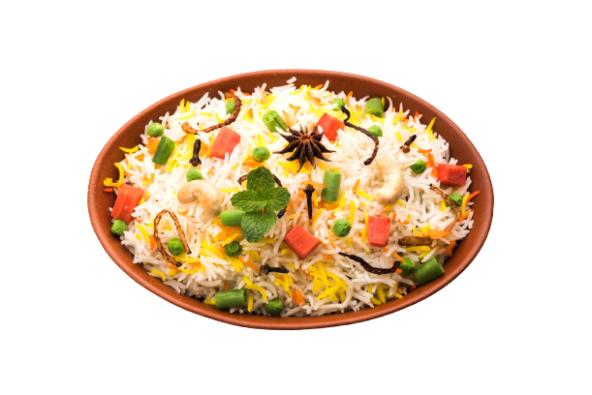
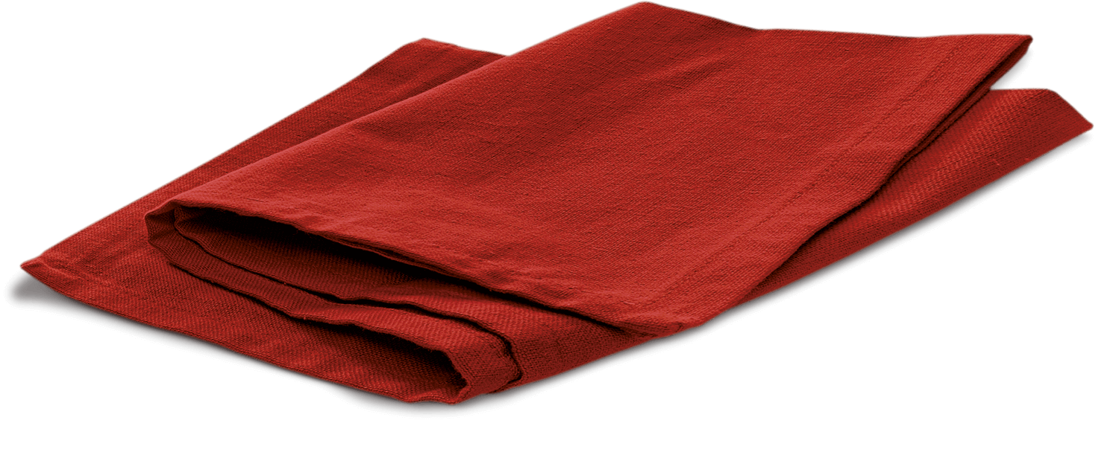
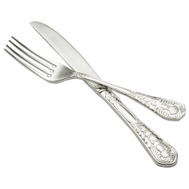
General Rules
Napkin:
Passing Items:
Keep the napkin on your lap when you sit down.
If you leave the table temporarily, put the napkin on your seat.
At the end of the meal, place the used napkin semi folded to the left side of your plate.
Ask for items to be passed to you rather than stretching across people or the table.
Pass the items counter-clockwise : to the right.
When several dishes are being passed at the same time, they all go in the same direction.
While passing Seconds, you can pass in any direction.
Taste the food before adding salt & pepper. To do otherwise insults the cook.
No negative comments about the food. Try at least a small portion of everything being served.
Thank the host!
Taste the food:

Slide 11


General Do’s & Don’ts
Do`s
Don’ts
Let your guest order first.
Usually the person who invites pays.
Be polite to the waiter – Use ‘Thank you’/ ’Please’whenever required.
Don’t stuff too much food at the same time.
Don’t pick your teeth.
Do not put any used spoon in the guest’s plate of common serving bowl.
Do not share from the same plate.
Notes:
Say: we have almost covered the basics of dining etiquette. I am sure you guys have fun.. Now, let’s discuss some of the basics that one has to follow under dining etiquette.
Note: Discuss the points mentioned.

Slide 12
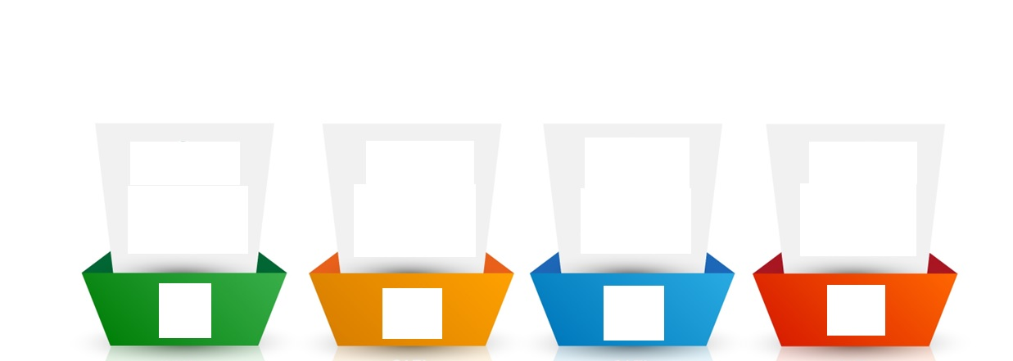
How should an ideal email be?
In intent, message, words and tone
To the point and preferably short
Polite, respectful and empathetic
Including all relevant information
Clear
Concise
Courteous
Complete
Notes:
Trainer:
An effective email has the following aspects:
Clear – As we saw earlier, a lot of misunderstanding and error can be caused due to unclear communication. Therefore, it is necessary to avoid vague responses. Statements like – I will let you know soon or phrases like as soon as you can, as soon as possible, in some time, do the needful etc. can be vague. Also, there must be clarity in the intent, message, words and tone of your email. Answer or ask in a simple, understandable manner. Use simple words and K.I.S.S (Keep It Short and Simple). All information in the email must be genuine
Complete – Your email must contain all the relevant information to the matter at hand so that there is no back and forth of emails. This will also need you to be clear about why you are writing the email and what information you want to share or ask for. Answer all questions and expected questions.
Concise – Your email must be preferably short and to the point. Avoiding unnecessary explanations or lengthy, complex sentences is necessary to maintain clarity and readability. Also, your email must be organized and clean for better understanding. Use shorter, meaningful statements and write to the point. Avoid unnecessary words and complicated vocabulary.
Courteous – As we know, your choice of words is all that matters in an email. Therefore, being polite, respectful and empathetic in your email will help you express your emotion, intent as well as involvement with the matter at hand. Usage of the right words will convey the right tone.
Remember: HOW you write an email shows WHO you are!
Now that we know how an email must be, let us look at the components of an email.
Transition to the next slide.

Slide 13
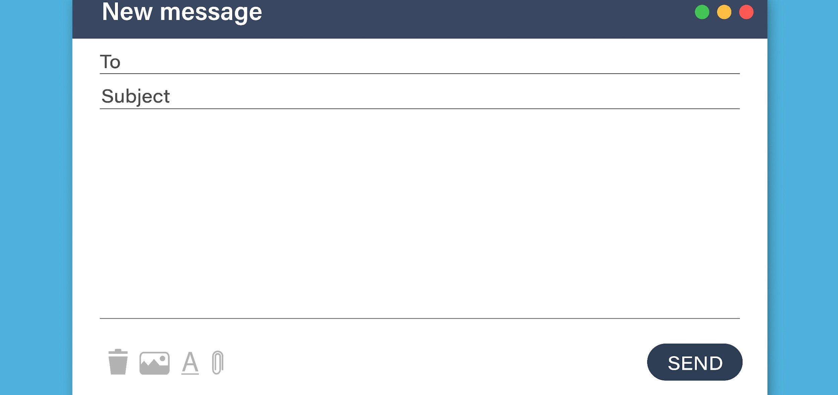
Components/Layout of an email
The Recipient/Address field – ‘To’ is mandatory, and Cc and Bcc are optional.
Subject line
Content box/ Email Body
Attachment
Notes:
Trainer:
Every typical email has some standard components:
The Recipient field – ‘To’ is mandatory, and Cc and Bcc are optional.
The Subject line
The content box/ Email Body
Attachment
Many other components like editing and formatting options depend on the email provider.
Let us look at how to draft an email.
Now, you may say – “I have been writing emails for ages now. What’s new?”
Trainer to ask:
When you are composing or drafting a new email, what is your first step?
Elicit responses. (You could ask each participant for their response)
Transition to the next slide.

Slide 14
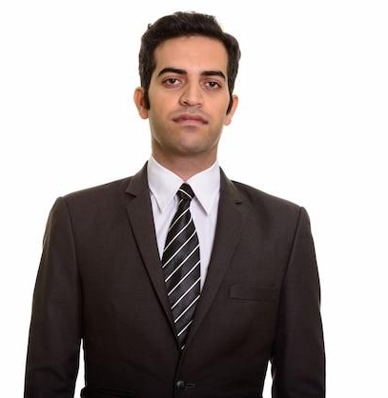
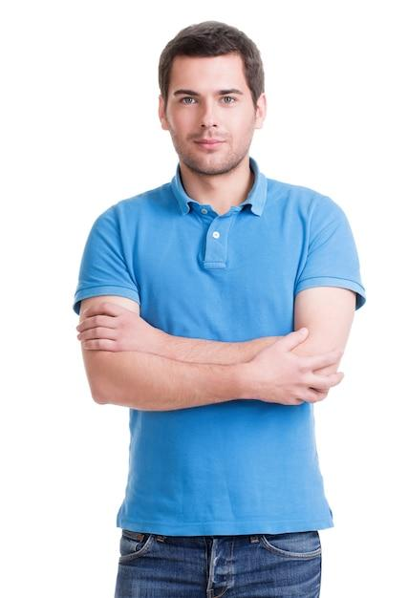

Salutations & Greetings
Hi
Most informal
Dear
Most formal
Hello
Semi-formal
Notes:
Trainer:
Every email starts with a greeting.
Like we pick up the phone every time and say Hello, every email must also start with a pleasantry.
There are 3 types of greetings:
Hi - extremely informal - used with close colleagues and peers
Hello – semi-formal – used with acquaintances, seniors and friendly customers
Dear – most formal – used with conservative, old-school individuals
We usually stick to “Hello” in most of our conversations.
Avoid using Hey! Or What’s up?
In India, the salutation ‘Respected’ is also often used.
But new-age communication doesn’t use this anymore.
However, you could use it while writing to someone that you truly respect or government officials. (respected more for their authority over matters)
Trainer to ask:
What greeting will you use while communicating with a new person?
Elicit responses.
You could use the salutation Dear and depending on the tone of their response, you could move to Hello in your next emails.
Trainer:
How do you use people’s names/titles after the salutation?
Elicit responses.
Debrief:
When you use a title – Mr, Ms, Mrs, Dr, you attach a person’s last name after it.
Usage of titles
Mr – for a man
Mrs – for a married woman
Ms – for any woman (especially if you don’t know if they are married or not)
Dr – for a medical doctor or a person with a doctorate
For example,
Mr. Khan
Ms. Cooper
Mrs. Nair
Dr. Einstein
If you are not using a title, you can use a salutation with a person’s first name.
For example,
Hello Shahrukh
Dear Amy
Hi Deepa
Dear Albert
The salutation and the name is followed by a comma but new-age email writing does need you to add one.
Some people also add a colon “:”.
The opening statement of an email starts after a line’s space.
Time-based greetings such as good morning/afternoon/evening is ok if you know the time zone of the reader.
Let us look at how to start an email.
Transition to the next slide.

Slide 15

Attachment
  Ensure that you attach the correct and latest file
  Name the file appropriately
  If there are multiple sheets in a spreadsheet (like Excel), you could mention them in the body of the email.
  If attachments are password protected, remember to drop a line in the email.
  Don’t Attach heavy files- Instead use a drive
Notes:
Trainer:
Here are some common points to remember about the attached documents:
Ensure that you attach the correct and latest file – often we have multiple files that are versions or updated documents saved as Doc (1) etc. To avoid confusion, you can consider placing the date ahead of the file name.
Name the file appropriately – It is necessary to name the file correctly instead of just saying report or manual. Be specific and name it a Quarterly Business Report or Training Manual.
If there are multiple sheets in a spreadsheet (like Excel), you could mention them in the body of the email – If a certain spreadsheet contains performance scores, appraisal percentages, attrition data etc.
If attachments are password protected, remember to drop a line in the email – sometimes, this is also added as a part of the signature if most files are sent securely.
Let us look at some examples.
Transition to the next slide.

Slide 16
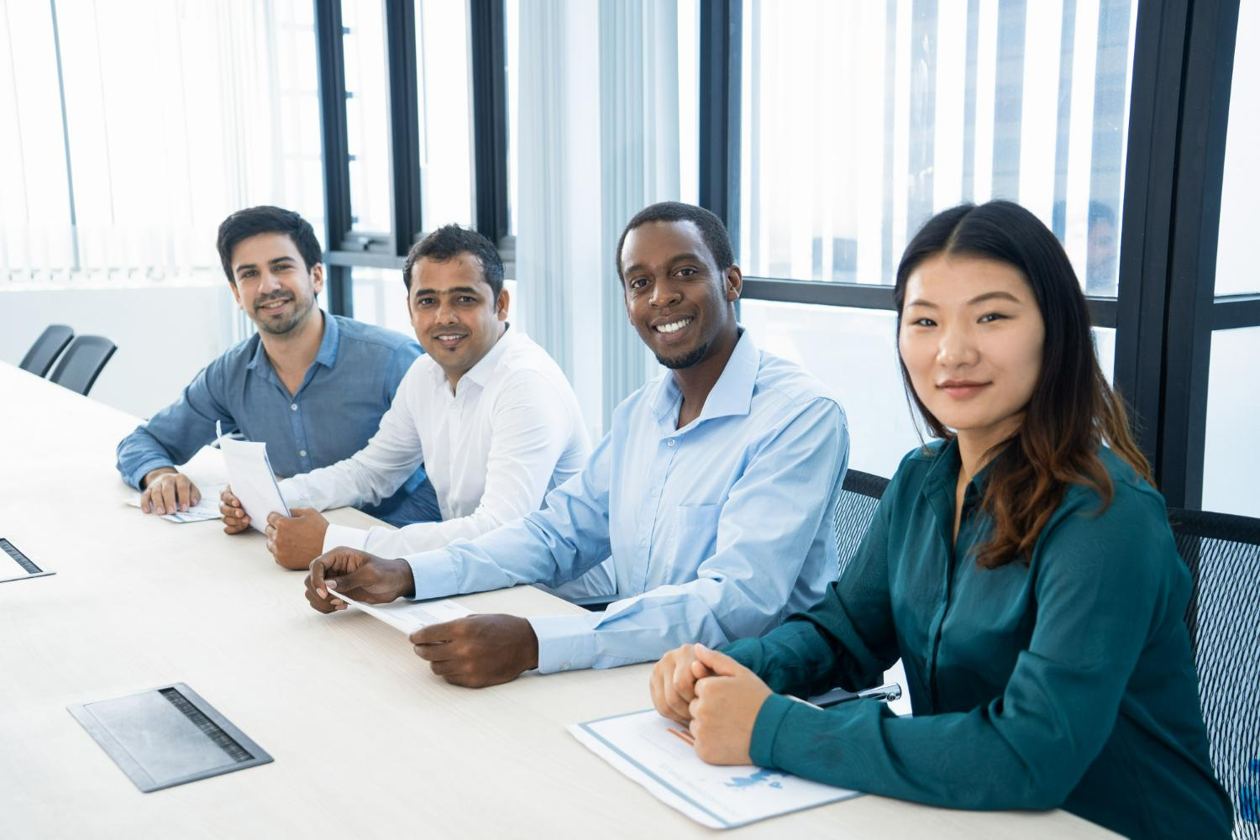
Essentials for an Effective Meeting – Dos’
  Have a strong agenda
  Sit appropriately [Posture]
  Speak up
  Understand the unwritten speaking rules
  Do not have your phone out
  Dress appropriately
Notes:
Work meetings aren't always fun. However, when you're required to attend one, it's important that you conduct yourself in a respectful and professional manner among your co-workers, bosses, and current or prospective clients.
1. Have a strong agenda.
This is part of being prepared, but you should have a good, strong agenda so that you can stay on track. If you do get off track, you should have a strong facilitator to get you back on track.
2. Sit appropriately.
Whether it’s a casual or a formal meeting, always sit straight and appropriately. Don’t slouch or lean back. Don’t forget to speak up.
If it's a sit-down meeting, you need to adjust your chair so that you're at equal height with everyone else at the table. Keep a check on your posture the whole time.
3. Speak up.
When people speak in meetings they need to speak loudly enough so that everyone hears what they're saying. "Many men and women, especially women, do not speak loudly enough. And speaking softly is a subtle nonverbal action that can affect your professionalism.
4. Understand the unwritten speaking rules.
It's not polite to interrupt others, but in some meetings, you have to interrupt at some point or you won't be heard. Understand the rules so that you can have a productive meeting.
5. Do not have your phone out.
A lot of people keep their phones on the table during meetings. Don't do this. This too, is a major distraction-even if it’s on silent mode.
Even if you aren't looking at your phone, it can get distracting if it starts lighting up or making noises.
Put it in your pocket, keep it on vibrate, and leave the room if you have to take the call or return a text,. It's really, really rude to be texting during a meeting.
6. Dress the Part: Always dress the part for any meeting. Your credibility will come under the scanner if you look sloppy.

Slide 17
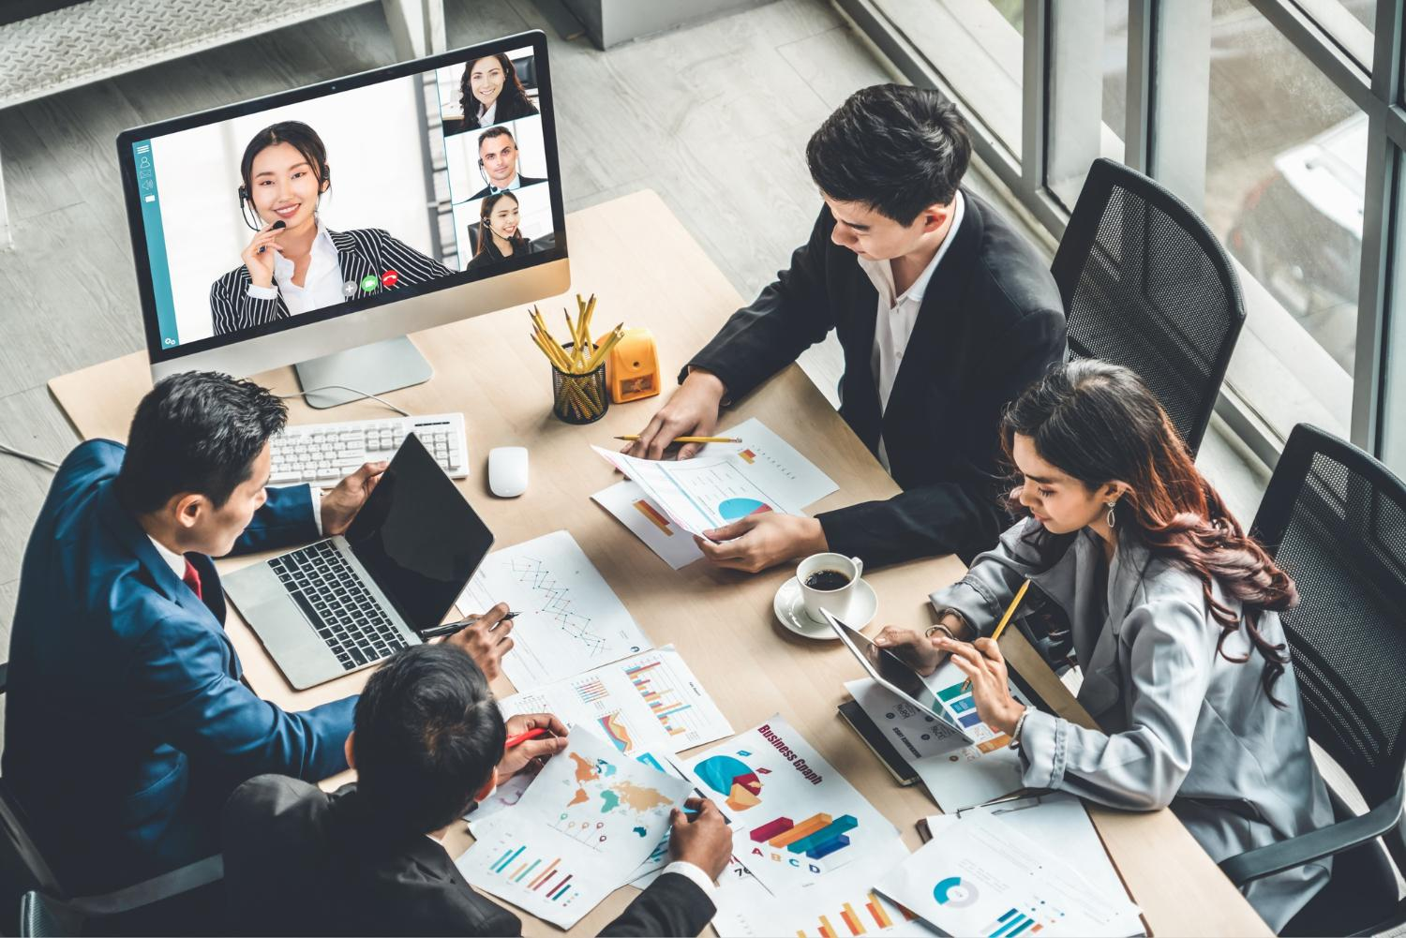
Virtual Meeting Etiquettes
  Be on time
  Stay on topic
  Keep your mic on mute
  Improve your Tone
  Be aware of Body Language & Facial Expressions
  Keep it Professional
  Actively Listen
  Ask Relevant Questions
  Choose your words carefully
  Avoid distractions
Notes:
The slide is self Explanatory

Slide 18

Importance of Telephone Etiquette:
  To Show professionalism
  Create a good first impression
  Increase trust and loyalty
  Help you build your Brand
  Customer Satisfaction
  Building long-term relations
  Better & Seamless Communication
Notes:
Explain the benefits as they are self explanatory

Slide 19
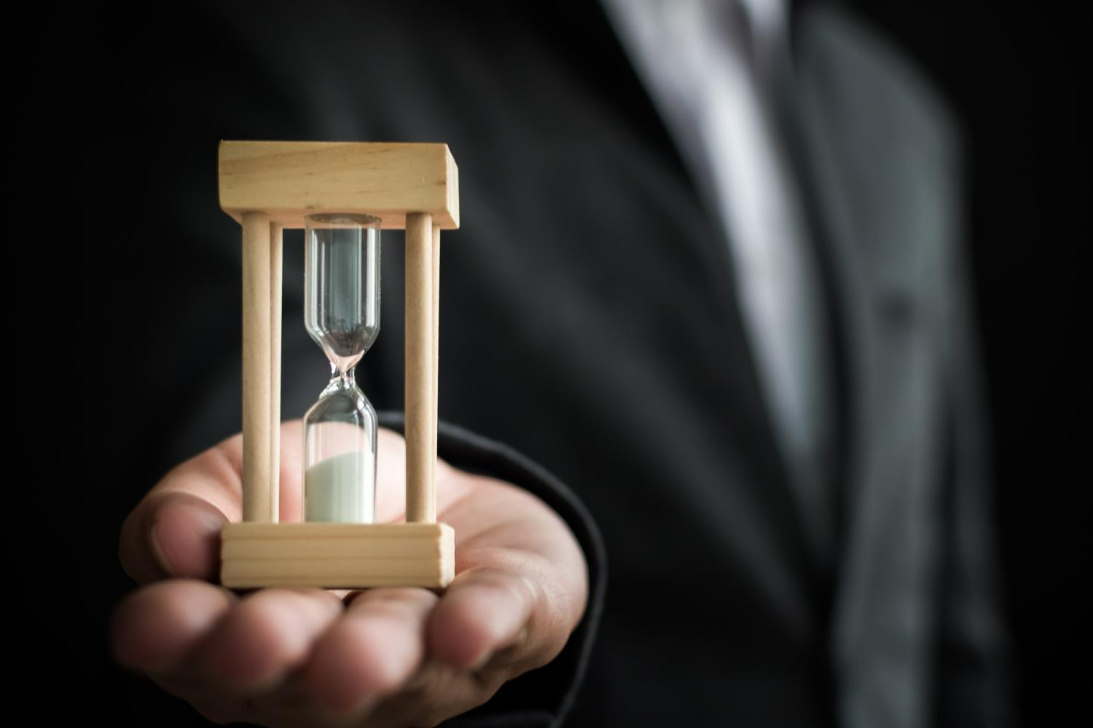
Social etiquette -Punctuality
  Punctuality communicates a plethora of positives to your employer and your peers.
  IST is not Indian Stretchable time.
  Be at least 10-15 minutes early for meetings
  Respect others time
  If you are not able to make it to the meeting-Keep others informed.
Notes:
Punctuality communicates a plethora of positives to your employer and your peers
Being punctual helps employees project a sense of professionalism and commitment.
.Punctuality is a simple way to show courtesy and respect for others: your customers, your clients and your colleagues.
When you show up late for appointments, meetings or meals, you send a clear message to others that your time is more important than theirs.
It shows that you’re dedicated to the job, interested in the work and capable of handling responsibility.
When leaders are late, it sends an irresponsible message to employees, which may lower morale; when leaders are punctual, it exhibits a work ethic to aspire to
When you arrive on time for work or work-related activities, it shows that you are capable of honoring your word.
For instance, when everyone is on time for a meeting, the meeting is able to start in full stride.
Punctuality may help you achieve advancement.
Research conducted by Diana DeLonzor, author of “Never Be Late Again: 7 Cures for the Punctually Challenged”, shows that managers are less likely to promote late employees.
Ask what is courtesy? And why is it important?
Collect responses and move to next sldie

Slide 20

Social Etiquette – Gifting
  In Indian business etiquette, gift giving is not a customary part.
  Moreover, when you are invited to social gathering or functions, you should bring a bouquet or convenient gift
  The idea is to keep the gift small, not very expensive yet thoughtful.”
  Taking the effort to wrap a gift or place it in a gift box or bag, on the other hand, might make a less expensive gift appear more valuable
  For corporate gift giving/ accepting- Please check your Gifts policy
Notes:
In Indian business etiquette, gift giving is not a customary part
Once a relationship has flourished, gifts may be exchanged.
Reciprocation is a respectable practice when gifts are received.
In India, many organizations and government encourage their employees not to accept any form of gifts to prevent them from the legal consequences.
However, it is essential to ensure that the gift is not expensive enough to be considered as bribe or inexpensive as to be considered as an insult.
Moreover, when you are invited to social gathering or functions, you should bring a bouquet or convenient gift
The idea is to keep the gift small, not very expensive yet thoughtful.”
Taking the effort to wrap a gift or place it in a gift box or bag, on the other hand, might make a less expensive gift appear more valuable

Slide 21




98752-08472
Hello@freelancetrainings.com
www.freelancetrainings.com
406, Titanium City Centre Mall, Anand Nagar, Satellite, Ahmedabad-380015

