Slide 1



Workshop on Image Management-1 Day
Notes:
Image Management
Understanding Image Management
Personal Vs Professional Image
Components of Image Management
Benefits of a Great Professional Image to Individuals

Slide 2

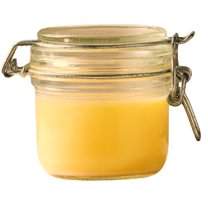

Which Ghee would you like to buy for your family?
Pure Ghee
Option 1
Option 2
Notes:
Which Ghee will you want to buy for your family. Both the products are of the same quality and of the same price.
Option A Or B.
80% of the audience will say Option 2- Ask the participants why and wait for the responses. The responses will be like
Option A is of dark colour giving an impression of impure
Option A is not a Brand
Option A is a loose ghee
Option A does not look hygienic
Trainer to prompt for answers and then move to the next slide

Slide 3
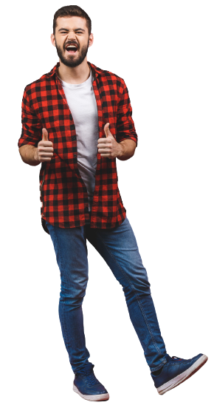
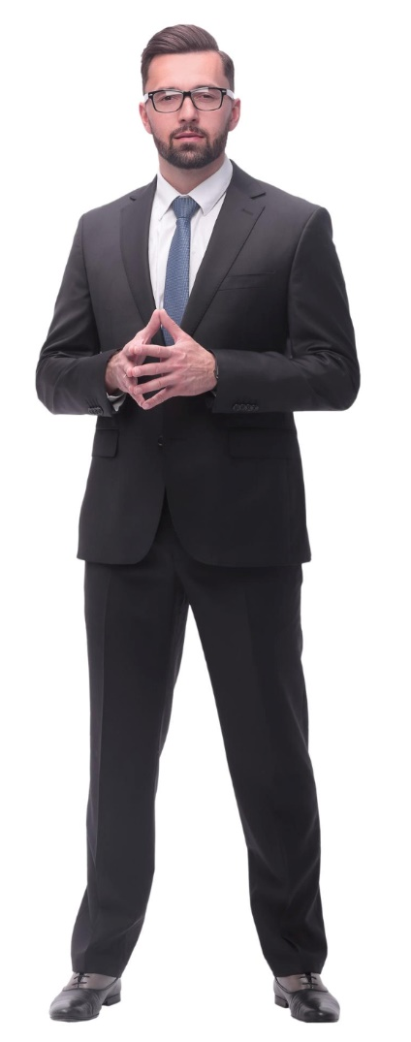
Who would you like to Hire as Manager
Option 1
Option 2
Notes:
Which of the 2 professionals will you like to hire
Option A Or B.
80% of the audience will say Option 2- Ask the participants why and wait for the responses. The responses will be like
Option A doesnot look serious
Option A is not dressed proferly
Option A is of casual nature
Trainer to prompt for answers and then move to the next slide

Slide 4

What is Attitude?
The way a person thinks or feels about a specific person, place, action or experience.
Notes:
Ask: What is attitude?
Elicit response.
Say: Attitude is the way a person thinks or feels about a specific person, place, action, or experience. Similar to the individual perspective, attitude encompasses the individual’s particular emotions and the way in which they act towards people and work. Attitude is a specific disposition that combines factors like beliefs, opinions, moods, and emotions. Sometimes, attitude is referred to as an outlook or mental state that affects the way people perceive the world around them and the way they experience life, work, relationships, and more.
Ask: Why is positive attitude so important for professional excellence?
Transition to the next slide.

Slide 5

Why is having a Positive Attitude Important for Professional
Boosts productivity
Reduces stress
Supports learning
Improves problem-solving
Increases confidence
Increases resilience
Helps you manage conflict
Notes:
Our attitude is directly responsible for our behavior. More wholesome our attitude, the more empowered our conduct.
With a positive attitude, you can improve your emotional well-being and self-image. It is a powerful tool for personal growth and professional excellence.
The power of a positive attitude in the workplace has been proven to:
Boost productivity
Reduce stress
Support learning
Improve problem-solving
Increase confidence
Increase resiliency
Help manage conflict
A positive attitude could also be regarded as one that is oriented toward finding what is best about a given situation or environment and then building on that.
While many factors are responsible to propel a wholesome professional attitude, we will be discussing four key ones today:
Taking ownership and accountability at work
Having a solution-centric approach
Avoiding blame game
Operating from one’s circle of control.
Transition to the next slide.

Slide 6
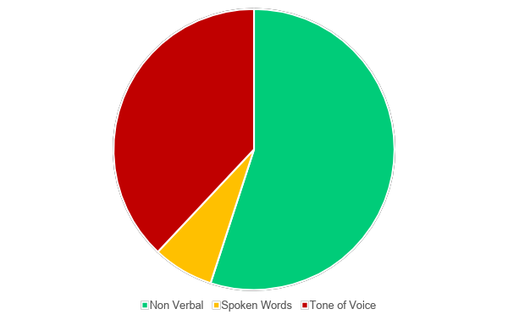
Nonverbal Communication- The Mehrabian Model
Tone of Voice
38%
Non Verbal
55%
Words
7%
“Actions speak louder than words!!!” -St. Anthony of Padua
Notes:
Say: What is nonverbal communication?
Actions speak louder than words!!
If you remember Merabian’s Theory : Dr. Mehrabian devised a formula to describe how the mind determines meaning. He concluded that the interpretation of a message is 7 percent verbal, 38 percent vocal and 55 percent visual. The conclusion was that 93 percent of communication is “nonverbal” in nature.
Nonverbal communication is the conveyance of information with the use of body language encompassing eye contact, facial expressions, voice tone, haptics and body gestures. For instance, smiling when you greet someone communicates warmth, acceptance and openness. Everyone, whether they realise it or not, utilises nonverbal communication all the time. As opposed to verbal communication that employs language to transmit information, be it through written text, speech or sign language, nonverbal communication relies on seeing and understanding physical gestures and movements.
So mainly we 4 things will discuss on the this.
Body Language 2. Gestures, Posture & Movement 3. Eye contact 4. Facial Expression.
Link for Ref -
What Is Nonverbal Communication (With Benefits and Types) | Indeed.com Singapore

Slide 7

Importance of Non Verbal Communication
Helps overcome cultural barriers
Helps communicate with the nonliterate or people with hearing disability
Increases workplace efficiency
Reinforces trust and credibility
Conveys emotions and feelings
Influences first impressions
Notes:
Say: Before we understand the aspects of non verbal communication in detail first let us list down the Importance Of Nonverbal Communication
Ask for few points from participants before displaying the points on screen.
Here’s how nonverbal communication helps. It:
Adds Value To Verbal Communication
Helps Overcome Cultural Barriers
Helps Communicate With The Nonliterate Or People With A Hearing Disability
Increases Workplace Efficiency
Reinforces Trust And Credibility
Conveys emotions and feelings
Influences first impressions
You will be an effective communicator if you pay attention to yours as well as other people’s body language.

Slide 8
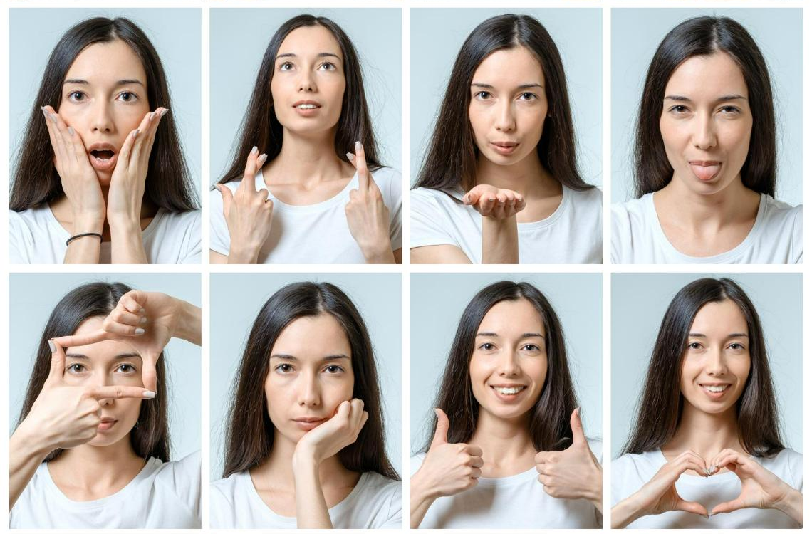
Facial Expressions
Facial expressions, gestures, and eye gaze are often important part of Body language
Notes:
Just a few examples of emotions that can be expressed via facial expressions include:
Happiness
Sadness
Anger
Surprise
Disgust
Fear
Confusion
Excitement
Desire
Contempt
The expression on a person's face can even help determine if we trust or believe what the individual is saying.
There are many interesting findings about body language in psychology research
. One study found that the most trustworthy facial expression involved a slight raise of the eyebrows and a slight smile
. This expression, the researchers suggested, conveys both friendliness and confidence.³
Facial expressions are also among the most universal forms of body language.
The expressions used to convey fear, anger, sadness, and happiness are similar throughout the world.
Researcher Paul Ekman has found support for the universality of a variety of facial expressions tied to particular emotions including joy, anger, fear, surprise, and sadness.⁴
Research even suggests that we make judgments about people's intelligence based upon their faces and expressions.

Slide 9

Professional Handshake
Culture Specific (Namaste/Shake hand).
Make sure your right hand is open so the lower joint of the thumb of both parties touch to ensure firm grip.
The grip should be firm--not limp or so strong that it hurts the other person. Firm Handshake shows Credibility, Confidence & Trust.
Adjust your grip to that of the other person and always stand and shake hand- Don’t do the same while sitting.
A good handshake has a smooth up-and-down motion.
Gauge when the person wants to end the shake, and then do so right away. (Ideal time is 2-3 seconds).
Notes:
Say Handshake is the first contact with anyone and hence it lays a very strong foundation of confidence, Trust and as a result a great first impression .Points to note
Handshake is culture specific and in some conservative cultures it is not the handshake that people are comfortable with. Gauge the culture and then either use a handshake or Namaste
Ensure right hand is open and palms touch
Have a firm grim not strong or limp. The firm handshake denotes confidence, credibility and Trust
Adjust grip basis comfort of the other party
Smooth up and down motion are features of a good handshake
Facial expressions and body language will indicate when the other person wants to end the handshake so observe the same and be aware
Ask so what is the right way to give a visiting card ?
Take responses then say ok now lets move to the next slide and learn the same

Slide 10
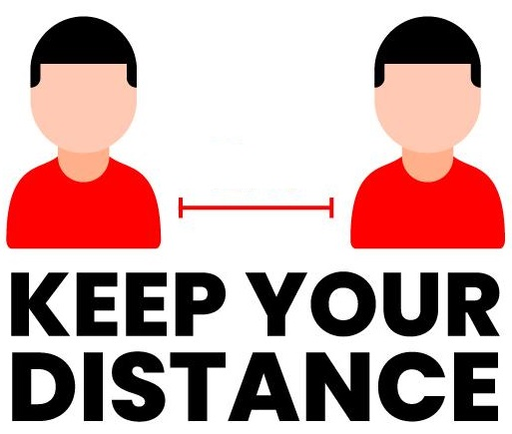

Space
Edward T. Hall invented the concept proxemics- which mentions the space Etiquettes.
Four Types of interpersonal distance, or degrees of proximity that we experience.
Public distance- (12-25 Feet)
Social distance (4-12 Feet)
Personal distance (1.5- 4 Feet)
Intimate distance (Less than 1.5 Feet)
12-25 Feet
4-15 Feet
1.5-4 Feet
≤1.5 Feet
Notes:
Classical proxemics theory was started in the 1960s by anthropologist Edward T. Hall. 1960s by anthropologist Edward T. Hall. Edward Twitchell Hall, Jr. was an American anthropologist and cross-cultural researcher. He is remembered for developing the concept of proxemics . Proxemics is the study of how space is used in human interactions..
He classified four degrees of interpersonal distance, or degrees of proximity that we experience
Public distance
Social distance
Personal distance
Public distance :At this distance (between 12–25 feet), you must speak louder to be heard, and it’s more difficult to maintain direct eye contact, so the connection between two people is minimal.
Social distance : This distance (between 4–12 feet) relies on visual and auditory cues to form a connection, since you’re still too far apart to touch or perceive body heat.
Personal distance : This distance (between 1.5–4 feet) is kept during interactions with friends. Here, vision is clear, eye contact is strong, and conversation flows easily.
Intimate distance: This distance (less than1.5 feet) is kept during interactions with friends. Here, vision is clear, eye contact is strong, and conversation flows easily.

Slide 11
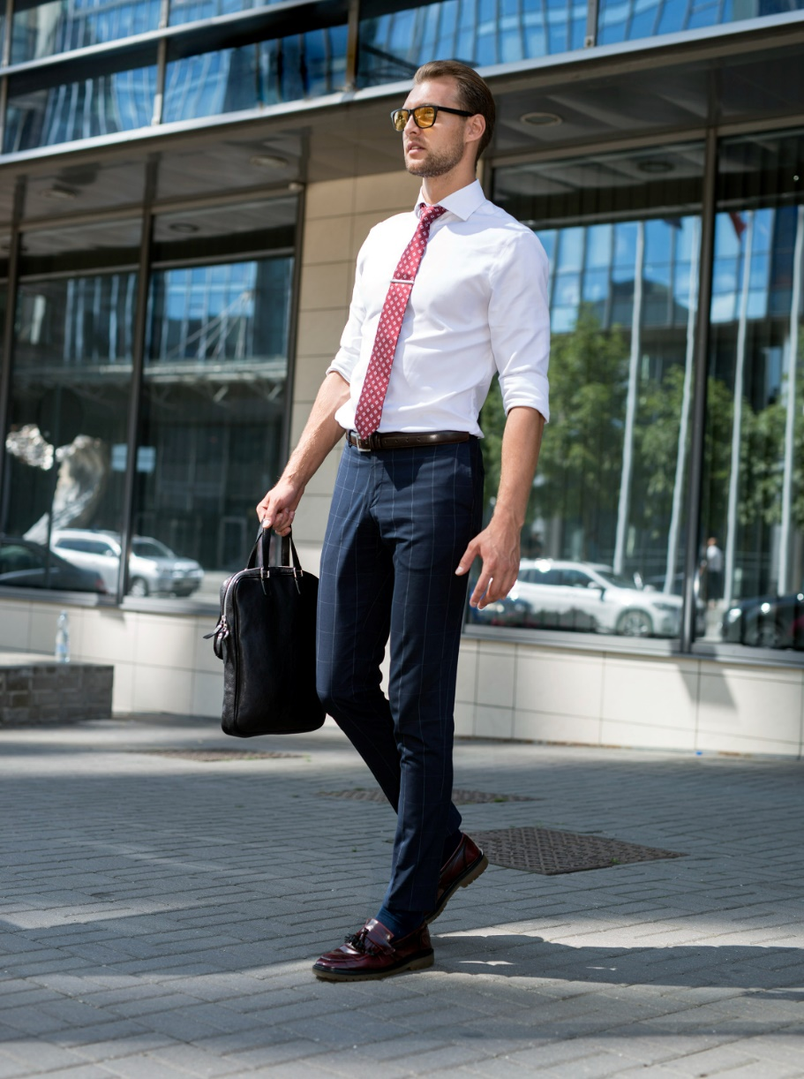
Corporate Dressing for Male -Some Tips
Do not wear flashy belts with broad buckles.
The color of your belt & shoes should match.
Make sure your sleeves touch the base of your hand. Do not roll up sleeves at work
Wear clean & washed socks.
Your socks should match the color of your pants /shoes
Shoes should be polished.

Slide 12

Casual Dressing -Some Tips
Women’s slacks are one of the favorite clothing pieces
Wear them with one of your favorite formal shirts, a casual tweed blazer, or a light sweater
The suit is, without doubt, the most formal piece of all the business formal wardrobe
To complete the perfect business casual outfit, you should take care of your shoes.
Notes:
Pair a blazer with a casual
Try wearing a sheath dress with an oversized linen blazer, bright and funky trench coat, or a chunky sweater for a more laid-back office environment. hirt, jeans or chinos, or a lightweight dress to keep the look clean and simple but still semi-formal.
Combine formal shirt with linen chinos, dark jeans (these should not be bleached or ripped), a sweater, or an oversized trench coat.
Wear slacks with one of your favorite formal shirts, a casual blazer, or a light sweater
Wear a pencil skirt with an informal shirt tucked in or a flared skirt with a plain t-shirt that fits you well.
Go for a suit in bright pastel colors that can be easily combined with a simple white t-shirt and ballerinas
Go for sleek looking loafers as a part of the dress code
For most women, a business wardrobe consists of essential pieces in neutral colors, such as black, dark blue, beige, or white.
Luckily for all, the business casual style allows us to introduce more colors into our daily outfits and make the whole color scheme available.

Slide 13






Thanks for Participation
987-5208-472
Hello@freelancetrainings.com
www.freelancetrainings.com
406, Titanium City Centre Mall, Anand Nagar, Satellite, Ahmedabad-380015

