Slide 1
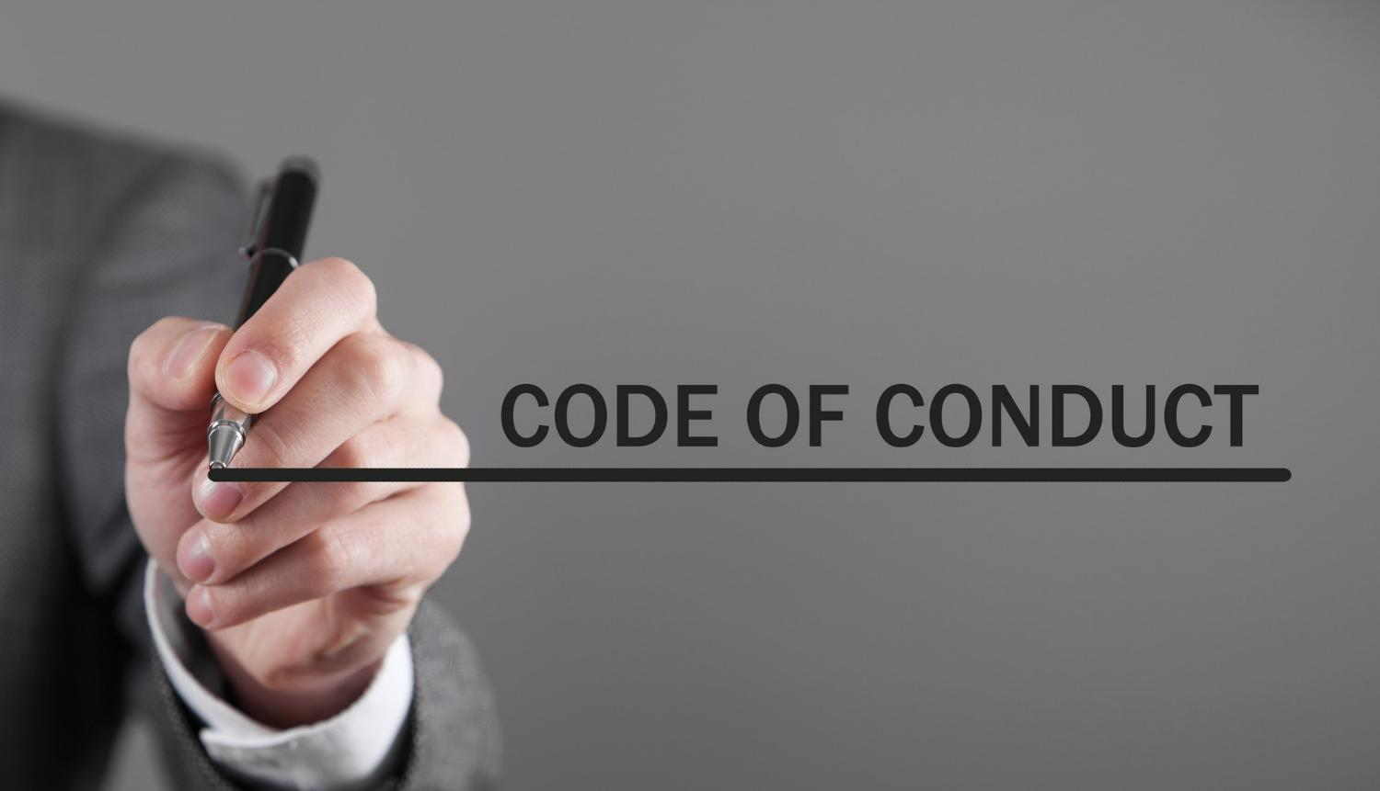


Code of Conduct Training Workshop
Notes:
Welcome to the training program on the Code of Conduct for our organization. In this session, we will delve into the importance of a Code of Conduct, its components, and how it contributes to maintaining a positive work environment and ethical practices within our company.
Trainer should customise this module depending on the code of conduct of the client organisation.

Slide 2

Notes:
Trainer to Start this Module by building on rules and how the rules are important in our life
We have rules everywhere and these rules are rules are not arbitrary restrictions but essential boundaries that maintain order and safety in our lives. Adhering to them is not a limitation but a pathway to our own protection and the protection of those we care about.
Our Mythology has many such stories where whenever the rules have not been followed there has been always been problems. Lets take the example of Famous Laxman Rekha example from Ramayan. When goddess sita did not follow that rule she was caught up in a trap of Ravan
This powerful anecdote teaches us a valuable lesson. It reminds us that rules and boundaries are often established for our own safety and protection. In our lives, we encounter various rules and guidelines that may seem restrictive at times, much like the Laxman Rekha. However, these rules are meant to safeguard us from potential harm, chaos, or danger.

Slide 3




Rules are Applicable Everywhere
Notes:
Rules are applicable in all the phases of our Life
School Life: Remember how rules in school ensured that the learning environment was conducive to education? Rules in school taught us discipline and respect for others.
College Life: In college, we encountered more independence, but there were still rules in place to promote a respectful and inclusive campus culture.
Family: Within our families, rules help maintain peace and harmony. They guide our interactions and expectations of one another.
Road: On the road, traffic rules are crucial for our safety. Ignoring them can lead to accidents and chaos.
Now, imagine what would happen if we ignored these rules in any of these contexts. Chaos, confusion, and potentially serious consequences would ensue. The same principle applies in our workplace

Slide 4

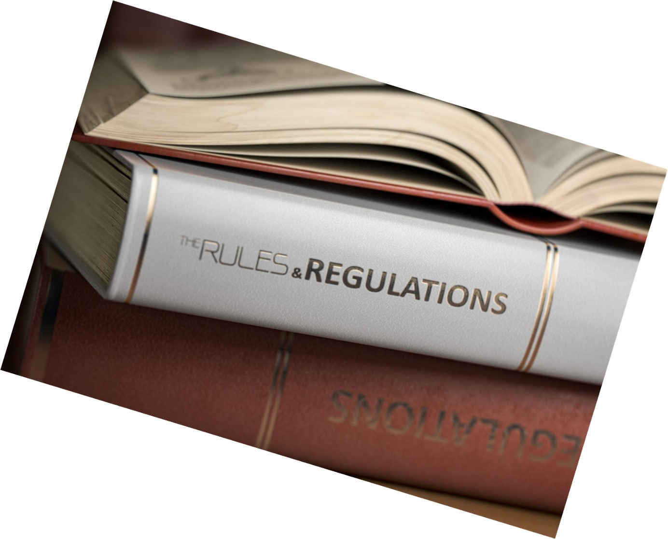
Corporate & Code of Conduct
The Perfect Alignment
Notes:
Similarly Corporate world also have different rules that we follow that define ethical and unethical behaviours. These Rules and regulations are called as Code of Conduct and Our company's Code of Conduct is the set of rules that guides our behavior, ensuring that we work together harmoniously, maintain a positive reputation, and uphold our values.

Slide 5
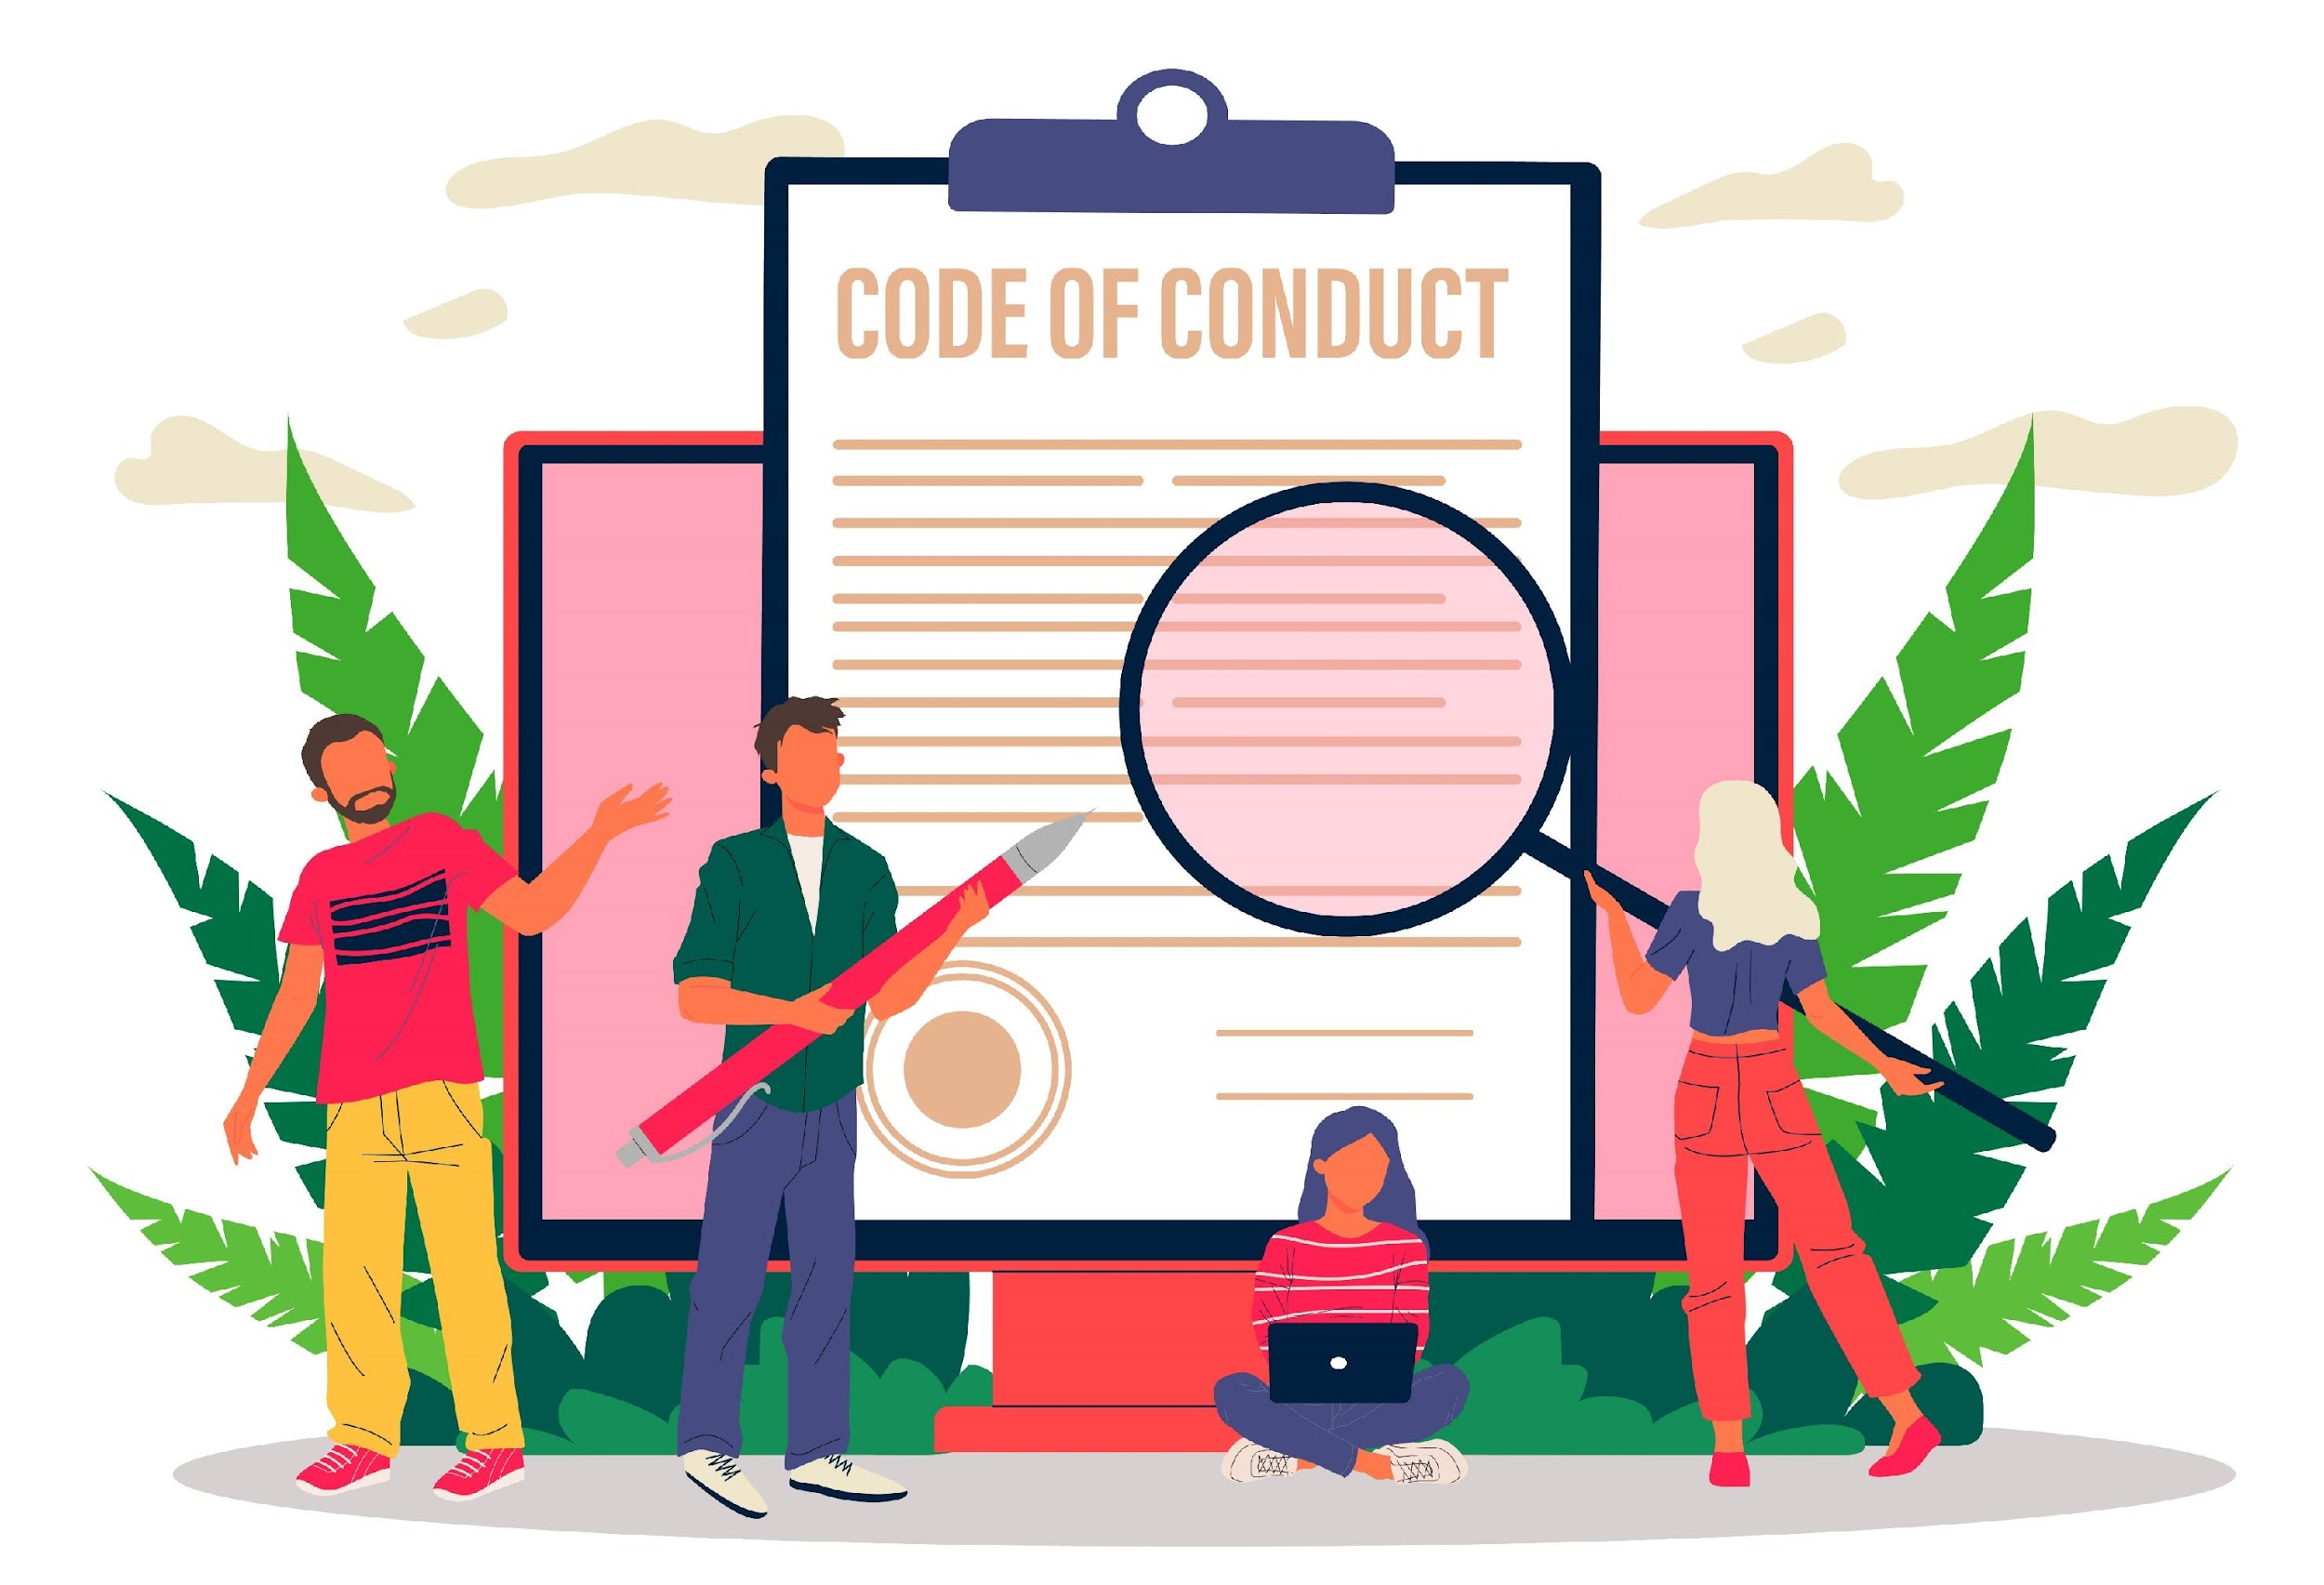
What is a Code of Conduct?
Comprehensive and formal document that outlines a set of principles, guidelines, and standards of behavior that individuals within a particular organization are expected to follow.
Reflects the organization's values, culture, and commitment to ethical practices.
Notes:
A Code of Conduct is a comprehensive and formal document that outlines a set of principles, guidelines, and standards of behavior that individuals within a particular organization are expected to follow. It provides a framework for ethical decision-making and governs interactions, both within the organization and with external stakeholders. A Code of Conduct serves as a guiding reference for employees, helping them understand what is considered acceptable and unacceptable behavior within the context of their workplace.
It typically reflects the organization's values, culture, and commitment to ethical practices.

Slide 6


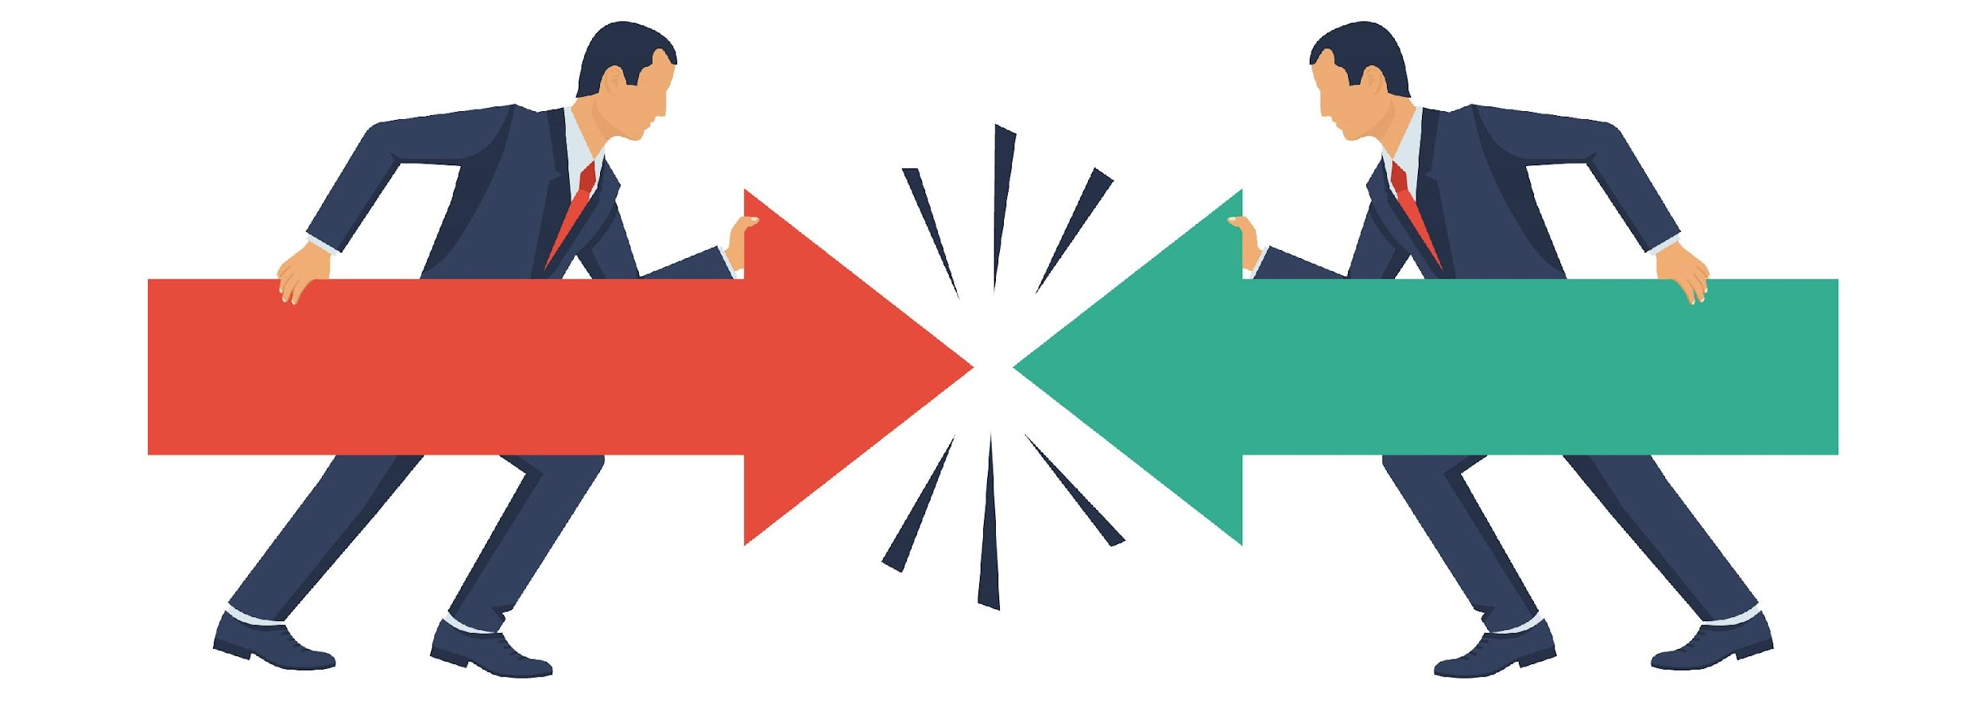
What are Key Elements of the Code of Conduct?
Ethical Standards and Values
Respectful and Inclusive Behavior
Conflicts of Interest
Notes:
The key elements of a Code of Conduct:
1. Ethical Standards and Values:
Ethical standards are principles that guide our behavior and help us differentiate right from wrong. They reflect the values we hold dear as an organization.
Employees should align their personal values with the company's ethical standards to maintain consistency in their actions.
Takeaway: Employees should leave this training with a strong understanding that ethical behavior is the bedrock of our organization, and they play a crucial role in upholding these standards.
2. Respectful and Inclusive Behavior:
Respect involves treating all individuals with dignity, regardless of their background, position, or beliefs. An inclusive workplace values diversity and promotes an environment where everyone can contribute their best. Harassment and discrimination in any form are unacceptable and will not be tolerated.
Training Approach:
Takeaway: The takeaway is that respectful and inclusive behavior is the cornerstone of a harmonious and high-performing workplace.
3. Conflicts of Interest:
Conflicts of interest occur when personal interests or relationships interfere with one's ability to act in the best interests of the organization. Employees should be aware of the organization's policies and procedures for disclosing conflicts of interest and should adhere to them diligently. Ignoring conflicts of interest can lead to damage to the organization's reputation and legal repercussions.
Takeaway: Employees should leave this training with a clear understanding of what constitutes a conflict of interest, how to manage it, and why transparency in this regard is vital for maintaining trust and credibility.
These Key elements can guide the development of Code of Conduct within your organization.

Slide 7

Respectful and Inclusive Behavior at Workplace
Treating all individuals with consideration, dignity, and fairness, regardless of their background, identity, or differences.
Benefits of Respectful & Inclusive Behaviour
Fosters Positive Relationships
Enhances Employee Well-Being
Boosts Productivity
Encourages Open Communication
Reduces Conflict
Reflects Organizational Values
Promotes Diversity and Inclusion
Notes:
Respectful and inclusive behavior in the workplace entails treating all individuals with consideration, dignity, and fairness, regardless of their background, identity, or differences.
It involves fostering an environment where every voice is heard, diverse perspectives are valued, and discrimination and harassment are strictly prohibited.
By embracing respectful and inclusive behavior, organizations promote diversity, equity, and a culture of mutual respect, which not only enhances employee well-being but also drives creativity and productivity.
Benefits of Respectful & Inclusive Behaviour
Fosters Positive Relationships: Treating others with respect creates a foundation of trust and goodwill. It helps build positive relationships both personally and professionally, leading to more effective communication and collaboration.
Enhances Employee Well-Being: When people are treated with respect and dignity, their self-esteem and overall well-being improve. This, in turn, leads to higher job satisfaction, better mental health, and reduced stress in the workplace.
Boosts Productivity: Respectful treatment fosters a sense of belonging and motivation among employees. When people feel valued, they tend to be more engaged, committed, and productive, contributing to the organization's success.
Encourages Open Communication: A respectful environment encourages open and honest communication. Employees are more likely to voice their ideas, concerns, and feedback when they know their input will be heard and respected.
Reduces Conflict: Respectful behavior minimizes misunderstandings and conflicts. When individuals treat each other with consideration, it becomes easier to resolve disagreements constructively and maintain a harmonious work atmosphere.
Reflects Organizational Values: Organizations that prioritize respect and dignity in their culture align their actions with their stated values. This consistency strengthens the organization's reputation and credibility.
Promotes Diversity and Inclusion: Respect and dignity are fundamental to creating a diverse and inclusive workplace. By valuing differences and ensuring all voices are heard, organizations can harness the power of diversity for innovation and growth.

Slide 8


Where to Apply Code of Conduct
Professional Communication
Workplace Behavior and Attire
Use of Company Resources
Gifts & Entertainment
Anti Harassment
Kickbacks, Anti - Bribery and Anti – Corruption
Treat everyone with dignity & Respect
Notes:
There are some important areas where we can apply Code of Conduct.
1. Professional Communication:
Professional communication in the workplace refers to the use of clear, respectful, and effective communication methods when interacting with colleagues, clients, and stakeholders. It encompasses verbal and written communication, active listening, and conveying information in a manner consistent with the organization's values and standards.
2. Workplace Behavior and Attire:
Workplace behavior and attire pertain to the expected standards of conduct and dress within an organization. It involves adhering to professional behavior, demonstrating respect for colleagues, clients, and the workplace, and wearing appropriate clothing and grooming that align with the company's culture and policies.
3. Use of Company Resources:
The responsible use of company resources involves using organizational assets, facilities, and tools for work-related purposes efficiently and ethically. This includes equipment, time, funds, and other resources. Misuse or abuse of these resources can have financial, operational, and ethical consequences.
4. Gifts & Entertainment:
Gifts and entertainment guidelines establish rules for giving and receiving gifts or hospitality in a professional context. These guidelines are essential to prevent conflicts of interest, maintain objectivity, and uphold ethical standards when dealing with clients, vendors, and business partners.
5. Anti Harassment:
Anti-harassment policies are designed to create a safe and respectful workplace by prohibiting any form of harassment, such as sexual harassment, bullying, or discrimination based on factors like gender, race, religion, or sexual orientation. These policies outline reporting procedures and consequences for violations.
6. Kickbacks, Anti-Bribery, and Anti-Corruption:
These policies and guidelines aim to prevent unethical practices like bribery, corruption, and kickbacks within the organization. They emphasize compliance with anti-bribery laws, fair competition, and maintaining integrity in business transactions.
7. Treat Everyone with Dignity & Respect:
Treating everyone with dignity and respect is a fundamental principle of workplace behavior. It entails valuing diversity, refraining from discrimination or harassment, and fostering an inclusive environment where all individuals are treated fairly and equitably.
These concise areas are key elements to apply Code of Conduct.

Slide 9


Workplace Behavior & Attire
Guidelines on professional behavior, respect for colleagues, clients, and the workplace, as well as expectations regarding appropriate clothing and grooming.
Professional Behavior:
Respect and Courtesy
Integrity and Honesty
Teamwork and Collaboration
Timeliness and Accountability
Conflict Resolution.
Ethical Decision-Making
Adherence to Policies
Professional Attire
Dress Code
Grooming and Hygiene
Adaptation to Occasion
Client and Customer-Facing Roles
Safety Considerations
Cultural Sensitivity
Company Brand
Notes:
Workplace behavior and attire, as outlined in a Code of Conduct, define the expected standards of conduct and dress within an organization. Guidelines on professional behavior, respect for colleagues, clients, and the workplace, as well as expectations regarding appropriate clothing and grooming.
Adhering to these standards fosters a professional, respectful, and inclusive work environment, aligning with the organization's values and promoting a positive corporate culture.
Professional Behavior:
Respect and Courtesy: Employees are expected to treat all colleagues, clients, and stakeholders with respect and courtesy. This includes using polite language, active listening, and consideration for diverse perspectives.
Integrity and Honesty: Employees should conduct themselves with integrity and honesty in all interactions. This involves being truthful, maintaining confidentiality when required, and avoiding conflicts of interest.
Teamwork and Collaboration: Organizations often expect employees to collaborate effectively with colleagues, promoting teamwork, and contributing to a positive work environment.
Timeliness and Accountability: Punctuality and meeting deadlines are important aspects of professional behavior. Employees are expected to take responsibility for their work and actions.
Conflict Resolution: When conflicts arise, employees should address them professionally, seeking resolution through respectful dialogue and, if necessary, involving appropriate channels or supervisors.
Ethical Decision-Making: Employees should make decisions based on ethical principles and the organization's values. This includes adhering to legal and regulatory standards.
Adherence to Policies: Employees are expected to follow all company policies and procedures, including those related to communication, technology use, safety, and ethics.
Professional Attire:
Dress Code: Organizations may have specific dress codes that dictate the type of attire considered appropriate for the workplace. These dress codes can range from formal business attire to business casual or industry-specific attire.
Grooming and Hygiene: Maintaining personal grooming and hygiene standards is crucial. This includes cleanliness, appropriate hairstyle, and well-kept grooming habits.
Adaptation to Occasion: Employees should adapt their attire to the occasion. This may involve dressing more formally for client meetings or special events and dressing more casually for day-to-day office work.
Client and Customer-Facing Roles: Those in client or customer-facing roles may have specific attire expectations to create a positive impression and align with client expectations.
Safety Considerations: In certain industries, attire may need to meet safety standards, such as wearing protective gear, uniforms, or specialized clothing.
Cultural Sensitivity: Organizations operating in diverse environments should be sensitive to cultural norms regarding attire and consider accommodating cultural preferences.
Company Brand: Some organizations require employees to wear clothing with the company logo or branding to promote a consistent and professional image.

Slide 10

Use of Company Resources
Misuse or abuse of company resources can lead to disciplinary actions.
6 Most commonly unauthorise use of Company’s Resources:
Personal Use of Company Equipment
Misuse of Office Supplies
Unauthorized Software Installation
Unauthorized Access to Data
Personal Use of Company Vehicles
Excessive Personal Phone Calls
Notes:
The use of company resources refers to how employees utilize the assets, facilities, and tools provided by their employer for work-related purposes.
It encompasses equipment, time, funds, and other assets. Adhering to responsible and ethical use of these resources is vital for efficiency, cost-effectiveness, and maintaining trust within the organization. Misuse or abuse of company resources can lead to disciplinary actions and negatively impact an organization's financial health and reputation.
Following are the 6 most commonly used examples of Unauthorised use of company’s resources
Personal Use of Company Equipment: Employees using company-owned computers, smartphones, or other devices for personal activities, such as excessive personal browsing, social media use, or gaming during working hours, without proper authorization.
Misuse of Office Supplies: Unauthorized use of office supplies, such as taking home office stationery, printers, or other materials for personal use or projects not related to work.
Unauthorized Software Installation: Installing unauthorized software or applications on company devices without proper approval, which can lead to security vulnerabilities and licensing violations.
Unauthorized Access to Data: Employees accessing and using company data, databases, or confidential information for personal purposes, such as sharing sensitive information with unauthorized parties or using data to benefit a personal venture.
Personal Use of Company Vehicles: Employees using company-owned vehicles for personal trips or purposes that are not related to business operations, increasing fuel and maintenance costs for the organization.
Excessive Personal Phone Calls: Making personal phone calls from company landlines or using company-issued mobile phones excessively and without authorization, leading to increased communication expenses for the organization.
It's important for organizations to have clear policies and guidelines in place to address unauthorized use of company resources. These policies should outline the consequences of such actions and provide employees with a clear understanding of what is considered acceptable use. Effective communication and regular reminders of company policies can help mitigate instances of unauthorized resource use.

Slide 11

Process For Reporting Violations Of The Code
Of Conduct
Legal and Compliance Teams
Internal Reporting
Ombudsman or Ethics Officer
HR or Compliance Department
Direct Contact with Leadership
Whistleblower Hotline
Online Reporting Tools
Written Reports
Email
Notes:
Companies typically establish multiple channels for employees and stakeholders to report violations or concerns related to the company's Code of Conduct and ethical standards. Ensuring accessible and confidential reporting mechanisms is crucial to encourage reporting. Here are various ways of reporting violations as per the company's Code of Conduct:
Internal Reporting: Employees can report violations directly to their immediate supervisor, manager, or another designated internal contact within the company. This is often the first step in addressing issues.
HR or Compliance Department: Companies typically have a Human Resources (HR) or Compliance department responsible for handling reports of misconduct. Employees can reach out to these departments to report violations confidentially.
Whistleblower Hotline: Many organizations establish anonymous whistleblower hotlines that employees, vendors, or other stakeholders can use to report violations. This provides an extra layer of confidentiality and protection for whistleblowers.
Online Reporting Tools: Companies may offer online reporting tools or web-based platforms where individuals can submit reports of misconduct. These platforms often allow for anonymous reporting.
Email: Employees may be encouraged to report violations via a designated email address, such as a compliance@company.com email, where they can detail their concerns.
Written Reports: Companies may provide forms or templates for individuals to submit written reports of violations. These can be submitted in person or through designated drop-off locations.
Direct Contact with Leadership: In some cases, employees may have the option to directly contact senior leaders, such as the CEO or members of the executive team, to report serious violations or concerns.
Ombudsman or Ethics Officer: Some organizations appoint an ombudsman or ethics officer who serves as an independent and neutral party to handle ethical concerns and misconduct reports.
Legal and Compliance Teams: Employees can report violations to the company's legal or compliance teams, which can investigate and take appropriate action in response to the report.
It's essential for companies to communicate these reporting options clearly to all employees and stakeholders and to ensure that individuals feel safe and protected when reporting violations. Whistleblower protection laws in many jurisdictions exist to safeguard individuals who report misconduct, and companies should adhere to these laws to protect whistleblowers from retaliation.

Slide 12






Thanks for Participation
98752-08472
Hello@freelancetrainings.com
www.freelancetrainings.com
406, Titanium City Centre Mall, Anand Nagar, Satellite, Ahmedabad-380015

