Slide 1



Anti-Bribery Awareness Workshop
Notes:
Note for the trainer: start the day with enthusiasm. Your enthusiasm should reflect in your tone of voice and body language.
Good morning everyone!
How are you today. Are you ready to dive into a day of learning, growth, and transformation? I know I am!
Today, we have a unique opportunity to learn from each other, challenge ourselves, and take our personal and professional lives to the next level. Today’s workshop is highly engaging, filled with activities, role plays, videos and discussions that are designed to inspire and empower you.
But this isn't going to be a passive experience. This isn't a lecture where you sit back and listen to someone else talk. This is an interactive, dynamic, and engaging workshop that requires your full participation, your curiosity, and your willingness to learn.
Throughout the day, you'll have the chance to connect with other like-minded individuals, share your own experiences and insights, and gain new skills and knowledge that will help you achieve your goals. You'll be challenged, pushed outside your comfort zone, and supported every step of the way.
So, are you ready to embrace this day with open hearts and open minds? Are you ready to learn, grow, and transform? I know I am, and I can't wait to see what we'll achieve together.
Let's get started!

Slide 2

Definition of Bribery & Corruption
Bribery: The offering, giving, receiving, or soliciting of something of value (such as money, gifts, favors, or services) to influence the actions or decisions of an individual in a position of power, often for personal gain.
A supplier offers a substantial sum of money to an employee to secure a contract, compromising fair competition and decision-making.
Corruption: The misuse of entrusted power for private gain, which can manifest through bribery, fraud, nepotism, embezzlement, or other unethical practices.
The Prevention of Corruption Act, 1988, is the primary legislation that addresses bribery and corruption in India.
Notes:
Bribery: The offering, giving, receiving, or soliciting of something of value (such as money, gifts, favors, or services) to influence the actions or decisions of an individual in a position of power, often for personal gain.
Contract Winning:
Company executive wants to secure a lucrative contract from a government agency. To increase his chances of winning the contract, He offers a government official, a substantial sum of money in exchange for her support. His intent is to influence decision in favor of his company, even though another company may offer better products or services. This exchange of money to sway a decision in a business context represents bribery.
Corruption: The misuse of entrusted power for private gain, which can manifest through bribery, fraud, nepotism, embezzlement, or other unethical practices.
Example:
Bid Rigging: The Purchase head and his team conspired with a few favored contractors and suppliers to manipulate the bidding process. They ensured that these companies had inside information about upcoming projects and bid specifications. In return, these companies would submit inflated bids, making it seem like there was competition, but the contracts were pre-arranged.
The Prevention of Corruption Act, 1988, is the primary legislation that addresses bribery and corruption in India.
Bribery and corruption are pervasive challenges in India, impacting various sectors, including government, business, and daily life. The act criminalizes the acceptance of bribes by public servants and those working in government organizations. Corruption can hinder economic growth, erode public trust, and perpetuate inequality.

Slide 3



Understanding the Actors
The Bribe Giver
(Offeror)
The Bribe Taker
(Recipient)
Middlemen
(Facilitators)
Notes:
The Bribe Giver, The Bribe Taker, and Middlemen are key actors in bribery and corruption scenarios:
The Bribe Giver (Offeror):The Bribe Giver is the individual or entity that initiates bribery by offering something of value, such as money, gifts, or favors, to influence a decision or gain an unfair advantage. This party seeks personal gain, often in exchange for favorable treatment.
The Bribe Taker (Recipient):
The Bribe Taker is the recipient of the bribe, typically a person in a position of power, authority, or influence. They accept the bribe with the understanding that they will act in favor of the giver's interests. This party compromises their duty for personal gain.
Middlemen (Facilitators):
Middlemen are intermediaries who facilitate bribery transactions between the giver and taker. They may act covertly, using their connections to arrange and execute the exchange of bribes. Middlemen help conceal the illegal activity and protect the interests of both parties.
These three roles are central in understanding how bribery operates and the complexities involved in identifying and preventing corrupt practices within organizations and societies.

Slide 4

Defining Gifts in a Business Context
Gifts items, objects, or goods that are given by one party to another, typically without the expectation of receiving payment in return.
Notes:
In a business context, gifts refer to items, objects, or goods that are given by one party to another, typically without the expectation of receiving payment in return. These gifts can be given for various reasons, including building relationships, expressing gratitude, or fostering goodwill. However, in the context of business ethics and anti-corruption measures, the concept of gifts becomes more complex.
Here is a more detailed definition of gifts in a business context:
Gifts in a Business Context:
Description: Gifts in the business world are tangible or intangible offerings given by one party, such as a vendor, client, employee, or business partner, to another party, often within a professional or corporate setting.
Purpose: Gifts in a business context can serve several purposes, including:
Building or strengthening business relationships.
Expressing appreciation for business opportunities or favors.
Enhancing goodwill and trust between parties.
Celebrating special occasions or milestones.
Types: Business gifts can take various forms, such as:
Physical items: These can include merchandise, products, or tangible objects like branded corporate gifts, electronic gadgets, or promotional items.
Monetary gifts: These may involve cash, checks, gift cards, or vouchers.
Intangible gifts: Services, favors, or non-monetary perks, like providing insider information or opportunities, can also be considered gifts.
Intent: While many business gifts are given with genuine intentions of goodwill, they can also be offered with ulterior motives, such as influencing decisions, gaining favor, or securing business advantages.
Ethical Considerations: In the context of business ethics, the appropriateness of giving and accepting gifts is a crucial consideration. Many organizations and industries have specific policies and guidelines regarding the value, frequency, and disclosure of gifts to prevent conflicts of interest, bribery, or unethical practices.
Compliance and Regulation: In some cases, gifts in the business context are subject to legal and regulatory scrutiny, particularly when they involve public officials, government agencies, or entities operating in highly regulated industries. Laws and regulations may impose restrictions or reporting requirements on gifts.
Transparency: Maintaining transparency and disclosure is often a key principle when giving or accepting gifts in a business context. Many organizations require employees to report gifts they receive, especially if they exceed specified thresholds, to ensure transparency and ethical conduct.
It's essential for businesses and individuals to understand the ethical, legal, and regulatory implications of giving and receiving gifts in a business context. Transparency, clear policies, and adherence to ethical standards are crucial in maintaining the integrity of business relationships and preventing potential conflicts of interest or corruption.

Slide 5


Laws And Regulations -Prevention of Corruption
Prevention of Corruption Act-1988
Primary legislation addressing corruption and bribery in India.
It defines various corrupt practices, prescribes penalties, and establishes procedures for investigation and prosecution.
Applies to public servants, including government officials and employees, and also covers individuals and entities engaged in bribery and corrupt practices with public officials.
Companies Act, 2013
Includes provisions related to corporate governance and integrity. It emphasizes responsible business conduct and ethical practices for companies.
The Act applies to companies incorporated under the Companies Act, 2013, including public and private companies.
Notes:
In India, several laws and regulations govern anti-bribery and anti-corruption efforts, including the Prevention of Corruption Act, 1988, which is a key legislation. Here's an overview of the relevant laws and regulations:
Prevention of Corruption Act, 1988:
Overview: The Prevention of Corruption Act, 1988, is the primary legislation addressing corruption and bribery in India. It defines various corrupt practices, prescribes penalties, and establishes procedures for investigation and prosecution.
Key Provisions:
Defines criminal misconduct by public servants.
Specifies the acceptance of bribes as an offense.
Addresses the abuse of official position by public servants.
Outlines procedures for investigating and prosecuting corruption cases.
Differentiates between different categories of public servants for prosecution purposes.
Applicability: The Act applies to public servants, including government officials and employees, and also covers individuals and entities engaged in bribery and corrupt practices with public officials.
Companies Act, 2013:
Overview: The Companies Act, 2013, includes provisions related to corporate governance and integrity. It emphasizes responsible business conduct and ethical practices for companies.
Key Provisions:
Requires companies to have a code of conduct and a whistleblower mechanism.
Mandates the establishment of an internal vigil mechanism for employees to report concerns about unethical behavior.
Applicability: The Act applies to companies incorporated under the Companies Act, 2013, including public and private companies.
Indian Penal Code (IPC):
Overview: The IPC contains various provisions related to corruption and bribery, including offenses like criminal conspiracy, cheating, and forgery, which can be used in corruption cases.
Key Provisions:
Section 120B: Deals with criminal conspiracy, which is often relevant in corruption cases.
Section 405: Addresses criminal breach of trust, which may apply in embezzlement cases.
Section 420: Deals with cheating and dishonesty, which can be linked to fraudulent practices.
Applicability: The IPC is a general criminal law applicable to all individuals and entities in India.
Whistleblowers Protection Act, 2014:
Overview: This Act provides protection to whistleblowers who report corruption, misuse of power, or criminal offenses. It aims to encourage reporting of corruption and unethical behavior.
Key Provisions:
Establishes mechanisms for receiving complaints from whistleblowers.
Prohibits retaliation against whistleblowers.
Applicability: The Act is relevant to all organizations and entities and encourages a culture of transparency and reporting.
Central Vigilance Commission (CVC) Guidelines:
Overview: The CVC is a government body responsible for promoting integrity and preventing corruption in public administration. It issues guidelines and recommendations for public servants and organizations.
Key Provisions:
Provides guidance on ethical conduct, vigilance, and anti-corruption measures.
Encourages reporting of corruption cases to the CVC.
Applicability: The guidelines are applicable to public servants and government organizations.
Foreign Corrupt Practices Act (FCPA):
Overview: While not an Indian law, the FCPA is relevant to Indian companies engaged in international business. It prohibits bribery of foreign officials and has extraterritorial reach.
Key Provisions:
Prohibits corrupt payments to foreign officials for business purposes.
Applies to Indian companies listed on U.S. stock exchanges and involved in cross-border transactions.
Organizations operating in India should be aware of these laws and regulations to ensure compliance and promote a culture of integrity and transparency within their operations.

Slide 6

Employees Duty to Report
Employees should be aware of the organization's anti-bribery and anti-corruption policies and the importance of reporting any suspicious or unethical behavior they encounter. Report any red flags to the appropriate channels.
Documentation
Confidentiality
No Retaliation
Notes:
Employees play a crucial role in preventing and reporting bribery and corruption within an organization. Their responsibilities include a duty to report unethical behavior, and organizations
Duty to Report:
Awareness: Employees should be aware of the organization's anti-bribery and anti-corruption policies and the importance of reporting any suspicious or unethical behavior they encounter.
Prompt Reporting: When employees become aware of bribery, corruption, or any form of unethical conduct within the organization, they have a duty to promptly report it to the appropriate channels.
Documentation: It is essential to document any relevant information, such as dates, times, individuals involved, witnesses, and any evidence that supports the report. This documentation can be crucial during investigations.
Confidentiality: Employees should understand the need to maintain the confidentiality of their reports to the extent possible, especially if they fear retaliation.
No Retaliation: Employees should be aware of their rights to protection from retaliation for making a good-faith report of misconduct. Retaliation can include actions like demotion, termination, or harassment.

Slide 7

Whistleblowers
Whistle blowing is a process when employees and stakeholders report unethical or illegal conduct within the organization
A whistleblower is an employee who reports misconduct, unethical behavior, or illegal activities within the organization.
Notes:
A whistleblower policy in a company's Code of Conduct is a set of guidelines and procedures that establish a framework for employees and stakeholders to report unethical or illegal conduct within the organization while providing protection from retaliation. Whistleblower policies are essential for promoting transparency, accountability, and ethical behavior within the company.

Slide 8

Reporting Procedures
Follow-Up
Maintain Confidentiality
Choose a Reporting Channel
Document the Concern
Notes:
Document the Concern: Encourage employees to document the violation as clearly and thoroughly as possible. This includes dates, times, locations, individuals involved, and any supporting evidence.
Choose a Reporting Channel: Instruct them on selecting the appropriate reporting channel based on their comfort level and the nature of the concern.
Maintain Confidentiality: Stress the importance of confidentiality during the reporting process.
Follow-Up: Explain that after reporting, employees can expect a follow-up from the company to gather more information and to provide feedback on the investigation progress.

Slide 9

Developing Anti-Bribery Policy & Code of Conduct
3
4
Whistleblower Protection
Investigation and Enforcement
2
5
10
Continuous Monitoring and Auditing
Documentation and Record-Keeping
Communication and Awareness
Training and Education
Reporting to Authorities
Transparency and Reporting
1
6
9
Leadership Accountability
Communication Channels
7
8
Notes:
Employers have a crucial responsibility to develop and implement an effective anti-bribery policy and code of conduct within their organizations. These policies set the tone for ethical behavior, help prevent bribery and corruption, and ensure legal compliance. Here are the key responsibilities of employers in this regard:
Training and Education:
Develop and implement training programs to educate employees, contractors, and relevant stakeholders about the anti-bribery policies and code of conduct. Training should be ongoing and tailored to different roles and responsibilities.
Communication and Awareness:
Communicate the policies and code of conduct effectively to all employees and stakeholders. Ensure that they are aware of the organization's commitment to ethical behavior.
Whistleblower Protection:
Establish mechanisms for reporting suspicions of bribery or corruption, and ensure that whistleblowers are protected from retaliation. Provide confidential reporting channels.
Investigation and Enforcement:
Outline the procedures for investigating allegations of bribery or corruption, and specify the consequences for violations, which may include disciplinary actions and legal proceedings.
Continuous Monitoring and Auditing:
Implement systems for ongoing monitoring and auditing to ensure compliance with the policies and code of conduct. Regularly review and update them to address changing risks.
Reporting to Authorities:
Establish protocols for reporting bribery and corruption to relevant authorities as required by law, while also maintaining legal and ethical standards of confidentiality.
Leadership Accountability:
Hold leaders and managers accountable for promoting and adhering to the anti-bribery policies and code of conduct, setting an example for others in the organization.
Communication Channels:
Provide accessible communication channels for employees and stakeholders to seek guidance, report concerns, and ask questions related to the policies and code of conduct.
Transparency and Reporting:
Publish reports or disclosures on the organization's efforts to combat bribery and corruption, demonstrating a commitment to transparency.
Documentation and Record-Keeping:
Maintain comprehensive records related to anti-bribery efforts, including training records, investigation outcomes, and compliance audits.
Developing and implementing effective anti-bribery policies and codes of conduct is not only a legal requirement but also an ethical imperative. Employers who take these responsibilities seriously can help create a culture of integrity, protect their organizations from corruption-related risks, and build trust with employees, clients, and stakeholders.

Slide 10
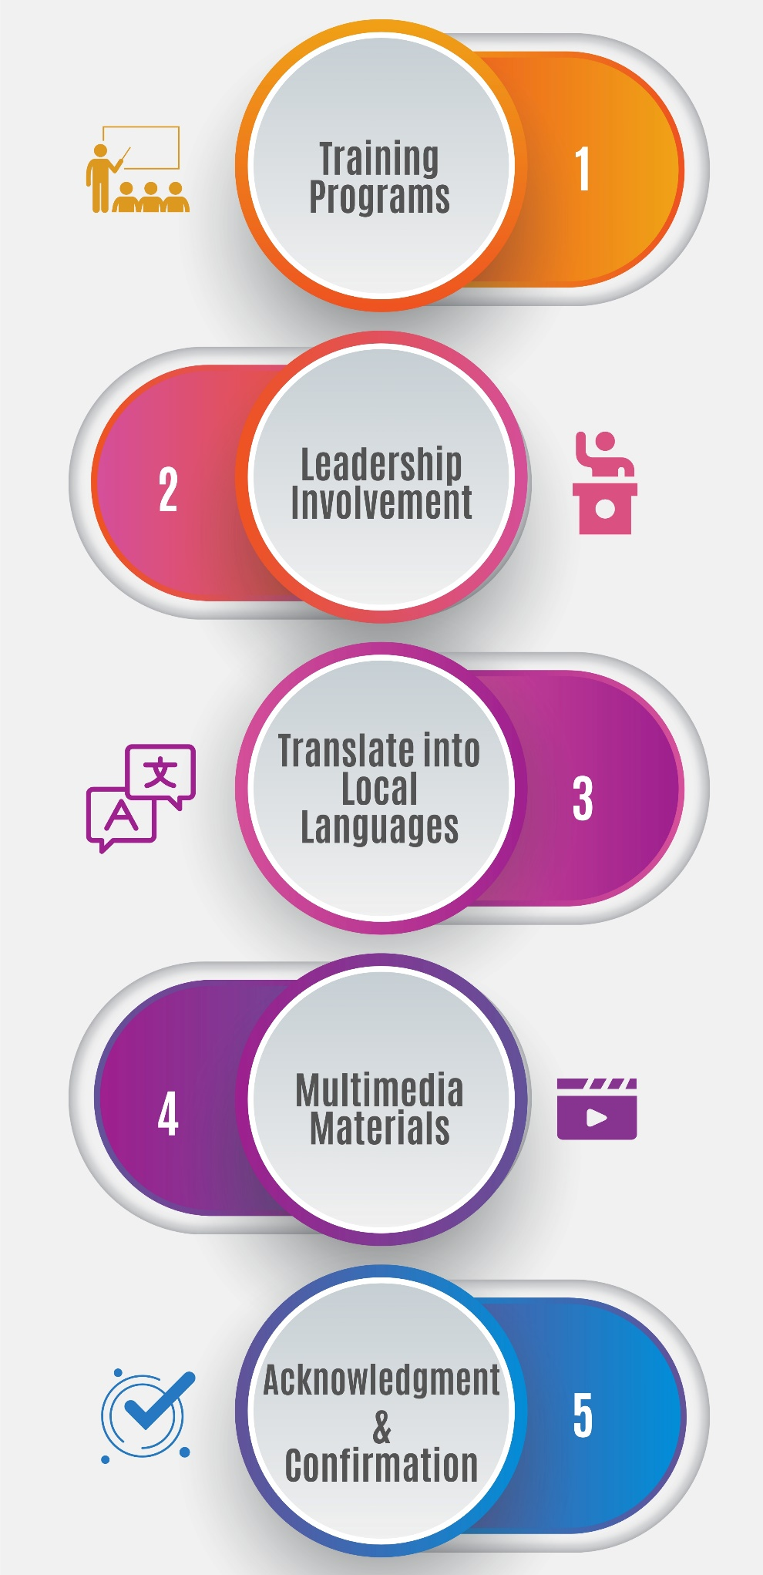
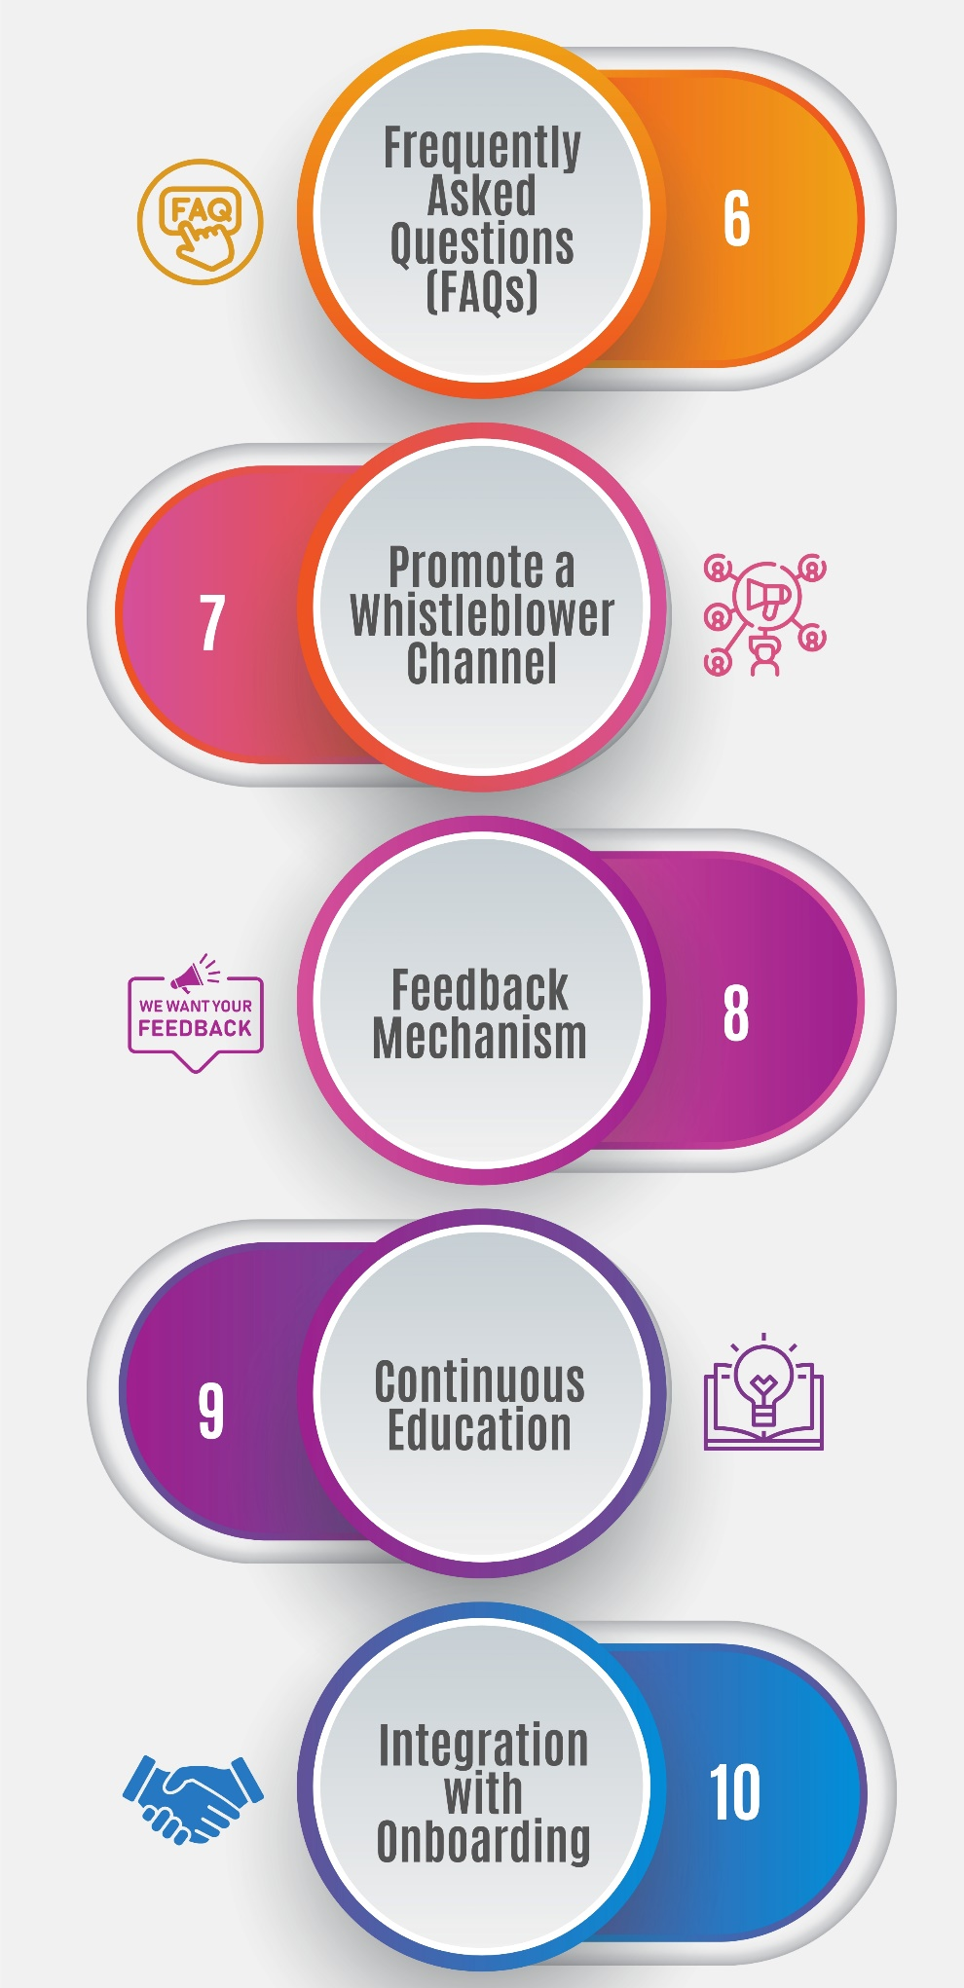
Ensuring Clear Communication of The Policy
Notes:
Ensuring clear communication of the anti-bribery policy to all employees is crucial for its effectiveness. Here are steps to help you communicate the policy effectively:
Training Programs:
Conduct training programs or workshops on the anti-bribery policy. Training sessions provide opportunities for employees to ask questions and seek clarification.
Leadership Involvement:
Encourage leaders and managers to personally communicate the importance of the anti-bribery policy to their teams. Their involvement reinforces the message's significance.
Translate into Local Languages:
If your organization operates in regions with different languages, consider translating the policy into the local languages spoken by employees to ensure comprehension.
Multimedia Materials:
Supplement written policies with multimedia materials, such as videos, infographics, or interactive e-learning modules. These formats can engage employees and reinforce understanding.
Acknowledgment and Confirmation:
Require employees to acknowledge receipt and understanding of the policy. This can be done through electronic signatures, written acknowledgments, or quizzes following training.
Frequently Asked Questions (FAQs):
Develop an FAQ document that addresses common questions and concerns employees may have about the policy. Make this document easily accessible.
Promote a Whistleblower Channel:
Emphasize the organization's whistleblower reporting mechanism. Encourage employees to report concerns and unethical behavior, assuring them of protection from retaliation.
Feedback Mechanism:
Establish a feedback mechanism where employees can provide input on the policy's clarity and effectiveness. Use their feedback to make improvements.
Continuous Education:
Provide ongoing education and awareness initiatives related to bribery and corruption. These can include workshops, webinars, and newsletters.
Integration with Onboarding:
Include information about the anti-bribery policy in the onboarding process for new hires. Make sure they understand its significance from the start.
By employing these strategies, you can enhance the clarity and effectiveness of your anti-bribery policy's communication, ensuring that all employees are well-informed and understand their roles in preventing bribery and corruption within the organization.

Slide 11






Thanks for Participation
98752-08472
Hello@freelancetrainings.com
www.freelancetrainings.com
406, Titanium City Centre Mall, Anand Nagar, Satellite, Ahmedabad-380015

