Slide 1


Workshop on MS-PowerPoint
Your
Company
Logo
Notes:
Note for the trainer: start the day with enthusiasm. Your enthusiasm should reflect in your tone of voice and body language.
Good morning everyone!
How are you today. Are you ready to dive into a day of learning, growth, and transformation? I know I am!
Today, we have a unique opportunity to learn from each other, challenge ourselves, and take our personal and professional lives to the next level. Today’s workshop is highly engaging, filled with activities, role plays, videos and discussions that are designed to inspire and empower you.
But this isn't going to be a passive experience. This isn't a lecture where you sit back and listen to someone else talk. This is an interactive, dynamic, and engaging workshop that requires your full participation, your curiosity, and your willingness to learn.
Throughout the day, you'll have the chance to connect with other like-minded individuals, share your own experiences and insights, and gain new skills and knowledge that will help you achieve your goals. You'll be challenged, pushed outside your comfort zone, and supported every step of the way.
So, are you ready to embrace this day with open hearts and open minds? Are you ready to learn, grow, and transform? I know I am, and I can't wait to see what we'll achieve together.
Let's get started!

Slide 2







Agenda of Workshop
Module 1
Module 3
Module 5
The Ribbons
The view Ribbon
Working with shapes & Graphs
Module 2
Module 4
Module 6
Getting Started
Working with Text & Animation
Slide Master & Insert Ribbon
Notes:
Welcome to the MS PowerPoint Presentation Workshop. Are you excited for today`s workshop? let me introduce todays workshop modules.
1 The Ribbons
2 Getting Started
3 The View Ribbon
4 Working with Text & Animation
5 Working with shapes & Graphs
6 Slide Master

Slide 3

The Ribbons
Notes:
Welcome to Module 1- Powerpoint Ribbons.

Slide 4

The Ribbons
Ribbon in Microsoft PowerPoint is a toolbar that organizes commands into tabs for easy access
Each tab groups related commands together, such as Home, Insert, Design, and more, streamlining the workflow
Adapts to your activity, showing contextual tools as needed thus providing smooth Navigation
Notes:
Trainer notes-The Ribbon in Microsoft PowerPoint is a toolbar that organizes commands into tabs for easy access. Each tab groups related commands together, such as Home, Insert, Design, and more, streamlining the workflow. The Ribbon adapts to your activity, showing contextual tools as needed. Mastery of the Ribbon is crucial for efficient navigation and utilization of PowerPoint's features.
File View
Home
Insert
Draw
Design
Transition
Animation
Slide Show
Review
View Ribbon

Slide 5
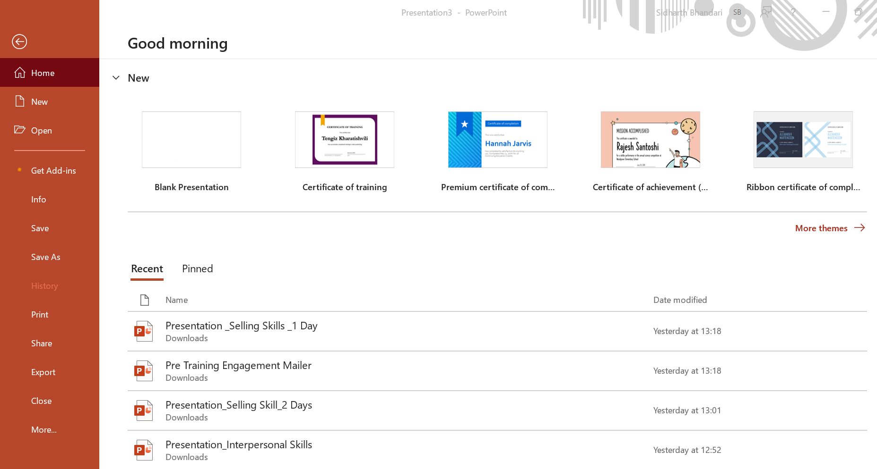
FILE Options
Create a new document.
Open existing documents
  Save the document in various formats.
Print the document
  Customize PowerPoint settings.

Slide 6
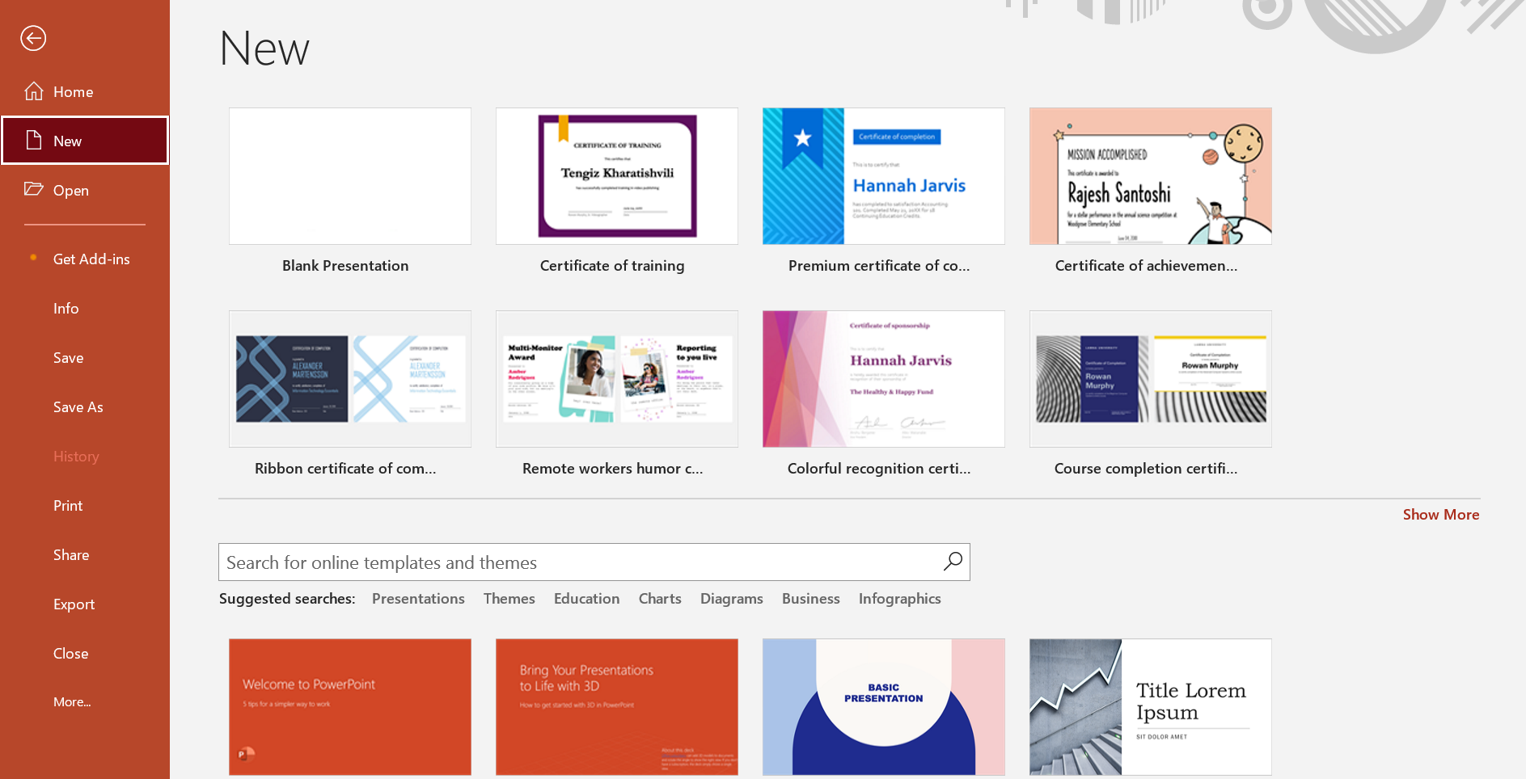
Creating new presentation
Start by clicking on "File" in the top left corner, then select "New
You can select a Blank slide
or choose from existing Temp
Short Cut
Ctrl + N (Windows) or Command + N (Mac)
Notes:
Trainer Notes:-Start by clicking on "File" in the top left corner, then select "New" to begin a new presentation. You can also use keyboard shortcuts like Ctrl + N (Windows) or Command + N (Mac) to quickly start a new presentation. Consider starting with a blank slide or choose from available templates based on your presentation needs.

Slide 7
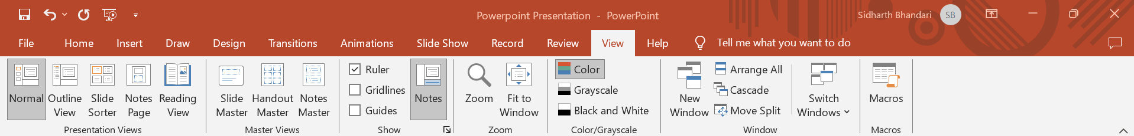

The view Ribbon
Provides various tools to customize and manage the presentation's appearance and structure
Includes options to switch between different views such as Normal, Slide Sorter, and Reading View, each tailored for specific tasks like editing, organizing, or presenting slides.
.Additionally, it offers features to manage the master slides, adjust zoom levels, and arrange windows, enhancing the efficiency and flexibility of your workflow.
Notes:
Trainer notes-The View Ribbon in Microsoft PowerPoint provides various tools to customize and manage the presentation's appearance and structure. It includes options to switch between different views such as Normal, Slide Sorter, and Reading View, each tailored for specific tasks like editing, organizing, or presenting slides. Additionally, it offers features to manage the master slides, adjust zoom levels, and arrange windows, enhancing the efficiency and flexibility of your workflow.
Changing the Views
Normal View
Slide Sorter View
Reading View
Slide Show View
Notes View
Outline View
Zoom Slider
Viewing a Slide Show from the First Slide
Viewing a Slide Show from the Current location

Slide 8
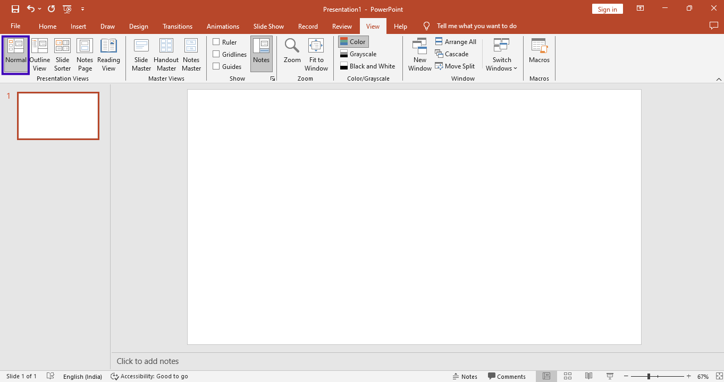

Normal View
Main working area for editing slides, arranging elements, and adding content
Ideal for detailed slide design, text formatting, and inserting multimedia
Notes:
Trainer notes:-Main working area for editing slides, arranging elements, and adding content. Ideal for detailed slide design, text formatting, and inserting multimedia. Customizable layout options and easy access to design and formatting tools.

Slide 9
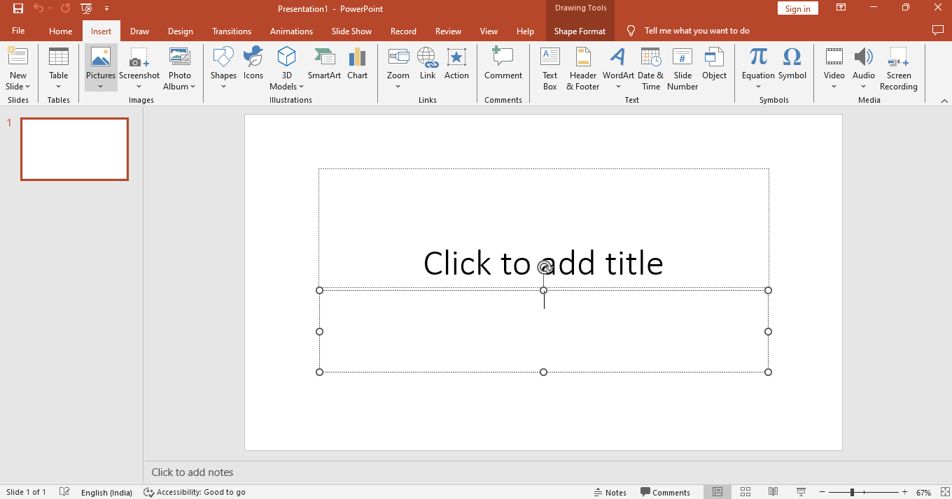

Adding Text to a Slide
Click on the text box or use the "Insert Text Box" option to place your text
.You can then start typing directly into the text box, and format it using the options in the toolbar.
Notes:
Trainer notes-Adding Text to a Slide
Adding text to a slide is essential for conveying your message. Click on the text box or use the "Insert Text Box" option to place your text. You can then start typing directly into the text box, and format it using the options in the toolbar.

Slide 10
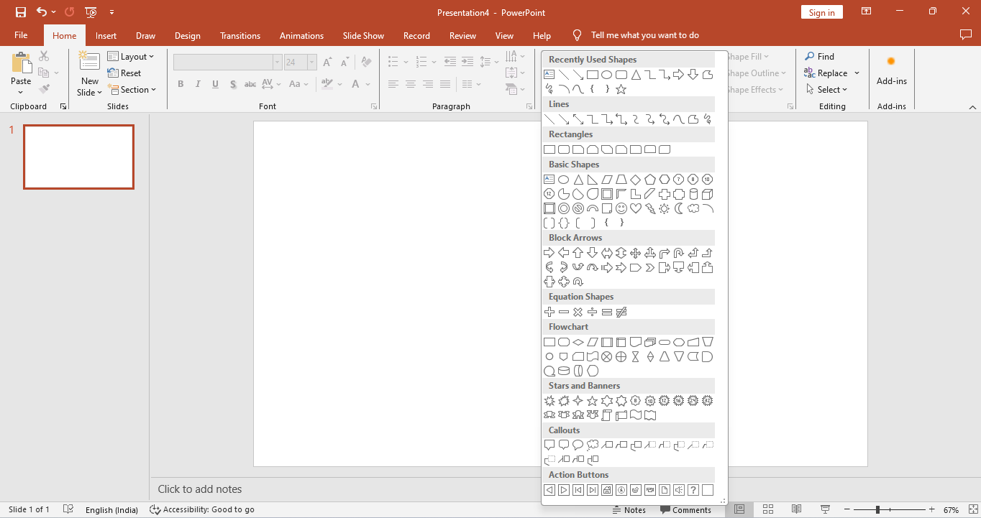

Drawing shapes
Drawing shapes in PowerPoint is fundamental for creating engaging and visually appealing slides.
Selecting the "Insert" tab, clicking on "Shapes," and then choosing from a variety of shapes like rectangles, circles, lines, and arrows
Simply click and drag on your slide to draw the shape to your desired size.
Notes:
Trainer notes-Drawing Shapes
Drawing shapes in PowerPoint is fundamental for creating engaging and visually appealing slides. You can draw shapes by selecting the "Insert" tab, clicking on "Shapes," and then choosing from a variety of shapes like rectangles, circles, lines, and arrows. Simply click and drag on your slide to draw the shape to your desired size.

Slide 11
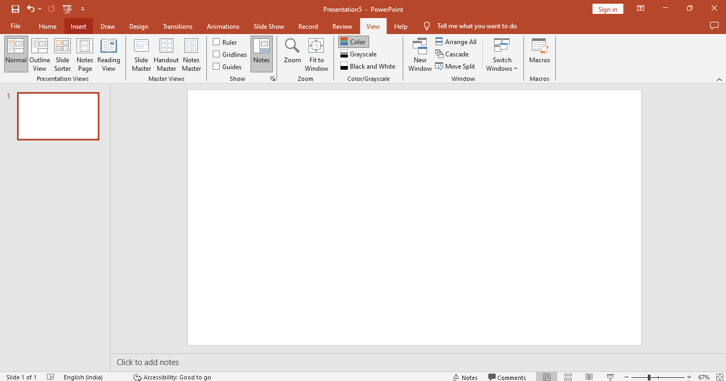
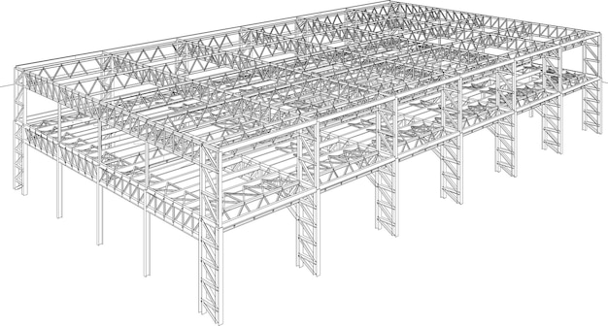
Accessing the Slide Master
Accessing the Slide Master is essential for creating uniform and professional PowerPoint presentations.
You can access it by clicking on the "View" tab and selecting "Slide Master" from the menu.
This allows you to make global changes to your slides, such as applying a consistent theme, font, or color scheme across all slides in your presentation
Notes:
Trainer notes-Accessing the Slide Master
Accessing the Slide Master is essential for creating uniform and professional PowerPoint presentations. You can access it by clicking on the "View" tab and selecting "Slide Master" from the menu. This allows you to make global changes to your slides, such as applying a consistent theme, font, or color scheme across all slides in your presentation

Slide 12





98752-08472
Hello@freelancetrainings.com
www.freelancetrainings.com
406, Titanium City Centre Mall, Anand Nagar, Satellite, Ahmedabad-380015

