Slide 1



Personality Development Workshop
Notes:
Note for the trainer: start the day with enthusiasm. Your enthusiasm should reflect in your tone of voice and body language.
Good morning everyone!
How are you today. Are you ready to dive into a day of learning, growth, and transformation? I know I am!
Today, we have a unique opportunity to learn from each other, challenge ourselves, and take our personal and professional lives to the next level. Today’s workshop is highly engaging, filled with activities, role plays, videos and discussions that are designed to inspire and empower you.
But this isn't going to be a passive experience. This isn't a lecture where you sit back and listen to someone else talk. This is an interactive, dynamic, and engaging workshop that requires your full participation, your curiosity, and your willingness to learn.
Throughout the day, you'll have the chance to connect with other like-minded individuals, share your own experiences and insights, and gain new skills and knowledge that will help you achieve your goals. You'll be challenged, pushed outside your comfort zone, and supported every step of the way.
So, are you ready to embrace this day with open hearts and open minds? Are you ready to learn, grow, and transform? I know I am, and I can't wait to see what we'll achieve together.
Let's get started!

Slide 2

Personality
Personality refers to a unique set of traits, behaviors, attitudes, and characteristics that collectively define an individual's distinctive pattern of thinking, feeling, and behaving.
Integral aspect of an individual's identity and influences how they perceive the world, make decisions, and engage with their environment.
Notes:
Personality refers to a unique set of traits, behaviors, attitudes, and characteristics that collectively define an individual's distinctive pattern of thinking, feeling, and behaving. It encompasses a person's typical ways of responding to various situations, interacting with others, and expressing themselves. Personality is an integral aspect of an individual's identity and influences how they perceive the world, make decisions, and engage with their environment.
Personality development refers to the process of enhancing and refining various aspects of an individual's personality, behavior, attitudes, and characteristics. It involves both self-awareness and intentional efforts to improve oneself in order to achieve personal growth, success, and a better quality of life. Personality development encompasses a wide range of factors that collectively contribute to an individual's overall demeanor, interactions with others, and effectiveness in various life domains.

Slide 3

Your Personality determines your Success
Elon Musk-Visionary, Ambitious
Steve Jobs-Innovative, Perfectionist,
Sachin Tendulkar-Dedication and Humility
Amitabh Bachchan- Resilience and Reinvention
Ratan Tata- Ethical Leadership and Philanthropy
Nelson Mandela-Resilient, Forgiving, Inspirational
Notes:
Trainer to Give some example of how personality helped some of the leading people in the world to become world famous.
Elon Musk: Personality Traits: Visionary, Ambitious, Determined Impact: Elon Musk's bold and ambitious personality has driven him to launch several groundbreaking companies, including SpaceX, Tesla, Neuralink, and The Boring Company. His determination to push boundaries and tackle complex challenges has revolutionized industries such as space travel, electric cars, and renewable energy.
Steve Jobs: Personality Traits: Innovative, Perfectionist, Creative Impact: Steve Jobs' innovative and perfectionist personality drove him to co-found Apple Inc. and pioneer products like the iPhone, iPad, and Macintosh. His insistence on design excellence and pushing the boundaries of technology transformed Apple into one of the most valuable and innovative companies globally.
Sachin Tendulkar - Dedication and Humility: Sachin Tendulkar, widely regarded as one of the greatest cricket players of all time, demonstrated unparalleled dedication to his sport. His unwavering commitment to improvement and constant humility despite his fame made him a role model for aspiring athletes around the world.
Amitabh Bachchan - Resilience and Reinvention: Amitabh Bachchan, the iconic Bollywood actor, demonstrated remarkable resilience and the ability to reinvent himself. Despite facing setbacks early in his career, he emerged as a megastar, evolving his roles and maintaining relevance over decades.
Ratan Tata - Ethical Leadership and Philanthropy: Ratan Tata, a prominent industrialist, is known for his ethical leadership and philanthropic endeavors. His commitment to corporate social responsibility and his role in transforming the Tata Group into a global conglomerate reflect his values-driven approach.
Nelson Mandela: Personality Traits: Resilient, Forgiving, Inspirational Impact: Nelson Mandela's resilience and ability to forgive despite 27 years of imprisonment had a profound impact on South Africa's transition from apartheid to democracy. His inspirational personality and commitment to reconciliation earned him global respect as a symbol of peace and social justice.
Have seen and understood this I am sure you are also looking forward to enhance your personality and hence we are all a part of this workshop Called as personality Development. What is personality development. Lets Move to the next slide.

Slide 4

What is Attitude?
The way a person thinks or feels about a specific person, place, action or experience.
Notes:
Ask: What is attitude?
Elicit response.
Say: Attitude is the way a person thinks or feels about a specific person, place, action, or experience. Similar to the individual perspective, attitude encompasses the individual’s particular emotions and the way in which they act towards people and work. Attitude is a specific disposition that combines factors like beliefs, opinions, moods, and emotions. Sometimes, attitude is referred to as an outlook or mental state that affects the way people perceive the world around them and the way they experience life, work, relationships, and more.
Ask: Why is positive attitude so important for professional excellence?
Transition to the next slide.

Slide 5

Having a Solution-Centric Approach
Solution-oriented people always find a way.
Solution-oriented people use critical thinking.
Solution-oriented people answer the ‘why’ question.
Notes:
Say:
Someone with a solution-centric mindset approaches work with a focus on honing in on solutions and forward progress. They don’t get stuck in setbacks or drama. Instead, they learn from setbacks and move forward. They don’t ignore or push problems aside. Instead, they voice problems with a proposed solution and align the team around a plan of resolution and execution. They make sure they (or someone on the team) close the loop in implementing the solution.
A solution-centric mindset is at the heart of making progress for a professional. It is not necessarily inherent; it usually comes from past experience and it can be taught and adopted.
Being solution-oriented means you will meditate to fix the problem. Solution-oriented people don’t just solve problems, they help identify the source of a question or challenge and provide the right or a better, way of doing things. Additionally, one of the greatest strengths of a solution-oriented individual is their ability to think critically. This requires the ability to think, evaluate, analyze, and decide clearly and quickly, in such a way that helps solve a problem. Lastly, solution-oriented people funnel all decisions through a filter that helps answer ‘why’. This unique approach immediately gets to the heart of the matter, or the individual, where the roots help clarify the situation or question.
Transition to the next slide.

Slide 6
Types of Communication
Communication
Assertive
Aggressive
Passive
Empathetic
Notes:
Say: Communication can further be categorized into 4 types:
Assertive
Aggressive
Passive and
Empathetic
So what are these?

Slide 7

What is a Goal?
A goal is a specific and measurable objective or target that an individual , department or organization aims to achieve within a set period of time.
Notes:
A goal is a specific and measurable objective or target that an individual or organization aims to achieve within a set period of time. Goals can be short-term or long-term and can be related to various aspects of life such as personal, professional, academic, or health-related goals.
Goals can help individuals to break down larger objectives into smaller, more manageable tasks and track progress towards their desired outcome.

Slide 8

What is Time Management?
The ability to use one's time effectively or productively, especially at work.
Notes:
Trainer builds on – Using time effectively – that is about one’s own capability. Everyone one has the same amount of time. But how we use it to our advantage can greatly differ from person to person.
We all have the same amount of time – some accomplish more, some accomplish less and some accomplish extraordinary things in a single lifetime.
For example – Dr Kalam – Also known as the Missile Man of India, was leading scientist, writer, President of India and head of many important scientific organisations and many others contributions to society.

Slide 9

Quadrant 1 -Important, but not Urgent - Plans
Activities that help you achieve your long and mid-term goals and objectives
Notes:
Trainer Explains the 1st quadrant with Examples - https://www.groupmap.com/portfolio/urgent-important-matrix
Important but Not Urgent – Plans
These are the activities that help you achieve your long and mid-term goals and objectives. Because they aren’t necessarily pressing for attention, we often put them off to deal with “urgent” issues.
Important but not Urgent activities might include:
Longer term planning
Work that directly contributes towards goals and objectives
Risk analysis
Relationship and team building
Education and training
Proactive maintenance
Creating a budget and savings plan
Invest more of your time in this quadrant to help prevent and eliminate many of the urgent activities in Q2 and balance the demands in Q4.

Slide 10
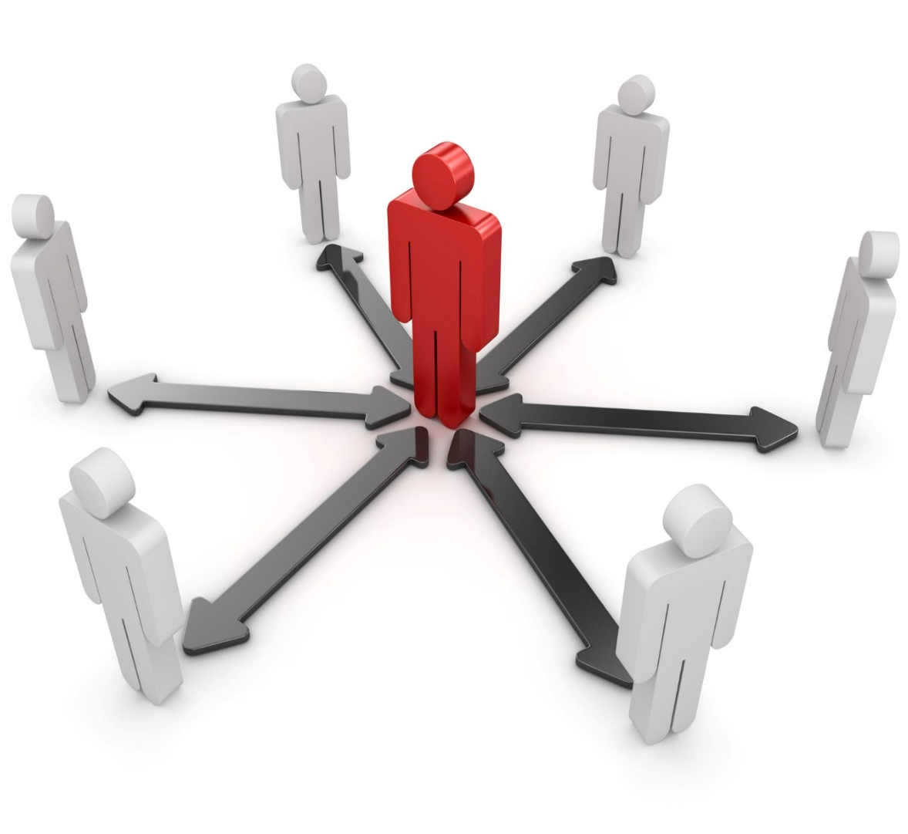
What is Interpersonal Effectiveness ?
The ability to understand, communicate and interact with other people in a way that leads to productive working relationships and enables the achievement of desired outcomes for you, your team and the organization.
Notes:
Interpersonal effectiveness refers to the ability to communicate and interact with others in a way that is respectful, assertive, and responsive to the needs of both oneself and others. It involves the skills of effective listening, expressing oneself clearly and assertively, understanding and respecting others' perspectives, negotiating conflicts, and managing emotions in relationships.

Slide 11






Building Interpersonal Effectiveness
Empathy
Assertive
Communication
Conflict Resolution
Developing Interpersonal Effectiveness
Active
Listening
Emotional
Intelligence
Notes:
Practice active listening: One of the most important skills in building strong relationships is the ability to listen actively. This means giving your full attention to the person speaking, asking clarifying questions, and responding in a way that shows you have understood their perspective. By actively listening, you can build trust and understanding in your relationships.
Practice assertive communication: Being assertive means communicating your thoughts, feelings, and needs in a clear, respectful, and direct way. It involves expressing yourself confidently while also respecting the feelings and perspectives of others. This can help you to avoid misunderstandings and conflicts, and build stronger, more authentic relationships.
Develop empathy: Empathy is the ability to understand and share the feelings of others. By putting yourself in someone else's shoes, you can gain a deeper understanding of their perspective and build stronger relationships based on mutual respect and understanding.
Learn conflict resolution skills: Conflict is a natural part of any relationship, and being able to resolve conflicts constructively is essential for building strong and healthy relationships. This involves identifying the root cause of the conflict, expressing your thoughts and feelings in a respectful way, and working with the other person to find a mutually beneficial solution.
Emotional Intelligence: Mindfulness is the practice of being present in the moment and fully engaged with your surroundings. By practicing mindfulness, you can develop greater self-awareness and emotional intelligence, which can help you to communicate more effectively and build stronger relationships.

Slide 12






Thanks for Participation
98752-08472
Hello@freelancetrainings.com
www.freelancetrainings.com
406, Titanium City Centre Mall, Anand Nagar, Satellite, Ahmedabad-380015

