Slide 1


Personal Effectiveness Workshop -2 Days
Your
Company
Logo
Notes:
Facilitator’s Notes:
Trainer to say in the loudest voice “Hello, Good Morning”. Then the participants will say ‘Good Morning’ in reply.
Trainer to say once again in the loudest voice “Hello Good Morning”. Trainer should speak in an energetic, passionate and enthusiastic tone. This activity/gesture will set the tone and energy for the session/workshop
Trainer: Well done friends! Great job! (Clap Loudly and tell the participants to clap as well for the superb performance.)
Trainer: I'm excited to be here with you all today and appreciate your presence. I hope you're all doing well and are ready to dive into the material.Move to next slide.

Slide 2







Agenda of Workshop- Day 1
Module 1
Module 3
Module 5
Understanding Personal
Effectiveness
Impactful
Communication
Goal Setting
Module 2
Module 4
Module 6
Building an Attitude
of Ownership
Building a Fool Proof Communication
Being a Team Player
Notes:
The agenda of todays workshop is as follows
Understanding Brand & Personal Effectiveness
Building an attitude of Ownership at workplace
Impactful communication
Building Fool Proof Communication
Goal Setting
Being a Team player

Slide 3



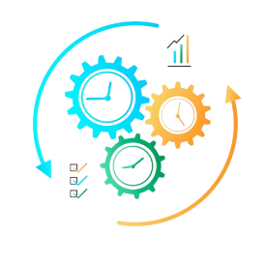

Agenda of Workshop- Day 2
Module 1
Module 3
Module 5
Managing Stakeholders
First Impression is the last Impression
Email etiquette
Module 2
Module 4
Recap/Revision
Manging Time & Prioritisation
First Impression is the last Impression Part-2
Notes:
The agenda of todays workshop is as follows
Managing Stakeholders
Managing Time & Prioristising
First Impression is the Last Impression-Part-1
First Impression is the Last Impression-Part-2
Email Etiquettes
Recap

Slide 4


Module-1 Understanding Personal Effectiveness?
Notes:
Say: So lets begin with very simple question. So what is your understanding on Personal Effectiveness
Collect few response and jot them on the board.
Lets do an activity
Start with the Activity of Piercing the Potato (If you still need more details on the activity please visit you tube and type Activity of Piercing the Potato )
Give each participant a potato and a drinking straw.
Instruct the participants to use the straw to pierce the potato through the center from one end to the other end without breaking the potato.
Set a time limit (e.g. 5-10 minutes) and challenge the participants to see who can successfully pierce their potato the fastest.
Most of the participants wont be able to do it while some will be.
The right way of doing it is by closing the straw with your thumb on one and using it like a knife to let It pass through(See the youtube video)
Ask following Questions
What strategies did you use to pierce the potato with the straw?
What challenges did you encounter during the activity?
How did you modify your approach as you encountered difficulties?
How did you feel when you successfully pierced the potato with the straw?
Debrief:
Everyone has unlimited potentital to do the things but the challenge is how do we realise that true potential. I am sure you will all agree that if you knew the right trick/skills this activity was very simple. Similarly in our professional life to become successful we also need to realise our true potential. In our today’s workshop we are going to see many such tools like communication, managing time which will help us to realise our true potential and become effective professionals
Lets move to the next slide

Slide 5
Benefits of Personal Effectiveness to Individual
Enhanced
Self-awareness
Improved
Decision-making
Better Time
Management
Increased
Resilience
Enhanced
Communication
Greater job Satisfaction and success
Overall well-being
Notes:
Increased/Enhanced self-awareness: Developing personal effectiveness helps individuals gain a better understanding of their strengths, weaknesses, values, and goals, which can enhance their overall self-awareness.
Improved decision-making: By developing skills such as problem-solving, critical thinking, and goal-setting, individuals can make more informed and effective decisions in their personal and professional lives.
Better time management: Personal effectiveness skills such as time management and prioritization can help individuals make the most of their time, leading to increased productivity and reduced stress.
Enhanced communication: Personal effectiveness skills such as active listening, empathy, and assertiveness can improve an individual's ability to communicate effectively and build positive relationships with others.
Increased resilience: Developing personal effectiveness can help individuals become more resilient in the face of challenges, setbacks, and changes, enabling them to bounce back and move forward.
Greater job satisfaction and success: By enhancing their personal effectiveness, individuals can improve their performance, increase their job satisfaction, and achieve greater success in their careers.
Improved overall well-being: By developing personal effectiveness, individuals can enhance their overall well-being, reduce stress, and improve their quality of life.
Overall, personal effectiveness is essential for individuals to achieve their goals and aspirations, improve their overall well-being, and succeed in their personal and professional lives.

Slide 6





1. Taking Ownership and Accountability
Taking the initiative to bring about positive results.
Being accountable for the results of your actions - that are the of the highest quality and delivered in a timely manner.
Taking ownership shows others that they can trust you to do the right thing
Not waiting for others to act, and caring about the outcome as much as an owner of the company would
Notes:
Say: Employees who do the bare minimum are a drain of energy in the office. On the other hand, professionals that have the attitude of ownership, are considered to be assets because they stretch themselves to get things done proactively. So what does taking ownership mean?
Ownership is taking the initiative to bring about positive results.
It means caring about the outcome and doing the best to see it execute to completion.
It is being accountable for the results of your actions - that are of the highest quality and delivered in a timely manner.
Taking ownership shows others that they can trust and rely on you.
To sum up, ownership means having an obligation to the organization in terms of results and acting on the items that impact those results.
Transition to the next slide.

Slide 7
Circle of Concern, Influence and Control
Circle of concern
Circumstances/Issues/ Problems
Over which we have No control- Also
known as No control Zone
Circle of influence
Circle of control
Circumstances/Issues/ Problems
Over which we have a indirect control
Invest your time, Energy
& Emotions Here
Circumstances/Issues/ Problems
Over which we have a direct control
Invest your time, Energy
& Emotions Here
Notes:
Dr. Stephen Covey in his best-seller book 7 Habits of Highly Effective People, talks about the three circles. Each of these represents a certain aspect of our life. As you see the outer circle (of no control ) will be the largest and the inner most (of control) will be the smallest.
Let’s learn in detail.
Circle of Concern: (Red Zone) Also known as the circle of no control, this comprises the wide range of circumstances, issues, and problems that we have, but over which we do not have any control. Examples: Past decisions, world peace, wars, natural calamities, government policies, death, traffic, company policies, election results, etc.
Circle of Influence:(Yellow Zone) This comprises those circumstances over which we have indirect control. Example: Other people’s thoughts, other people’s actions, other people’s choices and decisions, your future, your family’s future, etc.
Circle of Control (Green Zone): This encompasses those circumstances, issues, and problems that we have direct control over.
Example: My thoughts, my actions, my reactions, my mood, my work ethic, my choices, etc.
Professionals that have excellent attitude almost always operate primarily from circle of control (where they have direct control over) and then from the circle of influence (where they still have some degree of control). This attitude helps them focus only on things that they can do and accept things that they cannot. Professionals with bad attitude usually are stuck in ‘circle of concern’. They fret, complain, get stressed and waste time of thinking and discussing about how life and things are unfair. This is like hitting a wall expecting it to move and is a viscious cycle to continue with the stress cycle.
Let’s take a closer look at how the circles look with examples.
Transition to the next slide.

Slide 8
Types of Communication
Communication
Assertive
Passive
Empathetic
Aggressive
Notes:
Say: Communication can further be categorized into 4 types:
Assertive
Aggressive
Passive and
Empathetic
So what are these?

Slide 9
Listening
Doubts Clarify
Reconfirm
Asking Questions
L
A
D
R
Building Fool Proof Communication
Notes:
Welcome to the Module on Building Fool Proof Communication
In This module we will learn
• LADR Model of Communication • Listening Actively • Asking Questions (Open Vs Close ended) • Reconfirm

Slide 10





Goal Setting
Notes:
In our school days we all drew scenes and locations that we hoped to see someday! Let's use that talent to sketch your future now! To finish this task, you don't need to be a great artist! All you need to do is think of one or two things you want to do in five years or how you want to envision yourself then, and then draw a vivid picture of that. Are you all prepared?
Note: Elicit a strong ‘yes’ from the participants.
Instructions:
Give each participant one chart paper and crayons of different colours.
Draw an image of how they (Participants) imagine their life after 5 years &. (the drawings can be very simple for example: somebody might draw a holiday home, iphone. But it should be large enough to be visible to the class.)
Ask them to be as specific as possible.
Give them 5 minutes to complete the task.
Example: I wish to own a two storey building in Sai Shraddha society, Koregaon park, Pune, . I want to own a four wheeler and a two wheeler. I want my two kids to go to DPS School which is one of the best schools in our area. I want to take a vacation with my family to USA. I also want to save Rs.5 Lakhs for my future. I also want to rebuild my ancestral house located in my village.
Note: The participants have to draw images for representing each and every item in their dream list.
After the participants finish their drawings, ask each participant to explain their dream to the other participants (give each participant 1 minute to explain). Appreciate their effort after each presentation. Stick/paste their drawings to the wall in the training venue for everyone to see (if possible in the venue).
Note: If possible/ make it more personalised, the trainer can also ask the participants to take a selfie with their drawings and ask them to share with their dear ones. This will give a personal touch to this activity and also make the participants to take the training more seriously.
After everyone is done explaining, discuss the following debrief -
Debrief:
Say: You have all just decided what you want to do over the next five years! All of you want to reach the objectives you've set for yourself. But possessing such objectives is insufficient! To go closer to those objectives, you must have a STRONG desire. You should be willing to go above and beyond, and you should have faith in your own abilities to accomplish these goals. You won't be able to accomplish your goals unless you have a positive outlook on them. Do you agree with me?
Note: elicit response.
Say: Well! One of the direct way to achieve these personal goals is to become better at in your role that will finally lead to your financial growth and so on.

Slide 11

What is a Goal?
A goal is a specific and measurable objective or target that an individual , department or organization aims to achieve within a set period of time.
Notes:
A goal is a specific and measurable objective or target that an individual or organization aims to achieve within a set period of time. Goals can be short-term or long-term and can be related to various aspects of life such as personal, professional, academic, or health-related goals.
Goals can help individuals to break down larger objectives into smaller, more manageable tasks and track progress towards their desired outcome.

Slide 12
Goal Setting Process
Set Smart Goals
Build Action Plan
Implement Action plan
Notes:
Goals are a critical factor to ensure organisational success. We set objectives for team members each year. The team strives to accomplish these objectives. Setting goals effectively will motivate team members and guarantee achievement. It can also work the other way . Your team member could fail to reach certain goals on occasion because they are vague or out of reach. How you set team goals will determine whether or not your departmental vision is realised.
To set Goals effectively we must follow the Goal Setting process i.e
Setting SMART Goals
Build an Action Plan
Implement Action Plan
Lets move to the next slide

Slide 13
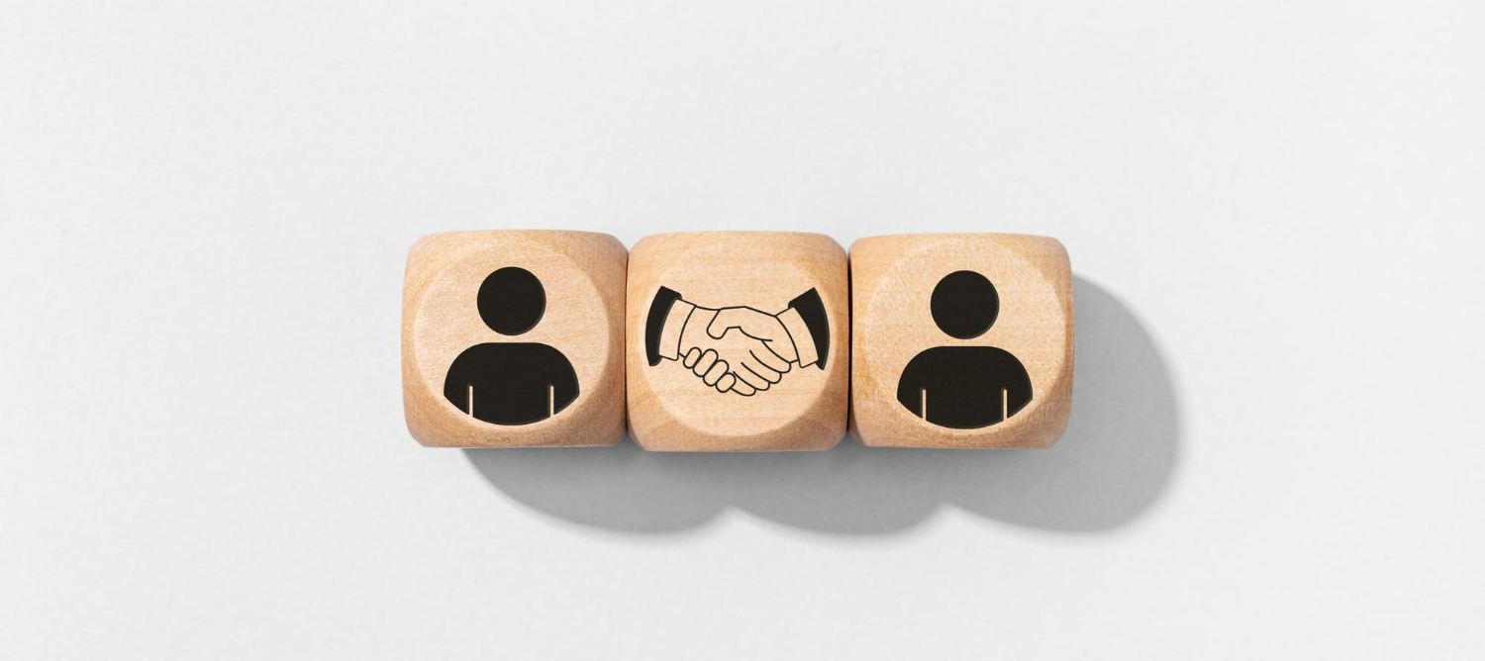
Managing Stakeholders
Notes:
Welcome to the module on Managing Stakeholders . In this module we will learn the following
Identifying the stakeholders
The Stakeholder Matrix
Plotting your stakeholder in Matrix
Develop strategies for different stakeholders

Slide 14


Stakeholder - Activity
Notes:
The objective of this activity is to help the participants understand the meaning of Stakeholder and the importance of the stakeholders in your career progress. The trainer is free to choose any training activity to derive the same objective from their own resources,
Lets start with the activity
Hand out a packet of straws (at least 150), a roll of sticky tape and a pair of scissors to each team;
Tell the teams that the aim of the exercise is to build the tallest, free-standing tower, using the materials provided, in the time given (30minutes)
15 mins into the activity tell that the tallest tower has to hold a tennis ball on the top of the tower for atleast 15 secs
Trainer has to observe how different players have played their parts, how each player played an important part to get the work done. Also with the 3rd announcements how priorities changes and how players deliver.
What have you learnt from this activity
What were the different roles that each team member played while building the tower
To complete your individual task in your team was your performance dependent on any other team members
How can you co-relate this activity to your daily workplace performance
Trainer to draw a parallel of this activity to how we also function in our daily lives at work places, how we have to coordinate with others and deliver.
Note:

Slide 15
Stakeholder Matrix
High
Stakeholder Matrix
Keep Satisfied
Manage Closely
Monitor
(Minimum Effort)
Keep Informed
Power of Influence
Low
Low
Level of Interest
High
Notes:
The stakeholder management matrix is a tool used to analyze and prioritize stakeholders based on their level of influence and interest in a project that you are executing. It is a grid with four quadrants, with the level of influence represented on the horizontal axis and the level of interest represented on the vertical axis.
By using the stakeholder management matrix, you can prioritize their efforts and resources to engage and manage stakeholders effectively, ensuring that their needs and concerns are addressed appropriately.

Slide 16
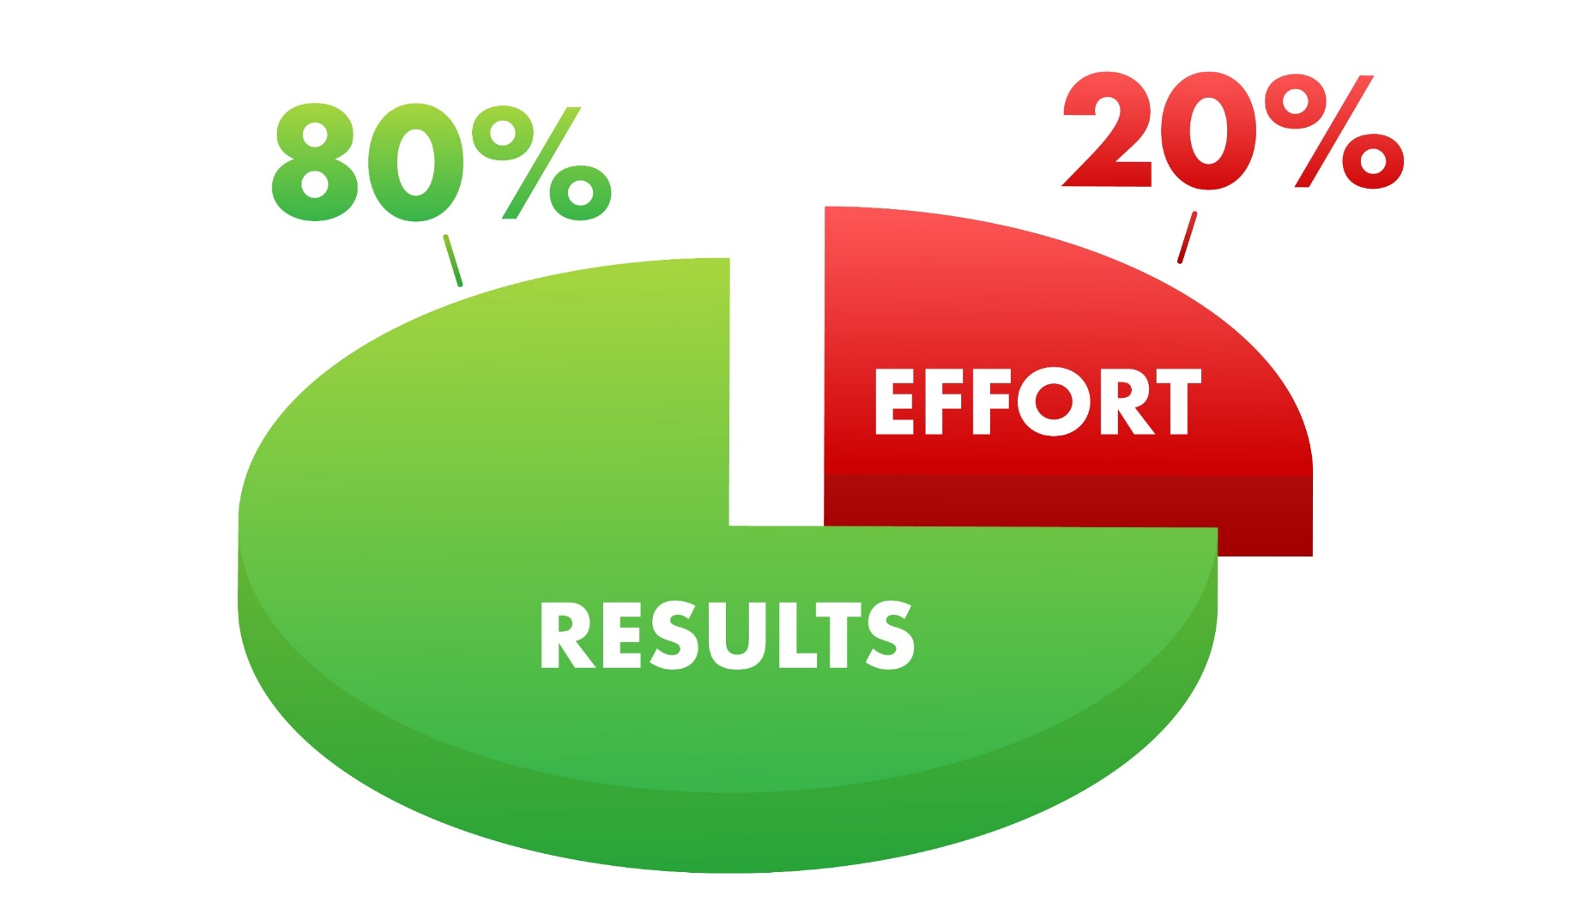
Understanding Pareto's Principle
80% of outcomes (or outputs) result from 20% of all efforts (or inputs) for any given event
Notes:
Benefits of using the Pareto principle
The biggest advantage of using the Pareto principle is that you can create the maximum amount of impact with the least amount of work. This can allow your team to work more efficiently and stay focused on specific initiatives.
The 80/20 rule can help your metrics increase in less time, simply by prioritizing initiatives in the right order.
Other benefits of using the Pareto principle:
Clear priorities both for you and your team
Increased daily productivity
Ability to portion your work into manageable segments
More focused strategy

Slide 17

Creating IMPACT
I – Introduce yourself
M –Make eye contact
P – Professional handshake
A – Acknowledge personal space
C – Create a good first impression
T – Thank the person
Notes:
Have a proper introduction say
Hello/Good morning /afternoon/evening Sir /mam my name is xyz pleasure meeting you
Make eye contact and talk it shows confidence
Have a firm grip while shaking hands
Ask questions during the conversation to understand and communicate better
Create a good first impression ie grooming ,dress code and personality
Thank the person before taking your leave eg Thank you Sir/Mam have an amazing day

Slide 18

Module-5
Email etiquette
Notes:
Trainer:
Remember, following etiquette in email communication is significant since:
Any written document is proof for you or against you – commitments of deadlines, setting expectations, defining the scope of a project and financial agreements are some significant aspects where sending an email is necessary. Emails are also useful when we have to give updates on the progress of the work undertaken.
Since you are not present in person, what and how you write an email forms an impression of you.
If the reader does not understand what you have written, the purpose of writing the mail is lost anyway.
Let us explore the concept of email etiquette and look at how an ideal email must be.
Transition to the next slide.

Slide 19
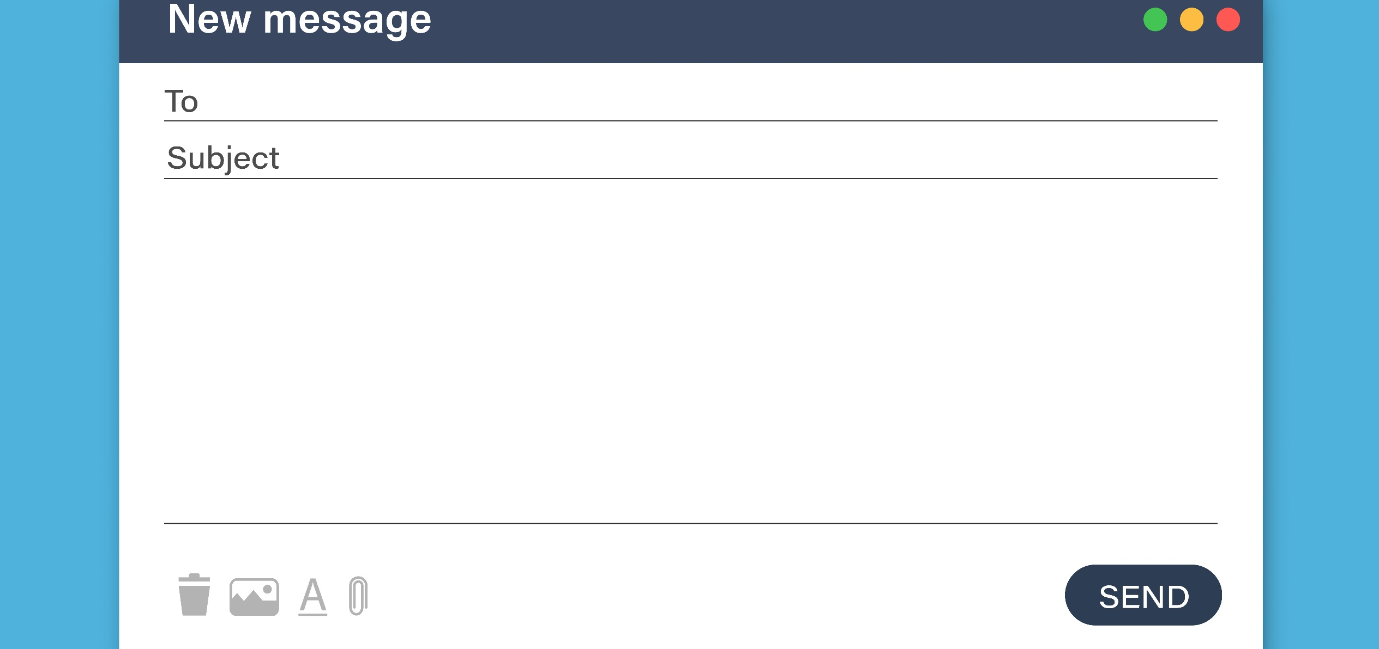
Components/Layout of an email
The Recipient/Address field – ‘To’ is mandatory, and Cc and Bcc are optional.
Subject line
Content box/ Email Body
Attachment
Notes:
Trainer:
Every typical email has some standard components:
The Recipient field – ‘To’ is mandatory, and Cc and Bcc are optional.
The Subject line
The content box/ Email Body
Attachment
Many other components like editing and formatting options depend on the email provider.
Let us look at how to draft an email.
Now, you may say – “I have been writing emails for ages now. What’s new?”
Trainer to ask:
When you are composing or drafting a new email, what is your first step?
Elicit responses. (You could ask each participant for their response)
Transition to the next slide.

Slide 20






98752-08472
Hello@freelancetrainings.com
www.freelancetrainings.com
406, Titanium City Centre Mall, Anand Nagar, Satellite, Ahmedabad-380015

