Slide 1


Personal Effectiveness Workshop
Your
Company
Logo
Notes:
Note for the trainer: start the day with enthusiasm. Your enthusiasm should reflect in your tone of voice and body language.
Good morning everyone!
How are you today. Are you ready to dive into a day of learning, growth, and transformation? I know I am!
Today, we have a unique opportunity to learn from each other, challenge ourselves, and take our personal and professional lives to the next level. Today’s workshop is highly engaging, filled with activities, role plays, videos and discussions that are designed to inspire and empower you.
But this isn't going to be a passive experience. This isn't a lecture where you sit back and listen to someone else talk. This is an interactive, dynamic, and engaging workshop that requires your full participation, your curiosity, and your willingness to learn.
Throughout the day, you'll have the chance to connect with other like-minded individuals, share your own experiences and insights, and gain new skills and knowledge that will help you achieve your goals. You'll be challenged, pushed outside your comfort zone, and supported every step of the way.
So, are you ready to embrace this day with open hearts and open minds? Are you ready to learn, grow, and transform? I know I am, and I can't wait to see what we'll achieve together.
Let's get started!

Slide 2
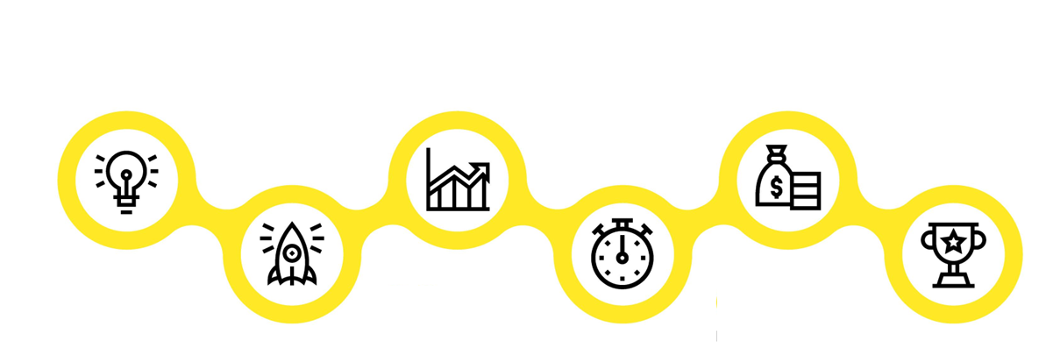

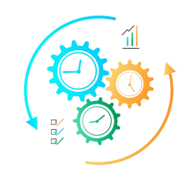


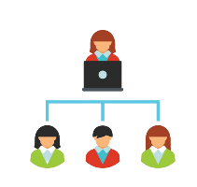

Workshop Agenda
Module 1
Understanding Personal Effectiveness
Module 3
Impactful Communication
Module 5
Manging Time & Prioritisation
Module 2
Building an Attitude
of Ownership
Module 4
SMART Goal Setting
Module 6
Being a team Player-Interpersonal Effectiveness
Notes:
Welcome to the Personal Effectiveness Workshop. Are you excited for today`s workshop? let me introduce todays workshop modules.
Understanding Personal Effectiveness
Building an attitude of Ownership & Accountability
Impactful Communication
Goal SMART Setting
Managing time & Prioritisation
Being a team Player-Interpersonal Effectiveness
I'm feeling really enthusiastic about this experience, I think it's going to be great.

Slide 3

Ice Breaker Activity- Tell me the Story
Notes:
Facilitator’s Notes:
The Trainer is free to use the Icebreaker of his/ her own choice instead of the one discussed here.
In this Ice breaker the entire batch is required to form one story where each participants contributes one line each. The Trainer starts with a sample one line and the next participant after that is required to introduce their name and add the next line to the story. While this story is being built the participant introduction is also happening side by side.
Aim of the Icebreaker
The aim is to know each other better and communicate.
Methodology
Gather all participants in a circle or around a table.
Trainer/ facilitator start as story For example, "Once upon a time, there was a magical forest deep in the heart of the mountains."
Choose one person to introduce themselves and build the next line of story by saying one sentence. (Each participant should contribute only 1 sentence)
Go around the circle or table with each person adding one sentence to the story.
Each sentence should build upon the previous one and move the story forward.
Continue the story until everyone has had a chance to contribute or until the story reaches a natural ending.
Encourage participants to be creative and imaginative with their contributions, and to listen to each other's ideas and build on them.
Lets move to next slide.

Slide 4

Benefits of Personal Effectiveness to Companies
Increased productivity
Improved decision-making
Enhanced customer satisfaction
Improved overall company culture
Increased employee engagement
Better Communication
Notes:
There are numerous benefits of personal effectiveness to companies
Increased productivity: Personal effectiveness skills such as time management, goal-setting, and prioritization can enhance employee productivity and efficiency, leading to better results and outcomes.
Improved decision-making: Personal effectiveness skills such as problem-solving and critical thinking can help employees make better decisions, leading to improved business outcomes and success.
Better communication: Personal effectiveness skills such as active listening and empathy can enhance communication between employees, leading to better teamwork, collaboration, and relationships.
Increased employee engagement: Personal effectiveness can help employees feel more engaged and motivated in their work, leading to improved performance and outcomes.
Enhanced customer satisfaction: By improving employee productivity, decision-making, and communication, personal effectiveness can lead to better customer service and satisfaction.
Improved overall company culture: Personal effectiveness can help create a positive and productive work environment, enhancing the overall company culture and reputation.
Overall, personal effectiveness is essential for companies to improve employee performance, engagement, and well-being, leading to improved business outcomes, customer satisfaction, and overall success.

Slide 5



Achieving Personal Excellence
Attitude
Skills
Knowledge
Notes:
Attitude: Attitude refers to a person's mindset or perspective. A positive attitude can help individuals overcome obstacles, maintain focus, and stay motivated in the face of challenges. Personal effectiveness requires a positive attitude that is characterized by resilience, self-confidence, and a growth mindset. Without a positive attitude, it can be difficult to achieve personal goals and objectives.
Skills: Skills are the abilities and competencies that individuals possess to perform specific tasks or activities. In order to be personally effective, individuals must possess a range of skills, including communication, problem-solving, time management, leadership, and teamwork. Developing these skills can help individuals to better manage their personal and professional lives and achieve their goals.
Knowledge: Knowledge refers to the understanding and awareness that individuals have of themselves, others, and the world around them. Personal effectiveness requires individuals to have a strong knowledge base in areas such as self-awareness, emotional intelligence, critical thinking, and decision-making. This knowledge can help individuals make informed choices, build strong relationships, and achieve personal and professional success.
In summary, a combination of a positive attitude, strong skills, and relevant knowledge is essential for personal effectiveness. Individuals who possess these qualities are better equipped to overcome challenges, achieve their goals, and make a positive impact in their personal and professional lives.

Slide 6




How to Avoid Blame Game/Walking the extra mile
Focus On Solutions
Respond with Empathy
Realise that mistakes are Inevitable
Notes:
How to avoid the blame game? 1. Focus on solutions: “The focus must be shifted from who is to blame to what can be done about it.
2. Respond with empathy: Even if someone has made a mistake, it’s important to see their situation empathetically.
3. Realize that mistakes are inevitable: Realize that mistakes are ubiquitous and a part of the human experience.
Assign responsibilities and expectations: It can be helpful to clearly establish responsibilities, so that everyone is aware of what they need to do and what everyone else is doing.

Slide 7

Impactful Communication
Notes:
Welcome to the 1st Module on Impactful Communication. In this module you will learn the following.
Verbal Vs Non-verbal Communication
Types of Communication (Assertive, Aggressive & Passive)
Developing assertive style of communication
Building Empathetic communication
Now, we will learn a variety of skills that will help us to develop an Effective Personal Skills and become effective professionals
Lets move to the next slide

Slide 8
Types of Communication
Communication
Assertive
Passive
Empathetic
Aggressive
Notes:
Say: Communication can further be categorized into 4 types:
Assertive
Aggressive
Passive and
Empathetic
So what are these?

Slide 9

What is a Goal?
A goal is a specific and measurable objective or target that an individual , department or organization aims to achieve within a set period of time.
Notes:
A goal is a specific and measurable objective or target that an individual or organization aims to achieve within a set period of time. Goals can be short-term or long-term and can be related to various aspects of life such as personal, professional, academic, or health-related goals.
Goals can help individuals to break down larger objectives into smaller, more manageable tasks and track progress towards their desired outcome.

Slide 10





Goal Setting Mistakes We Generally Make
Setting Unrealistic Goals
Neglecting Goals that Bring You Joy
Underestimating Completion Time
Goals which are not Aligned with Company Objective
Setting Too many Goals
Goals are too vague
Notes:
Mistake 1: Setting Unrealistic Goals When you're exploring possible goals, you need to unleash your imagination and ambition, put your reservations aside, and dream big dreams. However, once you've decided on a goal, make sure that it is realistic, and that you can actually achieve it in the time frame that you have set for yourself.
For instance, if your goal is to run a marathon, it's wildly unrealistic to sign up for one next month, unless you've already done several months of training. Or, if your goal is to become CEO of a company, but you have no experience, this goal might not be practical – at least not yet!
Mistake 2: Neglecting Goals That Bring You Joy
Imagine that you've just written your list of goals for the next year. You've committed to increasing your sales by 15 percent, applying for a promotion, and reading one leadership book each month.
Although this is an ambitious but achievable list of goals, there's a potential problem: these goals focus only on your career. You've completely omitted goals from other parts of your life.
Many people focus solely on their work when they set goals. However, you can't neglect activities that bring you joy. Goals like writing a book, competing in an adventure race, or starting a home garden might also be incredibly important for your happiness and well-being.
So, when you set your goals, make sure that you strike the right balance between different areas of your life. And remember that "balance" is different for everyone – use the Wheel of Life tool to understand which areas of your life you need to focus on most.
Mistake 3: Underestimating Completion Time
How often has a task or project taken longer than you thought? Probably more times than you can count! You may also say the same for goals that you've set in the past.
If you don't estimate goal completion time accurately, it can be discouraging when things take longer to achieve than you think they should. This can cause you to give up.
Mistake 4: Goals which are not Aligned with Company Objective
Lacking clarity or collaboration, setting unrealistic goals, using unclear metrics, lacking focus, or failing to prioritize are common mistakes done while setting Goals which are Aligned with Company Objectives.
Mistake 5: Setting Too many Goals
When managers set too many goals, they dilute their focus and resources, which can lead to poor performance in achieving the most critical objectives. Additionally, having too many goals can create confusion and result in a lack of prioritization, making it difficult for the team to stay focused and motivated. Therefore, it is important for managers to focus on a few critical goals to ensure that they can achieve the main objective effectively.
Mistake 6: Goals are too vague
When goals are too vague, it can lead to a lack of clarity and focus for the manager and the team. Vague goals can be interpreted differently by different team members, leading to confusion and misalignment of efforts.
When goals are not specific and measurable, it is difficult to track progress and assess success.

Slide 11

URGENT
IMPORTANT
V/s
Urgent V/s Important
Notes:
"Urgent vs. Important" is a concept that refers to the distinction between tasks that are pressing and require immediate attention (urgent) and tasks that have a significant impact on long-term goals and objectives (important).
Urgent tasks: Those that require immediate attention, usually because they have a deadline or a consequence if not done right away. Urgent tasks may be things like responding to an urgent email, handling a customer complaint, or dealing with an unexpected problem. These tasks can be time-sensitive and demand immediate action.
Important tasks: On the other hand, may not be time-sensitive but have a significant impact on long-term goals and objectives. These tasks may include things like setting goals, strategic planning, skill development, and building relationships with clients or stakeholders. These tasks often require more time, planning, and effort to complete, but they have a long-lasting impact on the success of the organization.
In the workplace, it is essential to prioritize important tasks over urgent, as they have a more significant impact on the long-term success of the organization. However, urgent tasks cannot be ignored entirely, and it is crucial to address them promptly to avoid negative consequences.
By understanding the difference between urgent and important tasks, individuals can manage their workload and priorities more effectively, leading to increased productivity and better outcomes for the organization.
We will learn this topic in detail on next slide.

Slide 12
Introduce Urgent Important Matrix
Urgent Vs Important Matrix
Important, But not urgent
Important and urgent
Not Urgent or Important
Urgent, But not Important
Importance
Urgency
Notes:
Trainer – For us to Plan our work better we must learn to prioritise our work. So that we get the right things done and on time.
Trainer introduces the Eisenhower Matrix
Trainer to explain the X axis and Y axis – that in terms importance of work and urgency of work .

Slide 13
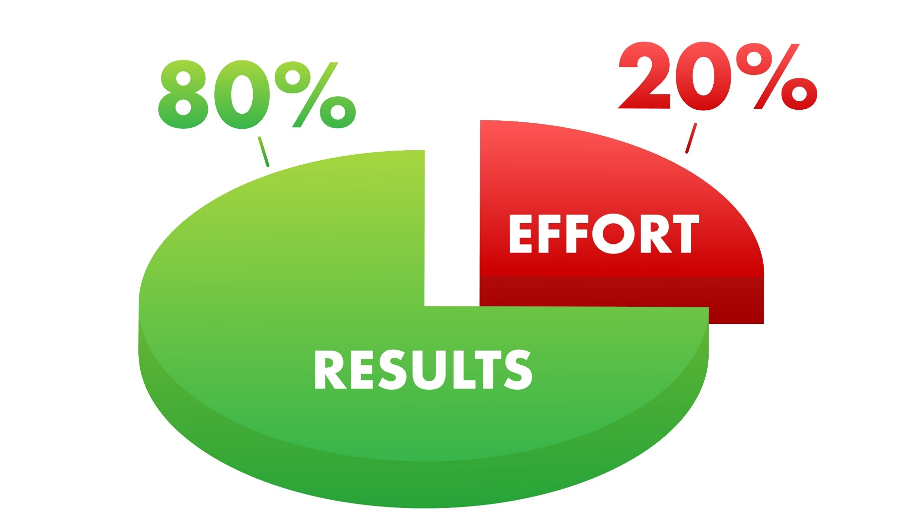
Understanding Pareto's Principle
80% of outcomes (or outputs) result from 20% of all efforts (or inputs) for any given event
Notes:
Benefits of using the Pareto principle
The biggest advantage of using the Pareto principle is that you can create the maximum amount of impact with the least amount of work. This can allow your team to work more efficiently and stay focused on specific initiatives.
The 80/20 rule can help your metrics increase in less time, simply by prioritizing initiatives in the right order.
Other benefits of using the Pareto principle:
Clear priorities both for you and your team
Increased daily productivity
Ability to portion your work into manageable segments
More focused strategy

Slide 14
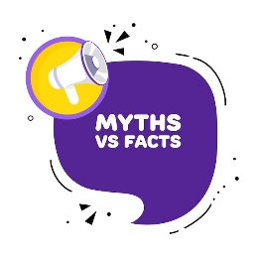
Myths about Interpersonal Skills
People have to always agree with one another.
I Always need to say Yes.
I like everyone and everyone likes me.
I should sacrifice my needs for those of others.
Being with people all the time.
I should have a lot of friends.
Notes:
People have to always agree with one another. No, interpersonal effectiveness does not mean that people have to always agree with one another. In fact, interpersonal effectiveness involves being able to communicate effectively and respectfully with others, even when there are disagreements or differences of opinion. It is about finding ways to express one's own thoughts and feelings in a clear and assertive way, while also listening actively to others and understanding their perspectives.
I Always need to say Yes. No, you do not always need to say yes. In fact, it is important to be able to say no when necessary in order to maintain healthy boundaries and prioritize your own needs and responsibilities. Saying yes all the time can lead to burnout, resentment, and a lack of respect from others, as it may communicate that your time and resources are not valuable.
I like everyone and everyone likes me. : Interpersonal effectiveness does not mean having a mutual admiration society. It is not possible for us to like everyone we interact or work with. However it is important for us to be able to maintain a professional working relationship with people.
I should sacrifice my needs for those of others.: While it is important to be considerate and empathetic towards others, it is not healthy or sustainable to sacrifice your own needs and well-being for the sake of others. Neglecting your own needs and prioritizing the needs of others all the time can lead to burnout, resentment, and a lack of respect from others. It is important to strike a balance between meeting your own needs and taking care of others. This means recognizing your own limits and boundaries, being assertive about your own needs and priorities, and communicating your needs clearly and respectfully to others.
Being with people all the time. Having good relationships with people is not directly proportional with the frequency of time spent but with the quality of interaction. You do not need to occupy the mind of another at all times to be important to them. But the kind of interaction that you have and the outcome of that interaction is what will define the effectiveness of the relationship.
I should have a lot of friends. Interpersonal effectiveness is not limited to friendship. It goes beyond that. It is the ability to interact with others in such a way that you are able to achieve your desired outcomes. It is true that people who are very effective in their relationships are likely to have more friends. But having fewer friends does not mean that you are any less effective.

Slide 15






Building Interpersonal Effectiveness
Empathy
Assertive
Communication
Conflict Resolution
Developing Interpersonal Effectiveness
Active
Listening
Emotional
Intelligence
Notes:
Practice active listening: One of the most important skills in building strong relationships is the ability to listen actively. This means giving your full attention to the person speaking, asking clarifying questions, and responding in a way that shows you have understood their perspective. By actively listening, you can build trust and understanding in your relationships.
Practice assertive communication: Being assertive means communicating your thoughts, feelings, and needs in a clear, respectful, and direct way. It involves expressing yourself confidently while also respecting the feelings and perspectives of others. This can help you to avoid misunderstandings and conflicts, and build stronger, more authentic relationships.
Develop empathy: Empathy is the ability to understand and share the feelings of others. By putting yourself in someone else's shoes, you can gain a deeper understanding of their perspective and build stronger relationships based on mutual respect and understanding.
Learn conflict resolution skills: Conflict is a natural part of any relationship, and being able to resolve conflicts constructively is essential for building strong and healthy relationships. This involves identifying the root cause of the conflict, expressing your thoughts and feelings in a respectful way, and working with the other person to find a mutually beneficial solution.
Emotional Intelligence: Mindfulness is the practice of being present in the moment and fully engaged with your surroundings. By practicing mindfulness, you can develop greater self-awareness and emotional intelligence, which can help you to communicate more effectively and build stronger relationships.

Slide 16






98752-08472
Hello@freelancetrainings.com
www.freelancetrainings.com
406, Titanium City Centre Mall, Anand Nagar, Satellite, Ahmedabad-380015

