Slide 1


Prevention, Prohibition, and Redressal of Sexual Harassment at Workplace
Your
Company
Logo
Notes:
Facilitator’s Notes:
Trainer to say in the loudest voice “Hello, Good Morning”. Then the participants will say ‘Good Morning’ in reply.
Trainer to say once again in the loudest voice “Hello Good Morning”. Trainer should speak in an energetic, passionate and enthusiastic tone. This activity/gesture will set the tone and energy for the session/workshop
Trainer: Well done friends! Great job! (Clap Loudly and tell the participants to clap as well for the superb performance.)
Trainer: I'm excited to be here with you all today and appreciate your presence. I hope you're all doing well and are ready to dive into the material.Move to next slide.

Slide 2

Workshop Agenda
Understand Sexual Harassment
The POSH ACT
Types of Sexual Harassment
POSH Complaint Filing Process
Consequence of Not following POSH ACT
Manager’s Role in POSH Compliance
Notes:
Welcome to the POSH awareness workshop Prevention, Prohibition, and Redressal of Sexual Harassment at Workplace. Are you excited for today`s workshop? let me introduce todays workshop modules.
Understand Sexual Harassment
The POSH ACT
Workplace Defined
Consequence of Not following POSH ACT
Types of Sexual Harassment
POSH Complaint Filing Process
I'm feeling really enthusiastic about this experience, I think it's going to be great.

Slide 3


Activity
What can I do to create a sexual harassment free work environment?
What are my rights and responsibilities?
Does the POSH policy cover males?
Isn’t the POSH sensitization only applicable for males?
Why do I need
POSH Sensitization?
Why do I need
POSH Sensitization?
Notes:
The Awareness about Prevention of Sexual Harassment (POSH) can be confusing for employees, especially if they are not familiar with the subject or if the organization has not provided sufficient education and training on the topic. Some of the reasons why POSH awareness can be confusing are:
Lack of clarity on what constitutes sexual harassment: Employees may be unsure about the various forms of sexual harassment, including verbal, physical, and visual. They may not have a clear understanding of what behaviors or actions qualify as harassment in the workplace.
Limited knowledge of company policies and procedures: Employees may not be aware of the specific policies and procedures in place within their organization to address sexual harassment. They may not know whom to contact, how to file a complaint, or the steps involved in the investigation process.
Misunderstanding of roles and responsibilities: Employees may not fully understand the roles and responsibilities of different individuals within the organization when it comes to preventing and addressing sexual harassment. They may be unclear about the role of supervisors, human resources, and the internal complaints committee (ICC).
Fear of consequences or retaliation: Employees may hesitate to come forward and report incidents of sexual harassment due to a fear of negative consequences or retaliation. They may be uncertain about the protections available to them as complainants and whether their confidentiality will be maintained.
Cultural and societal factors: Cultural and societal factors can also contribute to confusion regarding sexual harassment awareness. Different individuals may have varying perspectives on what is considered acceptable behavior, making it challenging to establish a common understanding.
To address these confusions and improve POSH awareness, today’s workshop will cover all the topics which will help you to have a better understanding about POSH and your rights as an employee of organization.

Slide 4


What Is Sexual Harassment?
Any unwelcome physical, verbal or non-verbal conduct of unnecessary, improper or unwelcome sexual nature:
Unwelcome
Physical, Verbal and Non-verbal
Sexual Nature
Though Sexual Harassment can be against a person of any gender but our workshop will focus on Prevention of Sexual Harassment of Women at the workplace.
Notes:
Sexual harassment refers to unwelcome behavior of a sexual nature that occurs in the workplace or other professional or social settings. It involves any form of unwanted sexual attention, advances, requests, or other verbal, non-verbal, or physical conduct that is offensive, intimidating, or creates a hostile work environment. Sexual harassment can happen to anyone, regardless of their gender or sexual orientation. In the next few slides we will try to see
Welcome Vs Unwelcome
Physcial Verbal and Non Verbal conduct of Sexual Nature

Slide 5
Welcome Vs Unwelcome Behaviors
Unwelcomed Behaviours
Feels bad
One sided
Feels powerless
Unwanted
Demeaning
Causes anger/sadness
Illegal
Welcomed Behaviours
Feels Good
Reciprocal
In control
Wanted
Appreciative
Happy
Legal
Notes:
Welcome Behaviors: Welcome behaviors are those that are desired, consensual, and mutually agreed upon by all parties involved. These behaviors are appropriate, respectful, and in line with the boundaries and consent of the individuals involved. In the context of relationships, welcome behaviors include acts of affection, intimacy, or sexual activity that are willingly and enthusiastically engaged in by all participants.
Unwelcome Behaviors: On the other hand, unwelcome behaviors are those that are unwanted, non-consensual, or go against the boundaries and desires of the individuals involved. These behaviors may cause discomfort, distress, or harm to the recipient. What is considered unwelcome can vary from person to person, and it is essential to respect individual boundaries and consent.
In the context of sexual harassment, unwelcome behaviors specifically refer to actions, comments, or gestures of a sexual nature that are imposed on someone without their consent or against their will. Unwelcome behaviors in this context include sexual advances, requests for sexual favors, sexually explicit comments or jokes, unwanted physical contact, or any other form of sexual behavior that is unwelcome, offensive, or creates a hostile environment.
Determining whether a behavior is welcome or unwelcome relies on the presence of consent.

Slide 6


Scenario
David and Emily are part of the same team. One day, during a team lunch, David makes a comment about Emily's appearance, saying she looks very hot in red dress- just like a rose. Although David meant it as a harmless compliment, Emily feels uncomfortable and objects to his comment. “Stop it David, I don’t like any personal comments , Please stay in your limits. If you do it again I will file a POSH Compliant”- David was shocked and was not able to understand what went wrong with Emily.
Is this sexual Harassment
It is not the Intention that matters rather the Impact which the incident has caused on the other person.
Notes:
Yes, the situation described could be considered as sexual harassment under the Indian POSH (Prevention of Sexual Harassment) Act. While David may have intended his comment as a compliment, it made Emily feel uncomfortable and objectified based on her appearance. The POSH Act defines sexual harassment broadly and includes unwelcome comments, gestures, or behavior of a sexual nature that creates someone uncomfortable.
Under the Indian POSH (Prevention of Sexual Harassment) Act, it is primarily the impact of the behavior on the recipient that matters in determining whether an incident qualifies as sexual harassment, rather than the intention behind the behavior.

Slide 7





Harassment of Sexual Nature
Physical Conduct
Contact & advances
Visual conduct,
like showing
porn content
Demand or
request for
sexual Favors
Verbal Conduct
Making sexually coloured remark
Non-verbal conduct
e.g Winking eye etc
Notes:
Different Scenario of Sexual Harassment
Physical Harassment: This refers to unwanted physical contact, such as touching, groping, pinching, or brushing against someone without their consent, blocking someone’s way.
Verbal Harassment: This includes offensive comments, Sexual jokes, slurs, or sexual innuendos, sexual terms. It can also involve persistent requests for sexual favors or sexually explicit conversations.
Visual Harassment: It involves displaying sexually explicit or offensive images, posters, or objects in a public or private space, showing pornography
Non-Verbal Harassment: This involves unwelcome gestures, leering, staring, winking of Eye or displaying sexually suggestive images or objects
Demand or request for Sexual favour : Requesting sexual favors in exchange for employment benefits, promotions, raises, or other professional opportunities; making persistent or unwanted romantic or sexual advances despite rejection.

Slide 8
POSH Guidelines- A Quick Glance
Workspaces should have complaint committee and counselor
Complaint procedures should be time bound
GUIDELINES
Committee must be headed by a woman
Maintenance of confidentiality of victim
Women are not to be discriminated in any form at workplace during the process
Notes:
having a complaint committee and counselor in the workplace is highly beneficial for addressing and preventing issues related to sexual harassment
One of the key provisions of the POSH Act is that the POSH committee must be headed by a woman who will act like a chairperson or a presiding officer. Any woman employed at a senior level in the organization or an external woman with experience in handling gender-related issues can head the committee.
Women should not face any form of discrimination in the workplace, including during the process of addressing and resolving complaints of sexual harassment.
Maintaining the confidentiality of the victim is of utmost importance when addressing cases of sexual harassment in the workplace. Confidentiality helps create a safe environment for individuals to come forward and report incidents without fear of reprisal or breach of privacy.
Time-bound procedures help ensure that complaints are addressed promptly, preventing unnecessary delays and minimizing the impact on the victim and the overall work environment.

Slide 9
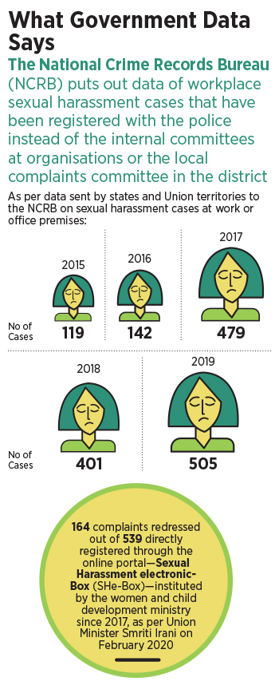
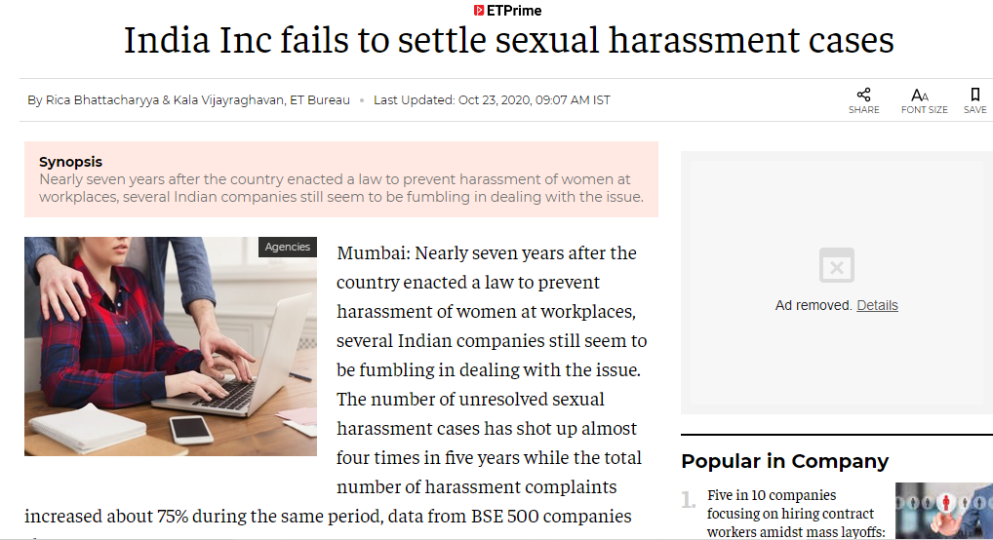
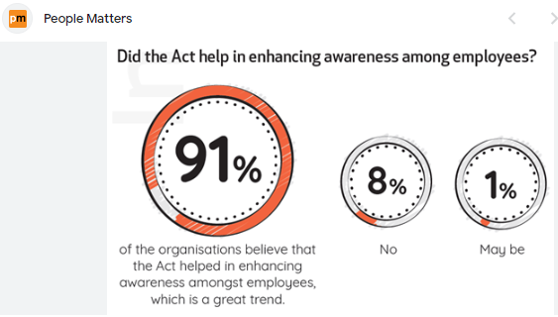
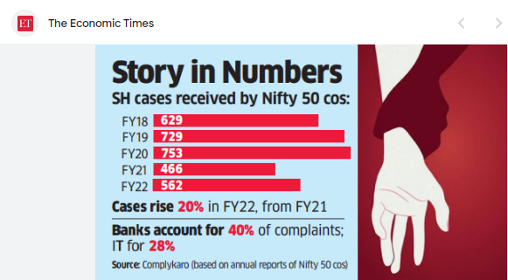
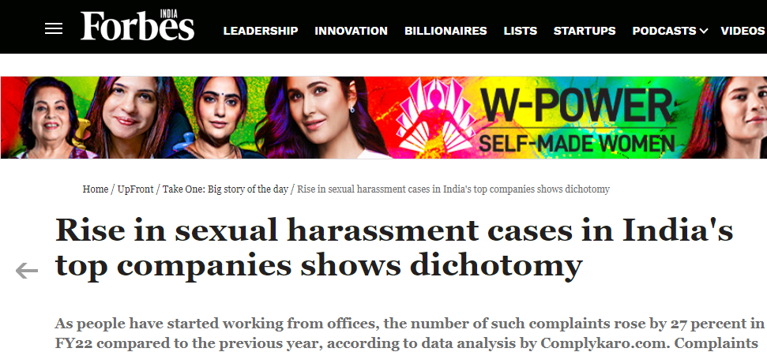
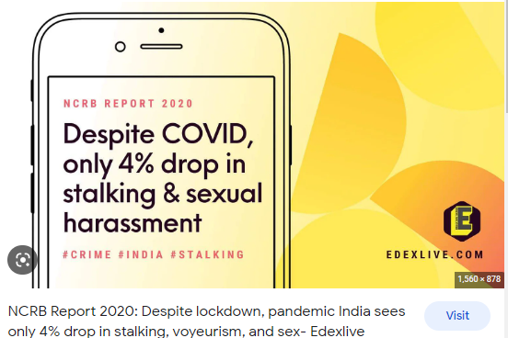
Why POSH Awareness?
Notes:
The Facts are self Explanatory

Slide 10




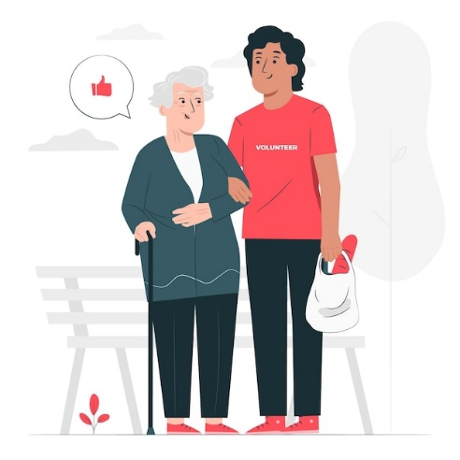
Who is an Employee under POSH ACT
Third-party workers:
Consultants, contractors, agents,
Regular employees:
Permanent, temporary, contractual, and probationary , Full time/ Part time
Trainees
Trainees, interns, apprentices, any any other form of Trainee
Workers & Laborer
Volunteers
social or charitable organizations
Manual, skilled, or unskilled labor
Notes:
Under the Sexual Harassment of Women at Workplace (Prevention, Prohibition, and Redressal) Act, 2013 in India, the term "employee" is not limited to regular full-time employees. The Act covers a broad range of individuals who can be considered as employees, including:
Regular employees: This includes permanent, temporary, contractual, and probationary employees who work in an organization, whether full-time or part-time.
Trainees: Trainees, interns, apprentices, or any other individuals undergoing any form of training within an organization are also considered employees under the Act.
Workers and laborers: Individuals engaged in manual, skilled, or unskilled labor, regardless of their employment status, are covered under the Act.
Third-party workers: The Act also extends its protection to individuals working as consultants, contractors, agents, or any other capacity with an organization.
Volunteers: In certain cases, volunteers who work in an organization, including social or charitable organizations, may also be covered under the Act, provided they perform work under the supervision and control of the organization.
It is important to note that the Act specifically addresses sexual harassment faced by women in the workplace. However, the definition of "employee" includes individuals of any gender who may experience or witness sexual harassment, ensuring a gender-inclusive approach to addressing workplace harassment.

Slide 11







Extended workplaces
Communication modes like (Meeting platforms- ZOOM, Whats app messages and even text messages)
Personal space of the senior or
the hiring authority
Work from Home,
Remote/Flexi working
Company provided transportation
& Accommodation
Client premises &
Meetings
Training programmes, Seminars, Office parties, off sites, Outbound Trainings
Business Travel &
Incentivised Trips
Notes:
Following are some of the examples of extended workplace
Places visited by employee like client premises
Company provided transportation & Accommodation
Business Travel-
Personal space of the senior or the hiring authority
Client meetings, Travel for office purpose
Training programmes, Seminars, Office parties, off sites, Outbound Trainings
Incentivised trips
Any other place where one visits in the course of due to employment
Communication mediums like (Meeting platforms- ZOOM, Whats app messages and even text messages)

Slide 12


Types of Sexual Harassment
Quid Pro Quo
Hostile Environment
Notes:
Sexual harassment can take various forms and may involve different behaviors. Following are the two most prevalent forms of Sexual Harassment encountered at the workplace.

Slide 13






Setting the POSH Compliance Framework
Step 3
POSH Awareness
Step 5
POSH Annual Report Filing
Step 1
POSH Policy
Formulation
Step 2
IC Committee
Formation
Step 4
IC Capability
Building
Notes:
Becoming POSH (Prevention of Sexual Harassment) compliant involves taking certain steps to ensure that the organization establishes a safe and inclusive work environment free from sexual harassment. Here are the key steps involved:
Formulate a POSH Policy: Develop a comprehensive policy that clearly defines sexual harassment, outlines prohibited behaviors, explains the complaint process, and emphasizes the organization's commitment to preventing and addressing sexual harassment.
Establish an Internal Complaints Committee (ICC): Set up an ICC as mandated by the POSH Act. The committee should be headed by a woman and consist of representatives from the organization, including both employees and external members knowledgeable about the issue. Ensure members receive appropriate training on handling complaints and conducting investigations.
POSH Awareness: Ensure all employees are aware of the sexual harassment policy by sharing it widely. Conduct training sessions or workshops to educate employees about what constitutes sexual harassment, the complaint procedure, and the support available to victims. Here the POSH Awareness training needs to be given to all the emplyees- Once in a year
POSH IC member training : On dealing with POSH matters and filing of POSH Reports
Annual POSH Report filing-

Slide 14








POSH Grievance Redressal Process
Employer
Action
ICC Enquiry
Recommendation
ICC Conciliation/ Enquiry
60 Days
Respondent’s written response
10 Working days
Letter to the respondent by
ICC.
Filing of written complaint
10 Working days
Incident of Sexual
Harassment happens
7 Working days
3 Months
90 Days
Once the complaint has been raised to ICC then the ICC takes over the entire process
Notes:
The process of filing a complaint under the Sexual Harassment of Women at Workplace (Prevention, Prohibition, and Redressal) Act, 2013 typically involves the following steps and time frames:
Filing the Complaint:
The complainant should submit a written complaint to the Internal Complaints Committee (ICC) within three months from the date of the incident.
If there are reasonable grounds for not filing the complaint within three months, the complainant should provide a written explanation for the delay.
Initial Inquiry:
Upon receiving the complaint, the ICC initiates an inquiry to ascertain the prima facie validity of the complaint within a week of receipt.
The ICC/LCC may hold preliminary discussions with the complainant and the respondent separately to gather information.
Completion of Inquiry:
The ICC/LCC is required to complete the inquiry within 90 days from the date of receiving the complaint.
The inquiry involves gathering evidence, interviewing relevant witnesses, and giving the complainant and respondent an opportunity to present their respective cases.
Submission of Inquiry Report:
The ICC/LCC submits a written inquiry report to the employer or the District Officer, as applicable, within ten days from the completion of the inquiry.
The report includes findings of the inquiry, recommendations, and actions to be taken by the employer or the District Officer.
Employer's Action:
Upon receiving the inquiry report, the employer is responsible for taking appropriate action based on the recommendations within 60 days from the receipt of the report.
The action may include disciplinary measures against the respondent, implementation of preventive measures, providing assistance to the complainant, or any other actions deemed necessary.
Review and Appeals:
Both the complainant and the respondent have the right to appeal against the findings or actions taken by the ICC/LCC or the employer.
The appeal should be filed within 90 days from the date of the employer's action or the lapse of the stipulated time frame for action.

Slide 15

POSH –Disciplinary Actions
Written Apology /
Warning
No
Appraisal
Termination
POSH
Penalties
Reprimand/ Censure’
Withholding Promotion/ Pay Hike
Notes:
Depending on the severity and nature of the sexual harassment incident, the accused (respondent) can be subjected to various disciplinary actions or consequences. These may include, but are not limited to:
Written Apology: The respondent may be required to provide a written apology to the complainant, expressing remorse for their actions.
Warning: A formal warning can be issued to the respondent, indicating that their behavior is unacceptable and any recurrence may result in more severe consequences.
No Appraisal: The organization may choose to withhold or delay the appraisal of the respondent as a consequence of their misconduct.
Reprimand/Censure: The respondent may be officially reprimanded or censured for their behavior, which is recorded in their employment record.
Withholding of Promotion or Pay Rise: The organization may choose to withhold or delay the promotion or pay rise of the respondent as a disciplinary measure.
Deduction of Compensation: In cases where compensation is awarded to the aggrieved woman, the organization may deduct the compensation amount from the salary or benefits of the respondent.
Termination: In serious cases of sexual harassment, where the actions of the respondent are found to be severe or repeated, the organization may terminate their employment.
The specific disciplinary action taken will depend on the outcome of the inquiry, the severity of the harassment, and the organization's policies and procedures. It is important to follow a fair and objective process while imposing any disciplinary action, ensuring that the rights of both the complainant and the respondent are respected.

Slide 16





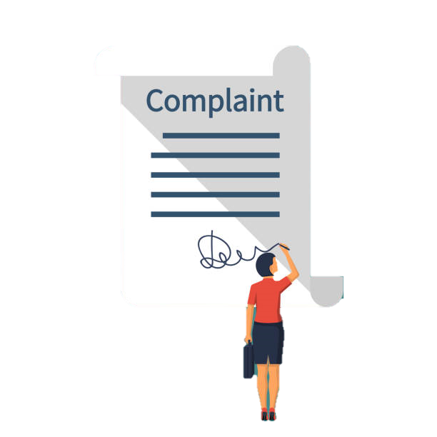
Duties of an employee
STEP-1
Tell the accused to Stop (Clearly, firmly & Directly)
STEP-2
If the behavior still continues file a complaint with the IC Team
STEP-3
IC team takes up the case/instance as per the POSH policy & ACT
Notes:
Step -1: The first step for the employee is to communicate clearly and directly with the person engaging in the inappropriate behavior. They should inform the accused that their behavior is unwelcome, making them uncomfortable, and request that it stops immediately. While this approach can empower the employee to address the issue at an initial stage, it is important to note that every situation is unique.
Step 2 : If the behavior persists or escalates despite the employee's direct communication, they should proceed to file a formal complaint with the designated IC Team or the appropriate authority within the organization. The complaint should be submitted in writing, providing a detailed account of the incidents and any supporting evidence available.
Step 3: IC Team teakes up the issue under the POSH Policy

Slide 17








Manager’s Role in POSH Compliance
Walk the Talk
Have a zero tolerance to any behaviour
of Sexual nature at work
Treat everyone you manage fairly
Don’t Ignore a sexual
harassment situation
Act on any complaint of
sexual harassment immediately
Encourage your team
members to speak up
Watchout for adult jokes/ comments
in your team even if it is in good humour.
Donot cross your boundaries
Notes:
Being a manager/ supervisor, you have following additional responsibilities to making the organisation POSH Compliant & ensuring a safe workplace for your teams
Walk the Talk- Donot Participate in any inappropriate behaviour
Have a zero tolerance to any behaviour of Sexual nature at work
Treat everyone you manage fairly
Donot Ignore a sexual harassment situation. Ignorance will mean that you promote /tolerate Sexual Harassment.
Act on any complaint of sexual harassment immediately- regardless of your personal opinion
Encourage your team members to speak up if they see anything that makes them Uncomfortable or feel is wrong.
Donot cross boundaries with any of your employees
Watchout for adult jokes/ comments in your team even if it is in good humour.
Do not retaliate or allow anyone to retaliate against an employee who has filed a compliant for sexual harassment
If a team member comes to you to discuss a POSH incident, kindly guide them/ help them to report the same to IC Team.

Slide 18

Scenario’s
Notes:
The Trainer can use these additional scenarios on POSH

Slide 19

Scenario 1
Jill and Amos had met at a company Out bound Training event held last month. While they don't work for the same department but they have been exchanging emails to compare notes on their respective fields. After a few emails, Amos quickly changes the subject from work to compliments for Jill, about how attractive and good-looking she is.
Jill tries to bring the subject back to work-related questions but Amos persists in writing Jill emails on a daily basis explaining how in love he is with her. This has been a regular phenomenon and is making Jill very uncomfortable. Jill informs her HR who in turn reaches out to Amos’
Does this portray Sexual Harassment?
Notes:
Yes it is a case of Sexual Harassment- Lets look at some important aspects
Unwanted and Inappropriate Comments: Amos quickly transitions from work-related discussions to complimenting Jill's appearance and making comments about how attractive she is. These comments go beyond professional boundaries and are not relevant to their work-related exchanges.
Persistence despite Discomfort: Jill tries to redirect the conversation back to work-related matters, indicating her discomfort with Amos's comments. However, Amos persists in sending daily emails expressing his romantic interest in her, disregarding her attempts to maintain a professional and work-focused communication.
]Impact on Comfort and Work Environment: Amos's continuous and unwelcome romantic expressions are causing Jill significant discomfort. This persistent behavior creates an intimidating, offensive, and hostile work environment for her, undermining her ability to engage in normal work-related interactions without fear or distress.
Jill's decision to inform HR about the situation is appropriate and aligns with the steps to address sexual harassment in the workplace. HR's intervention can help address the issue and ensure a safe and respectful work environment for all employees.

Slide 20





Thank You
98752-08472
Hello@freelancetrainings.com
www.freelancetrainings.com
406, Titanium City Centre Mall, Anand Nagar, Satellite, Ahmedabad-380015

