Slide 1



Onboarding Workshop- Soft Skills -2 Days
Notes:
Facilitator’s Notes:
Trainer to say in the loudest voice “Hello, Good Morning”. Then the participants will say ‘Good Morning’ in reply.
Trainer to say once again in the loudest voice “Hello Good Morning”. Trainer should speak in an energetic, passionate and enthusiastic tone. This activity/gesture will set the tone and energy for the session/workshop
Trainer: Well done friends! Great job! (Clap Loudly and tell the participants to clap as well for the superb performance.)
Trainer: I'm excited to be here with you all today and appreciate your presence. I hope you're all doing well and are ready to dive into the material.Move to next slide.

Slide 2
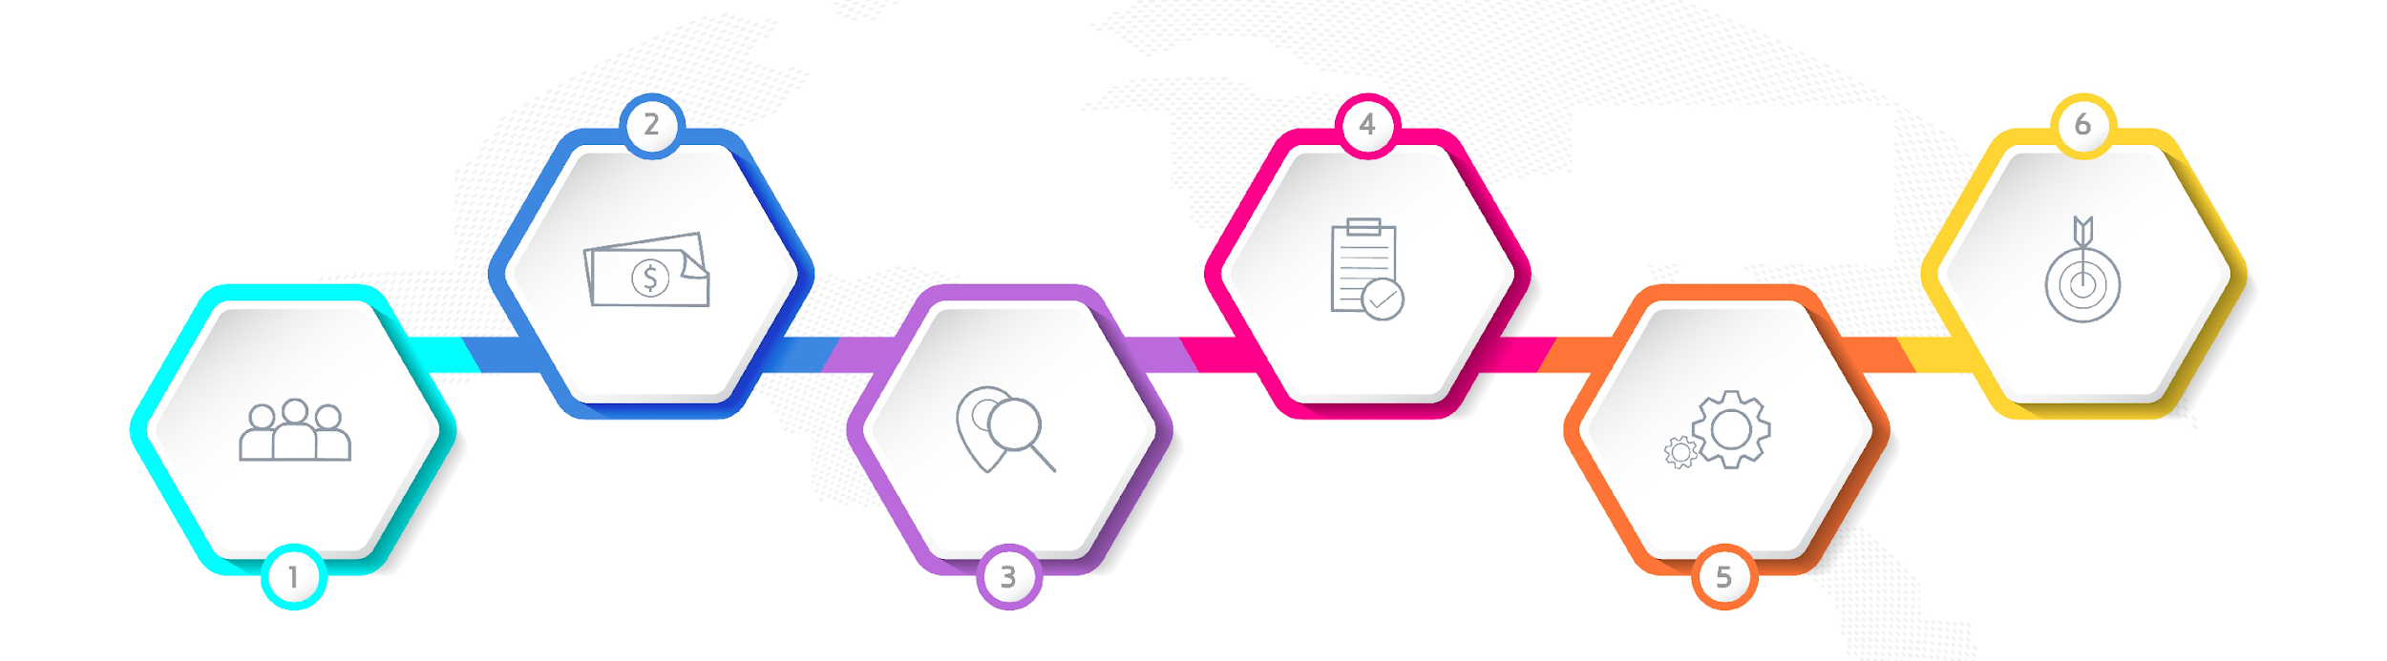






Agenda of Workshop- Day 1
Module 1
Module 3
Module 5
Understanding
Personal Effectiveness
Impactful
Communication
Goal Setting
Module 2
Module 4
Module 6
Building a Fool Proof Communication
Being a Team Player
Building an Attitude
of Ownership
Notes:
The agenda of todays workshop is as follows
Understanding Personal Effectiveness
Building an attitude of Ownership at workplace
Impactful communication
Building Fool Proof Communication
Goal Setting
Being a Team player

Slide 3
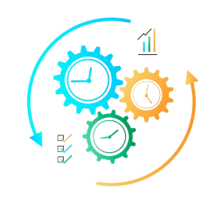


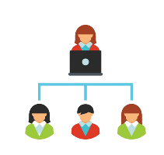


Agenda of Workshop- Day 2
Module 3
Module 1
Module 5
Managing Stakeholders
First Impression is the last Impression
Email etiquette
Module 2
Module 4
Recap/Revision
Manging Time & Prioritisation
First Impression is the last Impression Part-2
Notes:
The agenda of Day 2 workshop is as follows
Knowing & Managing stakeholders
Managing Time & Prioritization
First Impression is the last Impression- Part-1
First Impression is the last Impression- Part-2
Email Etiquettes

Slide 4

Who is a stakeholder?
Any person/ department who has an impact on your work performance
This can include employees, customers, investors, suppliers, government agencies, etc
Stakeholder Management is maintaining good relations with your stakeholders and keeping them engaged
Notes:
As your career develops, and you become more successful, the actions that you take start to affect more and more people. And the more people you affect, the more likely it is that some of them will have significant power and influence over your work.
These people are your stakeholders. They could be strong supporters of your projects – or they could block them. So you need to identify who your stakeholders are and win them over as soon as possible.
Knowing our stakeholder and their expectation from us regarding the project or our daily work will help us plan and prioritise our work efficiently. This will also keep the stakeholder satisfied and in loop.
Lets move to next slide and understand stakeholder management better.

Slide 5
Stakeholder Matrix
High
Keep Satisfied
Manage Closely
Stakeholder Matrix
Power of Influence
Monitor
(Minimum Effort)
Keep Informed
Low
Low
Level of Interest
High
Notes:
The stakeholder management matrix is a tool used to analyze and prioritize stakeholders based on their level of influence and interest in a project that you are executing. It is a grid with four quadrants, with the level of influence represented on the horizontal axis and the level of interest represented on the vertical axis.
By using the stakeholder management matrix, you can prioritize their efforts and resources to engage and manage stakeholders effectively, ensuring that their needs and concerns are addressed appropriately.

Slide 6

URGENT
IMPORTANT
Urgent V/s Important

Slide 7

Urgent V/s Important

Slide 8
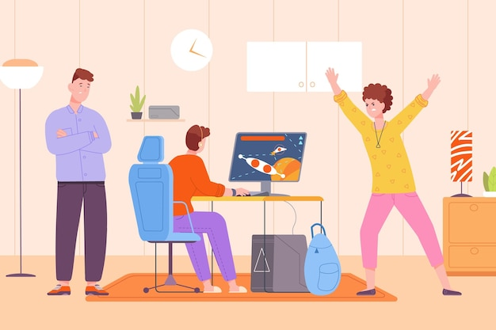
Quadrant 3 -Not Urgent and Not Important – Distractions
Excessive or irrelevant email
Personal phone calls
Social media usage
Unimportant or unproductive meetings
Anything that causes you to procrastinate on, or delay, Q1 tasks
These activities are neither important for achieving your long-term goals nor urgent. They are essentially distracting you from doing things that matter
Notes:
Trainer Explains the 3rd quadrant with Examples https://www.groupmap.com/portfolio/urgent-important-matrix
Not Urgent and Not Important – Distractions
These activities are neither important for achieving your long-term goals nor urgent. They are essentially distracting you from doing things that matter.
Not Urgent and Not Important tasks might include:
Excessive or irrelevant email
Personal phone calls
Social media usage
Unimportant or unproductive meetings
Anything that causes you to procrastinate on, or delay, Q1 tasks
Reduce, or completely avoid spending time, effort, and resources on activities in this quadrant if where possible.

Slide 9

Using 80/20 Principle for Prioritising Work
Clear priorities both for you and your team
Increased daily productivity
Ability to portion your work into manageable segments
More focused strategy
Notes:
Benefits of using the Pareto principle
The biggest advantage of using the Pareto principle is that you can create the maximum amount of impact with the least amount of work. This can allow your team to work more efficiently and stay focused on specific initiatives.
The 80/20 rule can help your metrics increase in less time, simply by prioritizing initiatives in the right order.
Other benefits of using the Pareto principle:
Clear priorities both for you and your team
Increased daily productivity
Ability to portion your work into manageable segments
More focused strategy

Slide 10

Corporate dressing for Male
Oil or gel your hair regularly
Hair length should not be below the shoulders
Either have a clean shave/ trim your moustache and beard
Avoid wearing chunky necklaces or too many bracelets to work.
Your tie should contrast with shirt and complement your overall look
Always Wear well fitted Clothes
Don’t Wear Tatoos/ Earrings (Only worn if they are tiny size)
Notes:
Oil or gel your hair regularly so that it is neat
The hair length should be till the shoulders and not below
Keep a shoe shiner handy.
Prefer dark leather shoes (Black or Brown) with black laces.
Wear dark coloured socks to work.
Do not wear sports shoes or sneakers to work.
Remove all other rings except your wedding ring.
Remember, there is a huge difference between your college and professional life.
College were the days when nobody told you anything when you wore ripped jeans, T shirts, sneakers, hats and proudly flaunted your tattoos and body piercings.
If you wear an earring, remove it immediately.
Tattoos and body piercings are not at all acceptable in a professional environment.
If you have a moustache, make sure it is neatly trimmed.
Do not attend office with beard unless and until there is an emergency.
Remember, your tie should complement your overall look.
Silk ties are always a safe bet. Do not wear ties in loud colours or jazzy patterns.
The tip of your tie should touch your belt buckles.
Do not wear flashy belts with broad buckles. Wear leather belts in dark colours preferably black or brown.
Wear socks that match your pants

Slide 11

Smart Casuals Male
Tops and outerwear pieces
Bottoms
Shoes
Accessories
Notes:
A casual dress code is a less formal version of outfits you can wear to your professional job. This dress code means employers allow their employees to wear clothing that is informal and more relaxed,
To help yourself adhere to a company's casual attire dress code, there are several tops and outerwear pieces you can select for a professional environment.
Tops- Some options include collared shirts, button-down tops, sweaters
Bottoms -Additionally, you can select clean and rip-free jean jackets, cardigans, blazers or other appropriate jackets for outerwear pieces.
Some bottom options you can choose are jeans, slacks, trousers, mid-length skirts, khaki pants or cropped pants with appropriate colours and patterns that are not too distracting to others or yourself.
Shoes: You can choose more dressed-up casual footwear and select heeled boots or other low-heeled shoes.
Other shoe options for this dress code can include flat boots, sneakers, loafers, or open-toed shoes.
You may pair bottoms, such as jeans, trousers or cropped pants, with a sensible belt. Other accessories can include simple watches, scarves, necklaces or bracelets.
Take responses and move to next slide

Slide 12

Corporate dressing for Female -Contd
Do not wear loud make up to work. Use lip colours of softer shades. Prefer lip gloss to lip stick. (avoid red, dark pink, orange lipsticks.)
It is important to smell good at the workplace. Keep a mild perfume handy.
Make sure your hands are clean and nails properly trimmed and manicured.
Hair should be neatly combed and properly tied.
Wear flats or platform heels to work.
Notes:
It is always wise to dress according to your office culture.
Business suits look best in colours like Blue, Black or Charcoal grey.Business suits constitute a crisp shirt teamed with a matching trouser
Avoid wearing loud colours to work. Colours such as hot pinks, reds, deep purples look odd at the workplace. They are meant to be worn at parties and get togethers with friends.
Animal prints and jazzy designs are not meant for offices.
Stud earrings look simple yet elegant on female professionals.
Do not wear chunky necklaces, large earrings and stacks of bangles at workplace. Flaunting your gold jewellery at office is foolish. Do not wear ring on every finger. Avoid wearing multiple bracelets. An elegant and simple watch looks best on professionals.
A nude look works best in offices. Don’t overdo your make up. I
Instead of a bright lipstick, a lip-gloss looks better and you can even reapply the same whenever needed. Minimal make up can not only make you look good but also extremely professional. Never apply layers of foundation on your face. Avoid cakey make up at workplace
Messy hair is not at all acceptable at workplaces. Do not adopt weird hairstyles at work..
Your heels should not be more than 2 inches.
Ask what is casual dress code ,take responses

Slide 13

Casual dressing Some other tips
Women’s slacks are one of the favorite clothing pieces
Wear them with one of your favorite formal shirts, a casual tweed blazer, or a light sweater
The suit is, without doubt, the most formal piece of all the business formal wardrobe
To complete the perfect business casual outfit, you should take care of your shoes.
Notes:
Pair a blazer with a casual
Try wearing a sheath dress with an oversized linen blazer, bright and funky trench coat, or a chunky sweater for a more laid-back office environment. hirt, jeans or chinos, or a lightweight dress to keep the look clean and simple but still semi-formal.
Combine formal shirt with linen chinos, dark jeans (these should not be bleached or ripped), a sweater, or an oversized trench coat.
Wear slacks with one of your favorite formal shirts, a casual blazer, or a light sweater
Wear a pencil skirt with an informal shirt tucked in or a flared skirt with a plain t-shirt that fits you well.
Go for a suit in bright pastel colors that can be easily combined with a simple white t-shirt and ballerinas
Go for sleek looking loafers as a part of the dress code
For most women, a business wardrobe consists of essential pieces in neutral colors, such as black, dark blue, beige, or white.
Luckily for all, the business casual style allows us to introduce more colors into our daily outfits and make the whole color scheme available.

Slide 14


Introduction
Hello Ma’am, I am RAM Kumar, ABC Ltd. It’s pleasure to meet you.
Good morning everyone! My name is Ram Kumar, ABC Ltd. How may I help you?
Younger/junior/lesser important people are introduced to older/senior/more important people
Junior ranking professionals to senior ranking professionals & Business contacts, boss and staff to clients
Personal acquaintances/family members to business professionals in any business function
Ram (subordinate) meet Mr. Doshi (client) who is our esteemed customer.
Sam sir (boss), this is Mr. Srivastav our customer from the Baroda branch.
Introducing Self
Introducing Others
Notes:
This slide is self Explanatory-
Trainer to focus on Introducing others- especially the hierarchy- As this might be a new for participants to understand

Slide 15

Eye Contact-Do’s
Hold your gaze for 4 to 5 seconds at a time
Smile
Use gestures
Move your eyes slowly
Maintain eye contact 50% of the time
Don’t Frown/ Stare
Notes:
Self Explanatory- Trainer can elaborate the points if required

Slide 16

Visiting card etiquette
Never leave the house or office without your business card
Keep your business card to yourself
Give your business card when a person asks for it
Make sure your business card is presentable
Business Card
Notes:
Knowing the rules of business card etiquette is just one more way to add the polish that builds your image as a professional, especially during meetings. We all agree that business card is a way to express your professionalism through a piece of paper.
Ask why should we never leave the house or office without business card
Say
First things first—always keep your visiting card with you,. You’ll never know when to give one. There is nothing more unprofessional than having to say to the person who asks for it, “Oh sorry, I forgot to bring my card…” or, “Sorry, I just handed out the last copy of my card…” This leaves a bad taste in the mouth. Not to mention, a lost opportunity for you. So, make sure you always have them with you.
Ask why should we keep the business card to ourself
Say Your business card is not something you hand to every people you meet on an event. Don’t think that just because you handed out 100 business cards during an event you will receive 100 calls in a few days. Nope. Although the goal of networking is to connect with as many people as possible, you still need to identify qualified leads, referral sources or future employers. Simply put, you need to be selective of who you are going to exchange calling cards with.
Ask why should we give our business card only when a person asks for it
Say Wait to be asked for your card. If an individual is interested in connecting with you beyond the event, he or she will ask about ways to contact you. This is the right time to give him or her your business card.
Hand your business card with discretion. Don’t give up to a dozen calling cards. This sends the message that your business card is not worth much as if you are telling the person to give them to others for you.
Ask why should business cards be presentable?make sure that your business card is not crumpled or dirty in any way. This makes for a really bad impression. Cards should be professional-looking. The same applies to giving a card where you crossed off an old contact info and written the new one.
Lets watch a video to learn good business card etiquette

Slide 17
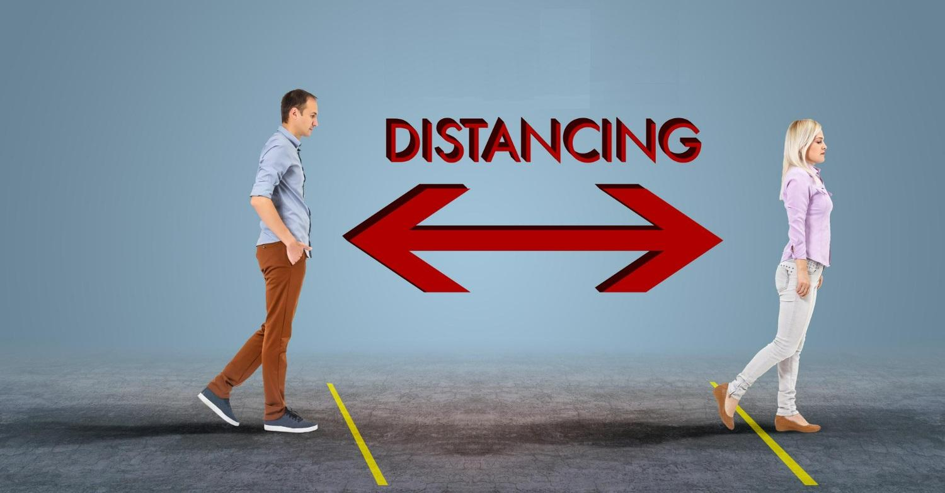
Space
Edward T. Hall invented the concept proxemics- which mentions the space Etiquettes.
Four Types of interpersonal distance, or degrees of proximity that we experience
Public distance- (12-25 Feet)
Social distance (4-12Feet)
Personal distance (1.5- 4 Feet)
Intimate distance (Less than 1.5 Feet)
Notes:
Classical proxemics theory was started in the 1960s by anthropologist Edward T. Hall. 1960s by anthropologist Edward T. Hall. Edward Twitchell Hall, Jr. was an American anthropologist and cross-cultural researcher. He is remembered for developing the concept of proxemics . Proxemics is the study of how space is used in human interactions..
He classified four degrees of interpersonal distance, or degrees of proximity that we experience
Public distance
Social distance
Personal distance
Public distance :At this distance (between 12–25 feet), you must speak louder to be heard, and it’s more difficult to maintain direct eye contact, so the connection between two people is minimal.
Social distance : This distance (between 4–12 feet) relies on visual and auditory cues to form a connection, since you’re still too far apart to touch or perceive body heat.
Personal distance : This distance (between 1.5–4 feet) is kept during interactions with friends. Here, vision is clear, eye contact is strong, and conversation flows easily.
Intimate distance: This distance (less than1.5 feet) is kept during interactions with friends. Here, vision is clear, eye contact is strong, and conversation flows easily.

Slide 18
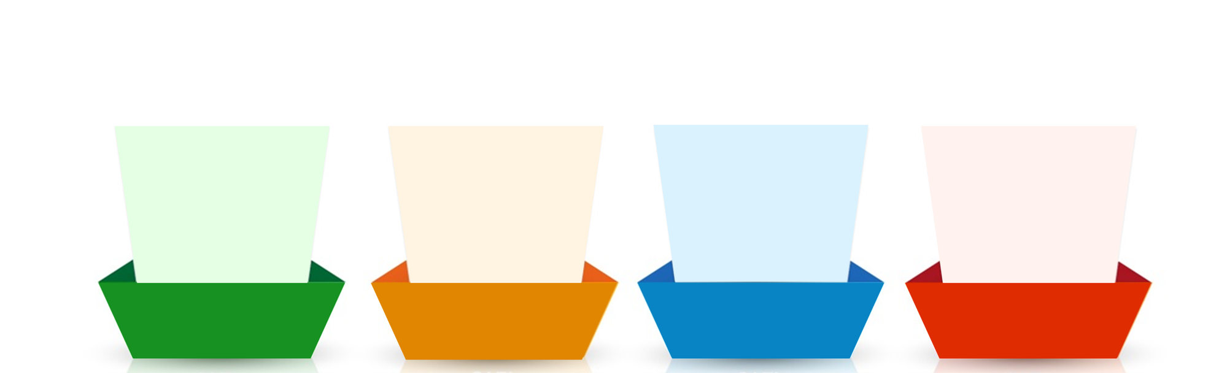
How should an ideal email be?
In intent, message, words and tone
Including all relevant information
To the point and preferably short
Polite, respectful and empathetic
Clear
Concise
Courteous
Complete
Notes:
Trainer:
An effective email has the following aspects:
Clear – As we saw earlier, a lot of misunderstanding and error can be caused due to unclear communication. Therefore, it is necessary to avoid vague responses. Statements like – I will let you know soon or phrases like as soon as you can, as soon as possible, in some time, do the needful etc. can be vague. Also, there must be clarity in the intent, message, words and tone of your email. Answer or ask in a simple, understandable manner. Use simple words and K.I.S.S (Keep It Short and Simple). All information in the email must be genuine
Complete – Your email must contain all the relevant information to the matter at hand so that there is no back and forth of emails. This will also need you to be clear about why you are writing the email and what information you want to share or ask for. Answer all questions and expected questions.
Concise – Your email must be preferably short and to the point. Avoiding unnecessary explanations or lengthy, complex sentences is necessary to maintain clarity and readability. Also, your email must be organized and clean for better understanding. Use shorter, meaningful statements and write to the point. Avoid unnecessary words and complicated vocabulary.
Courteous – As we know, your choice of words is all that matters in an email. Therefore, being polite, respectful and empathetic in your email will help you express your emotion, intent as well as involvement with the matter at hand. Usage of the right words will convey the right tone.
Remember: HOW you write an email shows WHO you are!
Now that we know how an email must be, let us look at the components of an email.
Transition to the next slide.

Slide 19

Subject Line- Important Pointers
Subject line is a mandatory
Must be Simple clear & Concise- Giving Idea about Email
It should contain 5 – 6 words to ensure that it is readable on phone as well
Must be logical keywords that are easy to search,
It could include your Organization’s name // Project Name// Project Date// Project Status
You CANNOT write an entire sentence in the subject line and leave the email content empty.
Notes:
Trainer notes:
Say: A subject line is the first most important part of an email. It is probing element to someone opening your email. If your subject line is poor, or unclear , it will not only reflect badly on the mail but will not attract people’s attention to open it.
Keep these pointers in mind while writing the subject line:
Subject line is a must!: Many a times we don’t write a subject line or just forget to write one. No mail should ever go without a subject line. In case you miss a subject line and send it, make it a point to resend the email with an apology in the body.
2. It should not be more than 5-6 words
In today’s day and age, we all access our emails on our phones. On phones you will be able to see the subject line as only 5-6 words, hence its smart to restrict your subject line.
4. Include keywords that are easy to search:
Most professionals have filters and folders set up to manage their email and probably won't focus on your message when they first see it. That's why it's important to include keywords related to the topic of the email that will make it searchable later.
5. Include your Organization Name //Project Name// Project Date // Project Status
The subject line must contain the keywords of the email. Often if the email is being sent as a follow-up of a conversation, the subject line will summarize the message. Also, schedules could be mentioned in the subject line so that the recipient does not need to open the email.
Please note that you CANNOT write an entire sentence in the subject line and leave the email content empty. It cuts a bad impression.

Slide 20

Attachment
Ensure that you attach the correct and latest file
Name the file appropriately
If there are multiple sheets in a spreadsheet (like Excel), you could mention them in the body of the email.
If attachments are password protected, remember to drop a line in the email.
Don’t Attach heavy files- Instead use a drive
Notes:
Trainer:
Here are some common points to remember about the attached documents:
Ensure that you attach the correct and latest file – often we have multiple files that are versions or updated documents saved as Doc (1) etc. To avoid confusion, you can consider placing the date ahead of the file name.
Name the file appropriately – It is necessary to name the file correctly instead of just saying report or manual. Be specific and name it a Quarterly Business Report or Training Manual.
If there are multiple sheets in a spreadsheet (like Excel), you could mention them in the body of the email – If a certain spreadsheet contains performance scores, appraisal percentages, attrition data etc.
If attachments are password protected, remember to drop a line in the email – sometimes, this is also added as a part of the signature if most files are sent securely.
Let us look at some examples.
Transition to the next slide.

Slide 21






98752-08472
Hello@freelancetrainings.com
www.freelancetrainings.com
406, Titanium City Centre Mall, Anand Nagar, Satellite, Ahmedabad-380015

