Slide 1


Your
Company
Logo
Managerial Effectiveness Workshop
Your
Company
Logo
Notes:
Branding Guidelines:
Please note that the Trainer/ corporate can use their own branding (like templates, colours, fonts, logo) to make the presentation more impactful
In the footer apart from workshop name all details are optional and as per the need of the trainer/ corporate. E.g Company name can be the trainer’s company name, client’s company name, etc. Similarly Trainer name is also optional (can be as per the need of the trainer/corporate).
Your company logo – Trainer can use their own logo or Corporate can also use their own logo

Slide 2
Agenda- Day-1 & Day 2
Managing Team
Goal Setting-For Team
Understanding your Team through Will/Skill Matrix
Effective Communication with team -Assertive Communication
Managing Teams
Motivating and Appreciating
Giving constructive feedback
Coaching and growing your team
Managing team Conflict
Managing Self
Understanding Managerial Effectiveness
Qualities of An effective Leader
Knowing your Leadership Style
Goal Setting-For Self
Managing Team
Communicating with Empathy
Confidence Building
Building Trust
Managing Business
Delegating the right way
Managing Change and Performance
Managing Task and Prioritization
Notes:
The qualities of an effective leader are those that manage themselves, their teams, and the organization’s business efficiently. In these 2 days, we will cover the top qualities that you must develop. Let us see what they are.
Note: Trainer to get any 3 participants read out topics within a part to promote more interactivity.

Slide 3

Managers vs Leaders
Has formal authority Vs having a Informal Authority
Reacts to change Vs promotes change
Is transactional in approach Vs Is transformational in approach
Focuses on work goals Vs Features on people who will achieve work goals
Performs process-related functions Vs Performs only one function -Direction
1
2
3
4
5
Notes:
Managers is represented in blue and the Leaders on this slide are mentioned in green
Trainer: And because we are now tending to become good leaders let’s talk about the difference between being managers and leaders. Could you explain these differences between a manager and a leader?
Elicit responses: (Give chocolates to participants who give good answers)
Manager – Has formal authority because this person is given the position/designation in the hierarchy
Leader – Has informal authority because of his qualities, values, and character – may not have an official position in the system but can still influence people. Sometimes, you will find a senior or skilled member of the team automatically assuming this role.
Manager – Focuses on work goals – primarily concerned with whether and how the work gets done.
Leader – Focuses on people who will achieve work goals – believes in explaining the goals to people and guiding them to achieve the goals
Manager – Performs process-related functions – since his role is to get the work done, the actions he takes are also related to the process
Leader – Provides direction to people about how the goal can be achieved as well as what is expected during the process – may allow the team to choose the way they complete the task
Manager – Reacts to change – since the focus is on the work goal, any deviation, challenge or failure may cause the manager to react (adversely) to the situation and people
Leader – Promotes change – since the focus is on directing people, any change that is beneficial for people or process (especially long-term) is accepted and promoted by a leader
Manager – Is transactional in his approach – since he has been designated to ensure that the work is done properly, his interactions are limited to work only and hence transactional
Leader – Is transformational in his approach – since he is engaged with people, his interactions are focused on the developments and transformations of people and therefore the process
Trainer: So what do we want to become - a manager or a leader?
Possible response: Most participants will say - leader.
Trainer: Although we all aspire to become leaders as we progress through our careers, the first step of becoming a leader is to be a good manager.
It is like going to kindergarten to first master the basics before we can enter school and eventually college.
Let us now look at the 3 main roles of a manager.
Transition to the next slide.

Slide 4
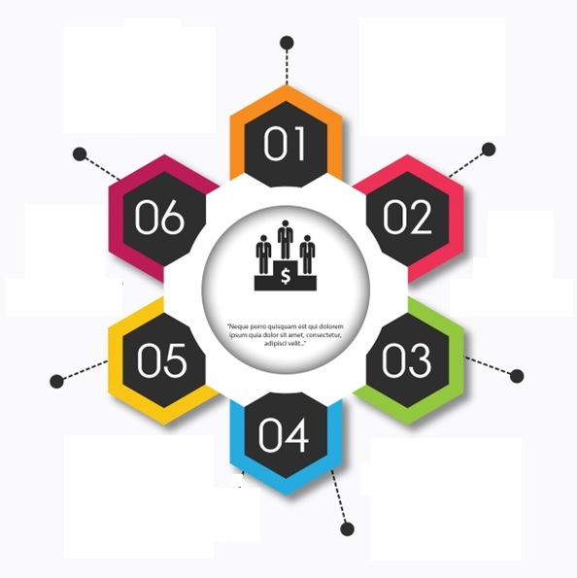

Qualities of a leader
Walking the talk
Having and inspiring a vision
Being resilient and far-sighted
Helping others grow and develop
Being empathetic and understanding
Making decisions that are fair
Notes:
Trainer to readout the qualities one by one
Transition to next slide

Slide 5
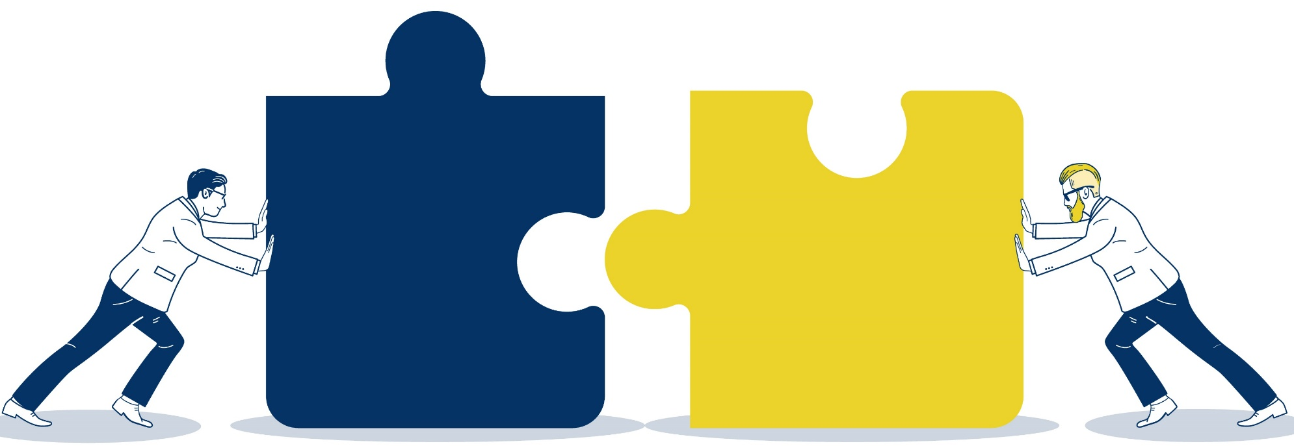
Managerial Effectiveness
Managerial Effectiveness involves managing people, getting work done as well as leading them effectively. This means bringing the best out of them and developing them to their best potential.
Manager
Leader
So managerial effectiveness amalgamates the strengths of both – managing as well as leadership.
Notes:
Managerial Effectiveness involves managing people, getting work done as well as leading them effectively. This means bringing the best out of them and developing them to their best potential.
So managerial effectiveness amalgamates the strengths of both – managing as well as leadership.

Slide 6

Knowing your Leadership Style
Leadership styles questionnaire
Notes:
Type: Individual Activity
Assessment Questionnaire – run the questionnaire ‘Leadership Styles’. The same is available in your Content Kit.- Handout 2
Time 15 mins
Trainer: Again this assessment tool is for your self-awareness. You need to be honest with yourself and you will not be forced to share the results if you want to keep it to yourself. This is a diagnosis to increase your understanding of your leadership style and not a means to judge where you stand as a manager. After you take this assessment, we will be discussing how to get to a wholesome leadership style.

Slide 7




Leadership styles
Authoritative
Democratic
Facilitative
Situational
Notes:
Facilitator
There is no right or wrong leadership style – however, depending on your personality, your team’s personality, the situation and the competence of your team, some styles work better than others.
Let us look at each style.
Transition to the next slide.

Slide 8

“Being Authentic Leader”
It is the healthy alignment between internal values and beliefs and external behavior
It comes from finding your style and your way of leading — and making life decisions that reflect your ethics, values, and your personality
It is doing one’s job without compromising on their core values and personality
Notes:
Authentic leadership is not a style but a philosophy. It encourages you to explore who you are as person, what your values and beliefs are and how that inherently rubs off in what you bring to the table as a leader.
Authenticity is the healthy alignment between internal values and beliefs and external behavior. Authenticity comes from finding your style and way of leading — and making life decisions that reflect your ethics, values, and your personality.
Leadership success starts with authenticity — doing our jobs without compromising our values and personality. People trust us when we are true to ourselves, and that trust makes it possible to get things done.
Leaders who are clear about the importance of building trust are better able to be authentic without being inappropriate. But being authentic and practicing honesty isn’t a license to behave without filters, political savvy, or good judgment.

Slide 9

Why goal setting is so important for self
Make you more resilient
Make you accountable
to yourself
Clarify your vision
Compel you to achieve your potential
Allow you to refine your strengths
and strengthen your weaknesses
Enable you to
check on your progress
Keep you focused
Motivates you
Notes:
Time: 10 mins
Goals clarify your vision - The mere act of creating a plan of action enables you to form a concrete idea of your future.
Goals keep you focused - Anything that is not a specific part of your plan is a distraction. Moreover, distractions prevent you from achieving what you set out for. By working solely toward the goals you have set, you remain focused on them, leaving no room for distractions.
Goals make you accountable to yourself - Once you set goals, you become accountable for meeting them. By doing so, you make yourself accountable, and it compels you to avoid procrastination, becoming the measure of how close you are to living up to your standards.
Goals are motivators - Attaining each of the smaller goals builds enthusiasm, motivating you to continue, spurring you to keep striving for the final goal.
Goals enable you to check on your progress - Whether you merely have a mental checklist or take the time to write it down, setting goals outlines your vision for the future, and striving to attain those goals sets your progress toward that vision.
Goals allow you to refine your strengths and strengthen your weaknesses - You may stumble along the way. However, mistakes are instructive, providing opportunities to build up those areas where you demonstrate weakness and further refine your strong suits.
Goals compel you to achieve your potential - Remember those childhood report cards with comments on whether you lived up to your potential? Goal-setting now compels you to stretch for that potential. You may find yourself exercising those muscles not previously used, enlarging the full extent of your potential in order to achieve them.
Goals can make you more resilient - Setbacks will occur. When you respond with resilience, you can perceive these setbacks as chances to try new methods rather than view them as an end in themselves.
Continued in the next slide.

Slide 10
Will/ Skill Matrix
High Will
Low Skill
High Will
High Skill
Low Will- High Will
Low Will
Low Will
Low Will
High Skill
Low Skill - High Skill
Notes:
Good managers and leaders are high on awareness – both self as well as their team members. We will discuss how you can know your subordinates better with respect to their levels of will and skill. This helps tremendously in managing your team members.
We already discussed in Authentic Leadership how inner reflection is important to be a good leader. Before we move on to understanding team management, let us clarify the terms - skill and will.
Transition to the next slide.

Slide 11



Why is empathy important in leadership?
Builds trust
Creates an environment of security
To have a loyal and motivated team
Notes:
Time: 5 mins
Trust
Being able to demonstrate empathy creates trust within your team. Trust creates an empowering, honest relationship with your team. In turn, this will increase collaboration and productivity, but most importantly your team will be assured that their feelings are being taken care of.
Creates an environment of security
If you’re able to demonstrate empathy, people will feel safe talking to you. It will allow you to listen and have a clearer picture of how to effectively manage your team.
Builds a loyal and motivated team
Being empathetic helps you be more connected and engaged with your team. When you attempt to understand your team members, especially in their difficult times, you build stronger relationships with them. Eventually, you build a team that is motivated and loyal.
We know how empathy is beneficial as a leader. Let us look at how to express empathy through communication.
Transition to the next slide.

Slide 12
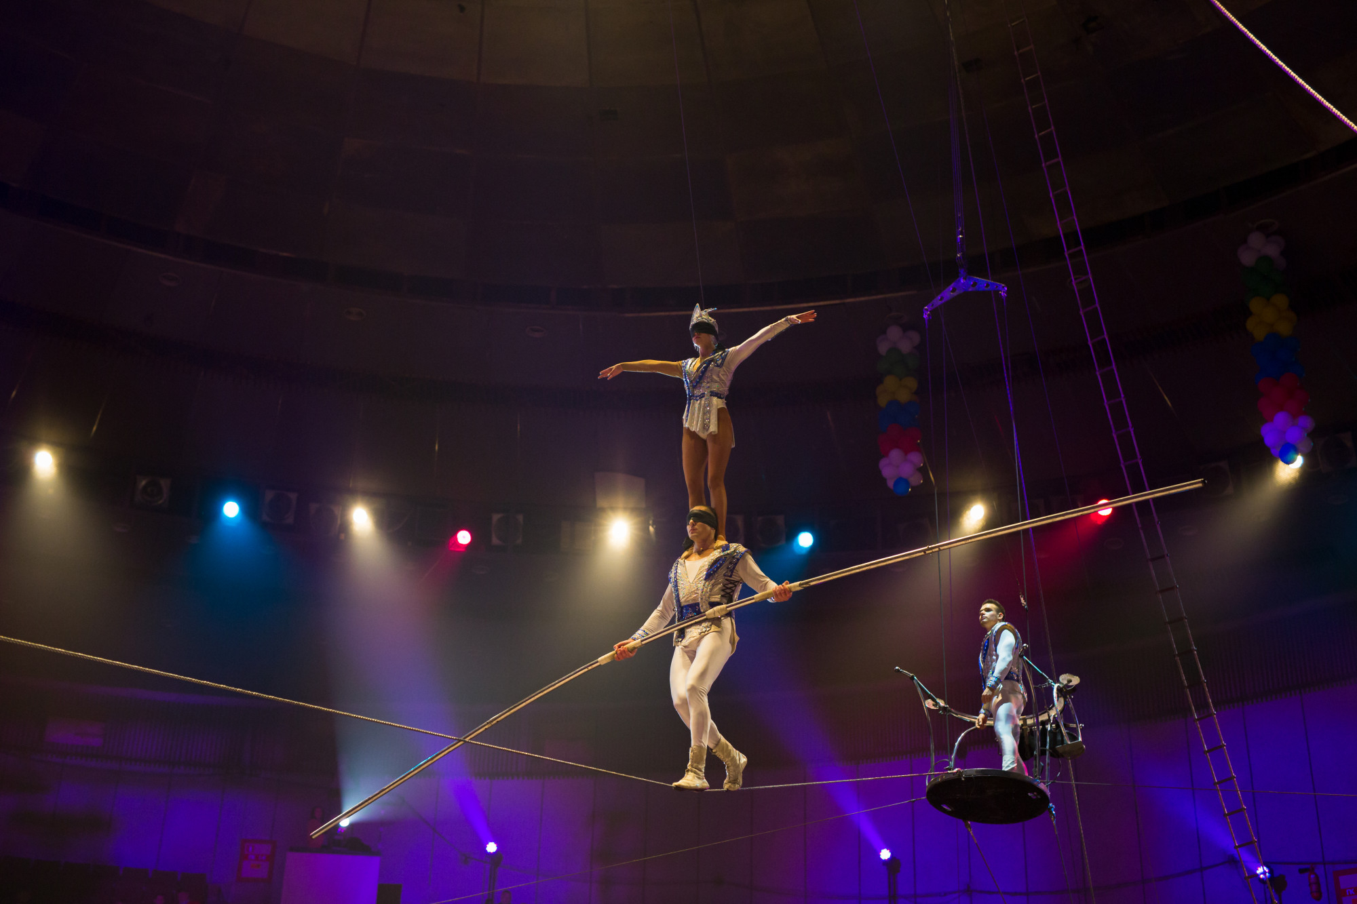
Building Trust
Notes:
A big part of leading a team is building trust.
When a team is able to trust its leaders, it is easier to align the team to the organizational goals and vision.
It also helps in employee retention, motivation and productivity.
But trusting others is difficult. It takes a long time to be certain of whom to trust - and this is mostly determined through experiences.
Although it is an obvious expectation of every leader that their team trusts them. However, is it that easy?
Let’s find that out through an activity.
Transition to the next slide.

Slide 13

Reinforces behavior
Makes the person valued and acknowledged
Motivates others to replicate behavior and performance
Creates a culture of observing goodness and expressing it
Team Motivation & Appreciation- Importance
Notes:
These additional points are self-explanatory.
Move on to debriefing the responses to the second question.
Transition to the next slide.

Slide 14

What matters while sharing feedback
Intent
Body language
Tone of voice
Choice of words
Solution orientation
Notes:
Trainer:
Like we said, feedback is a skill to be learnt over time.
Sharing feedback also needs the manager to have adequate preparation by collecting facts/data, practicing articulation and anticipating questions/objections.
The following factors are to be considered even before you share feedback:
Intent
What do you mean by intent?
Elicit responses and ask the audience to give examples.
Intent, also called intention, is what your objective of sharing feedback is.
For example, if your intent is to put a person in his place, the texture of the conversation will be different than
if your intent is to help someone understand the situation.
Trainer: What do you think the difference is?
Elicit responses.
Trainer: if your intent is to put a person in his place, your body language, tone and words will be more blunt and abrasive. It is possible that your ability to listen to the person may also be impacted. Because you will try to prove your point, the other person may follow suit and this may even lead to an argument.
On the other hand, if your intent is to help someone understand the situation, you will probably more open and articulate your message in a calmer, composed manner.
Remember it is very easy to find fault or criticize someone. But to be able to look at their positives or even if you can’t find positives in a certain situation, you can ap
Trainer: But what if I can control my body language and tone?
Trainer: Body language and tone of voice are directly and strongly connected to how you feel. You can control them only if you are aware of how you feel at that moment. Some gestures are quite automatic and can be controlled only if you become aware of your state of mind and compose yourself.
We all also unknowingly send out vibes through our gestures/body language, which the listener catches on to.
That is why when you ask your partner, “what’s wrong?” and they say “nothing”, you are not able to accept that it’s nothing. You kind of sense that something is wrong through their body language and tone.
Trainer: What all constitutes body language?
Elicit responses from each of the groups.
Trainer: Facial expressions, usage of hands (gestures), positioning of your body (posture) are major parts of body language.
Many people use the concept of ‘fake it till you make it’ especially in presentations. It definitely works but needs a lot of preparation before the actual conversation.
Play Charlie chaplin video. Link: https://www.youtube.com/watch?v=_0a998z_G4g
In this video you can understand every single thing that is happening despite there being no words. You see over-smartness, confusion, fear, upset, flirtatiousness! That is theb power of body language!
Trainer: What about tone of voice then? I can talk sweetly, if I want to. Can you give me examples of tone of voice?
Elicit examples from each of the groups.
Trainer: Like we discussed earlier, tone follows feeling. A simple phrase like “Ok, fine” will be articulated and actually have different meanings depending on the tone.
Make each group say the phrase, “ok, fine!” with emotions of happiness/excitement, anger & disappointment.
Note: To wrap up Tone of voice show the pan pasand video
Link: https://www.youtube.com/watch?v=3y8_YRDyFho
Trainer: Seems like feelings have a big role to play in our communication. Do we have control over choice of words
at least? What do you think?
Elicit responses.
Trainer: Fortunately, choice of words are a matter of practice and preparation. Of course, feelings can interfere here as well but it is easier to choose the right set of words just by keeping it simple and avoiding extreme words.
Trainer: for example?
Elicit examples of extreme words.
Trainer: Extreme words like horrible, pathetic, lazy, irresponsible, stubborn can trigger emotion in the listener and make them defensive. Instead use words like unacceptable, inflexible, laidback, poor quality etc.
Remember that if the listener becomes defensive or closed to feedback, the point of the conversation is defeated anyway. To drive a point, you must be able to allow openness in the conversation.
Trainer: What does solution orientation mean?
Elicit examples from each of the groups.
Trainer: Being solution-oriented means to focus and spend more time on looking at what is to be done or what is expected rather than being too focused on the mistake. Dissecting the mistake is okay to find the root cause but dwelling on it beyond that will only make the conversation more complex and possibly lead to blame games.
For example, if an employee forgot to submit a report for an important customer meeting, you could ask him what hurdles he faced or what went wrong that he couldn’t submit it on time. Each of the challenges will now need an action plan. More time should be spent on formulating a detailed action plan and its implementation.
Transition to the next slide.

Slide 15
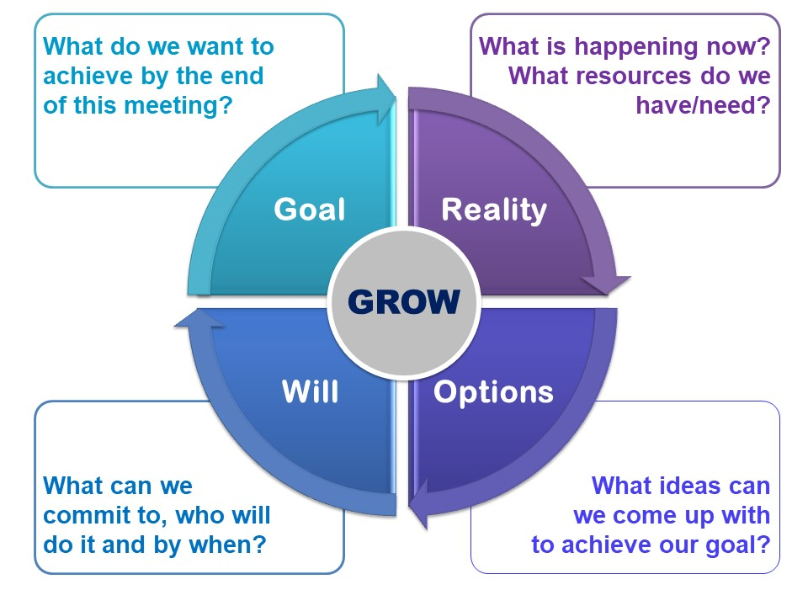
The coaching process
Notes:
This is the most common coaching model called GROW that is an acronym for Goals, Reality, Option, Will
Goal:
The Goal section of GROW is addressed at the beginning of each session and referred to again from time to time to keep the focus moving forward, especially if the coachee becomes stuck. It raises energy and clarifies thinking. Identifying what we want to achieve puts us on the path to accomplishing it by focusing on the solution rather than the problem.
Some Goal questions are:
What do you want?
Over what time frame?
Where would you like to be on a scale of 1–10?
Imagine you have achieved it:
What does it look like?
How do you feel?
What are people saying to you?
What are the benefits?
What do you want to achieve in five years/one year/three months?
How could you say your goal in a few words?
Which part of that is the real focus?
How will you know when you have achieved it?
In an ideal world, what do you really want?
Reality:
This is an exploration of the coachee’s world at the moment. Time spent here helps people get clear about what is happening and how it affects themselves and others. It provides an opportunity for viewing issues from different perspectives.
Some useful questions here are:
What is happening at the moment?
How important is this to you?
If an ideal situation is 10, what number are you at now?
What impact is this having on you/how do you feel?
What have you done so far?
Who else is affected?
What are you doing that’s working towards your goal?
What are you doing that is getting in the way of your goal?
Tim Gallwey, author of the ‘Inner Game’ series of books, was one of the pre-cursors of coaching. One of his key discoveries was that if he asked clients to ‘watch the ball’ they would tense up and under-perform. However, if he asked them to count how many times the ball spun as it went over the net, or how many centimetres it cleared above the net, their shots improved significantly. Neither of these measurements matters in terms of technique, but the process of focussing on the detail has the dual effect of forcing the coachee to watch the ball, and providing a distraction from internal ‘chatter’, like ‘I’ve failed before’, or ‘I can never hit the ball’.
Exploring the current reality is one of the practices that differentiates coaching from normal conversation, where we tend to go straight from the past to the future, for example from:
‘He said I was always late; I said I wasn’t; he said I was unreliable,’
to:
‘I’m going to resign!’
In the above statement, the speaker is taking the emotional baggage of the past into a crucial decision about the future. Reality questions (together with Goal questions, which can be thought of as ‘future reality’) enable coachees to step off the confusion track, gain some new perspectives, and make calm, informed decisions about how to move forward.
It may feel awkward at first to explore current reality, and new coaches are tempted to go straight to the Options or Actions stage of GROW. However, doing this without exploring the coachee’s Goal and Reality may well result in the answer ‘I don’t know what to do, that’s why I’m here!’.
All these questions help people dig deeper into their own awareness. They will show signs of energy, for instance, lightness in the voice, brighter eyes, a smile and more upright posture. That is the time to pin the new insights down to Options and Actions, and the chances are that by this time, coachees will spontaneously start originating actions where they were stuck before.
Note that we are exploring the present, and although we may ask what someone has done so far, we are not dwelling on the past or listening to stories about it. We are focusing on what the situation means to the coachee more than on the facts. We are not asking questions to find out what has happened, but to find out what impact it is having on the coachee’s work and/or life. When the coachee reaches a new insight or level of understanding, it is wise to explore the new Reality to embed the new awareness and to revisit the Goal. Possibly a new Goal or direction will emerge. Then the ‘Options’ and ‘Will’ sequence start again.
When the coachee reaches a new insight, these questions are useful:
What do you know now that you did not know before?
What is your insight about that?
What have you learned about yourself from that?
Where else could you use this?
Options
Coachees will move naturally towards the Options stage as their Reality becomes clearer. Often they show a new energy by sitting up and smiling, or a lighter tone of voice. Then it is useful to ask some of these questions:
What are your options?
What could you do?
What else?
If there were anything else, what would it be?
What has worked in the past?
What steps could you take?
Who could help you with this?
Where could you find out the information?
What might someone else do in your shoes?
Imagine you have achieved your goal; look back on the journey and tell me you got here.
Notice that most of these questions are almost all open. Keep asking open questions until the coachee has stopped coming up with options on the table. Once it seems that the list is complete, ask the closed question ‘is there anything else?’ to find out whether it is time to finalise the process. This question often results in new options and can be asked as many times as it continues to deliver results.
The following questions probe for more information and, in order not to commit the coaching sin of ‘leading’ the coachee, should be used only when the coachee has raised the subject in question, for example:
Coachee: I need some help.
Coach: Who could help you with this?
Coachee: I need more information.
Coach: Where could you find more information?
Will
As opposed to ‘Options’, which brings to light all possibilities, ‘Will’ is about discovering which actions the coachee can commit to undertaking. When asked, ‘What will you do about this?’ there is a danger that the coachee will make a list of what they think they should do, rather than choosing a pathway which suits their talents and ways of behaviour. The classic example is where a man commits to joining a gym because he wants to lose weight. However, if he is never going to attend because he hates going to the gym, he would get more benefit from committing to walk his dog every morning, if that is something he would enjoy.
Some examples of Will questions are:
What will you do about that?
How will you do that?
When?
What will it take for you to commit to that action?
What could you do to become more committed?
Could you do more?
How many?
How much?
How often?
Where will you find that?
Who will you talk to?
What else you could you do?
If the coach senses a lack of commitment, a question like, ‘How committed are you to doing that?’ should be asked straight away. If there is any hesitation, it is best to go back into the GROW process to clear any blocks and find the most comfortable way to move ahead.
With effective coaching, you can make your team highly productive as well as involved in achieving goals.
Transition to the next slide.

Slide 16



Prioritizing tasks
Urgent
Important
Has immediate, damaging consequences
Has beneficial outcomes, possibly in the immediate future and long-term
Needs immediate attention
Can lead to growth, profits, goodwill, credibility
Can lead to loss of business, goodwill, reputation
Can be pressurizing and seem out of control
Can be pressurizing and seem out of control
Can improve efficiency and effectiveness
Crisis, emergencies
Will allow control and a planned approach
Notes:
Trainer: A very simple concept, which will be later popularized by the 34th president of America (Dwight D. Eisenhower-hence also called the Eisenhower matrix).
Time management means paying attention and time to our activities in accordance with their importance and urgency.
Trainer: Imhotep is again lost - How do I identify whether the task is urgent or not?
Elicit responses.
Trainer:
Ask yourself 2 questions:
What will happen if I don’t do this right now?
If the answer to this question has damaging consequences, you can categorize the task as urgent.
The simplest, silly example is ‘wanting to go to the bathroom’
You know what the consequence can turn out to be.
In the organizational context, examples can be major glitches, breakdowns, defects and/or delays that can result in losing a customer, financial loss, negative publicity or customer goodwill.
Please note that the damaging consequence has to be factual, not perceived.
2. What will happen if I do this right now?
If the answer to this question has a high benefit, you can categorize the task as important.
The simplest, silly example is ‘exercising or eating healthy’
You know that in the long run or even through the day, this will have positive benefits.
In the organizational context, examples are best practices, process improvements, keeping your commitment towards the customers.
Trainer: Can you help Imhotep understand what will be the possible urgent and important tasks while he is building the pyramid?
Elicit responses.
Possible responses:
Important – getting the right skilled people, getting the right resources – stones, implements, ropes
Urgent – accidents, damage to the structure or people, sudden shortage of people etc.
Transition to the next slide.

Slide 17





98752-08472
Hello@freelancetrainings.com
www.freelancetrainings.com
406, Titanium City Centre Mall, Anand Nagar, Satellite, Ahmedabad-380015

