Slide 1

Introduction to Mindfulness
Awareness. Presence. Transformation.

Slide 2
What is Mindfulness?
"Mindfulness is the awareness that arises from paying attention, on purpose, in the present moment, and non-judgmentally."
— Jon Kabat-Zinn
Present Moment
Non-Judgmental Observation
Clarity & Calmness
Being fully present in the here and now, experiencing life as it unfolds.
Cultivating inner peace and mental clarity through conscious awareness.
Observing thoughts, emotions, and sensations without reaction or criticism.

Slide 3

The Essence of Mindfulness
Holistic Awareness
Awareness of body, breath, mind, and surroundings — connecting all aspects of your experience.
Conscious Response
Responding instead of reacting — choosing how to engage with life's moments.
Intentional Living
Living consciously rather than automatically — breaking free from autopilot mode.
Foundation for Growth
Building emotional intelligence, resilience, and compassion through mindful practice.

Slide 4
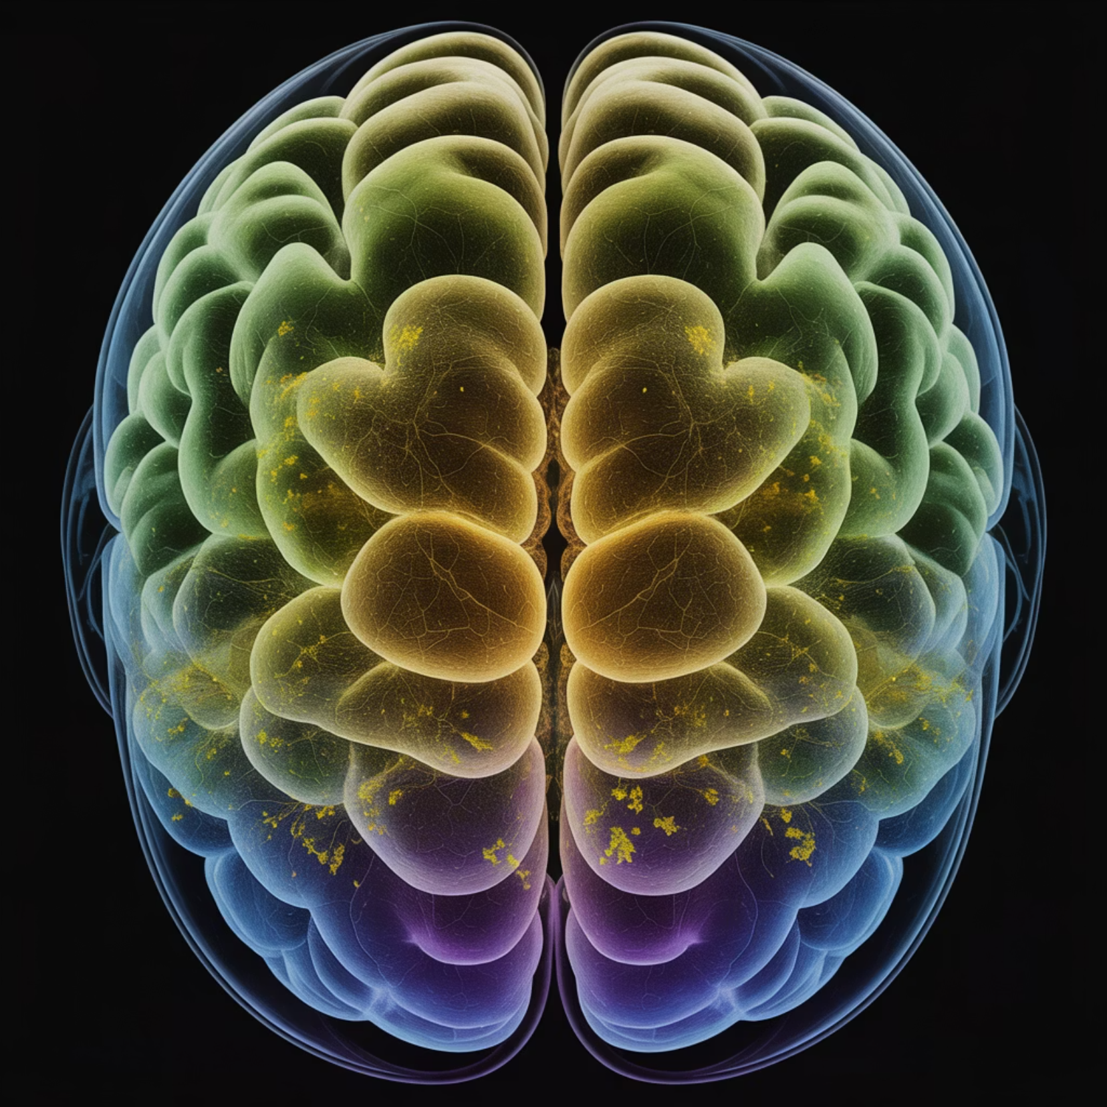
The Science of Mindfulness
What Research Reveals
Stress Reduction
Significantly reduces stress and anxiety levels (Harvard, 2014)
Cognitive Enhancement
Enhances focus, memory, and creative thinking
Emotional Balance
Improves emotional regulation and overall well-being
Social Connection
Boosts empathy and communication skills

Slide 5

Practice. Pause. Presence.
These three words capture the essence of mindfulness. Practice regularly, pause before reacting, and bring presence to each moment.

Slide 6
Closing Reflection
"The present moment is the only time over which we have dominion."
— Thích Nhất Hạnh
As you move forward, remember that mindfulness is not about achieving perfection or reaching some distant goal. It's about showing up, again and again, to the only moment we truly have — this one.
Each breath is a new beginning. Each moment offers a fresh opportunity to be present, aware, and alive.

Slide 7
Thank you for your mindful presence

