Slide 1


Induction Workshop- Soft Skills
Your
Company
Logo
Notes:
Facilitator’s Notes:
Trainer to say in the loudest voice “Hello, Good Morning”. Then the participants will say ‘Good Morning’ in reply.
Trainer to say once again in the loudest voice “Hello Good Morning”. Trainer should speak in an energetic, passionate and enthusiastic tone. This activity/gesture will set the tone and energy for the session/workshop
Trainer: Well done friends! Great job! (Clap Loudly and tell the participants to clap as well for the superb performance.)
Trainer: I'm excited to be here with you all today and appreciate your presence. I hope you're all doing well and are ready to dive into the material.Move to next slide.

Slide 2
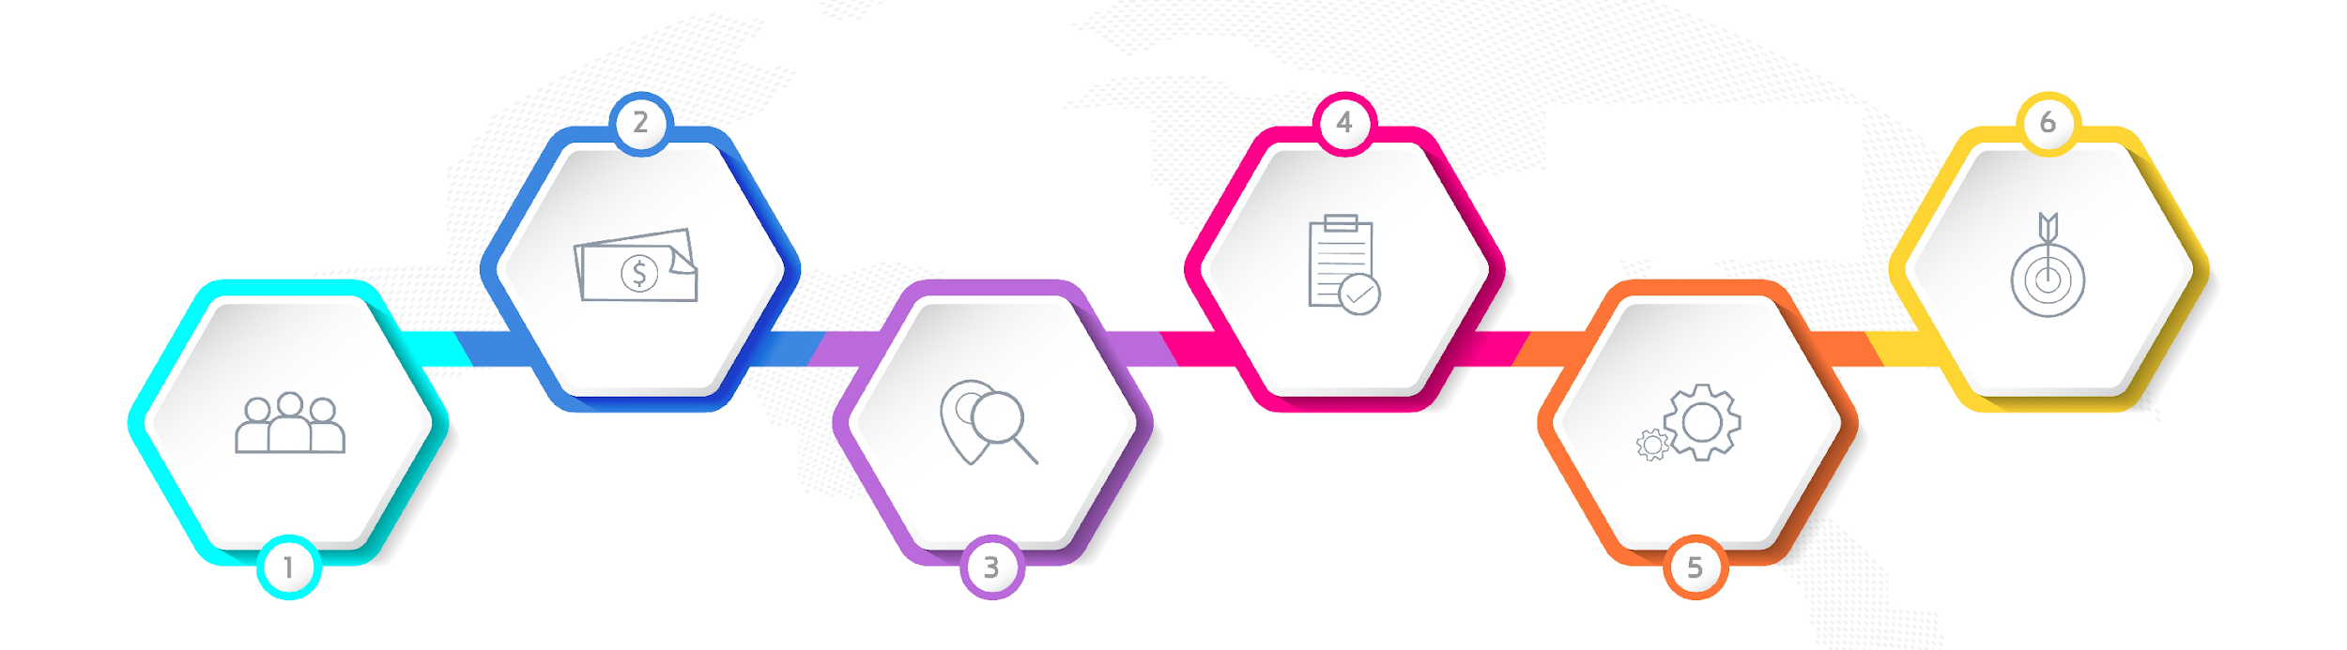






Agenda of Workshop
Module 1
Understanding Soft skills
& Personal Effectiveness
Module 3
Module 5
Impactful
Communication
Goal Setting
Module 2
Module 4
Module 6
Building a Fool Proof Communication
Being a Team Player
Building an Attitude
of Ownership
Notes:
The agenda of todays workshop is as follows
Understanding Personal Effectiveness
Building an attitude of Ownership at workplace
Impactful communication
Building Fool Proof Communication
Goal Setting
Being a Team player

Slide 3

Ice breaker Activity- Tell me the Story
Notes:
Facilitator’s Notes:
The Trainer is free to use the Icebreaker of their own choice instead of the one discussed here.
In this Ice breaker the entire batch is required to form one story where each participants contributes one line each. The Trainer starts with a sample one line and the next participant after that is required to introduce their name and add the next line to the story. While this story is being built the participant introduction is also happening side by side.
Aim of the Icebreaker
The aim is to know each other better and communicate.
Methodology
Gather all participants in a circle or around a table.
Trainer/ facilitator start as story For example, "Once upon a time, there was a magical forest deep in the heart of the mountains."
Choose one person to introduce themselves and build the next line of story by saying one sentence. (Each participant should contribute only 1 sentence)
Go around the circle or table with each person adding one sentence to the story.
Each sentence should build upon the previous one and move the story forward.
Continue the story until everyone has had a chance to contribute or until the story reaches a natural ending.
Encourage participants to be creative and imaginative with their contributions, and to listen to each other's ideas and build on them.
Lets move to next slide.

Slide 4

Module-1
Soft Skills Leads
Skills, to effectively interact with others, collaborate, and manage yourselves in various situations
Notes:
Soft skills, often referred to as interpersonal skills or people skills, are a set of personal qualities and attributes that enable individuals to effectively interact with others, communicate, collaborate, and manage themselves in various situations. These skills are not typically related to technical knowledge or expertise in a specific field, but rather focus on the way individuals handle themselves and their relationships. Soft skills are essential for personal and professional success as they contribute to effective communication, teamwork, adaptability, and overall personal effectiveness.

Slide 5
Benefits of Personal Effectiveness to Individual
Professional Communication
Business
Etiquettes
Better Time
Management
Taking Ownership & Collaboration
Personal
Branding
Leadership & Initiative
Adapting Organization culture
Networking
Notes:
Following are the benefits of a campus to corporate workshop thus leading to enhancing of personal effectiveness of the participants. These are also the topics that we are going to learn in our 2 days of workshop
Professional Communication: This includes improving written and verbal communication skills, understanding email etiquette, and learning how to interact effectively with colleagues, clients, and superiors.
Business Etiquette and Professionalism: Participants are educated about workplace behavior, dress code, punctuality, and other aspects of maintaining a professional demeanor.
Time Management and Productivity: Techniques for managing workloads, setting priorities, and meeting deadlines are often discussed to ensure participants can handle the demands of a professional role.
Teamwork and Collaboration: Workshops focus on how to work effectively within a team, contribute to group projects, and resolve conflicts that might arise.
Adapting to Organizational Culture: Companies emphasize the importance of aligning with the company's values, mission, and culture. This includes understanding company policies, hierarchies, and expectations.
Networking and Building Relationships: Workshops often highlight the value of networking within the company and the broader industry. Participants learn how to build professional relationships and leverage connections.
Personal Branding and Self-Presentation: Participants learn how to promote themselves professionally, develop a personal brand, and showcase their skills and achievements.
Leadership and Initiative: Some workshops touch on leadership skills, encouraging participants to take initiative, demonstrate ownership, and potentially grow into leadership roles.

Slide 6



Achieving Personal Excellence
Attitude
Skills
Knowledge
Notes:
Campus to corporate workshop helps the participants to achieve personal excellence
Attitude: Attitude refers to a person's mindset or perspective. A positive attitude can help individuals overcome obstacles, maintain focus, and stay motivated in the face of challenges. Personal effectiveness requires a positive attitude that is characterized by resilience, self-confidence, and a growth mindset. Without a positive attitude, it can be difficult to achieve personal goals and objectives.
Skills: Skills are the abilities and competencies that individuals possess to perform specific tasks or activities. In order to be personally effective, individuals must possess a range of skills, including communication, problem-solving, time management, leadership, and teamwork. Developing these skills can help individuals to better manage their personal and professional lives and achieve their goals.
Knowledge: Knowledge refers to the understanding and awareness that individuals have of themselves, others, and the world around them. Personal effectiveness requires individuals to have a strong knowledge base in areas such as self-awareness, emotional intelligence, critical thinking, and decision-making. This knowledge can help individuals make informed choices, build strong relationships, and achieve personal and professional success.
In summary, a combination of a positive attitude, strong skills, and relevant knowledge is essential for personal effectiveness. Individuals who possess these qualities are better equipped to overcome challenges, achieve their goals, and make a positive impact in their personal and professional lives.

Slide 7

Why is having a positive attitude important for a professional
Boosts productivity
Reduces stress
Supports learning
Improves problem-solving
Increases confidence
Increases resilience
Helps you manage conflict
Notes:
Our attitude is directly responsible for our behavior. More wholesome our attitude, the more empowered our conduct.
With a positive attitude, you can improve your emotional well-being and self-image. It is a powerful tool for personal growth and professional excellence.
The power of a positive attitude in the workplace has been proven to:
Boost productivity
Reduce stress
Support learning
Improve problem-solving
Increase confidence
Increase resiliency
Help manage conflict
A positive attitude could also be regarded as one that is oriented toward finding what is best about a given situation or environment and then building on that.
While many factors are responsible to propel a wholesome professional attitude, we will be discussing four key ones today:
Taking ownership and accountability at work
Having a solution-centric approach
Avoiding blame game
Operating from one’s circle of control.
Transition to the next slide.

Slide 8

Building Positive Attitude at workplace
Taking Ownership
Follow Solution Centric Approach
Avoid Blame Game

Slide 9
Circle of Concern, Influence and Control
Your past decision/ choice/ behaviour
Weather
If public transport is on time
World peace
Other People`s Action
The outcome of most court cases
Threat of war
Other People`s Thoughts
Other People`s Choice
Government policy
Who follows me on Social media
My thoughts
My words
My actions/ behavior
My reactions
My decisions/ choices
My attitude/ mindset
My mood
My work ethic
My productivity at works
Sport Match
Death
The Media
My commitments
Whether people like me or not
Where you were born
My reputation
Being made redundant
My children`s future
Traffic
Whether I get promoted
How much stock a retailer has
Who I vote for
Economy/ Prices
Where I work
How much my partner loves me
Celebrities behaviour & opinions
Stranger`s behaviour & driving habit
Strangers comments on forum & social media
Cyber threats
Notes:
Explain the 3 circles to the participants with examples

Slide 10
Types of Communication
Communication
Assertive
Aggressive
Passive
Empathetic
Notes:
Say: Communication can further be categorized into 4 types:
Assertive
Aggressive
Passive and
Empathetic
So what are these?

Slide 11

Tips for Communicating with Empathy
Your
Company
Logo
Respond in a timely manner to the concerns of your target audience
Take inspiration from reflective listening
Acknowledge people’s subjective experience even if you disagree.
Be accountable
Use emotive language in content responsibly
Communication Skill Training
Company Name
Trainer Name
Notes:
Respond in a timely manner to the concerns of your target audience. Whether it’s a global crisis or a support ticket, addressing the issue promptly (without instantly turning it into a marketing campaign) shows people you genuinely care how they’re feeling.
Take inspiration from reflective listening. Rather than simply saying “I understand your concerns,” try to pair your understanding with a reflection of the context that’s causing people to react in a particular way. Often it means adding an additional sentence like “I see where you’re coming from. I would feel the same way if I experienced that (validating the person’s emotional experience).” Without relying on interpretation, verbalizing someone’s feelings back to them in your own words helps people feel not only heard, but understood.
Acknowledge people’s subjective experience even if you disagree. “We know the recent changes to our terms and conditions may make some people uncomfortable, however, you can rely on us to provide you with clear communication and flexible options.”
Be accountable. Regardless of the intention behind your communication, your organization should take responsibility for how your content affects people, even if it elicits an undesired reaction.
Use emotive language in content responsibly. Use an emotional analysis tool to make sure you’re not unnecessarily evoking fear or anger to prompt a reaction from your target audience.
Empathic communication skills are vital for both internal and external communication — so for employees and customers.

Slide 12

Time to Warm up
Notes:
Say: Let us practice what we learnt so far. (You can also use a handout -1 from your content Kit)
Trainer to divide the group into 4 teams - give below 4 scenarios for role play – 1 scenario to 1 team…
It is set of verbal & non-verbal communication which each team need to enact and other teams to guess the situation and provide constructive solution. The rules for the role play is each team will have equal no. of participants using verbal and non-verbal communication (so if team is of 4 people – 2 of them will use verbal and 2 will use non-verbal to communicate) objective is to convey the scenario effectively.
Teams will have to prepare a 2 min skit / presentation and demonstrate – Refer to Handout 2 in the Content Kit
Scenario 1: One of the participant has come up for an interview and is sitting with the HR in the Interview round. The participants are expected to showcase the Passive style of communication
Scenario 2: Colleague has given some work to another colleague and together they have to make the report and presentation after 1 day to their boss. Boss is very happy with the presentation and team work. – Participants to show aggressive but positive communication here
Scenario 3: Colleagues are discussing salaries and suddenly HR comes in and guides them the right way to work at office – very critical point in any organization – it is not on what you say but how it is said (trainer to support this team specially before presentation so that message is not misinterpreted)(Assertive behavior and communication is expected through this dialogue)
Scenario 4: Welcoming new joinee in the office – showcase good and bad behavior. (Empathetic communication to be demonstrated here)

Slide 13




Fool Proofing Communication – LADR Approach
Listen Actively
Ask Effective Questions
Doubts should be Clarified
Reconfirm before proceeding
Notes:
Say: So what is LADR?
L for Listening actively:
A for Ask Questions:
D for Doubts Clarify:
R for Reconfirm before proceeding:

Slide 14

What is a Goal?
A goal is a specific and measurable objective or target that an individual , department or organization aims to achieve within a set period of time.
Notes:
A goal is a specific and measurable objective or target that an individual or organization aims to achieve within a set period of time. Goals can be short-term or long-term and can be related to various aspects of life such as personal, professional, academic, or health-related goals.
Goals can help individuals to break down larger objectives into smaller, more manageable tasks and track progress towards their desired outcome.

Slide 15




Benefits of Goal Setting
Clarity of Direction
Motivation
Accountability
Prioritization
Notes:
Clarity of Direction: Setting specific, measurable goals helps individuals and teams focus their efforts and resources towards achieving their desired outcomes.
Motivation: Goals provide a clear target and a sense of purpose, which can motivate individuals to work harder and persist through obstacles.
Accountability: Setting goals provides a clear benchmark against which progress can be measured, and holds individuals and teams accountable for their performance.
Prioritization: Goals help individuals and teams prioritize their activities and allocate their time and resources more effectively.
.

Slide 16
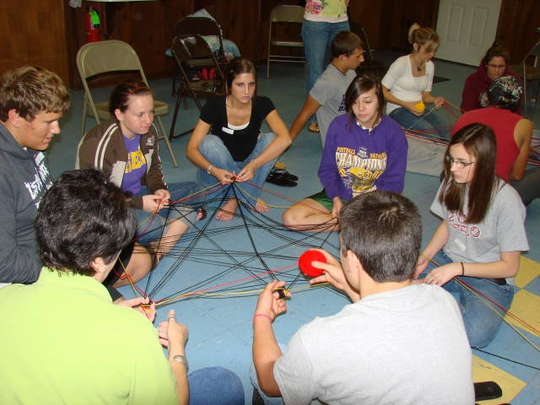

Activity- Unwind
Notes:
LET’S Unwind Objective To demonstrate the interdependency of individuals in an organization and hence the importance of great interpersonal skills.
Resources
A Big Ball of wool/Ball of String Procedure This activity involves all the participants in the class to stand in a circle.
The first person is given a ball of string and is asked to hold one end of the thread and then throw the ball to any person who he /she feels like throwing to. The next person. Likewise, needs to hold a part of the string and throw the ball to anybody from the circle.
The process continues till the ball of string / wool has been passed on to every person in the circle. At the end of the activity; every person needs to have held a small part of the long string.
The participants are asked to detangle the string such that a free flowing string passes from one participant to the one standing next to him.
Discussion Questions Even with the independent nature of our jobs, most of us still need others why?
Can you think of any cases where we operate totally without support?
Debrief:
We are part of an organization. The success of our work will largely depend also on the support that we receive from our colleagues, peers, inter-departmental staff etc.. This is the reason that having good interpersonal skills is important. The rest we will see through the course of the day.

Slide 17

What is Interpersonal Effectiveness
The ability to understand, communicate and interact with other people in a way that leads to productive working relationships and enables the achievement of desired outcomes for you, your team and the organization.
Notes:
Interpersonal effectiveness refers to the ability to communicate and interact with others in a way that is respectful, assertive, and responsive to the needs of both oneself and others. It involves the skills of effective listening, expressing oneself clearly and assertively, understanding and respecting others' perspectives, negotiating conflicts, and managing emotions in relationships.

Slide 18

Myths about Interpersonal Skills
People have to always agree with one another.
I Always need to say Yes.
II like everyone and everyone likes me.
I should sacrifice my needs for those of others.
Being with people all the time.
I should have a lot of friends.
Notes:
People have to always agree with one another. No, interpersonal effectiveness does not mean that people have to always agree with one another. In fact, interpersonal effectiveness involves being able to communicate effectively and respectfully with others, even when there are disagreements or differences of opinion. It is about finding ways to express one's own thoughts and feelings in a clear and assertive way, while also listening actively to others and understanding their perspectives.
I Always need to say Yes. No, you do not always need to say yes. In fact, it is important to be able to say no when necessary in order to maintain healthy boundaries and prioritize your own needs and responsibilities. Saying yes all the time can lead to burnout, resentment, and a lack of respect from others, as it may communicate that your time and resources are not valuable.
I like everyone and everyone likes me. : Interpersonal effectiveness does not mean having a mutual admiration society. It is not possible for us to like everyone we interact or work with. However it is important for us to be able to maintain a professional working relationship with people.
I should sacrifice my needs for those of others.: While it is important to be considerate and empathetic towards others, it is not healthy or sustainable to sacrifice your own needs and well-being for the sake of others. Neglecting your own needs and prioritizing the needs of others all the time can lead to burnout, resentment, and a lack of respect from others. It is important to strike a balance between meeting your own needs and taking care of others. This means recognizing your own limits and boundaries, being assertive about your own needs and priorities, and communicating your needs clearly and respectfully to others.
Being with people all the time. Having good relationships with people is not directly proportional with the frequency of time spent but with the quality of interaction. You do not need to occupy the mind of another at all times to be important to them. But the kind of interaction that you have and the outcome of that interaction is what will define the effectiveness of the relationship.
I should have a lot of friends. Interpersonal effectiveness is not limited to friendship. It goes beyond that. It is the ability to interact with others in such a way that you are able to achieve your desired outcomes. It is true that people who are very effective in their relationships are likely to have more friends. But having fewer friends does not mean that you are any less effective.

Slide 19






Building Interpersonal Effectiveness
Empathy
Assertive
Communication
Conflict Resolution
Active Listening
Developing Interpersonal Effectiveness
Emotional
Intelligence
Notes:
Practice active listening: One of the most important skills in building strong relationships is the ability to listen actively. This means giving your full attention to the person speaking, asking clarifying questions, and responding in a way that shows you have understood their perspective. By actively listening, you can build trust and understanding in your relationships.
Practice assertive communication: Being assertive means communicating your thoughts, feelings, and needs in a clear, respectful, and direct way. It involves expressing yourself confidently while also respecting the feelings and perspectives of others. This can help you to avoid misunderstandings and conflicts, and build stronger, more authentic relationships.
Develop empathy: Empathy is the ability to understand and share the feelings of others. By putting yourself in someone else's shoes, you can gain a deeper understanding of their perspective and build stronger relationships based on mutual respect and understanding.
Learn conflict resolution skills: Conflict is a natural part of any relationship, and being able to resolve conflicts constructively is essential for building strong and healthy relationships. This involves identifying the root cause of the conflict, expressing your thoughts and feelings in a respectful way, and working with the other person to find a mutually beneficial solution.
Emotional Intelligence: Mindfulness is the practice of being present in the moment and fully engaged with your surroundings. By practicing mindfulness, you can develop greater self-awareness and emotional intelligence, which can help you to communicate more effectively and build stronger relationships.

Slide 20






98752-08472
Hello@freelancetrainings.com
www.freelancetrainings.com
406, Titanium City Centre Mall, Anand Nagar, Satellite, Ahmedabad-380015

