Slide 1


First Time Manager Workshop-2 Days
Your
Company
Logo
Notes:
Note for the trainer: start the day with enthusiasm. Your enthusiasm should reflect in your tone of voice and body language.
Good morning everyone!
How are you today. Are you ready to dive into a day of learning, growth, and transformation? I know I am!
Today, we have a unique opportunity to learn from each other, challenge ourselves, and take our personal and professional lives to the next level. Today’s workshop is highly engaging, filled with activities, role plays, videos and discussions that are designed to inspire and empower you.
But this isn't going to be a passive experience. This isn't a lecture where you sit back and listen to someone else talk. This is an interactive, dynamic, and engaging workshop that requires your full participation, your curiosity, and your willingness to learn.
Throughout the day, you'll have the chance to connect with other like-minded individuals, share your own experiences and insights, and gain new skills and knowledge that will help you achieve your goals. You'll be challenged, pushed outside your comfort zone, and supported every step of the way.
So, are you ready to embrace this day with open hearts and open minds? Are you ready to learn, grow, and transform? I know I am, and I can't wait to see what we'll achieve together.
Let's get started!

Slide 2




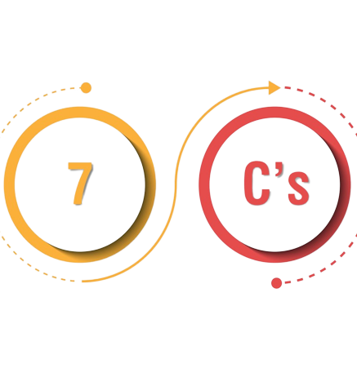


Workshop Agenda –Day-1
Making Communication Fool Proof
Setting SMART Goals
Team Communication
Qualities of being an Effective manager- 7C’s
Delegation-Building Equal Shoulders
First Time Manager Workshop
Understanding Managerial Effectiveness
Notes:
Welcome to the First Time Manager Workshop. Are you excited for today`s workshop? let me introduce todays workshop modules.
Understanding Managerial Effectiveness
Qualities of being an Effective Manager -7C`s
Setting SMART Goals
Making Communication Fool Proof
Team Communication
Delegation-Building Equal Shoulders
Move to Day-2 Slide

Slide 3





Workshop Agenda –Day-2
Giving Constructive Feedback
Motivating & Appreciating Team
Developing your Team-Coaching
Building Dream Teams
Time Management
First Time Manager Workshop
Notes:
For Day-2
Building Dream Teams
Motivating & Appreciating Team
Giving Constructive Feedback
Developing your Team-Coaching
Time Management
I'm feeling really enthusiastic about this experience, I think it's going to be great.

Slide 4

Understanding Managerial Effectiveness
Managerial Effectiveness is about getting results or meeting business objectives through people in the short & long term.
Notes:
Managerial effectiveness is about achieving business objectives through the effective management of people and resources in both the short and long term.
A manager who is effective is able to motivate and inspire their team to achieve their goals and meet business objectives.
They are able to communicate clearly, delegate tasks effectively, and provide support and guidance when needed. They are also able to make informed decisions and solve problems in a timely manner.
Effective managers are able to balance the needs of the business with the needs of their team members. They understand that a motivated and engaged workforce is essential for achieving long-term success and work to create a positive and supportive work environment. This includes setting clear expectations, providing feedback, and recognizing and rewarding team members for their contributions.
In short, managerial effectiveness is about achieving results through people while maintaining a focus on the long-term success of the organization.
Co-relate with the video

Slide 5


Individual Contributor to Manager (Shift in Mind-Set)
Notes:
Say:
Transitioning from an individual contributor to a manager is not just a change in job title or responsibilities. It also requires a significant shift in mindset. As an individual contributor, you are primarily responsible for your own work and output. You have a clear understanding of what is expected of you and can focus on delivering results.
However, as a manager, your focus shifts from individual work to team work. Your success is no longer determined solely by your own output, but by the output of your team as a whole. This requires a shift in mindset from "me" to "we".
As a manager, you need to develop a more strategic perspective and be able to see the bigger picture. You need to understand how your team's work fits into the broader goals of the organization and be able to align your team's efforts accordingly. You also need to be able to communicate effectively with your team, providing clear direction and expectations, while also being open to feedback and input from team members. You must be able to delegate tasks effectively, trusting your team to take on important responsibilities and ensuring that each team member is able to contribute their unique skills and expertise.
Finally, as a manager, you must be able to handle conflict and challenges that arise within your team, while also fostering a positive and productive work environment. This requires a level of emotional intelligence and interpersonal skills that may not have been as critical in your previous role as an individual contributor.
Overall, the transition from an individual contributor to a manager requires a significant shift in mindset, from focusing on your own work to focusing on your team's work and success. With the right attitude and a commitment to learning and growth, however, this transition can be a rewarding and fulfilling experience.

Slide 6

The Managerial /Leadership Ladder
Working at the CEO Level
You + 4000
Working as a Senior Level Manager
You + 20
Working as a Mid Level Manager
You + 10
Working as a Junior Level Manager
You + 3
Working in Individual Capacity
You + 0
Notes:
As you progress in your career your team size is going to increase definitely. E.g when you would have started your career you would have been an Individual contributor. As you grow along the professional ladder your team size increased and as a result you need to manage more people. The fact of corporate life is you need to master people management to become a successful professional. Thus, at every step of the ladder strong leadership skills are extremely important for your career because you will progress only if you can get work churned out of people.
For example: Trainer here can co-relate this managerial ladder with the client company .

Slide 7

7 C’s of Dream Manager
Competence
Credibility- Ownership
Care & Connect-Team
Communication
Courage & Commitment
Credit
Check
Notes:
The 7C concept is a framework that outlines seven key qualities that effective managers should possess. These qualities are:
Competence : a Leader's competence is crucial for gaining respect and effective leadership. Without the team's belief in the leader's capabilities, it becomes challenging to lead them. Competence in both hard and soft skills is essential, as people look up to leaders for learning and personal development, requiring constant self-improvement efforts.
Credibility- Ownership : A leader establishes credibility by taking ownership of their team and the task.
Care & Connect-Team: The No. 1 engager of people is whether or not they believe their leader cares for them. If your team believes that you genuinely care for their wellbeing, their progress, their success – they care back. This creates a team in the true sense of the word. "Care and connection are vital for effective leadership. When team members believe their leader genuinely cares about their well-being, progress, and success, it fosters a strong sense of teamwork and engagement, creating a cohesive and motivated group.“
Communication : A strong leader excels in communication, displaying empathy and avoiding aggression. They remain Cool, Calm, composed and connected, fostering assertive communication with their team.
Courage & Commitment : Courage and commitment are essential qualities for effective leadership. A leader lacking in these traits may struggle to gain the respect and trust of their team. By demonstrating courage, leaders can inspire their team members, delegate responsibilities with confidence, and foster a culture of empowerment and trust, leading to more successful outcomes. Just showing up everyday isn't nearly enough. If you're really going to make a difference, you need to be able to bring that commitment on board. commitment is your passion towards work & your desires for excellence.
Credit: A great leader acknowledges and celebrates the team's achievements, recognizing and rewarding their efforts instead of taking credit for their successes. Regularly appreciating even the smallest accomplishments of subordinates fosters a positive and motivated work environment, reinforcing their sense of value and contribution to the team's success.
Check : Effective leaders must be well-organized and adept at setting clear goals, deadlines, and timelines. They ensure that work is completed on schedule by providing thorough reviews and feedback, promoting a culture of accountability, and consistently aligning team efforts with business objectives.
Say: On the next slides we will discuss in detail and explore how a leader can build 7C’s one by one

Slide 8
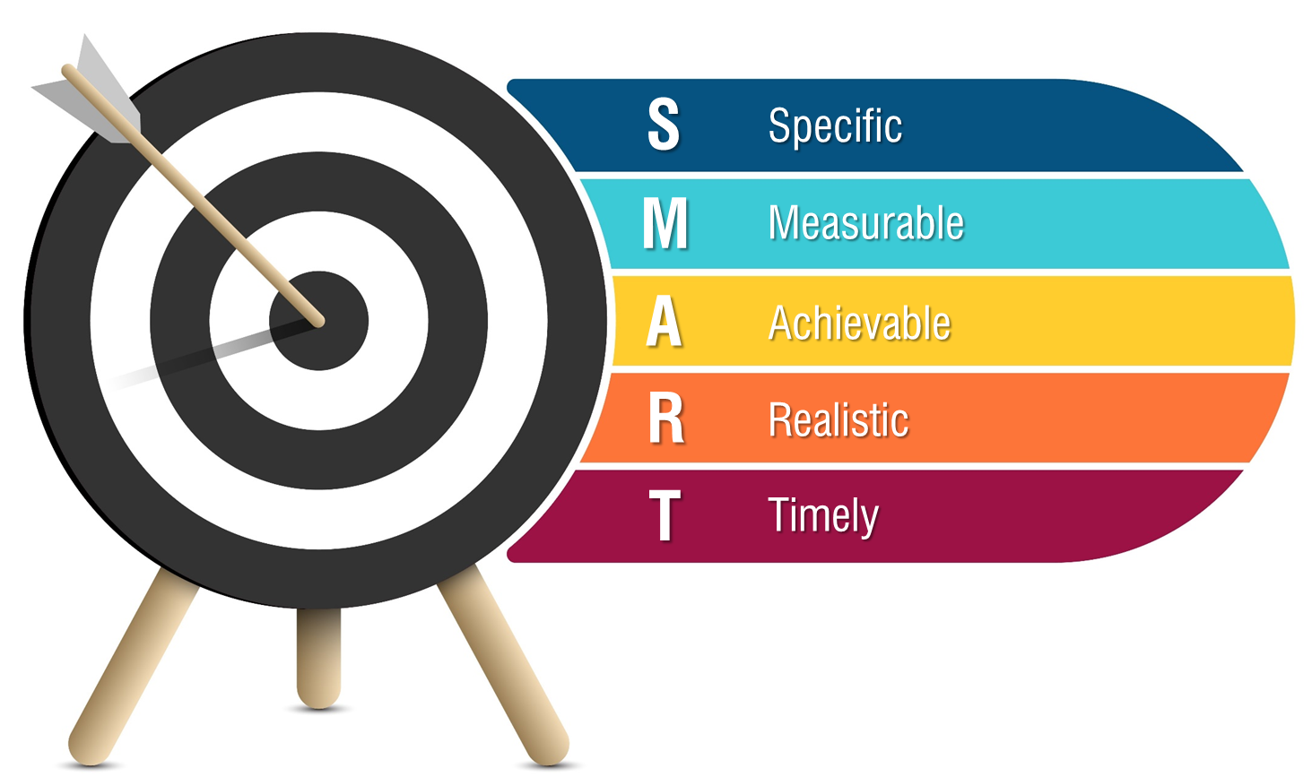

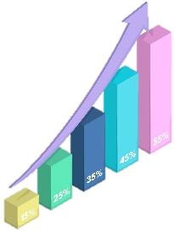



Setting SMART Goal
Who: Who is involved in this goal?
What: What do I want to accomplish?
Where: Where is this goal to be achieved?
When: When do I want to achieve this goal?
Why: Why do I want to achieve this goal?
How many/much?
How do I know if I have reached my goal?
What is my indicator of progress?
Do I have the resources and capabilities to achieve the goal? If not, what am I missing?
Have others done it successfully before?
1.Is the goal realistic and within reach?
2.Is the goal reachable, given the time and resources?
3.Are you able to commit to achieving the goal?
Does my goal have a deadline?
By when do you want to achieve your goal?
Notes:
Specific SMART Goals
Goals that are specific have a significantly greater chance of being accomplished. To make a goal specific, the five “W” questions must be considered:
Specific
Who: Who is involved in this goal?
What: What do I want to accomplish?
Where: Where is this goal to be achieved?
When: When do I want to achieve this goal?
Why: Why do I want to achieve this goal?
For example, a general goal would be “I want to get in shape.” A more specific goal would be “I want to obtain a gym membership at my local community center and work out four days a week to be healthier.”
Measurable
A SMART goal must have criteria for measuring progress. If there are no criteria, you will not be able to determine your progress and if you are on track to reach your goal. To make a goal measurable, ask yourself:
How many/much?
How do I know if I have reached my goal?
What is my indicator of progress?
For example, building on the specific goal above: I want to obtain a gym membership at my local community center and work out four days a week to be healthier. Every week, I will aim to lose one pound of body fat.
Achievable SMART Goals
A SMART goal must be achievable and attainable. This will help you figure out ways you can realize that goal and work towards it. The achievability of the goal should be stretched to make you feel challenged, but defined well enough that you can actually achieve it. Ask yourself:
Do I have the resources and capabilities to achieve the goal? If not, what am I missing?
Have others done it successfully before?
Realistic SMART Goals
A SMART goal must be realistic in that the goal can be realistically achieved given the available resources and time. A SMART goal is likely realistic if you believe that it can be accomplished. Ask yourself:
Is the goal realistic and within reach?
Is the goal reachable, given the time and resources?
Are you able to commit to achieving the goal?
Timely SMART Goals
A SMART goal must be time-bound in that it has a start and finish date. If the goal is not time-constrained, there will be no sense of urgency and, therefore, less motivation to achieve the goal. Ask yourself:
Does my goal have a deadline?
By when do you want to achieve your goal?
For example, building on the goal above: On August 1, I will obtain a gym membership at my local community center. In order to be healthier, I will work out four days a week. Every week, I will aim to lose one pound of body fat. By the end of August, I will have realized my goal if I lose four pounds of fat over the course of the month.

Slide 9
RELAY Model of Effective Delegation
R
Define the Outcome/ Results
E
Show the Entire Picture
L
Look for Understanding
A
Build an Action Plan
Y
Define the Yardstick/ Benchmark
Notes:
Note: Ask one participant at a time to read each acronym of the STIPS model aloud. Read it a several times so that it stays in mind of the participants.
SAY: We will now look at different techniques and tips of giving feedback one at a time.
Move to the next slide.

Slide 10
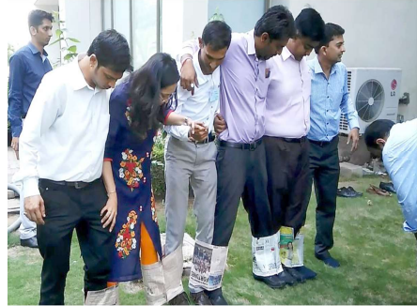

Caterpillar Walk
Notes:
This activity helps to build teamwork, communication, and trust within a group. It requires each member of the team to work together and communicate effectively to move forward as a unit. It also helps to improve coordination and balance, which can be useful in other team activities and in the workplace.
Resources Required- Newspapers full length, Staplers and stapple pins. Trainer needs to give equal and limited resources to each team like 10 newspapers,1 stapler and 1 pack of staple pins. Etc. Same resources to be shared with each team.
Have each team stand in a line with their feet shoulder-width apart and their hands on the shoulders of the team members
Each Team has their feet tied to a newspaper using stapler pins and they need to move sidewards to cover the distance from start to end
The person at the front of the line starts moving their feet, and the rest of the team follows, moving their feet in unison.
The team must work together to move forward without breaking their formation.
To make it more challenging, you can add obstacles for the team to navigate around.
The first team to reach the finish line wins.
Debrief: The trainer can ask each team
What did they Learn about team and team work
What went well and what can be done better next time
How can a seamless performance be teams help to achieve the organisational goals

Slide 11

How to build trust?
Create a better team culture with open and transparent employee communications
Share important information with your team
Be an approachable manager
Have your team’s back
Adopt the human-centric approach and enhance employee empowerment
Notes:
Create a better team culture with open and transparent employee communications:
Transparent communication does not mean hurting the other person. It means not hiding or lying about some information that may not be beneficial to the employee. For example, if an employee is expecting a promotion and the organization doesn’t have plans, let the employee know. Of course, also make sure you engage the employee and ensure that you reassure the employee and look for growth opportunities for them.
Share important information with your team:
As mentioned earlier, be mindful to share important information that will matter to your team. For example, if your organization is considering shuffling of teams or taking on a huge project, your team deserves to know.
Be an approachable manager
Be open to listen to your team members and listen to them - whether or not, you can help them or fix their challenges. This helps build trust and solve more than half of the complications you may have with team management.
Have your team’s back
Team members often make mistakes unknowingly. In such situations, it is important for you to have your team’s back and support them, especially in front of other teams.
Adopt the human-centric approach and enhance employee empowerment
Business is important but so are people. Like Richard Branson said, ‘Clients do not come first. Employees come first. If you take care of your employees, they will take care of the clients.’
Be mindful of building trust with your team consistently so that management becomes easier.
Once you have built trust, the next aspect of employee engagement is motivating them.
Transition to the next slide.

Slide 12
Top Motivators
5
Gives bigger and better responsibility – challenging assignments, believes in me.
Involves in Decision Making Process, Listens to their feedback and ideas.
Helps in developing me & in meeting my goals/targets – through great feedback, sending me for training programs, etc…
Stands by team in times of difficulty.
Appreciates and Recognizes – specially publicly.
Notes:
Say: top 5 motivators at workplace are –
The points are self explanatory. Trainer are free to add relevant examples

Slide 13

EXPLAIN Model of Giving Feedback
E
X
P
L
A
I
N
Ensure that the recipient understands the expectations.
Xclude Taunts & Sarcasm
Prepare before giving the Feedback (Be Specific & Give Examples)
Loudness & Tone
Avoid Personal attacks
In Time
No overload & next Steps
Notes:
Note: Ask the participants to repeat each point of the model. Reiterate the model so that it sticks better in the minds of the participants.
Move to the next slide.

Slide 14




The Coaching Process
G
R
O
W
Grow
What do you want?
Reality
Where are you now?
Options
What could you do?
Will
What will you do?
Notes:
This is the most common coaching model called GROW that is an acronym for Goals, Reality, Option, Will
Goal:
The Goal section of GROW is addressed at the beginning of each session and referred to again from time to time to keep the focus moving forward, especially if the coachee becomes stuck. It raises energy and clarifies thinking. Identifying what we want to achieve puts us on the path to accomplishing it by focusing on the solution rather than the problem.
Some Goal questions are:
What do you want?
Over what time frame?
Where would you like to be on a scale of 1–10?
Imagine you have achieved it:
What does it look like?
How do you feel?
What are people saying to you?
What are the benefits?
What do you want to achieve in five years/one year/three months?
How could you say your goal in a few words?
Which part of that is the real focus?
How will you know when you have achieved it?
In an ideal world, what do you really want?
Reality:
This is an exploration of the coachee’s world at the moment. Time spent here helps people get clear about what is happening and how it affects themselves and others. It provides an opportunity for viewing issues from different perspectives.
Some useful questions here are:
What is happening at the moment?
How important is this to you?
If an ideal situation is 10, what number are you at now?
What impact is this having on you/how do you feel?
What have you done so far?
Who else is affected?
What are you doing that’s working towards your goal?
What are you doing that is getting in the way of your goal?
Tim Gallwey, author of the ‘Inner Game’ series of books, was one of the pre-cursors of coaching. One of his key discoveries was that if he asked clients to ‘watch the ball’ they would tense up and under-perform. However, if he asked them to count how many times the ball spun as it went over the net, or how many centimetres it cleared above the net, their shots improved significantly. Neither of these measurements matters in terms of technique, but the process of focussing on the detail has the dual effect of forcing the coachee to watch the ball, and providing a distraction from internal ‘chatter’, like ‘I’ve failed before’, or ‘I can never hit the ball’.
Exploring the current reality is one of the practices that differentiates coaching from normal conversation, where we tend to go straight from the past to the future, for example from:
‘He said I was always late; I said I wasn’t; he said I was unreliable,’
to:
‘I’m going to resign!’
In the above statement, the speaker is taking the emotional baggage of the past into a crucial decision about the future. Reality questions (together with Goal questions, which can be thought of as ‘future reality’) enable coachees to step off the confusion track, gain some new perspectives, and make calm, informed decisions about how to move forward.
It may feel awkward at first to explore current reality, and new coaches are tempted to go straight to the Options or Actions stage of GROW. However, doing this without exploring the coachee’s Goal and Reality may well result in the answer ‘I don’t know what to do, that’s why I’m here!’.
All these questions help people dig deeper into their own awareness. They will show signs of energy, for instance, lightness in the voice, brighter eyes, a smile and more upright posture. That is the time to pin the new insights down to Options and Actions, and the chances are that by this time, coachees will spontaneously start originating actions where they were stuck before.
Note that we are exploring the present, and although we may ask what someone has done so far, we are not dwelling on the past or listening to stories about it. We are focusing on what the situation means to the coachee more than on the facts. We are not asking questions to find out what has happened, but to find out what impact it is having on the coachee’s work and/or life. When the coachee reaches a new insight or level of understanding, it is wise to explore the new Reality to embed the new awareness and to revisit the Goal. Possibly a new Goal or direction will emerge. Then the ‘Options’ and ‘Will’ sequence start again.
When the coachee reaches a new insight, these questions are useful:
What do you know now that you did not know before?
What is your insight about that?
What have you learned about yourself from that?
Where else could you use this?
Options
Coachees will move naturally towards the Options stage as their Reality becomes clearer. Often they show a new energy by sitting up and smiling, or a lighter tone of voice. Then it is useful to ask some of these questions:
What are your options?
What could you do?
What else?
If there were anything else, what would it be?
What has worked in the past?
What steps could you take?
Who could help you with this?
Where could you find out the information?
What might someone else do in your shoes?
Imagine you have achieved your goal; look back on the journey and tell me you got here.
Notice that most of these questions are almost all open. Keep asking open questions until the coachee has stopped coming up with options on the table. Once it seems that the list is complete, ask the closed question ‘is there anything else?’ to find out whether it is time to finalise the process. This question often results in new options and can be asked as many times as it continues to deliver results.
The following questions probe for more information and, in order not to commit the coaching sin of ‘leading’ the coachee, should be used only when the coachee has raised the subject in question, for example:
Coachee: I need some help.
Coach: Who could help you with this?
Coachee: I need more information.
Coach: Where could you find more information?
Will
As opposed to ‘Options’, which brings to light all possibilities, ‘Will’ is about discovering which actions the coachee can commit to undertaking. When asked, ‘What will you do about this?’ there is a danger that the coachee will make a list of what they think they should do, rather than choosing a pathway which suits their talents and ways of behaviour. The classic example is where a man commits to joining a gym because he wants to lose weight. However, if he is never going to attend because he hates going to the gym, he would get more benefit from committing to walk his dog every morning, if that is something he would enjoy.
Some examples of Will questions are:
What will you do about that?
How will you do that?
When?
What will it take for you to commit to that action?
What could you do to become more committed?
Could you do more?
How many?
How much?
How often?
Where will you find that?
Who will you talk to?
What else you could you do?
If the coach senses a lack of commitment, a question like, ‘How committed are you to doing that?’ should be asked straight away. If there is any hesitation, it is best to go back into the GROW process to clear any blocks and find the most comfortable way to move ahead.
With effective coaching, you can make your team highly productive as well as involved in achieving goals.
Transition to the next slide.

Slide 15
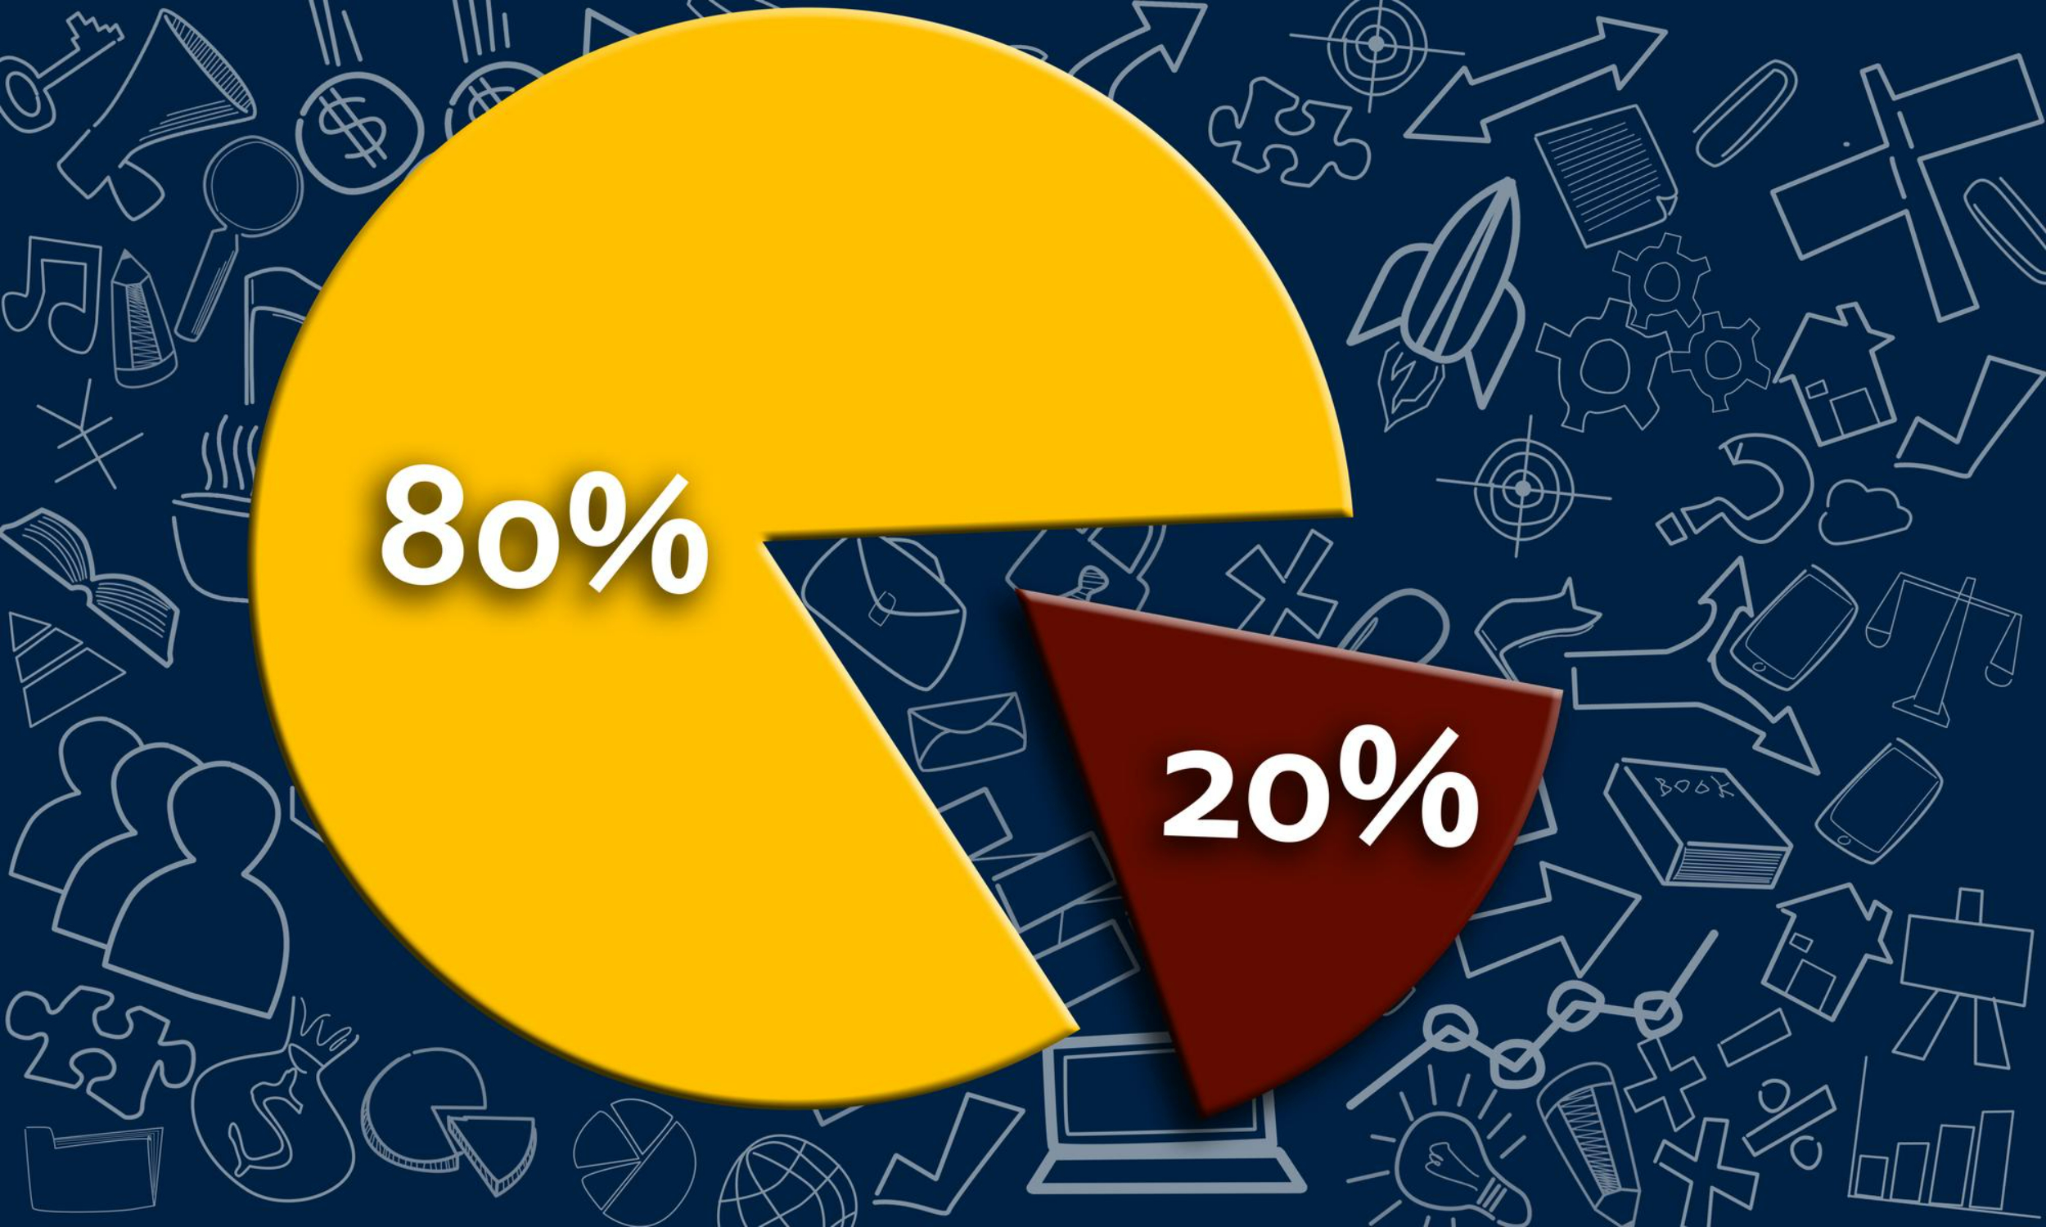
Understanding Pareto's Principle
80% of outcomes (or outputs) result from 20% of all efforts (or inputs) for any given event
Notes:
Benefits of using the Pareto principle
The biggest advantage of using the Pareto principle is that you can create the maximum amount of impact with the least amount of work. This can allow your team to work more efficiently and stay focused on specific initiatives.
The 80/20 rule can help your metrics increase in less time, simply by prioritizing initiatives in the right order.
Other benefits of using the Pareto principle:
Clear priorities both for you and your team
Increased daily productivity
Ability to portion your work into manageable segments
More focused strategy

Slide 16






98752-08472
Hello@freelancetrainings.com
www.freelancetrainings.com
406, Titanium City Centre Mall, Anand Nagar, Satellite, Ahmedabad-380015

