Slide 1


“Customer Service is an Attitude and not a department.” –Mo Hardy
Your
Company
Logo
Customer Service Workshop
Notes:
Note for the trainer: start the day with enthusiasm. Your enthusiasm should reflect in your tone of voice and body language.
Good morning everyone!
How are you today. Are you ready to dive into a day of learning, growth, and transformation? I know I am!
Today, we have a unique opportunity to learn from each other, challenge ourselves, and take our personal and professional lives to the next level. Today’s workshop is highly engaging, filled with activities, role plays, videos and discussions that are designed to inspire and empower you.
But this isn't going to be a passive experience. This isn't a lecture where you sit back and listen to someone else talk. This is an interactive, dynamic, and engaging workshop that requires your full participation, your curiosity, and your willingness to learn.
Throughout the day, you'll have the chance to connect with other like-minded individuals, share your own experiences and insights, and gain new skills and knowledge that will help you achieve your goals. You'll be challenged, pushed outside your comfort zone, and supported every step of the way.
So, are you ready to embrace this day with open hearts and open minds? Are you ready to learn, grow, and transform? I know I am, and I can't wait to see what we'll achieve together.
Let's get started!

Slide 2
Workshop Agenda
Customer Service Essentials
Building an attitude of Ownership & Accountability
Moment of Truth
Understanding Customer Needs
Dealing with Irate Customers
Art of Saying No to the Customer
Notes:
Welcome to the Customer Service Skills. Are you excited for today`s workshop? let me introduce todays workshop modules.
Customer Service Essentials
Building an attitude of Ownership & Accountability
Moment of Truth
Understanding Customer Needs
Dealing with Irate Customers
Customer Service Professionals
I'm feeling really enthusiastic about this experience, I think it's going to be great.

Slide 3

What is ‘Customer Service’?
Customer Service is the support we offer our customers, “both before, during and after they buy our product” that helps them have an easy and enjoyable experience with us.
Notes:
Ask: What do you mean by ‘Customer Service’?
Note: Elicit response. Give 1-2 mins to answer this.
Say:
Customer Service is the support we offer our customers — both before, during and after they buy our product — that helps them have an easy and enjoyable experience with us.
It’s more than just providing answers; it’s an important part of the promise our brand makes to its customers. Good customer service provides an experience that meets customer expectations. It produces satisfied customers. Bad customer service can generate complaints. It can result in lost sales, because consumers might take their business to a competitor.
Customer service is not a department, it is the ATTITUDE!

Slide 4
Why is it Important for an Organisation?
Stand out from competition
Retain customers through goodwill
Word of mouth publicity
Growth of revenue
Notes:
Ask: Why is delivering good customer service so important?
Note: Elicit responses.
Say: Well, you are right! the common reasons for us to excel in customer service are -
Note of the trainer:
Read one point at a time and discuss it. If participants have mentioned any additional points, make sure to cover those additional points as well at the end of these points.
Say:
Standing out from competition: Standing out from the competition in customer service is vital for customer retention, competitive advantage, positive reputation, increased customer acquisition, satisfaction, differentiation from price competition, and fostering a culture of continuous improvement and innovation. It contributes to the overall success and growth of your business in a highly competitive marketplace.
Customer retention through goodwill: Exceptional customer service builds strong relationships with customers, fostering loyalty and increasing the likelihood of repeat business. When customers feel valued and well taken care of, they are more likely to remain loyal to your brand.
Word of mouth (WOM) publicity: Exceptional customer service generates positive word-of-mouth recommendations, online reviews, and social media engagement. These testimonials and positive experiences contribute to a strong reputation, attracting new customers and establishing trust in your brand.
Growth of revenue: Satisfied customers become brand advocates, recommending your business to their friends, family, and colleagues. This leads to organic customer acquisition and helps expand your customer base.By prioritizing exceptional customer service, businesses can create a positive impact on their revenue streams and overall growth.
Ask: One of you please tell us about your one recent experience where great customer service led to growth of revenue. Say for example, one customer liked your service and switched from another brand to your brand.
Note: Give 1-2 mins to respond.
Say: This is what I am talking about growth of revenue by excellent customer service.

Slide 5





1. Taking Ownership and Accountability
Taking the initiative to bring about positive results.
Being accountable for the results of your actions - that are the of the highest quality and delivered in a timely manner.
Taking ownership shows others that they can trust you to do the right thing
Not waiting for others to act, and caring about the outcome as much as an owner of the company would
Notes:
Say: Employees who do the bare minimum are a drain of energy in the office. On the other hand, professionals that have the attitude of ownership, are considered to be assets because they stretch themselves to get things done proactively. So what does taking ownership mean?
Ownership is taking the initiative to bring about positive results.
It means caring about the outcome and doing the best to see it execute to completion.
It is being accountable for the results of your actions - that are of the highest quality and delivered in a timely manner.
Taking ownership shows others that they can trust and rely on you.
To sum up, ownership means having an obligation to the organization in terms of results and acting on the items that impact those results.
Transition to the next slide.

Slide 6

Moment of Truth
Notes:
Welcome to the 3rd Module on Moment of truth. In this module you will learn the following.
Understanding Moment of Truth
Moment of Misery Vs Moment of Magic
Exploring the customer delight moments
Building The Tragics into Magics
Now, we will learn a variety of skills that will help us to under stand Moment of truth in customer service to become an effective professionals
Lets move to the next slide

Slide 7
Areas that Cause Magics or Misery
First impression
Product or Service Delivery
Customer Service
Billing and Payment
Product or Service Performance
Post-Purchase Follow-up
Notes:
There are several things that can be a moment of truth for the customer, which can influence their perception of a company and their willingness to continue doing business with them. Here are some examples:
First impression: The initial interaction a customer has with a company, whether it's visiting a website, browsing a store, or speaking to a representative, can create a lasting impression.
Product or service delivery: The quality and timeliness of product or service delivery can have a significant impact on the customer's satisfaction and loyalty.
Customer service: Interactions with customer service representatives, whether it's through phone, email, or chat, can create a moment of truth depending on the level of empathy, responsiveness, and effectiveness of the representative.
Billing and payment: Billing and payment processes can be a source of frustration for customers if they are confusing, inaccurate, or time-consuming.
Product or service performance: How well a product or service performs can create a moment of truth, as customers will form an opinion based on their experience using it.
Post-purchase follow-up: A company's post-purchase follow-up, such as feedback requests or personalized messages, can create a moment of truth by showing the customer that the company values their opinion and is committed to their satisfaction.
By identifying these critical moments of truth and managing them effectively, companies can create a positive customer experience that can lead to customer satisfaction, loyalty, and ultimately, increased revenue.

Slide 8
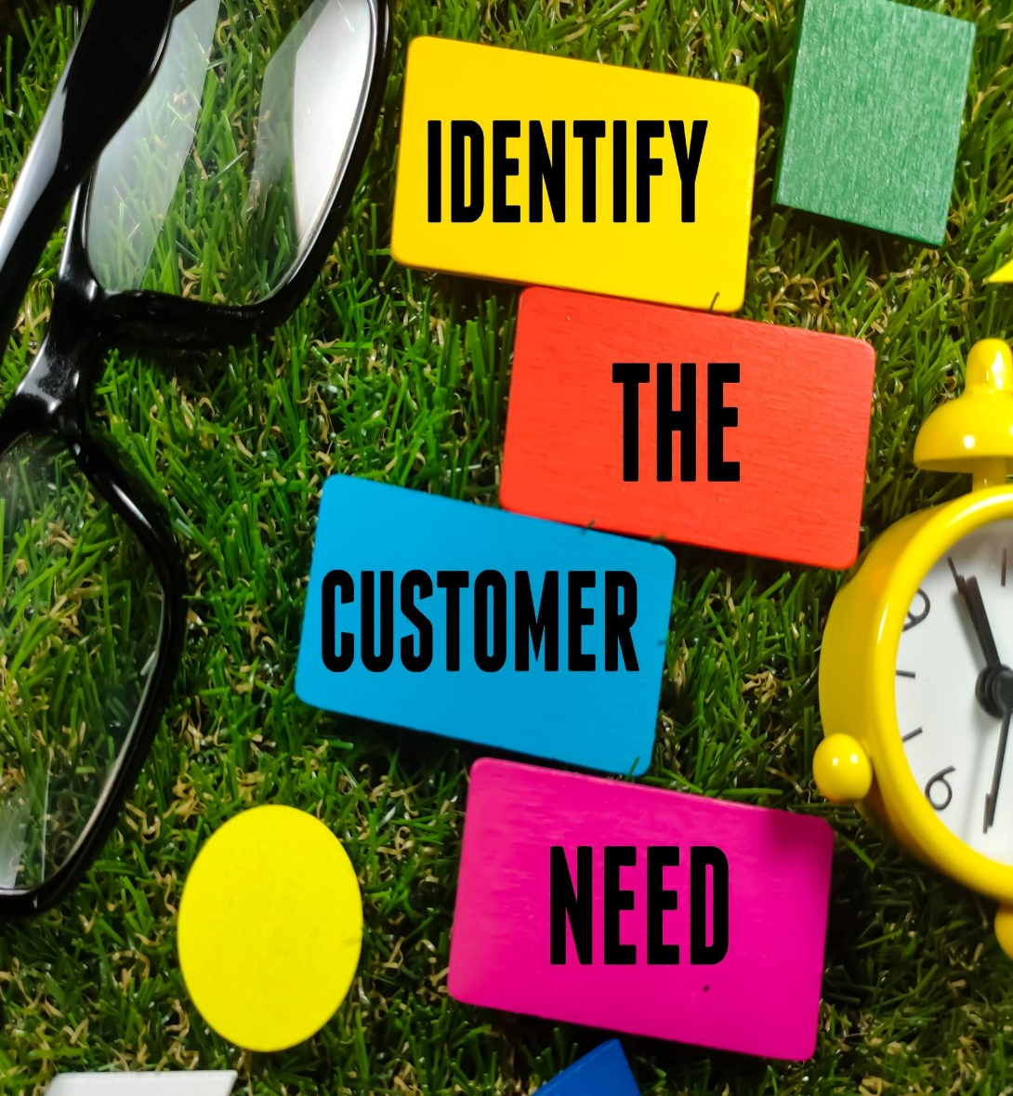
Identify Customer Needs- Importance
Selling Skill
Model
Tailored Solutions
Effective Communication
Increased Trust and Credibility
Higher Conversion Rates
Customer Satisfaction and Retention
Notes:
Sometimes prospects may not immediately recognize or acknowledge their need for a product or service, even if it could potentially benefit them. It can be a challenge for customer service professionals to navigate such situations. Rarely you may find a person who does not have a need for your product. However, few many acknowledge that they have a need. How do you uncover needs?
Tailored Solutions: When Customer service professionals have a clear understanding of customer needs, they can provide customized solutions that address specific pain points and challenges. This leads to more relevant and valuable offerings, increasing the chances of customer satisfaction and loyalty.
Effective Communication: Understanding customer needs enables Customer service professionals to communicate more effectively. They can use the customer's language, highlight relevant features and benefits, and address specific concerns. This creates a stronger connection with the customer and enhances the overall customer experience.
Increased Trust and Credibility: By demonstrating an understanding of customer needs, customer service professionals build trust and credibility. Customers appreciate when their concerns are heard and addressed, which fosters a positive relationship. This trust can lead to long-term partnerships and referrals, benefiting the customer service professional and the company.
Higher Conversion Rates: When customer service professionals truly understand customer needs, they can present solutions in a way that resonates with the customer. By aligning the features and benefits of the product or service with the customer's specific needs, the chances of closing a sale and achieving higher conversion rates increase significantly.
Customer Satisfaction and Retention: Meeting customer needs directly contributes to customer satisfaction. When customers feel that their requirements are understood and met, they are more likely to be satisfied with their purchase. Satisfied customers are more likely to become repeat customers and advocates for the company, leading to improved customer retention and increased referrals.
Lets see how to uncover the customer needs using the LADR Model

Slide 9

“Your most unhappy customers are your greatest source of learning. - Bill Gates
Notes:
Say: When we say no to a customer for something the obvious reaction that you would get is a disappointed, complaining or angry customer. So don’t you think its important that we learn how to manage such situation? Of course it is! Keeping that in mind, lets move to our next topic.
Ask: A complaint is a gift. Do you agree?
Note: Elicit responses to understand the participants view point on Complaints.
Say: In this business, Customer Complaints sometimes come up. However, it’s important for us to recover well from the mistakes/complaints that come from the customer. It is a proven fact that if you recover well from a complaint that the customer has, you are likely to get more business and appreciation from the customer once the complaint is resolved.
Stop thinking that complaints are a bad thing. Customers who want to tell you how they feel about your business should be encouraged.
Start thinking about how thoughtful your business could be, and what powerful corrective actions you could take, if you could understand how every one of your customers felt.
The complaint can be turned into an opportunity for your business. Therefore, we should look at every customer complaint as an opportunity to get more business from him.

Slide 10


Do not add fuel to fire by
Arguing
Passing the buck to a colleague
Blaming the organization
Making lame excuses
Taking it personally
Ignoring/ belittling the issue
Notes:
Say: While dealing with an angry customer, you have to be very careful.. Your words/actions may worsen the matter..
Explain as under:
Say:
Arguing : It doesn’t matter who was wrong or right. Even if customers were wrong, don’t ask them or expect them to apologize. Instead, move forward so the relationship is on stable ground again. No matter how rough the customer gets, it’s important to be polite and stay polite throughout the conversation. Move forward with the problem at hand and take the conversation forward.
Passing the buck to a colleague, blaming the organization : Never get into the blame game. Remember the customer has come to you with a problem he has faced with a product or service offered by your company. If you find yourself on the receiving end of blame, do your best to stay centered and move toward problem-solving. Articulate what you know about the problem, what you have tried, and where you need help to resolve the problem.
Making lame excuses : Avoid giving excuses to the customer. Provide reasons for the inability to provide the customers need. If you require time for a resolution, explain the same to the customer. Making excuses will sound repetitive and the customer will feel that his query is not important.
Taking it personally : From a customer standpoint, sometimes they forget that they are dealing with a person and not the actual company or problem itself. They are not angry with you, they are disappointed with a product or service and not you as a person. Remember that in most cases you did not directly create this anger and frustration, but you can help to influence its path.
Ignoring/ belittling the issue : The customer query might be a simple query for you, however, you will need to focus and treat it with the same care and attention as it would be any other query.

Slide 11

Art of Saying No to the Customer
Notes:
Welcome to the 6th Module on Art of Saying No to the customer. In this module you will learn the following.
How to say No to the customer.
Techniques to say no- 5 Techniques
Being Empathetic to Customer
Now, we will learn a variety of skills that will help us to understand Customer Service Professionals to become an effective professionals
Lets move to the next slide

Slide 12





Thank You
98752-08472
Hello@freelancetrainings.com
www.freelancetrainings.com
406, Titanium City Centre Mall, Anand Nagar, Satellite, Ahmedabad-380015

