Slide 1

Company Values- 1 Day
Notes:
Note: Please open this slide in the slideshow mode and use to welcome the participants in the class . Trainer Notes- These 4 Values that we are covering in this workshop are based on Industry good practices and trainer can customize this presentation in 2 ways
For companies that don’t have any defined values the presentation can be used as it is.
For companies that have pre defined values Trainer can co-relate the same with the 4 Values shared here. E.G Collaborative can be easily used for Team Player as a values
Please don’t forget to customize the examples of each value based on your discussion with the client.

Slide 2

Let’s Make Groups!
Notes:
Note: Divide the class into groups of 5. You will ask the participants to sequentially count from 1 to 5 such that the 6th participant has to begin counting from 1 and so it continues for the whole class.
You ask all the 1’s to sit together. All the 2’s to sit together. . All the 3’s to sit together. . All the 4’s to sit together. . All the 5’s to sit together.
Say: Ok! These will be your groups through the day! I need you to come up with an interesting group name.
As mentioned before, for every activity from here on you will get points for winning and also for answering!
So gear up!!
Note: give them 5 minutes to come up with an interesting group name.
Transition to the next slide.

Slide 3
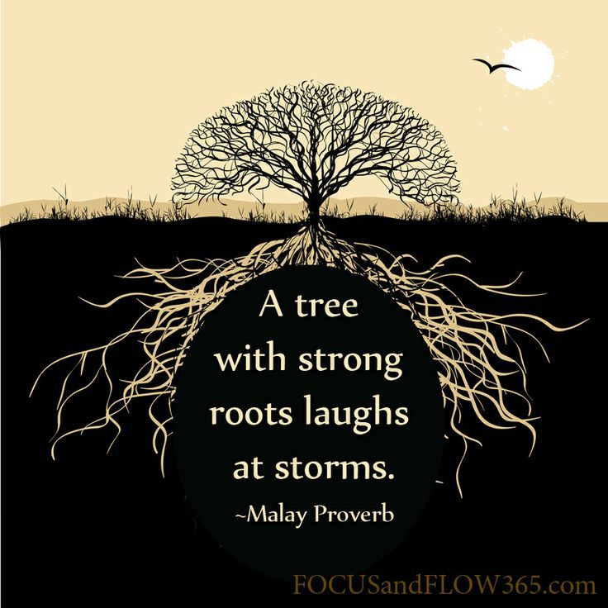
What Value Am I?
Notes:
Note: This is an icebreaker activity.
Say: We are going to play an interesting activity! It is called ‘What Value Am I.’
I need each one of you to think about one value that you can closely associate yourself with. It doesn’t matter personally or professionally. The value that we identify ourselves with the most stay with us in every walk of our life.
So here’s what you are going to do: I want the whole group to come in front of the class. The captain of the group will tell us their group name. then every individual needs to do the below!
Step 1: Tell us your name and your title (E.g. Riya Shah, Customer Service Associate)
Step 2: The value you associate yourself the best with and Why?
Step 3: 3 expectations you have from this training program as a group. The Captain can state it for each group.
Note: You (the trainer) will need to give an example of what value you are.
Say: Let me start with myself. For example –
I am Riya Shah. I am the customer Service Manager at ABC Organization
The value I think I am is ‘Patience’ because I feel I demonstrate patience with most people and in most situations of my life. It has helped me grow in my personal relations and in my professional life especially to accept people and understand them better.
Ask: got it?
Let’s start, shall we?
Note: Do this with the whole class.
Also, you may write down their expectations and align them with the scope of the training program.
Note: After you finish doing the exercise with the whole class; say the below:
Ask: Why do you think we did this exercise
Elicit response.
Say: The reason is that the training today is based on values.
So I would like to do a quick group activity with you.
Are you ready?
Transition to the next slide.

Slide 4
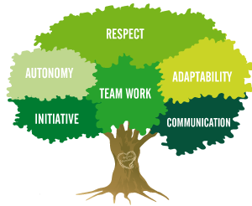
The Value Of Values!
COLLBORATE
Values are basic and fundamental beliefs that guide or motivate attitudes or actions.
ACCOUNTABLE
EXCELLENT
RESOLUTE
Notes:
Say: Values are basic and fundamental beliefs that guide or motivate attitudes or actions.
Why are they important to us? Because they help us to determine what is important to us. Values describe the personal qualities we choose to embody to guide our actions; the sort of person we want to be; the manner in which we treat ourselves and others, and our interaction with the world around us. They provide the general guidelines for conduct. Values in a narrow sense is that which is good, desirable, or worthwhile. Values are the motive behind purposeful action. Our values are important because they help us to grow and develop. They help us to create the future we want to experience. Values is what we fall back on while making decisions. Values are solid connecting factors between individuals. They may have different choices and preferences but what can bind them like peas in a pod are their common values! Some examples of workplace values include:
Being accountable. Making a difference. Focusing on detail. Delivering quality. Being completely honest. Keeping promises. Being reliable. Being positive. Meeting deadlines. Helping others. Being a great team member. Respecting company policy and rules, and respecting others. Showing tolerance.
Organizational values reflect how your organization shows up and operates in the world. An organization's workplace values set the tone for the company's culture, and they identify what the organization, as a whole, cares about. When this happens, people understand one another, everyone does the right things for the right reasons, and this common purpose and understanding helps people build great working relationships. Values alignment helps the organization as a whole to achieve its core mission. When values are out of alignment, people work towards different goals, with different intentions, and with different outcomes. This can damage work relationships, productivity, job satisfaction, and creative potential.
Please understand, establishing strong core values provides both internal and external advantages to the company:
Core values help companies in the decision-making processes. For example, if one of the core values of a company is to stand behind the quality of their products, any products not reaching the satisfactory standard are automatically eliminated.
Core values educate clients and potential customers about what the company is about and clarify the identity of the company. Especially in this competitive world, having a set of specific core values that speak to the public is definitely a competitive advantage.
Interestingly, Core values are becoming primary recruiting and retention tools. Many companies now ask questions and base their decisions of hiring a candidate basis their work values and the extent to which they match with the values of the organizations. For a fairly smart and competent professional, skills can be taught but values are more inherent.
Say: That is why we are here today. For you to get acquainted with your company’s values so that you can align your professional behavior and conduct as per the company’s expectations!
So without further adieu let us see what they are.
Transition to the next slide.

Slide 5
Core Values- CARE
COLLABORATIVE
ACCOUNTABLE
RESOLUTE
EXCELLENT
Notes:
Say: These are 7 values and the trainer can add/delete any value depending on the discussion with the client but these are the standard values
Note: Pick randomly 7 participants to read each value.
Say: please note that each of these values is so vast that it is a 1-day training program in itself. But we have only 1 day with each other. So let’s do our best to understand them and their practical applicability at your work stations!
Transition to the next slide.
Trainer is free to add company’s values after discussion with the client. The above abbreviation stands for CAREFIN just for the participants Revcall. Below are some additional options for the same
(Caring, Accountability, Respect, Empathy, Fairness, Integrity, Nobility)

Slide 6


Value 1 - COLLABORATIVE
Work together with various entities in achieving overall objectives/goals.
Notes:
Ask: What does collaboration mean to you?
Elicit response.
Say: Correct. It means coming together to do something. In the case of the video, it was all the fish jointly coming together to break free from the net in which they were trapped.
Ask: What is this ’something’ mean in your case?
Elicit response.
Say: it is as simple as – coming together to run a company.
In other words each one of you sitting here is running this company. It is exactly why you are expected to practice this value ‘Collaboration’ to work together, in harmony, in sync to achieve the organizations goals, vision and mission.
The - definition of Collaboration is on similar lines.
Transition to the next slide

Slide 7
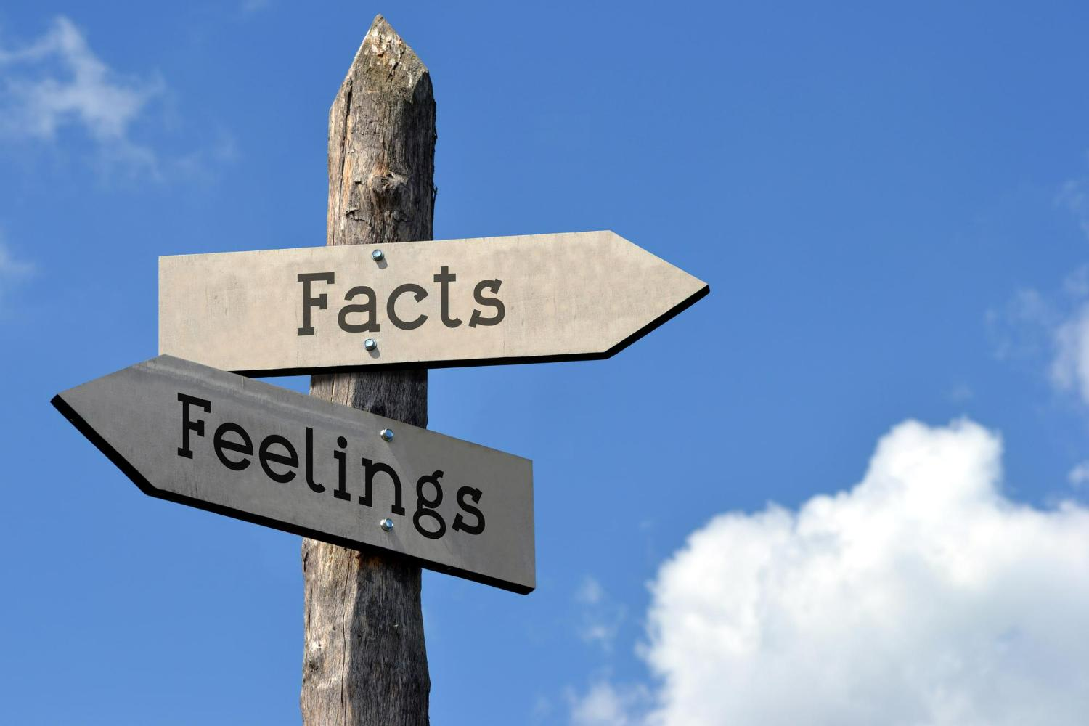
Interesting Facts!
Your career success in the workplace of today–independent of technical expertise–depends on the quality of your people skills.
The better your interpersonal skills are, the better you will be able to collaborate with your team leading to improved productivity and relationships.
People with strong interpersonal skills are usually more successful in both their professional and personal lives.
In business contexts, "interpersonal skills refers to a person's ability to operate within business organizations through social communication and interactions.
Employers often seek to hire staff with 'strong interpersonal skills' as they can work well in a team.
Notes:
Say: We are going to discuss some very interesting facts about interpersonal skills.
I need you to pay close attention.
Note: Explain each of the stated points.
Also, firmly reiterate how collaboration between teams or departments or any other stakeholder cannot happen if you have poor interpersonal skills. It is a must have.
If a professional is dominating, rude, disrespectful, etc. no one will want to work with him. Hence, proved!
Transition to the next slide

Slide 8

Activity - What Is Your Wish?
Notes:
Say:
I need you to tear a piece of paper from your notepads.
Write down your name on the top right corner. Next you can choose any person you want in this room and Write his name in the bottom right corner.
In the centre of the paper; write down any task you would like him or her to do. It could anything he or she should do in front of the class.
Note: Please ensure that people have understood where to write their own names and the name of the person the choose.
This is important for the trainer.
Say: please note, your names will be confidential and I will only be reading out the name of the person you have chosen and the task you have suggested he/she do.
Note: The above instruction is important since people then choose to give ridiculous tasks like singing, dancing etc to their chosen person.
Ask the participants to fold the piece of paper, after filling the information, in a way that the information is not seen.
Collect all the chits.
Note: Go through a few chits and declare the names of the participants who had chosen the tasks for a participants to instead come and do it themselves. Do not mention the names of the participants they had chosen.
Please note that because participants think that their names will be anonymous; they usually give embarrassing tasks to people they choose.
The debrief of this activity is that you need to make them reflect now that they are put in a spot how do they feel?
You will have a few participants who are sports; you could invite them to perform their acts.
Ensure that you humor them and make this a fun activity. It shoudn’t feel like a punishment of any form.
Discuss : When you were asked to perform yourself how did you feel?
Discuss that is what walking in someone else’s shoes feels like. Only when you go through what they do; or put yourself in that place will be able to understand them. This practice is called Empathy and is extremely important in developing great working relations with stakeholders at work.
Debrief:
What was the feeling while writing the tasks?
What was the feeling when you realized that you had to perform the task that you wanted someone else to do?
Transition to the next slide

Slide 9

2. What Is Empathy?
Empathy:
It is the ability to see the world as another person, to share and understand another person’s feelings, needs, concerns and/or emotional state.
Notes:
Say: 'Empathy is the ability to see the world as another person, to share and understand another person’s feelings, needs, concerns and/or emotional state.'
Empathy is to be able to feel the exact same feelings as the other person. Sometimes we say, “putting yourself in the other persons shoes.”
Put yourself in the other person’s shoes and think about how they will feel about what you are telling them; how would you feel if the roles were reversed?
Say: Empathy is a selfless act, it enables us to learn more about people and relationships with people - it is a desirable skill beneficial to ourselves, others and society.
Empathy is a skill that can be developed and, as with most interpersonal skills, empathising (at some level) comes naturally to most people.
Have you heard of Sympathy? Is there a difference between Empathy and Sympathy? What is the difference?
Elicit answers from participants.
Say: There is an important distinction between empathy and sympathy. We offer our sympathy when we imagine how a situation or event was difficult or traumatic to another person, we may use phases like, ‘I am very sorry to hear that’ or ‘If there is anything I can do to help…’, we feel pity or sorry for the other person.
Empathy really means being able to understand the needs of others. It means that you’re aware of their feelings and how it impacts their perception. It doesn’t mean you have to agree with how they see things; rather, being empathetic means that you’re willing and able to appreciate what the other person is going through.
Very often, shared experiences trigger empathy.
For eg - Imagine a colleague is going through tough time in his/her personal life. It’s causing a lot of stress, his/her productivity has fallen and deadlines are missed. He is unable to gather himself. Now imagine that you have gone through a similar situation. How would you react to this colleague?
In all probability, you might try to relieve work pressures and offer to help out where you could. Because you know how it “feels” to be in a tough situation.
Imagine a colleague has won an award for the best performance in the last quarter. How would you react especially when your numbers aren’t looking too good?
Elicit a discussion on similar situations and get participants to bring out empathy situations. Note that empathy situations are not all sad.
Transition to the next slide

Slide 10
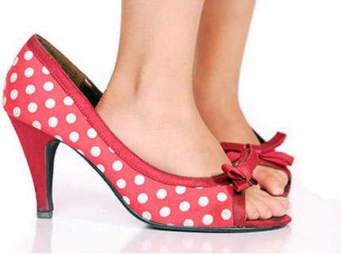
Benefits Of Empathy In Collaboration
Empathy is at the core of your mission
Empathy boosts productivity
Empathy fuels effective collaboration
Empathy elevates customer satisfaction
Empathy builds leadership
Empathy is a competitive advantage
Notes:
Empathy is a skill we can build, just like a muscle. When we exercise it, we grow stronger. Focusing our attention on the people around us strengthens our ability to learn, communicate, and get results.
1. Empathy is at the core of your mission
An organization cannot achieve its mission only through the top management and the board. It requires the strength and the support of each one of you. That is why it is important that employees, departments, investors work in collaboration to meeting this mission. One of the most important thing that is required for collaborating effectively is empathy. Without empathy things can become cut-throat and insensitive. Hence empathy is the core.
1. Empathy boosts productivity
Human connection is a powerful source of meaning and motivation. We work harder when we see that our work benefits people. Researchers have tested this idea using simple interventions. A study of university fundraisers found that those who were asked to read brief stories about how donations have helped scholarship students doubled the number of donations they obtained. People in completely different fields—like lifeguards and agricultural workers—have also showed increased productivity after reading stories about how their work helps people. Even seeing the faces of people we serve can improve performance.
2. Empathy fuels effective collaboration
3. Empathy elevates customer satisfaction
human interaction is the primary way people judge service quality, and these interactions shape an organization’s reputation. When we approach our work with a belief that each customer deserves our focused attention and kindness, it shows. It builds trust and loyalty. Taking time to observe, ask questions, and respond thoughtfully is key to meeting the needs of the people we serve.
4. Empathy builds leadership
People who are skilled at understanding others’ feelings and situations are more likely to be viewed as effective leaders. Empathetic leaders motivate teams to do their best work. They listen. They acknowledge others’ needs and contributions. They cultivate a shared vision and loyalty as a direct result of their investment in their team.
5. Empathy is a competitive advantage
And while the influence of technology is growing, our need for human connection is unchanging. So when the people representing your organization show humanity and kindness, now more than ever, it stands out.
Transition to the next slide

Slide 11

Activity – Best Compliments
Notes:
Note: This is a group activity.
Get every participant to write their respective name on a sheet of paper.
Each of these sheets is circulated to the other team members. Team members need to write down down 2 -3 nice things about the other team members on their respective sheets of paper.
After they finish writing; each member gets the sheet which has his name on it (on which other team members have written words of appreciation for him / her.)
Note for the trainer: Let the participants read what is written on their sheet.
Ask: How did you feel?
Transition to the next slide

Slide 12

Few Best Compliments
Notes:
Say: This is the power of appreciation. If you felt so good when people appreciated you; can you imagine how motivated, happy and reinforced people will feel when you compliment them genuinely?
Interestingly, because of our own frustrations and stresses in life we are wired to see problems and inadequacies in others. We are quick to criticize, point fingers and see mistakes at the drop of a hat.
Please understand that appreciation is not just saying something nice to others because it is the right way to do so. It is a keen sense and an ability to intelligently observe traits, behaviors, actions and skills that people demonstrate and communicate it back to them.
As easy as you may think, genuine appreciation is not easy. I need you to start looking at everyone from a fresh lens. You will notice that there is so much that you could have appreciated. Let’s face it, people love acknowledgment and appreciation. Appreciate people more – your family, friends, colleagues, boss, and even customers.
You will see how much you can learn if you genuine appreciate and think it is worthy emulating. And you will see how your relations improve and collaboration is easier!
Say: Appreciate people for their effort, not only results. Appreciate them for being there for you. Appreciate them for investing in you. Appreciate them for believing in you. Appreciate for the value they add – could be through knowledge, through skills or just by being able to inspire you.
On a slightly more philosophical level, when you appreciate you can be more grateful. It makes you feel better about yourself and your present moment.
Transition to the next slide

Slide 13

How does Accountability Translate?
Taking responsibility of the quality of work & behavior towards every stakeholder.
Working passionately even when not being watched.
Getting to the root of the problem.
Notes:
Let’s see this example: (Trainer Needs to customize ths example depending on the client’s industry & Business)
Ram and Priyesh are customer service executives in the same branch. The branch has a footfall of around 20-25 customers everyday. Surprisingly, of them 15 customers are the regular customers and the rest are new. It has been noticed that most of the regular customer prefer interacting with Ram. They are happy to wait, rather than be serviced by Priyesh. Although ram has double the work; he is easily meeting his targets of the month unlike Priyesh who is struggling.
A closer view in their professional lives – Ram regularly studies the banking products and policies. He studies all his customer profiles in and out. He ensures to service the customers in the best possible way to meet their needs. For him customers are people whose financial needs he is responsible for. He does this even when his boss or his seniors are not around. Achieving targets is a by product for him. At times he goes the extra mile to service them. This may involve working extra hours to meet a commitment or servicing on the weekend He tailors products as per the customer’s lifestyle and standard of living. He takes keen interest and responsibility to ensure that his customers are left with feeling good that their money is in safe hands. They feel better about banking when they interact with Ram.
Priyesh on the other hand looks at customers as his targets. He sells the what he thinks will help him close deals. He has mis-sold in the past which lost the branch 3 big accounts. He mis-commits and then shifts the blame on the banks policies. He behaves as sincere as possible when his boss is around him to get in his bosses good books. Since most of the customers personally choose to be serviced by his colleague Ram, he gets more time to be on social media and always gets home on time.
Question: if you were a customer, which banker would you prefer and why?
Elicit response.
Say: the answer ofcourse has to be Ram.
Say: Please understand that one of the important values that ram is exhibiting is ‘Accountability.’
This is an extremely important value and will take you really far in both your personal and professional life. Also, accountability is not what you do. It is how you feel about every single thing at work. It is this feeling or attitude as you call that will translate into actions. People that exhibit accountability do so because they feel strongly involved and responsible for their work, their stakeholders and understand the huge impact they have on the overall scheme of things even if they are at the junior most level. When you get just that, you have already made a huge shift in your professional demeanor for your won good. I repeat not for anyone else but for your own self! Professionals that work with the spirit of accountability are the most coveted. Their stakeholders – boss, subordinate, colleagues, customers, vendors, investors – love them. They carry an aura of trust and reliability which is the most charming part of their personality and work ethics.
Ask: What does accountability translate into?
1. Taking responsibility of the quality of work & behavior towards every stakeholder –
For - all its employees assuming accountability is very important. This means taking full responsibility of the quality of work as expected, committed to or mutually agreed upon. Taking full responsibility towards maintaining sound and caring professional relationships with each of your stakeholder.
Ask: Who are your stakeholders?
Say: Everyone that you serve and interact- your boss, super boss, the management, the customers, vendors, regulators, investors, your subordinates, colleagues, etc. Remember the case we discussed? Who would you want to be – Ram or Priyesh? Believe you me, being Priyesh is easy. Being temperamental, not having discipline to learning about your products is easy, being distracted on facebook is easy. A professional is builds a repute of being accountable doesn’t choose the easy road. He chooses the tough road which eventually builds his professional muscles and paves his way with opportunities.
Give me a few examples on assuming responsibility for quality of work and behavior.
2. Working passionately even when not being watched.
It is said that good work speaks for itself. It doesn’t need to be marketed or advocated loudly. A person that works with accountability does so for himself. He doesn’t act sincere but just is. He doesn’t do it to showcase himself or to get a certificate from anyone. His certificate is the credidibility he eventually creates because of the investment he makes regardless of whether or not anyone is watching. Who do you think between Ram and Priyesh demonstrates this?
It is a rhetorical question. You need to understand that no amount of showcasing accountability alone can compensate for actually working with accountability.
3. Getting to the root of the problem.
A professional that works with accountability doesn’t operate from a superfluous mentality. He assumes personal responsibility for everything that is in him purview. He doesn’t pass the ball around but does everything in his capacity to solve the issue for the stakeholder. For example, if a customer comes to you to say that he has been receiving SMSs of his debit card usage but not statements as hard copy in mail. Going to the root of the problem will mean not just emailing him his statements for the month but checking why he hasn’t been getting the hard copies. Is the wrong mailing address registered? Is there a problem with the courier services and ensuring that it is fixed.
Give me a few examples on getting to the root of the problem.
Note: Please give the groups points for good examples. Ensure you applaud them timely!
Say: Point at the hand-print. remember you always leave your print back. How would you want it to be?
Transition to the next slide.

Slide 14

Benefits Of Accountability?
Improved productivity
Aids career advancement
Improves your reputation
Enables you to open your mind to a bigger picture leading you to think macro & not micro.
Enables you and your team to be an example for others in the organization
Notes:
Say: I give you 10 Minutes as a team. Write down the benefits of Accountability for a professional. The more quality points, the more marks you earn.
Note: At the end of 10 minutes elicit response. Give points to the teams basis the number of good points they have made.
Say: Ownership is an important aspect of an entrepreneurial mindset.
1. Improved productivity – When you develop a sense of ownership towards your work, your productivity automatically improves because you feel an intrinsic motivation to complete one set of tasks and move to the next and keep going on. In turn, you also motivate your team with your enthusiasm and sense of ownership, thereby increasing productivity.
2. Aids career advancement – When you display ownership and responsibility at the workplace, it never goes unnoticed. Your managers and organisation will notice how reliable an employee you are and how you take charge of the work assigned to you. That will come in handy when it comes to your career development prospects.
3. Improves your reputation – Your reliability as a professional who takes ownership and responsibility for himself as well as for him team automatically helps improve your reputation within the organisation. Your stakeholders will bank more on you making you an important part of the system.
4. Enables you to open your mind to a bigger picture leading you to think macro & not micro – Taking ownership requires you to think like an owner and makes you develop a broader perspective towards your work. Your learning improves, your experience becomes stronger. It enriches you immensely on your knowledge and skills as a professional.
5. Enables you and your team to be an example for others in the organization – When you demonstrate ownership, you set yourself as a benchmark through your performance to others. This has a ripple effect and can take the performance of the entire brand to the next level. Never under-estimate the power you have on the over-all scheme of an organization!
Transition to the next slide.

Slide 15
1.Operating from the Circle of Influence
Price of Gas
Other People`s Opinion
Rainfall
Circle of Concern
(Factor we have NO Control)
Circle Of Influence (Factors we can Control)
My Words
My Behaviour
My Actions
Who will be the next President
Other People`s Action
War in Middle East
Notes:
Say: A Circle of Concern encompasses the wide range of concerns we have. On a macro level – pollution, changing government, tax policies, environment, petrol prices, war, rainfall etc. On a more professional level these concerns are –will my boss give me a good appraisal, will I get reasonable targets this year?, How will my customer react when I tell him about the reduced interest rates on savings? When the ops team give me the credit report on time?
Say: So basically, all the things in life over which we have no control over get covered in the circle of concern.
Ask: Now what is Circle of Influence?
Say: It is all those things that are directly under our control or influence. Such as:
My thoughts – do I think positively in general or am I a pessimist?
My feelings – what are my feelings towards myself and others? Are they respectful and loving or are they full of vengeance and hatred?
My behavior – Do I interact with people with compassion, trust and respect or do I take them for granted.
To address some points from the Circle of Concern – Have I set expectations in my appraisal and am I working hard towards meeting those expectations? Have I built trusting relations with my customers? Have I built strong, understanding relations with my colleagues from other departments such that they cooperate when necessary?
Please understand that with the Speed of Time, you will have absolute no control over what others think, feel or do. You will have no control on the decisions that they make which could impact you. To a great extent you will have no control over other people – your parents, children, partner, friends etc.
Like wise – your employees, boss, management, colleagues, customers, vendors, etc.
Ask: Where do you think you operate from – Circle of Concern or Circle of Influence?
Say: You don’t need to tell me. It is for you to know.
Ask; Now, what do you think happens when a person operates from circle of concern instead of circle of influence?
Elicit response and note them on the board one by one.
Say: stress, anxiety, anger, frustration, distrust, impatience, lack of peace, insomnia, depression, etc.
This causes bad relationships, poor decision making skills, and more and more stress. Eventually all these worries and stresses result in health problems. In today’s age health issues are on an unbelievable rise – diabetes, hyper-tension, blood-pressure, cancer, auto-immune disorders, heart problems etc. 30 years ago, if these problems would haunt the senior citizens, today you have the millennials and generation-z battling them.
Focusing on one’s circle of influence enables one to conserve one’s energy towards things that are doable and that matter. It reduces stress, makes you feel more in control & empowered. It also makes you feel less vulnerable and victimized.
So, remind yourself deliberately to operate from circle of influence and to do things that are in your control. People that take ownership work from the circle of influence and do everything that it takes to make things happen for the right cause.
It will be tough to change your perspective initially. But once you do, you will see how your life becomes so much simpler, easier and in control!
Transition to the next slide.

Slide 16

Value 3 - RESOLUTE
Be determined and faithful to accept challenges and try to find the best solutions possible.
Notes:
Say: We are discussing this because as professionals we will constantly be facing challenges in different aspects of our professional lives. Whether we choose to give into these challenges or resolve to stand up to them and overcome them will define us. That is exactly what our next value is. Resolute. To be determined and to resolve to battle any challenges – big or small – that will come your way.
Transition to the next slide.

Slide 17
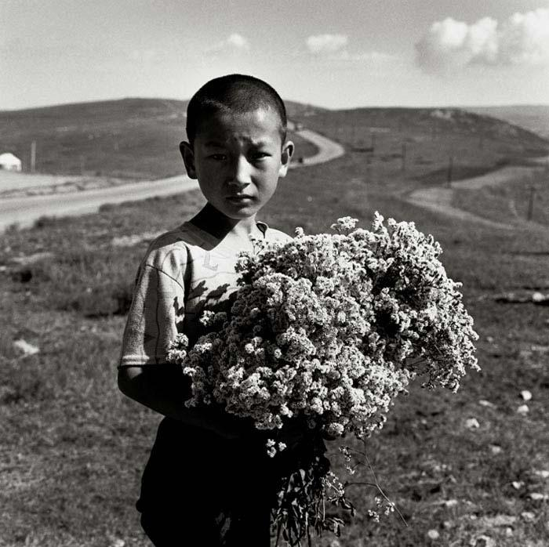
Activity- What’s his story
Notes:
There was a once a little boy called Toto Chan who lived in a small village of China. When he was 2 years old his parents were killed in an accident. Toto Chan was brought up by his grandmother who was very old and poor. She could hardly make ends meet. Sometimes they only ate a little rice for all their meals. Little Toto however was an ambitious young boy and wanted to go to school just like other children of his age did. Although, he would never mention this to his grandmother for she would feel sad.
Here’s your task.. Complete the story.
Note: this is group activity. Give the teams about 10 minutes to complete the story to an ending.
At the end of 10 minutes, get the captain of each team narrate the story till the climax.
Say: It is so interesting that each team made such fantastic ending to the story. Did you know, all of us to a great extent are capable to write our own destinies. Our decisions on an every day basis, our responses to the small-big challenges we face at work everyday – over a period of time designs our destiny!.
We can shape great destinies if we resolve to fight for ourselves and our challenges. Interestingly how we see life and how we see challenges depends a lot on our beliefs.
Transition to the next slide.

Slide 18
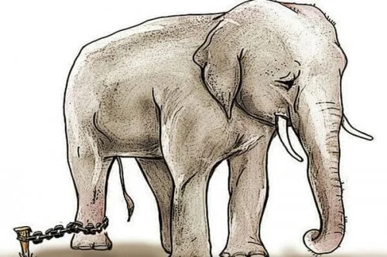
Activity- The Story of mighty Elephant
Notes:
Say: Be they humans or animals, mind plays a primary role in their behavior. Particularly, in the case of certain wild, conditioning their mind is part of training the animals undergo. Once trained, the animal follows a patterned behavior already set in their mind. Once a curious man went past an elephant that was tied to the tree with a rope. Upon seeing the rope that was preventing a huge animal from moving out, he became cofused and stuck to the view that in the absence of strong chains or a cage, the elephant could , at any time, break the rope and go free. But, for unknown reasons, the elephant stood in the same place and never tried to take a flight to freedom. Why? Being inquisitive, he saw the Mahout/trainer standing near-by and asked him , What made the elephant stand in the same place and why is it not trying to escape? The trainer said, "When the elephants were young and small, we used the same rope to tie them at that point of time and age and it was good enough for them to keep them safely in the same place, when undergoing proper training. As they grow up, they have been conditioned to such an extent that they believe that they can not break away once firmly tied up with a pole or stake. Now this particular elephant believes the rope still holds it so, it can not not try to break free". That is the mind power. The big animal can break the rope and free himself in a jiff, but still it stands in the same place, in the belief he can not break it. On account of his prolonged training (mental conditioning), no matter how strong and how big he has grown, he still feels that he can not break the chain or rope and move the stake and escape.
How many of us go through this mental ordeal and agony and believe that we can not fight our challenges because they seemed big and we failed miserably earlier. This mental block, once set in, will keep us on hold and we will be stuck where we are. We should not let this mental block creep into our mind. Just remember what has happened to the elephant who can not move far beyond the extent of his mind set.
Please note that successful professionals are adept at questioning themselves about their limited beliefs. They take time out to introspect what restricts them from facing their challenges. Is the limitation their belief system or is it a skill / knowledge problem. This clarity is the stepping stone to win any challenge.
When we win over our limiting beliefs; our determination takes a more powerful direction to beat the challenges on the way.
It is not just our belief that limits us. It is also the limiting beliefs of others that can shake our determination if we succumb to it!
Transition to the next slide.

Slide 19

Value 4 - EXCELLENT
Try and excel and be outstanding in whatever we set out to do.

Slide 20
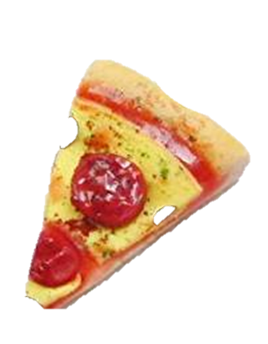
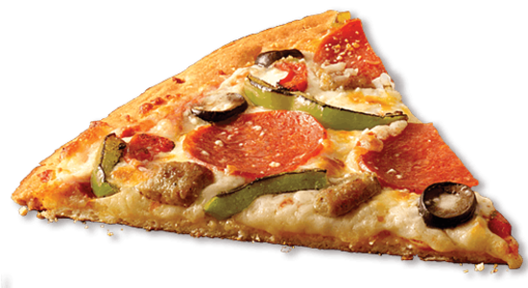
Moment of Misery
What customer Expects
What customer gets
Notes:
Ask: Tell me what moment is this?
Elicit the right response.
Transition to the next slide

Slide 21
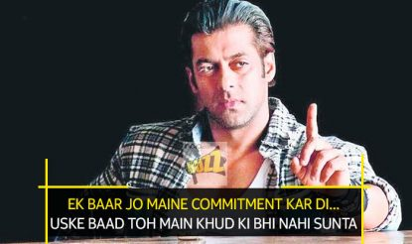
2. Meeting Commitments
Image Credits: Movie Buzz
Notes:
Do you ever say you’re going to do something and then “I’ll do it later” becomes never getting around to it. If you’re like most people, you do this in small ways throughout your life and while often unintentional- it comes at a cost.
You tell somebody you’ll call them later and then you don’t.
You put an item on your daily to-do list and don’t complete it.
You commit to doing something for someone else and don’t follow through.
All of this might seem harmless done once or twice. But little things done repeatedly have a big impact on our lives. Every time you don’t honor a commitment that you’ve made to yourself or someone else, it’s a message to your subconscious mind and to the world around you that what you say can’t be trusted, that your word doesn’t mean much. It prevents you from achieving your goals and eventually causes people not to trust you or think you’re full of shit. And just as bad- you lose respect for yourself.
On the other hand, honoring your commitments gives the words that come out of your mouth power. They actually mean something. Honoring your commitments can simply be defined as follows: You do what you say you’re going to do when you say you’re going to do it. Despite its simplicity, there’s great power to be found in honoring your commitments.
Like anything else in life, this takes practice. You will always have times when you are not able to be impeccable with your word. But as the words that come out of your mouth and physical reality start to align, you tap into the power to speak things into existence. You start to take control of designing your life.
Honoring your commitment is one of the unquestioned trait of a professional that strives for excellence.
Transition to the next slide

Slide 22






Thank You
98752-08472
Hello@freelancetrainings.com
www.freelancetrainings.com
406, Titanium City Centre Mall, Anand Nagar, Satellite, Ahmedabad-380015

