Slide 1
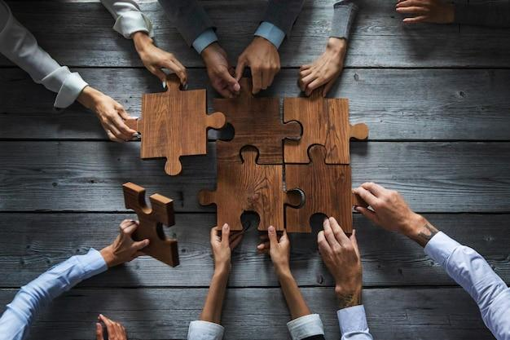
Company Values- 2 Days
Notes:
Note: Please open this slide in the slideshow mode and use to welcome the participants in the class.
These 4 Values that we are covering in this workshop are based on Industry good practices and trainer can customize this presentation in 2 ways
For companies that don’t have any defined values the presentation can be used as it is.
For companies that have pre defined values Trainer can co-relate the same with the 4 Values shared here. E.G Collaborative can be easily used for Team Player as a values
Please don’t forget to customize the examples of each value based on your discussion with the client.

Slide 2
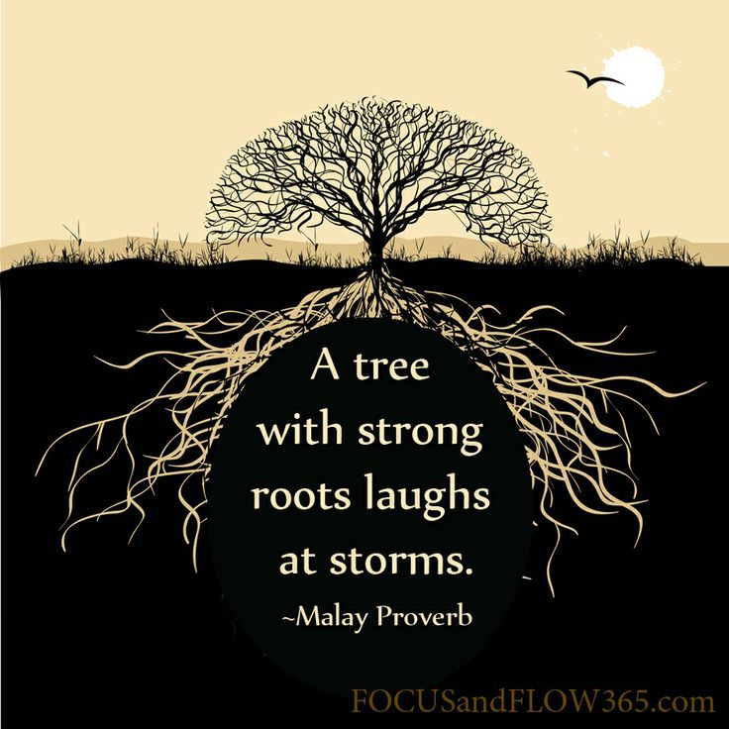
What Value Am I?
Notes:
Note: This is an icebreaker activity.
Say: We are going to play an interesting activity! It is called ‘What Value Am I.’
I need each one of you to think about one value that you can closely associate yourself with. It doesn’t matter personally or professionally. The value that we identify ourselves with the most stay with us in every walk of our life.
So here’s what you are going to do: I want the whole group to come in front of the class. The captain of the group will tell us their group name. then every individual needs to do the below!
Step 1: Tell us your name and your title (E.g. Riya Shah, Customer Service Associate)
Step 2: The value you associate yourself the best with and Why?
Step 3: 3 expectations you have from this training program as a group. The Captain can state it for each group.
Note: You (the trainer) will need to give an example of what value you are.
Say: Let me start with myself. For example –
I am Sidharth Bhandari. I am the Founder, Director & Master Trainer with Creating Impact Training & development.
The value I think I am is ‘Patience’ because I feel I demonstrate patience with most people and in most situations of my life. It has helped me grow in my personal relations and in my professional life especially to accept people and understand them better.
Ask: got it?
Let’s start, shall we?
Note: Do this with the whole class.
Also, you may write down their expectations and align them with the scope of the training program.
Note: After you finish doing the exercise with the whole class; say the below:
Ask: Why do you think we did this exercise
Elicit response.
Say: The reason is that the training today is based on values.
So I would like to do a quick group activity with you.
Are you ready?
Transition to the next slide.

Slide 3
Core Values- Agenda- Day1 & 2
COLLABORATIVE
ACCOUNTABLE
RESOLUTE
EXCELLENT
FAIR
INNOVATIVE
NIMBLE
Notes:
Say: These are 7 values and the trainer can add/delete any value depending on the discussion with the client but these are the standard values
Note: Pick randomly 7 participants to read each value.
Say: please note that each of these values is so vast that it is a 1-day training program in itself. But we have only 1 day with each other. So let’s do our best to understand them and their practical applicability at your work stations!
Transition to the next slide.
Trainer is free to add company’s values after discussion with the client. The above abbreviation stands for CAREFIN just for the participants Revcall. Below are some additional options for the same
(Caring, Accountability, Respect, Empathy, Fairness, Integrity, Nobility)

Slide 4


Value 1 - COLLABORATIVE
Work together with various entities in achieving overall objectives/goals.
Notes:
Ask: What does collaboration mean to you?
Elicit response.
Say: Correct. It means coming together to do something. In the case of the video, it was all the fish jointly coming together to break free from the net in which they were trapped.
Ask: What is this ’something’ mean in your case?
Elicit response.
Say: it is as simple as – coming together to run a company.
In other words each one of you sitting here is running this company. It is exactly why you are expected to practice this value ‘Collaboration’ to work together, in harmony, in sync to achieve the organizations goals, vision and mission.
The - definition of Collaboration is on similar lines.
Transition to the next slide

Slide 5

Why Is Interpersonal Effectiveness Of Employees Important For The Organization?
People drive business and hence whatever impacts people will ultimately impact the business results.
Organizations work as teams and effective teams can achieve more.
Better interpersonal relationships lead to more motivated and productive employees.
Effective interpersonal relationships are directly related to achievement of results and a positive culture.
Notes:
Say: A good professional always thinks macro. Your ability to think from the business or organizations perspective will give you a huge advantage always.
Which is why, let’s understand why interpersonal effectiveness of employees is important for organizations.
Ask: Why are we discussing this?
Elicit response.
Say: So you know what you lack and what you should build on.
I need you to pay close attention.
Note: Explain each of the stated points. The trainer needs to keep connecting interpersonal effectiveness to collaboration. They are very closely and indispensably related. Bring the connection so that you don’t seem to deviate from the Value – Collaboration.
Transition to the next slide

Slide 6

2. What Is Empathy?
Empathy:
It is the ability to see the world as another person, to share and understand another person’s feelings, needs, concerns and/or emotional state.
Notes:
Say: 'Empathy is the ability to see the world as another person, to share and understand another person’s feelings, needs, concerns and/or emotional state.'
Empathy is to be able to feel the exact same feelings as the other person. Sometimes we say, “putting yourself in the other persons shoes.”
Put yourself in the other person’s shoes and think about how they will feel about what you are telling them; how would you feel if the roles were reversed?
Say: Empathy is a selfless act, it enables us to learn more about people and relationships with people - it is a desirable skill beneficial to ourselves, others and society.
Empathy is a skill that can be developed and, as with most interpersonal skills, empathising (at some level) comes naturally to most people.
Have you heard of Sympathy? Is there a difference between Empathy and Sympathy? What is the difference?
Elicit answers from participants.
Say: There is an important distinction between empathy and sympathy. We offer our sympathy when we imagine how a situation or event was difficult or traumatic to another person, we may use phases like, ‘I am very sorry to hear that’ or ‘If there is anything I can do to help…’, we feel pity or sorry for the other person.
Empathy really means being able to understand the needs of others. It means that you’re aware of their feelings and how it impacts their perception. It doesn’t mean you have to agree with how they see things; rather, being empathetic means that you’re willing and able to appreciate what the other person is going through.
Very often, shared experiences trigger empathy.
For eg - Imagine a colleague is going through tough time in his/her personal life. It’s causing a lot of stress, his/her productivity has fallen and deadlines are missed. He is unable to gather himself. Now imagine that you have gone through a similar situation. How would you react to this colleague?
In all probability, you might try to relieve work pressures and offer to help out where you could. Because you know how it “feels” to be in a tough situation.
Imagine a colleague has won an award for the best performance in the last quarter. How would you react especially when your numbers aren’t looking too good?
Elicit a discussion on similar situations and get participants to bring out empathy situations. Note that empathy situations are not all sad.
Transition to the next slide

Slide 7

Activity – Best Compliments
Notes:
Note: This is a group activity.
Get every participant to write their respective name on a sheet of paper.
Each of these sheets is circulated to the other team members. Team members need to write down down 2 -3 nice things about the other team members on their respective sheets of paper.
After they finish writing; each member gets the sheet which has his name on it (on which other team members have written words of appreciation for him / her.)
Note for the trainer: Let the participants read what is written on their sheet.
Ask: How did you feel?
Transition to the next slide

Slide 8
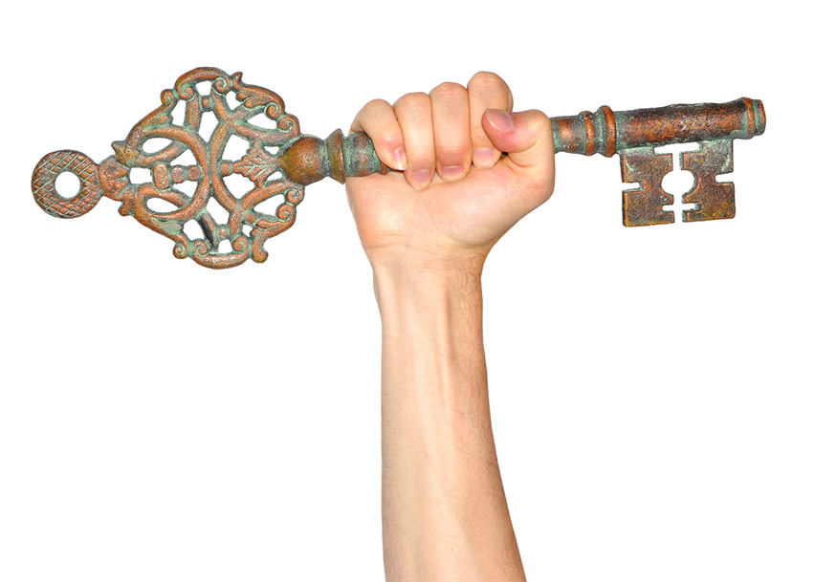
Value 2 - ACCOUNTABLE
Be answerable in a responsible manner to customers, vendors, regulators and investors.
Notes:
The next Value is Accountable
Say: this is how your organization defines Accountability.
Note: Make a participant read this aloud.
Note: get any questions clarified before you move ahead.
Transition to the next slide.

Slide 9
Make a note of all those elements that are in your circle of concern and in your circle of influence
Individual Activity
Circle of Concern
Circle of Influence
Notes:
Say: This is an individual activity.
You have 10 minutes to do this.
Note: get into a discussion with the class at the end of this activity.
Give points if applicable.
Transition to the next slide.

Slide 10

2. Avoiding Making Excuses and Blame Games
Notes:
Say:
All of us encounter problems while we are working.
Professionals that take accountability, own the tasks. When things don’t work out they do not blame anyone. They do not shrug off and make excuses. Instead they do just the opposite. They take personal responsibility to taking to task to it’s final execution. But for some reason that is not possible, they own up; learn from their mistakes and move on. That makes them nimble (a value we learnt about) and modest!
There is a famous quote which says – “You can either blame or get better.”
Please understand that excuses is only a way of denial and blame game cannot take you anywhere – not maturity wise or in building relations nor in getting the work done!
Ask: What do you think Virat Kohli does in his public statement when he loses a game?
Does he blame the his team? Does he blame the other team?
Elicit a discussion till they get the point that he has always assumed responsibility of the mistakes and moved on to learning from it!
Transition to the next slide.

Slide 11

Value 4 - EXCELLENT
Try and excel and be outstanding in whatever we set out to do.

Slide 12
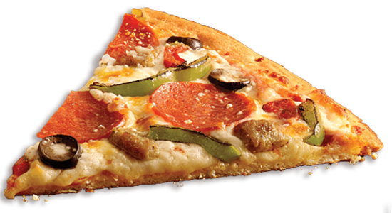
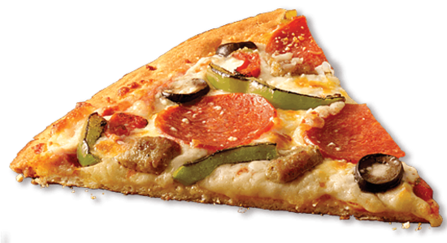
Moment of Mediocracy
What customer Expects
What customer gets
Notes:
Ask: Tell me what moment is this?
Elicit the right response.
Transition to the next slide

Slide 13

The Extra Mile
3.
Notes:
Note: use this platform to discuss episodes where the participants went the extra mile to serve a stakeholder or someone went for them (this could be them as customers as well.)
Make it interactive to drive home the point.
Transition to the next slide

Slide 14


Value 5 - FAIR
Being Fair to Stake Holders, Internal and external customers and regulators.
Notes:
Say: that is right – fairness in everything we do at work can make us a very reputable organization and improve our goodwill as professionals.
That is what our first value is –
Transition to the next slide

Slide 15

Some Examples In your Organization…
Trainer needs to discuss the same with the client. These specific examples will be shared by the client only- Mention this as a note over the slide
Notes:
Trainer needs to discuss the same with the client. These specific examples will be shared by the client only- Mention this as a note over the slide
Facilitate a discussion before discussing the examples.

Slide 16

Value 6 - INNOVATIVE
Innovating new ideas and methods to improve banking services.
Notes:
Say: This is the next value of -Innovative

Slide 17



Types Of Innovation
Breakthrough Innovation
Revolutionary Performance in existing category
Disruptive Innovation
Creates a new market or a new category and eventually disrupts an existing market and category
Incremental Innovation
Improve existing Product & services; Better, Faster & Cheaper
Notes:
Note: Trainer can give any example from the IT space.
Say: Breakthrough Innovation This is a meaningful change in the way you work that gives something demonstrably new (beyond "new and improved"). Breakthrough innovation produces a substantial competitive edge for a while, although the length of time anyone can maintain such an advantage is growing increasingly shorter. Examples: the automobile, the light bulb, and the Internet.
Disruptive Innovation : A disruptive innovation is an innovation that creates a new market or a new category and eventually disrupts an existing market and category, displacing established market leaders and alliances. The term was defined and phenomenon analyzed by Clayton M. Christensen beginning in 1995.
Examples:
Personal computers - Mainframe and mini computers
Mini mills - Integrated steel mills
Cellular phones- Fixed line telephony
Community colleges - Four-year colleges
Discount retailers - Full-service department stores
Incremental Innovation : This consists of small, yet meaningful improvements in your products, services, and other ways in which you work. These tend to be the "new and improved" innovations we are all bombarded with every day: new flavors, shifts to better or all-natural ingredients, packaging improvements, faster/slower functioning, just-in-time supply chain enhancements, bigger/smaller sizing, cost reductions, heavier/lighter weight. They can be easily visualized and quickly communicated and give you something new with which to grab attention in an increasingly noisy workplace.
For example: - Google’s release of Gmail, heralded by many as the best internet mail service, is an example of such dedication to incremental innovation. When Gmail launched it had a limited feature set but did one thing very well, delivered emails. Unlike competitors it was clean and easy to use with no distracting flash ads and numerous interface improvements. Over time Google released more features and made the service better, faster, and easier to use. Years later Gmail was taken out of “beta” and finally listed as being “complete,” though to this day improvements continue to happen. The company has used this exact same policy multiple times with their new products, from their Maps service to the browser Chrome. Their dedication to continuous improvement in a way that meets market demands keeps them:
Relevant to the consumer
Continually making their product more competitive
Focused on cost reduction (i.e. less bandwidth usage though more efficient code)
Given the kind of profile that you are into, the focus of this workshop will be on incremental innovation & not on revolutionary innovation. (Trainer to make this clear that this is to help them improve on a continuous basis – their self, their processes, the codes that they write & so on.. so that the cumulative effect is huge. At the end of the workshop, they are not expected to make breakthrough innovation.) Innovation is the essence of growth…. It is the one thing that brought us from the stone age to the current age of technology….. But remember that being innovative doesn’t mean we have to go to Himalaya and think about the next big idea…. It is allowing our mind to wander and think beyond the possibilities… it is not something we need to learn. There is no course in this world that you can teach you to be innovative… the only way to develop it is to believe that better is possible and you have the ability to do something differently!! I am not here to give you any short formula to think innovatively….. All I am going to do is trying to remove some mental barriers that stop us from being innovative and discuss how to go about executing them…
Say: innovation for you means the following:
Innovative in providing best experience to your customers.
Innovative in providing quality of service to your customers.
Innovative in integrating social values into operations.
Innovative in designing a tech based process which is cost effective to organisation, time effective to the staf

Slide 18

Value 7 - NIMBLE
Be quick and adaptable to changing technology and market requirements.
Notes:
The next value is Nimble

Slide 19
Personal Change Model
Resistance
Exploration
Internal
Personal Change Model
Behaviours
Denial
Commitment
External
Time
Notes:
The Change Curve
Change is never smooth and easy; it involves a lot of turbulence and if it is to be represented graphically it can never be a straight line. As soon as a change is proposed stress and negative emotions rise to a peak before the change gets acceptance and normalcy is restored. It’s important to understand the change curve and the typical reactions that you will display during the different stages of the change process. A change curve goes through four noticeable stages, and here’s more information on each of these stages. This is called as the Personal change model. Whenever we are subjected to change, we all go through this process. Some professionals that are more effective than others, usually because their journey from denial to commitment is much quicker in comparison to most average professionals that get stuck either in denial or resistance.
1. Denial
For most people in denial change is not easy to accept, and they react to change with a shock. In the first place most people do not believe that the change is happening for real and try to ignore thinking and talking about it. This denial is mostly on an internal level and to avoid showing off the denial people focus their attention on anything but the change. Since change is interpreted as uncertainty, people shift their attention to the past and familiar feelings that make them feel secure.
Resistance
Resistance to change begins as people realize that the change is actually taking place and there is no way to avoid it. During this stage of the change curve feelings like anger, self-doubt, fear and anxiety can build up, which can significantly stagger the progress of the change process, besides causing the morale and productivity to take a nosedive. This emotional mayhem is because people are being pushed out of their comfort zone. Arguments, blame game, and non-cooperation are some ways in which the professionals may show their resistance to the change.
Exploration
The next stage of the change curve is the exploration phase where the team members leave out their arguments and instead become a part of it. This is where people start acting and learning new ways so as to constructively contribute towards the change. A fresh wave of thinking sets in where people understand the rationality of the change process and the importance of their role in the change process. What’s worth noting here is that even though people may have started contributing towards the change they may still not have completely accepted the change at this stage. It’s mostly an explorative stage where people are experimenting with the change to find out what is in store for them, in the overall change process.
Commitment
Commitment is the final stage of the change curve, when productivity and emotional normalcy would have been completely restored. People feel more in control as they settle down into their new roles. Work activities return to normal as people begin to co-operate whole heartedly.

Slide 20

Our Perception to Change
Notes:
Say: One of the major reasons why we resist and are so averse to change is because how we build it up in our minds. In other words how we perceive change.
Let’s assume the following changes are being implemented. I need you to tell me what your reaction will be – Positive or Negative:
Note: Ask people to display their reactions with thumbs down for a negative reaction and thumbs up for a positive reaction.
Your work timings are now from 8 am to 2 pm everyday. You are free to go home after that.
You need to sell 1 new product everyday. Inability to do so will reflect on your promotion.
You will get 2 bonuses in a year.
You have to attend 3 new training programs for 3 weekends a month for the next 2 years. A contract will be signed with you.
You will have half the targets but double the incentives.
You have to mentor a poor performer and if you don’t do a good job, poor appraisal.
You will work 5 days a week and are free to work from home anytime you want.
Say: We gave a thumbs up or a thumbs down to a certain change basis what we think was beneficial to us. But could there be a possibility that our understanding of what is beneficial to us is limited?
Ask: Have there been times when you went through a tough situation, emerged victorious and then thought to yourself – ‘I’m glad it happened, I learnt so much from that experience!”
How we look at change is all about our perception. Most times we perceive it to be for the worse.
Note: click the image.
Say: it may be a cat but we perceive it at a deadly lion. We feel afraid and apprehensive. We start off on a wrong note.
Ask: But is all change bad?
Say: no. Another way to look at change is learning something new.
Think of the first day you went to pre-school (or your child)
There was crying, tantrum throwing, sadness. But was it essential for getting educated.
It is exactly like that. A lot of new changes will come will learnings. Some will teach you what to do and make you a better professional. Some will teach you what nOt to do and make you, yes, a better professional.
Again. Understand that a change is introduced to bring a positive shift. At least that is the intention. It is never to torture you. The management of your organization is dealing with business battles and competition in the market place everyday. Changes are brought about to rise the situation. You need to be on board quick and support the organization which you are an important soldier off.
The change may back fire. But know that that was not the intention. While not all change may be beneficial, a lot of them are. They help us expand our horizons and perspectives as professionals.
So rather than being afraid of it, dive into it. The sooner you do so, the better it is for you. Else, you will be left behind. Change waits for no one. But intelligent professionals understand this and adapt quickly!.
Transition to the next slide

Slide 21






Thank You
98752-08472
Hello@freelancetrainings.com
www.freelancetrainings.com
406, Titanium City Centre Mall, Anand Nagar, Satellite, Ahmedabad-380015

