Slide 1



Campus to Corporate Workshop -2 Days
Notes:
Facilitator’s Notes:
Trainer to say in the loudest voice “Hello, Good Morning”. Then the participants will say ‘Good Morning’ in reply.
Trainer to say once again in the loudest voice “Hello Good Morning”. Trainer should speak in an energetic, passionate and enthusiastic tone. This activity/gesture will set the tone and energy for the session/workshop
Trainer: Well done friends! Great job! (Clap Loudly and tell the participants to clap as well for the superb performance.)
Trainer: I'm excited to be here with you all today and appreciate your presence. I hope you're all doing well and are ready to dive into the material.Move to next slide.

Slide 2
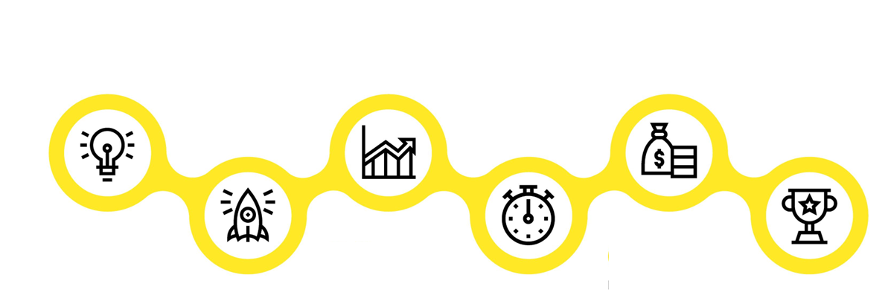
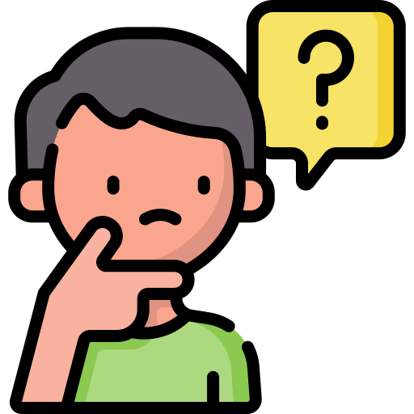





Agenda of Workshop- Day 1
Module 1
Module 3
Module 5
Campus to Corporate-
Personal Effectiveness
Impactful
Communication
Goal Setting
Module 2
Module 4
Module 6
Building an Attitude
of Ownership
Building a Fool Proof Communication
Being a Team Player
Notes:
The agenda of todays workshop is as follows
Understanding Brand & Personal Effectiveness
Building an attitude of Ownership at workplace
Impactful communication
Building Fool Proof Communication
Goal Setting
Being a Team player

Slide 3
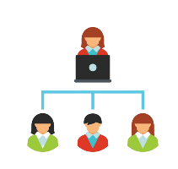
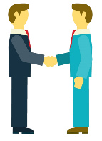



Agenda of Workshop- Day 2
Module 1
Module 3
Module 5
Managing Stakeholders
First Impression is the last Impression
Email etiquette
Module 2
Module 4
Recap/Revision
Manging Time & Prioritisation
First Impression is the last Impression Part-2
Notes:
The agenda of todays workshop is as follows
Managing Stakeholders
Managing Time & Prioristising
First Impression is the Last Impression-Part-1
First Impression is the Last Impression-Part-2
Email Etiquettes
Recap

Slide 4

Who is a stakeholder?
Any person/ department who has an impact on your work performance
This can include employees, customers, investors, suppliers, government agencies, etc
Stakeholder Management is maintaining good relations with your stakeholders and keeping them engaged
Notes:
As your career develops, and you become more successful, the actions that you take start to affect more and more people. And the more people you affect, the more likely it is that some of them will have significant power and influence over your work.
These people are your stakeholders. They could be strong supporters of your projects – or they could block them. So you need to identify who your stakeholders are and win them over as soon as possible.
Knowing our stakeholder and their expectation from us regarding the project or our daily work will help us plan and prioritise our work efficiently. This will also keep the stakeholder satisfied and in loop.
Lets move to next slide and understand stakeholder management better.

Slide 5
Stakeholder Matrix
High
Keep Satisfied
Manage Closely
Stakeholder Matrix
Power of Influence
Monitor
(Minimum Effort)
Keep Informed
Low
Low
Level of Interest
High
Notes:
The stakeholder management matrix is a tool used to analyze and prioritize stakeholders based on their level of influence and interest in a project that you are executing. It is a grid with four quadrants, with the level of influence represented on the horizontal axis and the level of interest represented on the vertical axis.
By using the stakeholder management matrix, you can prioritize their efforts and resources to engage and manage stakeholders effectively, ensuring that their needs and concerns are addressed appropriately.

Slide 6

URGENT
IMPORTANT
Urgent V/s Important

Slide 7

Urgent V/s Important

Slide 8
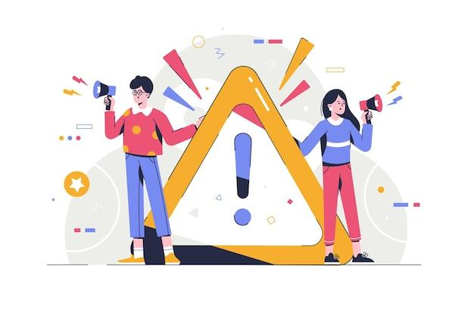
Quadrant 2 -Urgent and Important – CRISIS
Fire-fighting & pressing problems
Immediate Deadlines
Equipment breakdowns
Client complaints
Compliance Issues
These are things we have to manage right now and have a relatively short-term focus.
They are either emergencies that you couldn’t predict or those that you’ve left until the last minute and have reached crisis point.
Notes:
Trainer Explains the 2nd quadrant with Examples https://www.groupmap.com/portfolio/urgent-important-matrix
Urgent and Important – Crises
Important and Urgent activities are either emergencies that you couldn’t predict or those that you’ve left until the last minute and have reached crisis point.
These are things we have to manage right now and have a relatively short-term focus.
Important and Urgent tasks might include:
Fire-fighting & pressing problems
deadlines
Equipment breakdowns
Client complaints
Items from Q1 that weren’t dealt with
By spending more time in Q1, developing systems and plans, you can make many of these tasks more efficient or even eliminate them outright.

Slide 9
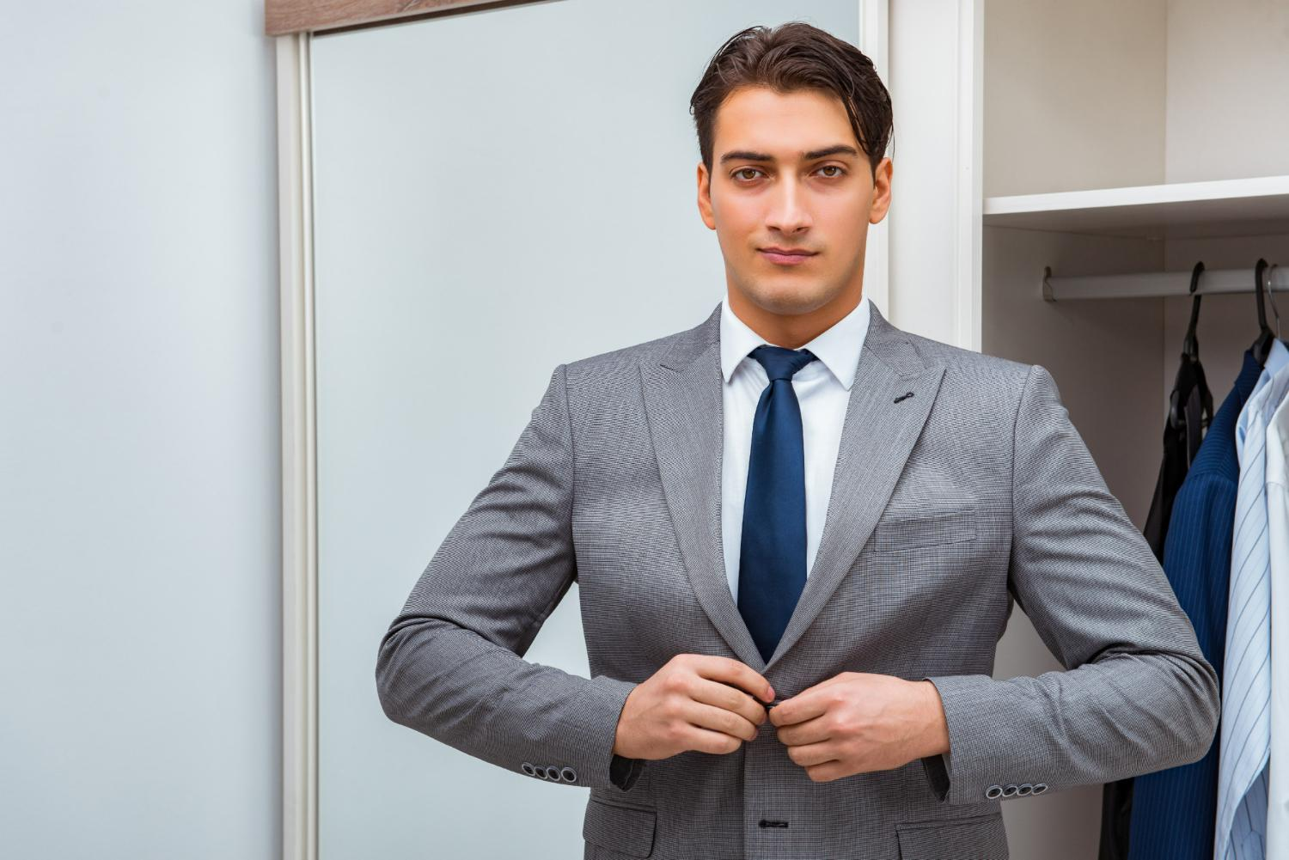
Corporate dressing for Male
  Oil or gel your hair regularly
  Hair length should not be below the shoulders
  Either have a clean shave/ trim your moustache and beard
  Avoid wearing chunky necklaces or too many bracelets to work.
  Your tie should contrast with shirt and complement your overall look
  Always Wear well fitted Clothes
  Don’t Wear Tatoos/ Earrings (Only worn if they are tiny size)
Notes:
Oil or gel your hair regularly so that it is neat
The hair length should be till the shoulders and not below
Keep a shoe shiner handy.
Prefer dark leather shoes (Black or Brown) with black laces.
Wear dark coloured socks to work.
Do not wear sports shoes or sneakers to work.
Remove all other rings except your wedding ring.
Remember, there is a huge difference between your college and professional life.
College were the days when nobody told you anything when you wore ripped jeans, T shirts, sneakers, hats and proudly flaunted your tattoos and body piercings.
If you wear an earring, remove it immediately.
Tattoos and body piercings are not at all acceptable in a professional environment.
If you have a moustache, make sure it is neatly trimmed.
Do not attend office with beard unless and until there is an emergency.
Remember, your tie should complement your overall look.
Silk ties are always a safe bet. Do not wear ties in loud colours or jazzy patterns.
The tip of your tie should touch your belt buckles.
Do not wear flashy belts with broad buckles. Wear leather belts in dark colours preferably black or brown.
Wear socks that match your pants

Slide 10
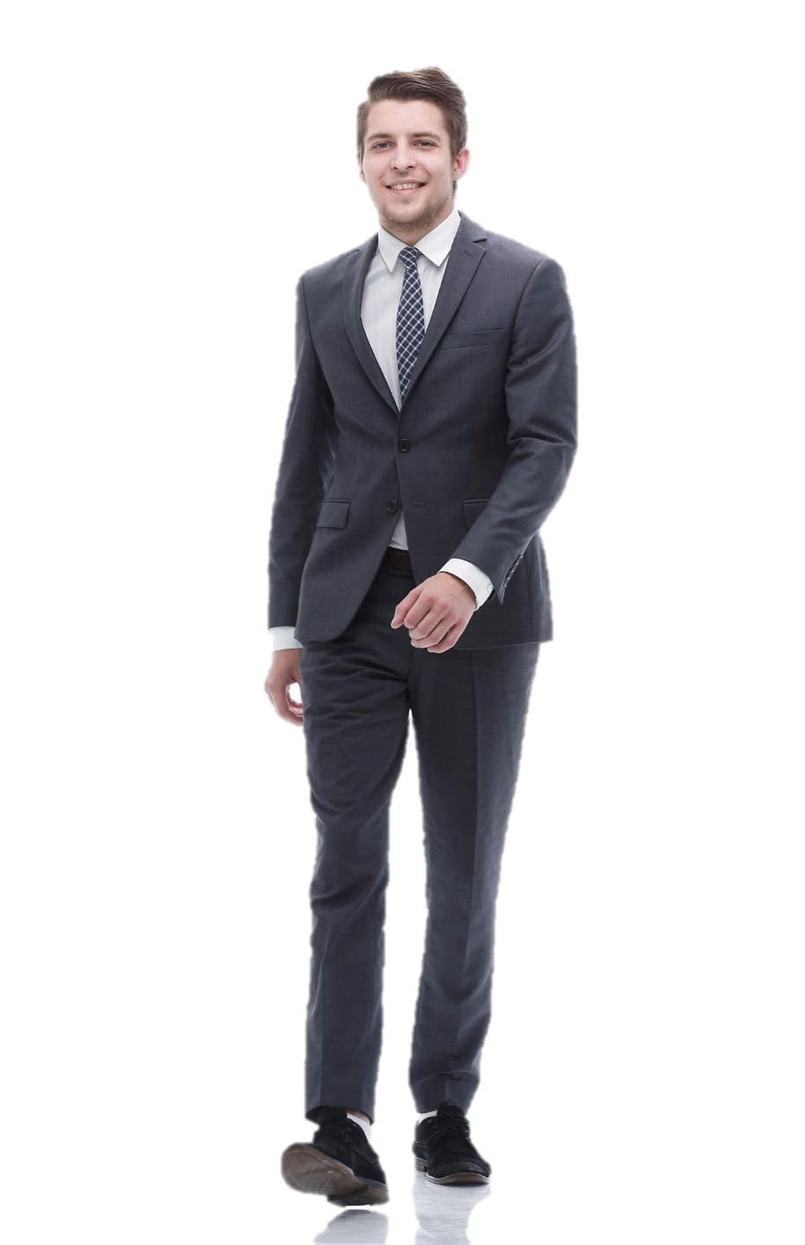
Corporate dressing for Male –Contd…
  Neutral colors of shirts such as blue, grey, white, khaki, black are guaranteed hits in a corporate setting
  Small Checks & Vertical Stripes are also a good choice
  Blazer can be blue/black, as per the latest season
  Trousers are usually of dark colors Blue/ Black /beige/grey and in contrast with shirt color
  Your tie should contrast with shirt and complement your overall look.
  Make sure your sleeves touch the base of your hand. Do not roll up sleeves at work
Notes:
Avoid wearing party shirts to work.
Do not wear loud colours or patterns that are too bold.
Subtle colours look good in offices.
Plain shirts are always in style but you can also go for shirts in stripes, checks or micro-checks.
Colours such as red, yellow, orange usually are not preferred to be worn at the workplace.
shirts look professional. Make sure your sleeves touch the base of your hand. Do not roll up sleeves at work.
Take care of the fit of the trouser.
Slim fit or flat front trousers in solid colours such as grey, black, blue look best at workplaces.
Avoid baggy trousers as one looks lazy and sloppy in the same. Your shirt should not be too tight.
You should be able to button your shirt properly without any gaps.
Clothing should be clean, wrinkle free and ironed.
Keep a shoe shiner handy.
Prefer dark leather shoes (Black or Brown) with black laces.
Wear dark coloured socks to work.
Do not wear sports shoes or sneakers to work.
Remove all other rings except your wedding ring.
Remember, there is a huge difference between your college and professional life.
College were the days when nobody told you anything when you wore ripped jeans, T shirts, sneakers, hats and proudly flaunted your tattoos and body piercings.
If you wear an earring, remove it immediately.
Tattoos and body piercings are not at all acceptable in a professional environment.
Do not attend office with beard unless and until there is an emergency.
Remember, your tie should complement your overall look.
Silk ties are always a safe bet. Do not wear ties in loud colours or jazzy patterns.
The tip of your tie should touch your belt buckles.
Do not wear flashy belts with broad buckles. Wear leather belts in dark colours preferably black or brown.
Wear socks that match your pants

Slide 11
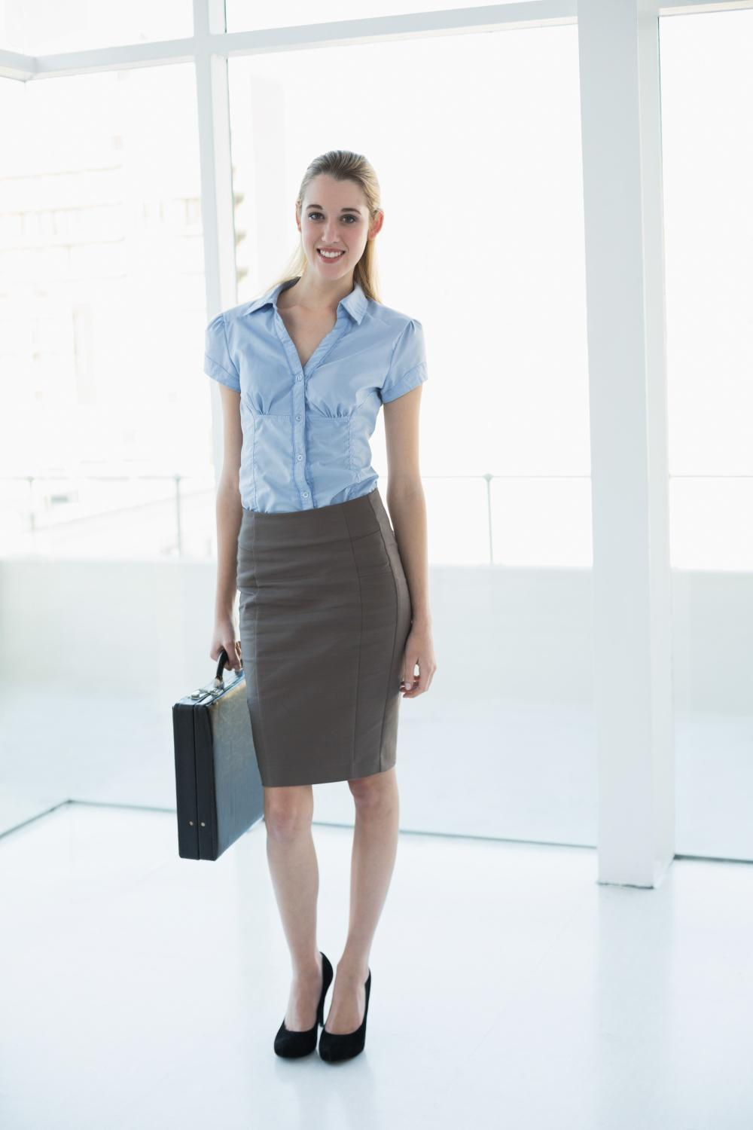
Corporate dressing for Female
  It is always wise to dress according to your office culture and clothes shall be well fitting.
  Shirt should be preferably in light shade and properly tucked into the trouser.
  Skirts should touch the knee or below
  Female executives should avoid wearing heavy jewelry to work- Avoid anything that dangles/ makes sound causing distraction.
  Choice of western formals (Blazer+ Skirt/Blazer+ Trousers) or Indian formals (Saree/ Salwar Kameez)
Notes:
It is always wise to dress according to your office culture.
Business suits look best in colours like Blue, Black or Charcoal grey.Business suits constitute a crisp shirt teamed with a matching trouser
Avoid wearing loud colours to work. Colours such as hot pinks, reds, deep purples look odd at the workplace. They are meant to be worn at parties and get togethers with friends.
Animal prints and jazzy designs are not meant for offices.
Stud earrings look simple yet elegant on female professionals.
Do not wear chunky necklaces, large earrings and stacks of bangles at workplace. Flaunting your gold jewellery at office is foolish. Do not wear ring on every finger. Avoid wearing multiple bracelets. An elegant and simple watch looks best on professionals.
A nude look works best in offices. Don’t overdo your make up. I
Instead of a bright lipstick, a lip-gloss looks better and you can even reapply the same whenever needed. Minimal make up can not only make you look good but also extremely professional. Never apply layers of foundation on your face. Avoid cakey make up at workplace
Messy hair is not at all acceptable at workplaces. Do not adopt weird hairstyles at work..
Your heels should not be more than 2 inches.
Ask what is casual dress code ,take responses

Slide 12

Corporate dressing for Female -Contd
  Do not wear loud make up to work. Use lip colours of softer shades. Prefer lip gloss to lip stick. (avoid red, dark pink, orange lipsticks.)
  It is important to smell good at the workplace. Keep a mild perfume handy.
  Make sure your hands are clean and nails properly trimmed and manicured.
  Hair should be neatly combed and properly tied.
  Wear flats or platform heels to work.
Notes:
It is always wise to dress according to your office culture.
Business suits look best in colours like Blue, Black or Charcoal grey.Business suits constitute a crisp shirt teamed with a matching trouser
Avoid wearing loud colours to work. Colours such as hot pinks, reds, deep purples look odd at the workplace. They are meant to be worn at parties and get togethers with friends.
Animal prints and jazzy designs are not meant for offices.
Stud earrings look simple yet elegant on female professionals.
Do not wear chunky necklaces, large earrings and stacks of bangles at workplace. Flaunting your gold jewellery at office is foolish. Do not wear ring on every finger. Avoid wearing multiple bracelets. An elegant and simple watch looks best on professionals.
A nude look works best in offices. Don’t overdo your make up. I
Instead of a bright lipstick, a lip-gloss looks better and you can even reapply the same whenever needed. Minimal make up can not only make you look good but also extremely professional. Never apply layers of foundation on your face. Avoid cakey make up at workplace
Messy hair is not at all acceptable at workplaces. Do not adopt weird hairstyles at work..
Your heels should not be more than 2 inches.
Ask what is casual dress code ,take responses

Slide 13
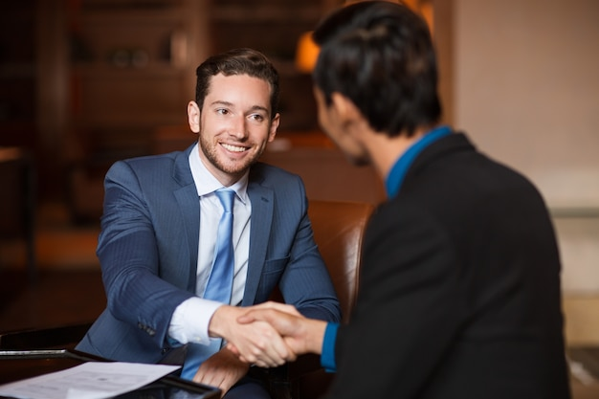
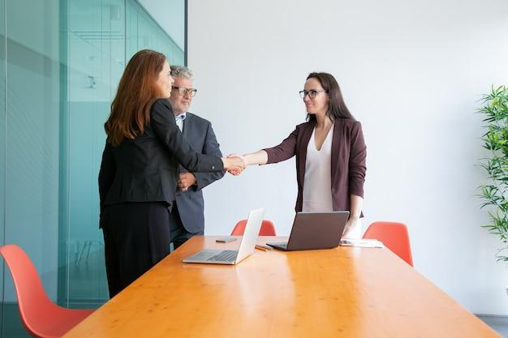
Introduction
  Hello Ma’am, I am RAM Kumar, ABC Ltd. It’s pleasure to meet you.
  Good morning everyone! My name is Ram Kumar, ABC Ltd. How may I help you?
  Younger/junior/lesser important people are introduced to older/senior/more important people
  Junior ranking professionals to senior ranking professionals & Business contacts, boss and staff to clients
  Personal acquaintances/family members to business professionals in any business function
  Ram (subordinate) meet Mr. Doshi (client) who is our esteemed customer.
  Sam sir (boss), this is Mr. Srivastav our customer from the Baroda branch.
Introducing Self
Introducing Others
Notes:
This slide is self Explanatory-
Trainer to focus on Introducing others- especially the hierarchy- As this might be a new for participants to understand

Slide 14
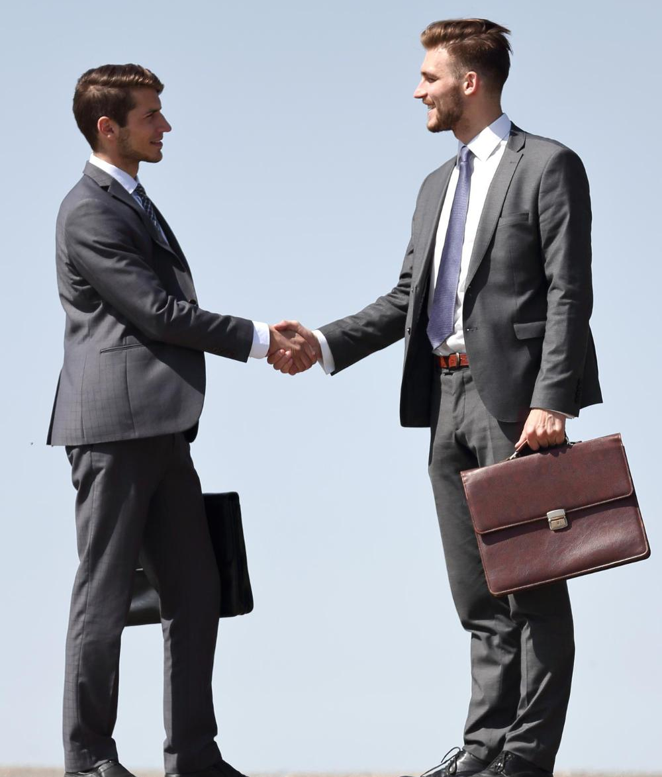
Professional Handshake
  Culture Specific (Namaste/Shake hand)
  Make sure your right hand is open so the lower joint of the thumb of both parties touch to ensure firm grip.
  The grip should be firm--not limp or so strong that it hurts the other person. Firm Handshake shows Credibility, Confidence & Trust
  Adjust your grip to that of the other person and always stand and shake hand- Don’t do the same while sitting.
  A good handshake has a smooth up-and-down motion.
  Gauge when the person wants to end the shake, and then do so right away. (Ideal time is 2-3 seconds)
Notes:
Say Handshake is the first contact with anyone and hence it lays a very strong foundation of confidence, Trust and as a result a great first impression .Points to note
Handshake is culture specific and in some conservative cultures it is not the handshake that people are comfortable with. Gauge the culture and then either use a handshake or Namaste
Ensure right hand is open and palms touch
Have a firm grim not strong or limp. The firm handshake denotes confidence, credibility and Trust
Adjust grip basis comfort of the other party
Smooth up and down motion are features of a good handshake
Facial expressions and body language will indicate when the other person wants to end the handshake so observe the same and be aware
Ask so what is the right way to give a visiting card ?
Take responses then say ok now lets move to the next slide and learn the same

Slide 15
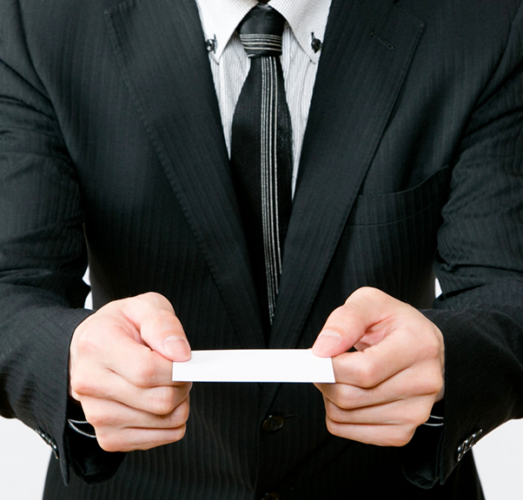
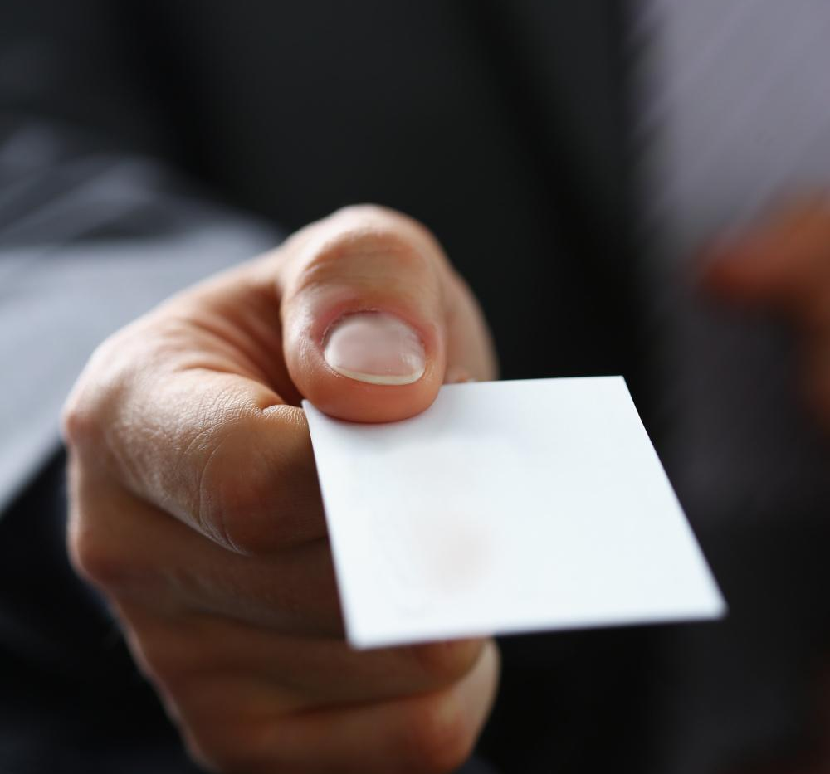
Exchanging Business Cards
CORRECT METHOD OF GIVING & ACCEPTING A CARD
INCORRECT METHOD OF GIVING & ACCEPTING A CARD

Slide 16
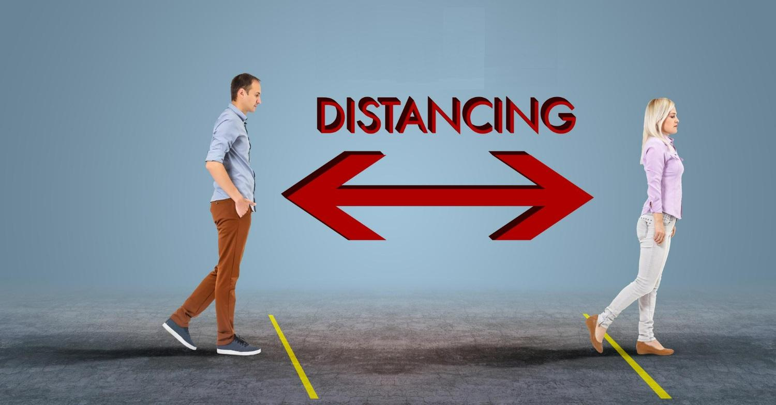
Space
  Edward T. Hall invented the concept proxemics- which mentions the space Etiquettes.
  Four Types of interpersonal distance, or degrees of proximity that we experience
  Public distance- (12-25 Feet)
  Social distance (4-12Feet)
  Personal distance (1.5- 4 Feet)
  Intimate distance (Less than 1.5 Feet)
Notes:
Classical proxemics theory was started in the 1960s by anthropologist Edward T. Hall. 1960s by anthropologist Edward T. Hall. Edward Twitchell Hall, Jr. was an American anthropologist and cross-cultural researcher. He is remembered for developing the concept of proxemics . Proxemics is the study of how space is used in human interactions..
He classified four degrees of interpersonal distance, or degrees of proximity that we experience
Public distance
Social distance
Personal distance
Public distance :At this distance (between 12–25 feet), you must speak louder to be heard, and it’s more difficult to maintain direct eye contact, so the connection between two people is minimal.
Social distance : This distance (between 4–12 feet) relies on visual and auditory cues to form a connection, since you’re still too far apart to touch or perceive body heat.
Personal distance : This distance (between 1.5–4 feet) is kept during interactions with friends. Here, vision is clear, eye contact is strong, and conversation flows easily.
Intimate distance: This distance (less than1.5 feet) is kept during interactions with friends. Here, vision is clear, eye contact is strong, and conversation flows easily.

Slide 17
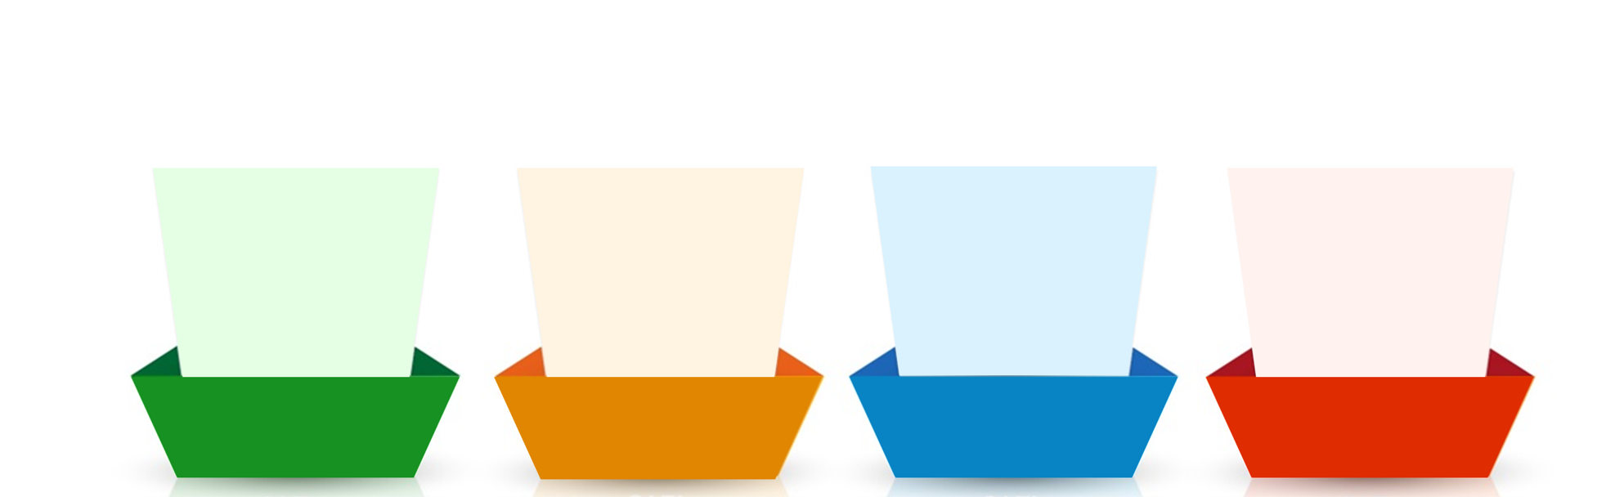
How should an ideal email be?
In intent, message, words and tone
Including all relevant information
To the point and preferably short
Polite, respectful and empathetic
Clear
Concise
Courteous
Complete
Notes:
Trainer:
An effective email has the following aspects:
Clear – As we saw earlier, a lot of misunderstanding and error can be caused due to unclear communication. Therefore, it is necessary to avoid vague responses. Statements like – I will let you know soon or phrases like as soon as you can, as soon as possible, in some time, do the needful etc. can be vague. Also, there must be clarity in the intent, message, words and tone of your email. Answer or ask in a simple, understandable manner. Use simple words and K.I.S.S (Keep It Short and Simple). All information in the email must be genuine
Complete – Your email must contain all the relevant information to the matter at hand so that there is no back and forth of emails. This will also need you to be clear about why you are writing the email and what information you want to share or ask for. Answer all questions and expected questions.
Concise – Your email must be preferably short and to the point. Avoiding unnecessary explanations or lengthy, complex sentences is necessary to maintain clarity and readability. Also, your email must be organized and clean for better understanding. Use shorter, meaningful statements and write to the point. Avoid unnecessary words and complicated vocabulary.
Courteous – As we know, your choice of words is all that matters in an email. Therefore, being polite, respectful and empathetic in your email will help you express your emotion, intent as well as involvement with the matter at hand. Usage of the right words will convey the right tone.
Remember: HOW you write an email shows WHO you are!
Now that we know how an email must be, let us look at the components of an email.
Transition to the next slide.

Slide 18
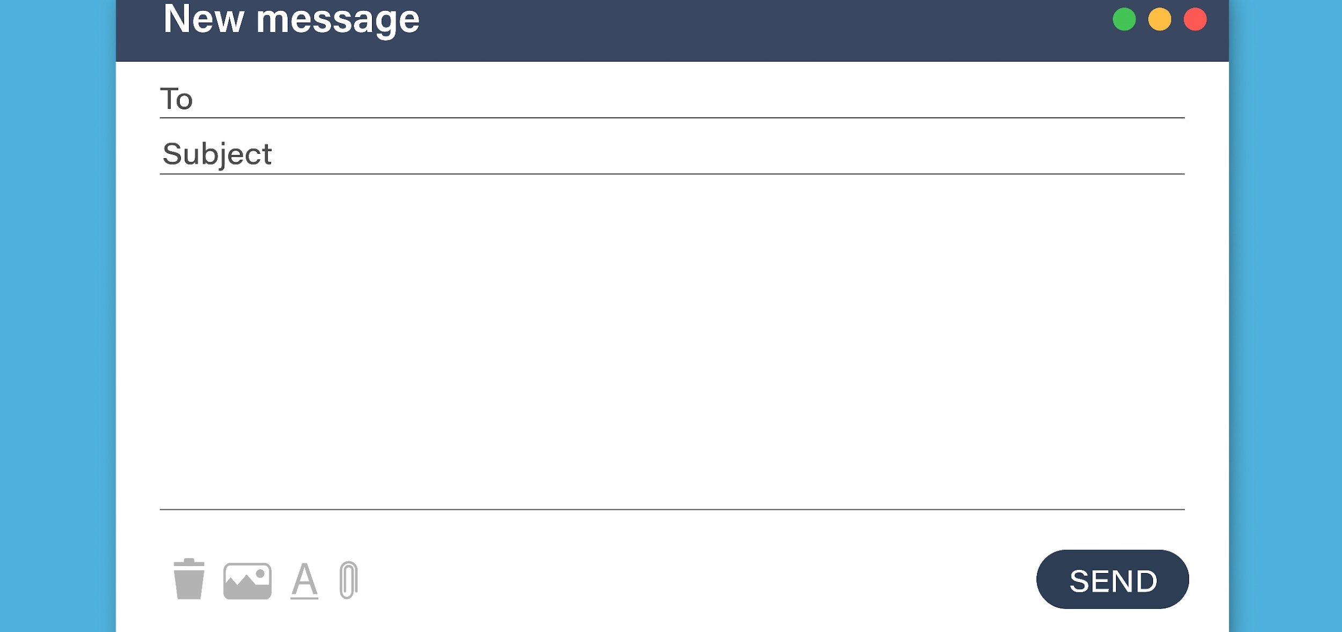
Components/Layout of an email
The Recipient/Address field – ‘To’ is mandatory, and Cc and Bcc are optional.
Subject line
Content box/ Email Body
Attachment
Notes:
Trainer:
Every typical email has some standard components:
The Recipient field – ‘To’ is mandatory, and Cc and Bcc are optional.
The Subject line
The content box/ Email Body
Attachment
Many other components like editing and formatting options depend on the email provider.
Let us look at how to draft an email.
Now, you may say – “I have been writing emails for ages now. What’s new?”
Trainer to ask:
When you are composing or drafting a new email, what is your first step?
Elicit responses. (You could ask each participant for their response)
Transition to the next slide.

Slide 19
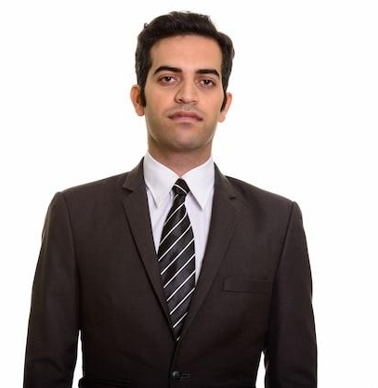
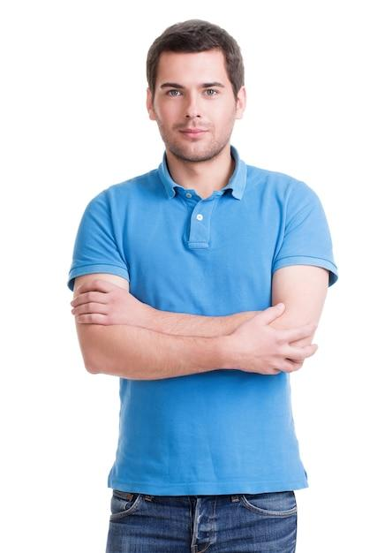

Salutations & Greetings
Hi
Most informal
Dear
Most formal
Hello
Semi-formal
Notes:
Trainer:
Every email starts with a greeting.
Like we pick up the phone every time and say Hello, every email must also start with a pleasantry.
There are 3 types of greetings:
Hi - extremely informal - used with close colleagues and peers
Hello – semi-formal – used with acquaintances, seniors and friendly customers
Dear – most formal – used with conservative, old-school individuals
We usually stick to “Hello” in most of our conversations.
Avoid using Hey! Or What’s up?
In India, the salutation ‘Respected’ is also often used.
But new-age communication doesn’t use this anymore.
However, you could use it while writing to someone that you truly respect or government officials. (respected more for their authority over matters)
Trainer to ask:
What greeting will you use while communicating with a new person?
Elicit responses.
You could use the salutation Dear and depending on the tone of their response, you could move to Hello in your next emails.
Trainer:
How do you use people’s names/titles after the salutation?
Elicit responses.
Debrief:
When you use a title – Mr, Ms, Mrs, Dr, you attach a person’s last name after it.
Usage of titles
Mr – for a man
Mrs – for a married woman
Ms – for any woman (especially if you don’t know if they are married or not)
Dr – for a medical doctor or a person with a doctorate
For example,
Mr. Khan
Ms. Cooper
Mrs. Nair
Dr. Einstein
If you are not using a title, you can use a salutation with a person’s first name.
For example,
Hello Shahrukh
Dear Amy
Hi Deepa
Dear Albert
The salutation and the name is followed by a comma but new-age email writing does need you to add one.
Some people also add a colon “:”.
The opening statement of an email starts after a line’s space.
Time-based greetings such as good morning/afternoon/evening is ok if you know the time zone of the reader.
Let us look at how to start an email.
Transition to the next slide.

Slide 20

Attachment
  Ensure that you attach the correct and latest file
  Name the file appropriately
  If there are multiple sheets in a spreadsheet (like Excel), you could mention them in the body of the email.
  If attachments are password protected, remember to drop a line in the email.
  Don’t Attach heavy files- Instead use a drive
Notes:
Trainer:
Here are some common points to remember about the attached documents:
Ensure that you attach the correct and latest file – often we have multiple files that are versions or updated documents saved as Doc (1) etc. To avoid confusion, you can consider placing the date ahead of the file name.
Name the file appropriately – It is necessary to name the file correctly instead of just saying report or manual. Be specific and name it a Quarterly Business Report or Training Manual.
If there are multiple sheets in a spreadsheet (like Excel), you could mention them in the body of the email – If a certain spreadsheet contains performance scores, appraisal percentages, attrition data etc.
If attachments are password protected, remember to drop a line in the email – sometimes, this is also added as a part of the signature if most files are sent securely.
Let us look at some examples.
Transition to the next slide.

Slide 21
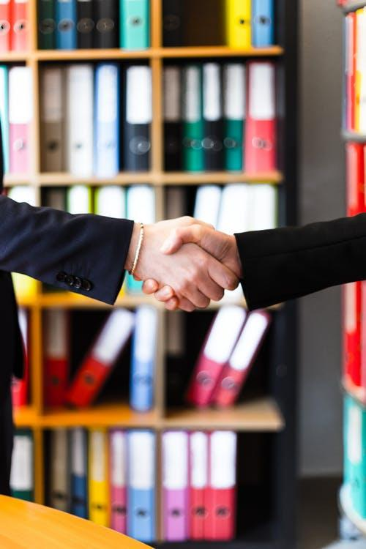





98752-08472
Hello@freelancetrainings.com
www.freelancetrainings.com
406, Titanium City Centre Mall, Anand Nagar, Satellite, Ahmedabad-380015

