Slide 1


Your
Company
Logo
Workshop on Business Etiquette
Notes:
The Trainer is free to customise this editable slide & entire presentation as per their own/client branding- You may keep the fonts/ Animation/ Images same to save the editing time.
Say Good morning/Afternoon /evening welcome to the workshop on business Etiquette
Welcome to the workshop on ‘Business Etiquette’! Today is going to be a fun filled, energy packed session with lots of interaction amongst us & a lot of learning from each other. We will learn each module through activity and experiential learning. Science shows that’s how adults learn best.. And that’s exactly how we will learn today!
Note: Trainer to say the above paragraph with lot of enthusiasm.
Transition to the next slide

Slide 2
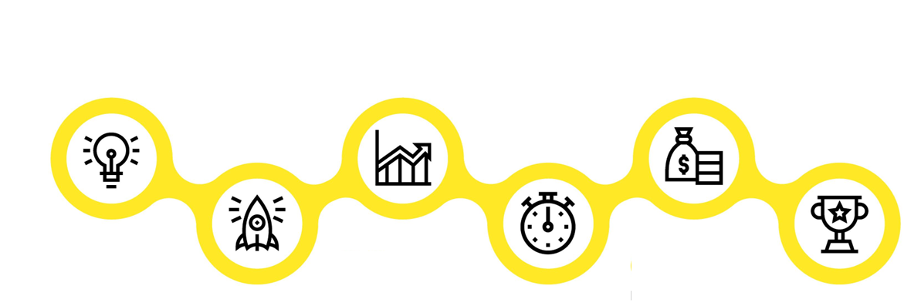

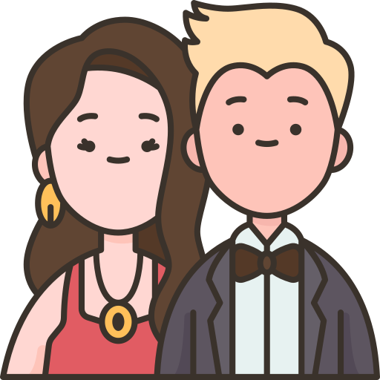

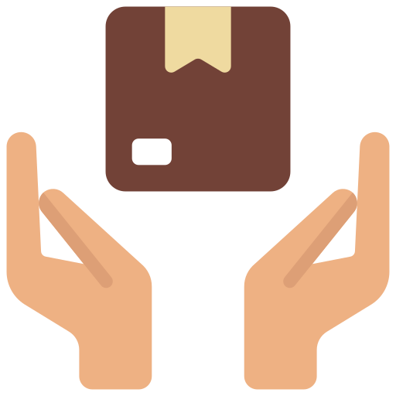
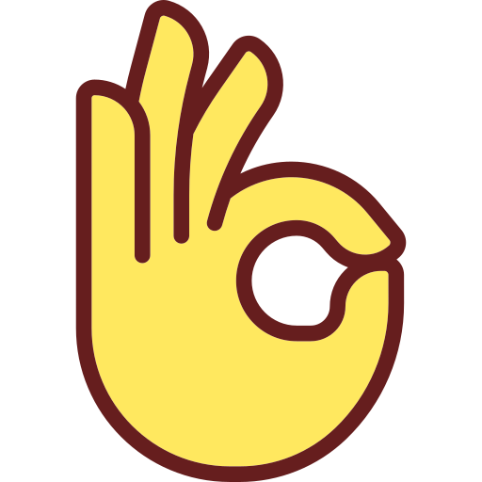

Agenda of Workshop- Day 1
Module 1
Module 3
Module 5
Understanding Brand &
Personal Branding
Non Verbal Communication
Looks Matter- Grooming
Module 2
Module 4
Module 6
Building an Attitude
of Ownership
Mastering Body Language
Watch the Odour
Personal Hygiene
Notes:
The agenda of todays workshop is as follows
Understanding Brand & Personal Branding
Building an attitude of Ownership at workplace
Non Verbal communication
Mastering Body language
Looks Matter –Grooming & Etiquette
Watch for Odour- Personal Hygiene

Slide 3


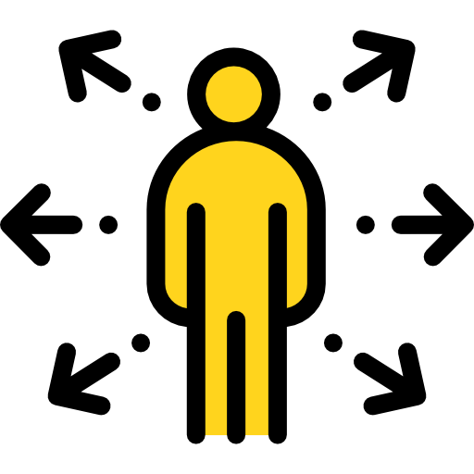



Agenda of Workshop- Day 2
Module 1
Module 3
Module 5
Vocal Communication
Email Etiquette
Social Etiquette
Module 2
Module 4
End of Workshop
Dining Etiquette
Telephone & Meeting Etiquette
Notes:
The agenda of todays workshop is as follows
Understanding Brand & Personal Branding
Building an attitude of Ownership at workplace
Non Verbal communication
Mastering Body language
Looks Matter –Grooming & Etiquette
Watch for Odour- Personal Hygiene

Slide 4
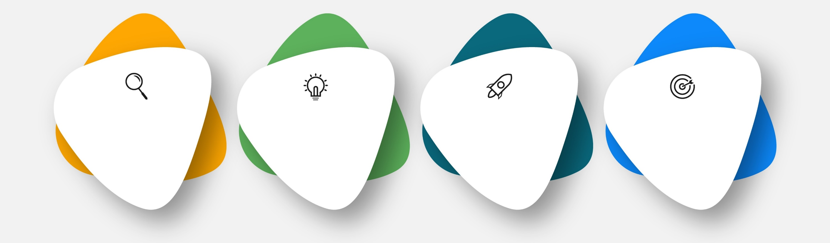
Qualities of a Brand
Powerful
Consistent
Visual
Valuable
Can Individuals also become brands.
Notes:
Trainer: To become a brand any product needs to build the following qualities
Powerful,
Consistent – Delivering the same experience always
Visible- The Look, packaging, colours, logo etc all that comprises of External facing image,
Valuable .
Powerful: The brands showcase expert power not only on their competitors but also in the entire Industry. They are so influential that the entire industry is known by their name e.g- When you say toothpaste the first image is of Colgate, Toofan drink means Thumsup, Photocopy is related to xerox.
Consistent – Delivering the same experience always: Same quality, taste, packing etc.- E.g. Mac aloo tiki will be same in any mac Donald outlet
Visible- The Look, packaging, colors, logo etc all that comprises of External facing image, Tata motors T Symbol in blue background
Valuable: People perceive value in the brand- Something which can make their lives easier and better- .
Can Individuals also become brands. Lets move to next slide

Slide 5


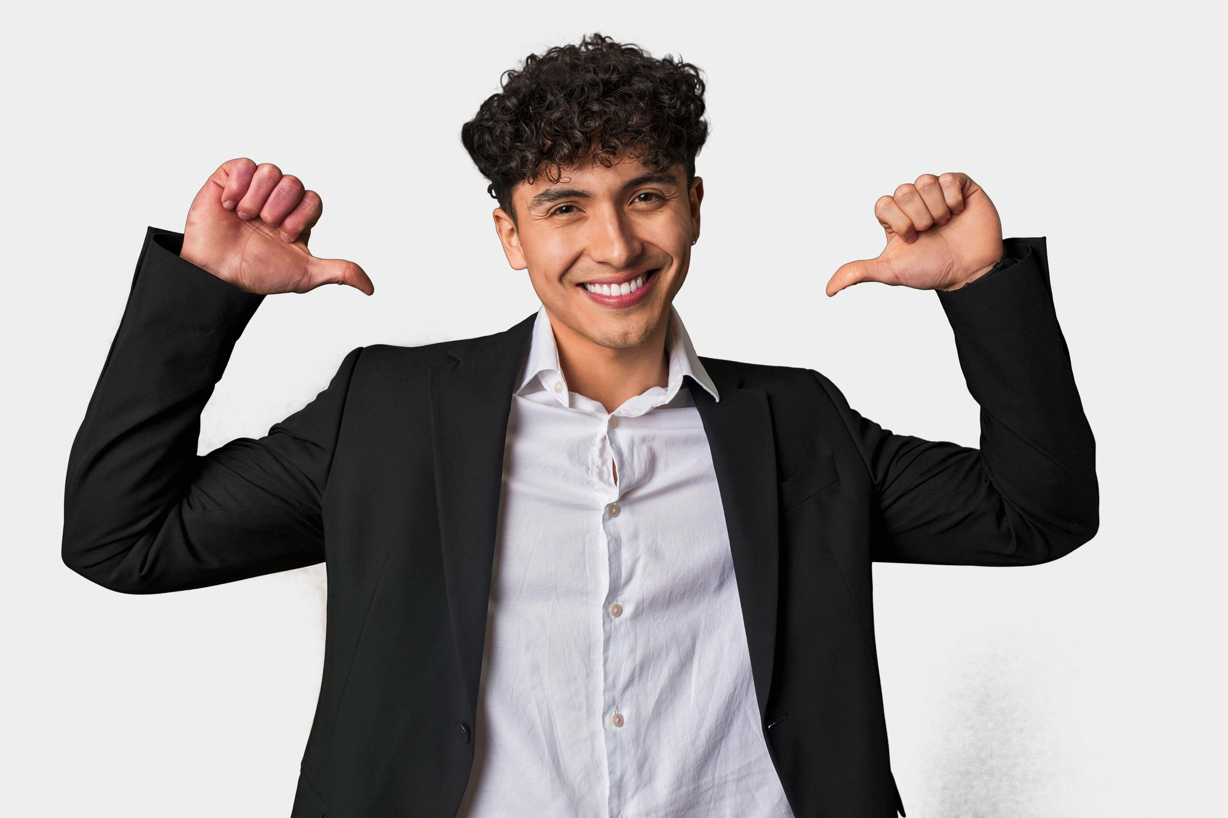


1. Taking Ownership and Accountability
Taking the initiative to bring about positive results.
Being accountable for the results of your actions - that are the of the highest quality and delivered in a timely manner.
Taking ownership shows others that they can trust you to do the right thing
Not waiting for others to act, and caring about the outcome as much as an owner of the company would
Notes:
Say: Employees who do the bare minimum are a drain of energy in the office. On the other hand, professionals that have the attitude of ownership, are considered to be assets because they stretch themselves to get things done proactively. So what does taking ownership mean?
Ownership is taking the initiative to bring about positive results.
It means caring about the outcome and doing the best to see it execute to completion.
It is being accountable for the results of your actions - that are of the highest quality and delivered in a timely manner.
Taking ownership shows others that they can trust and rely on you.
To sum up, ownership means having an obligation to the organization in terms of results and acting on the items that impact those results.
Transition to the next slide.

Slide 6
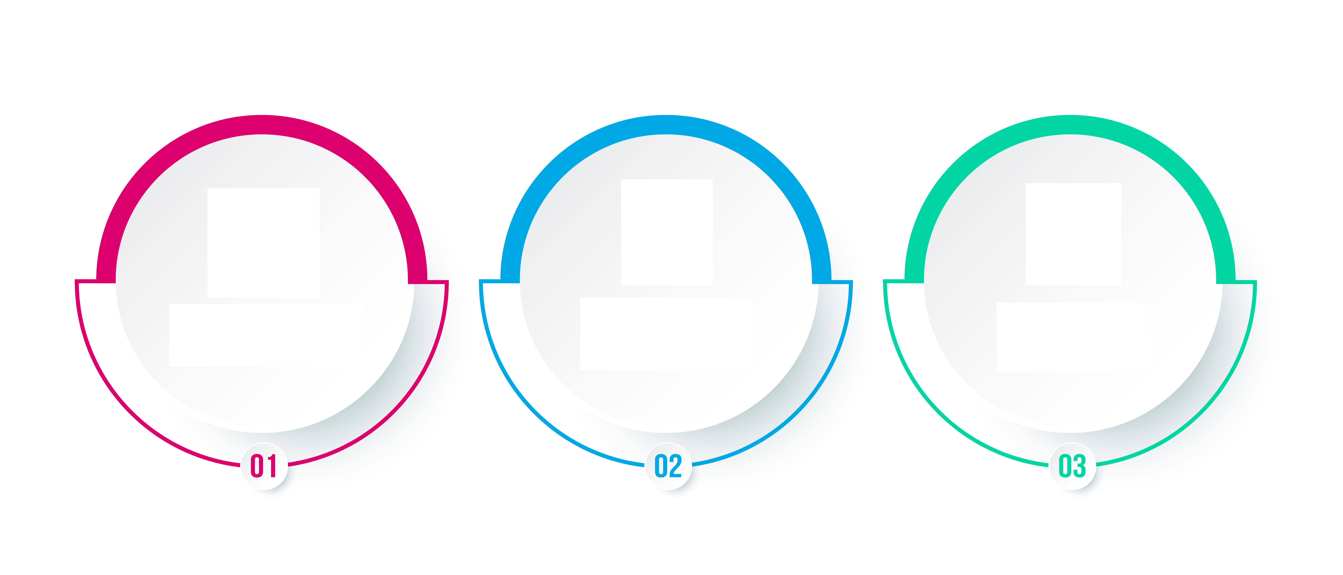



How to Avoid Blame Game/Walking the extra mile
Focus On Solutions
Respond with Empathy
Realise that mistakes are Inevitable
Notes:
How to avoid the blame game? 1. Focus on solutions: “The focus must be shifted from who is to blame to what can be done about it.
2. Respond with empathy: Even if someone has made a mistake, it’s important to see their situation empathetically.
3. Realize that mistakes are inevitable: Realize that mistakes are ubiquitous and a part of the human experience.
Assign responsibilities and expectations: It can be helpful to clearly establish responsibilities, so that everyone is aware of what they need to do and what everyone else is doing.

Slide 7

Activity on body language
Notes:
Say: now, let’s start this section with a fun activity.
Say: Now, divide yourself into 5 groups (note: the trainer can also divide into 4 groups depending on the no of participants).
Say: I have a bowl here full of chits. One volunteer from a team should come and pick one random chits. Then he/she has to introduce himself/herself to the class within 30sec while enacting the body language. Now, the rest of the class should pay close attention and have to guess the body language after the introduction is done. The participant who is the first to guess correctly will win a prize!!
Note: the trainer should have the following resources ready before the activity.
4 folded chits with different body language (negative) written on it and folded so that the participants cant see it without opening it.
A packet of melody (give 1-2 melody as a prize for every right answer)
Examples for body language:
Not making eye contact while talking
Hunched back
Crossed arms
Frowning
Note: the trainer should call one volunteer from each team one by one and ask them to pick one chit. Once they do that, ask them to demonstrate it in front of the class. The rest of the class has to guess the correct body language the volunteer is trying to demonstrate.
Note: After one participant finishes presenting one bad body language, the trainer should briefly discuss why it was a bad body language. Also ask the class what should be the correct body language for the same (example- instead of not making any eye contact, you should maintain a positive eye contact to show interest).
Note: the trainer should discuss the following after one volunteer done enacting the ‘bad’ body language and the participants are done guessing, ask the class-
What did you think about the person while he was showing the ‘bad’ body language? (elicit responses like – he seemed uninterested, less confident etc.)
Note: now ask the volunteer to reintroduce him/herself using the correct body language (eg. Instead of ‘frowning’, use enthusiastic and smiling facial expression)
Now, again ask the class -
Note: the trainer should be able to energize the class and make them competitive throughout the activity.
2. What did you think about the person now? (elicit responses like – he seemed interested, confident etc.)
Say: now, within a matter of 1 min, your perception towards him changed from ‘less confident’ to ‘confident’, ‘uninterested’ to ‘interested’ etc. and this is all due to a slight change in body language which made a huge impact on the perception that you create for yourself! The impression that you create in your customer’s and stakeholder’s mind is hugely effected by the body language that you show while communicating with them. Hence, be mindful of these points!
After the activity is over-
Say: great! All of us had fun right? Now, let’s quickly go through the points to remember regarding your body language while communicating with your stakeholders.

Slide 8

Facial Expressions
Facial expressions, gestures, and eye gaze are often important part of Body language
Notes:
Just a few examples of emotions that can be expressed via facial expressions include:
Happiness
Sadness
Anger
Surprise
Disgust
Fear
Confusion
Excitement
Desire
Contempt
The expression on a person's face can even help determine if we trust or believe what the individual is saying.
There are many interesting findings about body language in psychology research
. One study found that the most trustworthy facial expression involved a slight raise of the eyebrows and a slight smile
. This expression, the researchers suggested, conveys both friendliness and confidence.³
Facial expressions are also among the most universal forms of body language.
The expressions used to convey fear, anger, sadness, and happiness are similar throughout the world.
Researcher Paul Ekman has found support for the universality of a variety of facial expressions tied to particular emotions including joy, anger, fear, surprise, and sadness.⁴
Research even suggests that we make judgments about people's intelligence based upon their faces and expressions.

Slide 9

My Workspace
Your workspace is a representation of yourself.
Keep it clean and tidy
Keep your desk Organized
No Eating at desk/Workstation
Decorations
Avoid Talking loudly-Use meeting rooms
Notes:
Eating at your desk is a common practice. If, however, your food leave a lingering smell, then it is a bad idea.
There is little that will cause a negative impression like a bad smell.
So, if you are going to eat at your desk, make certain that you do everything possible to eliminate any lingering odor.
This means disposing of your waste outside of your workspace, cleaning up thoroughly any food spills, and using an air freshener to mask any difficult odors.
Having office decorations can be highly professional.
It shows that you care about your work environment.
Just like dressing nicely for work, adorning your office with appropriate decorations can have a positive impact.
Aside from quality furniture and technology, the most common decor include: Diplomas, Awards, Certificates, Books (general educational or professional subject-matter), family pictures, limited paraphernalia from a personal hobby or interest

Slide 10
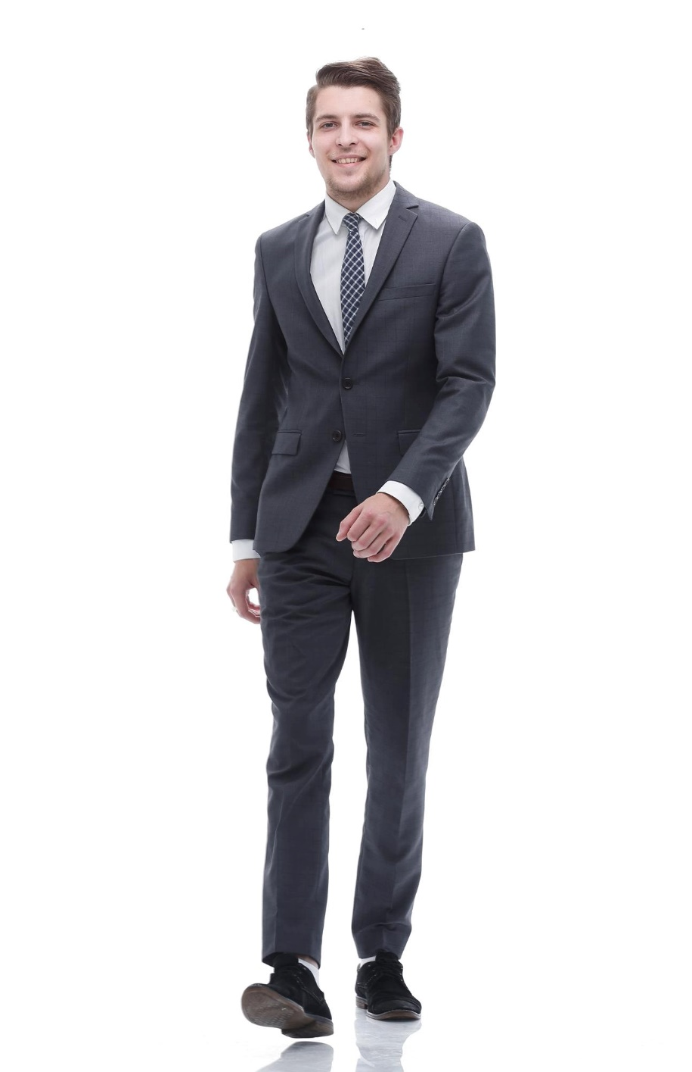
Corporate dressing for Male -Contd
Neutral colors of shirts such as blue, grey, white, khaki, black are guaranteed hits in a corporate setting
Small Checks & Vertical Stripes are also a good choice
Blazer can be blue/black, as per the latest season
Trousers are usually of dark colors Blue/ Black /beige/grey and in contrast with shirt color
Your tie should contrast with shirt and complement your overall look.
Make sure your sleeves touch the base of your hand. Do not roll up sleeves at work
Notes:
Avoid wearing party shirts to work.
Do not wear loud colours or patterns that are too bold.
Subtle colours look good in offices.
Plain shirts are always in style but you can also go for shirts in stripes, checks or micro-checks.
Colours such as red, yellow, orange usually are not preferred to be worn at the workplace.
shirts look professional. Make sure your sleeves touch the base of your hand. Do not roll up sleeves at work.
Take care of the fit of the trouser.
Slim fit or flat front trousers in solid colours such as grey, black, blue look best at workplaces.
Avoid baggy trousers as one looks lazy and sloppy in the same. Your shirt should not be too tight.
You should be able to button your shirt properly without any gaps.
Clothing should be clean, wrinkle free and ironed.
Keep a shoe shiner handy.
Prefer dark leather shoes (Black or Brown) with black laces.
Wear dark coloured socks to work.
Do not wear sports shoes or sneakers to work.
Remove all other rings except your wedding ring.
Remember, there is a huge difference between your college and professional life.
College were the days when nobody told you anything when you wore ripped jeans, T shirts, sneakers, hats and proudly flaunted your tattoos and body piercings.
If you wear an earring, remove it immediately.
Tattoos and body piercings are not at all acceptable in a professional environment.
Do not attend office with beard unless and until there is an emergency.
Remember, your tie should complement your overall look.
Silk ties are always a safe bet. Do not wear ties in loud colours or jazzy patterns.
The tip of your tie should touch your belt buckles.
Do not wear flashy belts with broad buckles. Wear leather belts in dark colours preferably black or brown.
Wear socks that match your pants

Slide 11

Corporate dressing for Female -Contd
Do not wear loud make up to work. Use lip colours of softer shades. Prefer lip gloss to lip stick. (avoid red, dark pink, orange lipsticks.)
It is important to smell good at the workplace. Keep a mild perfume handy.
Make sure your hands are clean and nails properly trimmed and manicured.
Hair should be neatly combed and properly tied.
Wear flats or platform heels to work.
Notes:
It is always wise to dress according to your office culture.
Business suits look best in colours like Blue, Black or Charcoal grey.Business suits constitute a crisp shirt teamed with a matching trouser
Avoid wearing loud colours to work. Colours such as hot pinks, reds, deep purples look odd at the workplace. They are meant to be worn at parties and get togethers with friends.
Animal prints and jazzy designs are not meant for offices.
Stud earrings look simple yet elegant on female professionals.
Do not wear chunky necklaces, large earrings and stacks of bangles at workplace. Flaunting your gold jewellery at office is foolish. Do not wear ring on every finger. Avoid wearing multiple bracelets. An elegant and simple watch looks best on professionals.
A nude look works best in offices. Don’t overdo your make up. I
Instead of a bright lipstick, a lip-gloss looks better and you can even reapply the same whenever needed. Minimal make up can not only make you look good but also extremely professional. Never apply layers of foundation on your face. Avoid cakey make up at workplace
Messy hair is not at all acceptable at workplaces. Do not adopt weird hairstyles at work..
Your heels should not be more than 2 inches.
Ask what is casual dress code ,take responses

Slide 12

Hygiene
Types of personal hygiene
Toilet
Shower
Nail
Teeth
Hands
Wear perfume or cologne
Notes:
Personal hygiene is how you care for your body. This practice includes bathing, washing your hands, brushing your teeth, and more.
Types of personal hygiene
Each person’s idea of personal hygiene differs. These main categories are a useful place to start for building good hygiene habits:
Toilet hygiene
Wash your hands after you use the restroom. Scrub with soap for 20 to 30 seconds, and be sure to clean between your fingers, on the back of your hands, and under your nails.
Rinse with warm water, and dry with a clean towel.
If you don’t have running water or soap, an alcohol-based hand sanitizer will also work.
Shower hygiene
Personal preference may dictate how often you wish to shower, but most people will benefit from a rinse at least every other day. Showering with soap helps rinse away dead skin cells, bacteria, and oils.
You should also wash your hair at least twice a week. S
Shampooing your hair and scalp helps remove skin buildup and protects against oily residues that can irritate your skin.
Nail hygiene
Trim your nails regularly to keep them short and clean. Brush under them with a nail brush or washcloth to rinse away buildup, dirt, and germs.
Tidying your nails helps you prevent spreading germs into your mouth and other body openings.
You should also avoid biting your nails.
Teeth hygiene
Good dental hygiene is about more than just pearly white teeth.
Caring for your teeth and gums is a smart way to prevent gum diseases and cavities.
Brush at least twice a day for 2 minutes. Aim to brush after you wake up and before bed.
If you can, brush after every meal, too.
Floss between your teeth daily, and ask your dentist about using an antibacterial mouthwash.
Sickness hygiene
If you’re not feeling well, you should take steps to keep from spreading germs to others.
This includes covering your mouth and nose when sneezing, wiping down shared surfaces with an antibacterial wipe, and not sharing any utensils or electronics
. Also, immediately throw away any soiled tissues.
Hands hygiene
Germs on your hands can easily enter your body through your mouth, nose, eyes, or ears. Wash your hands:
when you handle food
before you eat
if you handle garbage
when you sneeze
any time you touch an animal
Body odour happens due to sweat ensure you use a cologne or a perfume on your body and armpits as due to sweat the underarms tend to get sweaty
Its very important to notice odour .Why ? Collect responses and move to next slide

Slide 13
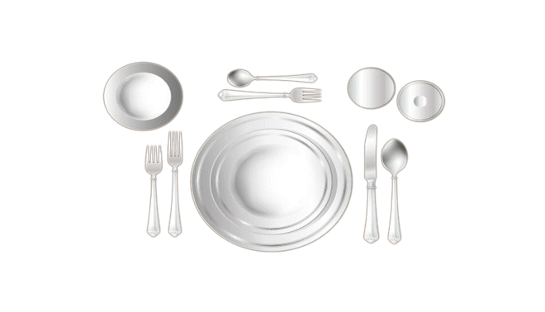
Place Setting
Desert Fork & Spoon
Water Glass
Bread Plate
Wine Glass
Salad Fork
Soup Spoon
Dinner Fork
Dinner Knife
Notes:
Say: Let us now understand how your table would have been set in a very formal lunch or dinner meetings.
The following is a standard table setting for a three-course meal. Note the basic "outside-in" rule. The piece of flatware that will be used last is placed directly next to the plate you are using.
FORKS
Both forks are placed on the left of the plate. The fork furthest from the plate is for salad. The fork next to the plate is for the dinner. (Please Note: At more formal meals where the salad is served after the main course, the order of placement is reversed.)
Fork tines may be placed downward, in the continental style, or upward, in the American style.
DINNER PLATE
The dinner plate is placed on the table when the main course is served and is not on the table when the guests sit down.
Large plates, such as the dinner plate and luncheon plate, are laid about one (1) inch in from the edge of the table.
SALAD PLATE
The salad plate is placed to the left of the forks.
Small plates, such as the salad plate, fish plate, and dessert plate, are laid about two (2) inches in from the edge of the table.
DINNER KNIFE
The dinner knife is placed on the right side, and directly next to and one (1) inch away from, the plate. The blade should face the plate. If the main course requires a steak knife, it may be substituted for the dinner knife.
SPOONS
The soup spoon is on the far right of the outside knife.
BREAD PLATE WITH BUTTER KNIFE
A small bread plate is placed above the forks, above and to the left of the service plate.
The butter spreader is laid on the bread-and-butter plate.
GLASSWARE
Usually one wine glass is used along with a water goblet. If the table setting is uncrowded, there is room to arrange glassware in any way you like, such as in a straight line parallel with the edge of the table or a diagonal line angled toward the table's edge.
WATER GOBLETS
The water glass is placed in a position closest to the hand, approximately 1 inch above the tip of the dinner knife.
WINE GLASSES
At least one wine glass should sit to the right and possibly above the water glass.
NAPKINS
Place the napkin in the place setting's center, or left of the last fork.
COFFEE CUPS
Place a cup and saucer to the right of the place setting. The coffee spoon goes to the right of the saucer.
Place approximately one (1) inch beyond the outermost piece of flatware. The top edge of the saucer is aligned with the top rim of the plate or bowl.
Cup handles are faced in the four o'clock position for easy access.
DESSERT SPOON AND FORK
At an informal meal, when two utensils are provided for dessert, the utensils are laid on the table or presented on the dessert plate.
The dessert spoon (or dessert knife) is laid on the table above the dinner plate in a horizontal position, handle facing right.
The dessert fork is laid beneath the dessert spoon (or dessert knife), handle facing left.
The dessert utensils may also be presented on the dessert plate in the same way as formal service.
SALT AND PEPPER
Since more people use salt than pepper (and most people are right-handed), the salt shaker is placed to the right of the pepper shaker, in a position closer to the right hand.
The placement of the pepper shaker is to the left of the salt shaker, and for added definition it is angled slightly above the salt shaker.
They are placed above the cover or between two place settings.
Because salt is finer than pepper, the lid of the salt shaker is punctured with smaller, more numerous holes than a pepper shaker.

Slide 14

Buffet Etiquette
Walk around
Get a fresh plate for refilling
Never reach around someone
Keep the line moving
Don’t touch the food in the serving dishes
Place all serving utensils in the original dishes
Leave the napkin on the table while refilling
Even though you are serving yourself at a buffet, you will want to leave a tip.
Notes:
Say: Buffet dining has become very popular in restaurants and at private dinner parties. It's a way to take as little or as much food as you want, and you're able to sample a wide variety of dishes.
Most people enjoy a good buffet, but some people's rude and sometimes disgusting behavior near the food can make it a less than desirable experience. Casual dining by its very nature seems to invite people to do things they wouldn't appreciate others doing.
Tips for restaurant buffet etiquette:
Walk around and look at all the food items before making your selection. That way you can plant, starting with what appeals to you the most and work your way toward items you would like to try without running out of room in your plate.
When dining out at a buffet style restaurant, always get a fresh plate before putting food on it. Returning with the same plate is unsanitary and may spread germs.
Never reach around someone. Doing so is not only rude, it's likely to cause an accident that can be avoided if you wait until they are finished making their selection.
Keep the line moving. Don't hover while trying to figure out whether or not you want something. If you aren't sure, move on and come back later after you decide.
Don't touch any of the food in the serving dishes. Never use your fingers to pluck something off a serving dish. You also don't want to lick your fingers while standing at the serving counter.
Place all serving utensils in the original dishes. You don't want to cross contaminate items. If someone is allergic to a food item that winds up in another dish, that person may become very sick.
When you get up from your table to return to the buffet, place your napkin on the seat of your chair to let others know you are returning.
Even though you are serving yourself at a buffet, you will want to leave a tip. The staff still has to remove dirty plates and clean the table.

Slide 15

How should an ideal email be?
In intent, message, words and tone
To the point and preferably short
Polite, respectful and empathetic
Including all relevant information
Clear
Concise
Courteous
Complete
Notes:
Trainer:
An effective email has the following aspects:
Clear – As we saw earlier, a lot of misunderstanding and error can be caused due to unclear communication. Therefore, it is necessary to avoid vague responses. Statements like – I will let you know soon or phrases like as soon as you can, as soon as possible, in some time, do the needful etc. can be vague. Also, there must be clarity in the intent, message, words and tone of your email. Answer or ask in a simple, understandable manner. Use simple words and K.I.S.S (Keep It Short and Simple). All information in the email must be genuine
Complete – Your email must contain all the relevant information to the matter at hand so that there is no back and forth of emails. This will also need you to be clear about why you are writing the email and what information you want to share or ask for. Answer all questions and expected questions.
Concise – Your email must be preferably short and to the point. Avoiding unnecessary explanations or lengthy, complex sentences is necessary to maintain clarity and readability. Also, your email must be organized and clean for better understanding. Use shorter, meaningful statements and write to the point. Avoid unnecessary words and complicated vocabulary.
Courteous – As we know, your choice of words is all that matters in an email. Therefore, being polite, respectful and empathetic in your email will help you express your emotion, intent as well as involvement with the matter at hand. Usage of the right words will convey the right tone.
Remember: HOW you write an email shows WHO you are!
Now that we know how an email must be, let us look at the components of an email.
Transition to the next slide.

Slide 16


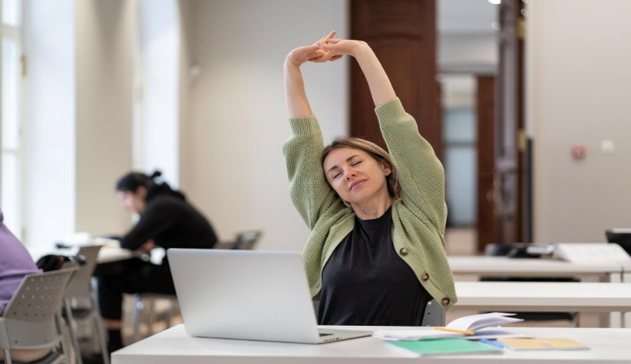
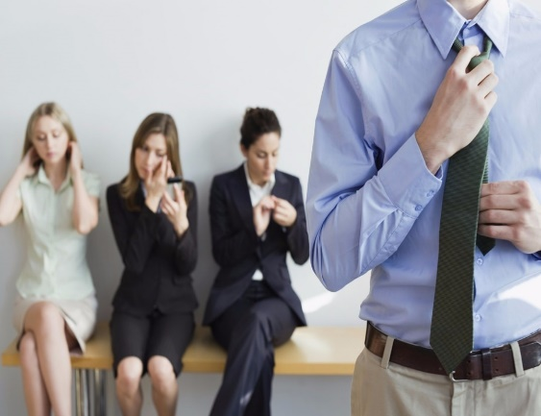

Meeting Etiquettes
Be on time
Fidgeting should be avoided
Avoid doing office yoga
in meetings
Unwinding in the
meeting
Do not yawn in
the meetings

Slide 17

Social etiquette

Slide 18




98752-08472
Hello@freelancetrainings.com
www.freelancetrainings.com
406, Titanium City Centre Mall, Anand Nagar, Satellite, Ahmedabad-380015

