Slide 1


Your
Company
Logo
Workshop on Business Etiquette
Notes:
The Trainer is free to customise this editable slide & entire presentation as per their own/client branding- You may keep the fonts/ Animation/ Images same to save the editing time.
Say Good morning/Afternoon /evening welcome to the workshop on business Etiquette
Welcome to the workshop on ‘Business Etiquette’! Today is going to be a fun filled, energy packed session with lots of interaction amongst us & a lot of learning from each other. We will learn each module through activity and experiential learning. Science shows that’s how adults learn best.. And that’s exactly how we will learn today!
Note: Trainer to say the above paragraph with lot of enthusiasm.
Transition to the next slide

Slide 2
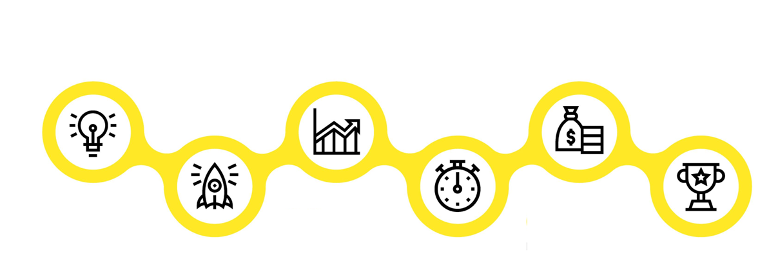

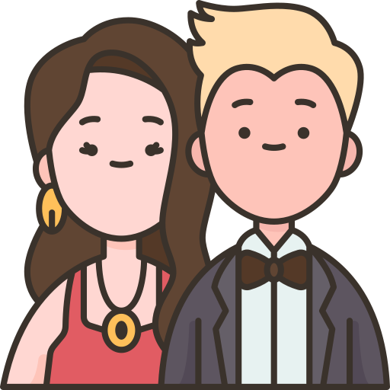


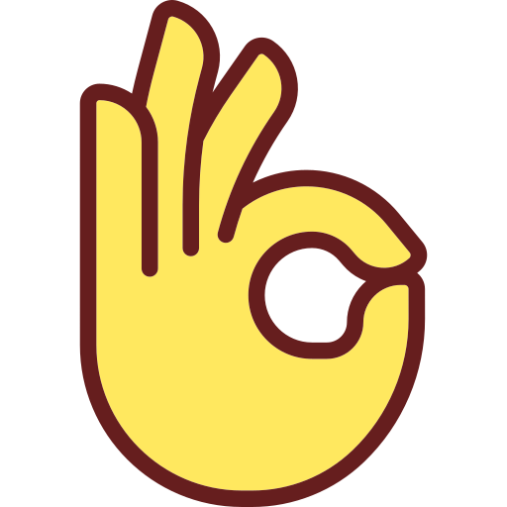
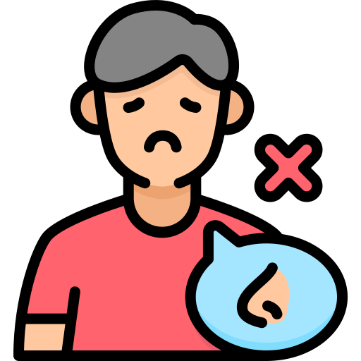
Agenda of Workshop
Module 1
Module 3
Module 5
Understanding Brand &
Personal Branding
Non Verbal Communication
Looks Matter- Grooming
Module 2
Module 4
Module 6
Building an Attitude
of Ownership
Mastering Body Language
Watch the Odour
Personal Hygiene
Notes:
The agenda of todays workshop is as follows
Understanding Brand & Personal Branding
Building an attitude of Ownership at workplace
Non Verbal communication
Mastering Body language
Looks Matter –Grooming & Etiquette
Watch for Odour- Personal Hygiene

Slide 3

Concept of a Brand
Notes:
Welcome to the first Module on Understanding Brand
Note for the Trainer: In this module we are trying to achieve the following things
First Impressions create a strong perception about anything (People/ Products)
Looking good/ Visually appealing is a first step to build a strong Brand
Personal Branding helps professionals to build their brand at the workplace
Business Etiquettes empowers the professionals not only to build great first impressions about themselves but also build you personal brand which brings bigger & better opportunities your way.

Slide 4
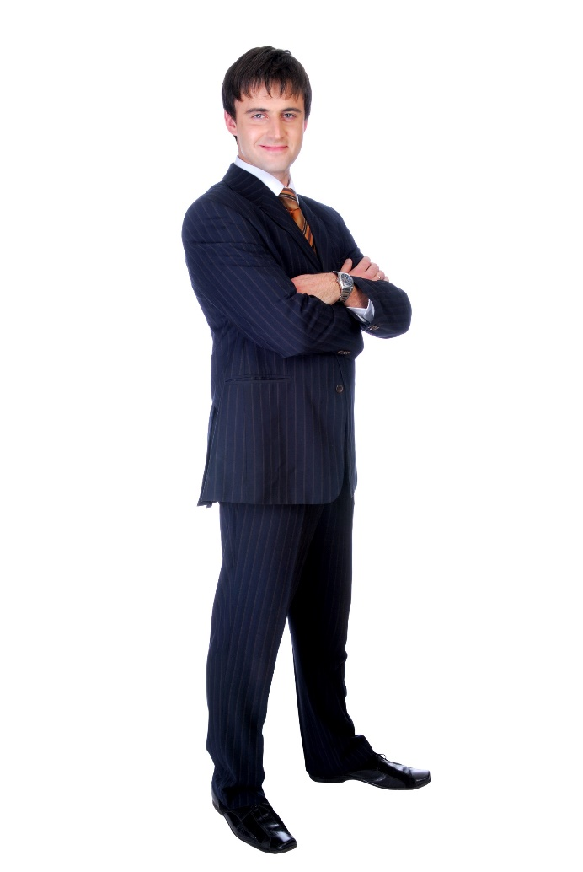
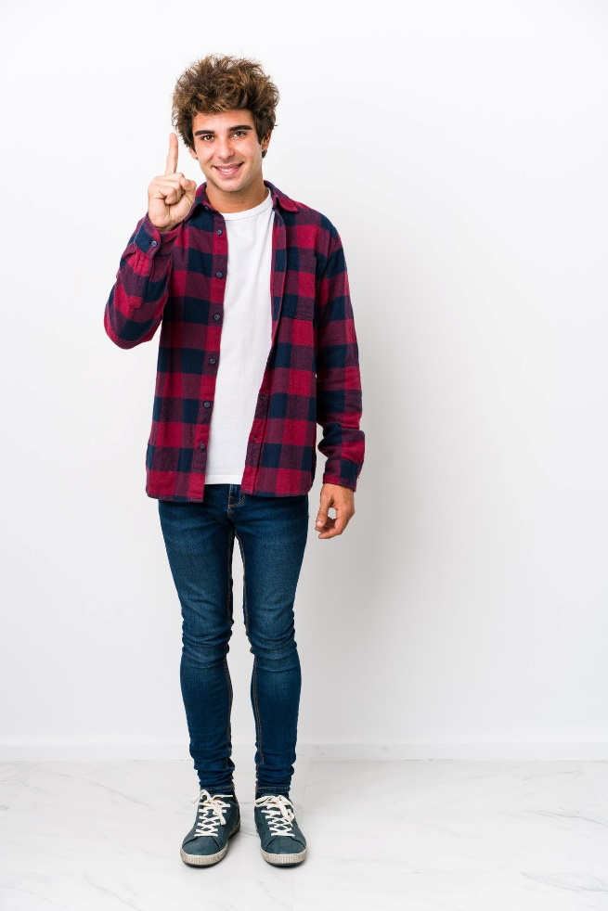
Who would you like to Hire as Manager
Option 1
Option 2
Notes:
Which of the 2 professionals will you like to hire
Option A Or B.
80% of the audience will say Option 2- Ask the participants why and wait for the responses. The responses will be like
Option A doesnot look serious
Option A is not dressed proferly
Option A is of casual nature
Trainer to prompt for answers and then move to the next slide

Slide 5
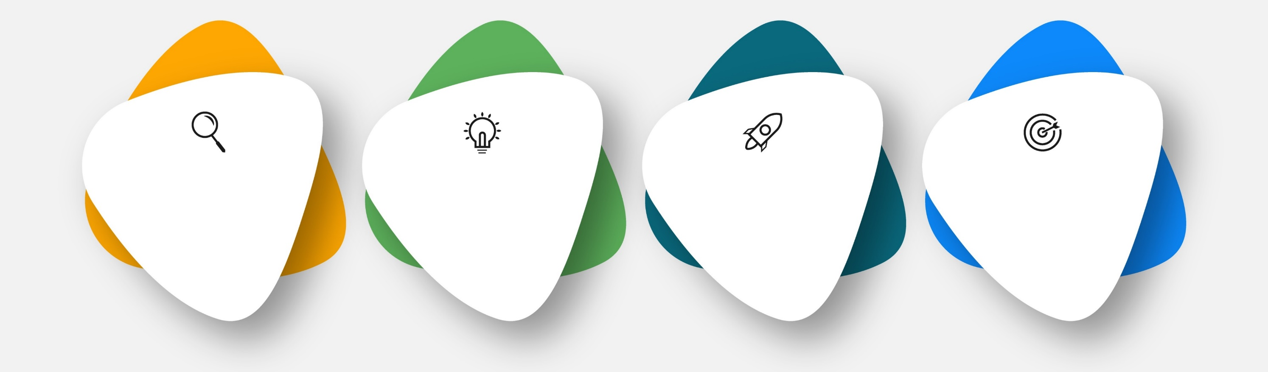
Qualities of a Brand
Powerful
Consistent
Visual
Valuable
Can Individuals also become brands.
Notes:
Trainer: To become a brand any product needs to build the following qualities
Powerful,
Consistent – Delivering the same experience always
Visible- The Look, packaging, colours, logo etc all that comprises of External facing image,
Valuable .
Powerful: The brands showcase expert power not only on their competitors but also in the entire Industry. They are so influential that the entire industry is known by their name e.g- When you say toothpaste the first image is of Colgate, Toofan drink means Thumsup, Photocopy is related to xerox.
Consistent – Delivering the same experience always: Same quality, taste, packing etc.- E.g. Mac aloo tiki will be same in any mac Donald outlet
Visible- The Look, packaging, colors, logo etc all that comprises of External facing image, Tata motors T Symbol in blue background
Valuable: People perceive value in the brand- Something which can make their lives easier and better- .
Can Individuals also become brands. Lets move to next slide

Slide 6
How can you make an impact at your workplace?
E.Q
Etiquette/ Social Grace
Communication Skills + Body Language
Grooming and Dressing
Education and Domain Knowledge
85%
15%
Notes:
Note: don’t show the image at this point.
Say: So, according to you, how can we make an impact at our workplace in other words- ‘what are the ways to make a positive corporate impact?
Note: elicit response. Give 2-3 mins to brainstorm with the class on this question.
Note: this information discussed on this slide is quoted from a study done by Carnegie Institute of Technology.
Say: well, there are various factors that play an important role in creating that positive impact.. However, there are certain points which are more important than the rest. Generally we put so much emphasis on the technical & domain related skills and expertise which we think is the most important part for career development. I know you all are here with a certain education and domain knowledge. You guys are specialized in all that you do. However, do you think only skill is enough to excel in your career and climb the career ladder?
Note: elicit response.
Say: Although I am not saying that domain skills are not required, but studies have shown that there are other peripheral factors which becomes more important to your career progression than your domain expertise after a certain level of your career. Let’s look at this image-
Note: show the image on the slide now.
Say: This study was conducted by Carnegie Institute of Technology of USA. According to this study, your education and domain knowledge is contributes to only 15% of your career growth. The rest 85% is contributed by other factors. Lets look at what REALLY makes people excel in their career.
Grooming/Body Language : next important for a person to excel is have a classy body language and first class grooming.
Communication skills: for anyone to move up the ladder, the next thing they need is communication skills. You will never find a CEO who cant communicate effectively. Good communication is the ability You don’t have to know good English for that. Communication doesn’t mean English. But to be able to speak well with people is necessary.
Social Graces/Etiquette: Social graces are important to stand out in the crowd. Have you seen how the top end men and women behave? They have a certain way in which they carry themselves. This is important to move up the ladder.
EQ: Although today we wont concentrate on EQ, it is important for one to be high on EQ to be at the top. You can’t have a CEO of a company screaming at a waiter in a party. It doesn’t look good and for someone to be at the top, to handle that kind of pressure while decision making, he needs to have good EQ.
Say: the objective of this workshop today is not to train you on domain knowledge. Today we will focus on the basics of communication skills, social and corporate etiquette and elements of grooming. EQ is a separate entity which will take an entire day to discuss. If you are really interested to know, you can go online and read materials on Emotional Quotient. But for today, lets focus on 3 main topics – communication, grooming & etiquette. Under grooming, we will also discuss briefly about personal hygiene.

Slide 7

Building Positive Attitude at workplace
Taking Ownership
Follow Solution Centric Approach
Avoid Blame Game

Slide 8
Circle of Concern, Influence and Control
Circle of concern
Circumstances/Issues/ Problems
Over which we have No control- Also
known as No control Zone
Circle of influence
Circle of control
Circumstances/Issues/ Problems
Over which we have a indirect control
Invest your time, Energy
& Emotions Here
Invest your time, Energy
& Emotions Here
Circumstances/Issues/ Problems
Over which we have a direct control
Notes:
Dr. Stephen Covey in his best-seller book 7 Habits of Highly Effective People, talks about the three circles. Each of these represents a certain aspect of our life. As you see the outer circle (of no control ) will be the largest and the inner most (of control) will be the smallest.
Let’s learn in detail.
Circle of Concern: (Red Zone) Also known as the circle of no control, this comprises the wide range of circumstances, issues, and problems that we have, but over which we do not have any control. Examples: Past decisions, world peace, wars, natural calamities, government policies, death, traffic, company policies, election results, etc.
Circle of Influence:(Yellow Zone) This comprises those circumstances over which we have indirect control. Example: Other people’s thoughts, other people’s actions, other people’s choices and decisions, your future, your family’s future, etc.
Circle of Control (Green Zone): This encompasses those circumstances, issues, and problems that we have direct control over.
Example: My thoughts, my actions, my reactions, my mood, my work ethic, my choices, etc.
Professionals that have excellent attitude almost always operate primarily from circle of control (where they have direct control over) and then from the circle of influence (where they still have some degree of control). This attitude helps them focus only on things that they can do and accept things that they cannot. Professionals with bad attitude usually are stuck in ‘circle of concern’. They fret, complain, get stressed and waste time of thinking and discussing about how life and things are unfair. This is like hitting a wall expecting it to move and is a viscious cycle to continue with the stress cycle.
Let’s take a closer look at how the circles look with examples.
Transition to the next slide.

Slide 9
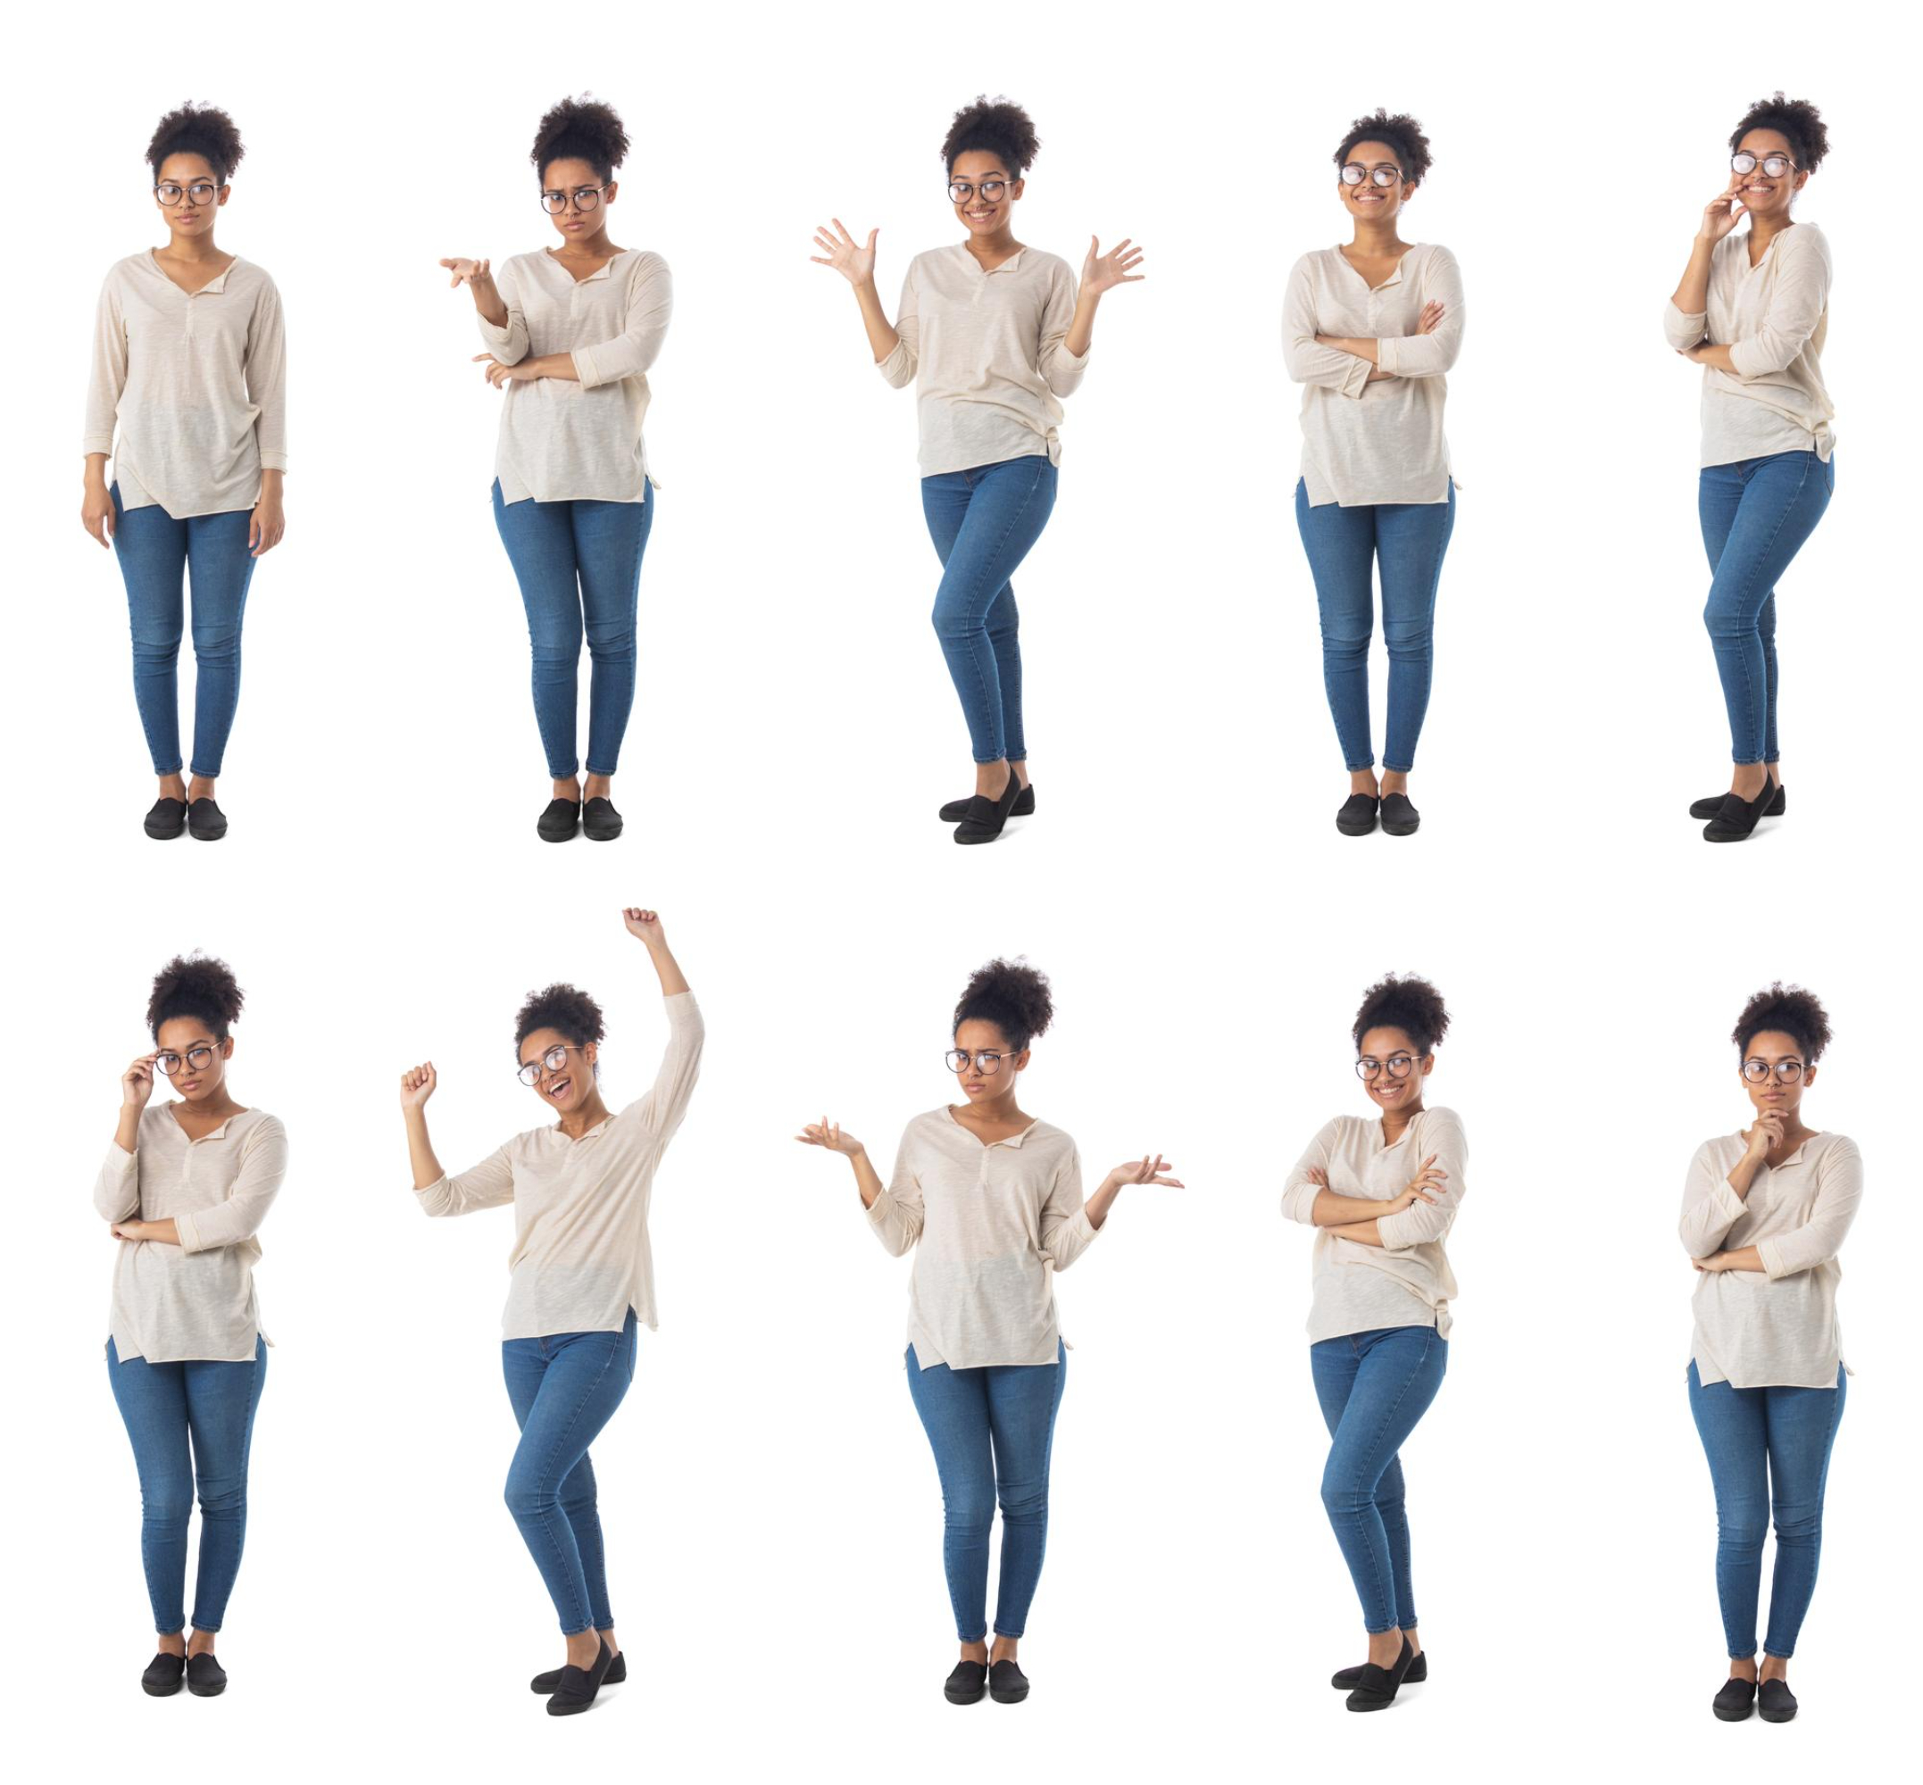
Body language is a silent orchestra, as people constantly give clues to what they’re thinking and feeling.
Body Language
Posture Facial Expression Creating IMPACT Handshake & Business Cards Space
Notes:
Welcome to the next module on Body Language
Say it’s a silent language wherein we get clues on what people are thinking and feeling
Non-verbal messages including body movements, facial expressions, vocal tone and volume, and other signals are collectively known as body language.

Slide 10

Activity on body language
Notes:
Say: now, let’s start this section with a fun activity.
Say: Now, divide yourself into 5 groups (note: the trainer can also divide into 4 groups depending on the no of participants).
Say: I have a bowl here full of chits. One volunteer from a team should come and pick one random chits. Then he/she has to introduce himself/herself to the class within 30sec while enacting the body language. Now, the rest of the class should pay close attention and have to guess the body language after the introduction is done. The participant who is the first to guess correctly will win a prize!!
Note: the trainer should have the following resources ready before the activity.
4 folded chits with different body language (negative) written on it and folded so that the participants cant see it without opening it.
A packet of melody (give 1-2 melody as a prize for every right answer)
Examples for body language:
Not making eye contact while talking
Hunched back
Crossed arms
Frowning
Note: the trainer should call one volunteer from each team one by one and ask them to pick one chit. Once they do that, ask them to demonstrate it in front of the class. The rest of the class has to guess the correct body language the volunteer is trying to demonstrate.
Note: After one participant finishes presenting one bad body language, the trainer should briefly discuss why it was a bad body language. Also ask the class what should be the correct body language for the same (example- instead of not making any eye contact, you should maintain a positive eye contact to show interest).
Note: the trainer should discuss the following after one volunteer done enacting the ‘bad’ body language and the participants are done guessing, ask the class-
What did you think about the person while he was showing the ‘bad’ body language? (elicit responses like – he seemed uninterested, less confident etc.)
Note: now ask the volunteer to reintroduce him/herself using the correct body language (eg. Instead of ‘frowning’, use enthusiastic and smiling facial expression)
Now, again ask the class -
Note: the trainer should be able to energize the class and make them competitive throughout the activity.
2. What did you think about the person now? (elicit responses like – he seemed interested, confident etc.)
Say: now, within a matter of 1 min, your perception towards him changed from ‘less confident’ to ‘confident’, ‘uninterested’ to ‘interested’ etc. and this is all due to a slight change in body language which made a huge impact on the perception that you create for yourself! The impression that you create in your customer’s and stakeholder’s mind is hugely effected by the body language that you show while communicating with them. Hence, be mindful of these points!
After the activity is over-
Say: great! All of us had fun right? Now, let’s quickly go through the points to remember regarding your body language while communicating with your stakeholders.

Slide 11

Creating IMPACT
I – Introduce yourself
M –Make eye contact
P – Professional handshake
A – Acknowledge personal space
C – Create a good first impression
T – Thank the person
Notes:
Have a proper introduction say
Hello/Good morning /afternoon/evening Sir /mam my name is xyz pleasure meeting you
Make eye contact and talk it shows confidence
Have a firm grip while shaking hands
Ask questions during the conversation to understand and communicate better
Create a good first impression ie grooming ,dress code and personality
Thank the person before taking your leave eg Thank you Sir/Mam have an amazing day

Slide 12
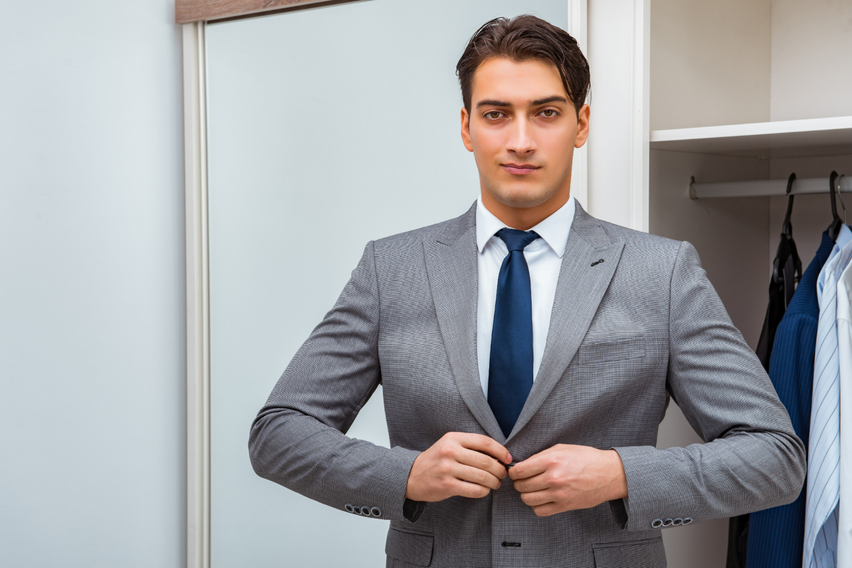
Corporate dressing for Male
Oil or gel your hair regularly
Hair length should not be below the shoulders
Either have a clean shave/ trim your moustache and beard
Avoid wearing chunky necklaces or too many bracelets to work.
Your tie should contrast with shirt and complement your overall look
Always Wear well fitted Clothes
Don’t Wear Tatoos/ Earrings (Only worn if they are tiny size)
Notes:
Oil or gel your hair regularly so that it is neat
The hair length should be till the shoulders and not below
Keep a shoe shiner handy.
Prefer dark leather shoes (Black or Brown) with black laces.
Wear dark coloured socks to work.
Do not wear sports shoes or sneakers to work.
Remove all other rings except your wedding ring.
Remember, there is a huge difference between your college and professional life.
College were the days when nobody told you anything when you wore ripped jeans, T shirts, sneakers, hats and proudly flaunted your tattoos and body piercings.
If you wear an earring, remove it immediately.
Tattoos and body piercings are not at all acceptable in a professional environment.
If you have a moustache, make sure it is neatly trimmed.
Do not attend office with beard unless and until there is an emergency.
Remember, your tie should complement your overall look.
Silk ties are always a safe bet. Do not wear ties in loud colours or jazzy patterns.
The tip of your tie should touch your belt buckles.
Do not wear flashy belts with broad buckles. Wear leather belts in dark colours preferably black or brown.
Wear socks that match your pants

Slide 13

Corporate dressing for Female
It is always wise to dress according to your office culture and clothes shall be well fitting.
Shirt should be preferably in light shade and properly tucked into the trouser.
Skirts should touch the knee or below
Female executives should avoid wearing heavy jewelry to work- Avoid anything that dangles/ makes sound causing distraction.
Choice of western formals (Blazer+ Skirt/Blazer+ Trousers) or Indian formals (Saree/ Salwar Kameez)
Notes:
It is always wise to dress according to your office culture.
Business suits look best in colours like Blue, Black or Charcoal grey.Business suits constitute a crisp shirt teamed with a matching trouser
Avoid wearing loud colours to work. Colours such as hot pinks, reds, deep purples look odd at the workplace. They are meant to be worn at parties and get togethers with friends.
Animal prints and jazzy designs are not meant for offices.
Stud earrings look simple yet elegant on female professionals.
Do not wear chunky necklaces, large earrings and stacks of bangles at workplace. Flaunting your gold jewellery at office is foolish. Do not wear ring on every finger. Avoid wearing multiple bracelets. An elegant and simple watch looks best on professionals.
A nude look works best in offices. Don’t overdo your make up. I
Instead of a bright lipstick, a lip-gloss looks better and you can even reapply the same whenever needed. Minimal make up can not only make you look good but also extremely professional. Never apply layers of foundation on your face. Avoid cakey make up at workplace
Messy hair is not at all acceptable at workplaces. Do not adopt weird hairstyles at work..
Your heels should not be more than 2 inches.
Ask what is casual dress code ,take responses

Slide 14
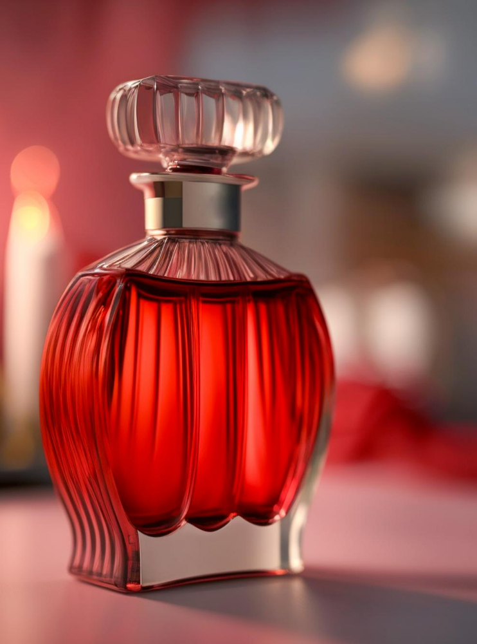
Watch out for the odor
If you sweat a lot, bathe 2-3 times a day.
Apply talcum powder on your body after shower. Especially arm pits. The talc will keep them dry.
OR Use a deodorant on your arm pits that is low on alcohol content- skin friendly.
Never wear moist/ wet clothes. Bacteria have a hard time breeding on dry surfaces.
Avoid eating food which emit high odor like raw onions, garlic, meat etc… which lead to both sweating and body odor.
Body odor is not a fun issue, but it is important to handle it in a professional manner.
Notes:
Body odor is not a fun issue to deal with in the workplace, but it is important to handle it in a professional manner.
Bad smells can impact morale both on the part of the other employees and the person causing it.
Regular baths or showers and underarm deodorant are the methods most people use to keep body odor under control.
Some users may need to reapply deodorant during the day or purchase an extra-strength product
Workplaces that require a high level of physical activity can cause a person to sweat and smell.
Hot weather conditions, hygiene, diet, and stress are other factors.
In addition, some people may be affected by the medical condition which causes excessive sweating.

Slide 15





98752-08472
Hello@freelancetrainings.com
www.freelancetrainings.com
406, Titanium City Centre Mall, Anand Nagar, Satellite, Ahmedabad-380015

