Slide 1
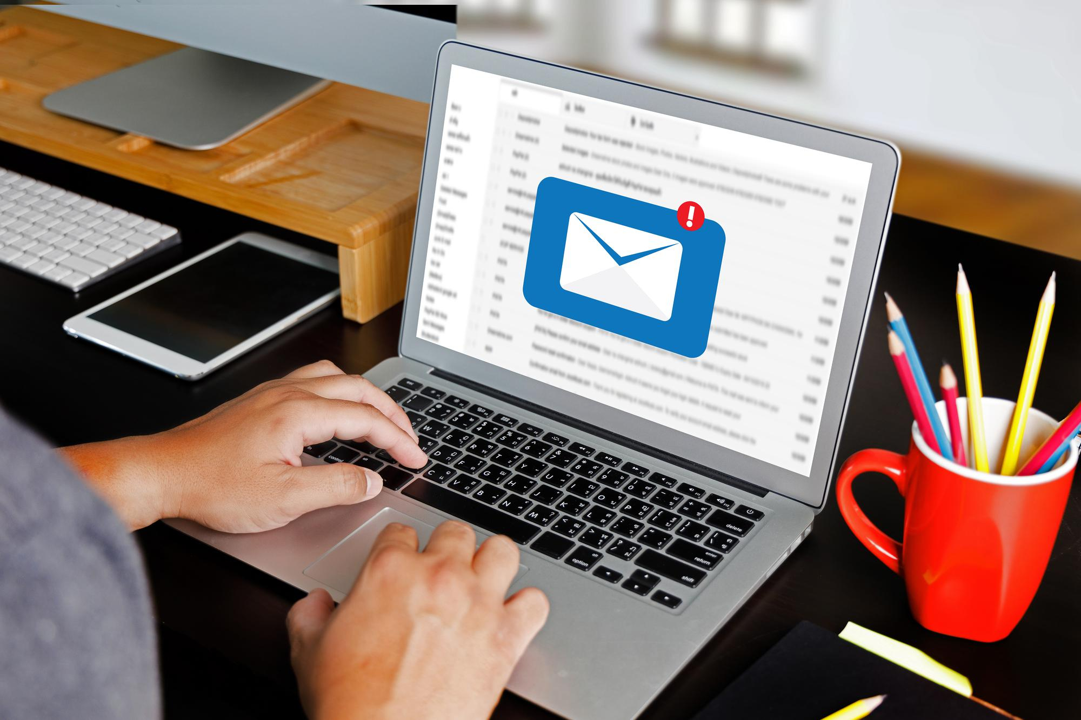

Business Communication
Your
Company
Logo
Strengthening professional relationships
Notes:
The Trainer is free to customise this editable slide & entire presentation as per their own/client branding- You may keep the fonts/ Animation/ Images same to save the editing time.
Trainer:
Hello and welcome to a session on Business communication/ Business writing!
Trainer and participant introduction.
Ice breaker, if necessary. (possibly Pictionary)
Language plays a major role in our everyday lives and development since humans discovered it.
We have also managed to use language and communication to serve many purposes and invented many tools to make the communication process easier. Business communication is something which creates our first impression in the minds of the receiver who can be a customer, prospect, vendor or an important stakeholder.
Let us understand what communication in the context of business means!
Transition to the next slide.

Slide 2
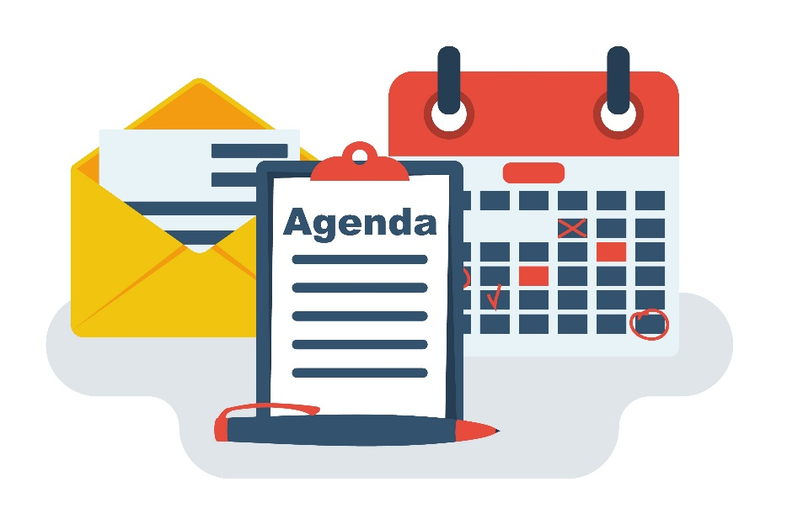
Workshop Agenda
Module No. | Topic
Module 1 | Introduction to Business Communication
Module 2 | Business Writing-Getting to Know Email
Module 3 | Email Structure
Module 4 | Writing Impactful Emails
Module 5 | Tone of Emails
Module 6 | Avoiding common errors & Email Management
Notes:
Facilitator’s Notes:
Tell: The agenda of the today’s training is to learn:
Module 1 What it means to take ownership and accountability
Module 2 Understand the importance of taking ownership and accountability
Module 3 Work to A structure that helps you identify opportunities for exercising ownership and accountability
Module 4 Key stages of accountability cycle
Module 5 Learn the lessons of unsuccessful outcome and develop a plan to overcome it
Module 6 Personal strength analysis
Course Objective
Participants will be able to take accountability and ownership of his decisions and actions
Stop blame game
Improved ‘can-do’ attitude
Improve employee engagement level
Improve productivity
Cordial interpersonal relations at workplace

Slide 3

Business communication?
Interactions with customers, internal teams and other stakeholders to clarify needs and expectations to meet mutual goals
Notes:
Trainer:
Let us understand the definition line by line -
- Business communication involves interactions or the exchange of information or data
- with customers to understand their needs, internal teams for follow-ups and information sharing and other stakeholders for updates
- to clarify needs and expectations
to meet mutual goals business or organizational goals and customer satisfaction.
By the looks of the definition, business communication seems quite significant.
Let us see how important it is.
Transition to the next slide.

Slide 4
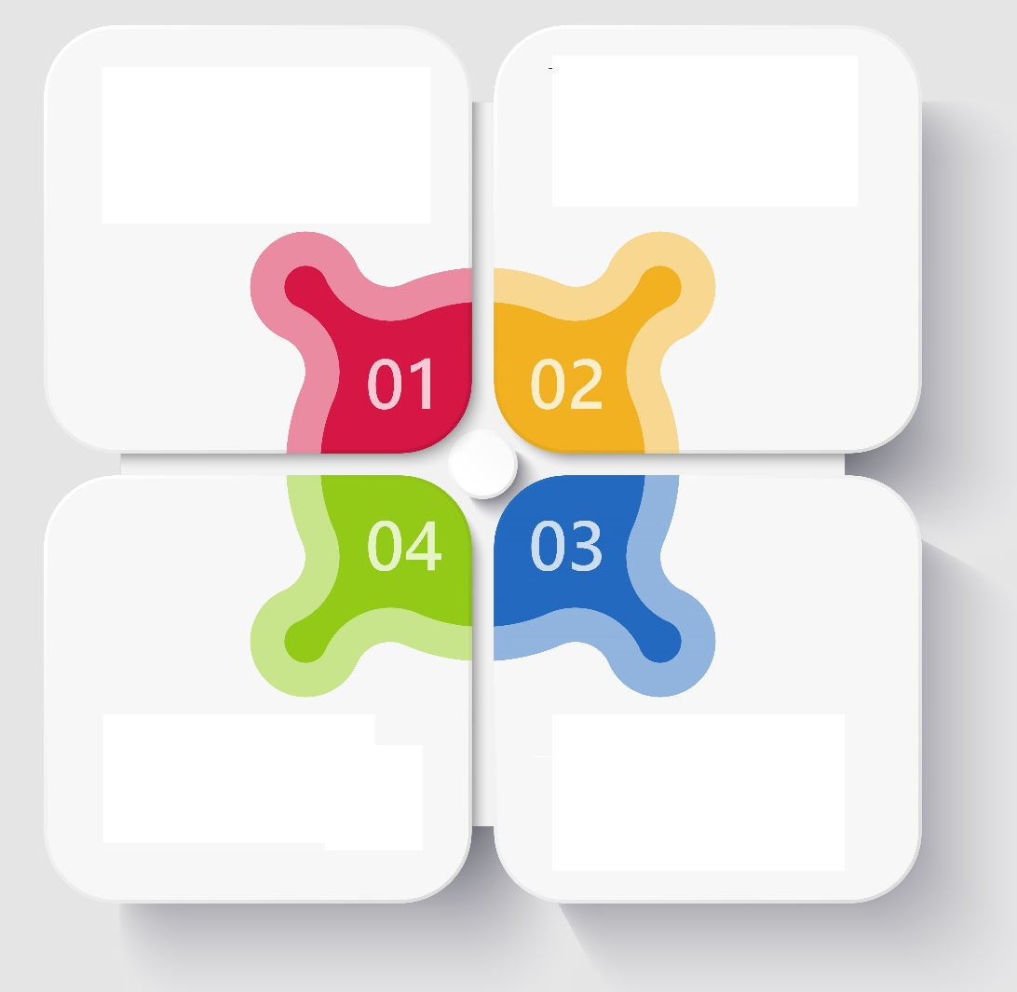
Modes of business communication
Verbal
Non-Verbal
Written
Visual
Notes:
Trainer:
What are the different modes of communication in business?
Can you give examples of each one of them?
Elicit responses.
Debrief:
Verbal communication – one-one meetings, group meetings and discussions, conferences, company-wide announcements, telephonic conversations, videos etc.
Non-verbal – one-one meetings, group meetings, interviews etc.
Written – emails, announcements, memos, messages, letters etc.
Visual – posters, presentations, videos etc.
Communication can be one-one or one-many (mass communication)
Communication channels flow in all directions within an organization – upward, downward, lateral and external (outside the organization – with customers and vendors etc.)
Of course, each of these has its role to play in an organization.
This session is focused on understanding written communication.
Transition to the next slide.

Slide 5
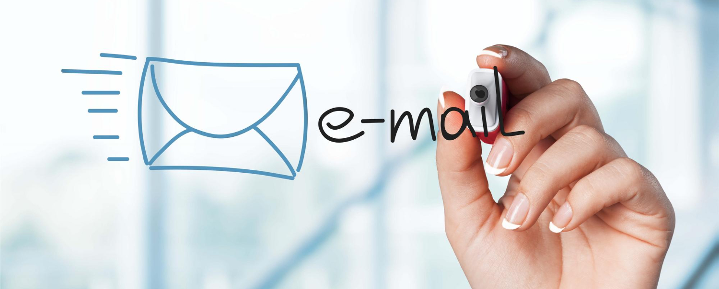
Email etiquette
A guide to writing effective emails
Notes:
Trainer:
Remember, following etiquette in email communication is significant since:
Any written document is proof for you or against you – commitments of deadlines, setting expectations, defining the scope of a project and financial agreements are some significant aspects where sending an email is necessary. Emails are also useful when we have to give updates on the progress of the work undertaken.
Since you are not present in person, what and how you write an email forms an impression of you.
If the reader does not understand what you have written, the purpose of writing the mail is lost anyway.
Let us explore the concept of email etiquette and look at how an ideal email must be.
Transition to the next slide.

Slide 6
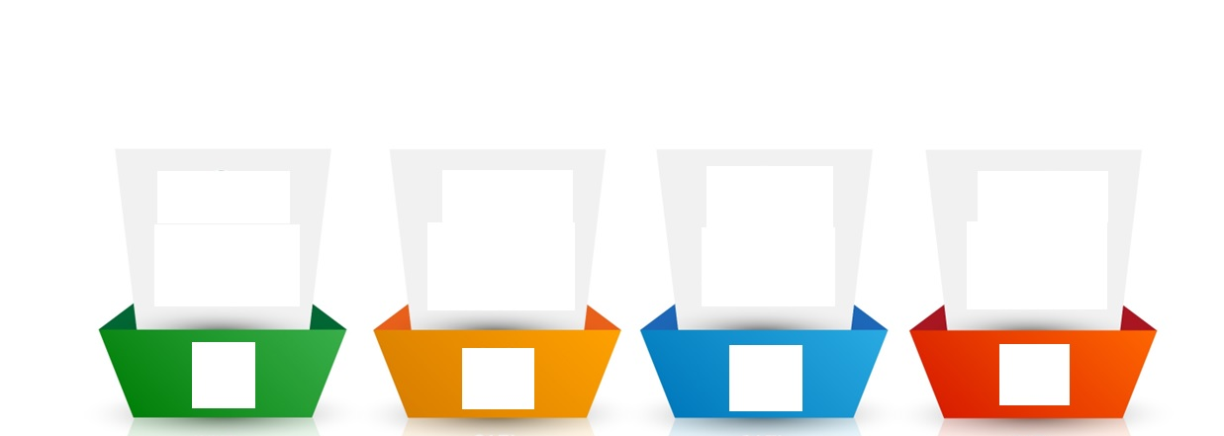
How should an ideal email be?
In intent, message, words and tone
To the point and preferably short
Polite, respectful and empathetic
Including all relevant information
Clear
Concise
Courteous
Complete
Notes:
Trainer:
An effective email has the following aspects:
Clear – As we saw earlier, a lot of misunderstanding and error can be caused due to unclear communication. Therefore, it is necessary to avoid vague responses. Statements like – I will let you know soon or phrases like as soon as you can, as soon as possible, in some time, do the needful etc. can be vague. Also, there must be clarity in the intent, message, words and tone of your email. Answer or ask in a simple, understandable manner. Use simple words and K.I.S.S (Keep It Short and Simple). All information in the email must be genuine
Complete – Your email must contain all the relevant information to the matter at hand so that there is no back and forth of emails. This will also need you to be clear about why you are writing the email and what information you want to share or ask for. Answer all questions and expected questions.
Concise – Your email must be preferably short and to the point. Avoiding unnecessary explanations or lengthy, complex sentences is necessary to maintain clarity and readability. Also, your email must be organized and clean for better understanding. Use shorter, meaningful statements and write to the point. Avoid unnecessary words and complicated vocabulary.
Courteous – As we know, your choice of words is all that matters in an email. Therefore, being polite, respectful and empathetic in your email will help you express your emotion, intent as well as involvement with the matter at hand. Usage of the right words will convey the right tone.
Remember: HOW you write an email shows WHO you are!
Now that we know how an email must be, let us look at the components of an email.
Transition to the next slide.

Slide 7
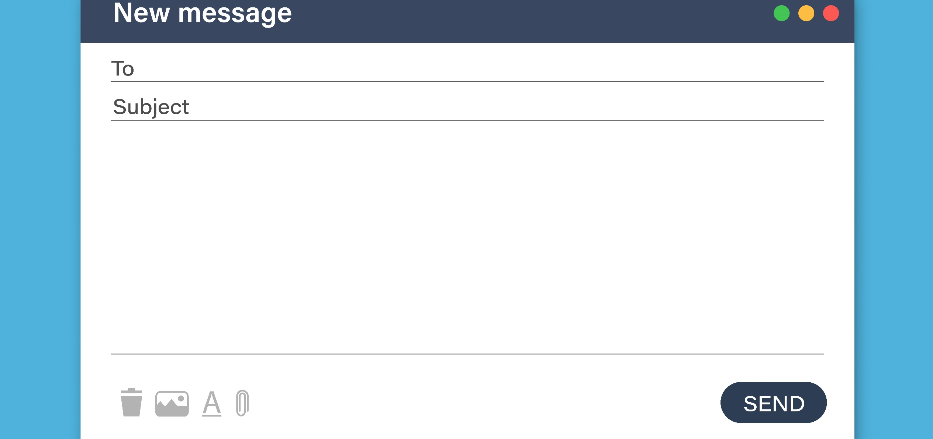
Components/Layout of an email
The Recipient/Address field – ‘To’ is mandatory, and Cc and Bcc are optional.
Subject line
Content box/ Email Body
Attachment
Notes:
Trainer:
Every typical email has some standard components:
The Recipient field – ‘To’ is mandatory, and Cc and Bcc are optional.
The Subject line
The content box/ Email Body
Attachment
Many other components like editing and formatting options depend on the email provider.
Let us look at how to draft an email.
Now, you may say – “I have been writing emails for ages now. What’s new?”
Trainer to ask:
When you are composing or drafting a new email, what is your first step?
Elicit responses. (You could ask each participant for their response)
Transition to the next slide.

Slide 8

Drafting a Subject Appropriate Line
Bedroom
Cupboard
Books- Study Room
Notes:
Trainer:
Imagine that you are moving homes.
How do you pack your things?
Elicit responses.
You put stuff from one space into the same box or put similar objects in the same box.
Most people label the box so that it becomes easier to unpack.
When you move to your new home, you look at the label and decide if you want to open that box on priority.
The subject line of the email serves the same purpose.
The subject line of an email helps the reader decide whether to open the email as a priority or not.
Trainer to ask:
How should a subject line be written?
Elicit responses.
Debrief:
Do you know about the telegram from the earlier days?
Elicit responses.
Technology for communication would be rare and expensive. When someone would send a telegram, each word would be charged money.
So people would try to drop unnecessary words and articles to save money.
Thus, the subject line should be like a telegram or a label – short and crisp.
Drop articles and prepositions.
Let us look at some examples of subject lines.
Transition to the next slide.

Slide 9
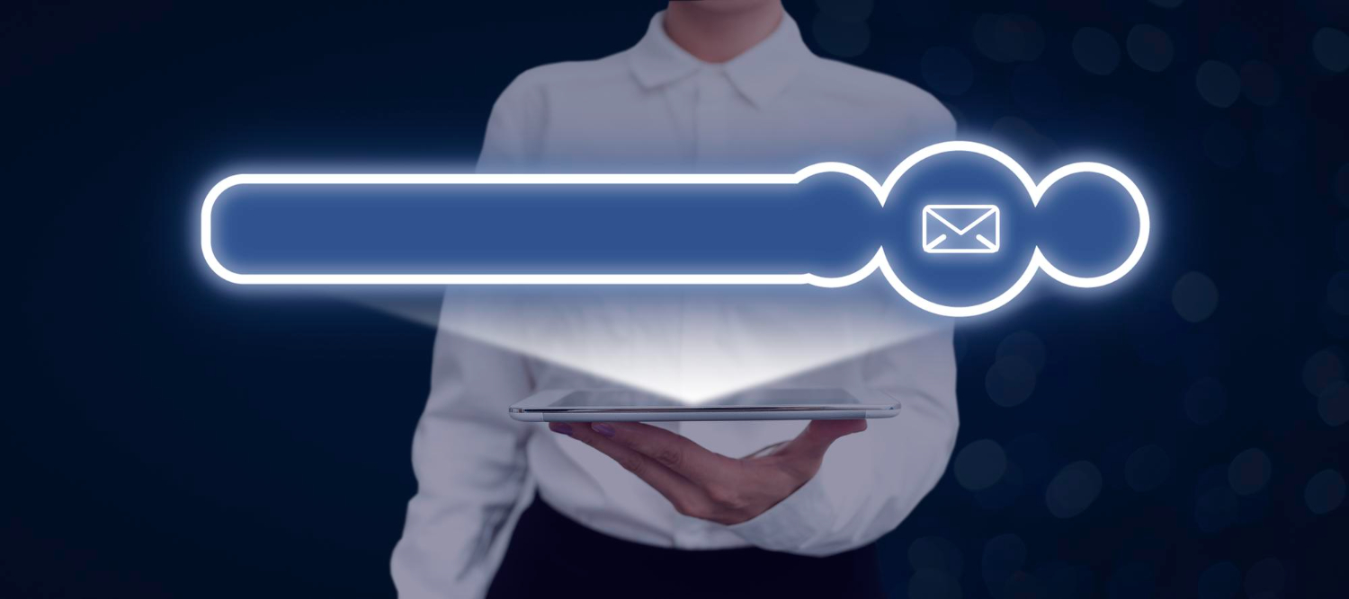
Example of subject line
Jan 2023 – Monthly Business Review - Accounts
Communication Training// 27 Jan 2023// 10.30 am // conference room
Audit report// Bangalore
[URGENT] Downtime – 1 April – 10 am to 6 pm
Service renewal – Order no. 12345
Case 789 – Troubleshooting steps
Reminder – stress management webinar – 31 Mar – 1 pm
Subject: Audit report – Bangalore
Notes:
Many organizations have a standard template for the subject line, depending on the teams.
Like case no. – issue – customer name
Let us do a quick activity.
Transition to the next slide.

Slide 10

Email- Body
Salutation
Greeting
Reason for your email
Call to action
Closing message
Signature
Dear Aanchal
Hope you had a great Start to your day
I am writing you this email to remind you regarding the
Documents pending at your end.
Kindly get these documents signed and shared with
me today before 3 PM so that I can get the same approved
From my manager.
Looking forward for your support as always
Thanks & Regards
Nina
Salutation
Greetings
Reason for the Email
Call to Action
Closing Message
Signature
Notes:
Say:
Above
1. Salutation: This is the first line of the email. –We have already covered the same in our Previous module. Use of Dear
2. Greetings: These are the opening line e.g Greetings from ……………Company, Hope this email finds you in great health: It was nice talking to you and knowing more about your requirement
3. The reason for your email: In this section you say, "I'm emailing to ask about..." or "I wondered if you could help with..." You'll sometimes need two sentences to explain your reasons for writing.
4. A call to action: After you've explained your reason for emailing, don't assume the recipient will know what to do. Provide specific instructions. We will discuss the same in our upcoming slides.
5. Closing: Closing sentence of the email. Looking forward for your reply. Looking forward to hearing from you again., Wishing you a great week ahead.
6 Signature is already covered in the previous module
After Explaining the email body parts-Show participants an example of an email and tell them to find the different Email body parts.

Slide 11
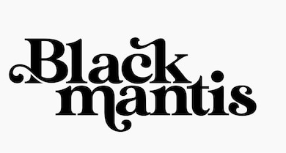

Font colour & Size
Use standard fonts like Times New Roman, Arial and Calibri etc.
Font size must be 11 or 12.
Use black as the standard font colour.
Use enough space between paragraphs for better readability.
In case your Organization has a predefined company font, Size and colur defined (as per their branding policy)- Please follow the same.
Notes:
Trainer:
The fonts that can be used for formal emails are Times New Roman, Arial and Calibri etc.
The font size can be 11 or 12.
Use enough space between paragraphs.
The font colour must be black.
Avoid using other colours unless for a security disclaimer or warning (which is usually mentioned in red)
Also, avoid using highlights since they can be very distracting.
Instead, use Bold, Italics and Underline to highlight keywords in a mail.
It is recommended that a maximum of 7 words be highlighted.
Instructions can be indicated by numbered bullets. 1,2,3…
The steps followed can be indicated by bullets. “● and – “can be used for bullets
This will ensure that your email will look standard and readable.
Here, I would like to remind you to maintain a vertical read and keep your text in a vertically rectangular writing space.
Let us look at the importance of grammar and punctuation in email writing.
Transition to the next slide.

Slide 12
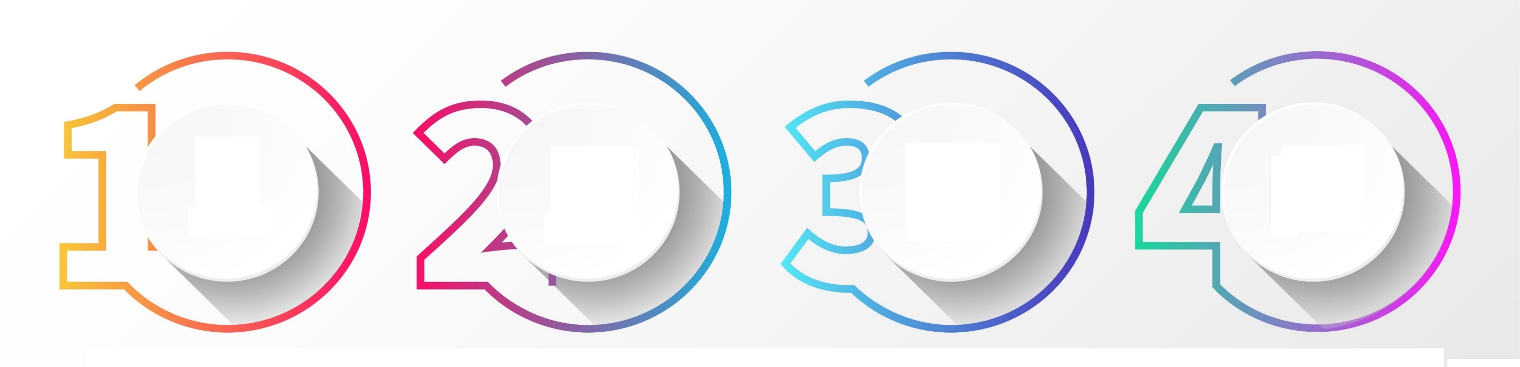
Tone of the email
C
A
R
E
Courteous
Assertive
Respectful
Empathetic
Notes:
Trainer:
The tone of your email is set by your intent and state of mind.
Avoid writing emails when you are upset or confused.
This may unconsciously reflect in your email through your choice of words.
I knew of this gentleman who would add extra question marks when the issue at hand bothered him.
“Why wasn’t this thought of earlier?????”
The simplest way to be mindful of your email’s tone is to CARE for your reader.
An acronym for being Courteous, Assertive, Respectful and Empathetic.
1. Courtesy or politeness in an email creates an impression about you.
Use words like please, could, would etc. to ask politely.
These words also soften the tone while asking a question.
Let us also look at the usage of the words please and request.
The word “please” is used as a courtesy in asking someone to do something (usually what is expected of them).
Just that you are asking them nicely.
E.g. please let me know when you fill the data in the sheet.
The word “request” is used when the reader or the other person is expected to take more effort or do something for you.
E.g. I request you to fill in the data by 4 pm today.
Being courteous ensures that the email is not misunderstood.
Let us understand how to be assertive in an email.
Transition to the next slide.

Slide 13
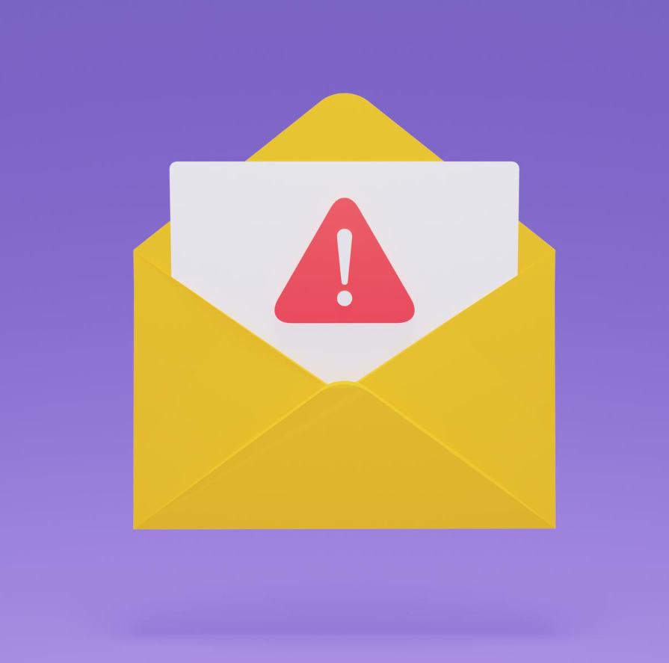
Errors within an email
Avoid smileys and winks.
Avoid jargon with people who are not from your field
Don’t use capital letters through and through
Avoid acronyms or shortcuts - ASAP, FYI, PFA, PFB
Don’t be vague.
Don’t use Uppercase for writing the entire email
Notes:
Trainer:
Avoid smileys and winks – they are not considered professional in emails.
Avoid jargon (technical/industry-specific words that a common man will not understand). Keep the words simple.
Examples of jargon in the software industry: GUI, VPN, DBMS. Operating System, Software development kit, SaaS
Don’t use Capital letters. Writing in upper case often indicates shouting.
E.g.: DON’T SHARE THIS INFORMATION WITH ANYONE. You can use bold, underline and/or increased font to stress the message.
Acronyms such as ASAP, FYI, PFA, PFB etc. should be avoided.
We are never too busy to write the complete word.
If you calculate the time saved by using shortcuts, they hardly amount to seconds.
asap is possibly the most misleading term used.
In your mind, you may consider asap as immediately but it actually is as soon as possible for the reader.
For all we know, it may be possible for them after 3 days since they are on leave!
Don’t be vague.
Avoid statements such as kindly do the needful, please send us the same, please revert to us asap, at your earliest etc.
Be specific about what you want the reader to do or what action is expected.
E.g. Please send the document before 6 pm today.
Please revise the product sheet before Friday.
Transition to the next slide.

Slide 14
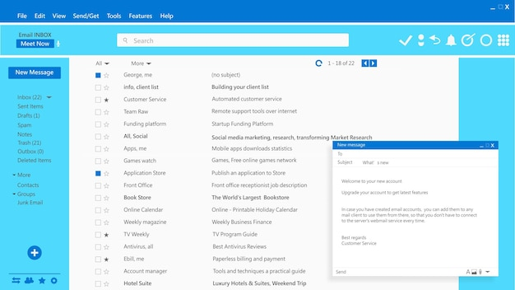
Preparing templates
Templates are to be used only when you send similar emails frequently
Common scenarios:
Promotions
Updates
Confirmation
Announcements
Common processes
Follow-ups
Notes:
Trainer:
A template is a standard set of sentences that can be used as a framework before customizing.
Overuse of templates may make the email seem impersonal and unprofessional.
As it is, there is less personal connection on email.
If a standard response is used for every email, it may seem like a big disconnect.
It is prudent to use standard sentences for similar, repeated email interactions like:
Promotions – products and services
Updates – product versions, upgrades, downtime etc.
Confirmation – of receipt of documents, information, payment, complaint, request etc.
Announcements – company-wide programs, initiatives, appointment of senior management etc.
Common processes – appointment, confirmation, appreciation, termination etc.
Follow-ups – complaints, requests, payments etc.
Often, templates are also used when there are deadline-driven targets per day.
E.g. Call centres, support centres, marketing or cold-calling
Be mindful of customizing templates well to avoid errors in names and crucial information.
Transition to the next slide.

Slide 15

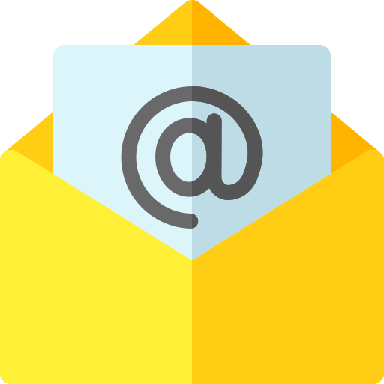



98752-08472
Hello@freelancetrainings.com
www.freelancetrainings.com
406, Titanium City Centre Mall, Anand Nagar, Satellite, Ahmedabad-380015

