Slide 1


Anti Money laundering and Know Your Customer India 2023
Your Company Logo
Notes:
Note for the trainer: start the day with enthusiasm. Your enthusiasm should reflect in your tone of voice and body language.
Good morning everyone!
How are you today. Are you ready to dive into a day of learning, growth, and transformation? I know I am!
Today, we have a unique opportunity to learn from each other, challenge ourselves, and take our personal and professional lives to the next level. Today’s workshop is highly engaging, filled with activities, role plays, videos and discussions that are designed to inspire and empower you.
But this isn't going to be a passive experience. This isn't a lecture where you sit back and listen to someone else talk. This is an interactive, dynamic, and engaging workshop that requires your full participation, your curiosity, and your willingness to learn.
Throughout the day, you'll have the chance to connect with other like-minded individuals, share your own experiences and insights, and gain new skills and knowledge that will help you achieve your goals. You'll be challenged, pushed outside your comfort zone, and supported every step of the way.
So, are you ready to embrace this day with open hearts and open minds? Are you ready to learn, grow, and transform? I know I am, and I can't wait to see what we'll achieve together.
Let's get started!

Slide 2

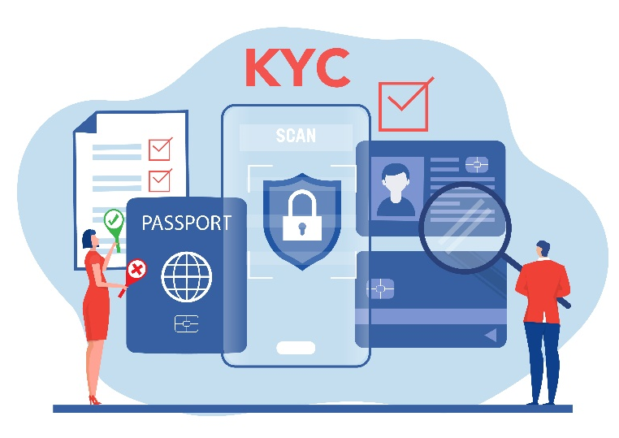
Anti Money laundering and Know Your Customer India 2023
As financial crimes continue to grow, it is increasingly important for Financial institutions in India to have a strong Anti Money laundering and Know Your Customer policy. This presentation will cover the importance of these policies, what the future holds in combating financial crimes and the process to comply with same.
Notes:
As financial crimes continue to evolve, it is crucial for institutions in India to have robust Anti-Money Laundering (AML) and Know Your Customer (KYC) policies in place. These policies help prevent illicit activities such as money laundering, terrorist financing, and fraud, while also ensuring that institutions have a clear understanding of their customers and their financial activities.
AML and KYC policies involve various measures and practices that financial institutions must implement.

Slide 3
Workshop Outline
Money Laundering and Process
Sources & Impact of Money Laundering
Money Laundering and law enforcement
Anti Money Laundering & KYC-Know Your Customer
AML & KYC Practical Approach
Notes:
In today’s workshop we will learn the following modules
Money Laundering & Process
Sources & Impact of Money Laundering
Anti Money Laundering and Law Enforcement
Anti Money Laundering & KYC-Know your customer
AML & KYC A Practical Approach

Slide 4

Module-1
Understanding Money Laundering and Process
Notes:
Welcome to the 1st Module on Understanding Money Laundering and Process. In this module you will learn the following.
Money Laundering and Cyber Laundering
Process – Money Laundering Cycle
Money Laundering-3 stages
Today, we will learn a variety of skills that will help us to Understanding Money Laundering and Process.

Slide 5

What Is ‘Money Laundering’ ?
    Process by which illegally obtained funds or "dirty money" are transformed into legitimate or "clean" assets, making it difficult to trace the illicit origin of the funds.
Money laundering is one of the most serious and widespread financial crimes that white-collar thieves and street criminals alike commit.
Notes:
Money Laundering is a process by which illegally obtained funds or "dirty money" are transformed into legitimate or "clean" assets, making it difficult to trace the illicit origin of the funds. It involves a series of transactions or activities designed to obscure the true source, ownership, or destination of the money.
The primary objective of money laundering is to integrate illicit funds into the legitimate financial system without arousing suspicion. This allows criminals to enjoy the proceeds of their illegal activities while giving the appearance that the money came from legal sources but in actuality came from an illegal activity in the first place.
The term "money laundering" refers to an illegal practice in whichIn a criminal case, the money associated with the crime is considered dirty money, and the process of laundering it creates the impression that it is clean.
There is no doubt that money laundering is one of the most serious and widespread financial crimes that white-collar thieves and street criminals alike commit.

Slide 6

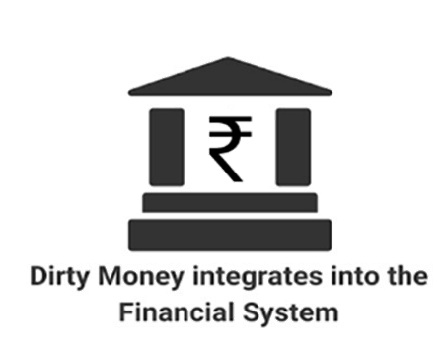


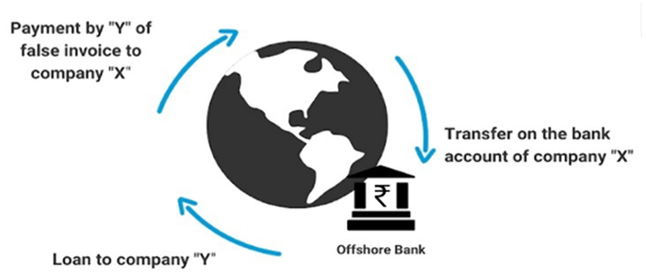
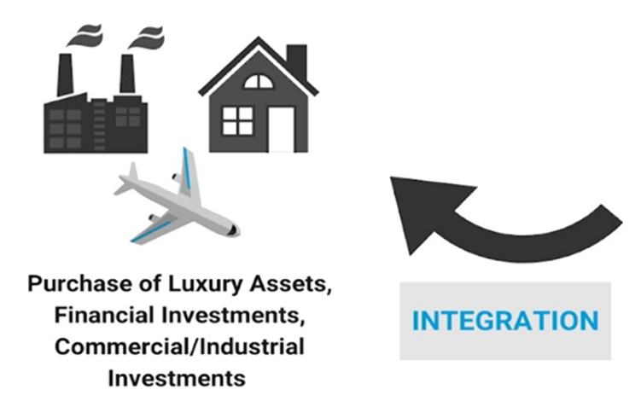
Process – Money Laundering Cycle
Notes:
This is the process of Money Laundering. Lets look about each stage in detail in the next slide.

Slide 7

Sources of Dirty Money
  Drug Trafficking
  Fraud
  Cybercrime
  Terrorism Financing
Other Illicit Activities
  Corruption
  Tax Evasion
  Organized Crime
  Illegal Trade
Notes:
Drug Trafficking: The illicit drug trade generates substantial amounts of illegal proceeds globally. Drug cartels and organized crime groups generate significant dirty money through the production, distribution, and sale of narcotics.
Corruption: Corruption, such as bribery, embezzlement, and abuse of public office for personal gain, can result in the accumulation of illicit funds. Corrupt officials and individuals exploit their positions to obtain illegal proceeds.
Fraud: Different types of fraud, including financial fraud, securities fraud, insurance fraud, and identity theft, can generate substantial amounts of illicit funds. Fraudulent activities involve deceit, misrepresentation, or manipulation to gain financial benefits illegally.
Tax Evasion: Individuals or businesses may engage in tax evasion by concealing income or assets to avoid paying taxes. The funds obtained through tax evasion are considered dirty money.
Cybercrime: The rise of cybercrime, including hacking, online scams, ransomware attacks, and cryptocurrency-related crimes, has led to the accumulation of significant amounts of illicit funds. Cybercriminals exploit digital platforms to obtain illegal proceeds.
Terrorism Financing: Financing terrorist activities requires financial resources, and terrorist organizations may engage in various illegal activities, such as drug trafficking, arms smuggling, and extortion, to generate funds. These funds are considered dirty money used to support terrorist operations.
Organized Crime: Organized crime groups engage in a range of illicit activities, including but not limited to drug trafficking, arms smuggling, human trafficking, illegal gambling, and counterfeit goods. These activities generate substantial amounts of dirty money.
Illegal Trade: Illicit trade, including the trafficking of wildlife, cultural artifacts, counterfeit goods, and contraband, can result in the accumulation of illegal proceeds. The profits generated from illegal trade are considered dirty money.
Other Illicit Activities: Dirty money can also come from other illegal activities, such as money counterfeiting, prostitution, illegal gambling operations, and environmental crimes.

Slide 8






Variants of Money Laundering
Trade-Based Money Laundering
Shell Companies
Cryptocurrencies
Smurfing
Offshore Accounts
Notes:
‘Offshore Accounts: Using offshore bank accounts and jurisdictions with strict banking secrecy laws to hide the true ownership and movement of funds.
Shell Companies: Setting up fictitious companies or using existing but dormant companies to create a layer of complexity and distance between the illicit funds and the criminals.
Smurfing: Breaking down large amounts of cash into smaller deposits or transactions to avoid suspicion and detection.
Trade-Based Money Laundering: Manipulating trade invoices, over or under-invoicing goods and services, or falsifying the value or quantity of goods in international trade transactions to move illicit funds across borders.
Cryptocurrencies: Exploiting cryptocurrencies and digital assets to transfer and convert illicit funds, as they offer anonymity and decentralized platforms that can be challenging to trace.
It's important to note that the techniques and methods used in money laundering can vary based on the sophistication of criminals and the evolving landscape of financial systems. Governments, financial institutions, and regulatory bodies work together to implement anti-money laundering measures, strengthen regulations, and promote international cooperation to combat money laundering and preserve the integrity of the financial system.

Slide 9

Statistics of Money Laundering across the Globe:
Anti-money laundering software is becoming more valuable on the market. In 2016 and 2017, the market was worth $690 million and $868 million, respectively. Statistics on anti-money laundering show that by the end of 2023, the market value of the sector will be $1.77 billion.
Only 0.1% of illegal monies are recovered through anti-money laundering operations, according to data and study.
The research estimates that the risk index for 2020 is 5.22 out of 10, with 10 representing the greatest risk. According to the research, just six countries increased their anti-money laundering measures as on 2023
Notes:
Money laundering is a persistent issue that affects countries all over the world.
Illicit funds are used to fund terrorist acts and criminal activities, and anti-money laundering regulations are becoming more complex over time.
Money laundering is a persistent issue that affects countries all over the world. Illicit funds are used to fund terrorist acts and criminal activities, and anti-money laundering regulations are becoming more complex over time. Below stated are some of the statistics around the globe
Fiat currencies are used to launder 400 times more money than cryptocurrency. Contrary to popular belief and what the media portrays, Bitcoin is not a typical venue for money laundering activities. Bitcoin has only accounted for $2.5 billion in money laundering since its inception in 2009. This amount is significantly less than the annual $1 trillion in fiat currency money laundering statistics estimate we lose.
The market for anti-money laundering software is expected to reach $1.77 billion by 2023. The market value of anti-money laundering software is increasing. The market was worth $690 million in 2016 and $868 million in 2017. According to available anti-money laundering statistics, the market value of the industry is expected to reach $1.77 billion by 2023.
Only 0.1% of criminal funds are recovered through anti-money laundering efforts. According to a study conducted by Ronald F. Pol of La Trobe University in Melbourne, Australia, the combined efforts of nations to combat money laundering appear to be ineffective. Using global money laundering statistics, this researcher discovered that only 0.1% of illegally obtained funds are recovered from criminals. This allows lawbreakers and organized groups to spend the majority of their funds on criminal activities.
In 2020, global money-laundering statistics related to terrorist financing remained high. The Basel AML Index tracks 144 countries' annual progress against money laundering and terrorist financing. According to the report, the index in 2020 is 5.22 out of 10, with 10 being the highest risk. Only six countries improved their anti-money laundering efforts, according to the report.
According to 2022 money laundering statistics by state, Florida has the highest number of offenders. The US Sentencing Commission issued its quick facts on money laundering in the country, which included a list of the top states or districts with money laundering cases. The Southern District of Florida had the most money laundering offenders, with 71 convicted criminals, according to the agency. The Southern District of Texas then prosecuted 49 offenders.
According to the data and figures gathered here, regulations and anti-money laundering policies appear to do little to track down funds amassed by criminals. In fact, statistics show that the costs outweigh the benefits and results. This is concerning because money laundering is a source of funding for all other crimes, not just white-collar crimes.
Law Enforcement for Money Laundering:
The 'Hawala System' is the name given to money laundering in India. It is India's most well-known strategy for moving money without the assistance of an administrative expert. The money is not actually transferred, but rather carefully transferred to another individual working under the Hawala framework, similar to the shipper.
In India, illicit money is frequently moved abroad through this framework. The following are the legally upholding resolutions used in India to distinguish and prevent money laundering:

Slide 10
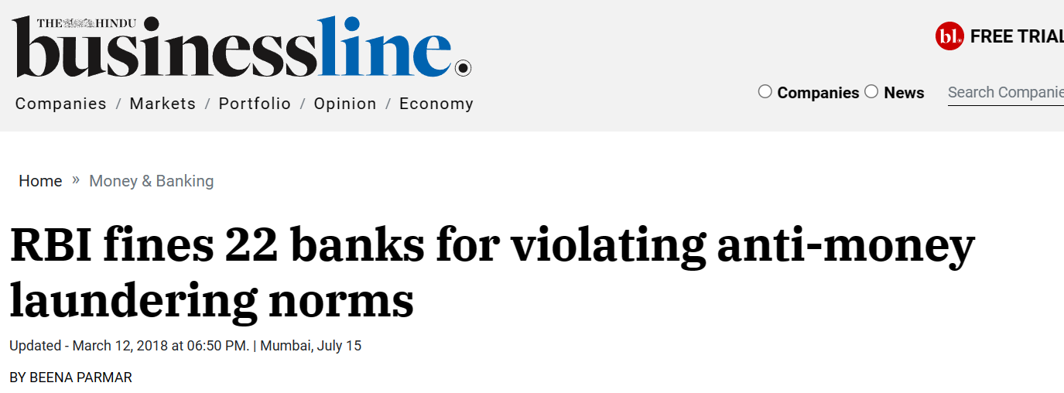
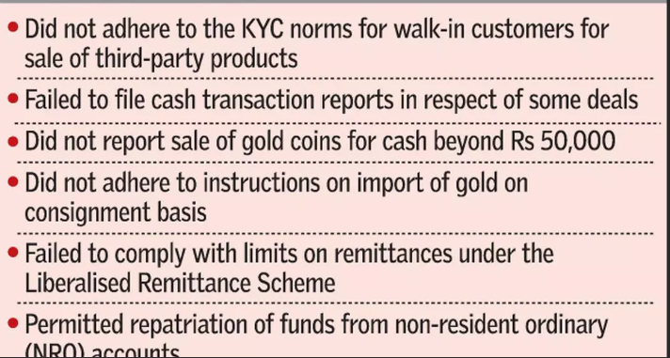
Source: BusinessLine
Notes:
Indian Examples- banks and financial institutions fined for money Laundering

Slide 11

PMLA- 2002 Indian Framework
  Money Laundering Offense
  Scheduled Offenses
  Appointed Authorities
  Investigation and Enforcement
  Attachment and Confiscation of Property
  Obligations of Reporting Entities
  International Cooperation
  Penalties and Punishments
Notes:
The Prevention of Money Laundering Act, 2002 (PMLA) is an Indian legislation enacted to prevent and control money laundering activities in the country. The Act was introduced to combat the illicit generation and circulation of funds derived from criminal activities and to confiscate and seize the proceeds of crime. Here are the key features and provisions of the PMLA:
Money Laundering Offense: The PMLA defines money laundering as the process of converting, concealing, or possessing proceeds of crime by knowingly indulging in activities that assist in projecting such proceeds as untainted property. It criminalizes the act of money laundering and establishes punishment for offenders.
Scheduled Offenses: The PMLA identifies a list of offenses known as "scheduled offenses," which include a range of predicate offenses such as drug trafficking, human trafficking, corruption, fraud, counterfeiting, arms smuggling, and terrorism-related activities. Money laundering charges can be brought against individuals involved in these scheduled offenses.
Appointed Authorities: The Act designates specific authorities responsible for the implementation and enforcement of the PMLA. These authorities include the Director of Enforcement Directorate (ED) and other officers appointed by the central government.
Investigation and Enforcement: The ED is empowered to investigate cases of money laundering and initiate legal proceedings against individuals or entities involved. The agency has powers similar to those of a civil court, such as summoning witnesses, examining them under oath, and compelling the production of documents.
Attachment and Confiscation of Property: The PMLA allows for the attachment and confiscation of property that represents the proceeds of crime or is involved in money laundering. The ED can issue provisional attachment orders, and after due process, the adjudicating authority can order the confiscation of the tainted property.
Obligations of Reporting Entities: The PMLA imposes obligations on various entities, including banks, financial institutions, intermediaries, and professionals such as chartered accountants and lawyers, to maintain records, report suspicious transactions, and comply with customer due diligence requirements. Non-compliance with these obligations can attract penalties and legal consequences.
International Cooperation: The Act facilitates international cooperation in combating money laundering by providing mechanisms for the exchange of information, mutual legal assistance, and extradition of offenders.
Penalties and Punishments: The PMLA prescribes penalties and punishments for offenses related to money laundering. These include imprisonment for a term ranging from three years to seven years and fines. Repeat offenders may face enhanced penalties.

Slide 12




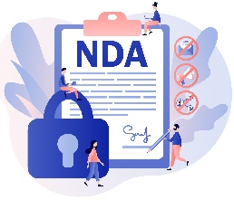




Process of Reporting By Banks
  Threshold for Reporting
  Suspicious Transaction Report (STR)
  Timelines for Reporting
  Confidentiality and Non-Disclosure
  Identification of Suspicious Transactions
  Immediate Reporting
  Online Reporting System
Notes:
Under the anti-money laundering framework in India, banks and other reporting entities are required to report certain transactions to the Financial Intelligence Unit-India (FIU-IND). The reporting timelines and steps involved in reporting are as follows:
Threshold for Reporting: Banks are required to report transactions that meet certain monetary thresholds specified by the regulatory authorities. The thresholds may vary depending on the type of transaction and the customer involved. For example, cash transactions above a specified amount, suspicious transactions, and cross-border transactions are subject to reporting requirements.
Identification of Suspicious Transactions: Banks need to establish robust customer due diligence processes to identify and monitor suspicious transactions. This involves ongoing monitoring of customer transactions, assessing the risks associated with the transactions, and identifying any red flags or unusual activities that may indicate potential money laundering or terrorist financing.
Suspicious Transaction Report (STR): When a bank identifies a transaction or activity that is deemed suspicious, it must file a Suspicious Transaction Report (STR) with the FIU-IND. The STR contains relevant information about the transaction, including the nature of the suspicious activity, the individuals or entities involved, and any supporting documentation or evidence.
Immediate Reporting: If a bank suspects that a transaction may be related to terrorism financing or if there are reasonable grounds to believe that it may have a bearing on the integrity or security of India, it must report the transaction immediately to the Director of FIU-IND, bypassing the normal reporting channels.
Timelines for Reporting: For transactions other than those requiring immediate reporting, banks are required to file the STR within a specific timeline. As per the guidelines issued by the regulatory authorities, banks generally have seven working days from the date of detection of a suspicious transaction to file the STR with the FIU-IND.
Online Reporting System: Banks report suspicious transactions electronically through the online reporting system provided by the FIU-IND. The system enables banks to securely submit the required information and documentation related to the suspicious transactions.
Confidentiality and Non-Disclosure: Banks must ensure the confidentiality and non-disclosure of the reporting process and any information related to suspicious transactions. The reporting is done in compliance with legal requirements and regulations, and the information is shared only with authorized entities involved in the investigation and prevention of money laundering and terrorist financing.

Slide 13

Steps in Anti Money Laundering
  6. Staff Training and Awareness
  5. Record Keeping
  4. Transaction Monitoring
  3. Suspicious Transaction Reporting
  2.- Know Your Customer (KYC)
  1- Customer Due Diligence (CDD)
Notes:
Customer Due Diligence (CDD): Financial institutions and other entities subject to AML regulations are required to conduct due diligence on their customers to verify their identities, understand their financial activities, and assess the risks associated with the business relationship. CDD measures involve obtaining and verifying customer identification documents, conducting background checks, and monitoring customer transactions for suspicious activities.
Know Your Customer (KYC): KYC procedures involve obtaining and verifying information about the identity, occupation, source of funds, and purpose of transactions of customers. KYC requirements enable financial institutions to assess the legitimacy of customer relationships and identify any potential risks or red flags.
Suspicious Transaction Reporting: Financial institutions are obligated to report suspicious transactions to the designated authorities, such as the financial intelligence unit, when there are reasonable grounds to suspect that the transaction is related to money laundering or terrorist financing. Suspicious transaction reports (STRs) provide valuable information for further investigation and enforcement actions.
Transaction Monitoring: Financial institutions employ automated systems and manual processes to monitor customer transactions in real-time. Transaction monitoring involves analyzing transaction patterns, detecting unusual activities, and identifying potential red flags that may indicate money laundering or other illicit activities.
Record Keeping: AML regulations require financial institutions to maintain comprehensive records of customer transactions, including account opening documents, transaction records, and supporting documentation. These records should be retained for a specified period and be readily accessible for regulatory examinations and law enforcement investigations.
Staff Training and Awareness: AML programs emphasize the importance of educating employees about money laundering risks, detection techniques, and reporting obligations. Regular training programs and awareness initiatives help employees stay vigilant and maintain a strong culture of compliance within the organization.

Slide 14

KYC Documents
  Identification Documents – Individual and Entity
  Address verification Documents- Individual and Entity
  Photograph of Individual
  Signature verification documents
Notes:
Customer Identity: This component of KYC focuses on establishing the customer's identity. It typically includes collecting and verifying the following information:
Name
Date of Birth
Photograph
Official identification documents, such as passports, driver's licenses, or identity cards
Address Verification: In addition to verifying the customer's identity, KYC also requires obtaining and validating the customer's address. This involves collecting documents that confirm the customer's residential or business address, such as utility bills, bank statements, or rental agreements.

Slide 15

AML & KYC Checklist
Checklist
One-time compliance
Rolling / Continuous compliance
Appointment of Principal Officer
Undertaking audit trail using company information
Record of transactions as per the rules
Undertaking due diligence for customer
Periodic review of the policies internally
Conducting client identification
Identification of risk sensitive customers
Notes:
A one-time compliance AML (Anti-Money Laundering) and KYC (Know Your Customer) checklist for banks and financial institutions typically involves several essential steps and requirements to ensure adherence to regulatory guidelines and the establishment of a robust AML and KYC framework
Appointment of Principal Officer:- Appoint a Principal Officer responsible for overseeing and managing the AML and KYC program. This individual should have the necessary authority and knowledge to fulfill this role effectively.
AML/KYC Policies and Procedures: Develop, review, and update comprehensive AML and KYC policies and procedures that align with local regulations and international AML standards, including those issued by the Financial Action Task Force (FATF).
AML/KYC Policies and Procedures: Periodic Review and Updates:- Establish a process for periodic reviews and updates of the AML/KYC program to ensure ongoing compliance with changing regulations and evolving risks.
Rolling & Continuous Compliances A rolling or continuous compliance AML (Anti-Money Laundering) and KYC (Know Your Customer) checklist for banks and financial institutions involves ongoing processes and checks to ensure that AML and KYC requirements are consistently met. Here are some key components of a rolling compliance checklist:
Audit Trail Using Customer Information: Maintain an audit trail that logs all significant customer-related transactions and activities. This helps in tracking and documenting any unusual or suspicious customer behavior.
Undertaking Due Diligence for Customers: Continuously perform customer due diligence (CDD) to verify and update customer information. This should include periodic reviews of customer profiles and risk assessments.
Conducting Client Identification: Regularly update and verify customer identification information, including name, address, and official identification documents. Ensure the information remains accurate and up to date.
Risk Sensitivity Assessment:- Continuously assess the risk profile of each customer to identify high-risk customers. This assessment should be dynamic and consider changes in customer behavior, transactions, and external factors.

Slide 16
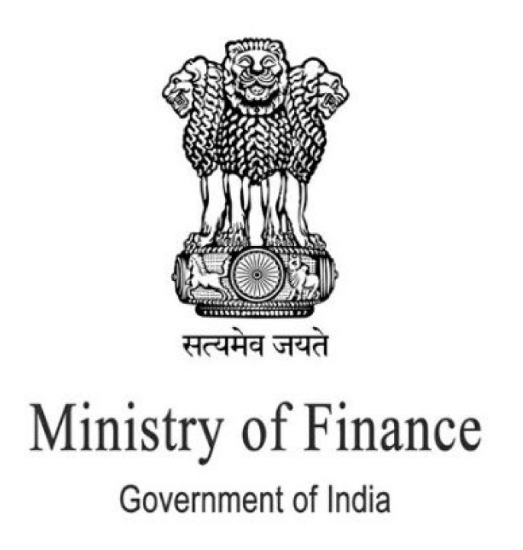
Amendment Rules AML-2023 – 7th March 2023,
The recent amendments to PMLA, 2002 includes below
    Politically exposed person
    Beneficial ownership
    Non-profit organization
    Due diligence and documentation
    Cryptocurrency and virtual digital assets (VDAs)
Notes:
The recent amendments to the Prevention of Money Laundering Act (PMLA), 2002, have introduced important changes to strengthen anti-money laundering (AML) and counter-terrorist financing (CTF) measures in India. These amendments cover various aspects which are as follows
Politically exposed person
Beneficial ownership
Non-profit organization
Due diligence and documentation
Cryptocurrency and virtual digital assets (VDAs)
Lets discuss them one by one on next slides

Slide 17
Emerging Technologies for AML Detection
Emerging technologies such as artificial intelligence and machine learning are being used to detect financial crimes more effectively.
Machine Learning
  Machine learning algorithms can identify patterns in financial transactions that may indicate money laundering or terrorist financing.
Natural Language Processing (NLP)
  NLP can analyze unstructured data such as social media posts and news articles to identify potential illegitimate activities.
Blockchain Analysis
  Blockchain analysis can be useful in identifying transactions that involve cryptocurrencies and can help to track the movements of funds across different accounts.

Slide 18






90239-71970
Hello@freelancetrainings.com
www.freelancetrainings.com
406, Titanium City Centre Mall, Anand Nagar, Satellite, Ahmedabad-380015

