Slide 1

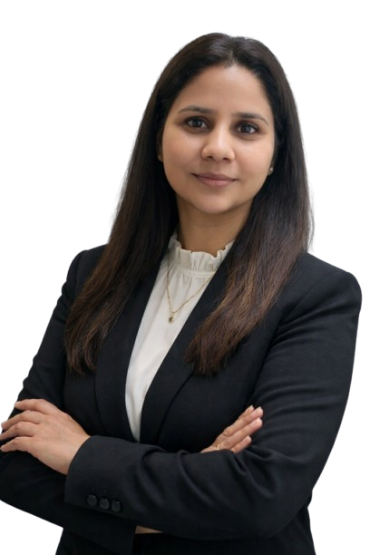
POSH ACT, 2013
BY:
WE for Women Empowerment at Workplace
Mandatory Compliance | Legal Obligations |Brand Reputation
Speaker:
Adv. Sarbjeet Kaur
Founder - WE
FOR CS, CA, HRs & Others Compliance Officer

Slide 2
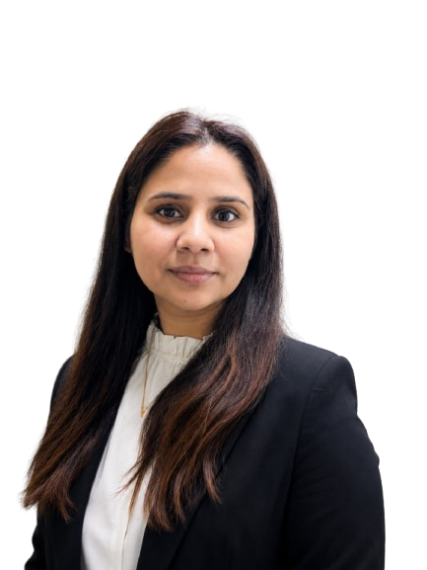
ADV. SARBJEET KAUR
  President & Founder, WE
  An International Trained Lawyer
  Subject Expert POSH
  10+ Years experience
  Serving as an External Member under POSH Committee in more then 50+ Renowned Organizations

Slide 3

Why this POSH Session is important for
HR, CA, CS, CFO

Slide 4
What is
POSH
Act, 2013 ?

Slide 5
Sexual Harassment of Women at Workplace (Prevention, Prohibition and Redressal) Act, 2013
Effective on December 9, 2013
Applicability:
  Private companies, regardless of size or industry.
  Companies with 10 or more employees (including contractual, temporary, or part-time staff, interns, or consultants).
  Companies with fewer than 10 employees with some less compliances.

Slide 6
If more then 10 Employees Works in an Organization
THEN?
Must have an IC Committee

Slide 7
Why HR, CA, CS, CFO
Are liable for POSH ACT?
COMPANY ACT, 2013

Slide 8
Company Act, 2013
May 2025 Amendment
Sec 134 (4)
Sec 134 (8)
read with Rule 8 (5) (A) Companies (Accounts) Rule 2014
Now need to provide statement that company is comply with PoSH
(a) number of complaints of sexual harassment received in the year;
(b) number of complaints disposed off during the year; and
( c) number of cases pending for more then 90 days.

Slide 9
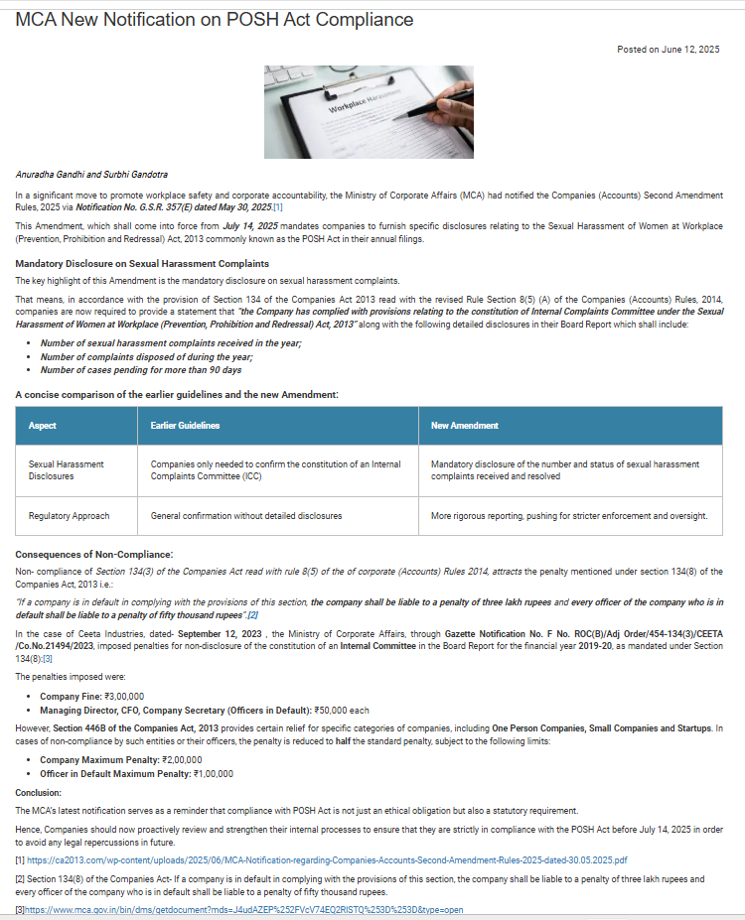
Sec 134 (4)
Sec 134 (8)

Slide 10
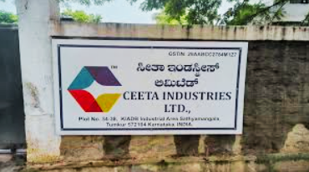
LANDMARK CASE - 2023
Ceeta Industries Ltd.
Company fine : 3,00,000 /-
Managing Director, CFO, CS (officer in default): 50,000/- each
Non- Disclosure of the constitution of an Internal Committee in the Board Report for the Financial Year 2019-20

Slide 11

LANDMARK CASE - 2019
Lalit Agrawal v. Institute of Chartered Accountants of India (ICAI) & Another's
Verdict: CA Member suspended for 3 years after firm found non-compliant with workplace safety norms during professional conduct review.
Your ICAI membership and CA certificate are at risk.
Non-compliance = professional misconduct.

Slide 12
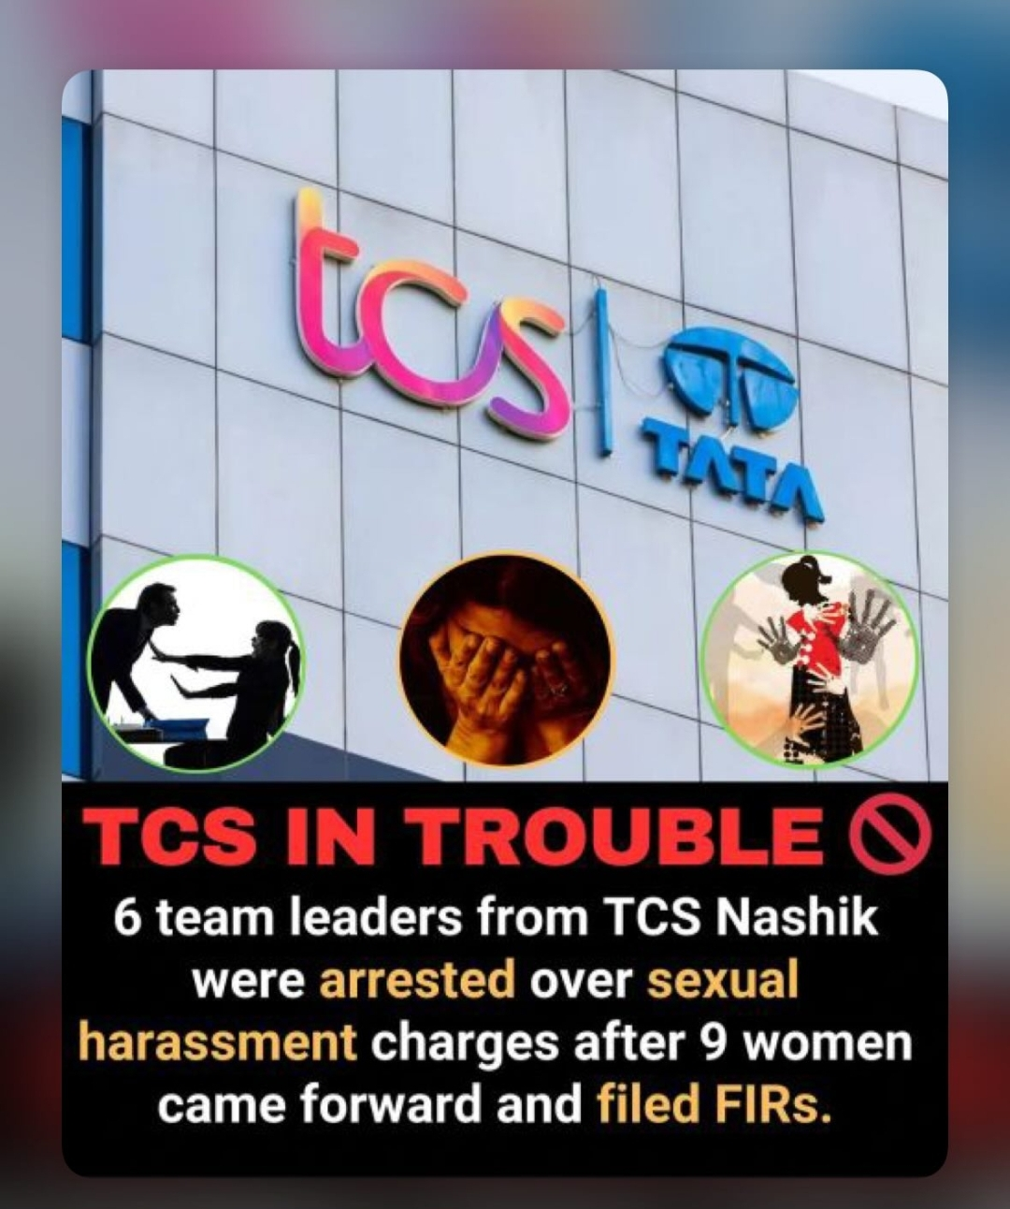
LANDMARK CASE - 2026
TCS Nashik Branch
HR
Team Leaders
IC Members
Other Officers
High Penalty & Punishment, Criminal Charges

Slide 13

KEY
REQUIREMENTS
Constitute IC Committee
PoSH Policy in Place
Awareness & Training Sessions
Display Notices at Workplace
Annual Report Filling
Create Safe Workplace Culture

Slide 14
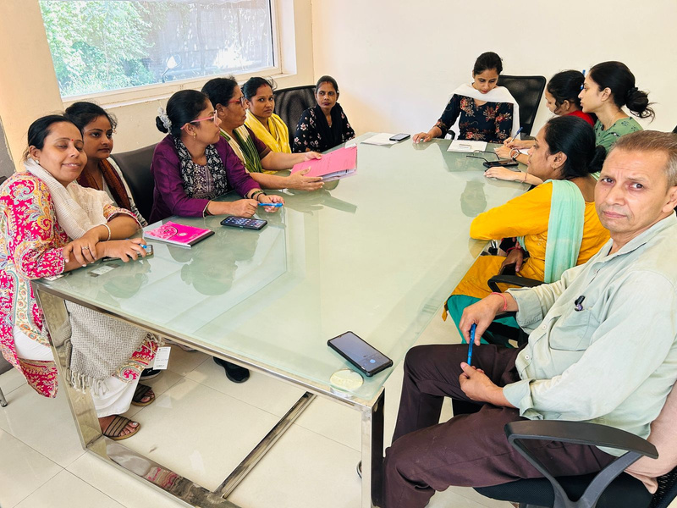
CONSTITUTION OF IC COMMITTEE
Internal Committee
Presiding Officer
Senior Level Women
Min. 2 IM
Committed to women cause
  NGO
  Legal Expert
  Person familiar with issues
External Member
Total
50% Women I Writing I 3year Term

Slide 15
Why Does Your Organization Need to Implement the
POSH Act?

Slide 16


1 Out of 4
Employees in the Workforce is a Women

Slide 17

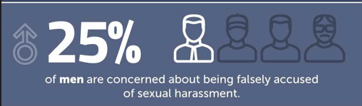

Slide 18

Real World Scenerio
New Joinee in Office
Name : Jasmine Kaur
Position: BDE
Get Harassed from Senior Employee in her new office
She want to file an FIR in nearest Police Station

Slide 19
Company Act, 2013
Factories Act, 1948
Shop & Establishment Act, 1948
UGC Regulations, 2015
AICTE Guidelines, 2016
CBSE Affiliation By-Laws, 2018

Slide 20

RISK
of Non - Compliance
THE BRAND
&
BUSINESS COST

Slide 21
Legal Penalties
  Under Company Act, 2013
  &
  POSH Act, 2013

Slide 22
POSH Act, 2013
  Rs. 50,000/- Fine,
  Business License Suspension
  Cancellation on repeat

Slide 23

Audit Flag
  Social Audit
  Statutory Audit
  ESG audits flag
  for POSH non-compliance.

Slide 24
Investor & Client Risk
  Institutional investors, global clients, tender committees now demand compliance certificates

Slide 25
Real Cost Examples
  TCS, Infosys, Wipro, Bajaj Finance – all faced media scrutiny on POSH failures.
  Each incident cost millions in PR, legal fees & market cap

Slide 26
THE CHOICE IS CLEAR -- ACT BEFORE THE COURT DOES
Don't Wait for a
Complaint to Happen
Every day without POSH compliance is a liability waiting to become a lawsuit.
Your Clients OR Your Organizations deserve protection. Your firm deserves protection.

Slide 27


POSH COMPLIANCE EXPERT
Your Trusted Partner for
End-to-End POSH Compliance

Slide 28
Why YOU or YOUR CLIENTS or YOUR ORGANIZATION Need –
a POSH Expert
Also called
External Member

Slide 29
Without a POSH Expert
X ICC formed incorrectly -- legally void
X Wrong members, no external NGO
X Policy copied from internet -- not customized
X No training -- ICC members clueless
X Inquiry process flawed -- court challenge
X Annual report missed -- fine triggered
X All the Professionals unable to certify compliance

Slide 30
With POSH Expert
OK Legally valid ICC constitution
OK Compliant, court-proof POSH Policy
OK ICC Training & Certification
OK Guided Inquiry Procedures
OK Annual Report filing to DO
OK Employee Awareness Programs
OK Audit-ready documentation

Slide 31

WE ?
Why

Slide 32
WE
- The Welfare Society
WE is a Non – Govt. Organization
WE is working for POSH since 2022
WE promotes POSH Act, 2013 compliance
WE helps organizations to create safe and respectful workplace for each employee
Certified Experts with 10+ Years in PoSH Compliance
Remote & Onsite Support across India

Slide 33
Legal Compliance
Improve Brand Value
Creates a safer workplace for employees
Improves employee retention
Social Audit Compliance
Save Company reputation
Improves productivity
Builds trust between employees and management
Exporter Compliance
Reduces legal risk and penalties
Employee performance

Slide 34
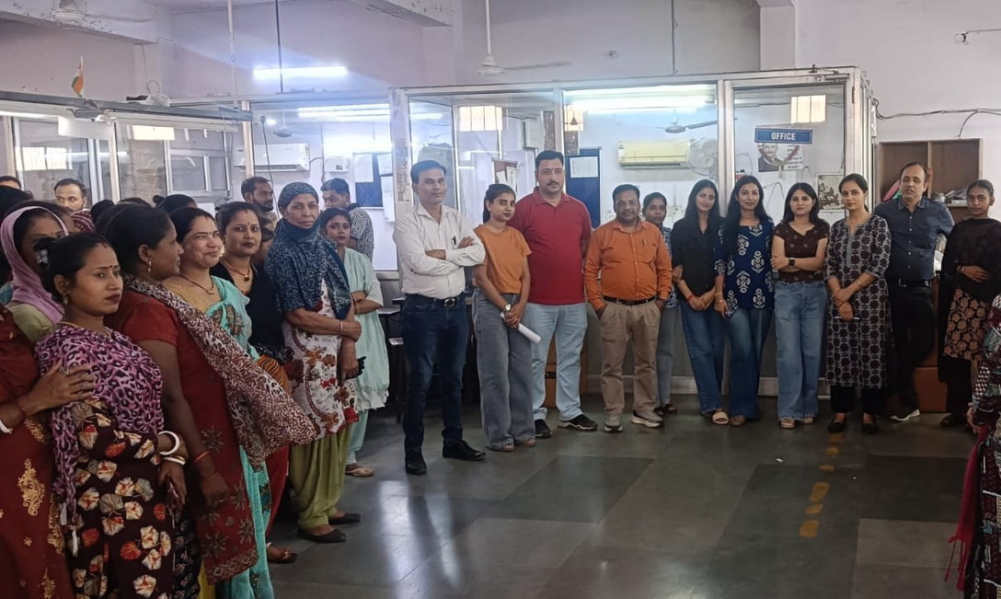
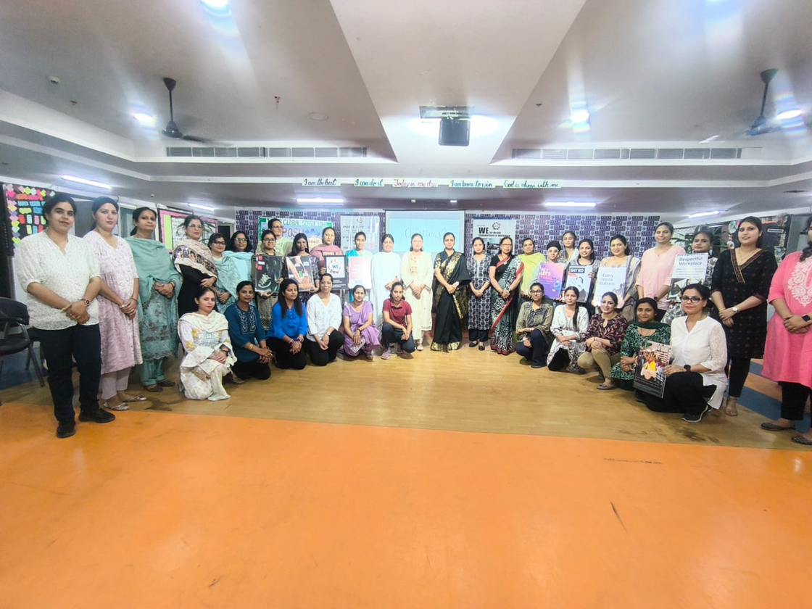
6000+
Individual
Trained

Slide 35
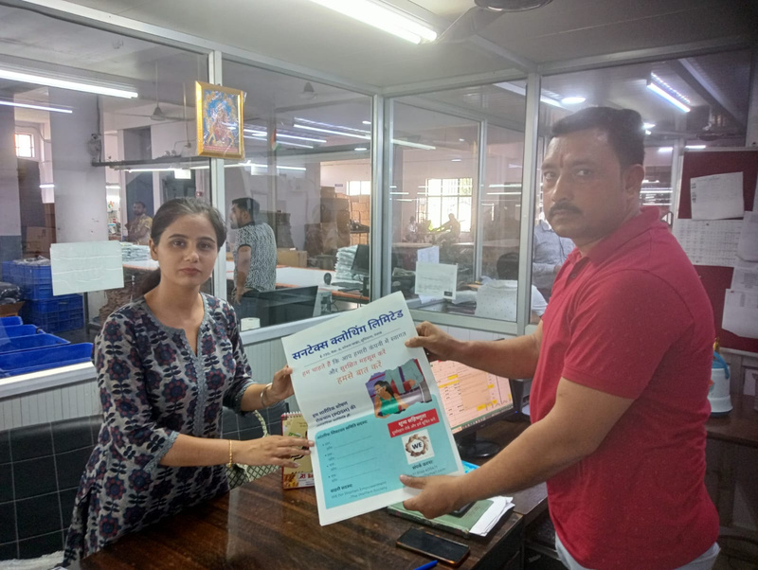
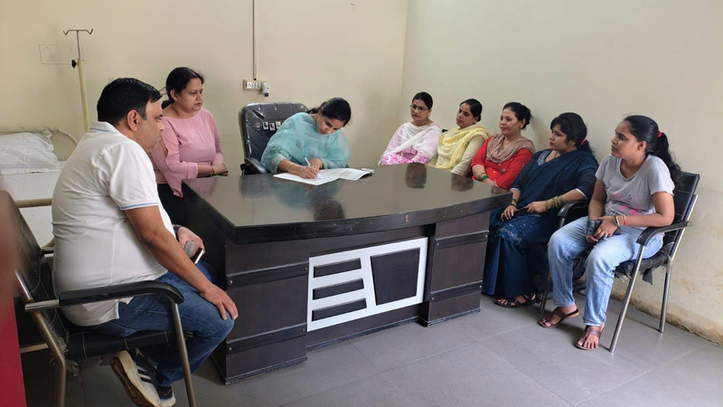
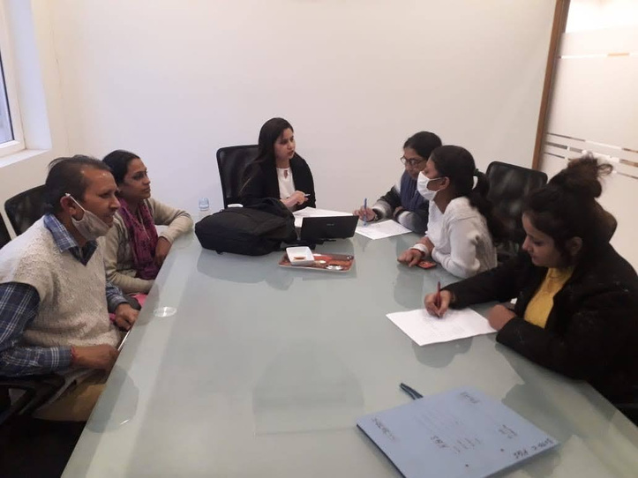
250+
PoSH Compliance
&
IC Training
POSH Awareness

Slide 36
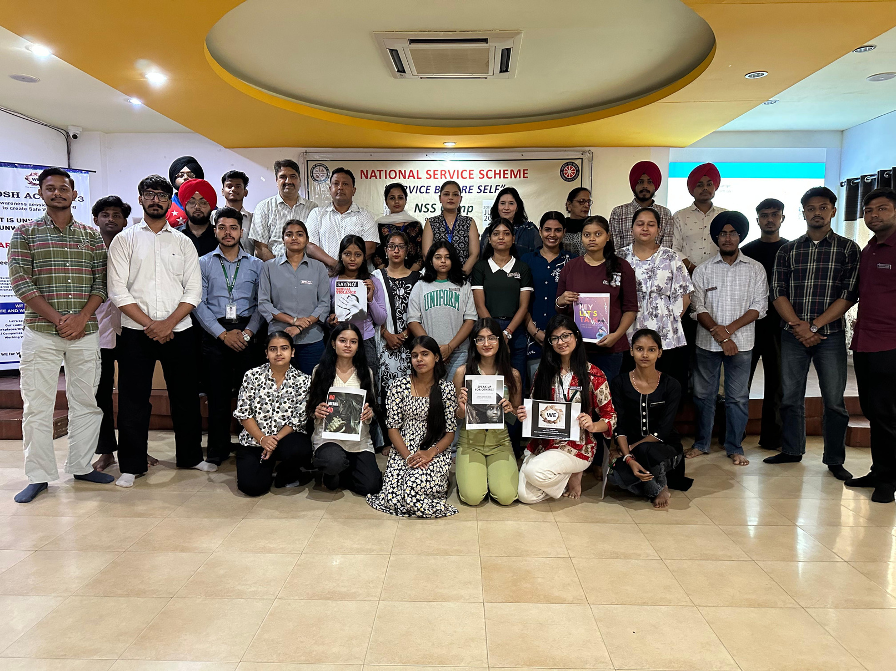
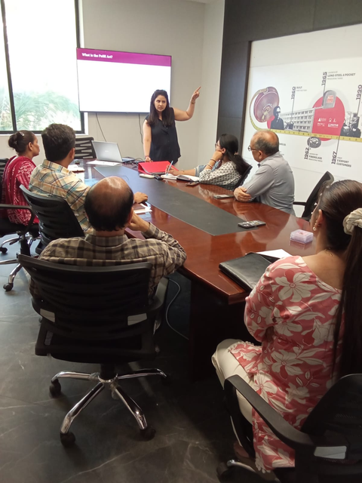
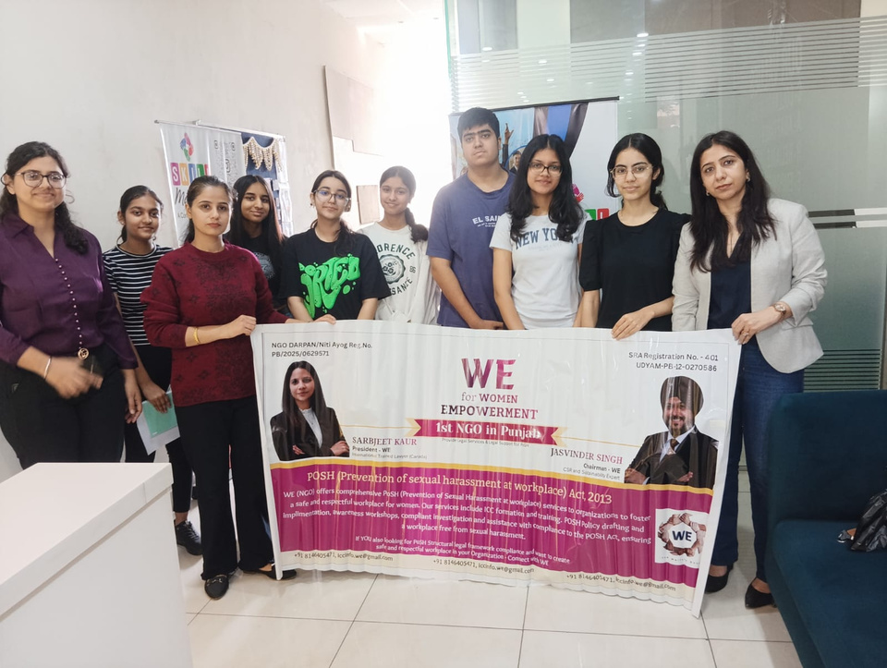
100+
Organization
&
Educational
Institutions

Slide 37
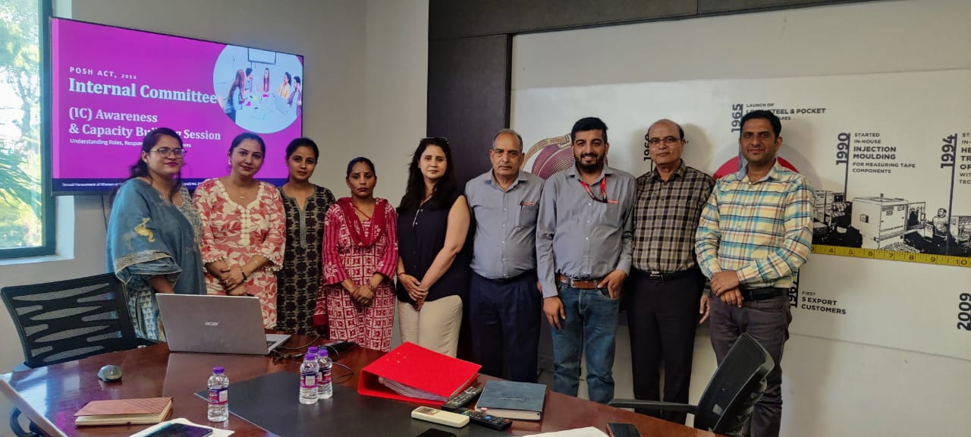
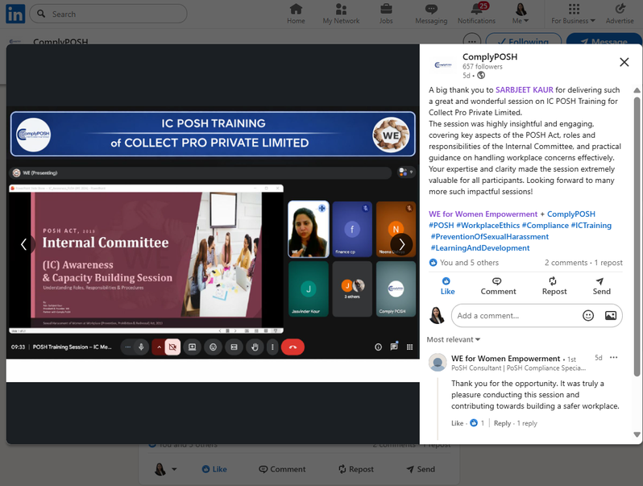
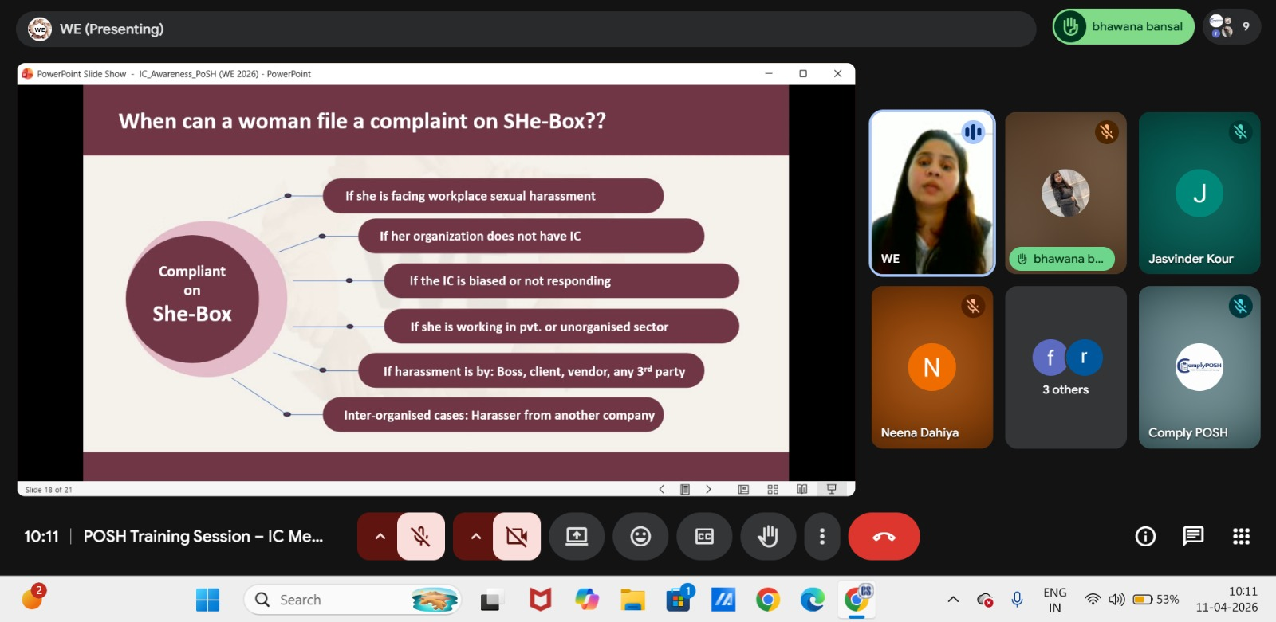
Trainings & Workshop

Slide 38
Pan INDIA:
Punjab:
Chandigarh:
Faridabad:
Mumbai:
Pune:
Delhi:

Slide 39

THANK YOU
Contact WE:
+91 8146405471
iccinfo.we@gmail.com
PCS Hardeep Singh Nijher
+91 9914622840
Follow WE:
POSH COMPLIANCE EXPERT
Your Trusted Partner for
End-to-End POSH Compliance
Insta
WhatsApp
LinkedIn

Slide 40

DUTIES,
ROLE,
RESPONSIBILITIES
OF AN
EMPLOYER

Slide 41

1. Safe Work Environment
Section 3
Employer Duty:
  Implement a zero-tolerance policy.
  Ensure all workplace locations are safe for all employees.
  Displayed on Notice Board
  Complaint is treated seriously

Slide 42
2. Constituting an IC
Section 4
Employer Duty:
  Constitute an IC
  Maintain and Support a functional IC.
  Train members in handling complaints fairly and confidentially.

Slide 43
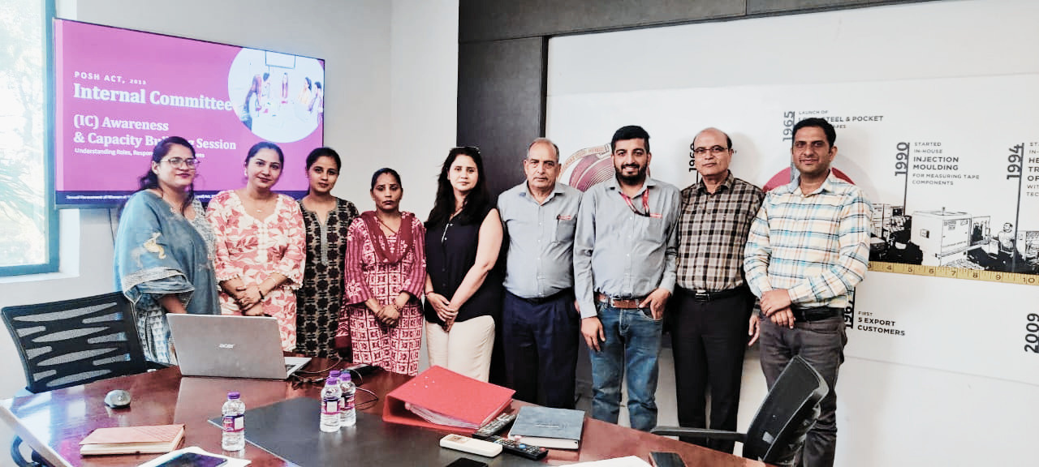
3. Awareness & Training
Section 19
Employer Duty:
  Conduct regular workshops and online or in-person sessions.
  Display IC contact information and complaint procedure prominently.

Slide 44

4. Annual Report Filling
Section 21
IC Submit Annual Report to DC Office and Employer
Employer Duty:
  Submit Annual Report to DC Office
  Mention no. of complaints received, pending, resolved, measurement action....

Slide 45

As per The PoSH Act
Complaint Mechanism –
6 & 9
Reporting & Record Keeping - 19 & 22
Maintaining Confidentiality
Take Action - 13

Slide 46
Media & Public Scrutiny
  Viral social media exposure
  Investigative journalism
  Public boycott campaigns can permanently damage brand equity

Slide 47
Talent Attrition
  Top talent – especially women – actively research workplace safety before accepting offers.
  Non-compliant companies lose hiring wars

Slide 48
Employee Trust Erosion
  Internal culture toxicity leads to disengagement and absenteeism
  Reduced productivity across the entire organization

Slide 49

WHEN BRANDS PAID THE PRICE — CASE EXAMPLES
Himat Kumar v. State of Punjab (Sept. 2025)
- No Overlapping Inquiry
Medanta Hospital Case (MP High Court)
  Penality 50,000/- No IC
  25 Lakhs to aggrived women
Ms. G vs. Isg Novasoft Technologies Ltd.
  Penality 1 crore 68 lakhs

Slide 50

Have
Any Questions?

Slide 51

LET’S MAKE OUR LUDHIANA
a harassment Free Workplace
and make POSH - Not a Compliance
But Workplace Culture

Slide 52
POSH
COMPLIANCE
EXPERT
Your Trusted Partner for
End-to-End POSH Compliance

